Slide 1
Exam Prep
In-Class Activity…

Slide 2
Roadmap
Week 1: Intro to MIS
Week 2: Systems Analysis
Week 3: Systems Analysis
Week 4: Systems Analysis
Week 5
Swimlanes
ERDs
Decision Trees
Architecture Diagrams
Exam #1
Learn IT! #1
Max Labs 0
What is MIS?
Week 6: Organizational Systems
Week 7: Organizational Systems
Week 8: Organizational Systems
Week 9
Decision Support
SDLC
Exam #2
ERP
Knowledge Management
Digital Innovation
Max Labs 1a & 1b
Week 10: Organizational Systems
Week 11: Organizational Systems
Platforms
Week 13: Organizational Systems
Week 14
Customer Relationship Management Systems
Cloud Computing
Artificial Intelligence
Exam #3 Prep
Supply Chain Management Systems
Week 12: Organizational Systems
Max Labs 3a & 3b
Learn IT! #2
Max Labs 2a & 2b

Slide 3
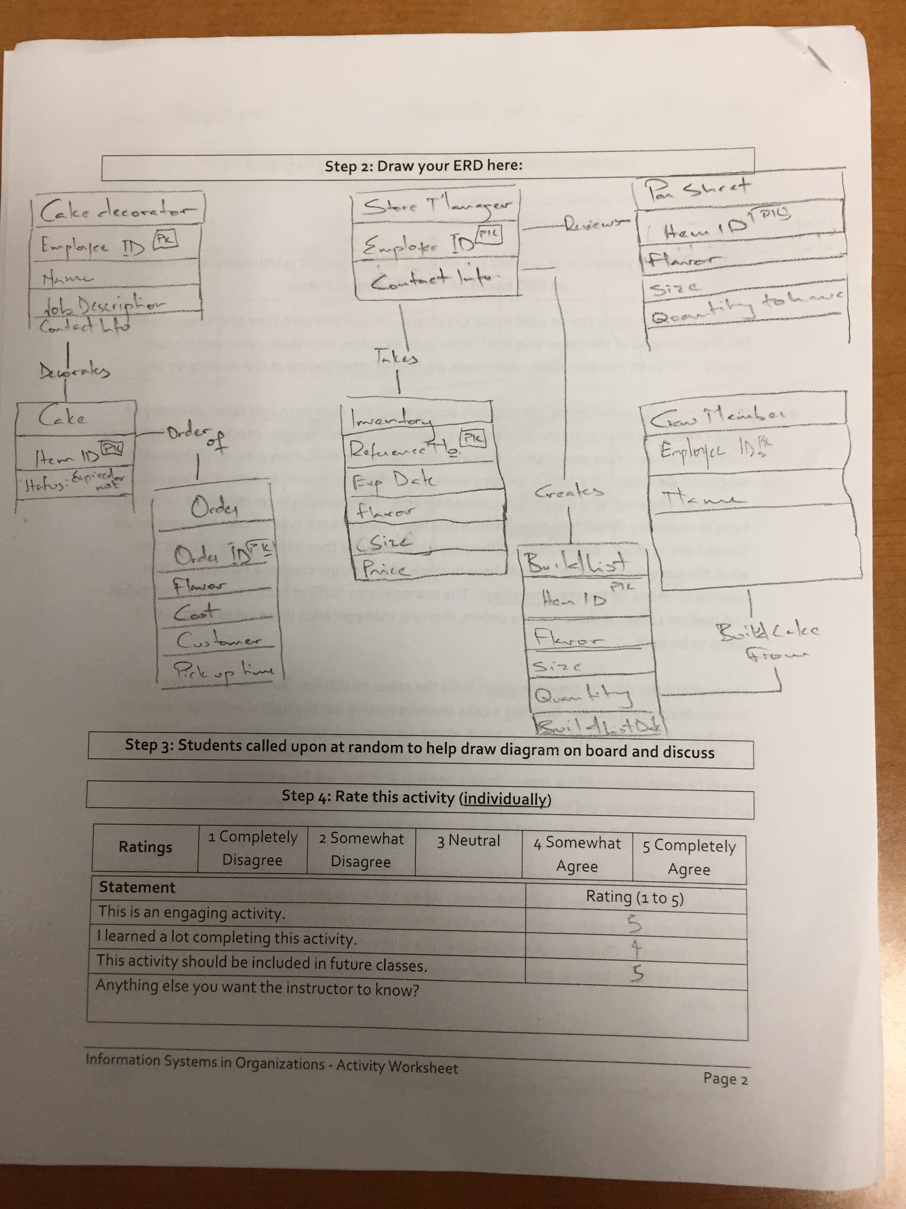
Worksheets will not be returned
In-class activities reinforce what was covered in
Assigned reading
Assigned videos
Lecture
Worksheets do NOT include new material that will be on exams
No need to study from worksheets to be successful on exams
Feel free to take pictures of your worksheets if you’d like

Slide 4
Exam will Cover
Readings, Videos and Lectures (60%)
What is MIS?
Swimlane Diagrams
ERDs
Decision Trees
Architecture Diagrams
Mini-Case – Demonstrate your ability to apply (40%)
Swimlane Diagrams
ERDs

Slide 5
Exam Prep
What:
Working in small teams, prepare challenging multiple choice exam questions from the:
Readings
Videos
Lectures
Discuss these questions and answers as well as why they would be challenging
Why:
To help you prepare for the upcoming exam

