Slide 1
Information Systems in Organizations

Slide 2
Intro to Instructor & ITA
Kapish Vanvaria
Senior Manager with Ernst & Young
kapishv@temple.edu
ITA – Sarita Cini
Sarita.Cini@temple.edu

Slide 3
Managing Expectations
Nobody teaches an intro class like this in Fox or in any other colleges!
We will face some challenges, plan on it!
You will find the class engaging and fun!!
You will acquire knowledge and skills that you will use in future classes and your career!!!

Slide 4
Course Description
Core concepts of MIS
Identify/analyze organizational systems & processes
  conceptual diagramming, process decomposition, & data modeling
Enterprise Systems : ERP, SCM, CRM
Platforms & Cloud Computing
Artificial Intelligence

Slide 5
Course Objectives
Understand core MIS concepts
Learn and practice how to Analyze Organizational Systems & Processes
Gain experience in identifying and using multiple types of systems used by organizations ranging from start-ups to global enterprises
Learn the basics of cloud computing and Artificial Intelligence

Slide 6
Graded Components
In-Class Activities & Worksheets (approximately 24) * must be present in class to earn credit – no exceptions! | 15%
Learn IT! and Max Lab Assignments ** no late assignments accepted – no exceptions! | 25%
Midterm Exam #1 | 20%
Midterm Exam #2 | 20%
Exam #3 (50 minutes – held during finals week) | 20%
In-Class activities will not be returned. If you would like a copy of your completed in-class activities, please take a picture of them before you hand them in.
Completed assignments will not be returned in class but will be retained by your instructor for a period of two weeks after grades have been posted. After this two week period completed assignments will be disposed of. If you would like your completed assignments returned, please make arrangements with your instructor to pick-up your completed assignments during office hours.

Slide 7


No Required Textbooks!
Vs.
An interesting collection of current, engaging
readings that are freely available over the Internet

Slide 8
No Required Textbook!
What you will love!
What you may dislike!
How much does the typical textbook cost?
No publisher that constantly changes editions so you can’t sell your old textbook
How old is the majority of the material in a traditional textbook?
Lots of different articles from:
  Different authors
  Different audiences
  Different formats
No author, editors & reviewers making the connections for you
Life as a business professional does not have a textbook that you can turn to for the
answers. This is how you will learn what you need to be successful in the real world.

Slide 9




Lecture vs. Activities
Vs.
Previous: 3 hours of lecture per week covering the topics the textbook tells us
Now: 1 hour of class discussion a week focusing on the most important learning objectives
And
2 hours of in-class activities that reinforce those key learning objectives

Slide 10
Active Learning
Analysis
Engagement
Synthesis

Slide 11
Active Learning
Solving business problems through Active Learning
Engagement
Analysis
Synthesis

Slide 12
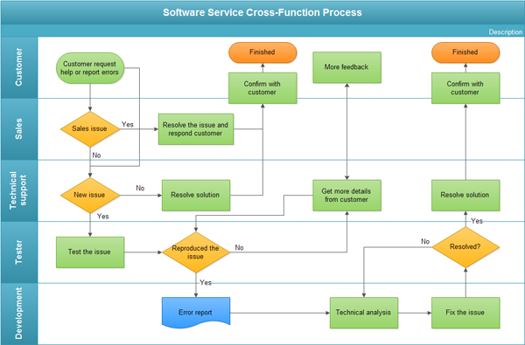
Active Learning
Students are creating these
Applying knowledge!
Engagement
Analysis
Synthesis
Learning to synthesize issues!
Real life, relatable examples!

Slide 13

Wikipedia (and other questionable sources)
Is there any value to sources like Wikipedia in an academic environment?
What are the risks?
How timely and relevant can Wikipedia articles be?
What is the value of crowdsourcing information?
What is the role information technology plays in crowdsourcing of information?
Can the benefits outweigh the risks if you understand them?

Slide 14
Roadmap
Week 1: Intro to MIS
Week 2: Systems Analysis
Week 3: Systems Analysis
Week 4: Systems Analysis
Week 5
Swimlanes
ERDs
Decision Trees
Architecture Diagrams
Exam #1
Learn IT! #1
Max Labs 0
What is MIS?
Week 6: Organizational Systems
Week 7: Organizational Systems
Week 8: Organizational Systems
Week 9
Decision Support
SDLC
Exam #2
ERP
Knowledge Management
Digital Innovation
Max Labs 1a & 1b
Week 10: Organizational Systems
Week 11: Organizational Systems
Platforms
Week 13: Organizational Systems
Week 14
Customer Relationship Management Systems
Cloud Computing
Artificial Intelligence
Exam #3 Prep
Supply Chain Management Systems
Week 12: Organizational Systems
Max Labs 3a & 3b
Learn IT! #2
Max Labs 2a & 2b

Slide 15
?
No overpriced, outdated textbooks
Superficial knowledge vs. deeper understanding
What is going to be so special about this class?
It’s just another intro class?
Less is more!
Use these techniques to look like a rock-star in your other classes
Less lecture, more activities
Active learning

Slide 16
Class Site Review
No Blackboard
https://community.mis.temple.edu/mis2101sec007f17

Slide 17
?
Engaging
Working in small teams
Must be present to receive credit
What exactly do you mean by in-class activities?
Must hand in completed worksheet to receive credit
Develop deeper understanding of material

Slide 18
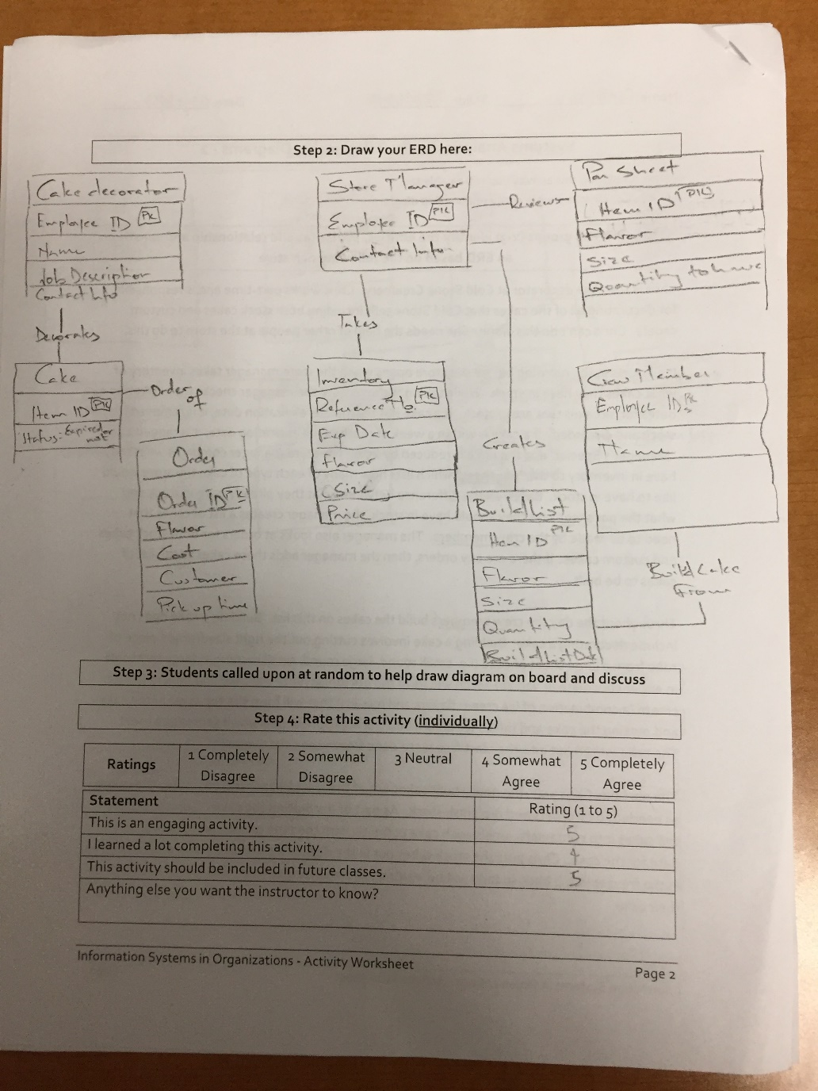
Worksheets will not be returned
In-class activities reinforce what was covered in
  Assigned reading
  Assigned videos
  Lecture
Worksheets do NOT include new material that will be on exams
No need to study from worksheets to be successful on exams
Feel free to take pictures of your worksheets if you’d like

Slide 19
First In-Class Activity…
Learn more about the course and instructor
Must complete individual worksheet for all activities (even if working in a group)
All activities are graded pass/fail based on doing your due diligence

Slide 20
On to Unit 1!
Prepare with Readings & Videos before our next Class!

