Slide 1
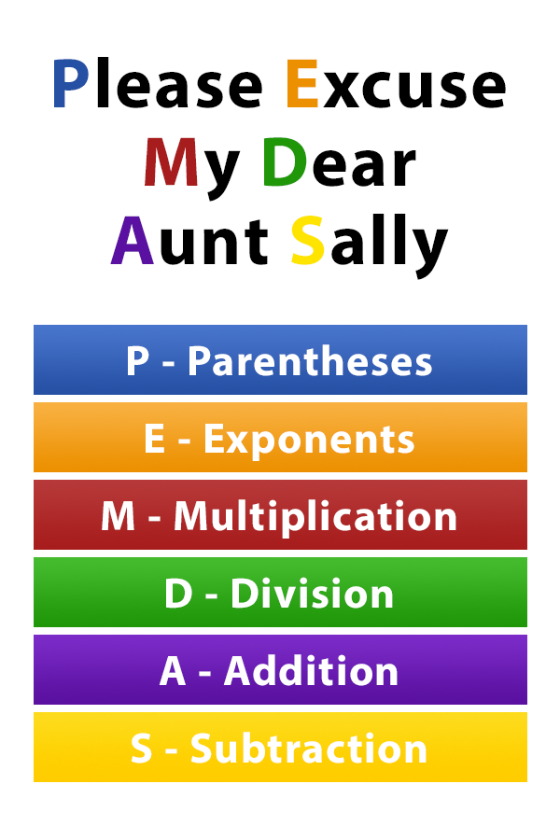
The Order of Operations
Why is it important to remember PEMDAS while coding?
Because JavaScript follows these rules!
Source: https://www.pinterest.com/pin/10344274128829700/

