Slide 1
Information Systems in Organizations
10.1.0 An Introduction to Programming
FOX
MIS

Slide 2
WE ARE HERE
ROADMAP
START
Week 1:
Introduction & Systems Analysis
Course Description
Systems Thinking
Week 2:
Introduction to Process Mapping
Systems & Processes
Swim Lane Diagrams
Assignment #01
Week 3:
Digital Product Management
Max Labs 1a & 1b
Assignment #02
Week 4:
Information Systems – Part I
CRM & ERP
Max Labs 2a & 2b
Assignment #03
Week 5:
Exam #1
Midterm review
Exam Prep
*check course calendar
Week 9:
Exam #2
Midterm review
Exam Prep
*check course calendar
Week 8:
Cybersecurity & the Enterprise
Protection Protocols
Artificial Intelligence
Assignment #06
Week 7:
Platforms & Digital Business Models
API’s
Max Labs 3a & 3b
Assignment #05
Week 6:
Information Systems – Part II
Data Analytics & CRM
Learn IT #1 & 2
Assignment #04
Week 10:
JavaScript Unit #1
Hello World, Variables
Input and Output
Assignment #07
Week 11:
JavaScript Unit #2
Operator types
Strings
Assignment #08
Week 12:
JavaScript Unit #3
Logical Operators
Conditional Types
Assignment #09
Week 13:
JavaScript Unit #4
Intro to Loops
While and Do
Assignment #10
Week 14:
JavaScript Unit #5
HTML basics
CSS basics
Assignments #’s 11 & 12
FINISH

Slide 3
An Introduction to Programming
Week 10
FOX
MIS
Notes:
How does programming work? Take a look at Tuportal, look at the source code using chrome. So much is going on in the background.
We are going to Demystify that for you
We are going to learn what is the magic behind this.
Programming requires you to apply your logic.
Some of the best programmers are the ones who are very creative with their code.
It is not easy, you all will be very frustrated by this, but once you get it

Slide 4
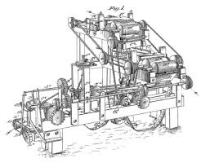
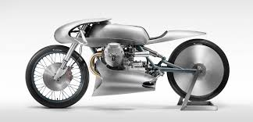
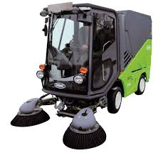
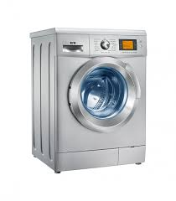
Machines
How many different things does a machine do?
Source: https://lh3.googleusercontent.com/_MsstYyQ4UORpFRdwNu6BN2_cL3vu_raiYq-RErSsdf_Y6v_lKZss8N-8qCO-Tnf3aalDw=s170
Source: https://lh3.googleusercontent.com/GB8PJSrB61OSat3rBAJO-wEjTGstYfB2N4ECL2LSYOahESElAVf7LWJMNrJ0undIP10o=s119
Source: https://lh3.googleusercontent.com/VVZxPvd2BpOPvECeBytaSZqFUfAg5UqPmeroft5ONc3bQVKYqr2s5IxoI4NvEP4unuJiFDI=s94
Source: https://lh3.googleusercontent.com/eZGdlrLtdzW9nEKR758LiagZ3_-wjxflYbpU-IfZeVdny34bXSgn4s0DQTsfS3t_O2eZ_g=s85
Source: https://lh3.googleusercontent.com/OCVAphS1iC9nYvF2FeP_llNXwWQ69mCX8HjK2DJ7UU_xGnoHOgXd4YX8O4Zes09WIcIFxP8=s85
Source: https://lh3.googleusercontent.com/mCtpPS6Qz3guK0-cyCruwUwgbKYAJhWH1iTqGbCNjMOvSnGMvL1FeBGeDIBYboOC7P-gfQ=s102
FOX
MIS
Notes:
Think about machines.
What do machines do?
How many different things do machines do – one thing – can do this but can’t do that – compare and contrast.
What does a motorcycle do? - Gets you from point A to B
What does a washing machine do? – Washes clothes

Slide 5
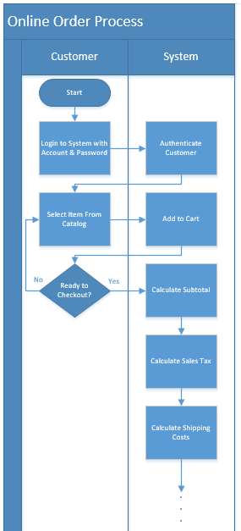
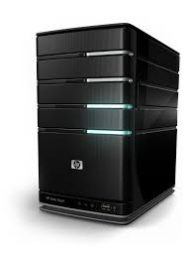
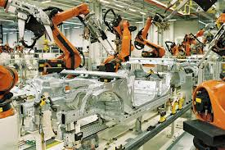
Machines (cont.)
How many different things does a computer do?
How can this machine do so many different things?
Source: https://lh3.googleusercontent.com/59wm5Z8eXC40_WKib3Ghe3ORRuSITa17Xl5BN8QIikEh_cDnScrGnOouZnO4X-cBY6ad5w=s128
Source: https://lh3.googleusercontent.com/luQcPRIrni_WsHytr016U1SPu7FvyVlK2AfyBH3fXEjhoBPrmpzuTfgjvQV40UR63ZTq1jk=s134
Source: https://lh3.googleusercontent.com/Mkj8bl6o0XbrVqnFs40Y3AFVMibSJX1xra-Ll5rwbMCxGs67gpljSny2TUI4KASK1u8sD-M=s85
Source: https://lh3.googleusercontent.com/dMhdY1wyo91ER5uMkI1recx4-0w7fOjNUNmSB9ZCgVnIMqqqXNDkxiw9ckuWij_vtzFSEw=s128
Source: https://lh3.googleusercontent.com/qu1kdMmaM8SbvpyiDQEULPMPGfCrHneGT7WZ494FhgM8N4SHp-TOQvmuKBK2leESFBSPUjg=s151
FOX
MIS
Notes:
Computer is a special type of machine – can do lots of very different things – these are all computer programs that make up a machine
Toaster – single purpose
Computer – multipurpose
You can do process automation for companies, write code to streamline the operation process for a company.
Computers do so many things, play video games, do automation.
A gazillion things can be done if you want to.

Slide 6
Software Programs = Software = Apps
But aren’t all programmers geeks?
FOX
MIS
Notes:
Interchangeable, it is the code that sit on the computer and perform the processes.
We are going to get a taste of it in the coming classes

Slide 7
In the digital economy, geeks are…
Problem Solvers
Designers
Creators
Enablers
Source: https://lh3.googleusercontent.com/1w8YU_tUBElGdnnz7bm6J11P0r1ULETREi4a66qF_kQCwwMF4VRdytLg_iu2sXcFSeru=s128
Source: https://lh3.googleusercontent.com/T1uuAU2Ov5B0oYU4KCifPlOaYu8cZCqbUBwF_4KXAHzvbU_VKp0ymBGetZ1pBUL0Q73oL4o=s159
FOX
MIS
Notes:
Want to be a playa?
How many here are geeks?
People use to think of geeks as losers, but they are the ones who are smart and put
in effort.
Technology makes the companies different from each other in this modern day.

Slide 8
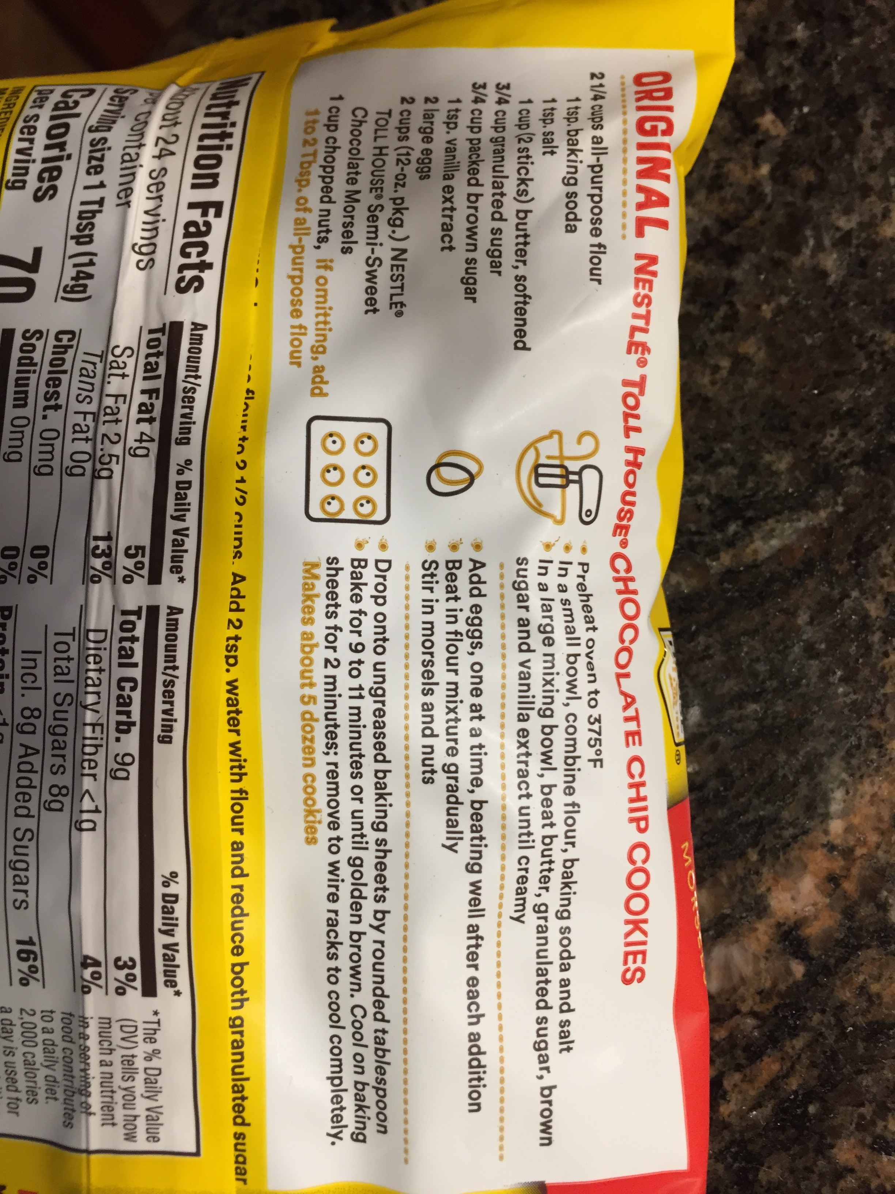
What exactly is a program?
Source: https://lh3.googleusercontent.com/ZcDhYsffPS_f2HRcyXUenTLZm9EeoVwHGlxcMrlw7G4HsGcCE_7o3HcToGjynKLosbP2EQ=s114
FOX
MIS
Notes:
A program is a detailed list of instructions that the computer will follow to perform some task.
It is an extremely logical and creative process.
It sounds easy, will be frustrating for you at first but once you get you know you’ll get it.

Slide 9
How to learn how to program
Program
Program some more
Program more after that
Delete everything and program it all over again
Source: https://i.pinimg.com/originals/75/0f/6f/750f6fae522eb0e3b03d49a7e46b6c58.jpg
FOX
MIS
Notes:
Practice will make you perfect.
You cant learn it from a book, you need to practice it.

Slide 10
“To err is human, but to really foul things up you need a computer.”
- Paul R. Ehrlich
FOX
MIS
Notes:
There is no computer error, it must be an error in the logic. When you code does not work, it is your fault not the computer’s

Slide 11
Managing Expectations
Who here just LOVES music?
Source: https://lh3.googleusercontent.com/nLWIDzFEKGeMf5fbx1TqPCByiu0FAqARpXYexvoOsJeyccXS1U0fgllH946Zjdrr0L6MSw=s157
FOX
MIS
Notes:
Managing expectations – but people who really understand this will have a great foundation moving forward.
You have start somewhere.
If you have a better understanding of technology, that is what is going to separate you.
Programming is the reading, writing of the digital age

Slide 12
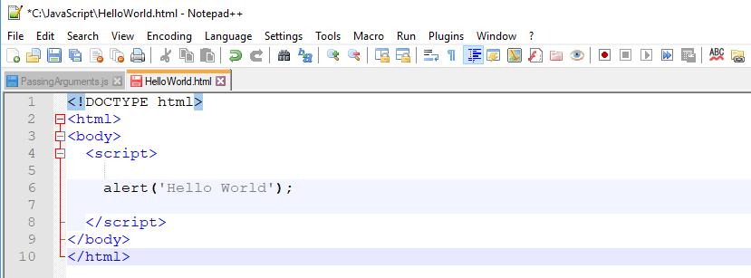
Hello World
Keep track of where you store your code!
}
This is the HTML and never changes
This is the JavaScript code
}
This is the HTML and never changes
FOX
MIS
Notes:
Install a text editor to create code. The program will always be on your hard disk. Unless you delete it. Make a specific directory for your programs.
The alert(‘Hello World’); makes Hello World to appear on the browser
The file extension should be .html, otherwise you wont be able to see all the hard work
After coming from the next slide:
Ask the students to just type it character by character.
People with windows use notepad++, people with mac use BBedit

Slide 13
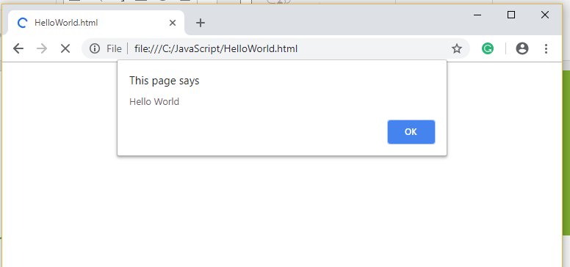
Hello World
Keep track of where you store your code!
Output from Alert
FOX
MIS
Notes:
The output shown by the code
After coming from the slide 10.1.1
Make sure that the code works.

Slide 14
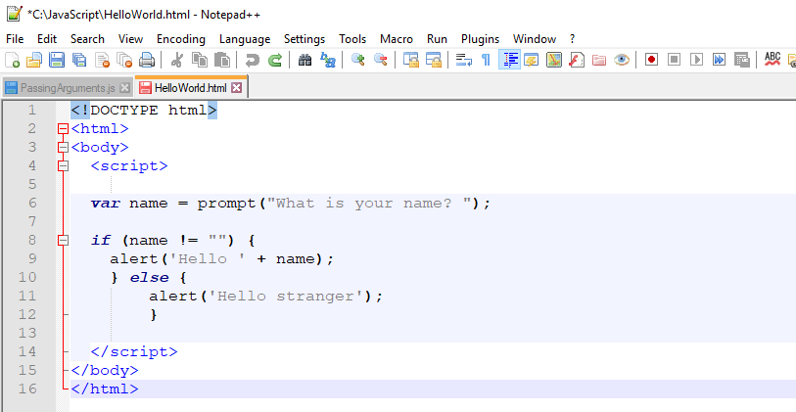
Fancy Hello World!
}
This is the HTML and never changes
}
This will make more sense in the coming weeks
}
This is the HTML and never changes
FOX
MIS
Notes:
This is a more complicated version of the hello world program, we’ll come back to it
Look how the tags do not change, only the code inside changes.
After coming from 10.1.1:
More complex program
Part where prompt is, prompt generates input. It gets in data from user.
When user enters name and hits enter, the name will be taken by prompt and stored in variable called ”name” using equals to operator “=“.
A variable is a container, it holds something.
In this example, the variable is called name.
When user hits enter by tying their name for example Sam,
The value for variable called name will be Sam.
Anytime ”name” is referenced, Sam will be shown there.
Here the if statement is called a conditional logic. It will check if the name has anything in it.
If there is a name, then it will display the value stored inside the variable called name to the user.
Else is used to form an alternative action, If the “if” conditional is false. Here in the else section we assume there is no name entered by the user and we just display hello stranger.

Slide 15
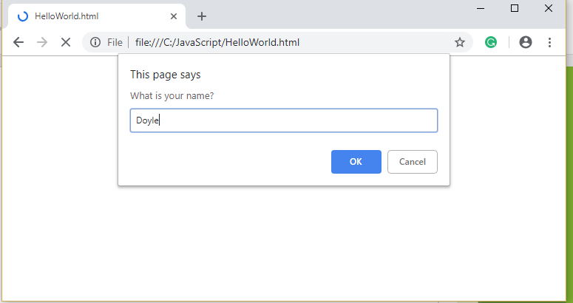
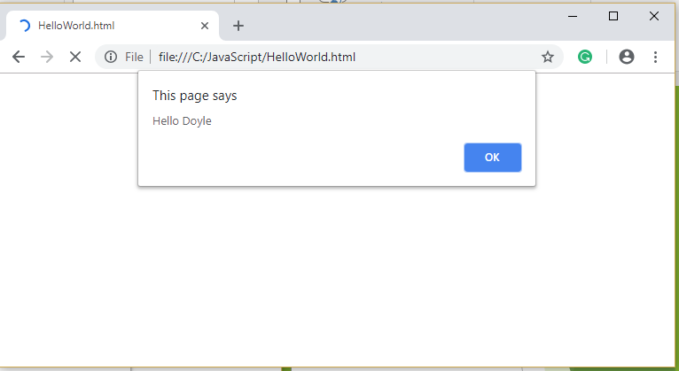
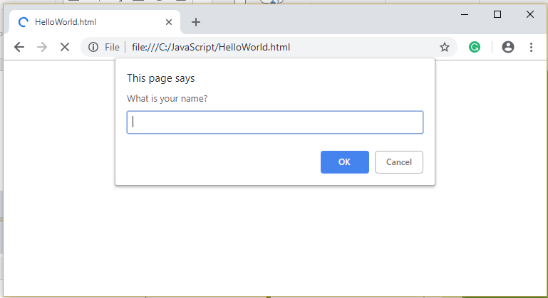
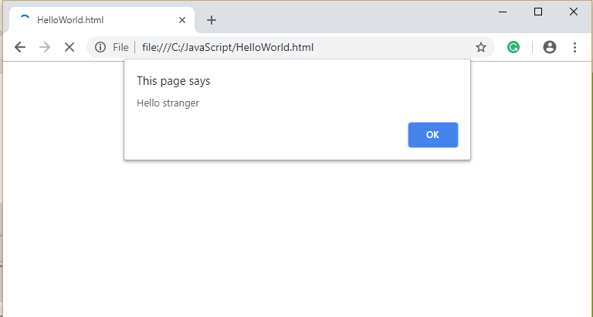
Fancy Hello World!
FOX
MIS
Notes:
Go to slide 10.1.1

Slide 16
To code, we will need a text editor: Windows and Mac users: VS Code Download the installation instructions file, and carefully follow the instructions to install VS Code. However, ignore the reference to “git”.
FOX
MIS

Slide 17
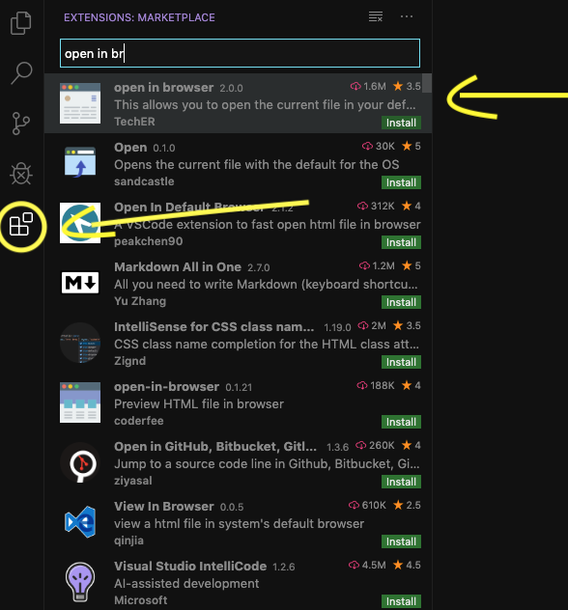
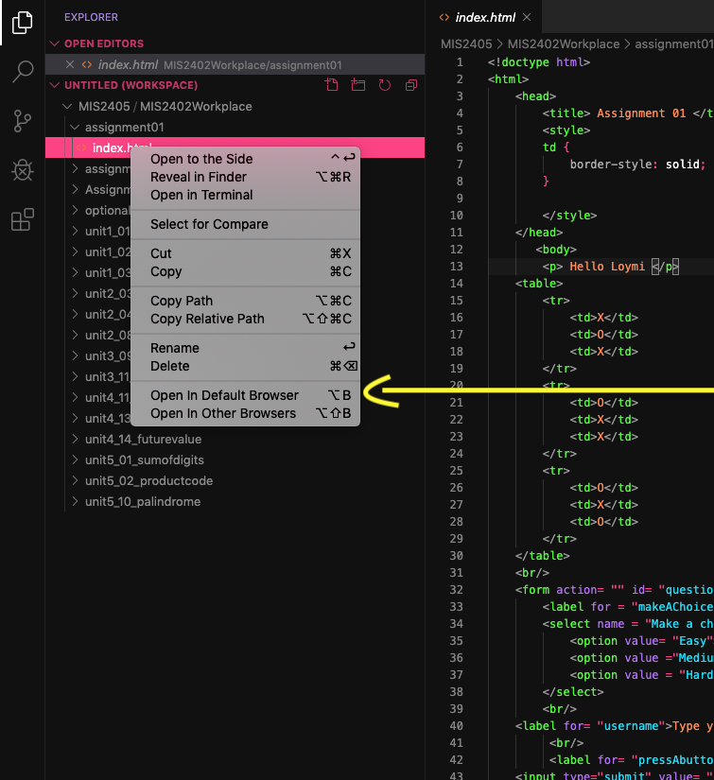
Special Message for Mac Users
The windows version of VS Code has a default option to view a file that you have edited in your browser. On a Mac, you have to install
the Open in Default Browser extension to enable this:

Slide 18
Working with the .html file
The html files that you will write Javascript in reside on your computer in a folder. This folder is also used as the workspace for VS Code.
While in the folder, the file is edited by VS Code, and read by Google Chrome. After every edit you have to reload it in Chrome.
You can do this by hitting the reload button, or by re-opening it while you are in VS Code.
Save your file after every edit! Ctrl-C (Windows) or Command-C (Mac).
Must reload file in
browser after every edit
VS Code
Editor
Google Chrome
Browser
.html
File
File stays in folder

Slide 19
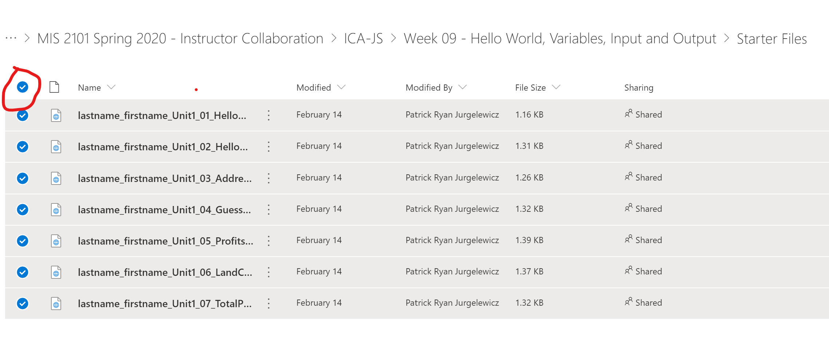
Coding Files AKA Starter Files
From the main course menu, click on Activities and select In-Class Activities.
Scroll to the bottom of the page, and click on the Coding Files for this week.
Mouse-over Name, and a radio button will magically appear. Click on it, and all files will be selected.
Select download, and place them somewhere on your computer where you can easily find them.

Slide 20
Coding Files AKA Starter Files, Continued
When you download the coding files, they will be embedded in a zip file.
A zip file is essentially a folder with files. The folder has been compressed so that it doesn’t take up much space
You can look at a file inside a zip file, you can for instance open a .html file in Google Chrome.
HOWEVER, you cannot save a file that is stored inside a zip file.
So, in order to edit the coding files, you will have to copy them from the zip file and place them in a folder on your computer:
Select all the files in the zip file, copy them, and paste them in a sensibly named folder. E.g. “Week 10 Hello World Coding Files”
Make sure that you know exactly where your files are. You do not want to submit a wrong version of your answer file!

Slide 21
File Naming Convention: Lastname_Firstname_Unit1_01_HelloWorld.html Properly naming you file is very important, if it is improperly named then you will not receive the points for your assignments and challenges.
FOX
MIS

