Slide 1
Information Systems in Organizations Introduction Christy L. Greening

Slide 2
Intro to instructor
IT Manager at Main Line Health – a not for profit healthcare system in suburbs of Philadelphia.
IT Service Delivery Processes – i.e., Incident, Change, Problem Management
IT Manager at Rohm and Haas Company (now Dow Chemical Company)
ERP/SAP Basis, eMail

Slide 3
Managing Expectations
Complete Course Redesign last Fall
Nobody teaches an intro class like this in Fox or in any other colleges!
We will still face some challenges, plan on it!
You will find the class engaging and fun!!
You will acquire knowledge and skills that you will use in future classes and your career!!!

Slide 4
Course Description
Core concepts of MIS
Identify/analyze organizational systems & processes
conceptual diagramming, process decomposition, & data modeling
Enterprise Systems : ERP, SCM, CRM
Platforms & Cloud Computing
Artificial Intelligence

Slide 5
Graded Components
In-Class Activities & Worksheets (approximately 24) * must be present in class to earn credit – no exceptions! | 10%
Learn IT! Assignments #1 – Digital Identity: Establish ePortfolio #2 - System Analysis: Creating Swim Lane Diagram #3 - SAP: System Walkthrough #4 - Learn IT! #4 – An Hour of Code #5 - Digital Identity: Networking and Analytics ** no late assignments accepted – no exceptions! | 15%
Midterm Exam #1 | 25%
Midterm Exam #2 | 25%
Final Exam | 25%

Slide 6
No Required Textbooks!
Vs.
An interesting collection of current, engaging
readings that are freely available over the Internet

Slide 7
No Required Textbook!
What you will love!
What you will hate!
How much does the typical textbook cost?
No publisher that constantly changes editions so you can’t sell your old textbook
How old is the majority of the material in a traditional textbook?
Lots of different articles from:
Different authors
Different audiences
Different formats
No author, editors & reviewers making the connections for you
Life as a business professional does not have a textbook that you can turn to for the
answers. This is how you will learn what you need to be successful in the real world.

Slide 8
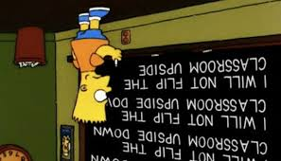

Slide 9
Lecture vs. Flipped Classroom
Lecture
Flipped
The content is covered in the lecture
Students take notes
Students study notes, memorize terms and recall on exams
Very little retention long-term and very little ability to apply what they learned after graduation
There are no lectures
Content is covered in the readings/videos that students must complete before class
Class discussions/activities help develop deeper understanding of content
Superior long-term retention and greater ability to apply what they learn after graduation

Slide 10
Lecture vs. Activities
Vs.
Previous: 3 hours of lecture per week covering the topics the textbook tells us
Now: 1 hour of class discussion a week focusing on the most important learning objectives
And
2 hours of in-class activities that reinforce those key learning objectives

Slide 11
Active Learning
Analysis
Media
Engagement
Synthesis

Slide 12
Active Learning
Solving business problems through Active Learning
Engagement
Analysis
Synthesis

Slide 13
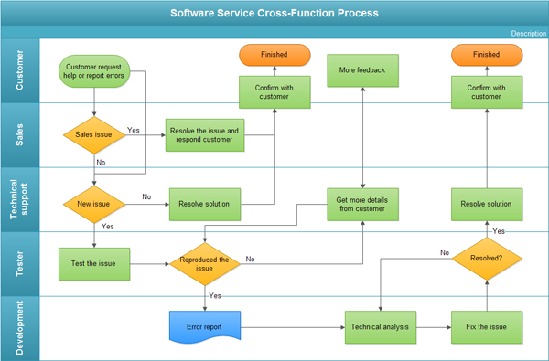
Active Learning
Students are creating these
Applying knowledge!
Engagement
Analysis
Synthesis
Learning to synthesize issues!
Real life, relatable examples!

Slide 14
?
Can you follow class discussion?
Will you ever make connections between readings and class discussion?
In a flipped classroom, what happens if a student doesn’t prepare for class?
Can you contribute to class discussion?
Will in-class activities make any sense?
How challenge will the exams seem?

Slide 15
Build Your Own Study Guide
Don’t ask for a study guide…make your own as we work through the material
Document provided to help you do this

Slide 16
Build Your Own Study Guide For Each Assigned Reading
Link to the article
Your notes (in outline form)
3 key points (1-2 sentences each)
3 important details (1-2 sentences each)
A set of fill in the blank questions

Slide 17
Build Your Own Study Guide
During Lectures
Students called upon at random to share info from their study guide
In-Class Activities – Exam Prep
Students will share info from their study guides in small teams
Preparing for Exams
You have most of what you need to ace the exams!

Slide 18
Build Your Own Study Guide
Guess where 20% of the questions on the exam will come from?

Slide 19
Wikipedia (and other questionable sources)
Is there any value to sources like Wikipedia in an academic environment?
What are the risks?
How timely and relevant can Wikipedia articles be?
What is the value of crowdsourcing information?
What is the role information technology plays in crowdsourcing of information?
Can the benefits outweigh the risks if you understand them?

Slide 20
Course Topics Overview
Unit 1: Introduction (weeks 1)
Unit 2: Systems Analysis (weeks 2-4)
Midterm #1 (week 5)
Unit 3: Organizational Systems part 1 (weeks 6-8)
Midterm #2 (week 9)
Unit 4: Organization Systems part 2 (weeks 10-14)
Final Exam (finals week)

Slide 21
?
No overpriced, outdated textbooks
Superficial knowledge vs. deeper understanding
What is going to be so special about this class?
It’s just another intro class?
Less is more!
Use these techniques to look like a rock-star in your other classes
Less lecture, more activities
Active learning

Slide 22
Class Site Review

Slide 23
?
Engaging
Working in small teams
Must be present to receive credit
What exactly do you mean by in-class activities?
Must hand in completed worksheet to receive credit
Develop deeper understanding of material

Slide 24
Introduction to Information Systems in Organizations
In-Class Activity…

Slide 25
On to Unit 1!

