Slide 1
Information Systems in Organizations 5.1 Platforms and Network Effects 5.2 Cloud Computing

Slide 2
Roadmap
Week 1: Intro to MIS
Week 2: Systems Analysis
Week 3: Systems Analysis
Week 4: Systems Analysis
Week 5
Swimlanes
ERDs
Decision Trees
Architecture Diagrams
Exam #1
Learn IT! #1
Max Labs 0
What is MIS?
Week 6: Organizational Systems
Week 7: Organizational Systems
Week 8: Organizational Systems
Week 9
Decision Support
SDLC
Exam #2
ERP
Knowledge Management
Digital Innovation
Max Labs 1a & 1b
Week 10: Organizational Systems
Week 11: Organizational Systems
Platforms
Week 13: Organizational Systems
Week 14
Customer Relationship Management Systems
Cloud Computing
Artificial Intelligence
Exam #3 Prep
Supply Chain Management Systems
Week 12: Organizational Systems
Max Labs 3a & 3b
Learn IT! #2
Max Labs 2a & 2b
Both extra credit

Slide 3
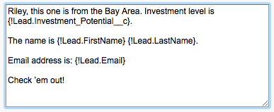
Max Labs 3a & 3b
Due TODAY– Each part will take about an hour
Max Labs 3a
4 Screenshots
Make the app scalable
See how CRM systems make life easier
Max Labs 3b
3 Screenshots
Go full cyborg
Make connections between Salesforce and social media

Slide 4
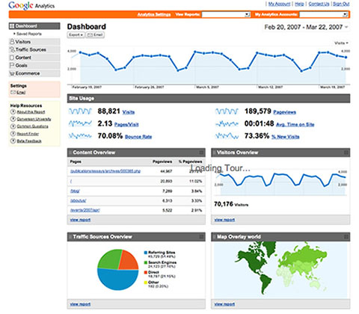
Learn IT! #2 Digital Identity Management
Due by end of day December 5
Part 5 of Learn IT! #1
Revisit your Google Analytics page
Define terms & find actual data
How could you make the numbers better?

Slide 5
Required Reading
What is a Platform?
Business Model Analysis, Part 2: Platforms and Network Effects
What Makes Uber Different from Android? How to Make Sense of Platform Businesses
Airbnb and the unstoppable rise of the share economy

Slide 6
What is a Platform?
Discuss:
1. What was this article about?
2. Why should you care?
We learned that a platform is a business model that creates value by facilitating exchanges between two or more independent groups, usually consumers and producers.
Some of the most exciting new businesses out there today are built on platforms. With an understanding of technology, platforms and the different types of platforms, maybe you will be the creator of the next Uber!

Slide 7
Required Viewing 1/4

Slide 8
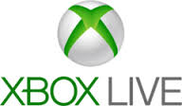
What is a Platform?
A platform is an environment provided by an intermediary (proprietary or hosted) encompassing infrastructure and rules to facilitate users’ interactions with each other.
A platform is a business model that creates value by facilitating exchanges between two or more interdependent groups, usually consumers and producers.
Exchange Platforms
Maker Platforms

Slide 9
Business Model Analysis, Part 2: Platforms and Network Effects
Discuss:
1. What was this article about?
2. Why should you care?
This article discusses different types of platforms and the impact of the network effect has on the value of a business built on a platform.
For many platform based businesses, the number of people involved makes the difference between making money and losing money.

Slide 10
Required Viewing 2/4

Slide 11
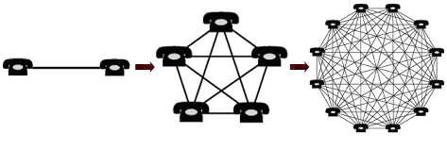
What is a Network Effect?
In economics and business, a network effect is the effect that one user of a good or service has on the value of that product to other people.
“Network effects are evident when any given customer’s willingness to pay (WTP) for a product depends on the number of other customers with whom they can interact by using the product.”

Slide 12
What Makes Uber Different from Android? How to Make Sense of Platform Businesses
Discuss:
1. What was this article about?
2. Why should you care?
Both Uber and Android are platforms that provide the foundation for great businesses but they are very different types of platforms that make money in different ways, Uber is an exchange platform while Android is a maker platform.
As a business person, you need to understand the different types of platform, how the platforms create value and how the money flows.

Slide 13
Platform Mediated Networks
Connect networks of customers / users, and are not limited to information industries:
Financial services (e.g., stock exchanges, credit cards, ATMs),
Health care (e.g., HMOs)
Energy (e.g., the power grid)
Transportation (e.g., airlines, container shipping, gasoline stations)
Retailing (e.g., shopping malls, barcodes). A diverse array of matchmaking businesses mediate network transactions, including auctioneers, executive recruiters, realtors, and travel agencies.
Enable communication & commerce

Slide 14
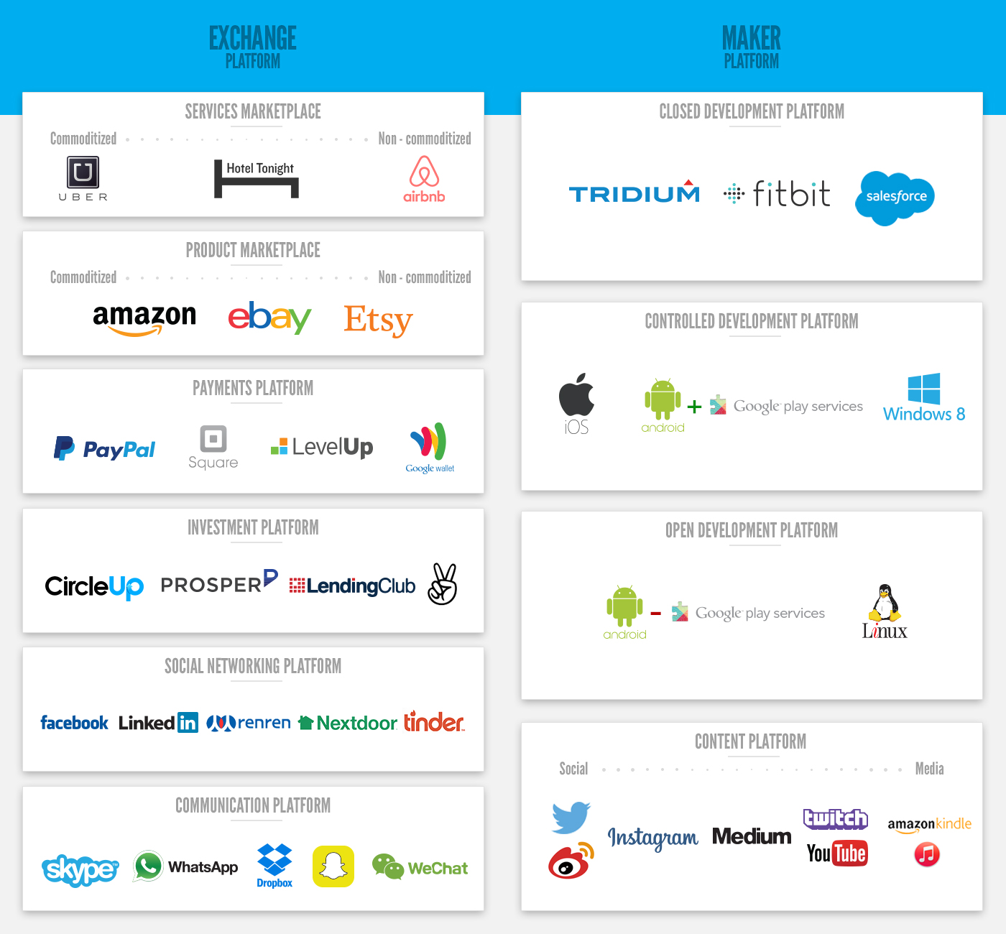
http://www.applicoinc.com/blog/what-is-a-platform-business-model/

Slide 15
Airbnb and the unstoppable rise of the share economy
Discuss:
1. What was this article about?
2. Why should you care?
How we have seen the rise of platform being leveraged as a business model. Asset owners use this model to capitalize the unused capacity of items they already have, such as car or house, and consumers rent from their peers rather than rent or buy from a company.
We are moving from a world where we're organized around ownership to one organized around access to assets. As a business professional it is important to understand the capabilities of this new business model.

Slide 16
Platform Business Models
Proprietary
Single provider with exclusive control over technology, standards, pricing leverage (e.g. eBay, Federal Express, Google)
Shared
Multiple providers collaborate in developing technology, then compete in differentiating services (e.g. Xbox, Windows, cellular LTE)

Slide 17
Roadmap
Week 1: Intro to MIS
Week 2: Systems Analysis
Week 3: Systems Analysis
Week 4: Systems Analysis
Week 5
Swimlanes
ERDs
Decision Trees
Architecture Diagrams
Exam #1
Learn IT! #1
Max Labs 0
What is MIS?
Week 6: Organizational Systems
Week 7: Organizational Systems
Week 8: Organizational Systems
Week 9
Decision Support
SDLC
Exam #2
ERP
Knowledge Management
Digital Innovation
Max Labs 1a & 1b
Week 10: Organizational Systems
Week 11: Organizational Systems
Platforms
Week 13: Organizational Systems
Week 14
Customer Relationship Management Systems
Cloud Computing
Artificial Intelligence
Exam #3 Prep
Supply Chain Management Systems
Week 12: Organizational Systems
Max Labs 3a & 3b
Learn IT! #2
Max Labs 2a & 2b
Both extra credit

Slide 18
Required Reading
Cloud Computing 101
How to Choose Your Cloud Service Provider
Cloud Failures Will Happen. Are You Ready?

Slide 19
Required Viewing 3/4

Slide 20
Cloud Computing 101
Discuss:
1. What was this article about?
2. Why should you care?
This article give a simple overview of cloud computing including what it is, the types of cloud computing (IaaS, PaaS and SaaS) and some of the pros/cons of utilizing cloud computing.
Cloud computing means a lot of different things to a lot of different people. Some organizations benefit from one type of cloud computing while other benefit from another type. You need to have a basic understanding of cloud computing if your organization is going to benefit from it.

Slide 21
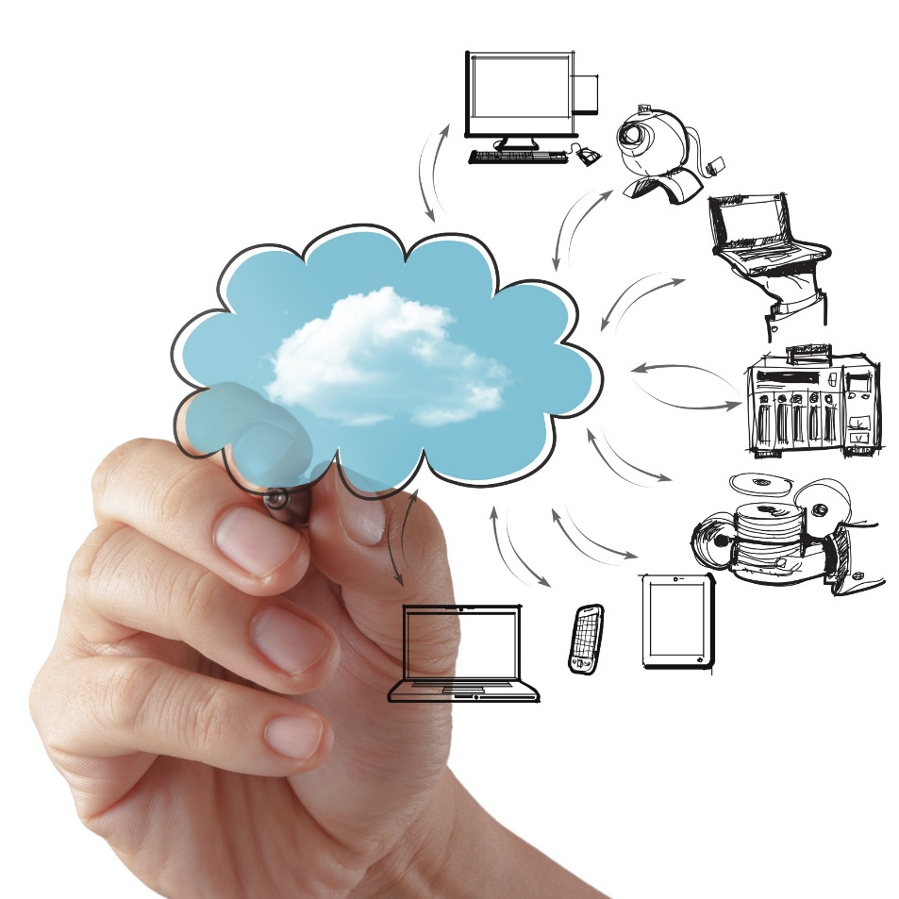
Enterprise Cloud Computing
Computing On Demand
Characteristics:
On demand self-service
Network access from anywhere
Rapid elasticity (scalability) & Resources pooling
Measured services (pay for services you use)

Slide 22
Enterprise Cloud Computing
Technology as a “utility”
Capital Expenditures become Operating Expenditures
Enables universal, global, & mobile collaboration
Source: http://www.dailytech.com/Cloud+Computing+Changing+IT+in+Small+Business+World/article33635.htm

Slide 23
Cloud Computing
Pros
Anywhere, Anytime collaboration / remote access
A green choice
Reduced Support/IT Staff and Hardware Needs
Less expensive
Increased Agility/Scalability
Disaster Recovery
Easy to Use
Improved service and performance
Cons
Device Security
Downtime & Availability of data
Data Integrity
Privacy & confidentiality of data

Slide 24
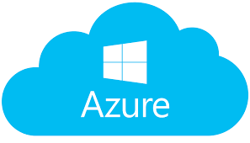
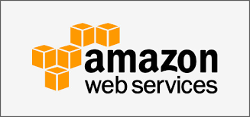
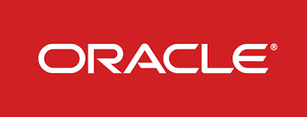
Big Players in Cloud Computing
Amazon Web Services (AWS)
Google Cloud Platform
Microsoft Azure
Oracle
And many others

Slide 25
How to Choose Your Cloud Service Provider
Discuss:
1. What was this article about?
2. Why should you care?
There are lots of cloud providers out there, each with their own individual strengths and weaknesses. This article helps you understand what you should be looking for when trying to find a partner in the cloud space.
For some organizations, selecting a cloud provider is literally a “bet the business” proposition. If the cloud provider has problems, your business will pay the price. Choose wisely!

Slide 26
Required Viewing 4/4

Slide 27
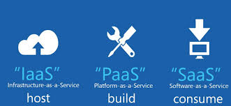
Cloud Computing Models
IaaS: Infrastructure as a Service
PaaS: Platform as a Service
SaaS: Software as a Service
Various other models exist (XaaS) / Hybrid

Slide 28
IaaS, PaaS, SaaS Explained
IaaS: “host” – you pay for the infrastructure but you are responsible for all application development and deployment and support activities.
PaaS: “build” – you pay for the infrastructure and for a developing platform that supports many areas of deployment so you can just focus on programming your application.
SaaS: “consume” – you pay for an entire solution that is fully built, deployed, and distributed over the web for you to consume on demand. You have no infrastructure, development, deployment, or support responsibilities.

Slide 29
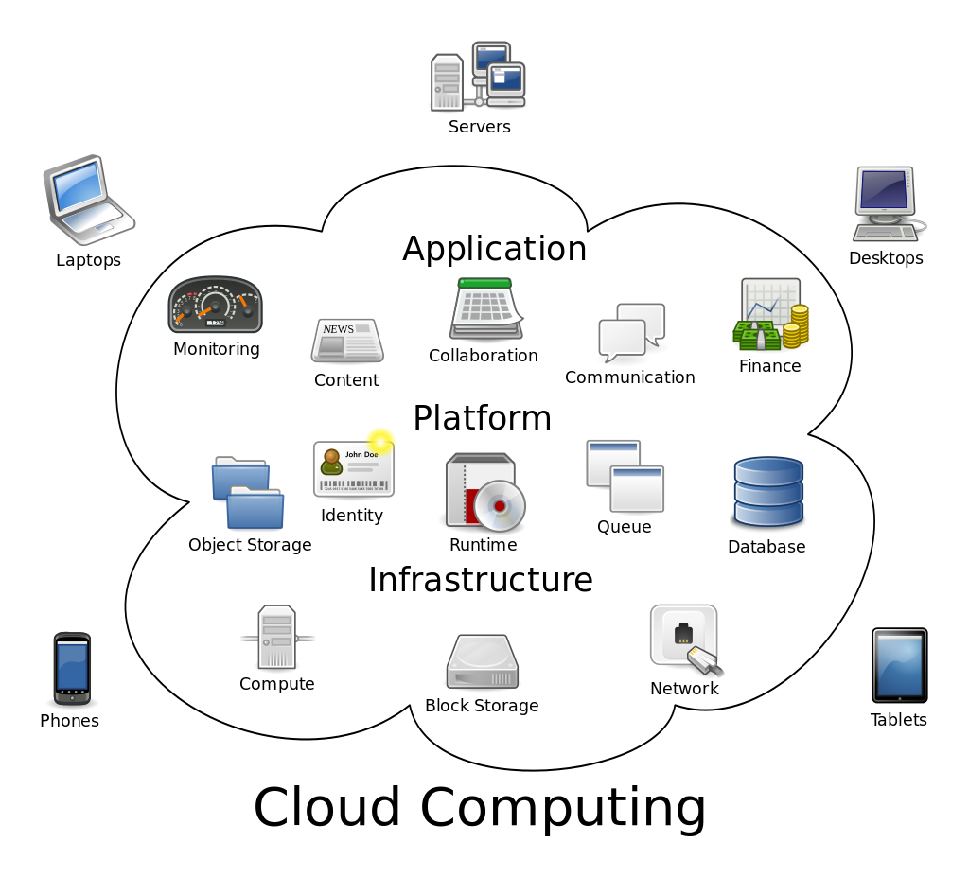

Slide 30
Which environment would be best if you need a simple, rapid, high-availability solution to answer a standard business problem?
SaaS
Which environment would be best if your use case requires a lot of customization and proprietary code to support a unique business model, and you have a big budget and plenty of developing, back-end, and support talent?
Which environment would be best if you need to rapidly deploy your own application but need the support of a developing environment and automated support to your code?
IaaS
PaaS

Slide 31
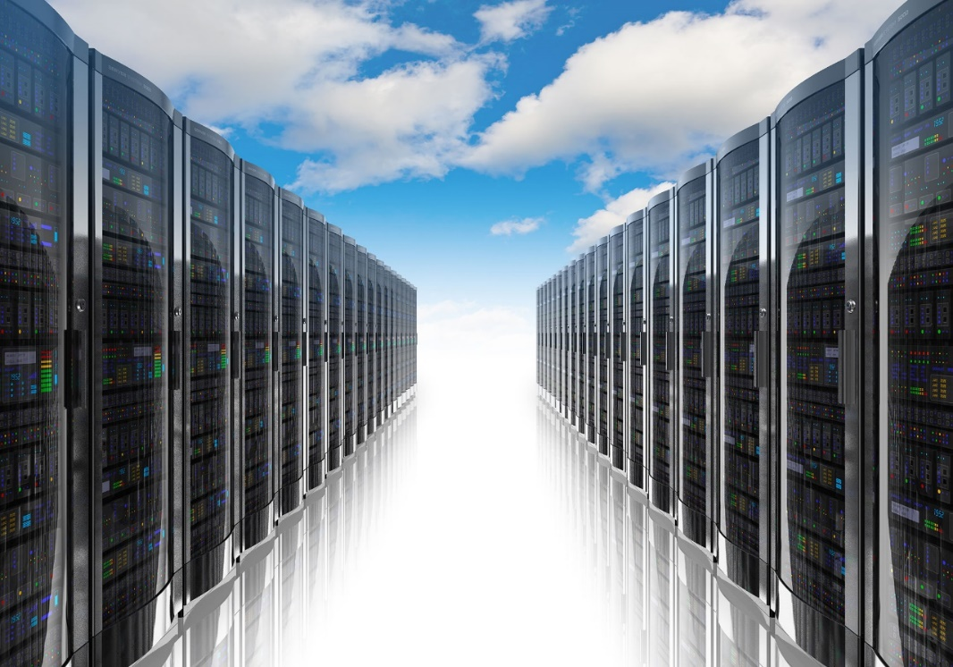
1) IaaS (Infrastructure as a Service)
“Online services that abstract user from the detail of infrastructure like physical computing resources, location, data partitioning, scaling, security, backup, etc.”
The user is responsible for installing and maintaining the operating system and the application software.
Resource Pooling
Pay for resources allocated and consumed, much like a utility service.

Slide 32
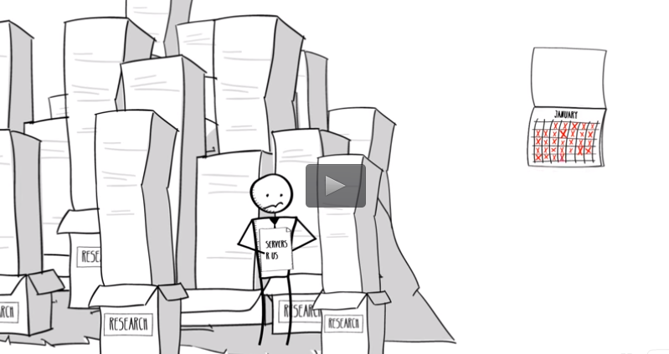
IaaS: Amazon Web Services: EC2
The gold standard in IaaS
Many services you use run on AWS
Hundreds of success stories
Click image to watch demo
Notes:
4 min video : optional viewing, no captions provided

Slide 33
AWS Case Study: Netflix
<< Click image to watch video
8 years migration to AWS – no more data center!
AWS manage the infrastructure
Nimble architecture
Increased productivity
Netflix developers team now focuses on developing features unique to Netflix

Slide 34
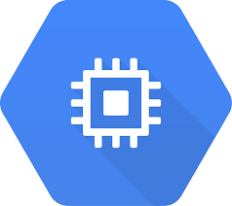
Google Cloud Platform: Compute Engine
Built on the same infrastructure as Google search engine, Gmail, YouTube: “Powered by Google”
Scalable virtualization on demand
Pay per consumption, like a utility, cents per hour of usage
Each virtual machine instance is equipped with resources like disk, network, firewall, etc.

Slide 35
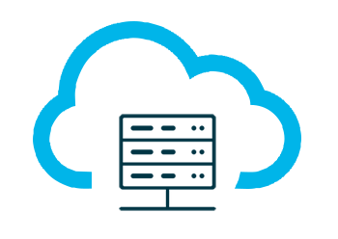
2) PaaS (Platform as a Service)
Build and deploy applications to the web quickly and without the significant capital expenditures and complexity of investments in infrastructure and support layers
Platform includes security layers, databases, operating systems, and developing/execution environments
Rapid deployment
Automatic Scaling
Integration with developing tools
Pay for what your application consumes

Slide 36
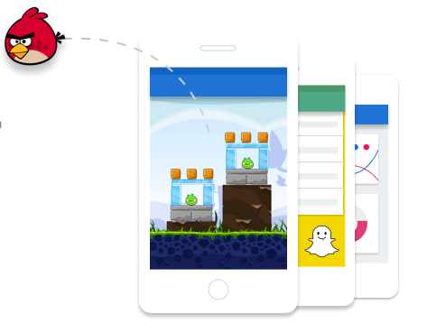
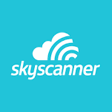
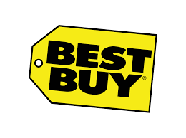
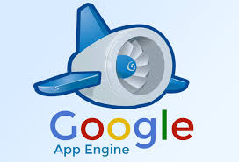
PaaS: Google App Engine (2008)
The gold standard in PaaS
Supports Python, Java, PHP, and Go
Includes free quotas
Pay per application consumption
Hundreds of apps built and deployed

Slide 37
GCP Case Study: Snapchat
<< Click image to watch video
Snapchat has been valued at ~$15 Billion
All it offers is an app to share temporary, fleeting images
Why is scalability so important?
How might demand surge during events like Superbowl, Academy Awards, Elections, etc.?
Notes:
5 min video

Slide 38
PaaS: AWS Elastic Beanstalk (2011)
Launched 3 years after (and in response to) Google App Engine
Supports more programming languages than Google
Uses similar quotas and pay per consumption model
Click image to watch demo
Notes:
3 min video optional, no Captions Available

Slide 39
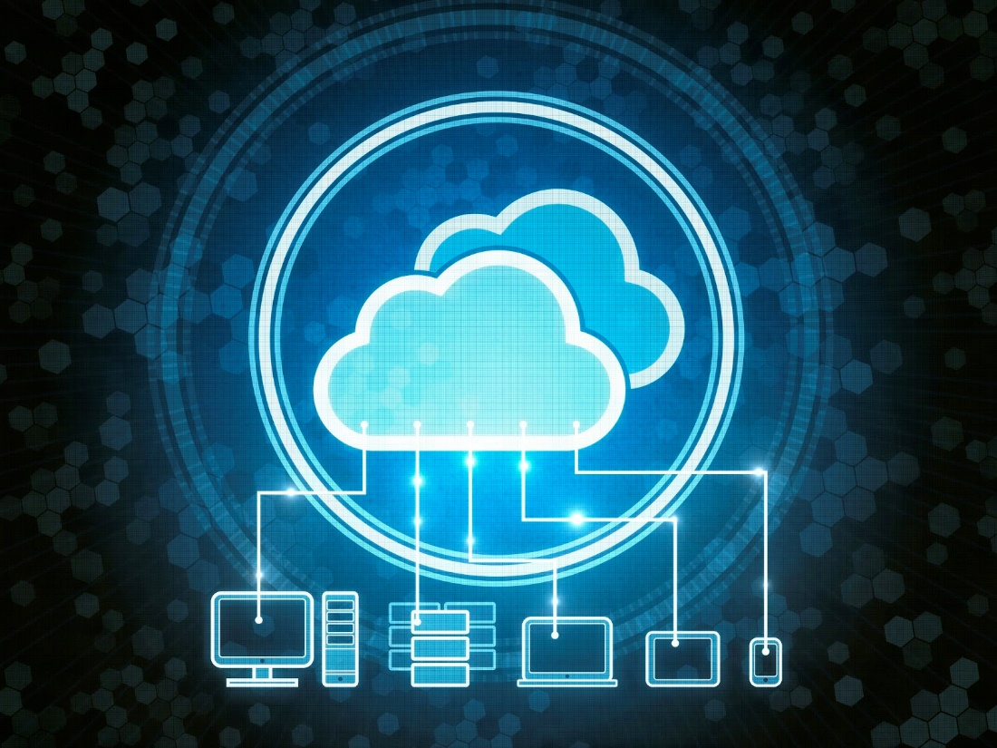
3) SaaS (Software as a Service)
Cloud based software
Central, multi-tenant or virtualization architecture supports scalability
Distributed via web browsers; available anywhere with an internet connection
Compatible with multiple operating systems and devices
Easy to use, collaborate, update, and sync
Reduced time to benefit / rapid prototyping
Revenue model is subscription based

Slide 40
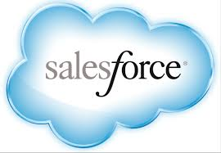
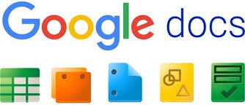
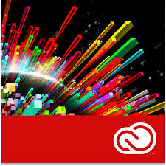
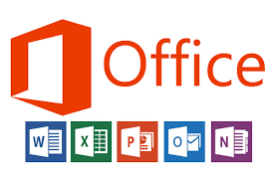
Examples of SaaS
SalesForce
CRM tool
NetSuite
CRM and ERP combined service
Constant Contact
Marketing automation tool
GoToMeeting
Conferencing solution
Google Docs
Collaboration tool
DropBox
Storage solution
Adobe Creative Cloud
Suite of creative solution
Microsoft 365
Suite of creative solutions

Slide 41
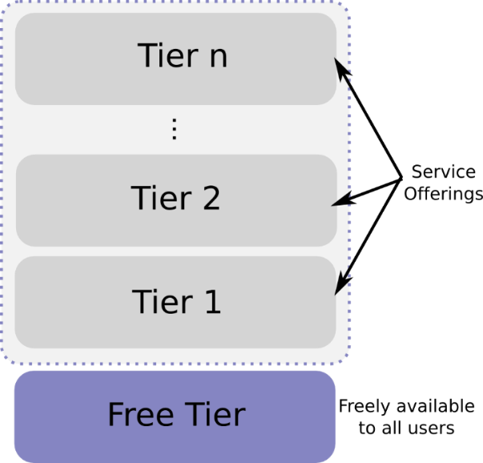
SaaS Subscription Types
Monthly billing
Term billing
Freemium: limited version free forever (usually very low conversion rate)
Free Trial: full version free for a period (conversion rates should be higher)
Paywall: similar to free trial, content blocked by quota
Freemium

Slide 42
On Premise
IaaS
PaaS
SaaS
Applications
Applications
Applications
Applications
You Manage
Data
Data
Data
Data
You Manage
Middleware
Middleware
Middleware
Middleware
Vendor Manages
Operating System
Operating System
Operating System
Operating System
You Manage
Virtualization
Virtualization
Virtualization
Virtualization
Vendor Manages
Servers
Servers
Servers
Servers
Vendor Manages
Storage
Storage
Storage
Storage
Networking
Networking
Networking
Networking
Notes:
Source: https://www.youtube.com/watch?v=KgL3BfAc9Cs

Slide 43
Cloud Failures Will Happen. Are You Ready?
Discuss:
1. What was this article about?
2. Why should you care?
Nothing is certain except death and taxes…and technology failures. If your company uses a cloud provider, will you survive if they have a failure? This article lists a number of things to consider.
If your cloud provider is down then your business is down. Have you researched the cost of downtime for an organization and will you still be in business if your cloud provider has a catastrophic failure?

