Slide 1
Information Systems in Organizations
Entity Relationship Diagrams - 1
In-Class Activity
FOX
MIS

Slide 2
What is an entity relationship diagram?
An Entity Relationship Diagram (ERD) is a visual representation of different data using conventions that describe how these data are related to each other.
Diagram Components:
Entity (noun)
Attributes (characteristics of the entity)
Relationship (verb)
FOX
MIS

Slide 3
Crow’s Foot Database Notation
A shopper walks into a store to buy an item. When the shopper makes a purchase, the system is updated with information about the person, including their name, loyalty card id and zip code. The store also records which items were purchased, including details like item name, price and item source.
Chen’s Database Notation
FOX
MIS

Slide 4
ICA19: Entity Relationship Diagrams - 1
What:
Interpret an entity relationship diagram
Construct a simple entity relationship diagram from provided story
Add the attributes you would expect to be needed for each entity
Why:
ERDs model the information required for a process
ERDs supplement swim lane diagrams and complete a bigger picture
FOX
MIS

Slide 5
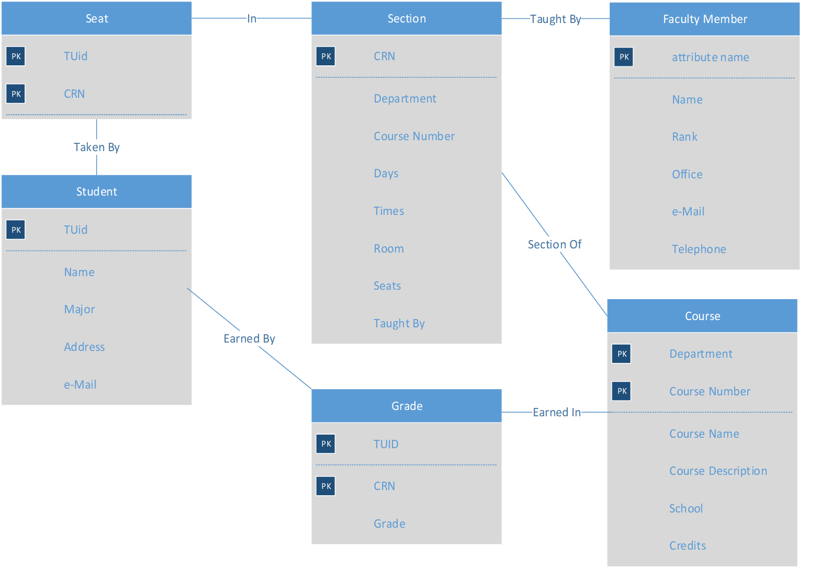
Entity Relationship Diagram (ERD)
Legend :
PK : Primary Key
FK : Foreign Key (refer to PK)

Slide 6
Swim Lane From a couple of weeks ago…
Start
End

Slide 7
Entity Relationship Diagram (ERD)
Conduct interviews (phone and FTF)

