Slide 2
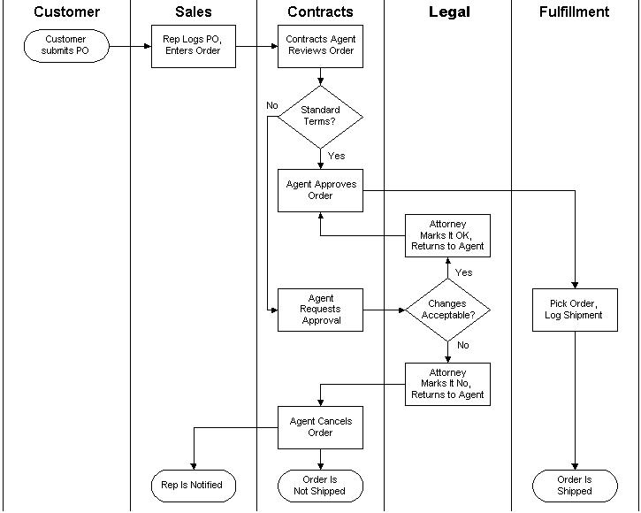

Slide 3
The Hiring Process
Mike is the HR manager at Playwicki Financial Services. They need to hire a new systems analyst. The job has been posted on the company’s web site and a few people have applied for the position. The hiring process starts when Mike reviews the applications and matches them up with the job requirements to identify the best candidate. Once the best candidate has been identified, their resume is sent to the hiring manager to review. If the hiring manager is not interested they ask Mike for another candidate and Mike starts looking for another candidate. If the hiring manager is interested in interviewing the candidate they let Mike know and Mike schedules a phone interview with the hiring manager. The hiring manager conducts the phone interview with the candidate. If the hiring manager is not happy with the candidate they ask Mike for another candidate and the process starts over again. If the hiring manger is happy with the candidate then they let Mike know and Mike schedules a face-to-face interview for the candidate with the hiring manager. The hiring manager conducts the interview. If the hiring manager is not happy with the candidate they let Mike know and the process starts over again. If the hiring manager is happy with the candidate they notify Mike that they’d like to hire the candidate. Mike call the candidate to offer them the position over the phone. If the candidate is interested, Mike assembles the formal offer and mails it to the candidate. The candidate signs the offer, returns it to Mike and the new employee is officially hired.

