Slide 1
Information Systems in Organizations
1.1 Introduction to MIS

Slide 2
Roadmap
Week 1: Intro to MIS
Week 2: Systems Analysis
Week 3: Systems Analysis
Week 4: Systems Analysis
Week 5
Swimlanes
ERDs
Decision Trees
Architecture Diagrams
Exam #1
Learn IT! #1
Max Labs 0
What is MIS?
Week 6: Organizational Systems
Week 7: Organizational Systems
Week 8: Organizational Systems
Week 9
Decision Support
SDLC
Exam #2
ERP
Knowledge Management
Digital Innovation
Max Labs 1a & 1b
Week 10: Organizational Systems
Week 11: Organizational Systems
Platforms
Week 13: Organizational Systems
Week 14
Customer Relationship Management Systems
Cloud Computing
Artificial Intelligence
Exam #3 Prep
Supply Chain Management Systems
Week 12: Organizational Systems
Max Labs 3a & 3b
Learn IT! #2
Max Labs 2a & 2b

Slide 3
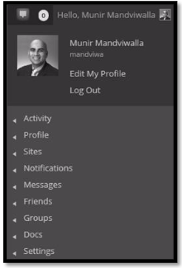
Learn IT! #1
Digital Identity Management
Due week 2 – 10/27 @ 11:59PM
4 Parts
  Part 1: Digital Identity (Create a profile on eportfolio site)
  Part 2: Digital Portfolio
  Part 3: Analytics
  Part 4: Build a Professional Network
  Ignore Part 5 for now

Slide 4
Required Reading
What is MIS?
Difference between IS, CS and IT
Information Systems vs Information Technology
AIS Information Systems Job Index
Wikipedia, Business Analyst
Wikipedia, Systems Analyst

Slide 5
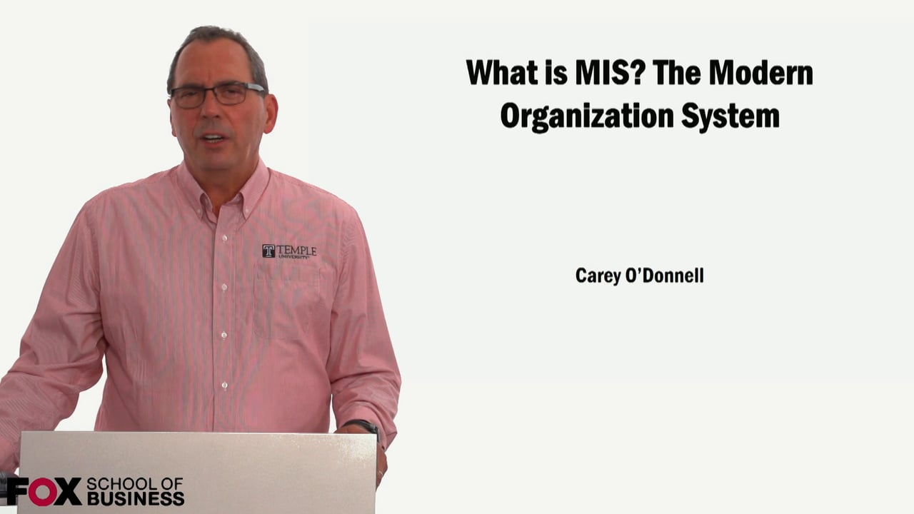
Required Viewing 1/2

Slide 6
What is MIS?
Discuss:
  1. What was this article about?
  2. Why should you care?
MIS, or Management of Information Systems, is a growing field with opportunity where a professional uses technology to improve business functions.
All businesses today need technology; by knowing a little MIS, we become far more valuable as business people.

Slide 7
?
What is the current demand for MIS workers?
What is an MIS System?
What do MIS people do?
What are the salary ranges for MIS professionals?
What is MIS?
How is MIS different from Computer Science?
What are the prospects for women in MIS?
Who works in MIS?
What type of programming do you do in MIS?

Slide 8
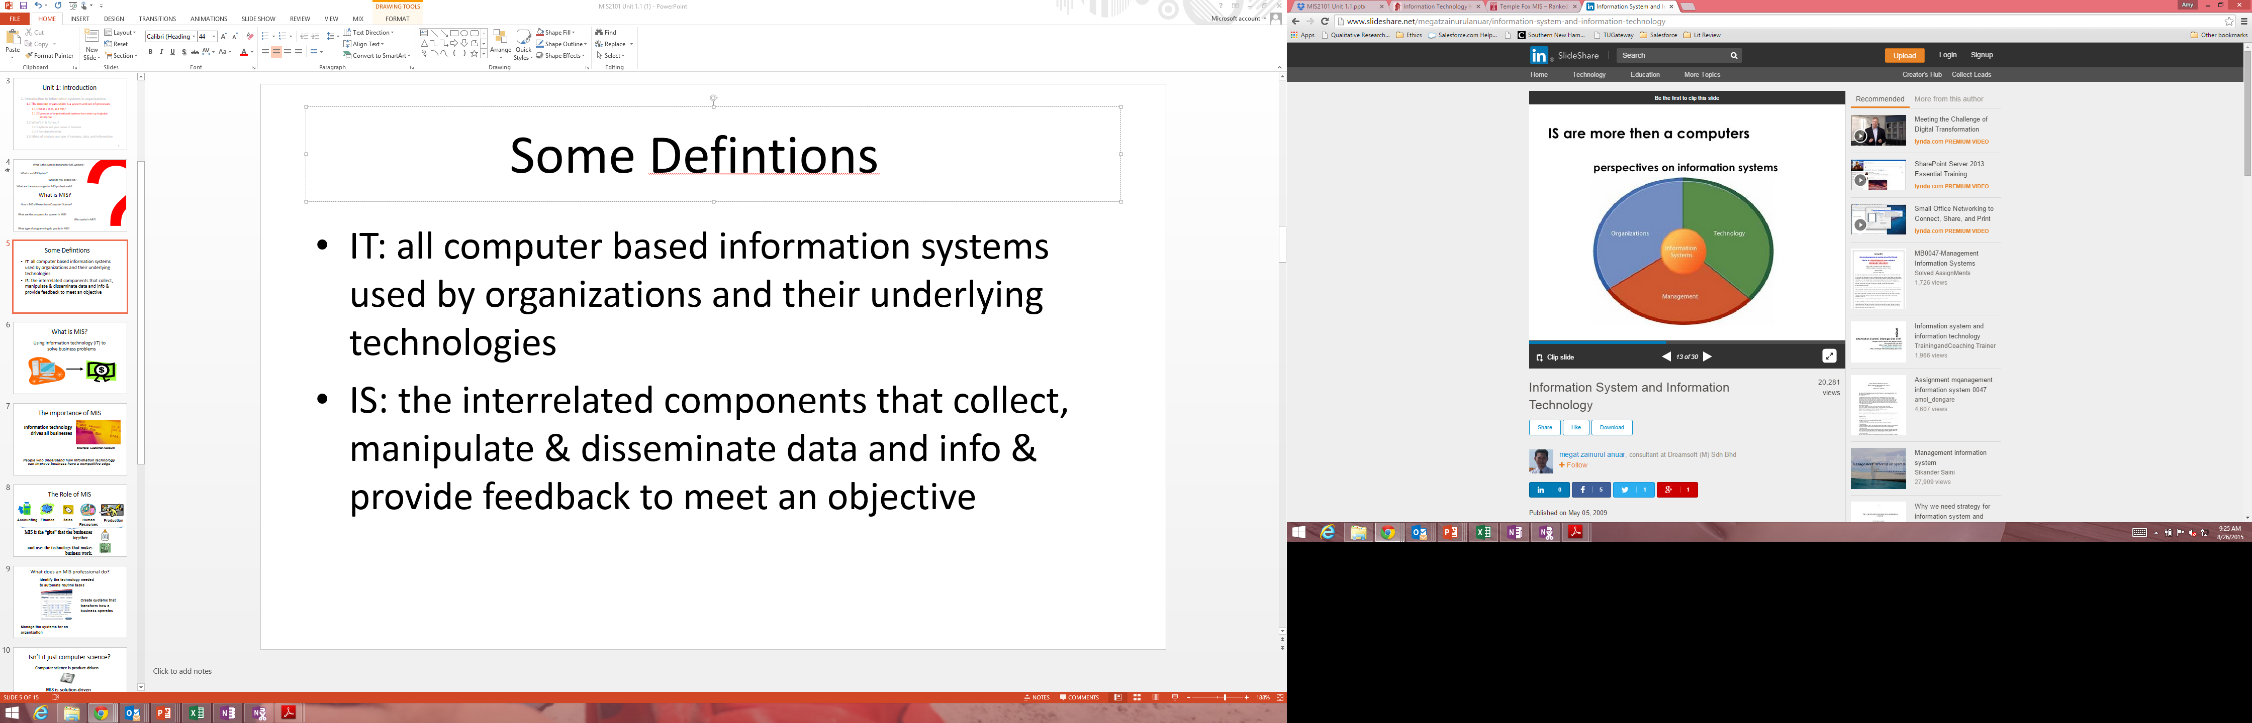
Information Systems is more than computers

Slide 9

MIS is the study of People -
Who are the stakeholders in an organization?
How do they interact with technology and systems?
How do they work through the process of getting their job accomplished?

Slide 10

MIS is the study of Technology
What are the information systems that are used by a business to record, understand and disseminate information?
How does an organization use technology to provide efficiencies across users?
How does an organization utilize technology to streamline business processes and accomplish their main goal?

Slide 11

MIS is the study of Organizations
What technology is utilized in an organization?
How do they utilize this technology?
Does the technology assist the organization in achieving their goals?
What business problems or opportunities does an organization face and how can technology be used to help them achieve their goals?

Slide 12



MIS is the study of People, Technology & Organizations
Focus – how people utilize technology in their organization to solve problems, find opportunities and further the mission of the organization.
Goal: Efficiency utilizing people & technology!
Think about your major – what role does technology play in your future career path?

Slide 13
What is MIS?
Using information technology (IT) to
solve business problems

Slide 14

The Importance of MIS
Information technology drives all businesses
Example: Customer Account
People who understand how information technology can improve business have a competitive edge

Slide 15
The Role of MIS
Accounting
Finance
Sales
Human Resources
Production
MIS is the glue that ties businesses together…
…and uses technology to make businesses work.

Slide 16
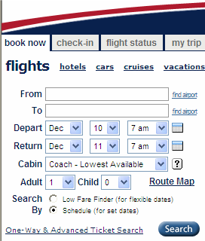
What does an MIS professional do?
Create systems that transform how a business operates
Identify the technology needed to automate routine tasks
Manage the systems for an organization
Notes:
Automate: Create a system to process airline reservation
Transform: Increase the speed of making an airline reservation by reducing the number of people involved
Manage: Analyze the cost and time it will take to integrate the systems of a newly acquired company (e.g., Usair and AmericaWest)

Slide 17
Difference between IS, CS and IT
Discuss:
  1. What was this article about?
  2. Why should you care?
While all three terms relate to technology related careers, these are really three very different areas. It all comes down to if your goal is to create new technologies that don’t already exist or leverage technology to create value in an organization.
There is a lot of confusion about these different roles and it is difficult to discuss the various careers without understanding the differences between these roles.

Slide 18
Information Systems vs. Information Technology
Discuss:
  1. What was this article about?
  2. Why should you care?
IS is the umbrella term for systems, people and processes designed to create, store, manipulate, distribute and disseminate information which may or may not be automated using IT. IT is about the technology that implements many systems.
While many people use these terms interchangeably, they are different and understanding the difference is important when communicating ideas.

Slide 19
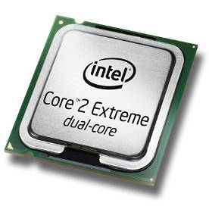
Isn’t it just computer science?
Computer science is product-driven
MIS is solution-driven
Example: Create systems to deliver products to customers

Slide 20

Required Viewing 2/2

Slide 21
AIS Information Systems Job Index
Discuss:
  1. What was this article about?
  2. Why should you care?
There are a lot of interesting opportunities in this field for people with a wide range of interests.
If you like both business and technology, there is nothing but opportunity in this field.

Slide 22
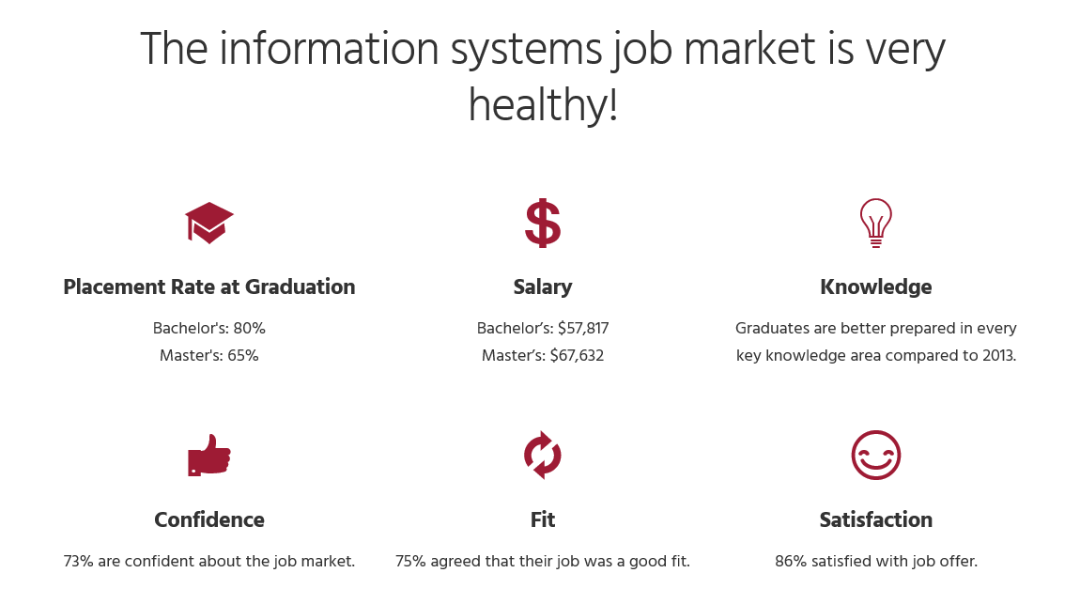
Based on 1600+ recent graduates from 57 universities across the U.S.

Slide 23
Information systems is open!
Double the percentage of females as compared to Computer Science

Slide 24
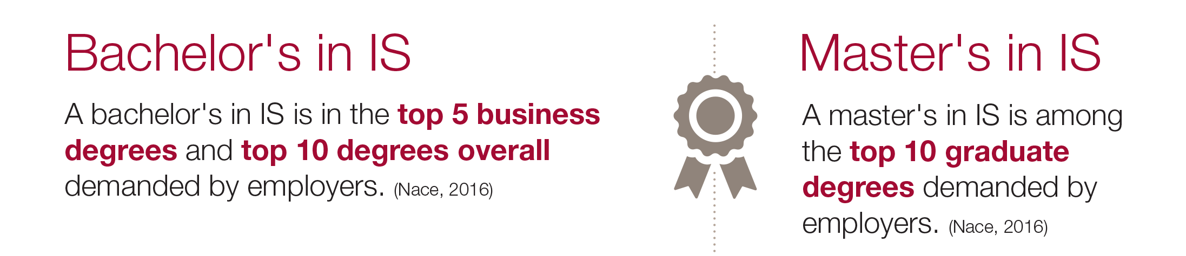

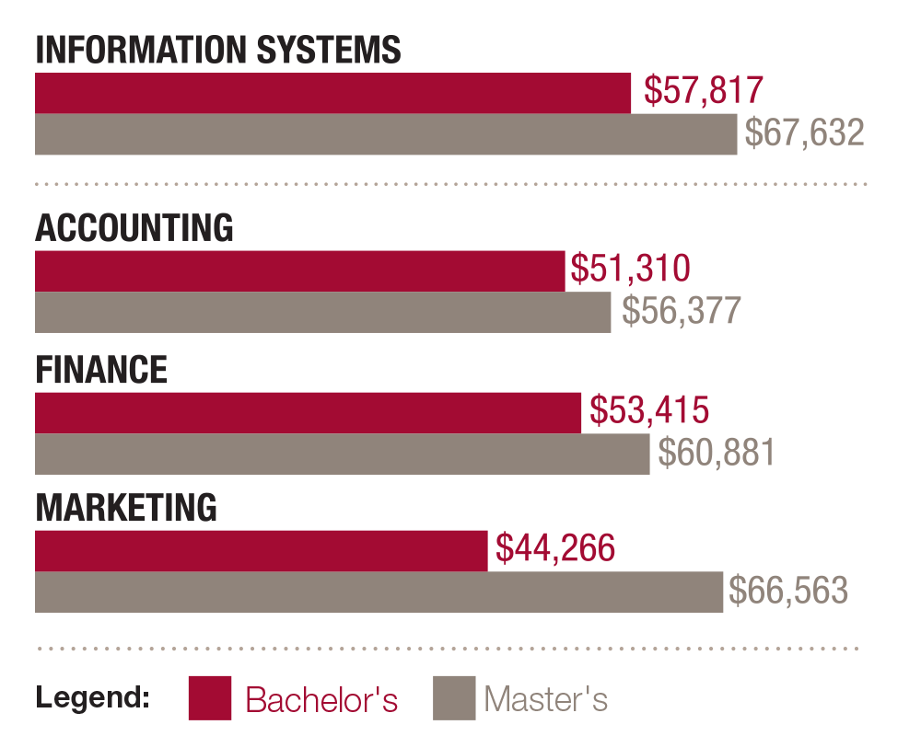
Information systems is hot!

Slide 25
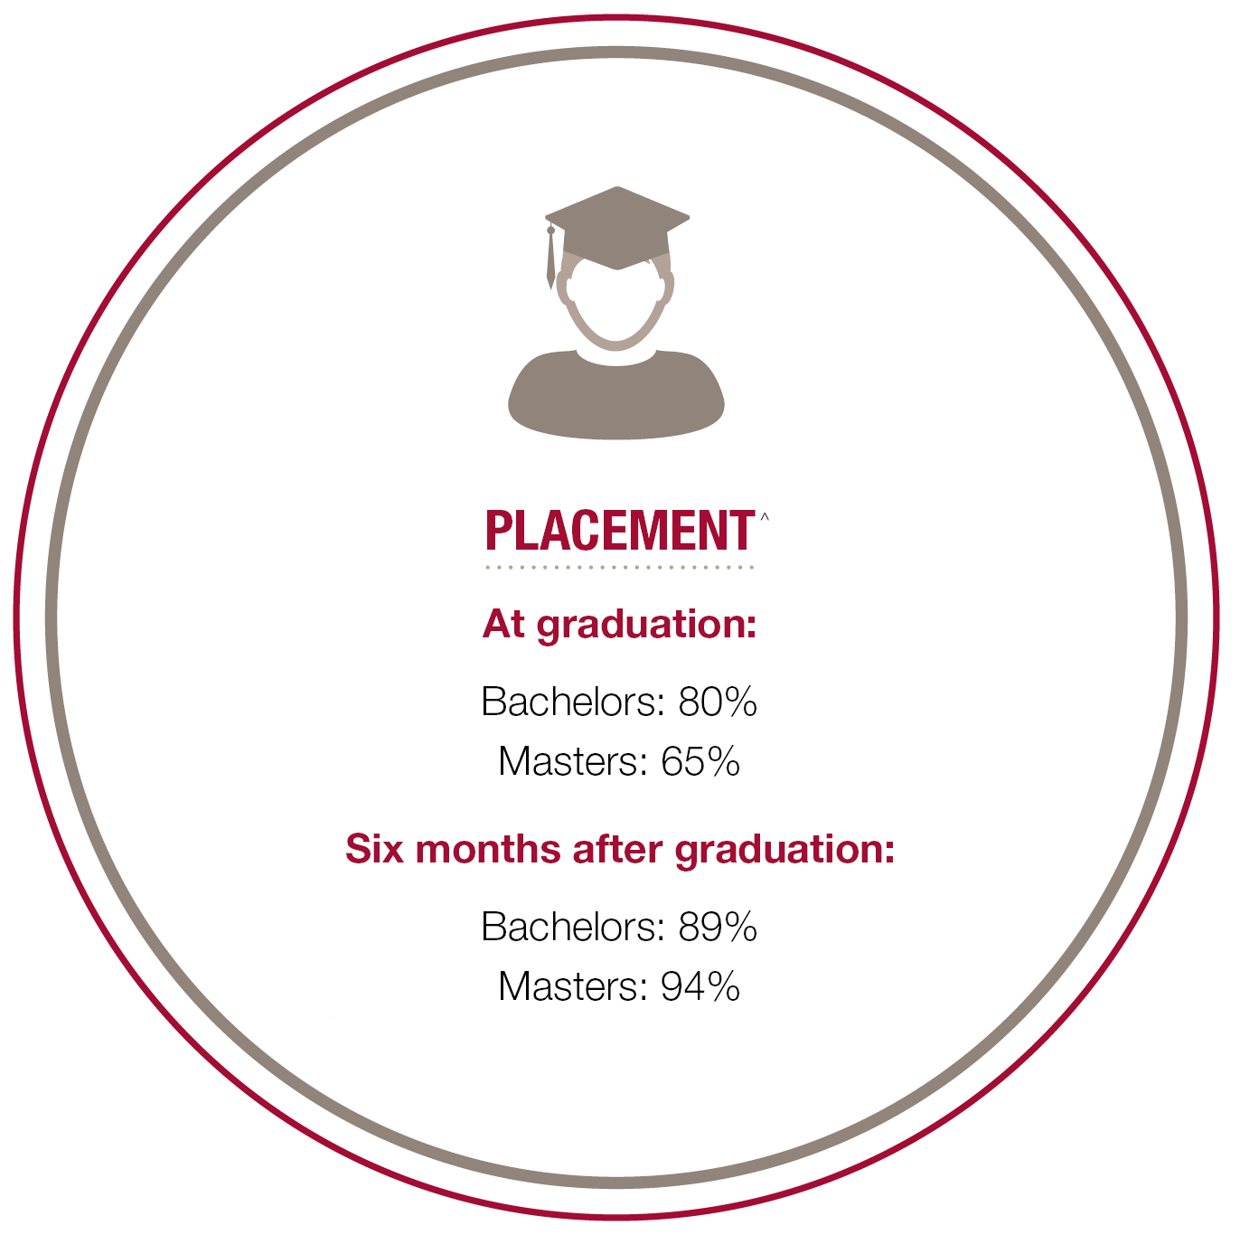
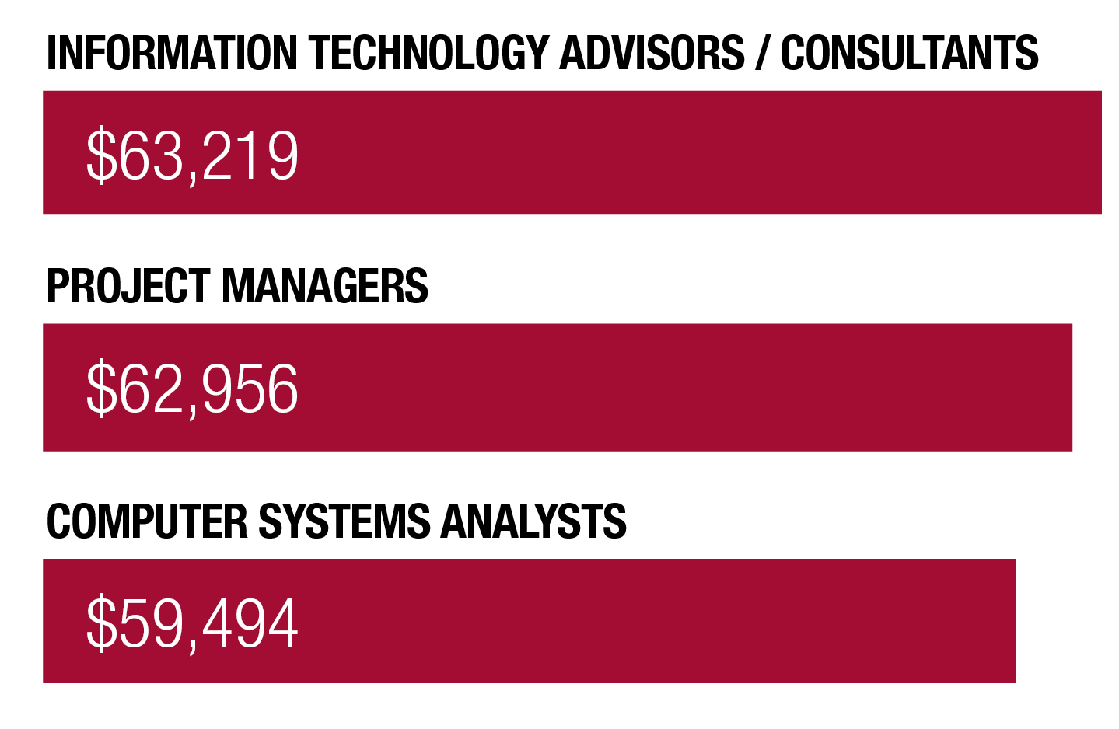
Three best paying jobs in IS:
Notes:
Placement versus 30% of 2014’s graduating class who applied for a job and got at least one upon graduation (Undergraduates).

Slide 26
Wikipedia, Business Analyst
Discuss:
  1. What was this article about?
  2. Why should you care?
Many IS professionals work as Business Analysts so it is important to understand the role and the difference between a Business Analyst and a Systems Analyst.
If you are more interested in the business and the processes and systems within a business then Business Analyst may be the role for you.

Slide 27
Wikipedia, Systems Analyst
Discuss:
  1. What was this article about?
  2. Why should you care?
Many IS professionals work as Systems Analysts so it is important to understand the role and the difference between a Business Analysts and a Systems Analyst.
If you are more interested in the technology and designing or implementing of systems to support a business then Systems Analyst may be the role for you.

Slide 28
MIS Career Paths
Security Analyst
CIO
Technical support
Systems Architect
Programmer Analyst
Consultant
Application programmer
Data Administrator
Project Manager
Business Analyst
CTO
Software Designer
Data Analyst
Fox MIS Students 100% Placement
Notes:
Systems Analyst/Designer – Redesign Company Intranet
Database Administrator - Design, Implement, Upgrade, Company DB
Information Systems Manager – Over sees a new or existing project
MIS Consultant – Advise companies on newest technologies available
Network Specialist-Monitor and update companies Network
Software Designer-Develop programs for Playstation & pc applications
Web Developer- Design, manage and run web applications
Analyst/Programmer – Program in C#

Slide 29
Important Qualities
Analytical Skills
Communication Skills
Decision-Making Skills
Leadership Skills
Organization Skills
Notes:
Are good problem solvers
Like to work with people
Can think strategically about technology
Like responsibility for developing and then implementing their ideas
Can bridge both technology and business
Can see both details and the big picture
Are excellent communicators
Can manage time and resources well

Slide 30
Learn IT! #1
Digital Identity Management
Due week 1/27 @ 11:59PM
4 Parts
  Part 1: Digital Identity (Create a profile on eportfolio site)
  Part 2: Digital Portfolio
  Part 3: Analytics
  Part 4: Build a Professional Network
  Ignore Part 5

Slide 31
Roadmap
Week 1: Intro to MIS
Week 2: Systems Analysis
Week 3: Systems Analysis
Week 4: Systems Analysis
Week 5
Swimlanes
ERDs
Decision Trees
Architecture Diagrams
Exam #1
Learn IT! #1
Max Labs 0
What is MIS?
Week 6: Organizational Systems
Week 7: Organizational Systems
Week 8: Organizational Systems
Week 9
Decision Support
SDLC
Exam #2
ERP
Knowledge Management
Digital Innovation
Max Labs 1a & 1b
Week 10: Organizational Systems
Week 11: Organizational Systems
Platforms
Week 13: Organizational Systems
Week 14
Customer Relationship Management Systems
Cloud Computing
Artificial Intelligence
Exam #3 Prep
Supply Chain Management Systems
Week 12: Organizational Systems
Max Labs 3a & 3b
Learn IT! #2
Max Labs 2a & 2b

Slide 32
Learn IT! #1
Digital Identity Management
Due week 2
4 Parts
  Part 1: Digital Identity (Create a profile on eportfolio site)
  Part 2: Digital Portfolio
  Part 3: Analytics
  Part 4: Build a Professional Network
  Ignore Part 5

