Slide 1
Information Systems in Organizations
2.1.3 Modeling Business Rules with Decision Trees &
2.1.4 Conceptual Architecture Diagrams

Slide 2
Roadmap
Week 1: Intro to MIS
Week 2: Systems Analysis
Week 2: Systems Analysis
Week 3: Systems Analysis
Week 3
Swimlanes
ERDs
Decision Trees
Architecture Diagrams
Exam #1
Learn IT! #1
Max Labs 0
What is MIS?
Week 4: Organizational Systems
Week 4: Organizational Systems
Week 5: Organizational Systems
Week 5
Decision Support
SDLC
Exam #2
ERP
Knowledge Management
Digital Innovation
Max Labs 1a & 1b
Week 6: Organizational Systems
Week 6: Organizational Systems
Platforms
Week 7: Organizational Systems
Week 7
Customer Relationship Management Systems
Cloud Computing
Artificial Intelligence
Exam #3 Prep
Supply Chain Management Systems
Week 7: Organizational Systems
Max Labs 3a & 3b
Learn IT! #2
Max Labs 2a & 2b

Slide 3

Max Labs 0
This assignment is purely reading- read it! The other Max Labs are based off this reading.

Slide 4
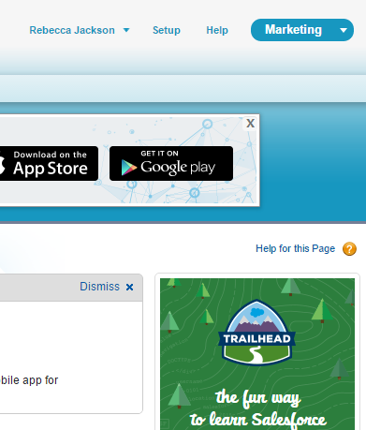
How to: Max Labs
1. Review the preflight checklist. (Trust us, it’s worth it.)
2. Read through and follow Max’s steps on your own Salesforce account.
3. Take screen shots where indicated
  Make sure your name is visible
  You will not receive credit if your name is not visible
4. Paste screenshots into the numbered spot in the answer sheet.
5. Follow the directions provided by your instructor to hand your answer sheet in before the due date.
6. No late assignments accepted. No exceptions.

Slide 5

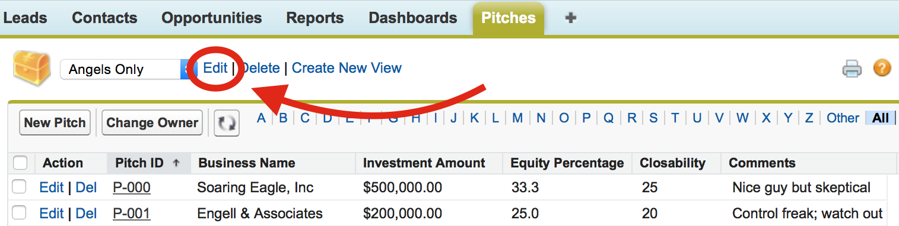
Max Labs 1a & 1b
Due week 6 – Each part will take about an hour
Max Labs 1a
  2 Screenshots
  Make a salesforce account – use TUmail!
  Make Max’s app!
Max Labs 1b
  4 Screenshots
  Use your app to find “loaded & likely” investors
  Track and monitor tasks

Slide 6
Required Reading
Wikipedia, Business Rules
What is a Decision Tree?
Business Analyst Training on How to Use Decision Trees
Investigative Architecture: The Conceptual Diagram

Slide 7

Required Viewing 1/2

Slide 8
Wikipedia, Business Rules
Discuss:
  1. What was this article about?
  2. Why should you care?
This article explains what business rules are all about, basically, they the rules the organization follows when operating the business.
Business rules are implemented within business processes and if you don’t understand these rules, you don’t know how things get done. It is critical to understand how the work is being done, so you can eventually improve the processes.

Slide 9
What is a Decision Tree?
Discuss:
  1. What was this article about?
  2. Why should you care?
Decision trees are a great tool for modeling business rules. This article gives you the basic mechanics for creating decision trees to model business rules.
To operate and run your business, you must understand the business rules under which your business runs. Decision trees are a great way to model these business rules so that these business rules can be communicated to others and analyzed to find opportunities to improve the business.

Slide 10
Business Analyst Training on How to Use Decision Trees
Discuss:
  1. What was this article about?
  2. Why should you care?
While the previous article described the basic syntax of decision trees, this video explains how Business Analysts create decision trees as part of understanding how thing work in an organization.
Like the other models we have looked at so far, decision trees help us understand and document how work gets done in an organization. We need this information to be able to execute and improve business processes.

Slide 11
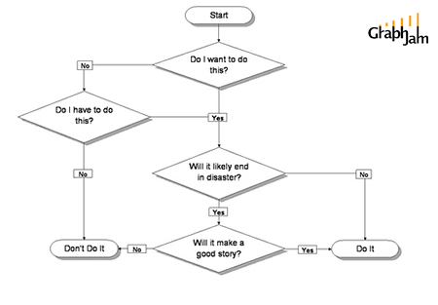

Slide 12
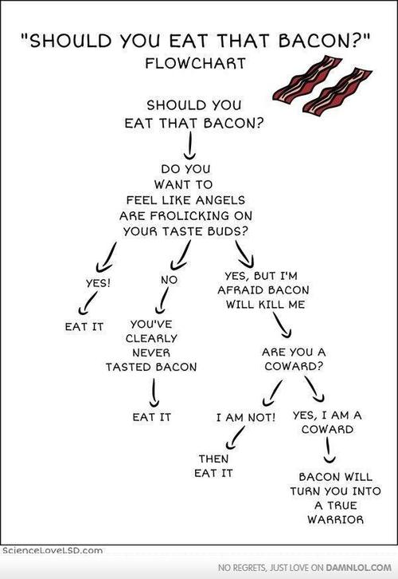

Slide 13
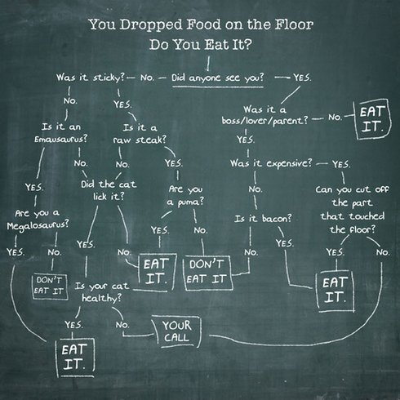

Slide 14
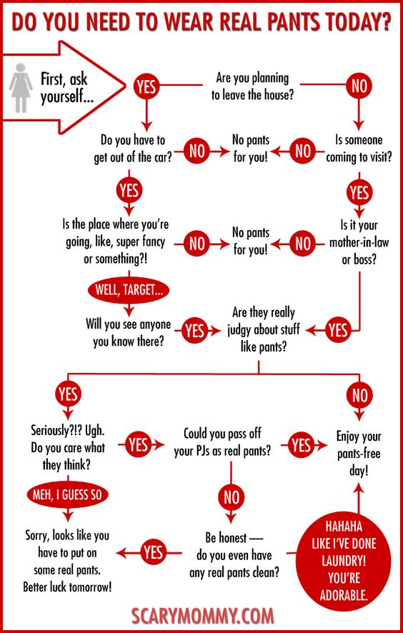

Slide 15
Business Rules
A business rule is a rule that defines or constrains some aspect of business.
  Free shipping on orders of $50 or more
  If the vehicle has not been serviced in the last 5,000 miles, schedule service immediately
Sometimes business rules are simple and straightforward
Sometimes business rules are not so simple and straightforward!
  Decision trees will help us with these more complex situation

Slide 16
How to map a decision tree
A condition (also refer to as a decision point) is declared in a diamond-shaped node
The possible values for the condition are represented by branches
The actions (also refer to as outcome) are declared at the end of each branches in a rectangle

Slide 17
Messy Business Rules
Answer
Shipping charges are a function of the weight of the shipment, how the shipment is being sent and where the shipment is being sent. For domestic shipment orders can be shipped via air or surface. For air shipments the cost is $2/lb ($20 minimum) with a maximum of 50 lbs. Over 50 lbs the cost is $100 plus $1/lb for every pound over 50. For surface the price varies based on if the shipment is to the same state or a different state. Within the same state the charge is $1/lb ($5 minimum) with a maximum of 60 lbs. Over 60 lbs costs $60 plus $0.25 for every pound over 60. Surface to another state is $1/lb ($7 minimum) with a maximum of 60 lbs. Over 60 lbs the cost is $60 plus $0.50/lb for every pound over 60. For international shipments the cost is $4/lb ($40 minimum) for shipments up to 60 lbs. Over 60 lbs the cost is $240 plus $2/lb for every pound over 60.
You have 15 seconds to answer the following question…
How much will it cost to ship a 12 pound package
from Philly to California via air?
The correct answer is?
12 pounds x $2/pound = $24

Slide 18
Answer
You have 15 seconds to answer the following question…
How much will it cost to ship a 12 pound package from Philly to California via surface?
The correct answer is?
12 pounds x $1/pound = $12

Slide 19
Examples of Business Rules
Talk to the people sitting around you.
Based on your collective work experiences, can you come up with a set of business rules that are complex enough to model with a decision tree?
Let’s see if we can create a decision tree to model these business rules!

Slide 20
Roadmap
Week 1: Intro to MIS
Week 2: Systems Analysis
Week 3: Systems Analysis
Week 4: Systems Analysis
Week 5
Swimlanes
ERDs
Decision Trees
Architecture Diagrams
Exam #1
Learn IT! #1
Max Labs 0
What is MIS?
Week 6: Organizational Systems
Week 7: Organizational Systems
Week 8: Organizational Systems
Week 9
Decision Support
SDLC
Exam #2
ERP
Knowledge Management
Digital Innovation
Max Labs 1a & 1b
Week 10: Organizational Systems
Week 11: Organizational Systems
Platforms
Week 13: Organizational Systems
Week 14
Customer Relationship Management Systems
Cloud Computing
Artificial Intelligence
Exam #3 Prep
Supply Chain Management Systems
Week 12: Organizational Systems
Max Labs 3a & 3b
Learn IT! #2
Max Labs 2a & 2b

Slide 21
Investigative Architecture: The Conceptual Diagram
Discuss:
  1. What was this article about?
  2. Why should you care?
A conceptual architecture diagram is a high-level diagram that describes a system including who interacts with the system, how they interact, the processes the system supports and the resources the system utilizes to make this all happen.
Regardless of your major you will be involved in the envisioning, planning, deployment and support of the systems that support your business. Conceptual architecture diagrams are useful for documenting and communicating ideas about how systems do or should work.

Slide 22
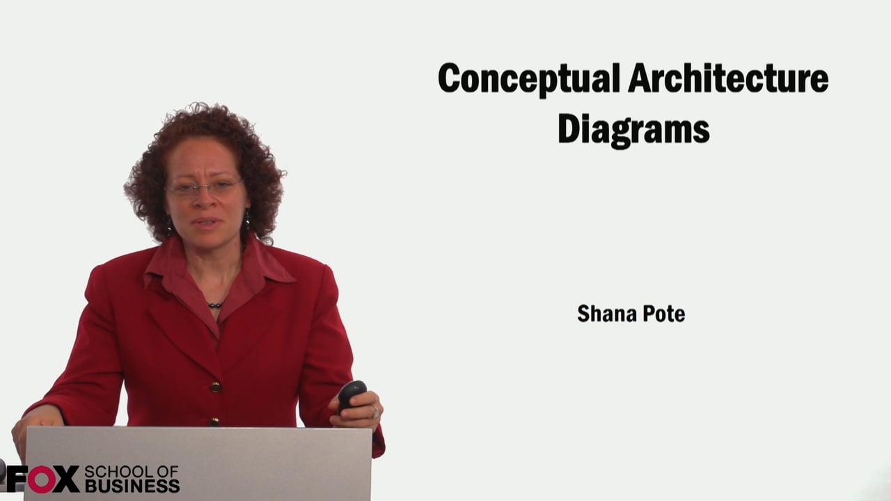
Required Viewing 2/2

Slide 23
?
Sell the idea
Refined Later
Marketing View
What is “conceptual diagraming”?
Big Picture
Guide the Architect
Informal/Lightweight

Slide 24

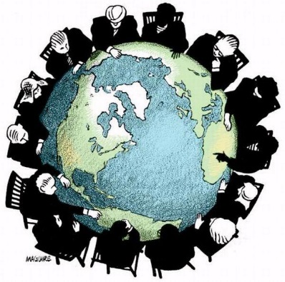


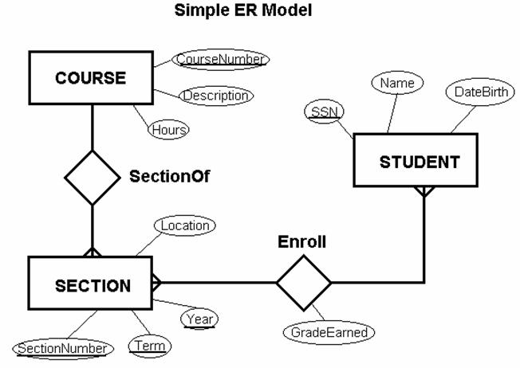
Where are We?

Slide 25
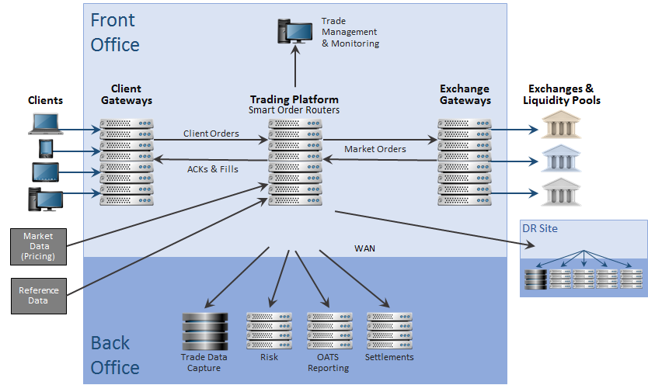
Case in Point (Trading Platforms)
Electronic trading systems are typically proprietary software (etrading platforms or electronic trading platforms), running on COTS hardware and operating systems, often using common underlying protocols, such as TCP/IP.
Exchanges typically develop their own systems (sometimes referred to as matching engines), although sometimes an exchange will use another exchange's technology (e.g. e-cbot, the Chicago Board of Trade's electronic trading platform, uses LIFFE's Connect system), and some newer electronic exchanges use 3rd-party specialist software providers (e.g. the Budapest stock exchange and the Moscow Interbank Currency Exchange use automated trading system originally written and implemented by FMSC, an Australian technology company that was acquired by Computershare, and whose intellectual property rights are now owned by OMX).
Exchanges and ECNs generally offer two methods of accessing their systems –
  an exchange-provided GUI, which the trader runs on his or her desktop and connects directly to the exchange/ECN, and
  an API which allows dealers to plug their own in-house systems directly into the exchange/ECN's.
From an infrastructure point of view, most exchanges will provide "gateways" which sit on a company's network, acting in a manner similar to a proxy, connecting back to the exchange's central system.
ECNs will generally forego the gateway/proxy, and their GUI or the API will connect directly to a central system, across a leased line.
Many brokers develop their own systems, although there are some third-party solutions providers specializing in this area. Like ECNs, brokers will often offer both a GUI and an API (although it's likely that a slightly smaller proportion of brokers offer an API, as compared with ECNs), and connectivity is typically direct to the broker's systems, rather than through a gateway.
Investment banks and other dealers have far more complex technology requirements, as they have to interface with multiple exchanges, brokers and multi-dealer platforms, as well as their own pricing, P&L, trade processing and position-keeping systems. Some banks will develop their own electronic trading systems in-house, but this can be costly, especially when they need to connect to many exchanges, ECNs and brokers. There are a number of companies offering solutions in this area.
Notes:
Just to contrast the simplicity of the model with the definition from the text

Slide 26
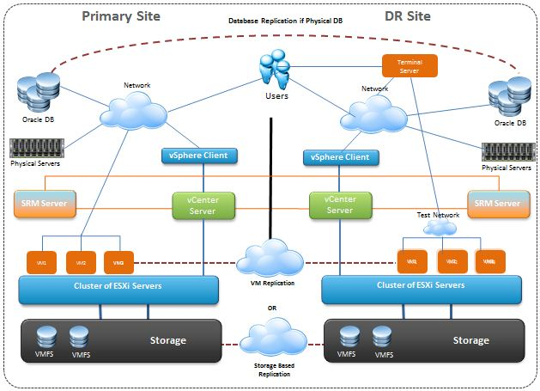
How would we do something like this (In practice)?

Slide 27
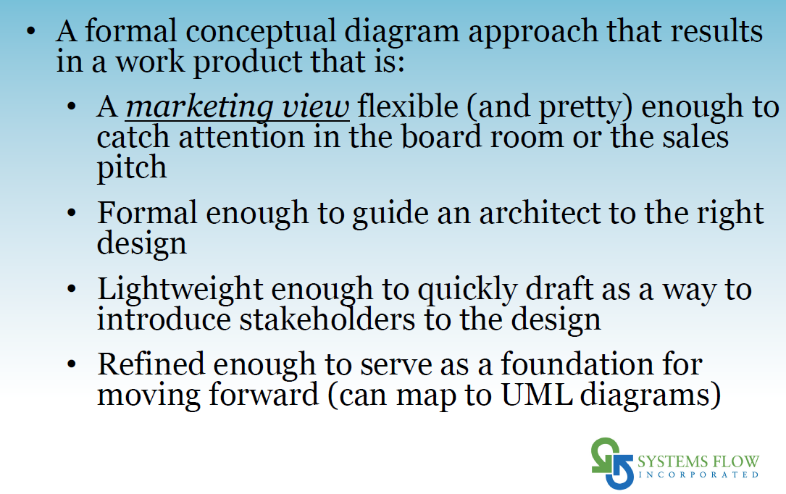

Slide 28
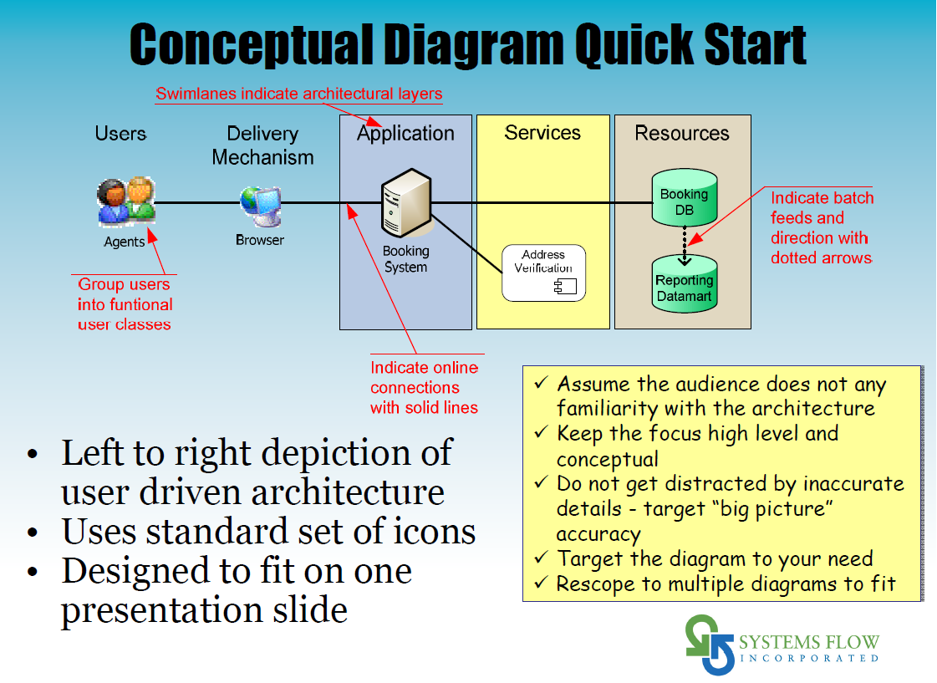
have

Slide 29











Example Conceptual Architecture Diagram
Users
Interface
Processes
Resources
De
System
Administrator
Desktop
Textbook
Content
Import From
Publishers
Professor
Web
Define Course
Course
Content
Database
Students
Phone App
Use Study Aids
Clipart from: https://openclipart.org

Slide 30
Roadmap
Week 1: Intro to MIS
Week 2: Systems Analysis
Week 3: Systems Analysis
Week 4: Systems Analysis
Week 5
Swimlanes
ERDs
Decision Trees
Architecture Diagrams
Exam #1
Learn IT! #1
Max Labs 0
What is MIS?
Week 6: Organizational Systems
Week 7: Organizational Systems
Week 8: Organizational Systems
Week 9
Decision Support
SDLC
Exam #2
ERP
Knowledge Management
Digital Innovation
Max Labs 1a & 1b
Week 10: Organizational Systems
Week 11: Organizational Systems
Platforms
Week 13: Organizational Systems
Week 14
Customer Relationship Management Systems
Cloud Computing
Artificial Intelligence
Exam #3 Prep
Supply Chain Management Systems
Week 12: Organizational Systems
Max Labs 3a & 3b
Learn IT! #2
Max Labs 2a & 2b

Slide 31
Coming up :
Midterm # 1
  Covers Unit 1 and Unit 2 (everything thus far)
  Review : Articles, Videos, Activities, Slides
  Blackboard & Examity

