Slide 1
Information Systems in Organizations 3.2 Systems Management

Slide 2
Course Topics Overview
Unit 1: Introduction
Unit 2: Systems Analysis
Unit 3: Organizational Systems
Unit 4: Consumer Systems

Slide 3
Unit 3: Organizational Systems
How do large firms function today?
3.1. Types of systems in organizations
3.1.1. Running the business: enterprise systems (ERP)
3.1.2. Managing the business: decision-making (analytics, BI, dashboards)
3.1.3. Growing the business: knowledge management, R&D, and social business

Slide 4
Unit 3: Organizational Systems
3.2. Systems management
3.2.1. Business analysis, requirements, and systems acquisition
3.2.2. Developing systems: programming, testing, and deployment
3.2.3. Systems integration: standards, interoperability, and external collaboration
3.2.4. Managing risk: security, hackers, and privacy

Slide 5
Unit 3: Organizational Systems
3.3. Digital business innovation
3.3.1. Generating IT value
3.3.2. Competitive advantage of digital business models

Slide 6
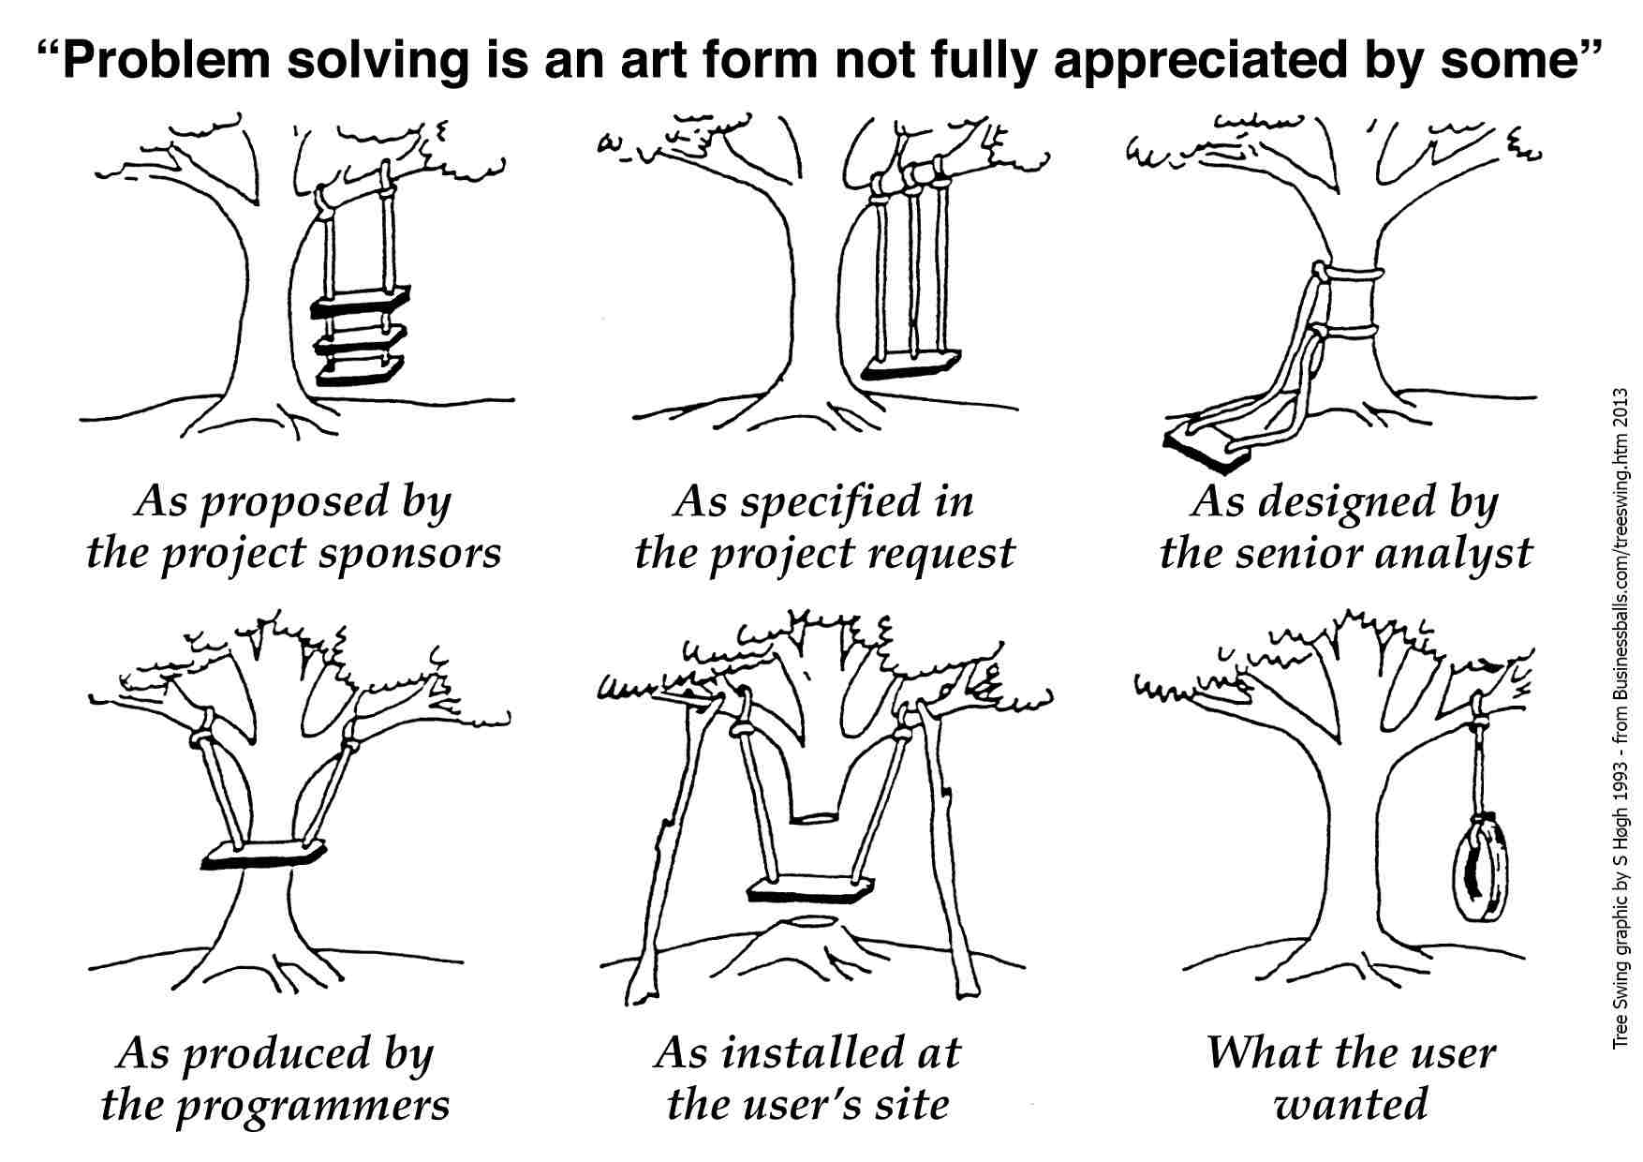

Slide 7
?
Testing
Waterfall
Maintenance
Design
Go Live
Requirements
What is the Systems Development Life Cycle (SDLC)?
Buy vs. Build
Analysis
Training
Agile
Coding
Notes:
Spend a little time in class talking about the SDLC and what these terms mean and where they fit in. In the next few slides we’ll talk about the SDLC. We’ll talk about the major phases in the traditional SDLC. We’ll also highlight where some of these terms apply and what you are doing at that point.
We’ll talk a bit about Agile in a few slides and we’ll want to compare that to the traditional SDLC.

Slide 8
Requirements Gathering
Sources of Requirements
Users
Administrators and maintenance
staff
Partners
Domain Experts
Industry Analysts
Information about competitors
Customers

Slide 9
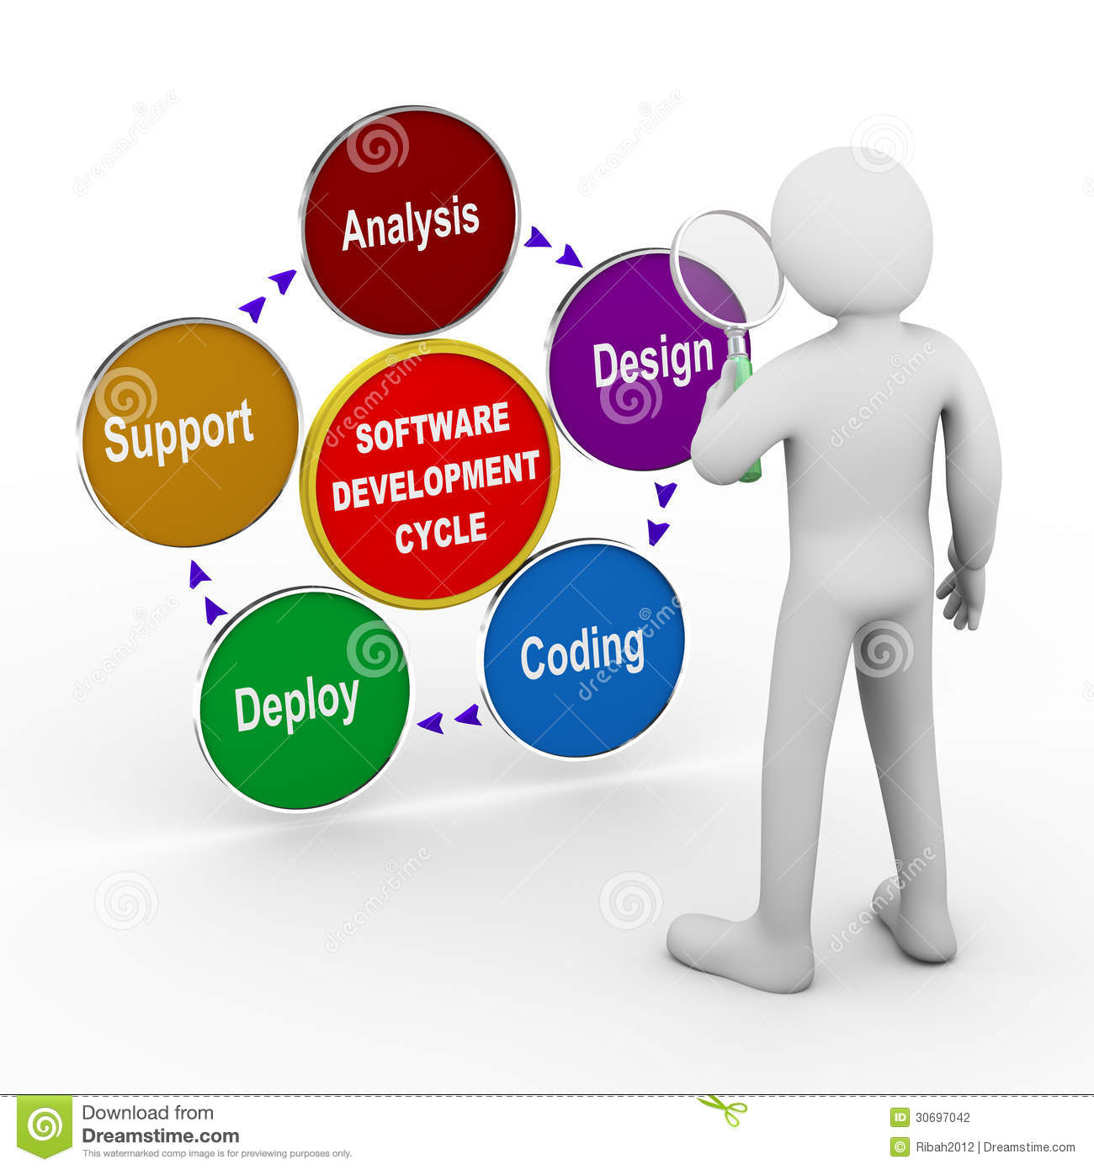
This is where we
collect requirements
Build vs. Buy
Maintenance
Testing
Go Live
Training

Slide 10
Custom Software over Canned Solutions
Buy
Build
Notes:
How do you decide?

Slide 11
?
What is better, to buy solutions off the shelf or build your own solution?
How does this impact the SDLC?

Slide 12
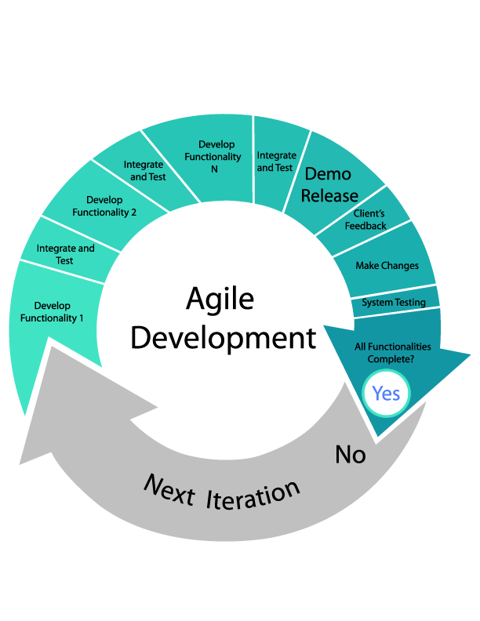
Notes:
While some organizations still use the traditional SDLC and while the traditional SDLC is a great way to look at projects from a high level, many organizations now us variations on the traditional SDLC that use an iterative approach to deliver solutions. Make sure that students understand that this approach enables the development team to demonstrate value early on even if you need to go through many iterations to achieve the final deliverable. Make sure they understand that the subject matter experts typically have a more intimate involvement with the development process using this type of approach.

Slide 13
?
Do hackers have business models?
How can you go wrong with a TED Talk?
Notes:
Students have a number of readings about hackers and cyber crime. This is a good TED talk that get you thinking about these things. One thing that students typically find interesting is that you can purchase hacking kits, complete with CRM like dashboards that provide analytics on how your hacking is going and, even better, you can purchase technical support.

Slide 14
?
Where is my data?
How do I secure that device?
Who can you trust?
Disposing of old systems/media?
How do we protect our “information assets”?
Employee training?
What are the basics?
What do you really need access to?
Security policies?
Physical security?
Floods, fires, earthquakes?
Notes:
These min-questions come from one of the readings. Get students talking about the importance of these topics. Keep an eye on the clock. This is a great place to share some information about the ITACS program with students.

Slide 15
MS in Information Technology Auditing and Cyber-Security
Risk
ITACS is about assuring the confidentiality, integrity and availability of a company’s systems
MIS
ACCT
Notes:
Info Tech Auditing and Cyber security
IT Risk is real to all organizations
Intersection of Risk, Accounting and MIS
We are looking for interested students from these, or related, disciplines
ITACS is really attractive to Accounting students who are need 150 credits to sit for the CPA but really are not looking forward to another year or so completing a masters in Accounting. This give them a new and unique skill set that the Big Four fight over students for.

Slide 16
The Career
Public Accounting
Internal Accounting
Government Service
Corporate Security
IT Management
S.T.E.M.
Notes:
Jobs in a variety of sectors/industries
Fastest growing line of business in Big Four
IT Auditors used by IRS and FBI (counter terrorism and cyber-crime)
STEM = Science.Technology Engineering Math - ITACS only Fox degree recognized as STEM
STEM status means international students who graduate can work in US for up to 29 months without sponsorship

Slide 17
The MS ITACS Program
Ten plus courses, professional MS program
Professional certification (CISA) preparation
$1,000 per credit
Scholarships available
Looking for:
Accounting, Finance, MIS, or Risk majors
Some systems background
GPA 3.0 or higher
Notes:
Professionally oriented, hands on, graduate education in IT risk assurance.
You will work with many of the technology components that you will fine in the field
An executive coach will work with you on your business consulting skills
An experienced CISA who is familiar with the exam will help you prepare for the CISA exam

Slide 18
For more information about ITACS check out:
community.mis.temple.edu/itacs
Or contact:
Rich Flanagan, Director ITACS Program
215 204 3077
richard.flanagan@temple.edu

Slide 19
Unit 3: Organizational Systems
How do large firms function today?
3.1. Types of systems in organizations
3.1.1. Running the business: enterprise systems (ERP)
3.1.2. Managing the business: decision-making (analytics, BI, dashboards)
3.1.3. Growing the business: knowledge management, R&D, and social business

Slide 20
Unit 3: Organizational Systems
3.2. Systems management
3.2.1. Business analysis, requirements, and systems acquisition
3.2.2. Developing systems: programming, testing, and deployment
3.2.3. Systems integration: standards, interoperability, and external collaboration
3.2.4. Managing risk: security, hackers, and privacy

Slide 21
Unit 3: Organizational Systems
3.3. Digital business innovation
3.3.1. Generating IT value
3.3.2. Competitive advantage of digital business models

