Slide 1
Information Systems in Organizations
4.1 Supply Chain Management Systems

Slide 2
Learn IT Assignment #4 :
An Hour of Code
All done on www.codecademy.com
This is where you learn what coding is all about
Complete three activities:
  Animate your name (JavaScript)
  About me (HTML)
  Sun and earth (HTML and CSS)
Due April 4th

Slide 3
Build Your Own Study Guide
Supply chain management
What are 3 key points from this reading?
What are 3 important details from this reading?
Students will be called upon at random

Slide 4
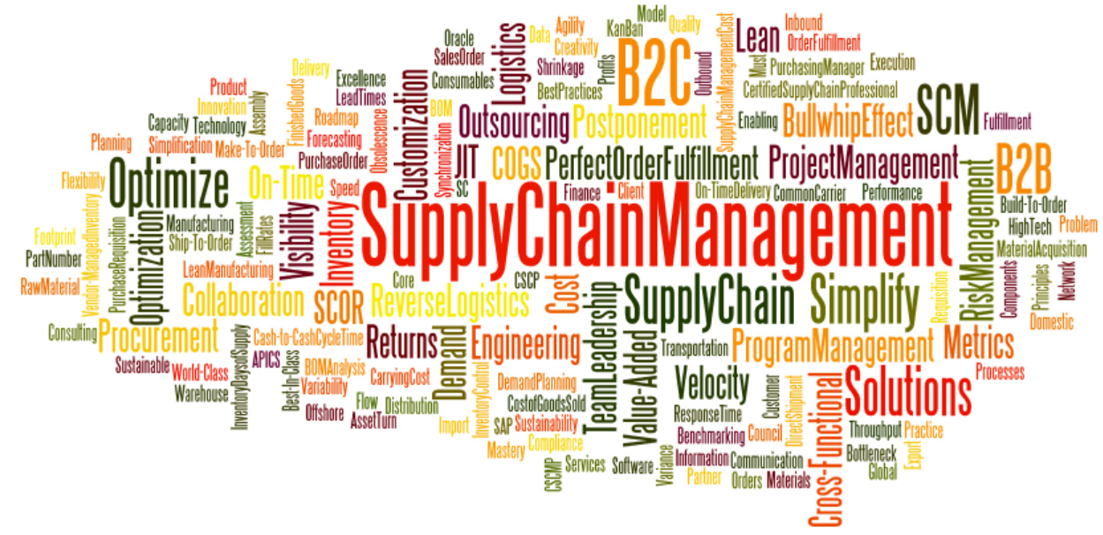

Slide 5
Build Your Own Study Guide
Supply Chain Management Definition and Solutions
What are 3 key points from this reading?
What are 3 important details from this reading?
Students will be called upon at random

Slide 6
Build Your Own Study Guide
Integrated Planning - Optimization for the entire internal supply chain
What are 3 key points from this reading?
What are 3 important details from this reading?
Students will be called upon at random

Slide 7
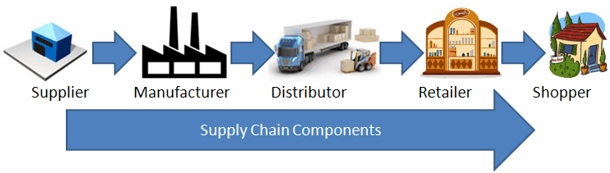

Slide 8
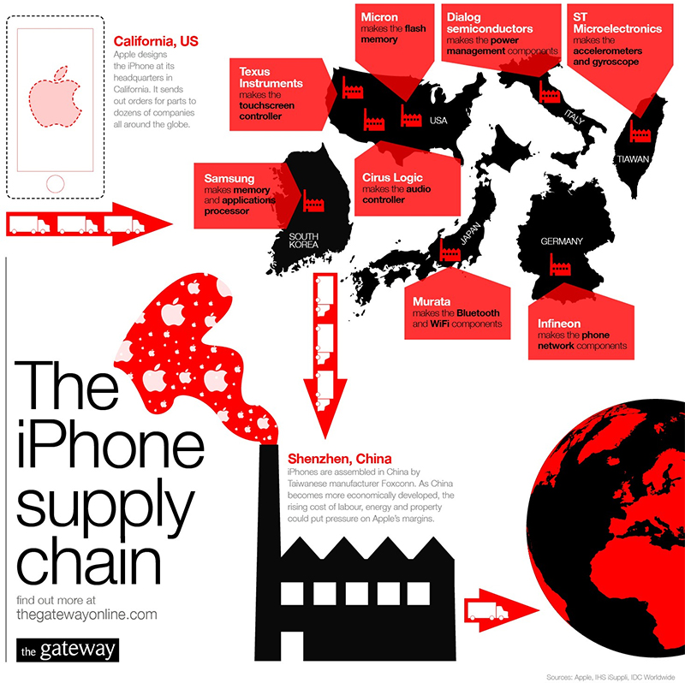
Where is your
iPhone “made”?
What happens in
Shenzhen, China
if there are any
delays?

Slide 9
Question
Who works for a company which manufactures some product?
What do you make?
What stuff do you need to make your product?
Where do you get this stuff?
What happens to you if they run out of this stuff?

Slide 10
?
How difficult is it to get the right product on the right shelf at the right time and the lowest possible cost?

Slide 11
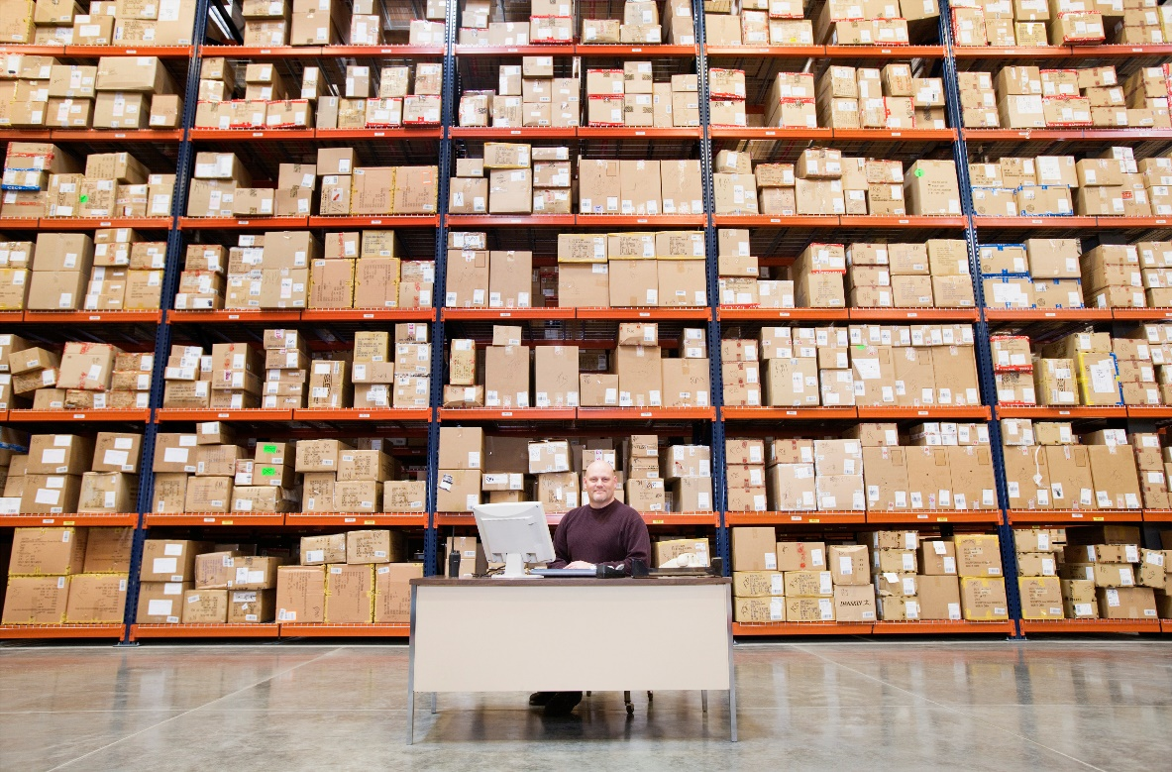
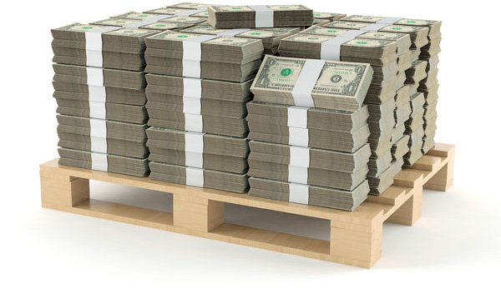
Safety Stock – That’s the Answer!
Here’s what the people in
order fulfilment see
Here’s what the people in
accounting see

Slide 12
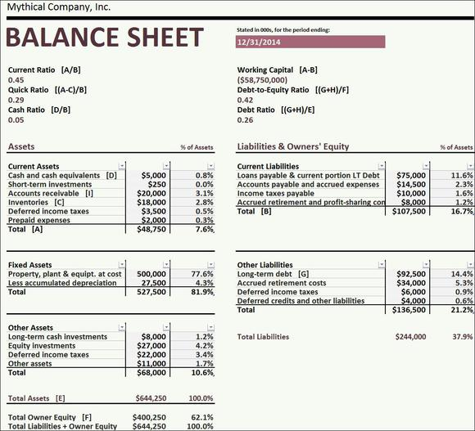
What else could I do with this cash?
If this goes up
then this goes down…
What else could I do
with this cash?

Slide 13
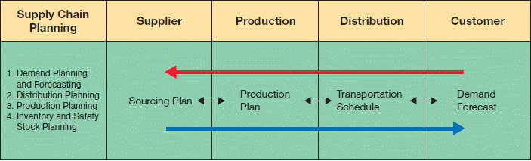
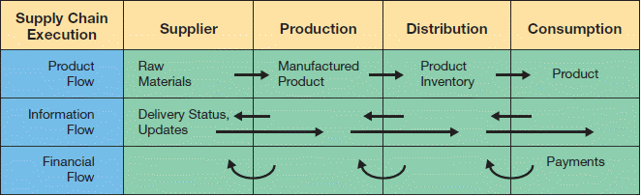
SCM Architecture
SCM modules support two functions.
  Supply chain planning—development of resource plans to support production.
  Supply chain execution—efficient flow of products, information, and financing.
Copyright © 2014 Pearson Education, Inc.

Slide 14
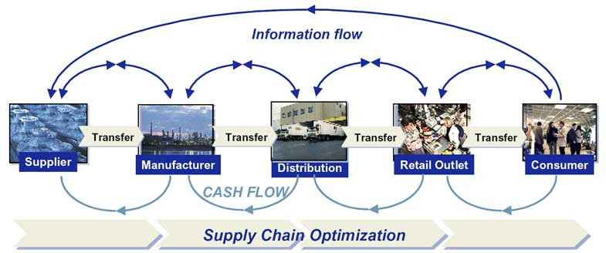

Slide 15
Build Your Own Study Guide
Just-in-Time Manufacturing
What are 3 key points from this reading?
What are 3 important details from this reading?
Students will be called upon at random

Slide 16
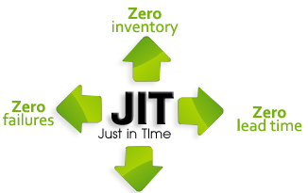

Slide 17
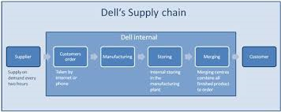
Dell’s Supply Chain
Dell Internal
Supplier
Customer Order
Manufacturing
Storing
Merging
Customer
Supply on demand every two hours
Taken by Internet or phone
Taken by Internet or phone
Taken by Internet or phone

Slide 18
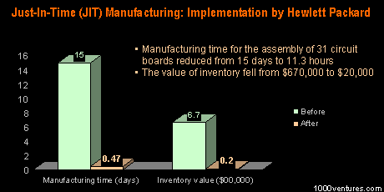
What else could I do with this cash?

Slide 19
Build Your Own Study Guide
Vendor-Managed Inventory (VMI): What is it and When Does It Make Sense to Use It
What are 3 key points from this reading?
What are 3 important details from this reading?
Students will be called upon at random

Slide 20
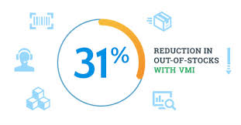

Slide 21

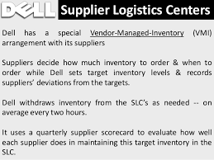

Slide 22
Build Your Own Study Guide
What is RFID?
What are 3 key points from this reading?
What are 3 important details from this reading?
Students will be called upon at random

Slide 23
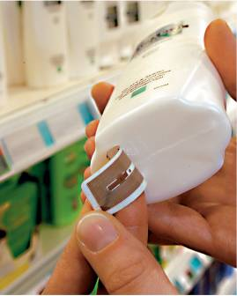
Radio Frequency Identification (RFID)
RFID tags will soon replace standard bar codes.
  RFID is the use of electromagnetic energy to transit energy between a reader (transceiver) and the tag (antenna).
  Line-of-sight reading is not necessary.
  RFID tags can contain more information than bar codes.
Tags are programmable, so there is a vast array of potential uses.
Scanning can be done from greater distance.
  Passive tags—inexpensive, range of few feet.
  Active tags—more expensive, range of hundreds of feet.
Source: METRO AG.

Slide 24
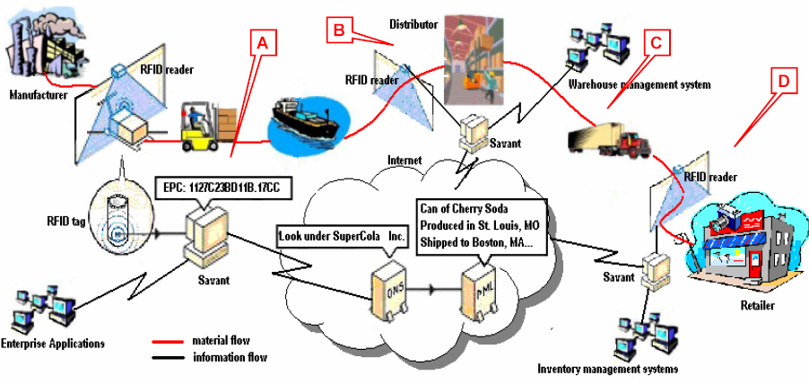
The Big Picture

