Slide 1
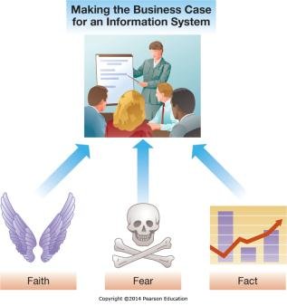
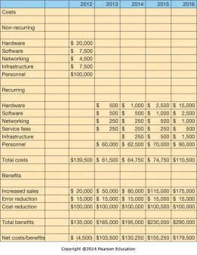
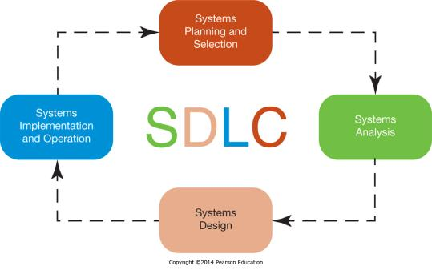
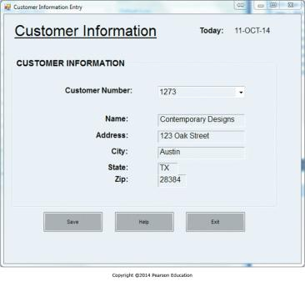
Chapter 9 - Developing and Acquiring Information Systems
Managers from across organizations are involved in developing and acquiring information systems

Slide 2
Chapter 9 Learning Objectives
Making the Business Case
Describe how to formulate and present the business case for technology investments.
The Systems Development Process
Describe the systems development life cycle and its various phases.
Acquiring Information Systems
Explain how organizations acquire systems via external acquisition and outsourcing.

Slide 3
Making the Business Case
Making the Business Case
Describe how to formulate and present the business case for technology investments.
Cyberwar and Cyberterrorism
Describe and explain the differences between cyberwar and cyberterrorism.
Acquiring Information Systems
Explain how organizations acquire systems via external acquisition and outsourcing.

Slide 4
Business Case Objectives
The Business Case sells an investment
Lays out the costs and benefits
Used to make a “go” or “no-go” decision
May be used to justify continued funding
Ensures an investment is adding value
Notes:
A business case is, quite simply, a complete justification for making or continuing to make an investment in a new or ongoing information system.
It demonstrates how the investment is justified and better than the possible alternatives.

Slide 5
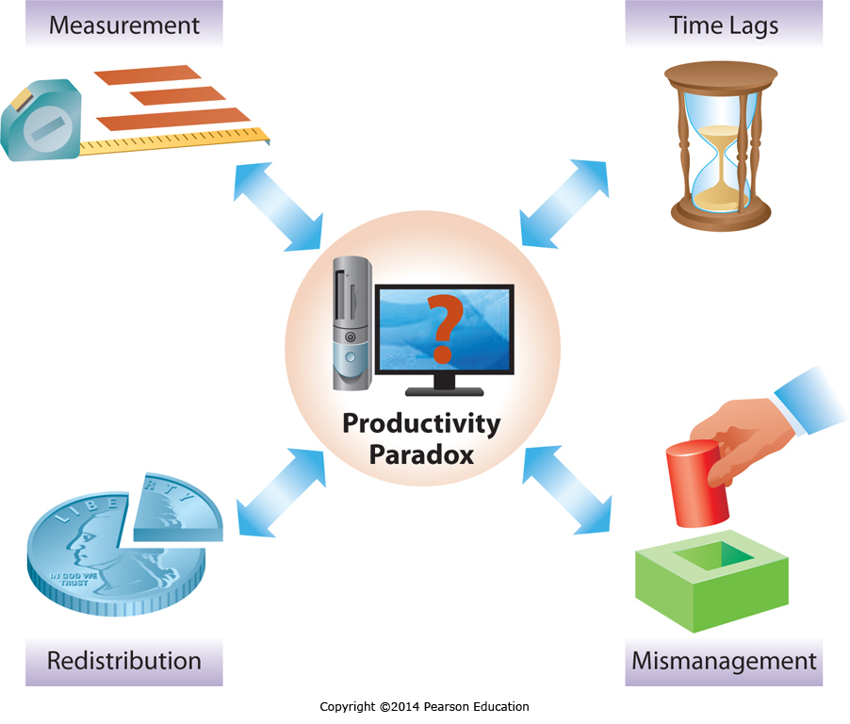
The Productivity Paradox
Notes:
The Productivity Paradox stems from the difficulty many early professionals had showing that worker productivity, measured as worker output per employee hour, was increasing due to investments in Information Technologies. There are, however, many reasons for this apparent dilemma that have come to light since the initial research.
One problem has been in Measurement. Companies typically focus on efficiency, or doing something with few resources, over effectiveness, or doing something well, and Information Systems sometimes increase effectiveness over efficiency. Hence businesses are doing things better, which can then impact competitiveness and product quality and lead to other changes, but initial efficiency measurements may show little or no improvement.
There is also a timing issue, many information systems take years to hit the bottom line so any measurement immediately after implementation may show no, or even a negative productivity impact.
Some industries have a limited size, so the first mover in the industry may get a bigger slice of the pie, but overall it is a zero sum game, so once everyone has implemented the new technology to catch up, overall it looks like there is no improvement across the industry.
Finally, some IS implementations are the result of mismanagement and aren’t appropriate, so the investment actually has a negative return.

Slide 6
Making a Successful Business Case: Identifying Costs and Benefits
Identifying Costs
Tangible Costs – Total Cost of Ownership (TCO)
Non-recurring costs
Recurring costs
Intangible Costs
Identifying Benefits
Tangible Benefits
Intangible Benefits
Notes:
The Business Case needs to have system costs and benefits at its heart.
Costs and benefits can be tangible or intangible, with all tangible costs being rolled up using a Total Cost of Ownership approach.

Slide 7
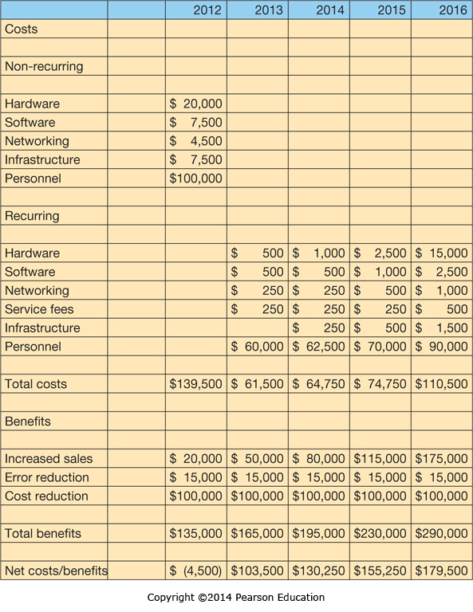
Making a Successful Business Case: Performing Cost–Benefit Analyses
Notes:
Here is an example cost-benefit analysis for a project starting in 2012 and running through 2016, which is a reasonable timeframe for an IS development project.
Costs are divided into recurring and non-recurring, and benefits are shown here as recurring with sales benefits growing slowly over time.
The bottom line is the net of costs and benefits, and is suitable for an ROI analysis.

Slide 8
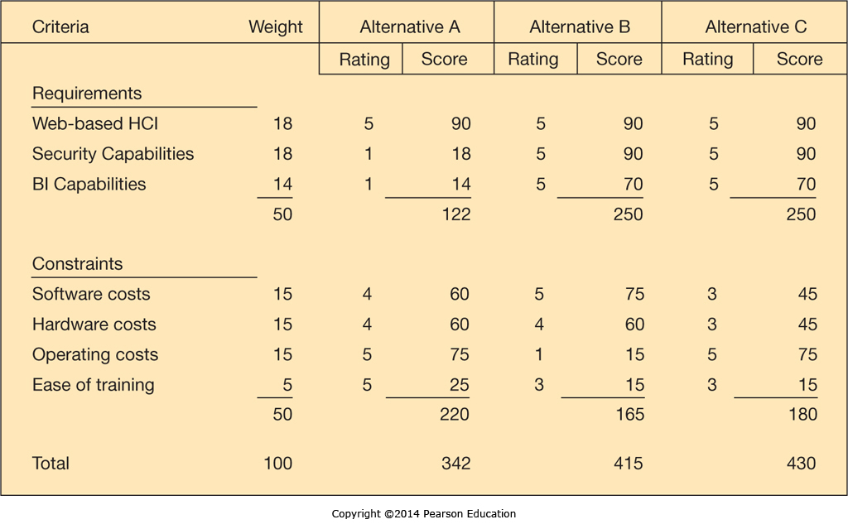
Making a Successful Business Case: Comparing Competing Investments
Notes:
Sometimes the justification for a system has more intangibles then tangibles, or a financial analysis doesn’t paint a clear picture between alternatives.
In these cases a weighted multicriteria analysis can be performed instead, showing which alternatives meet organizational goals and priorities more completely than others.

Slide 9
Presenting the Business Case
Know the Audience
Know who you are presenting to, what their background is, and what they care about
Convert Benefits to Monetary Terms
Show benefits as $ per time period, often annual
Devise Proxy Variables
Measure What Is Important to Management
Know management “hot-button” issues
Describe how the system impacts them
Notes:
While the financials may speak for themselves, it is still important to make the business case.
The first rule is know your audience, you don’t want to talk above or below them, you want to know what they care about, you want to make sure you are presenting what they need to hear.
Once you know your audience make sure you put everything into financial terms, translate benefits into a uniform measure such as an annual cost savings. This allows your audience to readily grasp what you are saying and compare it to other alternatives.
A proxy variable is a variable that is relevant to the audience if your normal metrics aren’t. For example, if spending hours with the customer is important, you could translate hours saved planning each days sales stops to annual additional customer contact hours.
Finally, be sure to address any specifics that management considers key and would want to hear something about.

Slide 10
The Systems Development Process
Making the Business Case
Describe how to formulate and present the business case for technology investments.
The Systems Development Process
Describe the systems development life cycle and its various phases.
Acquiring Information Systems
Explain how organizations acquire systems via external acquisition and outsourcing.

Slide 11
Customized versus Off-the-Shelf Software
Customized Software
Customizability – tailored to unique needs
Problem Specificity – pay only for what is needed
Off-the-Shelf Software (Packaged Software)
Less costly than customized systems
Faster to procure than customized systems
Of higher quality than customized systems
Less risky than customized systems
Notes:
Customized software is nice, customized, focused, and expensive.
Off-the-shelf software is typically cheaper, easier, faster, more thoroughly tested, and less likely to fail.

Slide 12
Off-the-Shelf Software: Examples
Category | Application | Description | Examples
Business information systems | Payroll | Automation of payroll services, from the optical reading of time sheets to generating paychecks | ZPAY Intuit Payroll
 | Inventory | Automation of inventory tracking, order processing, billing, and shipping | Intuit QuickBooks InventoryPower 5
Office automation | Personal productivity | Support for a wide range of tasks from word processing to graphics to e-mail | OpenOffice Corel WordPerfect Microsoft Office
Notes:
Here are some examples of off-the-shelf Business Information Systems and Office Automation Systems.
This chart includes both business information systems and office automation systems, but there are many more types of off-the-shelf software.

Slide 13
Open Source Software
Program’s source code is freely available for use and/or modification
Linux is a prevalent example
Free to use, but “Hidden” Support Costs
Typically no support for the free version
Commercial vendors may offer commercial grade support to industry users for a fee
Notes:
Open source software can be a boon, as the up-front costs can be very low, but there can be many hidden support costs when there is no vendor to call when a problem arises.
Companies typically have to internalize the support or sometimes hire a commercial vendor to provide support for the open source software.

Slide 14
Combining Customized, Open Source, and Off-the-Shelf Systems
Off-the-shelf systems can often be customized
Off-the-shelf systems may interact with open-source systems (e.g., the MySQL open-source database can be used to store data for a small business ERP system)
Notes:
There is no reason companies can’t use all three types of software where it makes sense.
However, using all three types will mean integrating them, which could require additional custom code.
Some commercial applications are designed to work with specific open-source products.

Slide 15
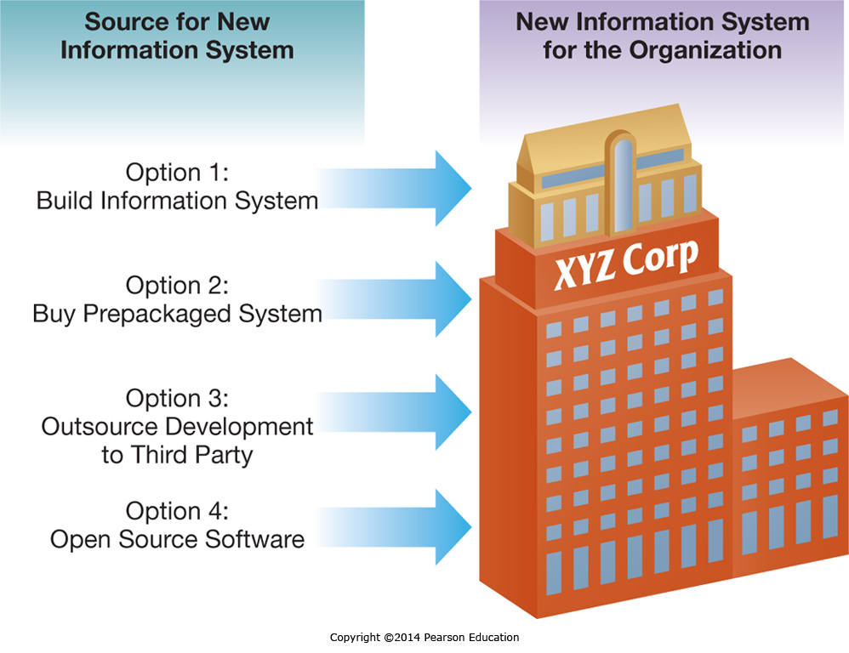
IS Development in Action
Notes:
There are a variety of sources for any new information system initiative a company is considering.
Which one makes the most sense will depend on many factors and a structured approach is necessary to ensure a suitable solution is found and implemented.

Slide 16
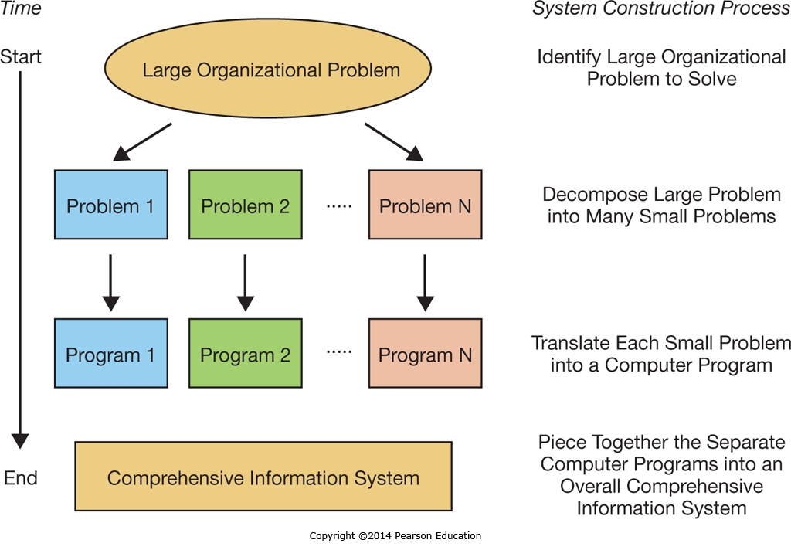
IS Development in Action
Notes:
Large organizational problems may require large solutions, but decomposing the large problem down into manageable problems that can be readily addressed makes the overall process manageable.
The ability to decompose problems is critical to any IS project manager.

Slide 17
The Role of Users in the Systems Development Process
System Analysis design the System
System Users know what is needed
System Analysis depend on System Users
System Users are key throughout the process
Notes:
While system analysts have the background to design new systems, they typically aren’t the Subject Matter Experts in every aspect of the business. That honor generally goes to the users, who know what the current system does, and often what the new system needs to accomplish even if they aren’t versed on the latest technologies that might be implemented to accomplish it. As such, system user involvement is critical throughout the process.

Slide 18
Steps in the Systems Development Process
Systems planning and selection
Systems analysis
Systems design
Systems implementation and operation
Notes:
The Systems Development Life Cycle is a four step structured process starting with Systems Planning and Selection, going through Analysis, Design, and ending with Implementation and Operation.

Slide 19
Phase 1: Systems Planning and Selection
Resources are limited so projects must be limited
Analyst gathers information and builds the case
Multiple approaches to selecting projects
Formal IS planning process
Ad-hoc planning process
The business case role
Business cases for different projects compared
Multiple selection criteria
Notes:
All organizations face resource constraints of one kind or another, and hence they need to limit their IS projects to those that can succeed given the resources at hand.
This may take place through a very formal IS planning process or organizations may have a more informal ad-hoc process for generating and approving IS investments.
Regardless of the approach, each project typically has its own business case which is used to justify the resources necessary to go forward with it, and often this business case is compared with the other business cases for competing IS projects.
The criteria for selecting from competing projects can be varied, but ideally will be based on core criteria such as alignment with the firms objectives, or strategic alignment, as well as tangible benefits.
Additional factors such as intangible benefits, risk, project size, and resource availability will all also play a role.

Slide 20
Phase 2: Systems Analysis
Collecting Requirements
May be the most important part of Systems Development
Dictates how the proposed system should function
Modeling Data
What data is needed
Modeled using Entity-Relationship diagrams
Modeling Processes and Logic
Model the Data flow
Model the Processing Logic
Develop System Designs & Evaluate, Selecting One
Notes:
Systems Analysis involves determining what the optimal approach will be. This requires gathering requirements and performing modeling at a deeper level than in Phase 1, but not at the level that will be required in Phase 3. This is almost an iterative step, where the goal is to just gather enough information and put together enough models that an optimal final direction can be chosen and pursued.

Slide 21
Phase 3: Systems Design
The system design chosen from Phase 2 is now elaborated to where it could be built
Human-computer interface
Point of contact between the user and the system
Data entry and management forms
Databases and files
Processing and logic
Modeled using one of many techniques
Models converted into code in Phase 4
Notes:
The Systems Design phase takes the output of Phase 2, the analysis phase. This includes the Phase 2 models and optimal architecture or System Design.
In this phase the system is completely modeled based on those decisions, the prior knowledge from the analysis phase, and the additional work being done to complete the design.

Slide 22
Phase 4: Systems Implementation and Operation
Convert design into a working system
Software programming & software testing
System conversion, documentation, training, and support
User and reference guides
User training manuals and tutorials
Installation procedures and troubleshooting suggestions
Notes:
The final phase is implementation and operation which involves converting the design to a system, implementing the database, creating the user guides, conducting the training, and switching over to the new system.

Slide 23
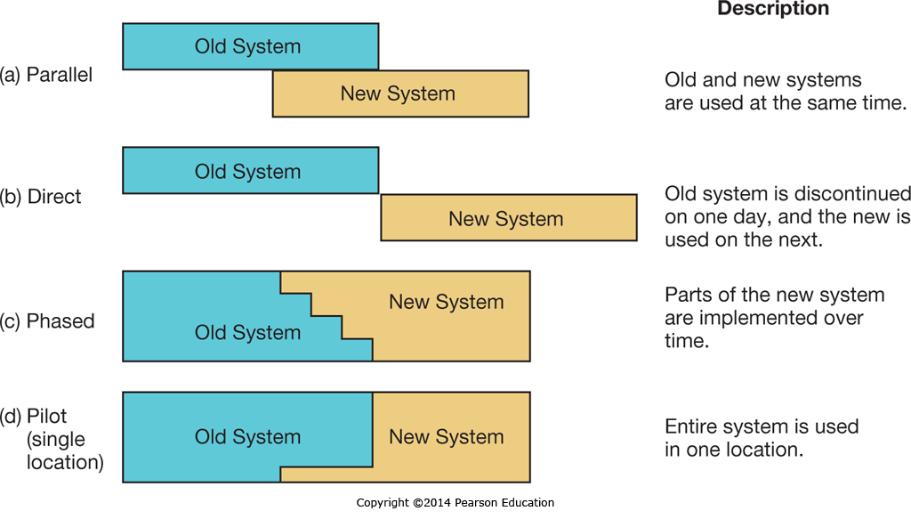
Phase 4: Systems Implementation and Operation: Conversion Strategies
Notes:
There are multiple strategies available for converting from an organization’s old software to a new system, including parallel, direct, phased, and pilot.
Most organizations choose a pilot or phased implementation, due to the large resource requirements of a parallel conversion and the large risk involved in a direct conversion.
However, a parallel conversion has the lowest risk, and as such is sometimes implemented.
A direct conversion may be mandated where for one reason or another it isn’t possible to have a phased or pilot implementation with different parts of the organization running on different systems.

Slide 24
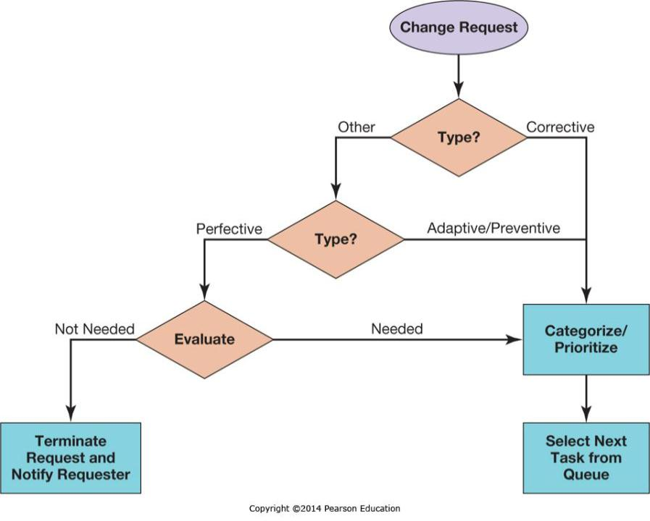
Repeating the SDLC: Systems Maintenance
Notes:
Once the system is implemented it enters a Maintenance phase.
At this point in time there will still be regular changes, upgrades, and maintenance activities to perform.
Change management is necessary to ensure that the system remains stable and functional, and that change requests are appropriate and justified.
Each change request is like a miniature SDLC.

Slide 25
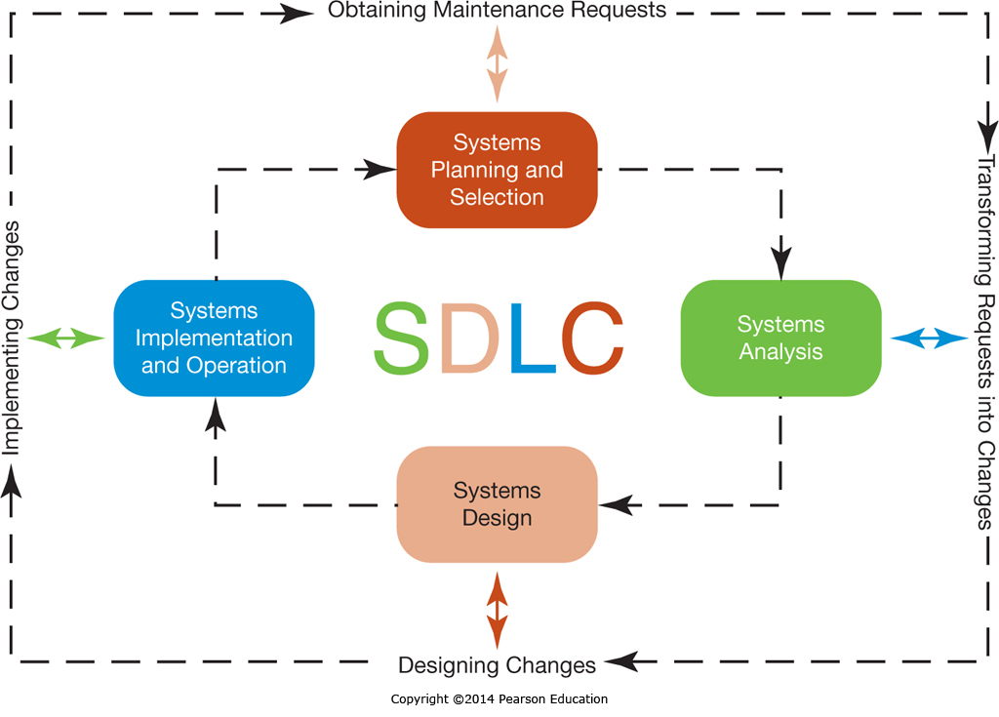
Repeating the SDLC: Systems Maintenance: Activity Mapping
Notes:
As you can see, each phase of the maintenance process maps directly to an SDLC phase.
Because the system maintenance processes are repeated over and over, the total amount of development during the systems maintenance phase typically exceeds the amount of development during the original SDLC implementation.

Slide 26
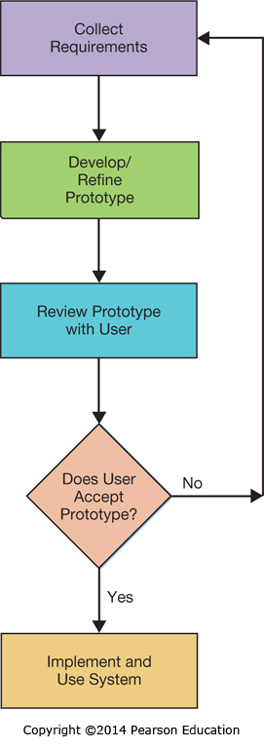
Other Approaches to Designing and Building Systems
Prototyping
Trial-and-error
Works even when the desired endpoint isn’t known, if there is a basis for determining when one prototype is better than another
RAD & Extreme Programming
Notes:
The SDLC isn’t always a practical approach to every problem. It requires the output be known up front, for example, and that isn’t always possible.
One alternative is prototyping, where after the Analyst learns some core needs, a prototype is developed and evaluated. Good features are retained and problematic ones replaced with candidate alternatives. As prototypes are iterated the process will ideally converge on a working solution.
There are also processes such as Rapid Application Development and Extreme Programming which are applicable to a limited set of situations. They won’t be covered here, but do have their place.

Slide 27
Acquiring Information Systems
Making the Business Case
Describe how to formulate and present the business case for technology investments.
The Systems Development Process
Describe the systems development life cycle and its various phases.
Acquiring Information Systems
Explain how organizations acquire systems via external acquisition and outsourcing.

Slide 28
External Acquisition: Reasons for External Acquisition
Situation 1: limited IS staff
Situation 2: IS staff has limited skill set
Situation 3: IS staff is overworked
Situation 4: problems with performance of IS staff
Notes:
There are many reasons to go outside a corporation for a system.
Often the IS staff doesn’t have the resources or expertise to attempt the systems development effort in-house.
Systems development takes dedicated resources with the project management, system analyst, database design and management, systems architecture, programming, testing, and training skills necessary to make it a success. These skills are often specialized, and may not exist or be available within the organization.

Slide 29
External Acquisition: Steps
Systems planning and selection
Systems analysis
Development of a request for proposal
Proposal evaluation
Vendor selection
Notes:
The first two steps of an external acquisition are the same as the first two steps in the SDLC. The third step is where the paths diverge. We’ll cover them in the next three slides.

Slide 30
External Acquisition: Steps: Development of a Request for Proposal
A summary of existing systems and applications
Requirements for system performance and features
Reliability, backup, and service requirements
The criteria that will be used to evaluate proposals
Timetable and budget constraints (how much you can spend)
Notes:
Creating a Request for Proposal, or RFP, can be an involved process in and of itself. In fact, some companies outsource the RFP development to a consulting firm, which then helps them select and manage the vendor that will perform the systems development work.
The RFP needs to include enough information that vendors can submit an informed proposal that will meet the company needs. This includes the current situation, all the requirements for the new system, how the new system will be evaluated, and any constraints on the proposal.

Slide 31
External Acquisition: Steps: Proposal Evaluation
The proposal needs to be evaluated based on the cost and benefits, which is often interpreted as functionality
Total cost of ownership
System features – compared to RFP
System benefits – based on system features
System benchmarks – measure of system features
Other factors – risk
Notes:
The evaluation of the proposal will involve looking at all the financials, but will also involve comparing the proposed solution to the requested features, and noting differences and capabilities.
Some variations may be insignificant while others could be deal-breakers.
Finally, each proposal should be looked at in terms of risk, what is the probability things won’t work out and what is the impact if that is the case.

Slide 32
External Acquisition: Steps: Vendor Selection
Typically multiple feasible solutions
Prioritize or rank competing proposals
Weighted scoring system works well for this
Notes:
Once all the proposals are in and evaluated, those that meet your needs should be scored and ranked to provide a solid basis for comparison.

Slide 33
Outsourcing Systems Development: Why Outsourcing?
Outsourcing Reasons | Description
Cost and Quality Concerns | Vendors have economies of scale, and can develop better systems at a lower cost
Problems in IS Performance | Outsourced vendors more reliable and consistent
Supplier Pressures | Aggressive sales forces
Simplifying, Downsizing, and Reengineering | Companies retreating to core competencies, outsourcing functions not core to value creation
Financial Factors | An arms-length relationship with vendors can create more efficient use, IT assets can be liquidated
Organizational Culture | Internal politics may block IT from moving forward
Internal Irritants | If the IS staff and users are not interacting well together, removing that source of tension can be a relief
Notes:
There are many different reasons to outsource systems, often the driving factor is the limitations of the internal IT staff.
Many companies aren’t systems development companies and hence have limited resources and skillsets in that area.
Beyond that, an organization may see outsourcing as an opportunity to streamline the business, remove liabilities, or eliminate ongoing problems.

Slide 34
Outsourcing Systems Development: Managing the IS Outsourcing Relationship
Outsourced relationships take continuous management
Realistic, tangible measures of performance should be developed and tracked
Multiple levels of interaction based on the type of interaction
Operational & tactical
Policy & relationship
Notes:
The outsourced IT relationship needs continuous monitoring and management.
The company doing the outsourcing cannot simply let all its internal IT staff go and just assume the vendor will do “good” things.
A solid CIO, working with the legal team and IT staff members, needs to manage the relationship.

Slide 35
End of Chapter Content

Slide 36
Managing in the Digital World: Microsoft Is “Kinecting” Its Ecosystem
Microsoft released the Kinect in 2010, a motion capture device for the Xbox with a USB interface
Programmers saw the potential to use the Kinect in new and novel ways
Microsoft resisted, and threatened lawsuits
Programmers ignored Microsoft, developing drivers connecting the Kinect to computers
Microsoft realized the Kinect programming was here to stay, and now supports users programming new applications for it
This bolstered Microsoft's reputation with programmers, and now an ecosystem is developing around Kinect programming

Slide 37
Brief Case: The Cold War in Software Patents
Originally, internet software was based on open standards
As profits and competition increased, patenting software has become commonplace
Companies now waging patent battles so block rivals and secure market advantages
Some companies buy up patents for the sole purpose of suing other companies infringing on them
The resulting battles stifle creativity, reduce market competitiveness and choice, and drive up costs which are ultimately paid for by the consumer

Slide 38
Coming Attractions: Microsoft’s PixelSense—Any Place, Any Time
Pixelsense is a Microsoft technology allowing tabletop display of data that can be manipulated with gestures through touch and computer vision
Currently bulky and expensive
Introduced in 2008 as a tabletop display
Upgraded in 2012 to be thinner, but still not mobile
Microsoft working on mobile version that can be powered by a laptop
Microsoft sees it eventually becoming pervasive, with inexpensive screens on many surfaces that users can interact with

Slide 39
Ethical Dilemma: Genetic Testing
Genetic testing is now a reality
Many people have genes that predispose them to certain diseases
In 2008 Congress passed a law to prevent genetic discrimination
Cannot be used in hiring / firing decisions
Cannot be used in insurability and insurance premium decisions
Knowing our genetic heritage will give us new opportunities, but may lead to abuse if the information isn’t protected

Slide 40
Who’s Going Mobile Creating Mobile Apps
Smartphone apps are being rapidly developed and deployed
Hundreds of thousands of apps compete on iTunes and Google Play
Only a relatively few are highly successful
26% of downloaded apps only used once
Successful apps require both strategy and luck
Unique idea with significant market potential
Customer research into key features
Pricing (often free to start) and placement in an app store
A great app can go viral, allowing an updated, paid version to be released

Slide 41
Key Players: Game Development Studios
Game development is a unique endeavor
Most software companies - several revenue sources
Game development requires unique skills and focus
Leading games can cost $100 million to develop
Game development studios use special development methodologies
Games require extensive testing and refinement
Game studios focus on producing games to leverage their unique skills, specialization, and resources

Slide 42
When Things Go Wrong: Conquering Computer Contagion
Blue Frog had a new solution to combat SPAM
For every email received, sent a response email
Six of the top 10 spammers dropped Blue Frog’s clients from their lists
One spammer fought back, inundating Blue Frog’s clients with so much spam ISP servers crashed
Blue Frog decided to fold instead of creating a new cyberwar

Slide 43
Industry Analysis: Broadcasting
Broadcasters of Radio and Television are facing dwindling viewership
The Internet has opened new entertainment sources and competition to viewers
Advertisers are willing to pay less for smaller audiences
Broadcasters now use the internet as another distribution channel, and can charge for online show advertising
Some formats are requiring shorter broadcast formats to cater to online audiences

