Slide 1

MIS 2101 Exam 2 Review

Slide 2

Exam Will Cover Discussions: week 3 & 4
Readings, Videos and Lectures (60%)
  ERP & CRM
  Data Analytics & SCM
  Platform, Cloud computing & API
  Cybersecurity & AI
Mini-Case – Demonstrate your ability to apply (40%)
  Swim Lane Diagram
  ERD
Source: https://ccesnews.org/opinion/2018/04/23/10-tips-for-exam-preparation/#photo
FOX
MIS
Notes:
25 questions
Readings /Videos & Lectures: 9 questions
Pre-flight & Max Labs 1a1b: 6 questions
Swim Lane/ERD : 10 questions

Slide 3



Advice
Review the slide decks
Review assigned readings
Review assigned videos
How to prepare…

Slide 4
Information Systems - Part 1
Topics and Required Reading
What is ERP?
5 ERP Trends
What is CRM?
Missing the Most Important Part of CRM
CRM vs. ERP: What’s the Difference?
3 CRM Use Cases
Required Viewing
What is ERP
ERP Challenges and Benefits

Slide 5

What is ERP?
Enterprise Resource Planning
Software or a System that
  Integrates functions
  Streamlines processes
  Manage core business

Slide 6
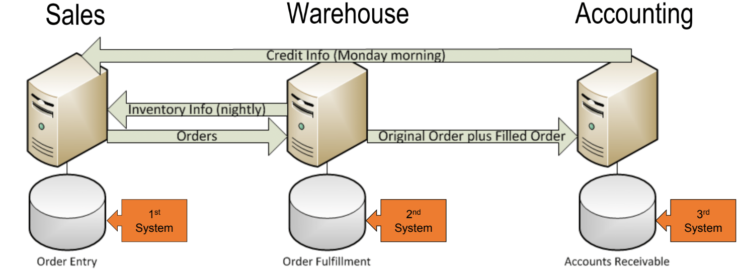
Legacy Systems

Slide 7
ERP – Key Takeaways
How does ERP create value?
Integrated Database
  One copy of data
Collaboration
  Improves decision making
Flexibility & Mobility
  Access anywhere/anytime
Lower costs

Slide 8
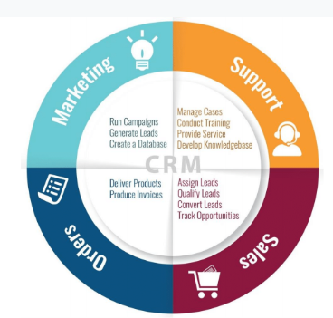
What is CRM?
Customer Relationship Management
Who uses CRM?
  Sales
  Marketing
  HR
  Accounting

Slide 9
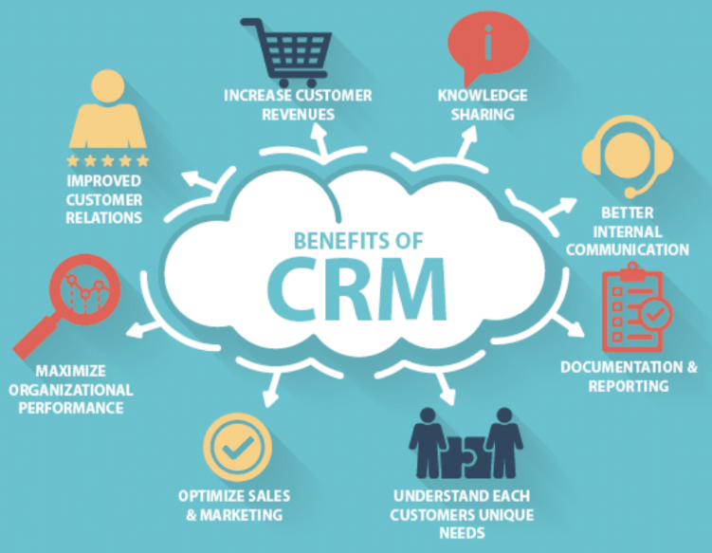
CRM Benefits
Maximize Profits
Understand Your Customer (data)
  Analyze buying patterns
  Problem solve
Accountability
Customer Communication

Slide 10
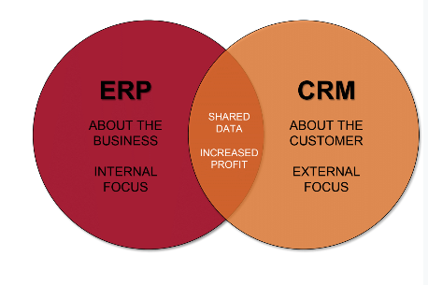
ERP & CRM
What’s the difference?
& PROCESS

Slide 11
Information Systems – Part II
Topics and Required Reading
What Is The Difference Between Data Analysis And Data Visualization?
What is BI?
Companies Are Failing in Their Efforts to Become Data-Driven
Disney’s $1 Billion Bet on a Magical Wristband
McDonald’s Bites on Big Data With $300 Million Acquisition How Companies Say They’re Using Big Data
Required Viewing
Data Analytics
Big Data
What is SCM?

Slide 12
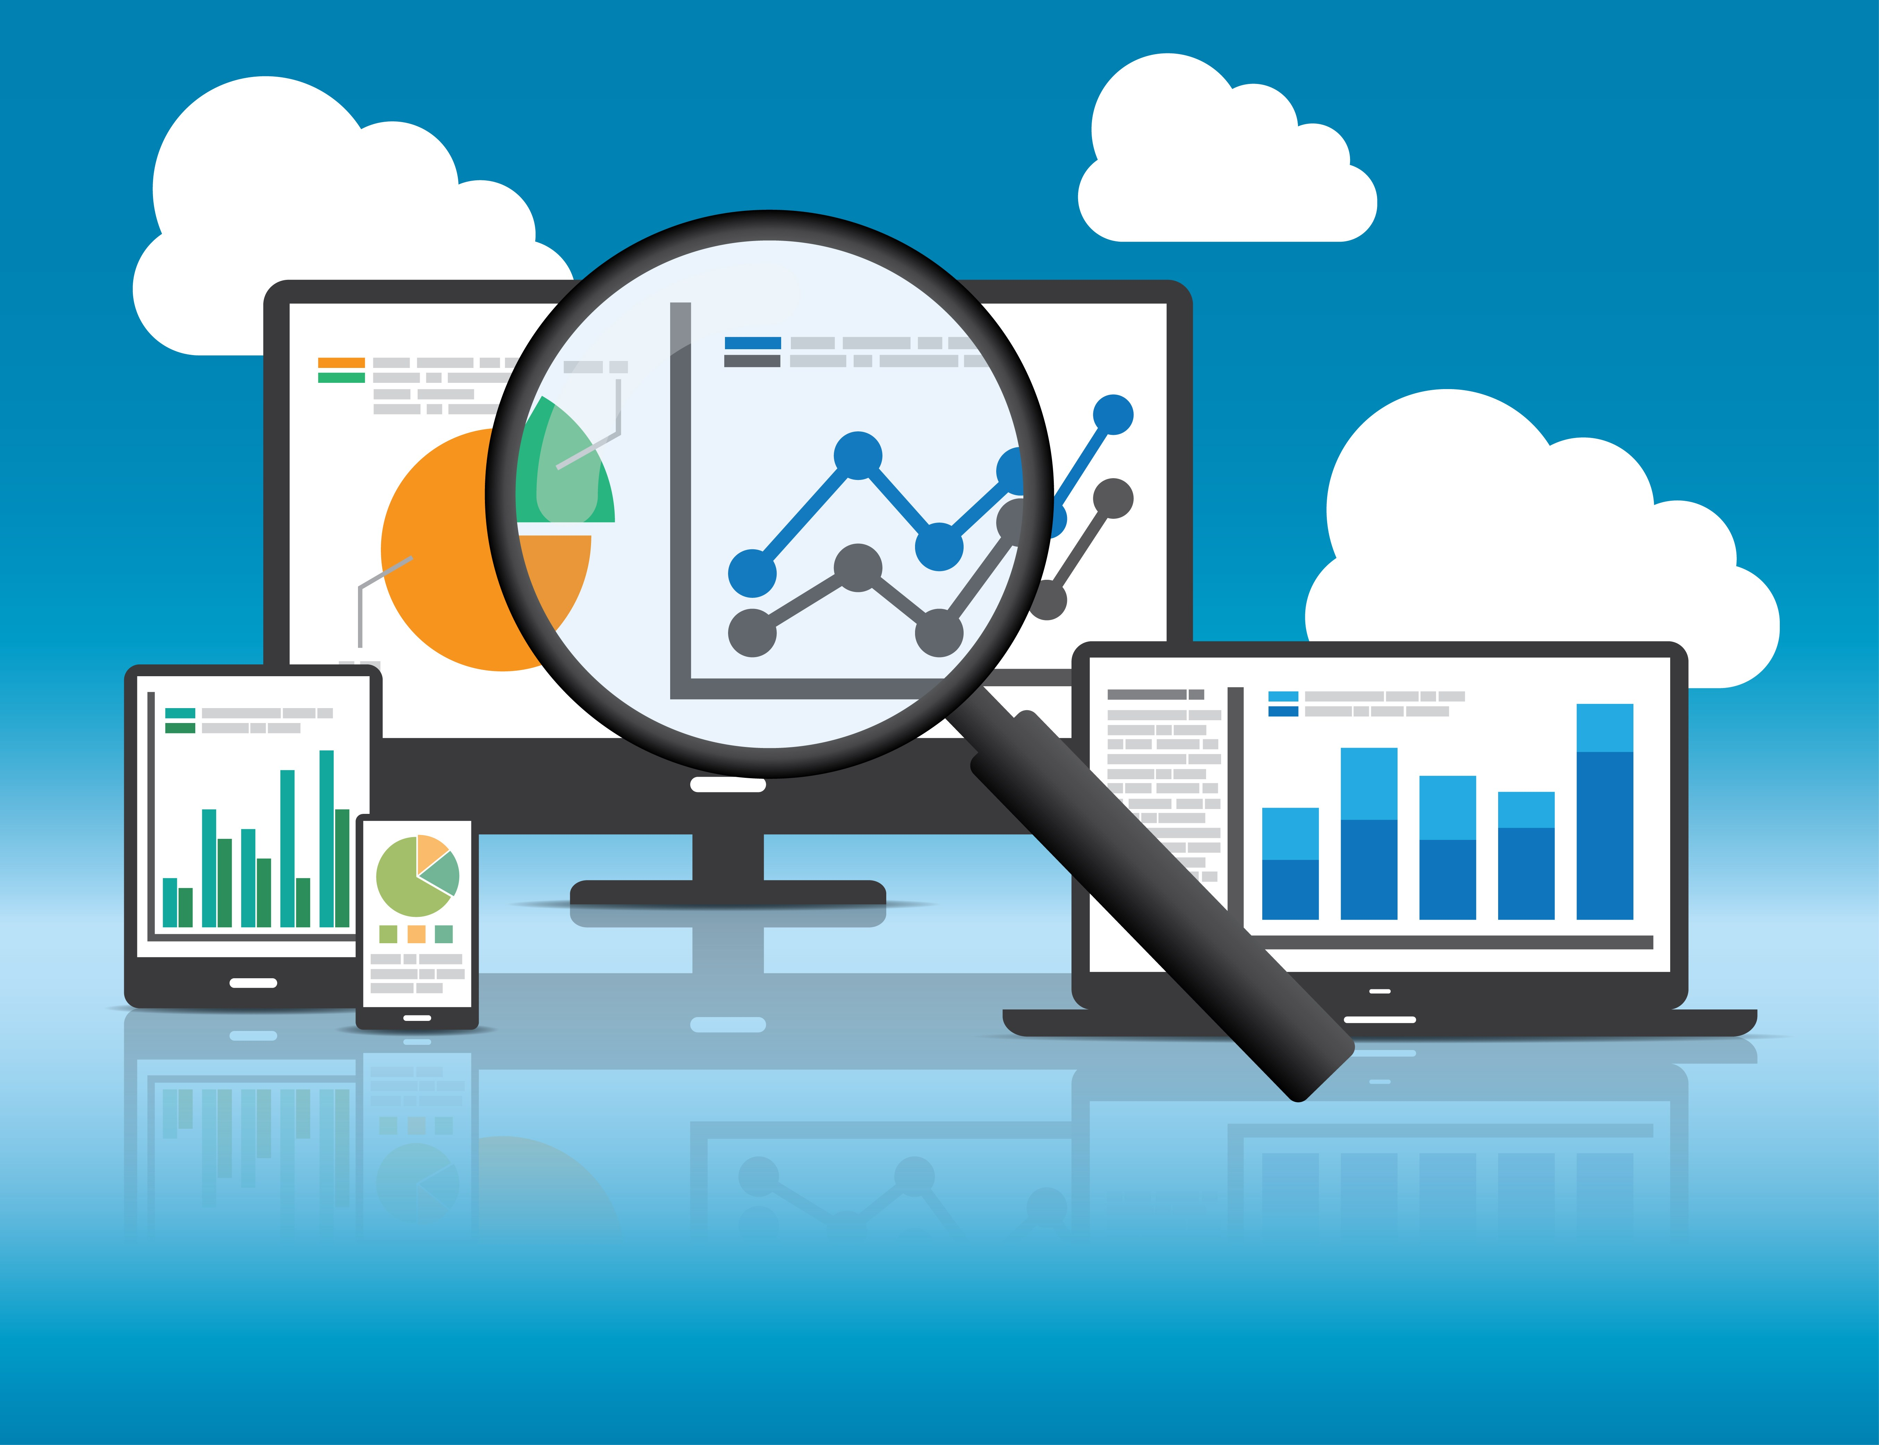
What is Data Analytics?
“The use of tools & people to uncover hidden patterns in the data that might not be readily available to the naked eye”
– Professor Lavin

Slide 13

3 types of analytics
Descriptive – Dashboards (BI)
Predictive – use past data to model future
Prescriptive – Optimization – advise on how best to do your job.
Notes:
3 types of analytics (we discussed two of them a few minutes ago)
Descriptive – Dashboards (you will create a dashboard in Max Labs and through your Learn IT assignment!)
Predictive – use past data to model future outcomes…how customers will respond to a promotion (think Burger King’s new Taco promotion) or Sales affected by market conditions
Prescriptive – Optimization – advise on how best to do your job. (Help your sales team close more deals…like Max helping her boss identify which lead is the best).

Slide 14

Data Investments… Why Care?
Top Reasons Why:
Decrease Expenses
Find New Innovations
Launch New Products/Services
Increase Efficiency
Transform Business
Establish Data-Driven Culture

Slide 15
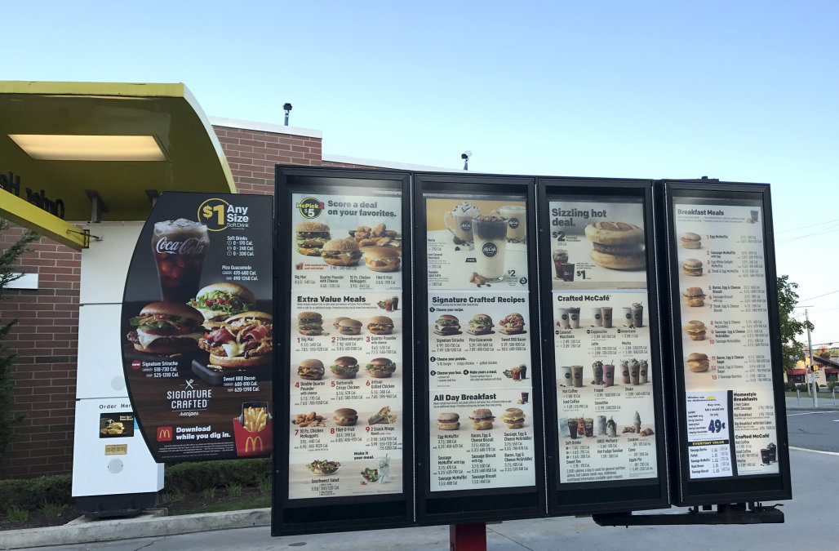

McDonald’s & Big Data
300 Million Acquisition
Customer experience
  Mass personalization
Infrastructure
Technology Transformation
  Algorithms crunch data
  Machine Learning
Replacing stagnant signs
  Digital displays

Slide 16
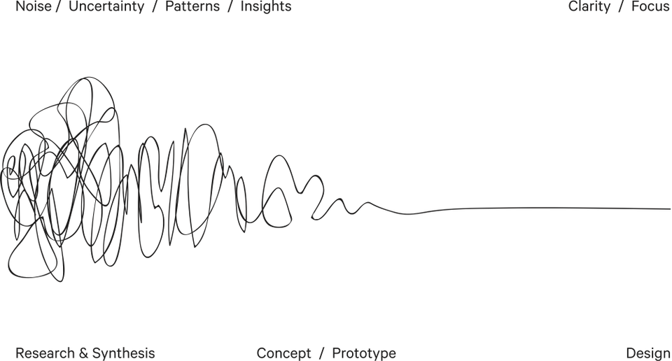
Data Analysis & Data Visualization
Data analysis is an exploratory process that often starts with specific questions.
Data visualization involves the visual representation of data, ranging from single charts to comprehensive dashboards.
Notes:
What’s the difference?
Data Analysis: an exploratory process
Data Visualization: visual representation

Slide 17
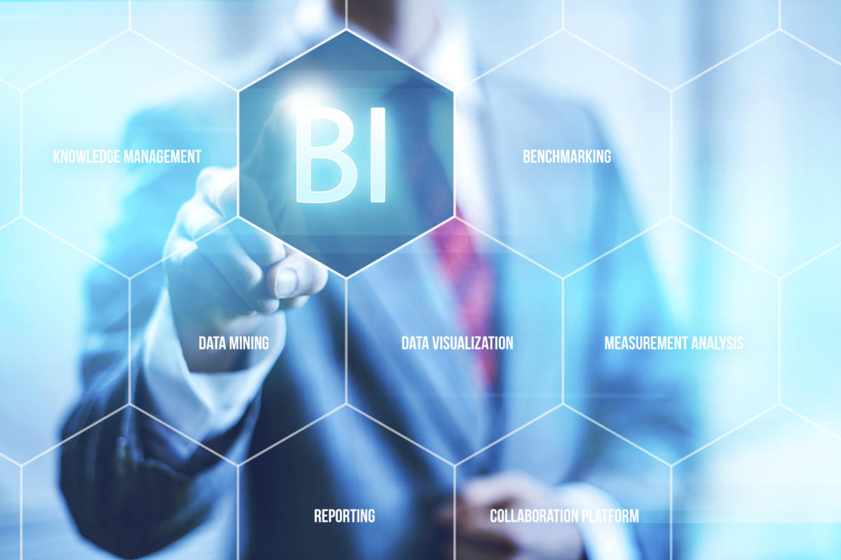
Business Intelligence (BI)
BI Leverages Software & Services to Transform Data into actional intelligence that informs the organization’s business decisions
BI is descriptive analytics: it describes a past or current sate
Analytical findings can be presented in:
  Reports
  Summaries
  Dashboards
  Graphs
  Charts
  Maps
Notes:
Business intelligence (BI) leverages software and services to transform data into actionable intelligence that informs an organization’s strategic and tactical business decisions. BI tools access and analyze data sets and present analytical findings in reports, summaries, dashboards, graphs, charts and maps to provide users with detailed intelligence about the state of the business.

Slide 18
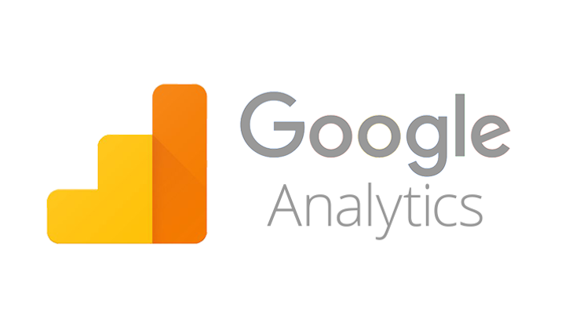
Google Analytics
Track
Website engagement
Number of sessions
Number of pages visited
Bounce Rate
Conversion Rate
Notes:
Conversion is the most important metric for users of Google Analytics. It tracks how many users of a web site make a certain desirable action, for example, fill out a contact form, subscribe to a feed, or purchase an item.

Slide 19
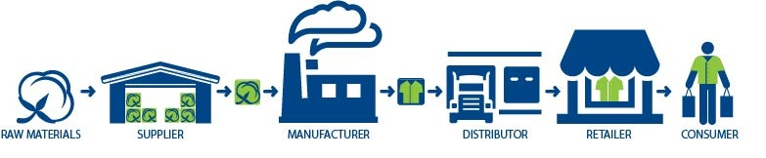
Supply Chain Management
“Supply Chain includes many components…from Procurement to Manufacturing to Distribution. It’s about getting the right product on the right shelf at the right time!” – Professor Doyle
Best approach: Planning backwards and project execution
Cross Functional Approach:
Improves trust & collaboration
Improves inventory visibility & velocity
Improves company long-term performance
Notes:
Cross Functional Approach…what does that mean???
Improves trust & collaboration – among supply chain partners. Think about all of the stakeholders involved.
Improves inventory visibility & velocity – this is all about the movement of materials and products.
Safety Stock is not always the answer!
Think about the Costs included:
Buying the raw materials.
Labor and other direct costs in making finished goods.
Distribution costs to get products out to distribution centers and retail locations.
Storage of finished goods.

Slide 20
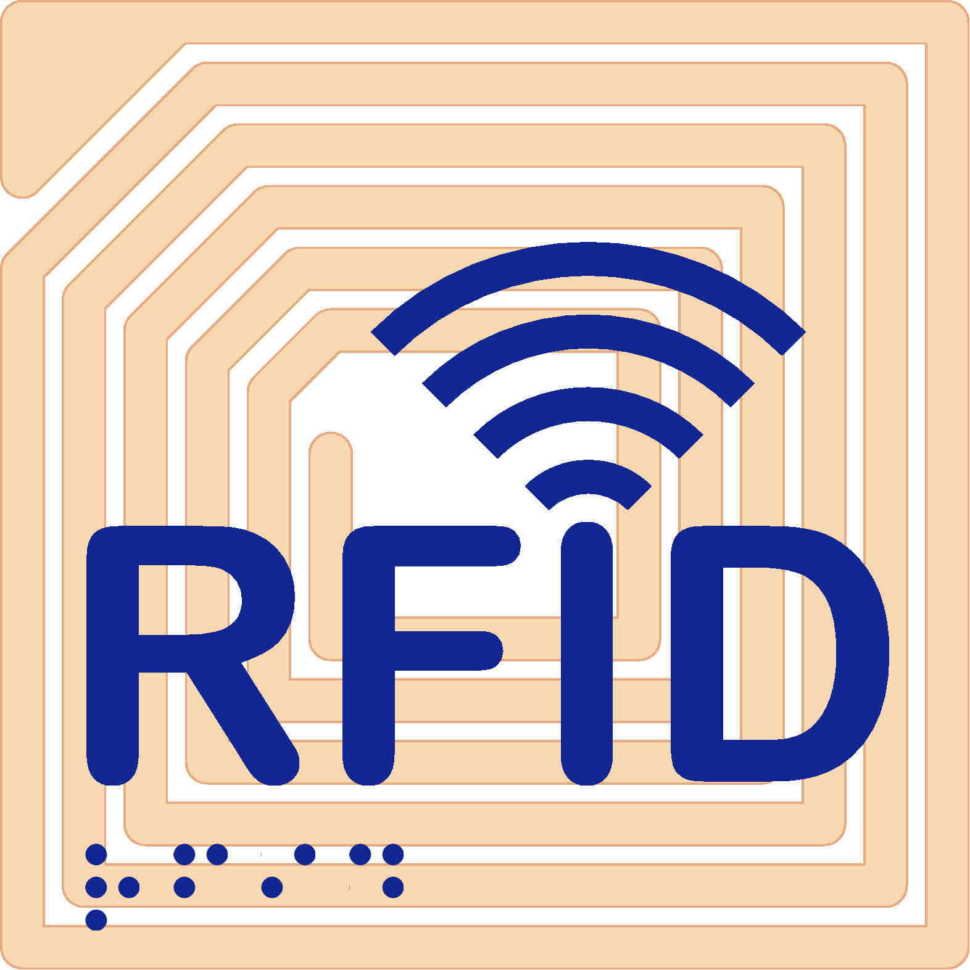
RFID
What is RFID?
Radio Frequency Identification
Wireless technology that lets you identify objects that have been fitted with special RF identification tags
What is RFID good for?
Inventory control, access control…
How it works
Antenna reads electromagnetic energy
Can penetrate non-metallic solid objects
Notes:
The use of electromagnetic energy to transit energy between a reader (transceiver) and the tag (antenna).
RFID tags can contain more information than bar codes.
Tags are programmable
Scanning can be done from greater distance.
Passive tags—inexpensive, range of few feet.
Active tags—more expensive, longer range

Slide 21

Disney Magic Band
$1 Billion Investment
Design the Customer’s experience
Customer Tracking
  Parks & Hotels
Everything is linked together
  Removes the customer’s need for:
    Credit Cards
    Tickets
    Trip Itinerary
Notes:
Turned the entire park into a computer system
Designing the Experience
RFID Chip in stylish rubber wristband

Slide 22
Platforms & Digital Business Models
Topics and Required Reading
API Imperative
How the API economy is igniting a cultural shift in businesses
What are digital platforms?
Product Managers for the Digital World
What’s the difference between IaaS, Saas & PaaS?
What is the Network Effect?
Platform Businesses
9 types of software platforms
Required Viewing
The API Economy
What is a Platform
Cloud Computing Models
Notes:
Api
Cloud Computing

Slide 23

Digital Platforms?
“…facilitates commercial interactions between at least two different groups…”
What are some core functions of a platform?
Audience Building
Matchmaking
Providing Core Tools & Services

Slide 24

Digital Platform Benefits
Easier to find customers
Monetize underutilized assets
Reduce transaction costs
Reduce barriers to entry
Reduce Search costs

Slide 25

Network Effects
The indirect value goods and services gain as more people use them.
ex. Uber, dating sites

Slide 26
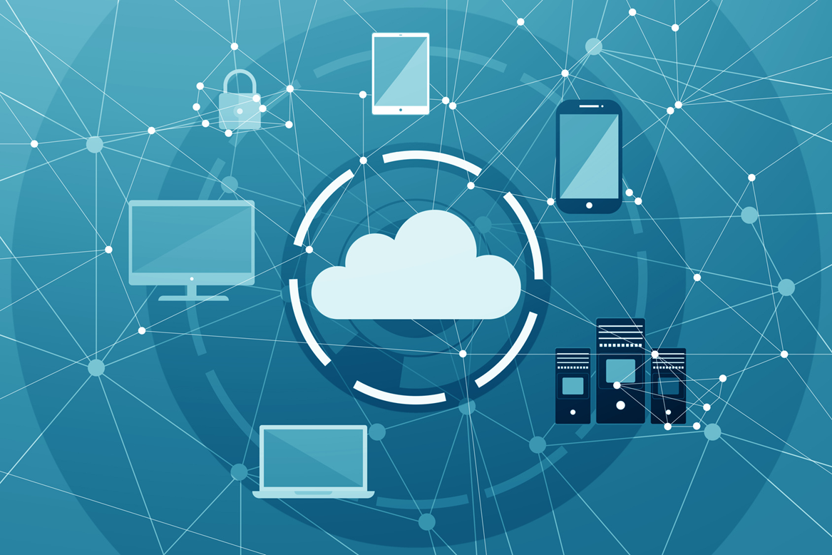
Cloud Computing
Pros
Collaboration
Environment
Cost
Ease of use
Cons/Pitfall
Security
Data Integrity
Availability
Privacy
Notes:
Cloud computing pitfalls to consider/discuss with the students:
Downtime – Network availability is an issue; outages do happen. So do incorrect access policies and other mistakes that can lead to the inability to access critical data. Contracts called Service Level Agreements between the provider and the customers that spell out guaranteed levels of service are meant to address these types of problems.
Device security – Employees lose mobile devices and fail to use strong passwords; updated malware and antivirus definitions, timely patches and updates are critical.
Data integrity – Potential problems that affect the integrity of a company’s data include corruption, misplacement, accidental deletion, physical accidents, malicious acts, hardware failures and a lack of proper policies.
Privacy & confidentiality of data – Data is vulnerable while being transmitted outside of the corporate firewall and once in the data center, it has to be kept separate from other companies’ data. Reliable identity authentication is also extremely important. Whether you choose a public or private cloud influences how much you have to worry about security issues. In some cases, a hybrid cloud may be the answer to your concerns. It is up to you to make sure that your cloud service provider has adequate safeguards in place to protect critical applications and sensitive data in case of hardware failures, natural disasters, cyber crime or data breaches.

Slide 27
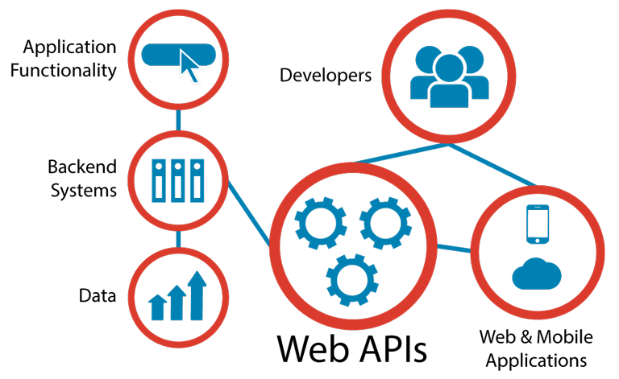
API’s: Application Programming Interface
What is an API?
Connect computer software components
  API enable organization to open their back-end data for use
Contract for Data Interaction
  Facilitates interactions between front & backend IT systems (Web API’s)
Facilitate development of applications: Web, Mobile, Cloud
Re-usable asset…. It’s a product!
Notes:
APIs (application programming interfaces) provide a way to connect computer software components. Broadly speaking, APIs make it possible for organizations to open their backend data and functionality for reuse in new application services.
An API achieves this by facilitating interactions between code modules, applications and backend IT systems. The API specifies the way in which these different software components can interact with each other and enables content and data to be shared between components.
The API is not a new concept. But as the complexity of computer systems has increased, the need for APIs has increased, as evidenced by their prevalence in operating systems, programming languages and networks – including the Web.
As more and more organizations have adopted the Web as the primary network for systems integration and have started seeking ways to connect their information technology assets to online portals and mobile apps, adoption of APIs has grown rapidly.
When people talk about APIs today, they are more often than not referring to these “Web APIs”. On a technical level, a Web API can be defined as any software interface exposed over the HTTP protocol in order to facilitate the development of Web, mobile and cloud applications.
Web APIs are particularly important in social media – for example, a network might publish an API that allows developers to create client applications for posting status updates from mobile devices. However, Web APIs are becoming increasingly vital to organizations across all sectors.

Slide 28
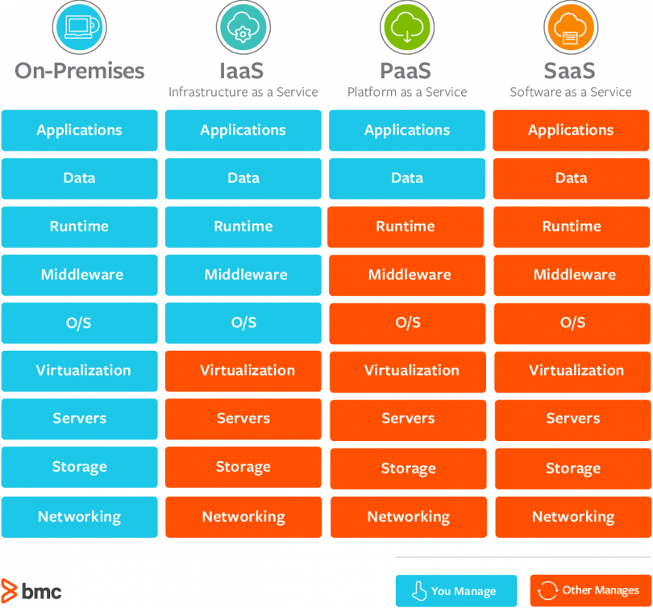
Cloud Computing
3 Basic Service types to Consider
Infrastructure as a Service (IaaS)
  Amazon Web Service
Platform as a Service (PaaS)
  Google App Engine
  Microsoft Azure
Software as a Service (SaaS)
  DropBox
  G-Suite (gmail, google doc…)
Notes:
IaaS: “host” – you pay for the infrastructure but you are responsible for all application development and deployment and support activities.
PaaS: “build” – you pay for the infrastructure and for a developing platform that supports many areas of deployment so you can just focus on programming your application.
SaaS: “consume” – you pay for an entire solution that is fully built, deployed, and distributed over the web for you to consume on demand. You have no infrastructure, development, deployment, or support responsibilities.

Slide 29
Product Manager
Product Manager’s maturity can be assessed in 6 areas
Customer-experience grounding
Market Orientation
Business acumen
Technical skills
Soft skills
Enablers
Product managers of the future will be analytics gurus and less reliant on analysts for basic questions. They will be able to quickly spin up a Hadoop cluster on Amazon Web Services, pull usage data, analyze them, and draw insights. They will be adept at applying machine-learning concepts and tools that are specifically designed to augment the product manager’s decision making.
McKinsey, “Product managers for the digital world”

Slide 30
Cybersecurity & the Enterprise
Topics and Required Reading
What is threat modeling?
Data Breaches
John Deere’s Promotional USB Drive Hijacks Your Keyboard
These are the worst corporate hackers of all time
5 Worst Data Hacks
What is AI
The Wired Guide to Artificial Intelligence
Why Hospitals Are The Perfect Target For Ransomware
Required Viewing
3 Types of AI
Cybersecurity Concepts
Cybersecurity: Vulnerability & Protection
Case Study: Ransomware
Cybersecurity Future & AI
Notes:
Max Labs 1a & 1b

Slide 31
Cybersecurity – Core Fundamentals
Five Questions for treat modeling:
What do you want to protect?
Who do you want to protect it from?
How likely is it that you will need to protect it?
How bad are the consequences if you fail?
How much trouble are you willing to go through in order to try to prevent those consequences?

Slide 32
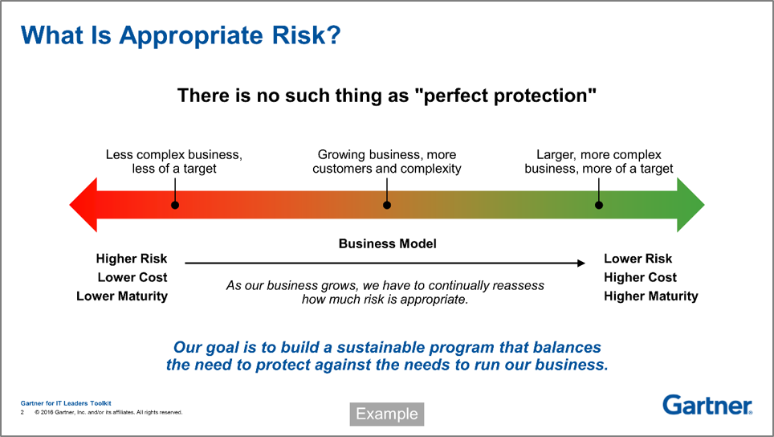
Myths of Protection
Right fit for the Organization
Five key BUILD elements:
Build 1:do/not do
Build 2: risk/cost ratios
Build 3: industry risk profile
Build 4: growth perspective
Build 5: sustainability

Slide 33
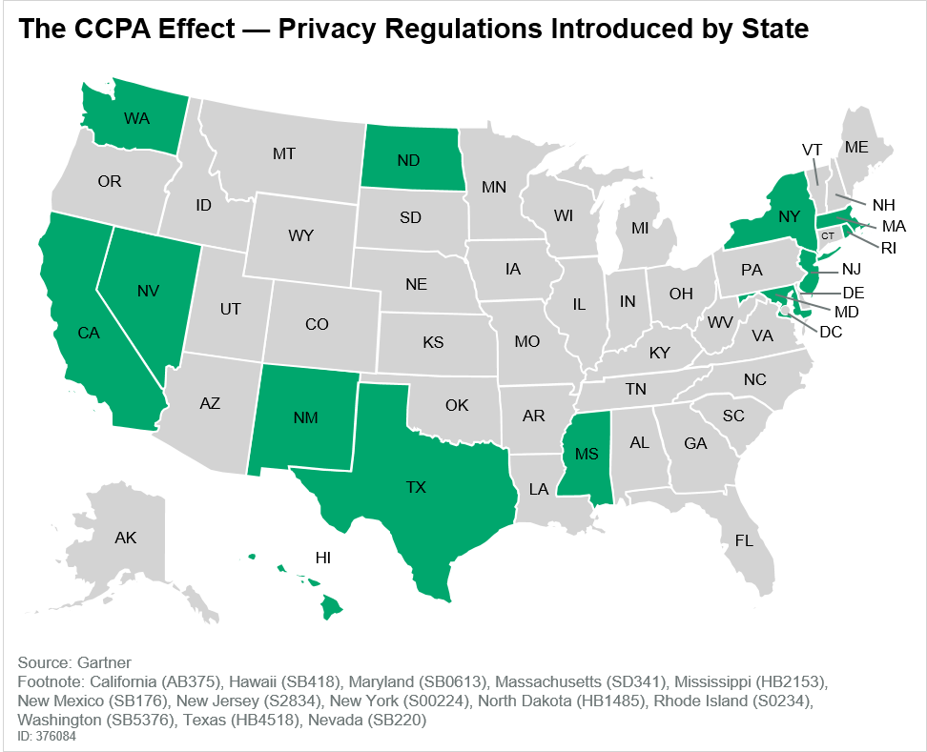
Regulations
Privacy and Personal Data Protection
California Consumer Privacy Act (CCPA)
Few Federal cybersecurity regulations
1996-Health Insurance Portability and Accountability Act (HIPAA)
1999-Gramm-Leach-Bliley Act
2002 Homeland Security Act, includes
Federal Information Security Management Act (FISMA)
IT Professional need to consider regulatory acts when developing systems (example: ERP)!
Notes:
California Consumer Privacy Act (CCPA)3 emerged on the legislative scene and passed in record time, paving the way for change across the U.S. privacy landscape. As shown in Figure 2, at the time of publication, 13 states have followed suit, introducing draft laws, some of which exceed the CCPA in scope. Cumulatively, they impact nearly 40% of the population in the U.S.

Slide 34

Password Management
Password Basics
Keep them in you head?
Don’t change them?
Reuse them?
Password Management
Consider a passphrase
  Access a vault of your passwords
Two-Factor Authentication

Slide 35
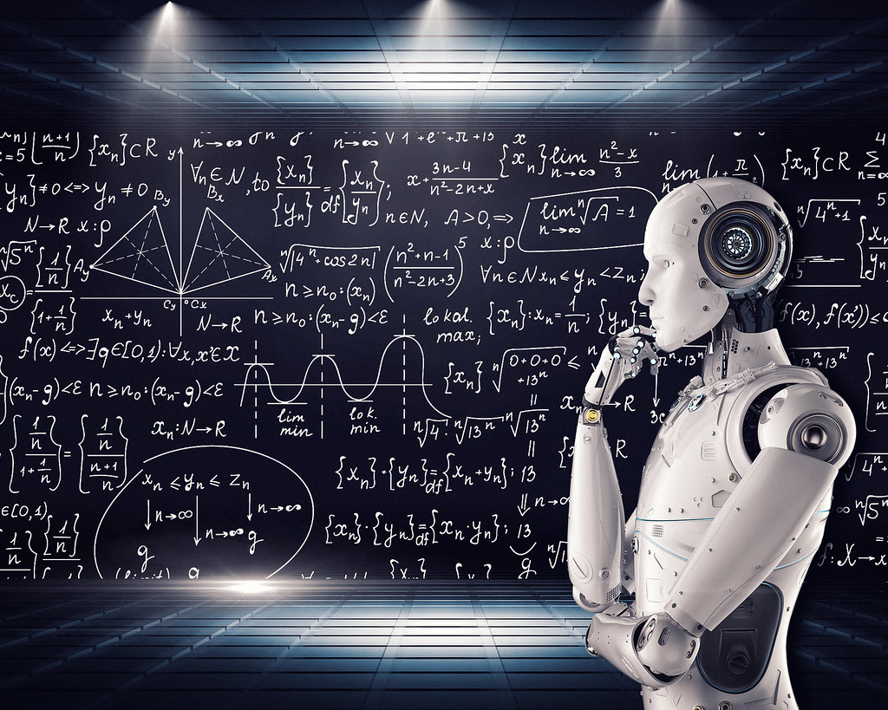
Artificial Intelligence
Three Types
Narrow (ANI)
General (AGI)
Superintelligence (ASI)
Notes:
Ask the students for examples of all 3 types:
Narrow (ANI) – all around us…google maps/waze/Facebook/autonomous cars/amazon suggestions
General (AGI) – Human Level Intelligence
Superintelligence (ASI) – Intelligence that exceeds that of a human

Slide 36
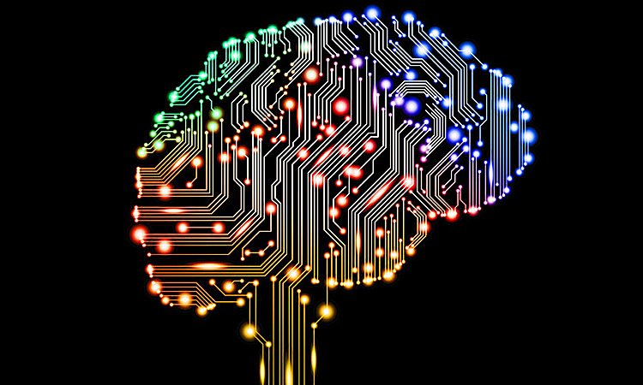
AGI Tests
The Turing Test
The Coffee Test
The College Student Test
The Employment Test
Notes:
The Turing Test, developed by Alan Turning in 1950, tests a machine’s ability to exhibit intelligent behavior equivalent to, or indistinguishable from, that of a human. It is essentially having a person interact with either a machine or a person and not being able to tell the difference

Slide 37
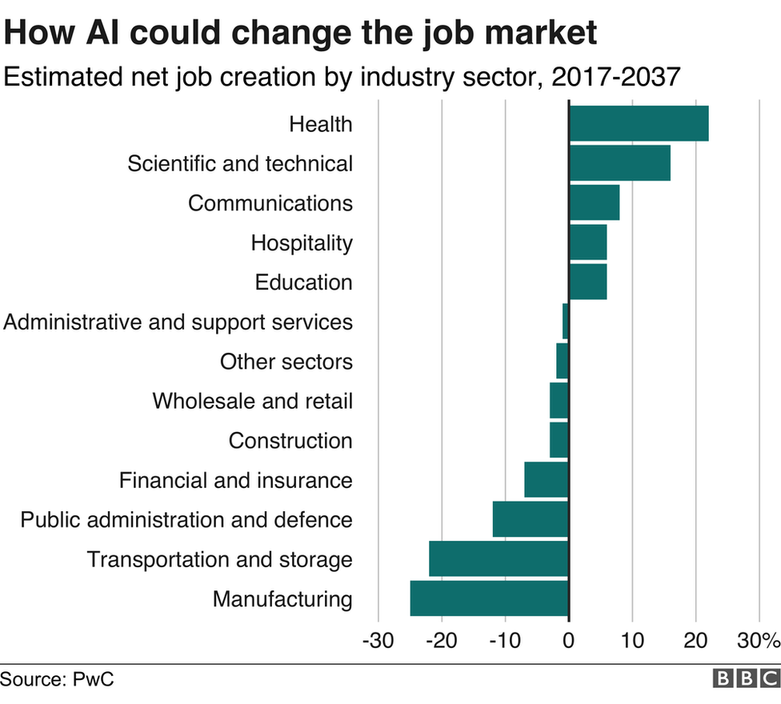
Future of AI

