Slide 1
Information Systems in Organizations
1.1 Introduction to MIS
FOX
MIS

Slide 2
Welcome!
Spring 2020
FOX
MIS

Slide 3

Introduction to Instructor
Marie-Christine Martin
E-mail: mcmartin@temple.edu
Office: Speakman 209J
Office Hours:
  M 1-2 pm, W 1-2 pm, F 10-11 am
  Also by appointment
FOX
MIS

Slide 4



Introduction to Instructor (cont.)
Education
  BS Industrial Engineering
  MBA, Finance
Pre-Temple
  IBM (Canada, USA & Singapore)
  HP Global
  Oracle, USA
  Self Employed Consultant
Adjunct Faculty
  Temple University, MIS
Full-Time Faculty Temple University
  Undergraduate - MIS
  Graduate - FOX Business School MBA
  Director of MIS Masters Programs
FOX
MIS

Slide 5

Course Support: Information Technology Assistants (ITAs)
Ashlin Cheriyan
ashlin.bc@temple.edu
Office Hours: by appointment
FOX
MIS

Slide 6
“Tell me and I forget. Teach me and I remember. Involve me and I learn.”
- Benjamin Franklin

Slide 7
Managing Expectations
This class is unique!
We will work through challenges together…plan on it!
You will find the class engaging and fun!
You will acquire knowledge and skills that you will use in future classes and your career!!!
FOX
MIS

Slide 8
Course Highlights
Systems Analysis
Process Mapping (Modeling with swim lanes & entity relationship diagrams)
Digital Product Management
Information Systems CRM & ERP, Data Analytics & SCM
Platforms & Digital Business models, including API’s
Cyber security and the Enterprise plus AI
Programming including: JavaScript, HTML & CSS
FOX
MIS

Slide 9
Course Objectives
Explore the systems which organizations use to create their digital products
Explore the platforms which these digital systems are built upon
Explore the API ecosystems by which systems extend their reach and capability.
Discuss cyber security including risks & responses surrounding digital products
Introduction to the creation of software
Learning the basics of programming in JavaScript
FOX
MIS

Slide 10
Graded Components
Component | Percentage
In-Class Activities & Worksheets (approximately 14) * must be present in class to earn credit – no exceptions! | 10%
Learn IT! and Max Lab Assignments ** no late assignments accepted – no exceptions! | 30%
Exam #1 (50 minutes) | 20%
Exam #2 (50 minutes) | 20%
Exam #3 (50 minutes) | 20%
*In-Class activities must be submitted while in class.
**Completed assignments will not be returned in class. Grades will be posted to the gradebook. Please note that two weeks after a grade is posted, the grade will be considered “final.”
FOX
MIS

Slide 11


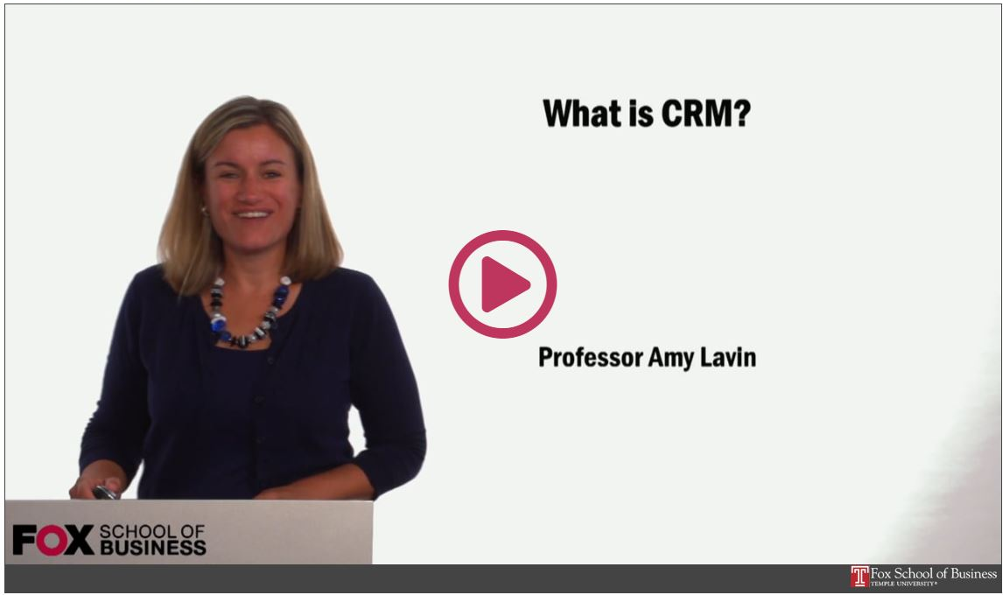
Readings & Videos – Part 1
No required texts the first half of the semester!
Engaging collection
Current content
Available for Free!!!
FOX
MIS

Slide 12

Readings & Videos – Part 2
JavaScript
  Create simple JavaScript programs
  Prompt users for input
  Utilize loops
  Process Information
FOX
MIS

Slide 13

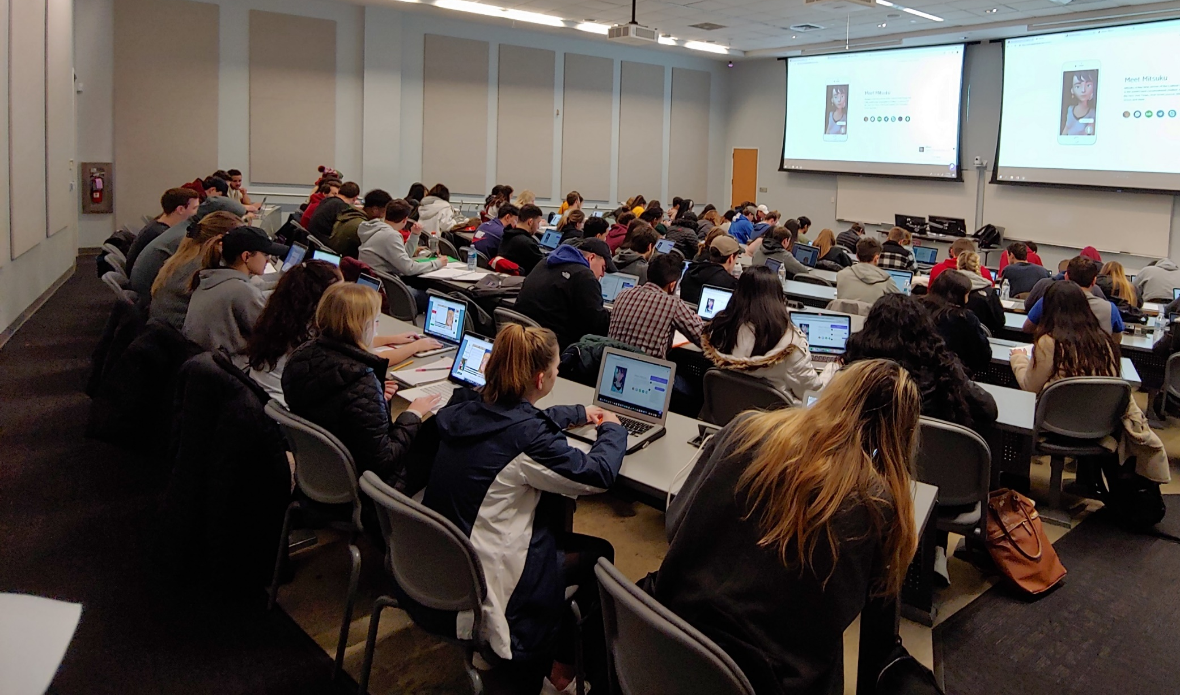
Lecture vs. Activities
Source: https://www.theodysseyonline.com/11-things-college-lecture-hall
3 Hours of zzzzzzzzz’s
1 Hour Discussion
2 Hours of Activity
FOX
MIS

Slide 14
Active Learning Components
TECHNOLOGY
CONTENT
ACTIVITY
FOX
MIS

Slide 15
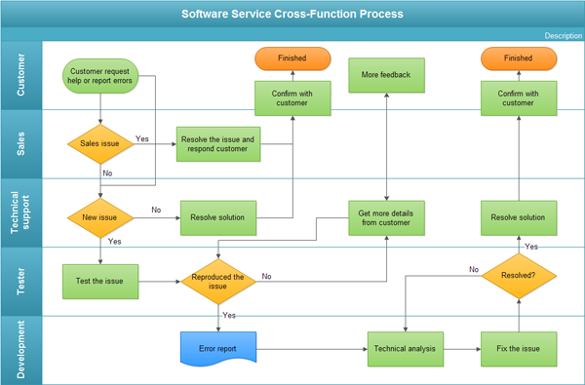
The In-class Activity
Process Diagrams
  Swim lane diagram
Real life scenarios
Knowledge Application
Problem Solve
Synthesize Solutions
Engagement
Analysis
Synthesis
FOX
MIS

Slide 16
The Active Learning Funnel
CONTENT
TECHNOLOGY
ACTIVITY
ENHANCED LEARNING ENVIRONMENT
FOX
MIS

Slide 17
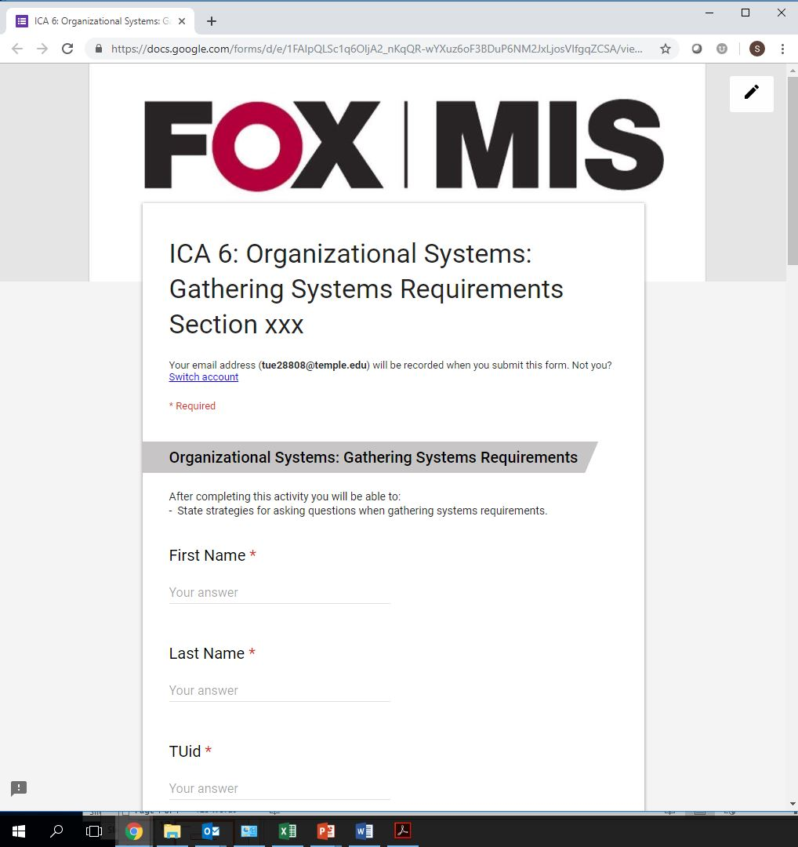
The In-class Activity – Google Forms
Reinforce assigned materials
  Readings
  Videos
  Lecture
Exam Preparation
Must be present in class
You keep your work
Synthesis
FOX
MIS

Slide 18
Not Just Another Intro Class!
Accounting
Business Management
Entrepreneurship & Innovation Management
Financial Planning
International Business Administration
Marketing
Risk, Insurance & Healthcare Management
Supply Chain Management
Actuarial Science
Economics
Finance
Human Resources Management
Legal Studies in Business
Management Information Systems
Real Estate
Statistical Science and Data Analytics
FOX
MIS

Slide 19

FOX
MIS

Slide 20
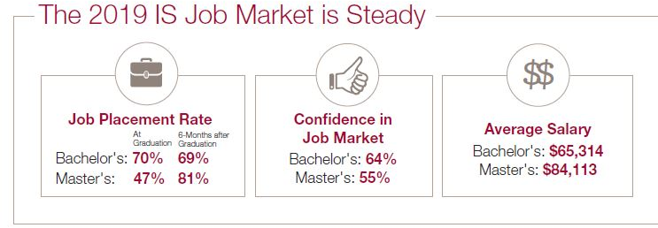
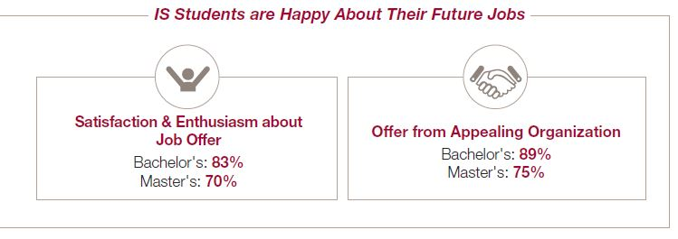
Based on 1420 recent graduates from 43 universities across the U.S.
FOX
MIS

Slide 21
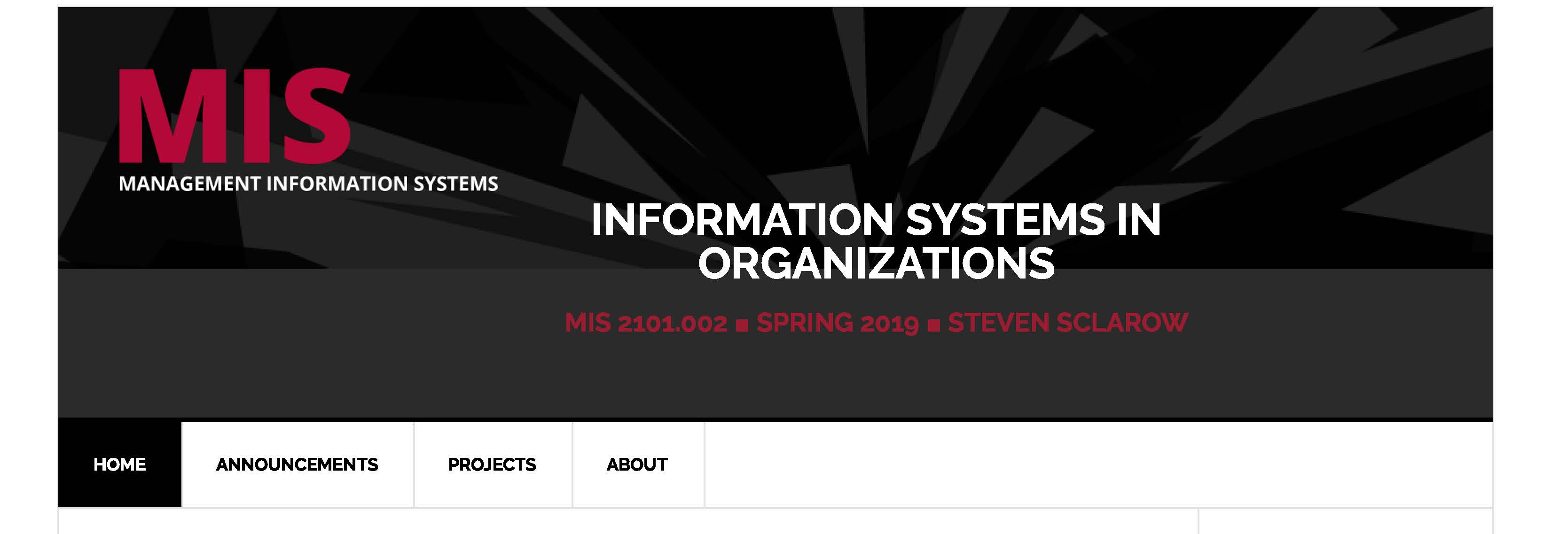
Class Site Review
We use Canvas for our exams.
The rest of the information is on our MIS site:
  https://community.mis.temple.edu/mis2101sec702spring2020
  /
FOX
MIS

Slide 22
ROADMAP
START
Week 1:
Introduction & Systems Analysis
Course Description
Systems Thinking
Week 1:
Introduction to Process Mapping
Systems & Processes
Swim Lane Diagrams
Max Labs 0- due
Week 2:
Digital Product Management & ERD
Max Labs 1A/1B- due
Week 2:
Introduction to Data Modeling
Week 2:
Exam #1
3/27-3/29: Exam Availability
Week 4 :
Exam #2
4/10-4/12 Exam Availability
Week 4:
Cybersecurity & AI
Protection Protocols
Artificial Intelligence
Cybersecurity/AI assignment due
Max Labs 3a/3b due
Week 4:
Platforms & Digital Business Models
API’s
Cloud
Week 3:
Information Systems
ERP & CRM
Data Analytics & SCM
Max Labs 2A/2B due
Lean IT #1 due
Week 5:
JavaScript Unit #1 & 2
Hello World, Variables
Input and Output
Operator types
Strings
Watch Lynda.com video – due
Code Academy due
Coding assignment #1-due
Week 6:
JavaScript Unit #3&4
Logical Operators
Conditional Types
Intro to Loops
While and Do
Writing the code
Coding Assignment #2-due
Week 7:
HTML & CSS
Coding Assignment #3-due
Lean IT #2 due
Week 7:
Exam #3
4/28-4/29: Exam Availability
FINISH

Slide 23
Information Systems in Organizations
1.1 Intro to Information Systems in Organizations
In-Class Activity
FOX
MIS

Slide 24
Intro to Information Systems in Organizations
What?
  Ask your instructor questions about the course and about themselves
  Learn what “In-Class Activities” are all about
Why?
  Regardless of your major, the more you understand about information systems, the more successful you will be
  This course uses activity-based learning to help students develop a deeper, more genuine understanding of topics. This is your first taste of “In-Class Activities”
FOX
MIS

Slide 25
Information Systems in Organizations
1.2 What are Systems?
FOX
MIS

Slide 26
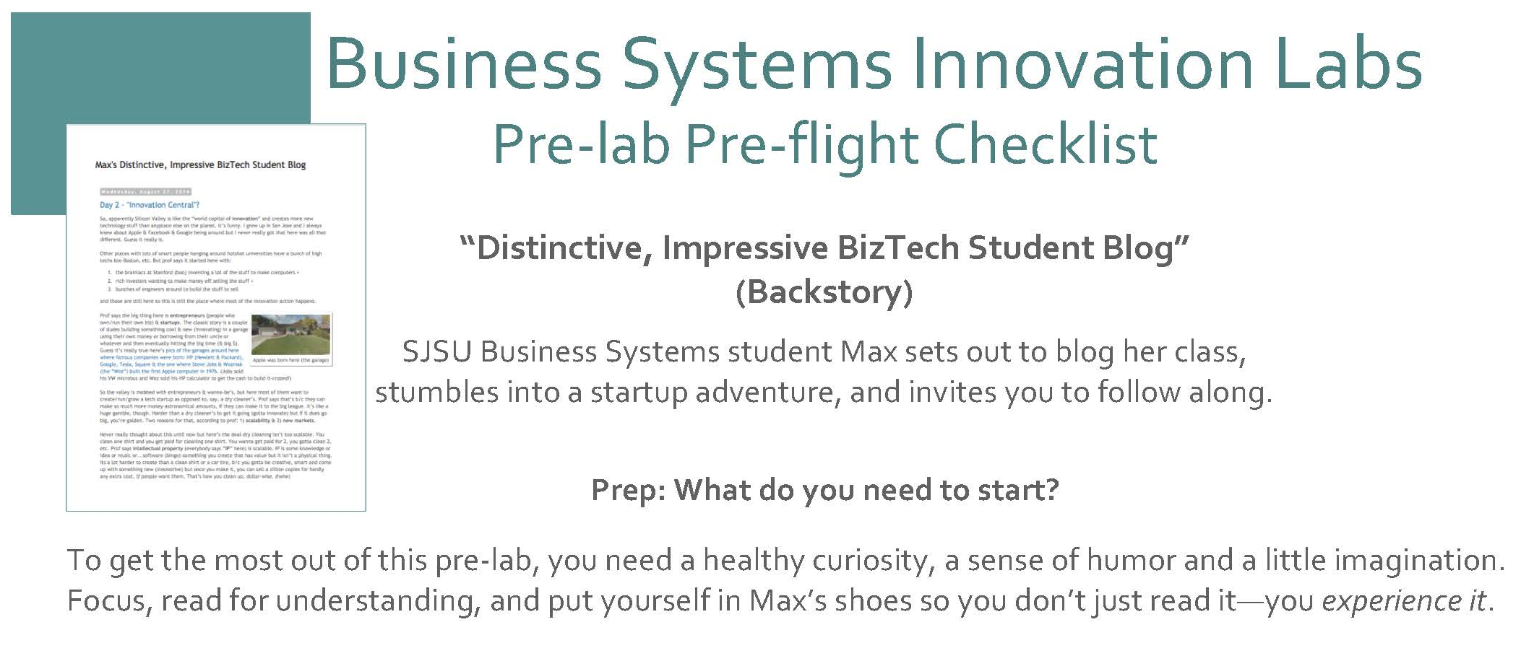
Max Labs
DUE BY EOD FRIDAY!
FOX
MIS

Slide 27

World View – A collection of “Systems”
Systems = people + process + technology
Manipulation of information = value
Managed by MIS professionals
Systems surround us 24/7
Application Program Interface (API’s)
Source: https://www.aecom.com/ca/management-information-systems-mis/
FOX
MIS

Slide 28

Understanding Systems
Buying textbooks on Amazon
What is part of that system?
Log-in (multiple steps)
Search
Shopping Cart
Purchase (Multiple steps)
And much more…..
FOX
MIS

Slide 29

Understanding Systems (cont.)
Buying lunch
What is part of that system?
Take the order
Hand order to cook
Prep to-go bag
Order cooked (multiple steps)
And much more….
FOX
MIS

Slide 30


Understanding Systems (cont.)
Describe the Process of Ordering
What keeps info accurate?
  Data
Who is involved?
  Customer ♦ Store ♦ Warehouse Mgr. ♦ Admin ♦ UPS driver…
How much effort?
  None…it’s automated!
  Technology !!!
FOX
MIS

Slide 31
“information system – an integrated set of components for collecting, storing, and processing data and for providing information, knowledge, and digital products.”
- Encyclopedia Britannica
Source: https://www.britannica.com/topic/information-system/Management-support

Slide 32

A collection of technologies
Including:
Hardware
Software
Policies
Education tools
API’s
Etc…
Source: https://www.kisspng.com/png-laptop-computer-hardware-computer-repair-technicia-1180595/preview.html
FOX
MIS

Slide 33
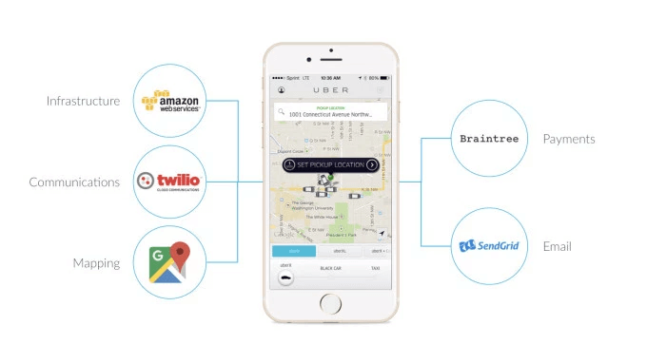
API’s Case Study: UBER
Requesting a ride?
Describe what happens...
  What are these systems?
  How do they work?
Source: https://www.okta.com/security-blog/2019/05/how-uber-takes-advantage-of-the-api-economy/
FOX
MIS

Slide 34

Four Core Steps of Designing UX
Problem Definition
Documenting Business Processes
Process Decomposition
Data Modeling
Source: http://www.petraware.com/consulting/
FOX
MIS

Slide 35

Software Development Lifecycle (SDLC) methodologies
Waterfall
Agile
Lean
Scrum
DevOps
Image: http://www.xanadutec.com/software-as-a-service.html
FOX
MIS

Slide 36
“Once a Product Manager / Technologist understands the business problem, they can architect a solution.”
- Mart Doyle
What is “Systems analysis?”: Problem solving technique that “decomposes” a system into its component pieces for the purpose of studying how well these parts work & interact to accomplish their purpose

Slide 37
Process Decomposition
INPUTS: credit card, address, e-mail, phone, shipping preferences, etc.
Purchase Text
OUTPUTS: textbook, packing slip, delivery box
Single entity
Subsystem
Select Text
Check Out
Deliver Text
Shipping address
Payment method
Review Items
Shipping
Change
Add cards
Select card
Reward points
Use method
FOX
MIS

Slide 38
“Systems Architecture is a response to the conceptual and practical difficulties of the description and the design of complex systems.”
- Boris Golden
What is “Systems Architecture?”: Representation of the system & all of its parts/components

Slide 39
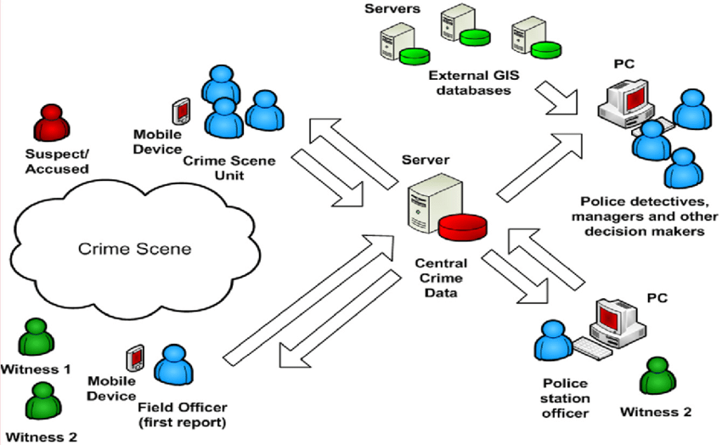
Systems Architecture
Conceptual Diagram
Structural components
Identify/Solve Problems
Existing or New
Communication tool
Source: https://www.researchgate.net/figure/Conceptual-System-Architecture_fig2_327987580
FOX
MIS

Slide 40
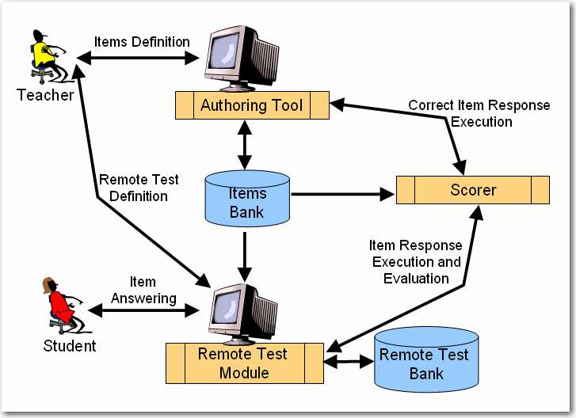
Systems Architecture
Test question defined
  Authoring tool
Remote test created
  Test module
Student responses
  Test module
Execution & Evaluation
Source: http://spmarchitecture.com/systems-architecture/system-architecture-learning-environment-for-automatic-rating-64721-2/
FOX
MIS

Slide 41
Information Systems in Organizations
2.1 Intro to Process Mapping
FOX
MIS

Slide 42

Process Mapping
What
Visual Representation
Why
Identify Problems
How?
Draw the “as-is”
Source: https://creately.com/blog/diagrams/process-mapping-guide/
FOX
MIS

Slide 43

What’s a Picture Worth?
How about a diagram???
How fast does the brain process images?
70% of your sensory receptors are in your eyes
50% of your brain is active in visual processing
Source: https://tax.thomsonreuters.com/blog/the-importance-of-visual-content-marketing-infographic/
Source: http://esheninger.blogspot.com/2018/08/a-picture-is-worth-thousand-words.html
FOX
MIS

Slide 44
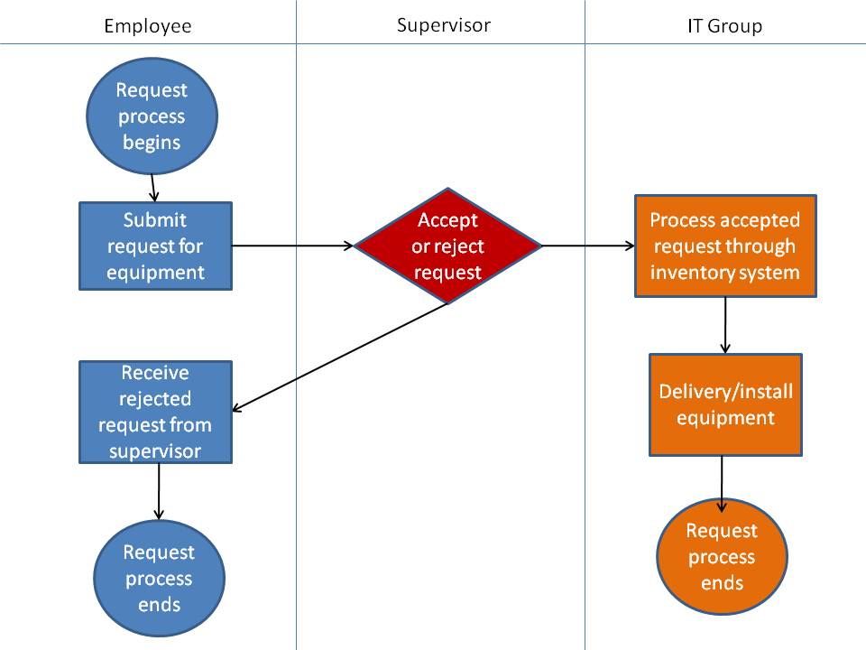
Swim Lane Diagrams
Advantages
Identifies who does what & in what order
  Logical & Chronological
  Indicates hand-offs
Versatile
  Applied to other diagrams
  Training tool
FOX
MIS

Slide 45
Swim Lane Diagrams - symbols
A circle signifies the starting and ending of an event in the process
A rectangle represents an activity in the process.
A diamond represents a decision that must be made.
Arrows indicate the flow of the process.
A cylinder represents stored data.
FOX
MIS

Slide 46
Swim Lane Diagrams – Order to Cash (O2C)
The process starts when the customer contacts Sales to place an order. The person in Sales creates the sales order. As part of doing this, the person in sales first checks to see if the customer has enough available credit to cover the order. They do this by looking up the customer’s credit on a report that is generated by Accounting and sent to Sales every Monday morning. If the customer doesn’t have enough available credit then the person in sales notifies the customer who can then either update or cancel their order. Next the person in sales checks to see if the items being ordered are in stock. They do this by checking a report on inventory that the Warehouse created at the end of each day. If the items being ordered are not in stock then the person in Sales notifies the customer who can then update or cancel their order. If the report indicates the items are in stock then the order goes to the Warehouse where the workers there will pick the order. Since Sales is looking at a report that is only updated at the end of each day, there is a chance that they accepted an order for an item that is not really in stock. If that is the case the Warehouse notifies Sales who then notifies the customer who can update or cancel their order…
FOX
MIS

Slide 47
Swim Lane Diagrams – Order to Cash (O2C)
…Once the people in the warehouse pick the order, the people in Accounting have to make sure that the customer actually has enough credit to cover the order. Since the people in Sales use a credit report that is generated on Monday morning, there is a chance that the information on the credit report is old. If the customer doesn’t have enough available credit then Accounting notifies Sales who then notifies the customer who can then choose to update or cancel their order. If the customer has enough available credit then their available credit is reduced by the total cost of the order and the warehouse is notified and they pack and ship the order. As soon as the order is shipped the people in the warehouse notify accounting and accounting generates and sends the invoice to the customer. When the customer pays the invoice the people in Accounting increase the customer’s available credit by the amount of the payment, they post the payment and we’re done.
FOX
MIS

Slide 48
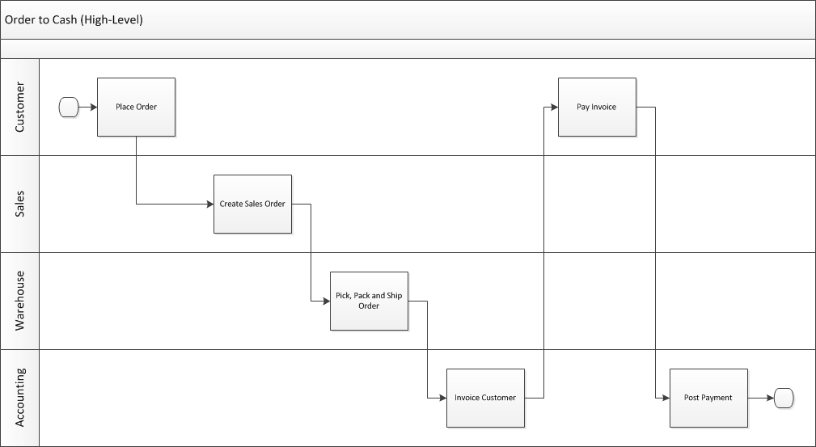
Swim Lane Diagrams – Order to Cash (O2C)
Who does What & When
Overview example
FOX
MIS

Slide 49
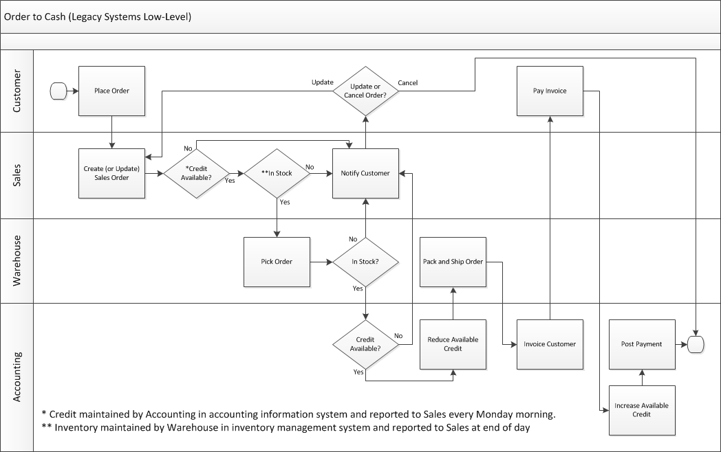
Swim Lane Diagrams – Order to Cash (O2C)
Who does What & When
Complexity added
Legacy system
FOX
MIS

Slide 50
Swim Lane Diagrams – Create your own
Actors
Title of the Process you are documenting
Actor 1
Actor 2
Actor 3
Actor 4
FOX
MIS

Slide 51
Information Systems in Organizations
Swim Lane Diagrams #1
In-Class Activity
FOX
MIS

Slide 52
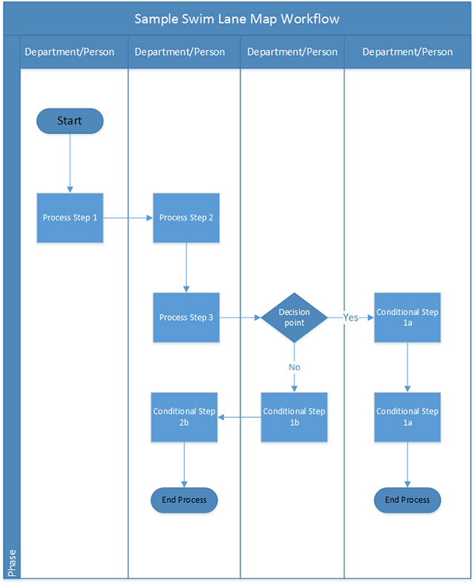
Swim Lane Diagrams #1
What?
  Interpret a swim lane diagram
  Construct a swim lane diagram from provided story
Why?
  Simple, effective tools for documenting a business process and eventually improve it!
  Everything you do at work will be part of a business process
    Modeling processes = analysis and improvement opportunities
  Swim lane diagrams will be on the first 2 exams!
Source: https://www.businessport.net/wp-content/uploads/2018/10/Swim-Lane-Map-Businessport-blog.jpg
FOX
MIS

Slide 53
More to Come
Prepare with Readings & Videos before our next class!!!

