Slide 1
Information Systems in Organizations
3.1 Digital Product Management &
Max Lab 1a|1b
FOX
MIS

Slide 2
ROADMAP
START
Week 1:
Introduction & Systems Analysis
Course Description
Systems Thinking
Week 1:
Introduction to Process Mapping
Systems & Processes
Swim Lane Diagrams
Max Labs 0- due
Week 2:
Digital Product Management & ERD
Max Labs 1A/1B- due
Week 2:
Introduction to Data Modeling
Week 2:
Exam #1
3/27-3/29: Exam Availability
Week 4 :
Exam #2
4/10-4/12 Exam Availability
Week 4:
Cybersecurity & AI
Protection Protocols
Artificial Intelligence
Cybersecurity/AI assignment due
Max Labs 3a/3b due
Week 4:
Platforms & Digital Business Models
API’s
Cloud
Week 3:
Information Systems
ERP & CRM
Data Analytics & SCM
Max Labs 2A/2B due
Lean IT #1 due
Week 5:
JavaScript Unit #1 & 2
Hello World, Variables
Input and Output
Operator types
Strings
Watch Lynda.com video – due
Code Academy due
Coding assignment #1-due
Week 6:
JavaScript Unit #3&4
Logical Operators
Conditional Types
Intro to Loops
While and Do
Writing the code
Coding Assignment #2-due
Week 7:
HTML & CSS
Coding Assignment #3-due
Lean IT #2 due
Week 7:
Exam #3
4/28-4/29: Exam Availability
FINISH

Slide 3


The Max Labs Project
Overview & Startup
Source: https://www.salesforce.com/

Slide 4

Why Salesforce?
This is not Salesforce training – rather, a great platform to deliver cloud-based systems products.
Enables & Enhances Business
Used By Industry Fortune 100’s
  Across All Business functional Areas
Great Resume Builder For You!
Source: https://www.salesforce.com/
FOX
MIS

Slide 5
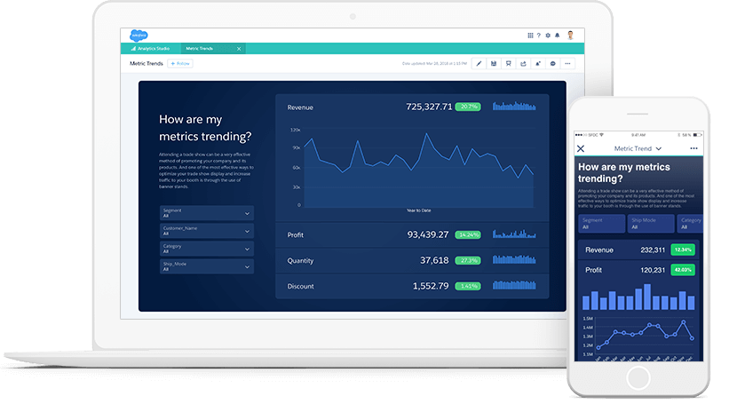
Max Labs – Enabling Organizations
Technology Enables Organizations to work faster/smarter/more efficient
See How It Works First-Hand
Understand how Used by Industry Fortune 100’s
  Across all Business Functional Areas
Great Resume Builder For You!
Source: https://www.salesforce.com/
FOX
MIS

Slide 6
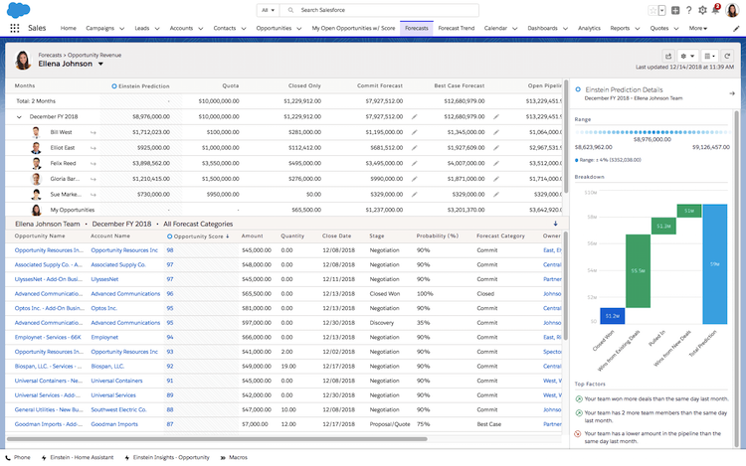
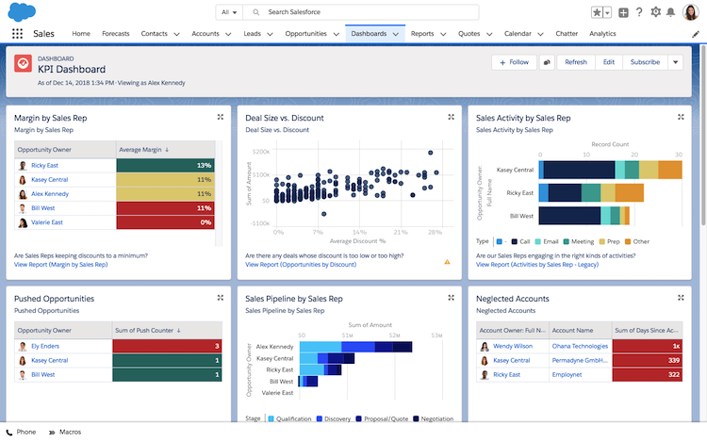
Max Labs – What do they include?
Source: https://www.salesforce.com/
FOX
MIS

Slide 7

Max Labs – Tips for Your Success
READ the Pre-lab first. (Set’s up your entire experience.)
READ & FOLLOW every single instruction EXACTLY, in order. (You'll have no problems.)
READ the cover sheet BEFORE you start every lab.
ALWAYS read stories BETWEEN instructions. (Connections to our key Course Concepts)
They’re quick (allow about 60-90 min for each lab)
DO NOT get the 30-day trial account from www.salesforce.com.
The Lab 1b instructions tell you EXACTLY how to pay the lab fee. (Just follow them)
If you’re stuck, FIRST check the Help FAQ at MaxzPlace.com
BE SURE your name appears on every screen-capture you submit to show your progress
DO NOT use Yahoo! for your Salesforce account email. (Use Gmail)
They’re on the exams (w/un-guessable questions)
They’ll help you get a job (IF you can explain what you did/learned)
Source: https://www.maxzplace.com/what
FOX
MIS

Slide 8
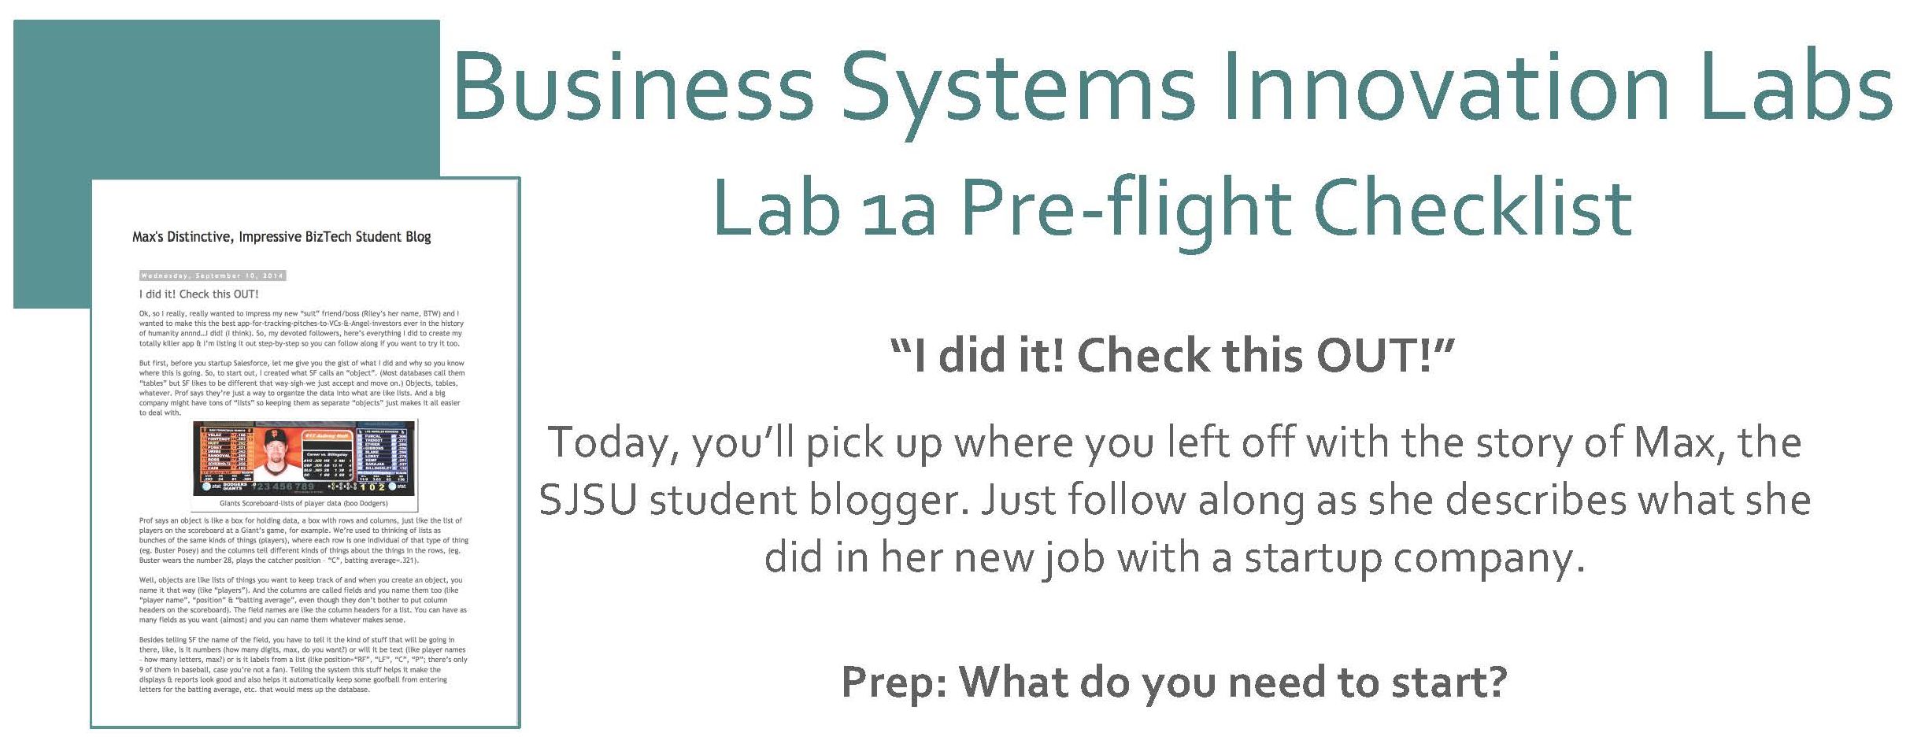
Max Labs 1a
Spring 2020
FOX
MIS

Slide 9
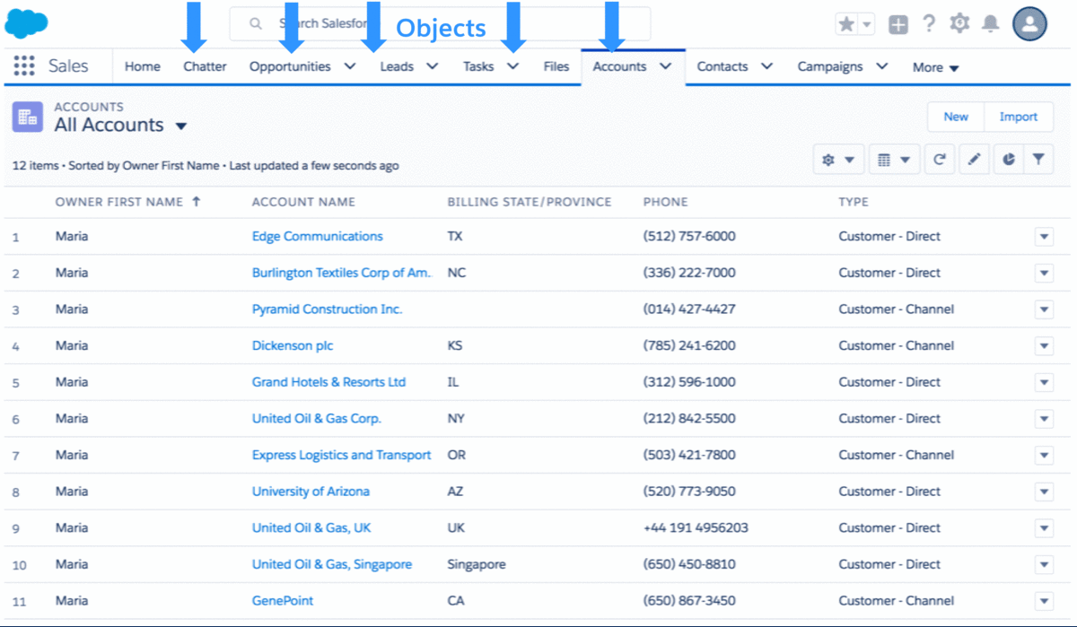
Max Labs – 1a Discussion
Creating Databases (objects)
Why do we need these lists?
Why not just use Excel?
What are we tracking?
Unique ID?
Source: https://developer.salesforce.com/blogs/developer-relations/2017/04/salesforce-data-security-model-explained-visually.html
FOX
MIS

Slide 10
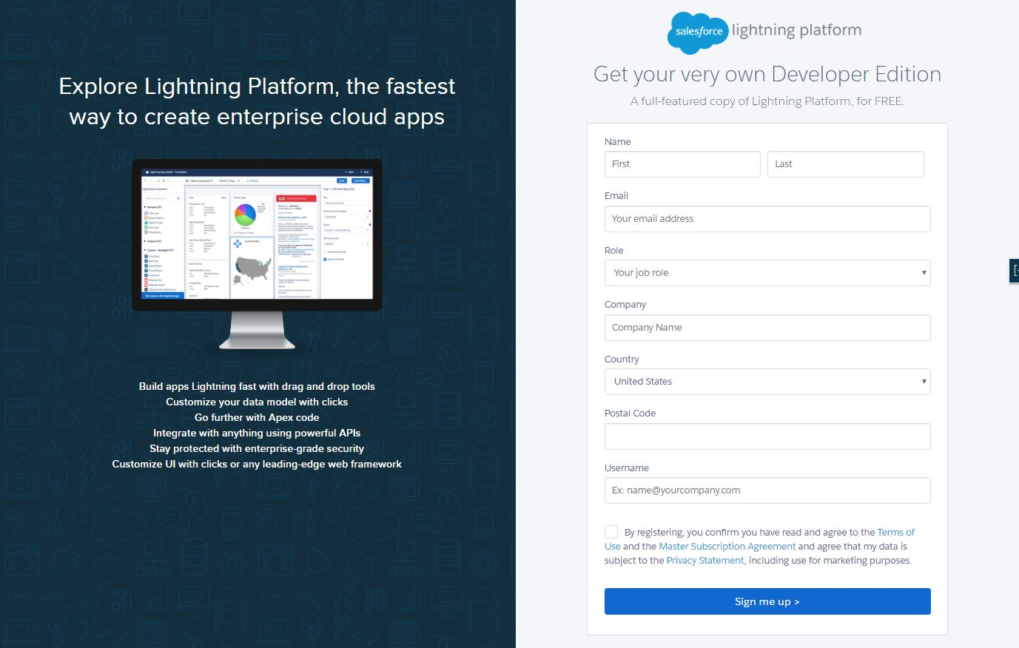
Max Labs – 1a Discussion
Getting Started
Get a Salesforce account
DO NOT get the 30-Day Free Trial Account
DO NOT use an AOL, Hotmail or Yahoo account
Do use a new Gmail account you create for this project.
Source: https://developer.salesforce.com/signup
FOX
MIS

Slide 11
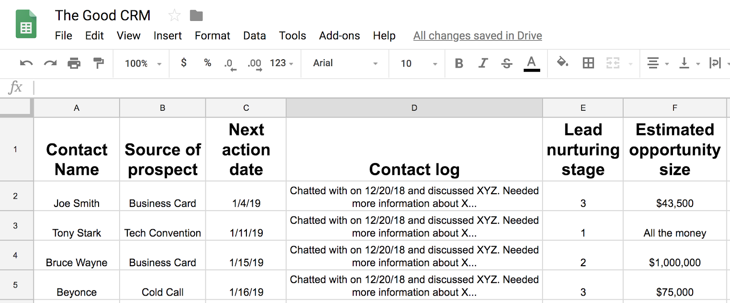
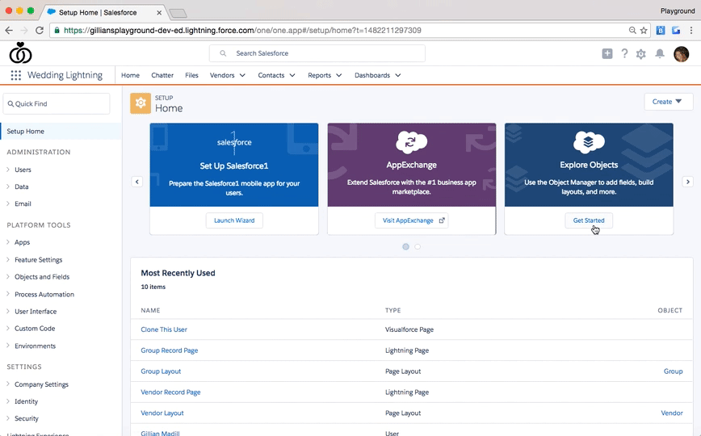
Max Labs – 1a Discussion
Determining Data Needs
What are Max’s needs for creating the “Pitch”
What data are we capturing?
What are we tracking?
How will this data be used?
Source: https://admin.salesforce.com/learn-lightning-create-edit-objects
Source: https://www.softwareadvice.com/resources/update-how-to-use-google-sheets-to-create-your-business-first-crm/
FOX
MIS

Slide 12
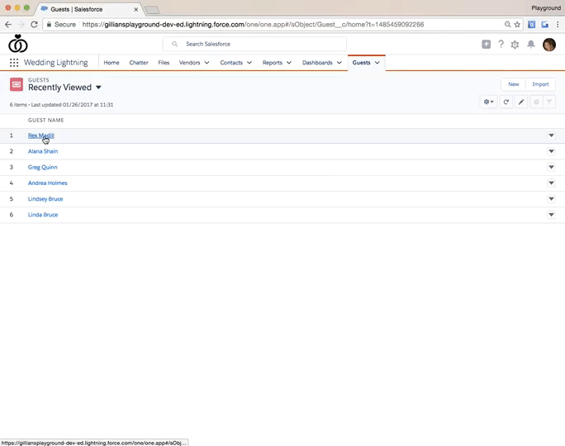
Max Labs – 1a Discussion
Page Layouts
What information do we want to show.
Why are aesthetics important?
Creating cleaner data?
Source: https://admin.salesforce.com/learn-lightning-compact-layouts
FOX
MIS

Slide 13
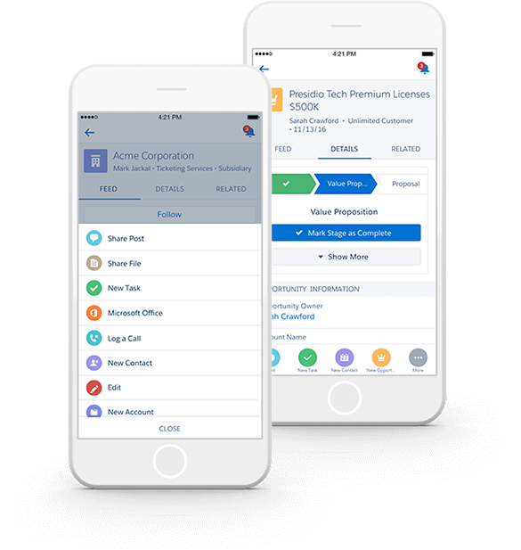
Max Labs – 1a Discussion
Mobile App
What information do we want to show.
Why are aesthetics important?
Is this an API, ERP, Both?
Source: https://www.salesforce.com/eu/learning-centre/crm/mobile-crm/
FOX
MIS

Slide 14
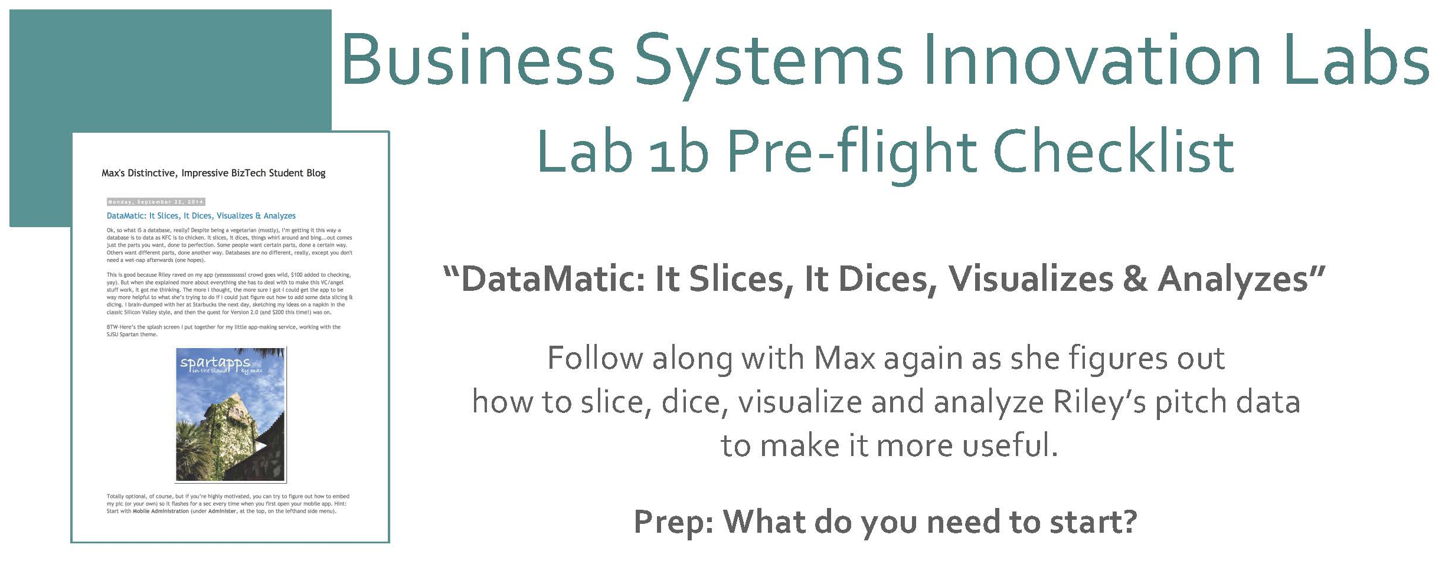
Max Labs 1b
Spring 2020
FOX
MIS

Slide 15
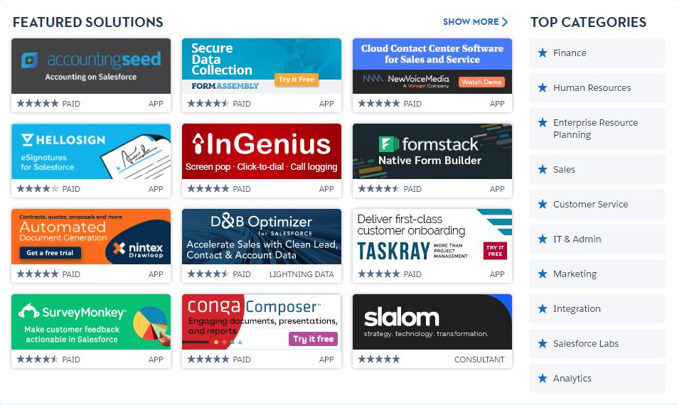
Max Labs – 1b Discussion
Digital Business Models.
Share & Communicate
Revise and Redesign
3rd Party Products (APIs)
Source: https://appexchange.salesforce.com/
FOX
MIS

Slide 16

Max Labs – 1b Discussion
$19.99
Monetize Max’s Blog
Do Not Close Your Browser
Buy Now
Click Confirmations
Install (Launch Process)
Max’s Pitch Package
Source: https://www.themaxlabsprojectshop.com/
FOX
MIS

Slide 17

Max Labs – 1b Discussion
Pitch Data File
CSV files
Organization
Viewing the Data
  Customization
Source: https://www.salesforce.com/ca/blog/2016/09/sales-search-cheat-sheet.html
FOX
MIS

Slide 18
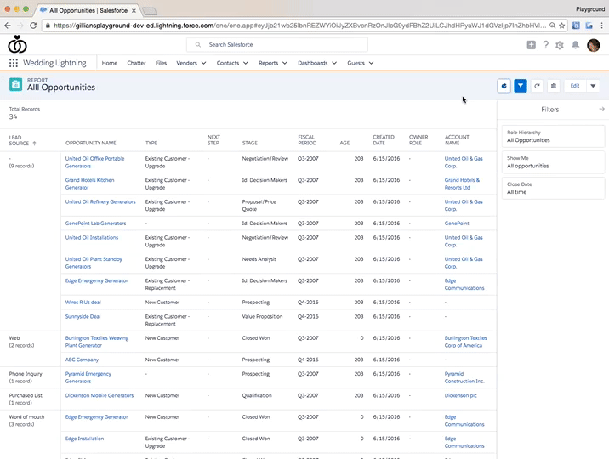
Max Labs – 1b Discussion
Generating Reports
CSV files
Organization
Viewing the Data
  Filtering
  Integration
Source: https://admin.salesforce.com/learn-lightning-create-reports
FOX
MIS

Slide 19
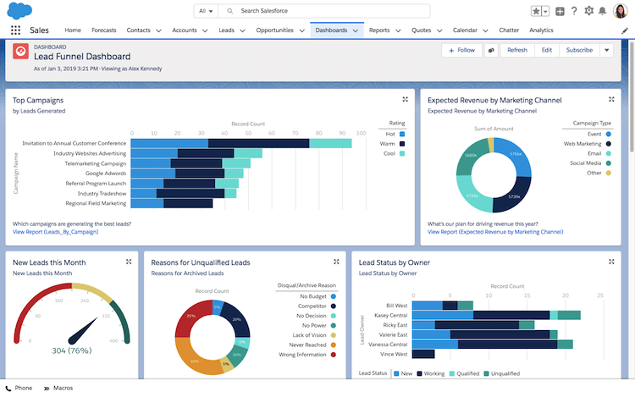
Max Labs – 1b Discussion
Dynamic Dashboards
Database
Monitoring
Collaboration
Customization
Source: https://admin.salesforce.com/learn-lightning-create-reports
FOX
MIS

Slide 20
Information Systems in Organizations
3.2 Data Modeling with
Entity Relationship Diagrams (ERD)
FOX
MIS

Slide 21
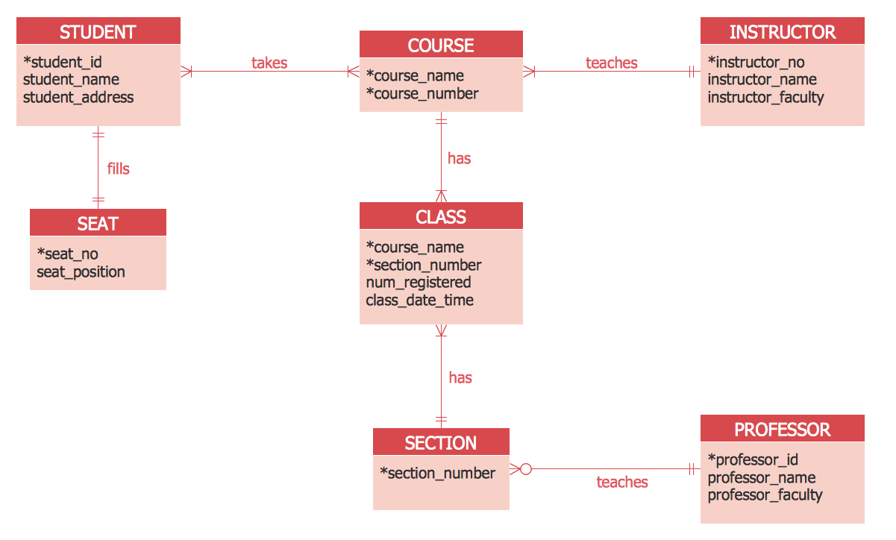
What is an “Entity Relationship Diagram”?
Data Model
Entity = Noun | Attribute = Adjective | Relationship = Verb
Source:https://www.conceptdraw.com/How-To-Guide/picture/SOFTWARE-DEVELOPMENT-ERD-Crows-Foot.png

Slide 22
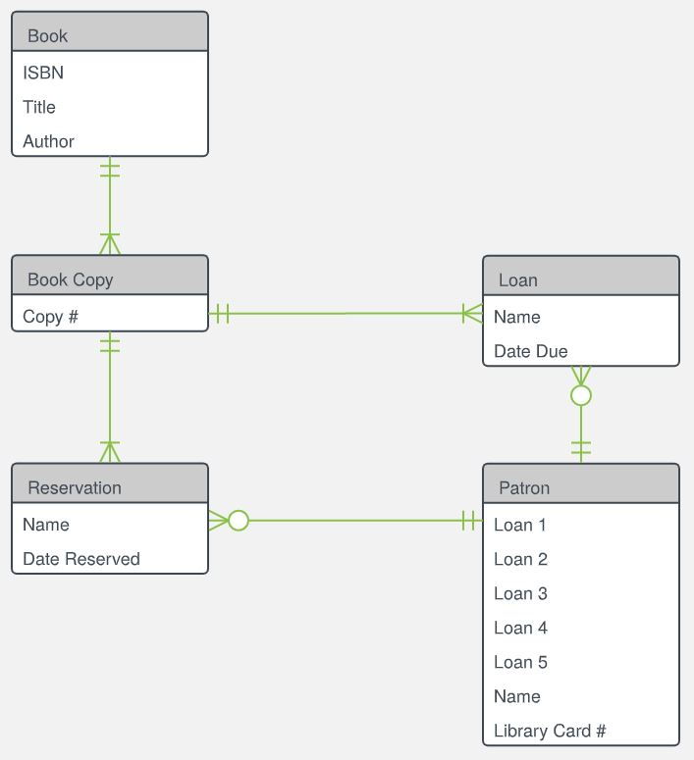
What is an Entity Relationship Diagram?
An Entity Relationship Diagram (ERD) is a visual representation of different data using conventions that describe how these data are related to each other.
Source:https://d2slcw3kip6qmk.cloudfront.net/marketing/pages/chart/examples/libraryerdiagram.svg
FOX
MIS

Slide 23
Primary ERD Symbols: Chen’s Database Notation
Entity = noun
ex: shopper, item
Attribute = adjective/characteristic
ex: item price
Relationship = verb
ex: buys
FOX
MIS

Slide 24
Translating
A shopper walks into a store to buy an item. When the shopper makes a purchase, the system is updated with information about the person, including their name, loyalty card id and zip code. The store also records which items were purchased, including details like item name, price and item source.
FOX
MIS

Slide 25
Entity Relationship Diagram
Chen’s Database Notation
FOX
MIS

Slide 26
Entity Relationship Diagram: ERD tables
Crow’s Foot Database Notation
FOX
MIS

Slide 27
Entity Relationship Diagram: recap
A shopper walks into a store to buy an item. When the shopper makes a purchase, the system is updated with information about the person, including their name, loyalty card id and zip code. The store also records which items were purchased, including details like item name, price and item source.
Chen’s Database Notation
Crow’s Foot Database Notation
FOX
MIS

Slide 28
Swim Lane Diagrams – Order to Cash (O2C)
The process starts when the customer contacts Sales to place an order. The person in Sales creates the sales order. As part of doing this, the person in sales first checks to see if the customer has enough available credit to cover the order. They do this by looking up the customer’s credit on a report that is generated by Accounting and sent to Sales every Monday morning. If the customer doesn’t have enough available credit then the person in sales notifies the customer who can then either update or cancel their order. Next the person in sales checks to see if the items being ordered are in stock. They do this by checking a report on inventory that the Warehouse created at the end of each day. If the items being ordered are not in stock then the person in Sales notifies the customer who can then update or cancel their order. If the report indicates the items are in stock then the order goes to the Warehouse where the workers there will pick the order. Since Sales is looking at a report that is only updated at the end of each day, there is a chance that they accepted an order for an item that is not really in stock. If that is the case the Warehouse notifies Sales who then notifies the customer who can update or cancel their order…
FOX
MIS

Slide 29
Swim Lane Diagrams – Order to Cash (O2C)
…Once the people in the warehouse pick the order, the people in Accounting have to make sure that the customer actually has enough credit to cover the order. Since the people in Sales use a credit report that is generated on Monday morning, there is a chance that the information on the credit report is old. If the customer doesn’t have enough available credit then Accounting notifies Sales who then notifies the customer who can then choose to update or cancel their order. If the customer has enough available credit then their available credit is reduced by the total cost of the order and the warehouse is notified and they pack and ship the order. As soon as the order is shipped the people in the warehouse notify accounting and accounting generates and sends the invoice to the customer. When the customer pays the invoice the people in Accounting increase the customer’s available credit by the amount of the payment, they post the payment and we’re done.
FOX
MIS

Slide 30
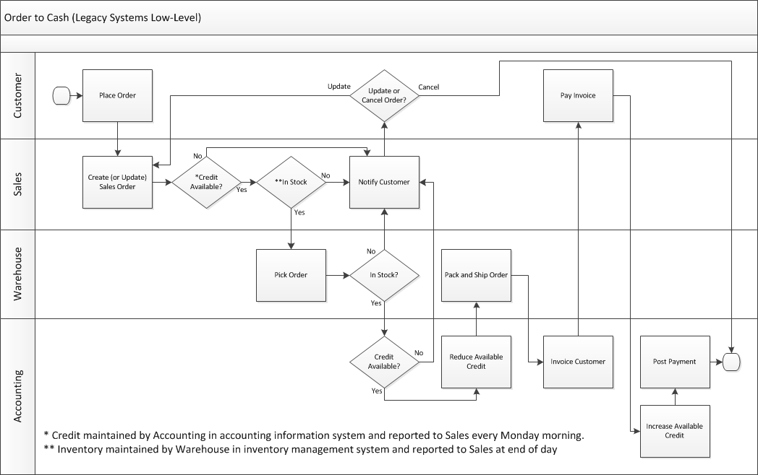
What pieces of information do I need to take, check, ship and bill the customer for this order?
FOX
MIS

Slide 31
ERD: tables
Relationship, i.e. verb is written on the arrow
Entity listed at the top of the table
Attributes are listed under the entity
Legend :
PK : Primary Key
FOX
MIS

Slide 32
Information Systems in Organizations
Entity Relationship Diagrams - 1
In-Class Activity
FOX
MIS

Slide 33
Information Systems in Organizations
Entity Relationship Diagrams - 2
In-Class Activity
FOX
MIS

Slide 34
Entity Relationship Diagrams - 2
What:
Construct a more complex entity relationship diagram from provided story
Why:
ERDs model the information required for a process
ERDs supplement swim lane diagrams and complete a bigger picture
FOX
MIS

Slide 35
Exam 1 using ProctorU
Opens Friday (3/27) at 6PM
Close Sunday (3/29) at 6PM

Slide 36

Exam Will Cover Discussions: week 1 & 2
Readings, Videos and Lectures (35%)
  What is MIS?
  Systems Analysis & Systems Architecture
  Swim Lane Diagrams
  ERD
Max Labs 1a/1b & 2a 2b (25%)
  Digital Product Management
  Concepts of Max Labs
Mini-Case – Demonstrate your ability to apply (40%)
  Swim Lane Diagram
  ERD
Source: https://ccesnews.org/opinion/2018/04/23/10-tips-for-exam-preparation/#photo
FOX
MIS
Notes:
25 questions
Readings /Videos & Lectures: 9 questions
Pre-flight & Max Labs 1a1b: 6 questions
Swim Lane/ERD : 10 questions

Slide 37
To do: Exam Prep
Practice Swim Lane (let’s review answers!)
Review slide deck “MIS 2101 Exam 1 prep”
Practice ERD (will send email)

Slide 38
More to Come
Prepare with Readings & Videos before our next class!!!

