Slide 1

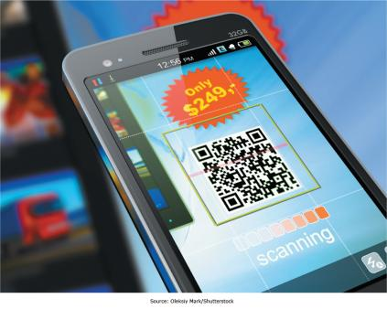

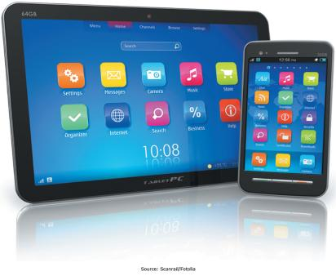
Chapter 4 - Enabling Business-to-Consumer Electronic Commerce
The Internet and World Wide Web are extremely well suited for conducting business electronically on a global basis

Slide 2
Chapter 4 Learning Objectives
After this chapter, you will be able to:
Electronic Commerce Defined
Describe electronic commerce, how it has evolved, and the strategies that companies are adopting to compete in cyberspace.
Business-to-Consumer E-Commerce and Internet Marketing
Describe the stages of business-to-consumer electronic commerce, understand the keys to successful electronic commerce applications, and explain the different forms of Internet marketing.
Mobile Commerce, Consumer-to-Consumer EC, and Consumer-to-Business EC
Describe mobile commerce, consumer-to-consumer electronic commerce, and consumer-to-business electronic commerce.
E-Government
Explain different forms of electronic government.
Managing Finances and Navigating Legal Issues in EC
Describe how to conduct financial transactions and navigate the legal issues of electronic commerce.

Slide 3
Electronic Commerce Defined
Electronic Commerce Defined
Describe electronic commerce, how it has evolved, and the strategies that companies are adopting to compete in cyberspace.
Business-to-Consumer E-Commerce and Internet Marketing
Describe the stages of business-to-consumer electronic commerce, understand the keys to successful electronic commerce applications, and explain the different forms of Internet marketing.
Mobile Commerce, Consumer-to-Consumer EC, and Consumer-to-Business EC
Describe mobile commerce, consumer-to-consumer electronic commerce, and consumer-to-business electronic commerce.
E-Government
Explain different forms of electronic government.
Managing Finances and Navigating Legal Issues in EC
Describe how to conduct financial transactions and navigate the legal issues of electronic commerce.

Slide 4
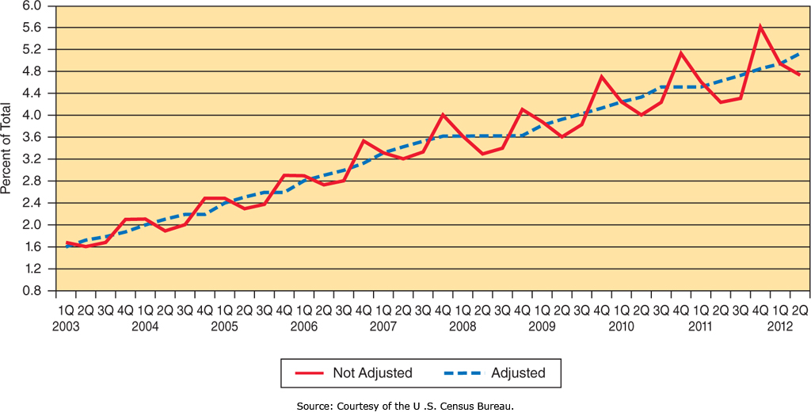
Electronic Commerce Defined
Electronic Commerce
    “the exchange of goods, services, and money among firms, between firms and their customers, and between customers, supported by communication technologies and, in particular, the Internet”
Notes:
Electronic Commerce occurs when any aspect of the transaction is facilitated by Electronic Communication Technologies.
We typically think of the Internet, which is where the vast majority of Electronic Commerce takes place.
Exchanges can involve consumer, businesses, and the government where any of these can be the buyer, the seller, or both.

Slide 5
Electronic Commerce Defined:
Types of Electronic Commerce (EC)
Type of EC | Description
Business-to-consumer (B2C) | Transactions between businesses and their customers
Business-to-business (B2B) | Transactions among businesses
Consumer-to-business (C2B) | Transactions between customers and businesses
Consumer-to-consumer (C2C) | Transactions between people not necessarily working together
Government-to-citizen (G2C) | Transactions between a government and its citizens
Government-to-business (G2B) | Transactions between a government and businesses
Government-to-government (G2G) | Transactions among governments
Notes:
There are many types of Electronic Commerce, based on who is interacting or selling to whom.
Business to Consumer is Businesses selling to Consumers; Consumer to Business is Consumers selling to Businesses.

Slide 6
Internet and World Wide Web Capabilities:
Dissemination, Integration, Customization
Information Dissemination
  Products and services can be marketed over vast distances
Integration
  Web sites can be linked to corporate databases to provide real-time access to current and/or personalized information
Mass Customization
  Firms can tailor their products and services to meet a customer’s particular needs
Notes:
The World Wide Web allows for information to be readily disseminated to anyone visiting a Web site, which allows products to be marketed on a global basis.
As companies become more sophisticated, they may link databases containing information such as product specifications to their Web site, allowing customers and potential customers to call up details at the click of a mouse.
Companies can even set up Web sites that allow customers to not only order products, but also specify individual customizations to them.

Slide 7
Internet and World Wide Web Capabilities:
Communication, Transactional, Disintermediation
Interactive Communication
  Companies can communicate with customers, improving their image of responsiveness
Transaction Support
  Clients and businesses can conduct business online without human support
Disintermediation
  Cutting out the “middleman” and reaching customers more directly and efficiently
Notes:
The World Wide Web also supports interactive communication, transactions, and bypassing the middleman. Companies can do online chat sessions with customers who need more information, and then the customer can complete the order online.
Disintermediation is where companies who have typically sold through distributors and or retailers now sell direct to end users, eliminating some of the expenses that the distributors and retailers have and impose on the distribution channel.

Slide 8
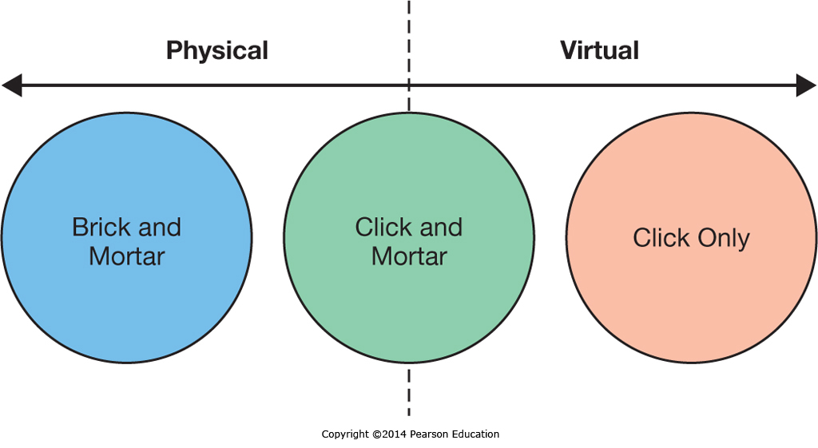
EC Business Strategies
Notes:
Companies can ignore E-Commerce and just sell through physical outlets, can be virtual companies that only sell through online store fronts, or can combine them using a “Click and Mortar” approach that allows both online transactions and physical store sales.
The physical, store-only company has a limited product reach as well as limited sales and support hours.
The online company can sell anywhere in the world 24/7, but customers must wait for their product to be shipped and some products require physical inspection and testing to verify suitability.
Click-and-Mortar stores often combine the best of both worlds, but retailers must overcome the pricing differences inherent between online and physical locations as well as the complexity of two sales channels.

Slide 9
EC Business Strategies:
Revenue Models
Revenue Type | Description | Who is Doing This?
Affiliate marketing | Paying businesses that bring or refer customers to another business | Amazon.com’s Associates program
Subscription | Users pay a monthly or yearly recurring fee for the product/service | Netflix.com, World of Warcraft
Licensing | Users pay a fee for using protected intellectual property | Symantec, Norton
Transaction fees/Brokerage | A commission is paid to the business for aiding in the transaction | PayPal.com, eBay.com, Groupon.com
Traditional sales | A consumer buys a product/service from the Web site | Nordstrom.com, iTunes.com
Web advertising | A free service/product is supported by advertising on the Web site | Facebook.com, Answers.com
Notes:
There are many ways E-Commerce can be monetized outside of simple sales transactions. Some companies work strictly as referrals companies, receiving affiliate marketing fees.
Subscription fees allow access or use for a limited time period.
Licensing transfers the right to use, but not ownership.
Transaction fees are based on aiding a transaction between two parties.
Web advertising leverages the users visiting a site to derive advertising revenue.

Slide 10
Business-to-Consumer E-Commerce and Internet Marketing
Electronic Commerce Defined
Describe electronic commerce, how it has evolved, and the strategies that companies are adopting to compete in cyberspace.
Business-to-Consumer E-Commerce and Internet Marketing
Describe the stages of business-to-consumer electronic commerce, understand the keys to successful electronic commerce applications, and explain the different forms of Internet marketing.
Mobile Commerce, Consumer-to-Consumer EC, and Consumer-to-Business EC
Describe mobile commerce, consumer-to-consumer electronic commerce, and consumer-to-business electronic commerce.
E-Government
Explain different forms of electronic government.
Managing Finances and Navigating Legal Issues in EC
Describe how to conduct financial transactions and navigate the legal issues of electronic commerce.

Slide 11
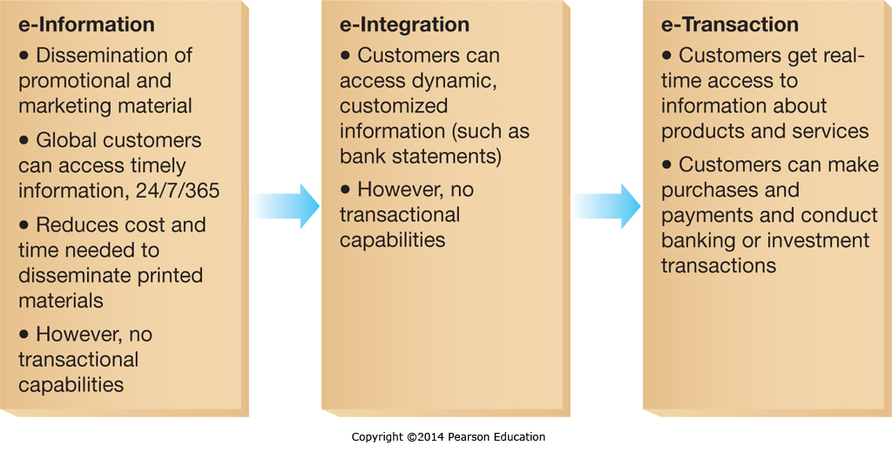
Stages of B2C EC
Notes:
As businesses become more comfortable with and versed in Electronic Commerce they progress from simple, static informational Web sites to more sophisticated sites that can support customized information retrieval and/or perform transaction processing.

Slide 12
E-Tailing: Selling Goods and Services in the Digital World
Companies utilizing E-Tailing have unique benefits
  Product Benefits: With no store size and shelf space restrictions, companies can sell a far wider variety of goods.
  Place Benefits: Internet storefronts are available on almost every computer connected to the Internet.
  Price Benefits: The efficiency of online retailers, with high volumes and low overhead allow for very competitive pricing.
Notes:
When companies are selling online, they can take advantage of the elimination of the Retail Market space, selling a much wider variety of products, targeting unique market segments on a global basis, and undercutting competitors pricing.

Slide 13
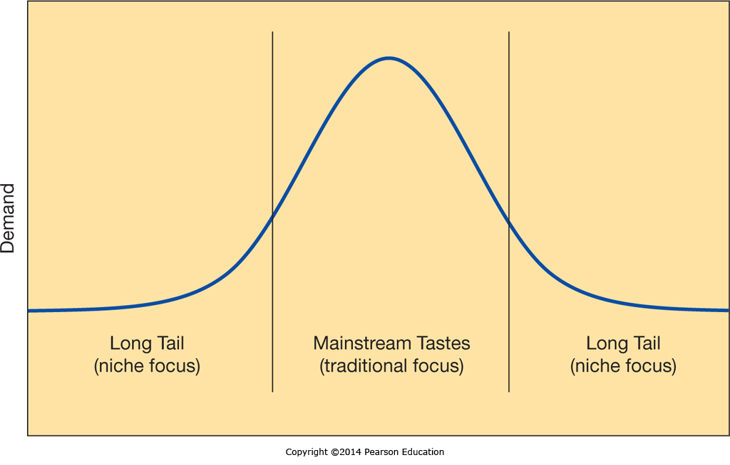
E-Tailing: Selling Goods and Services in the Digital World: The Long Tail
Notes:
Online retailers can cater to “The Long Tail”, or niche markets in addition to (or instead of) purely selling mainstream products.
While customers with unusual wants or needs may not be able to support a local storefront, there are often enough individuals in larger geographic regions to support an online merchant.

Slide 14
EC Web Sites: Attracting and Retaining Online Customers – 4 Key Recommendations
The Web site should offer something unique
The Web site must motivate people to visit, to stay, and to return
You must advertise your presence on the Web
You should learn from your Web site
Notes:
Online customers have many choices, but if you can provide customers with something they can find nowhere else, then they will have to come to you to get that benefit.
You can compete for customers on price, but if you also offer them service, support, community, or other benefits you can build a relationship to draw customers to you instead.
Customers have to find you to buy from you.
If you have features on your Web site that are prompting customers to buy, or to leave, you should know what they are. By tracking how customers navigate through your site you can learn what is working and what isn’t, and make adjustments accordingly.

Slide 15
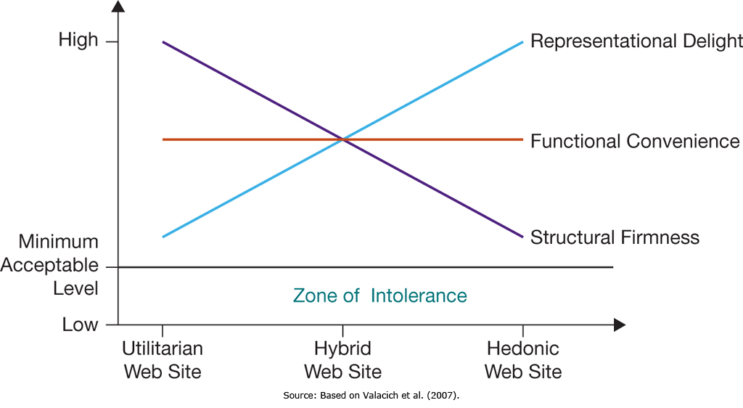
EC Web Sites: Attracting and Retaining Online Customers
Notes:
Consumers need Web sites to meet their basic needs, which vary depending on why they are using the site.
If a site can’t reliably process transactions, is difficult to use, and is off-putting in it’s design, consumers are unlikely to use it.

Slide 16
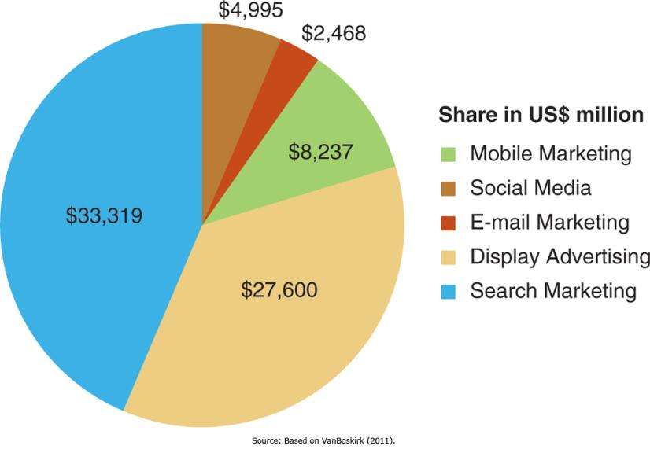
Internet Marketing
If you build it, they won’t come unless you market it
Search Engine Optimization (SEO) can be critical to your Web site’s success

Slide 17
Internet Marketing Methods
Search Marketing | Includes Paid Search, Placing Ads on search Web sites based on Search Terms, and Search Engine Optimization (SEO), optimizing your Web site and it’s relative search engine ranking
Display Ads | Simple banner ads, but now often contextualized to what the person is viewing
E-mail Marketing | Extremely low cost, less than a penny an email, and hence very popular; Effectiveness also easy to track
Social Media | Increasingly used for interactive communication and relationship building with customers
Mobile Marketing | If ads can be tailored to a users location then highly targeted marketing opportunities open up
Pricing Models & Click Fraud | Impression, Pay-per-Click/Click Through, and Conversion models
Notes:
Advertisers continually look for ways to deliver targeted information at the time and place where it will be most likely to stimulate a purchase or build a relationship increasing the lifetime value of the customer base. Internet marketing is no exception, and these approaches all seek to address these needs.
As with many aspects of business, there is a potential for fraud in advertising if aspects of the transaction can’t be monitored, and click fraud by the ad seller trying to drive up revenue or a competitor (or disgruntled employee) trying to drive up business costs can readily occur.

Slide 18
Mobile Commerce, Consumer-to-Consumer EC, and Consumer-to-Business EC
Electronic Commerce Defined
Describe electronic commerce, how it has evolved, and the strategies that companies are adopting to compete in cyberspace.
Business-to-Consumer E-Commerce and Internet Marketing
Describe the stages of business-to-consumer electronic commerce, understand the keys to successful electronic commerce applications, and explain the different forms of Internet marketing.
Mobile Commerce, Consumer-to-Consumer EC, and Consumer-to-Business EC
Describe mobile commerce, consumer-to-consumer electronic commerce, and consumer-to-business electronic commerce.
E-Government
Explain different forms of electronic government.
Managing Finances and Navigating Legal Issues in EC
Describe how to conduct financial transactions and navigate the legal issues of electronic commerce.

Slide 19
Mobile EC
Location-Based M-Commerce
  Services can be offered tailored to a person’s needs based on their current location
Information on the Go
  Customers can get further information about a product wherever they are, including in the store, but this can lead to “showrooming”
Product and Content Sales
  Consumers use mobile apps to make purchases while on-the-go
Notes:
Mobile E-Commerce is an emerging field that is still finding it’s place.
The promise of Mobile E-Commerce includes location-based services.
Customers can also look up additional information in a store about it’s products, but this sometimes leads to comparison shopping with online retailers.
Finally, mobile apps now allow consumers to make purchases wherever they are.

Slide 20
C2C EC
E-Auctions
  Consumers can sell items, including rare and unusual items, at online auctions where competition can result in a fair price even if the seller isn’t sure what a fair price is
  Businesses participate in reverse auctions to compete for the right to make a sale
Online Classifieds
  Typically local in nature, these have flourished in recent years
Notes:
Consumer-to-Consumer E-Commerce allows consumers to achieve a fair price for goods which they otherwise might not be able to achieve.
E-Auctions allow consumers to sell rare and unusual items to a world market.
Online Classifieds allow consumers to sell and search for products locally, reaching a wider audience but still facilitating what is often a local face-to-face transaction.

Slide 21
C2B EC
Relatively new, this is where consumers can sell relatively small pieces of work (e.g.: photos) or services to businesses
It might be argued that anyone who made a living doing this is actually in business for themselves, and technically isn’t a consumer anymore
Notes:
A relatively new phenomenon is C2B E-Commerce. This involves consumers selling what is typically small slices of work to businesses.
A good example might be businesses that buy photos from Amateur photographers to sell online to interested parties. Each photo is a small piece of work, but when they sell the photographer gets a small commission.

Slide 22
Managing Finances and Navigating Legal Issues in EC
Electronic Commerce Defined
Describe electronic commerce, how it has evolved, and the strategies that companies are adopting to compete in cyberspace.
Business-to-Consumer E-Commerce and Internet Marketing
Describe the stages of business-to-consumer electronic commerce, understand the keys to successful electronic commerce applications, and explain the different forms of Internet marketing.
Mobile Commerce, Consumer-to-Consumer EC, and Consumer-to-Business EC
Describe mobile commerce, consumer-to-consumer electronic commerce, and consumer-to-business electronic commerce.
E-Government
Explain different forms of electronic government.
Managing Finances and Navigating Legal Issues in EC
Describe how to conduct financial transactions and navigate the legal issues of electronic commerce.

Slide 23
E-Banking
Online Banking
  Convenience
  Security Concerns
  Mobile banking
Online Investing
  Increased access to financial information and analytical tools
  Online investing
  Mobile investing
Notes:
Online banking has become widely accepted, although many people are still worried about the security aspect.
An emerging trend is mobile banking apps allowing anytime, anywhere banking.
Online investing has also taken off, with a variety of sites offering financial information, investment advice, and online brokerage accounts.

Slide 24
Securing Payments in the Digital World
Credit and Debit Cards
  Credit Cards are a simple mechanism
  Consumers have to transfer a lot of personal information to the seller
Managing Risk
  Businesses are financially liable for fraudulent transactions
  Businesses have to look for fraud indicators and sometimes reject risky transactions
Notes:
Online payments are readily made using credit cards, which offer consumers some protection against fraud by the seller, who typically still requires a significant amount of personal information to complete the sale.
At the same time, the merchant is at significant risk of fraud from buyers, and unlike “card-present” sales in traditional stores, when a sale is made online the merchant is financially liable if the sale is fraudulent.
Merchants now employ additional safeguards to flag and reject sales that have warning signs indicating they may not be legitimate.

Slide 25
Legal Issues in EC
Taxation
  Sales Taxes
Digital Rights Management
  Preventing unauthorized duplication
  Restrict which devices can play media
  Limit number of times media can be played
Notes:
Sales taxes have historically not been levied on companies selling to consumers in different states.
EC both reduces state sales tax revenues and makes local business less competitive as compared to out-of-state online retailers.
Digital Rights Management, or DRM, includes practices to limit the copying and distribution of digital goods to paying customers.

Slide 26
E-Government
Electronic Commerce Defined
Describe electronic commerce, how it has evolved, and the strategies that companies are adopting to compete in cyberspace.
Business-to-Consumer E-Commerce and Internet Marketing
Describe the stages of business-to-consumer electronic commerce, understand the keys to successful electronic commerce applications, and explain the different forms of Internet marketing.
Mobile Commerce, Consumer-to-Consumer EC, and Consumer-to-Business EC
Describe mobile commerce, consumer-to-consumer electronic commerce, and consumer-to-business electronic commerce.
E-Government
Explain different forms of electronic government.
Managing Finances and Navigating Legal Issues in EC
Describe how to conduct financial transactions and navigate the legal issues of electronic commerce.

Slide 27
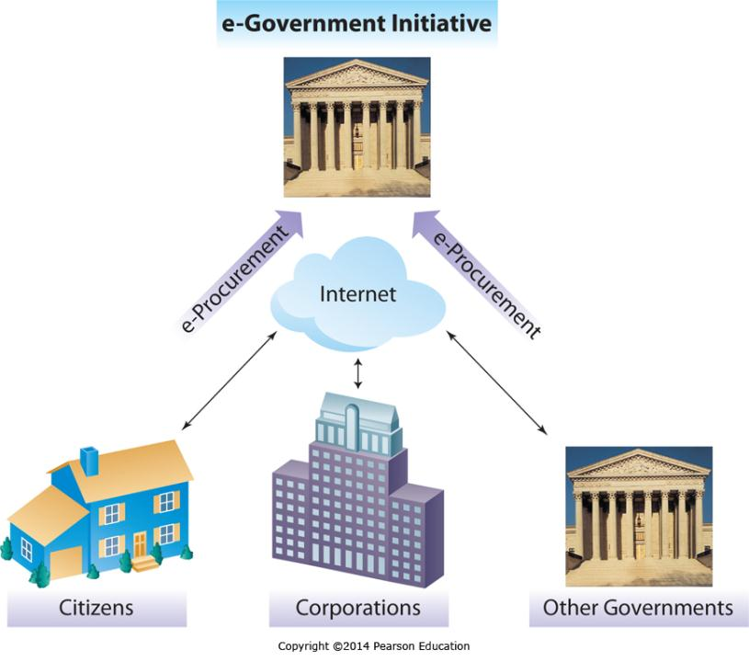
E-Government
Government-to-Citizens
Government-to-Business
Government-to-Government
Notes:
Governments use e-Government to increase efficiency and effectiveness much like businesses do.
By reducing paperwork and allowing for the electronic dissemination of information and the automated processing of transactions, governments can significantly reduce operating costs while increasing services.
Examples of this might include the electronic filing of income tax returns, the online filing of business license applications, or the ability to share data electronically between different law enforcement agencies.

Slide 28
End of Chapter Content

Slide 29
Managing in the Digital World:
Taobao and the World of e-Commerce
Taobao is the largest digital marketplace in China
  By 2011 more registered users (370 million) than the population of the United States
  Online marketplace for multiple companies
  Online consumer-to-consumer sales, much like eBay
  Notorious for piracy and counterfeit goods
360buy new fast growing competitor
  Not on the list of notorious markets
Sales in China pose huge logistics headaches
  Widely varying population densities
  No ‘overnight shipping’ infrastructure

Slide 30
Brief Case: Catchafire—Fueling “Volunteer-to-Charity” e-Commerce
Many people want to donate time / service as well as or instead of money
Matching people and charities is difficult
Catchafire is an online platform to bridge this gap
Potential volunteers can “shop” for a good fit

Slide 31
Ethical Dilemma:
The Ethics of Reputation Management
Online reviews can be critical to a customers buying decision
Biased and fake reviews can affect a businesses profitability, or even survival
Owners are tempted to post fake positive reviews
Competitors are tempted to post fake negative reviews
Reputation Management can help offset negative biased reviews, but poses ethical dilemmas

Slide 32
Key Players: Behind the Online Storefront: How e-Commerce Giants Help Small Businesses Flourish
Starting an online business can be complex
  Commercial giants such as eBay and Amazon allow small retailers to sell through their sites
  Large hosting companies such as GoDaddy provide hosting and online shopping carts
  Payment services such as Intuit and PayPal offer credit card services
  Fulfillment centers, such as Amazon, handle packaging and shipping individual orders
These simplify small business implementations

Slide 33
When Things Go Wrong:
Rigging Search Results
Sites often try to raise their search profile
Many sites use techniques Google considers ‘cheating’
When Google discovers a site cheating, they demote them or remove them from the search results altogether
There is a constant struggle between search engines trying to provide accurate results and sites seeking to skew results in their favor

Slide 34
Coming Attractions:
Smartphones of the Future
Upcoming smartphone technologies are a closely guarded secret
However, some suppliers have announced new developments
  Tactus Technology has developed a layer for a screen that can make shapes rise, so a virtual keyboard would have bumps with the keys
  Near-field communication allows devices to exchange information with a tap

Slide 35
Who’s Going Mobile:
Mobile Payments
Electronic payment technologies can now eliminate the need for cash and checks
Emerging technologies use near field communication or on-screen barcodes to allow payment by phone
In Kenya subscribers can use M-Pesa to pay via text message
Security concerns remain, as there is a record of every transaction

Slide 36
Industry Analysis:
Retailing
Retailing has embraced new technologies
  Bar code scanning for price, inventory management, self-checkout
  RFID functions like a barcode but uses wireless technologies, and can be integrated with other information technologies
  New forms of electronic payment, whether by pin, phone barcode, near-field communication technologies, or fingerprint are gaining traction

Slide 37
