Slide 1
Chapter 5 - Enhancing Organizational Communication and Collaboration Using Social Media
Social media provides new opportunities, and threats, for today’s organizations

Slide 2
Chapter 5 Learning Objectives
The Need for Communication and Collaboration
Explain organizations’ needs for communication and collaboration.
The Evolving Web
Explain social media and Enterprise 2.0.
Traditional Collaboration Tools
Describe traditional technologies used to support communication and collaboration.
Managing the Enterprise 2.0 Strategy
Describe how companies can manage their Enterprise 2.0 strategy and deal with potential pitfalls associated with social media.
Social Media and the Enterprise
Describe various social media applications, and explain their role in enhancing communication, collaboration, cooperation, and connection.
Notes:
This chapter focuses on social media in and around the context of the business organization.

Slide 3
Virtual Teams
Notes:
Organizations typically strive to put together the right members of a team or task force to solve challenging business problems regardless of where they are located geographically within the organization.
When team members are located at different physical locations, they are a “Virtual Team”.
Virtual teams face the challenge of communicating and collaborating at a distance, and use modern technologies such as teleconferencing and online Web technologies to interact and share documents and information.

Slide 4
Evolving Social Interaction
Web 2.0 Technologies change how people interact and enable Social Media
Online information at our fingertips
Personal expression available 24/7
Individuals often post very private information
About themselves
About others
Without thinking about the consequences
Notes:
Now that users can readily share information as well as consume it, social media has changed dramatically to take advantage of these capabilities.
Users now have information, and the ability to express their opinion on it, at their fingertips literally 24/7.
This has led to an explosion in the sharing of personal information, sometimes very private, and often without taking into account the consequences.

Slide 5
Evolving Collaboration through Collective Intelligence: Shifting Perspectives
Web 1.0 | Web 2.0
Me | Me and you
Read | Read and write
Connect ideas | Connect ideas and people
Search | Receive and give recommendations to friends and others
Find | Share
Techies rule | Users rule
Organizations | Individuals
Notes:
As we transition from the Web 1.0 model to the interactive Web 2.0 model, the Web experience changes to become both more individual and more interactive.
In this table we can see specific examples of this evolution, such as the transition from just reading information to also writing.

Slide 6
The Evolving Workspace
A generation of social media users
Different workplace expectations
Portfolio careers, not cradle-to-grave
State-of-the-art technology valued
55% use Instant Messaging as a work tool
Notes:
The current generation of workers grew up in an internet enabled world and expect an internet enabled workplace.
They expect to have multiple jobs with multiple companies throughout their life and value a workplace where they can leverage modern technologies versus being banned form utilizing and accessing them.

Slide 7
Future Web Capabilities
The Semantic Web
Machine readable Web pages
Enhanced search results
Web 3.0, or ‘What comes next?’
Mobility?
The contextual Web?
Enterprise 2.0
Leverage social media for Enterprise objectives
Notes:
Innovation continues to abound and future Web technologies may go in may different directions.
The Semantic Web is an effort to make the abundance of Web pages readable by machines as well as people so they can process them more accurately and greatly enhance our ability to search for and find information.
While no one knows what Web 3.0 will entail, some speculate it will revolve around mobility and mobile computing while others believe it will entail contextual filtering, so users will see information based on what they are doing, where they are, what time it is, or a combination thereof.
Even as we race towards Web 3.0, enterprises seek to leverage social media within their boundaries and with their customers to become social enterprises.

Slide 8
Traditional Collaboration Tools
The Need for Communication and Collaboration
Explain organizations’ needs for communication and collaboration.
The Evolving Web
Explain social media and Enterprise 2.0.
Traditional Collaboration Tools
Describe traditional technologies used to support communication and collaboration.
Managing the Enterprise 2.0 Strategy
Describe how companies can manage their Enterprise 2.0 strategy and deal with potential pitfalls associated with social media.
Social Media and the Enterprise
Describe various social media applications, and explain their role in enhancing communication, collaboration, cooperation, and connection.

Slide 9
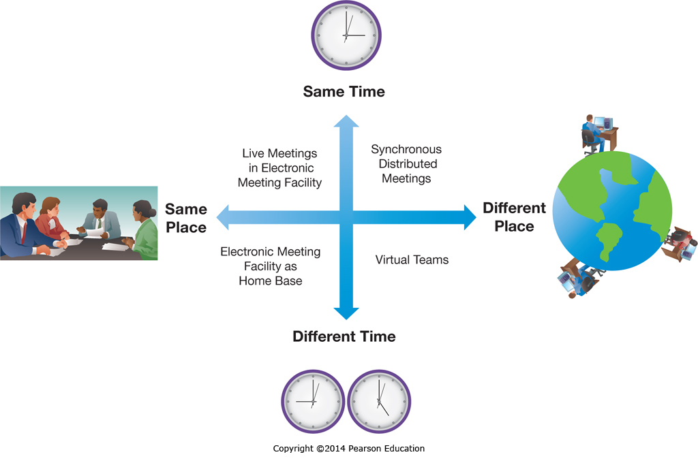
Groupware
Notes:
Groupware can be divided into synchronous and asynchronous tools, as well as into tools that enhance working at the same location or across different locations.
Synchronous means at the same time, such as when two people are talking on the telephone.
Asynchronous means disconnected in time, such as when someone reads an email a day after it was sent.

Slide 10
Groupware: Benefits
Benefit | Example
Process structuring | Keeps the group on track and helps it avoid costly diversions
Parallelism | Enables many people to speak and listen at the same time
Group size | Enables larger groups to participate
Group memory | Automatically records member ideas, comments, and votes
Access to external information | Can easily incorporate external electronic data and files
Spanning time and space | Enables members to collaborate from different places at different times
Anonymity | Members can discuss controversial or sensitive topics without fear of identification or retribution
Notes:
There are many benefits to using Groupware, including those that involve letting participants from multiple locations participate.
Some of the less obvious benefits include the facilitation benefits that allow larger groups to still work effectively and stay on track.
Some groupware processes also allow parallel processing, where multiple individuals can contribute at the same time, and contributor anonymity, where critical concerns or new ideas can surface without fear of ridicule or reprisal.

Slide 11
Videoconferencing
Desktop Videoconferencing
Simple & low cost
Internet based
Dedicated Videoconferencing
Organizational conference rooms
Multiple people and/or locations
Highly realistic/excellent video and audio quality
Can be extremely expensive, up to $500k
Notes:
Videoconferencing is a simple solution to the problem of people needing to talk who are in different locations.
Desktop videoconferencing solutions are both low cost and functional, but only support one individual at each site.
Dedicated videoconferencing rooms support larger groups meeting in real time as if in the same room. They have excellent audio and video quality, and can eliminate the need for groups to travel, but can cost up to $500k per dedicated installation.

Slide 12
Intranets and Employee Portals
Real-Time Access to Information
Updated information instantly available throughout the organization
Enterprise Search
Company focused, including corporate databases
Collaboration
Document sharing and co-editing
Employee Portals
Employee benefits self-service
Notes:
Companies create Intranets to share documents and information within the organization.
Employee portals are often set up so employees can access self-service benefits.

Slide 13
Social Media and the Enterprise
The Need for Communication and Collaboration
Explain organizations’ needs for communication and collaboration.
The Evolving Web
Explain social media and Enterprise 2.0.
Traditional Collaboration Tools
Describe traditional technologies used to support communication and collaboration.
Managing the Enterprise 2.0 Strategy
Describe how companies can manage their Enterprise 2.0 strategy and deal with potential pitfalls associated with social media.
Social Media and the Enterprise
Describe various social media applications, and explain their role in enhancing communication, collaboration, cooperation, and connection.

Slide 14
Enhancing Communication Using Social Media
Blogs
Topical blogs of interest to customers
Microblogging Tools
Post news to customers
Instant Messaging
Within the Company
With customers
Virtual Worlds
Product showcases
Notes:
Companies can enhance their communication through the effective use of social media.
Depending on the objectives, many different tools can be implemented.
For example, a company may have experts write blogs on topics that customers find interesting and would like to know more about.

Slide 15
Social Media Jobs!
Social Media Coordinator/Strategist
$61,000
SEO Specialist
$69,000
Online Community Manager
$59,000
Blogger
$43,000
http://jobs.aol.com/articles/2014/01/13/6-social-media-jobs-that-will-be-big-in-2014/
Notes:
Companies can enhance their communication through the effective use of social media.
Depending on the objectives, many different tools can be implemented.
For example, a company may have experts write blogs on topics that customers find interesting and would like to know more about.

Slide 16
Enhancing Cooperation with Social Media
Media Sharing
Social Bookmarking
Social Cataloging
Tagging
Geotagging
Notes:
Cooperation between users can be increased through the use of cooperative tools, where everybody gets to take advantage of each users contributions.
This can include cooperative efforts to find, tag, bookmark, or catalog Web content. This builds a repository of useful information references that can be accessed by other participants, who are also contributing to the pool for the greater good.

Slide 17
Enhancing Collaboration with Social Media
Cloud-Based Collaboration Tools
Content Management Systems
Learning Management Systems
Peer Production
Wikis
Human-Based Computing (Crowdsourcing)
Notes:
Collaboration can also benefit from social media. There are multiple different ways people can work together, and collaboration tools facilitate that process.
Content management systems allow multiple users to coordinate working on documents, without accidently overwriting or deleting each others work, and often saving multiple prior versions in case the need to access them arises.
Peer Production systems like wikis are similar to content management systems in that they include version control, but typically include additional functionality such as document editing and linking functionality.
Crowdsourcing is where businesses allow individuals to come and participate in meeting their needs or functions, often through an online portal.

Slide 18
Crowdsourcing
Notes:
Crowdsourcing takes advantage of individuals from all over the world sharing their knowledge, expertise, or resources.
Sometimes this can be done at a fraction of the cost of normal businesses, such as when amateur photographers share their photos online for a small fee.

Slide 19
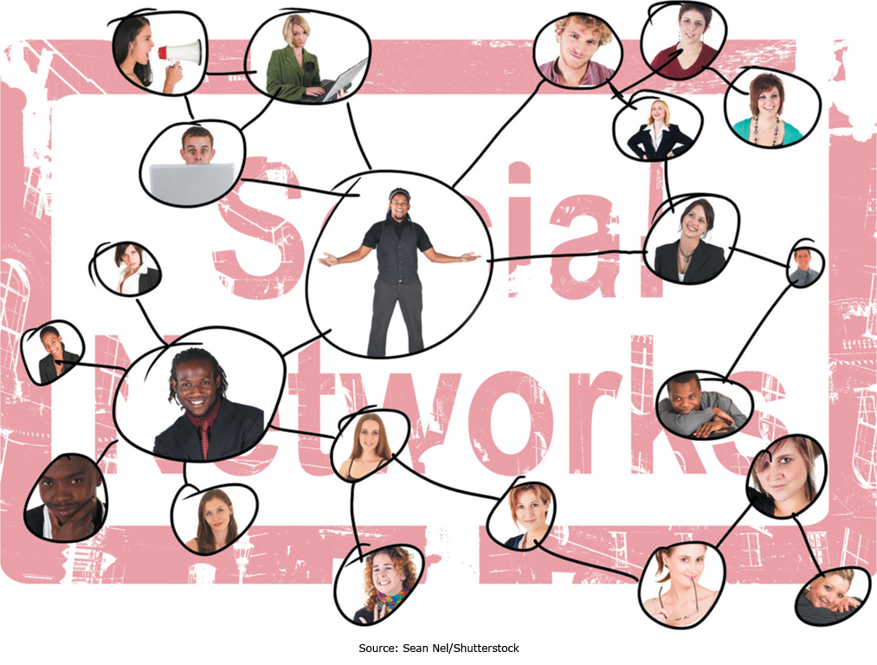
Enhancing Connection with Social Media
Notes:
Social networks allow individuals to meet and collaborate online, drawing together individuals with specific interests and giving them a communications platform.

Slide 20
Enhancing Connection with Social Media
Social Networking
Social Search
Viral Marketing
Notes:
Social networking involves letting people communicate and network online, but social search takes that one step further.
With Google’s +1 button, users are effectively recommending a search result to others in their social circles, which Google can take into account when presenting search results. Social search in general tries to take into account content from social networking sites.
Viral marketing is based on users promoting content they find interesting or engaging to their friends, in effect, users are “infecting” other users. This can be a very powerful and effective marketing strategy.

Slide 21
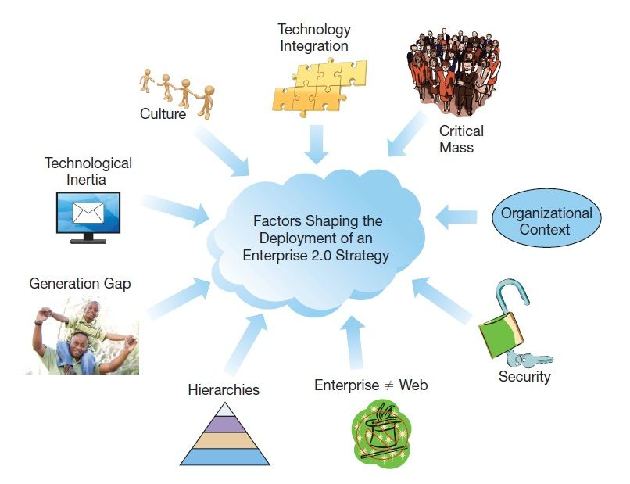
Organizational Issues
Notes:
The Enterprise is not like the Web, and what dictates Internet success doesn’t necessarily translate directly to Enterprise 2.0 success.
Corporate culture plays a critical role, as does corporate context.
When corporations have an open culture based on sharing then employees will be more supportive of initiatives requiring sharing.
The Web 2.0 tool deployed should be tailored to the organizational context, for example wikis and blogs fulfill different needs.
Focused departmental initiatives can be more readily successful than enterprise wide initiatives, which typically require cultural changes and senior management championship.
Not everyone will participate in contributing content, so there needs to be enough support from those who will contribute to achieve critical mass.
Employees unused to Web 2.0 technologies may be slow to adopt them or learn them unless they see tangible benefits.
Once deployed, these applications need to be integrated into the overarching technological framework and have appropriate security controls just like any other enterprise application.

Slide 22
Pitfalls of Web 2.0 Marketing
Online Product Reviews
Negative reviews from competitors
Companies paying for positive reviews
Microblogging
Easy to “cross a line” and offend
Negative publicity can come quickly
Social Networks
Fine line between maintaining control and offending customers
Individuals sharing too much personal information
Notes:
Web 2.0 provides many opportunities, but also poses many threats to organizations.
Not all competitors are scrupulous and it is easy for companies to post negative reviews of competitors or arrange for positive reviews of themselves.
Even activities under a companies control, such as its Twitter account or social network site, can pose a risk as it is easy to release a tweet or exert controls that customers find offensive and overbearing.

Slide 23
More Pitfalls of Web 2.0 Marketing
Bad Vibes going Viral
Negative publicity can spread like wildfire
Videos can easily go viral
Lessons Learned
News travels fast
Have a crisis team and a plan
Prepare for your worst social media nightmare
Monitor the environment
Respond within 24 hours
Notes:
Once negative information is online about a company, it can easily go viral and spiral out of control.
This is particularly true of videos and other engaging content that can easily be shared through a link.
Companies should be prepared for this type of negative publicity, continuously monitoring the social environment and ready to respond within 24 hours with a suitable crisis team and management plan.

