Slide 1
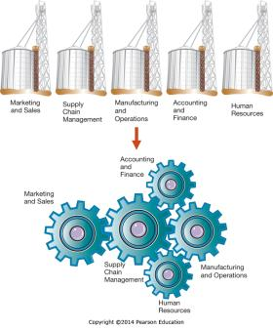
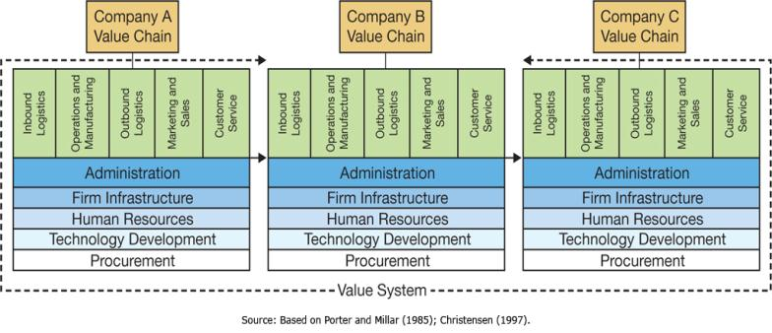
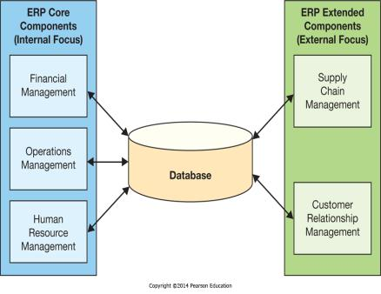
Chapter 7 - Enhancing Business Processes Using Enterprise Information Systems
Enterprise systems integrate business activities across the organization and with business partners

Slide 2
Chapter 7 Learning Objectives
Core Business Processes and Organizational Value Chains
Explain core business processes that are common in organizations.
Enterprise Systems
Describe what enterprise systems are and how they have evolved.
Enterprise Resource Planning
Describe enterprise resource planning systems and how they help to improve internal business processes.
The Formula for Enterprise System Success
Understand and utilize the keys to successfully implementing enterprise systems.

Slide 3
Core Business Processes and Organizational Value Chains
Core Business Processes and Organizational Value Chains
Explain core business processes that are common in organizations.
Enterprise Systems
Describe what enterprise systems are and how they have evolved.
Enterprise Resource Planning
Describe enterprise resource planning systems and how they help to improve internal business processes.
The Formula for Enterprise System Success
Understand and utilize the keys to successfully implementing enterprise systems.

Slide 4
Organizations and Functions
Notes:
Corporations are made up of different functional areas.
These different functions need to work together to maximize the efficiency and effectiveness of the organization.

Slide 5
Core Business Processes
Order-to-Cash
The process of selling goods or services and collecting revenue for them
Procure-to-Pay
The process of ordering goods or services and paying for them
Make-to-Stock/Make-to-Order
The process of manufacturing goods, either based on forecasts or based on orders
Notes:
There are several core business processes every company has and must execute.
These include Order-to-cash and Procure-to-Pay.
Manufacturing companies also have the Make-to-Stock and Make-to-Order processes.

Slide 6
Core Business Processes: Order-to-Cash
Functional Areas in Order-to-Cash
Marketing and Sales
Accounting and Finance
Manufacturing and Operations
Notes:
The Order-to-Cash process includes every aspect of receiving an order, fulfilling it, and receiving payment for the same.
It involves multiple steps as well as multiple business functions to be completed successfully.

Slide 7
Core Business Processes: Procure-to-Pay
Functional Areas in Procure-to-Pay
Supply Chain Management
Accounting and Finance
Manufacturing and Operations
Notes:
The Procure-to-Pay process is the opposite of Order-to-Cash. It involves every step necessary to acquire goods and materials necessary for the business to function.
It also involved multiple business functions with a need to communicate throughout the process.

Slide 8
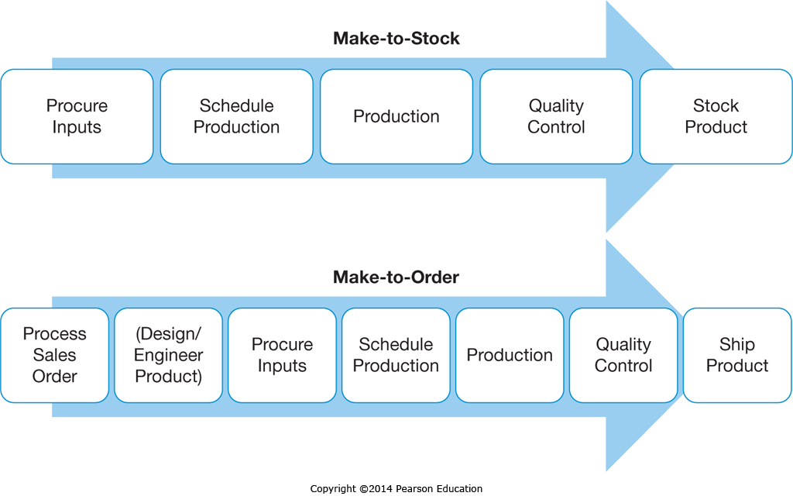
Core Business Processes: Make-to-Stock & Make-to-Order
Notes:
The Make-to-Stock and Make-to-Order processes both involve the production of goods, but the Make-to-Order process is more complex as it includes additional steps involving taking the order and then doing any design and engineering work required.
The Make-to-Stock process is based on forecast or budgeted sales figures.

Slide 9
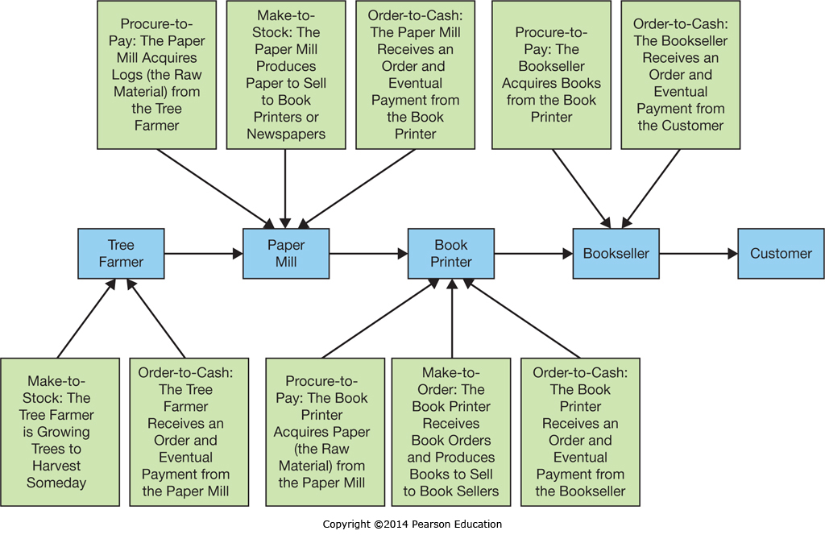
An Example Supply Chain
Notes:
This diagram shows the supply chain of a book, which is comprised of several organizational value chains feeding into each other with business processes until the book reaches the final end customer.

Slide 10
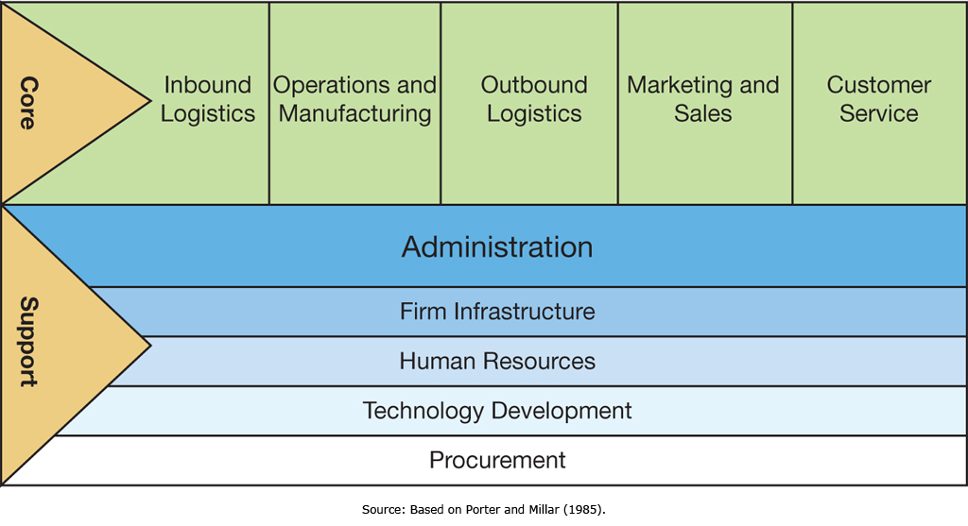
Organizational Activities Along the Value Chain
Notes:
A corporation is comprised of both core and support activities.
Core activities are focused on the actual value creation processes within the organization, including Inbound Logistics, Operations and Manufacturing, Outbound Logistics, Marketing and Sales, and Customer service.
These core activities form the organization’s “Value Chain”.
Different industries can have significant variance in their core activities.
Support activities are those activities that enable the core activities (and the other support activities) to function efficiently and effectively, but don’t directly create value for the customer.

Slide 11
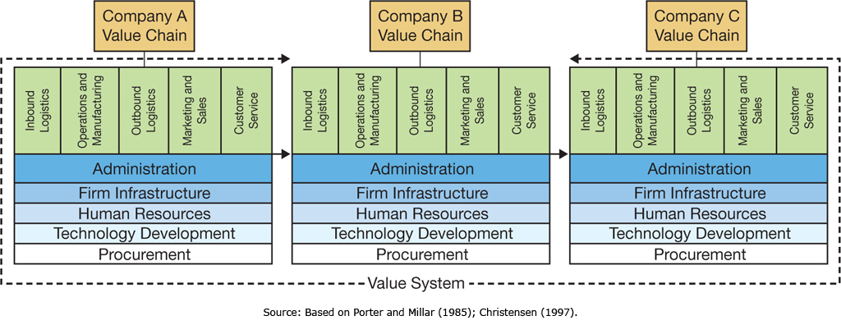
Value Systems: Connecting Multiple Organizational Value Chains
Notes:
Companies purchase goods and services from other companies, and often sell to other companies as well.
Multiple organizations working together form a value system.
It is necessary for information to flow between companies for the smooth and efficient operation of the value system.
When companies tie their information systems together, they can send and receive information with other companies up and down the value system.

Slide 12
Enterprise Systems
Core Business Processes and Organizational Value Chains
Explain core business processes that are common in organizations.
Enterprise Systems
Describe what enterprise systems are and how they have evolved.
Enterprise Resource Planning
Describe enterprise resource planning systems and how they help to improve internal business processes.
The Formula for Enterprise System Success
Understand and utilize the keys to successfully implementing enterprise systems.

Slide 13
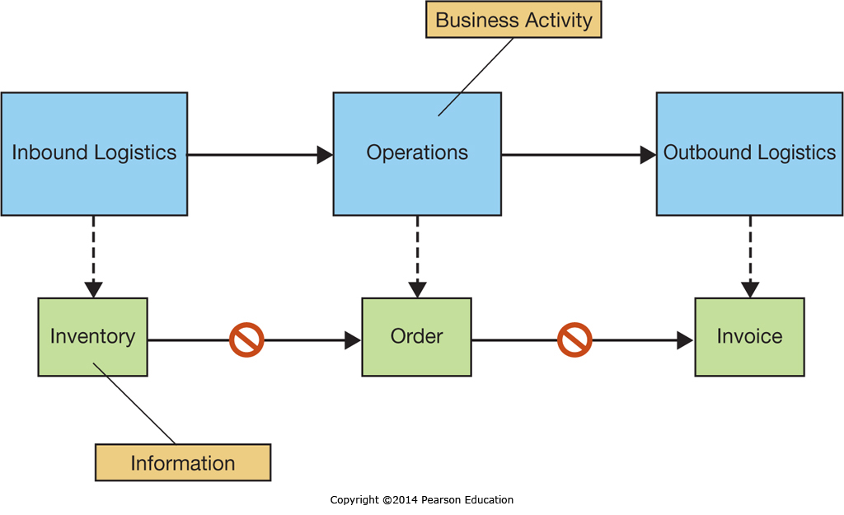
The Rise of Enterprise Systems: Stand-alone systems
Notes:
When organizations first started using information systems, they typically implemented proprietary systems from multiple vendors on a department-by-department or process-by-process basis.
This resulted in multiple information systems optimizing the practices of each department or process independent of the rest of the organization, with a marked lack of data-flow between business departments or processes.
This lack of continuous data-flow created large inefficiencies.
These older stand-alone systems are now typically referred to as legacy systems, reflecting their advancing age and lack of upgradability.

Slide 14
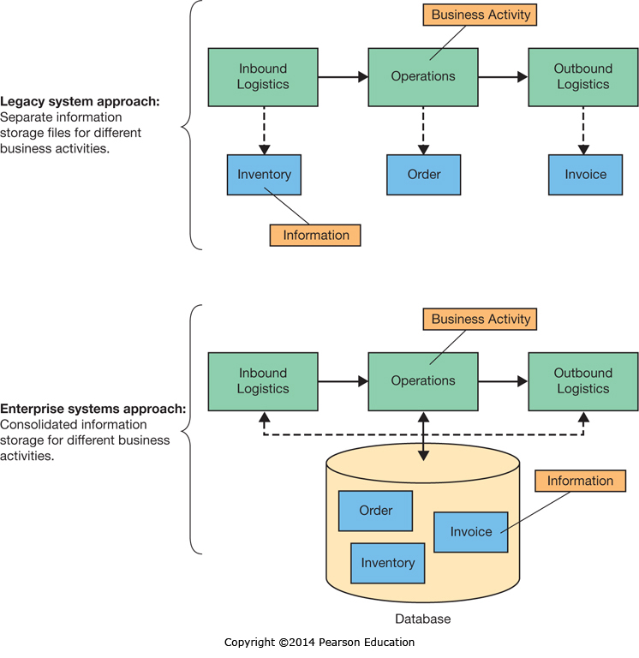
The Rise of Enterprise Systems: Integrated Enterprise Systems
Notes:
Enterprise systems perform all the functions legacy systems used to perform, but with the added benefit of being integrated across the value chain with a consolidated database.
This ensures all departments and processes have access to both their internal information and the information of upstream and downstream processes and functions.
This integrated approach streamlines operations across the entire value chain, eliminating road blocks and enhancing efficiency.

Slide 15
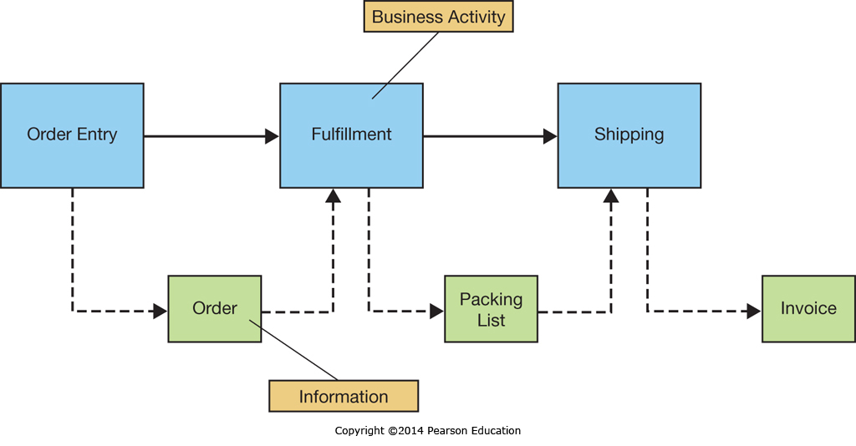
Supporting Business Processes: Internally Focused Systems
Notes:
Internally focused systems integrate and automate information flows between departments and processes, streamlining operations and facilitating smooth business operations.

Slide 16
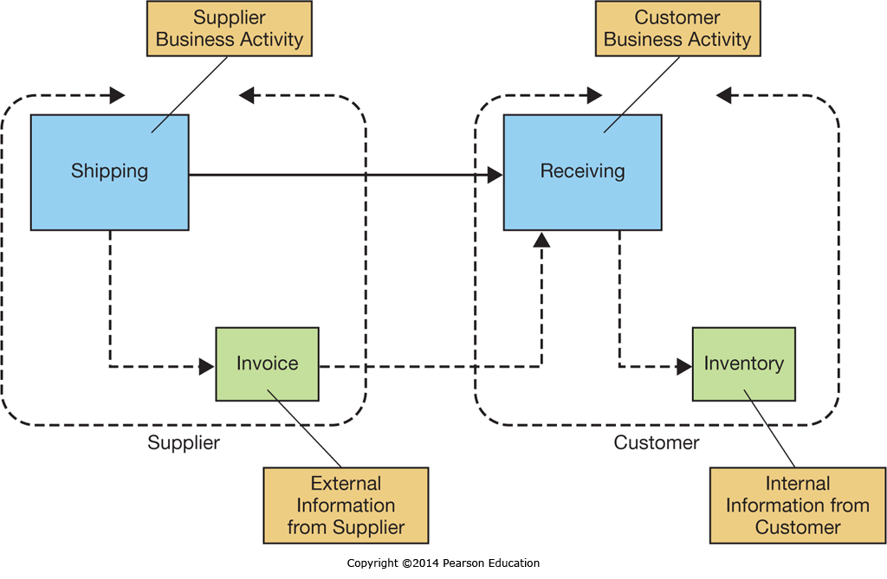
Supporting Business Processes: Externally Focused Systems
Notes:
Externally focused systems focus on improving communication and coordination with other businesses in the overall value system.
These externally focused systems include Supply Chain Management and Customer Relationship Management systems, which will be specifically addressed in Chapter 8.

Slide 17
Improving Business Processes Through Enterprise Systems: Software Types
Packaged Software
Also called “off-the-shelf”
May or may not require significant configuration
Enterprise software often divided into modules
Special functionality may require customizing the packaged (or vanilla) version
Custom Software
Designed and developed exclusively for a specific organization (Chapter 9)
Notes:
Packaged software is preprogrammed software a business buys to meet business needs. It may range from simple word-processing software to very complex enterprise systems.
Simple software is typically used as-is, while complex or enterprise software requires configuring.
When configuring alone won’t meet a businesses unique needs, either custom software can be written from scratch, or an existing module can be customized by the software vendor.
Customizing software typically entails significant cost, and often creates a version that cannot be upgraded without reprogramming the customizations.
Hence, a cost-benefit analysis needs to be performed before undertaking any customizations to ensure the value is really there.

Slide 18
Improving Business Processes Through Enterprise Systems: Best Practices
Packaged Enterprise Software
Typically Designed to operate with Industry Standard Best Practices
May not accommodate unique organizational practices that provide a competitive advantage
Modifying Enterprise software can be a long and costly process depending on the inherent flexibility of a given system
Notes:
Implementing enterprise software provides an opportunity for organizations to migrate under-performing processes to industry best practices, which are typically built into the software implementation.
However, if an organization has unique practices which are superior to industry standard best practices, the enterprise software may be unable to support them without significant customization.
An organization needs to understand how it is performing against industry benchmarks to know when it should adopt industry best practices and when it should keep unique business practices in place.

Slide 19
Improving Business Processes Through Enterprise Systems: BPM
Business Process Management
Actively managing business processes
Using a structured approach
May be ongoing
May include radical process reengineering
Notes:
Business Process Management involves actively managing a companies business processes.
This typically includes functions such as process modeling, redesign, and improvement.
At some points in time, when companies have fallen behind their competition, a complete reengineering of the company may be necessary to make the radical changes necessary for it to be competitive again.
When properly supported by management with realistic expectations and clear goals, BPM can be very beneficial.

Slide 20
Improving Business Processes Through Enterprise Systems: Benefits & Costs
56% of Implementation costs over budget
Average over budget is by US$2Million
Typically costs underestimated
Scope expanded
Unexpected technical & organizational change management issues
Many potential Costs & Benefits make implementation planning complex & uncertain
Notes:
Enterprise systems are, by their very nature, highly complex with significant impacts throughout an organization.
This complexity and wide impact makes budgeting for their implementation and forecasting benefits both complex and difficult.
As a consequence, there are often unanticipated costs that can push an implementation over budget.

Slide 21
Enterprise Resource Planning
Core Business Processes and Organizational Value Chains
Explain core business processes that are common in organizations.
Enterprise Systems
Describe what enterprise systems are and how they have evolved.
Enterprise Resource Planning
Describe enterprise resource planning systems and how they help to improve internal business processes.
The Formula for Enterprise System Success
Understand and utilize the keys to successfully implementing enterprise systems.

Slide 22
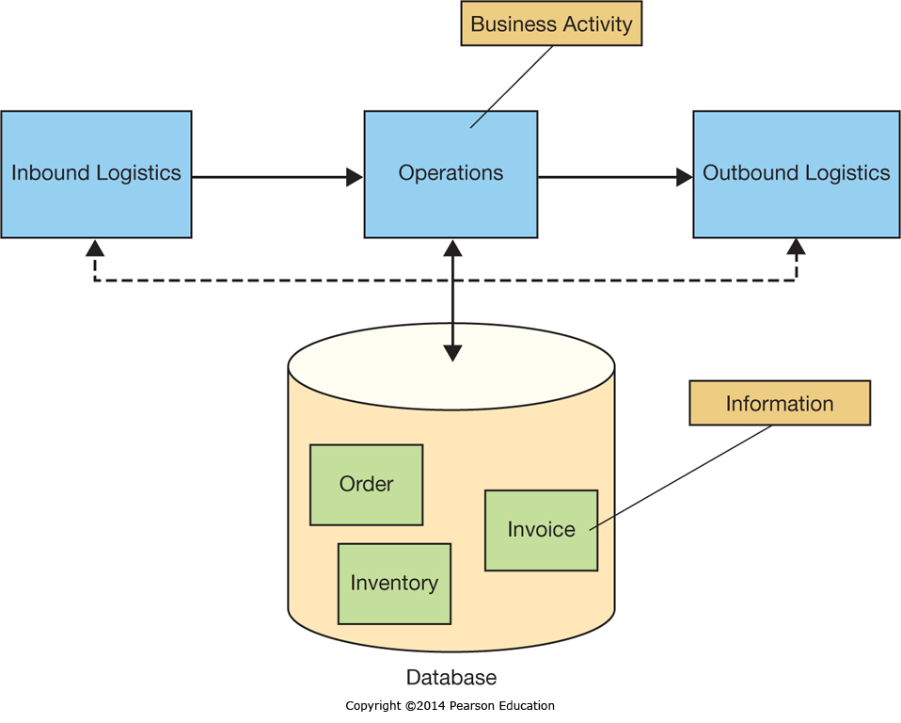
Integrating Data to Integrate Applications
Notes:
It is difficult to integrate applications when all the overlapping data needs to be continuously passed between them.
ERP systems resolve this be using a common integrated database to support the information needs across the system, ensuring that data is always consistent and shared in common.

Slide 23
Responding to Compliance and Regulatory Demands
ERP systems have built-in control systems
Mirror organizational processes
Support segregation of duties
Monitor business activities
Notes:
ERP systems were designed for organizations needing to meet modern regulatory requirements; they have the functionality necessary to support the implementation and documentation of internal controls, procedures, and policies.

Slide 24
Choosing an ERP System
ERP Control
Centralized or Decentralized across business units
Policies and Procedures
Do they need to be flexible?
Do they need to be standardized?
ERP Business Requirements
What modules are available?
How well do they meet specific business needs?
Notes:
Choosing an ERP system is a difficult task which needs to take into account both business needs and system functionality.
The system selected must support the business management practices of centralized or decentralized control, which often hinges on how much flexibility and independence individual business units have.
In addition, each ERP system has different built-in functionality which will meet business needs to varying extents.
The ERP system selected should met all the business needs, and should be particularly good at meeting the most critical business functions.

Slide 25
Enabling Business Processes Using ERP Core Components
ERP systems support core business processes
Often Packaged Industry Specific ERP versions
Support Industry Specific core processes
Healthcare
Automotive
Construction
Retail
Specialized manufacturing industries
Notes:
ERP systems often have versions tailored to individual industries, with customizations already integrated to support the core business processes as practiced in that specific industry.
Implementing an industry specific ERP package, which includes all the core components that industry needs, can simplify and streamline ERP selection and implementation.

Slide 26
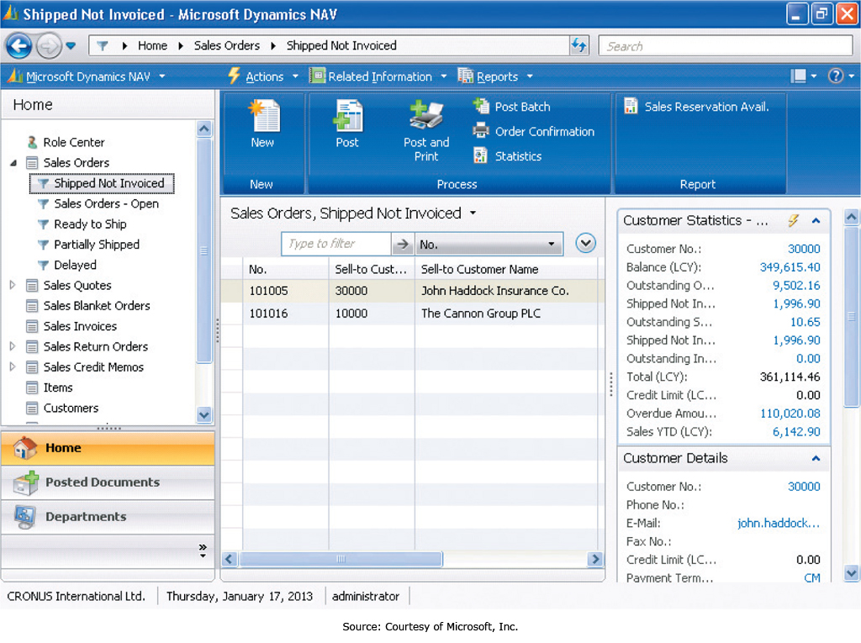
Core Business Process Support
Notes:
This is a screenshot of the Microsoft Business Dynamics NAV system supporting the Order-to-Cash Process.

Slide 27
ERP Installation
Configuration is critical
Specifying the data to be in the underlying database
Thousands of decisions related to business processes
Companies need to understand how they do business to implement and configure their ERP system
Notes:
All ERP systems require extensive configuration to map to a specific business. A company needs to understand its processes to make the thousands of necessary configuration decisions. Often, companies will hire outside experts to help them understand their own business and then implement the ERP based on this understanding.

Slide 28
ERP Limitations
ERP systems are internally focused
Managing the Value Chain requires externally focused components (Chapter 8)
Notes:
ERP systems, for all their benefits, are essentially focused on the internal workings of an organization.
To achieve benefits in external functions such as Supply Chain Management or Customer Relationship Management companies need to implement externally focused modules or systems designed to handle that aspect of the business.

Slide 29
The Formula for Enterprise System Success
Core Business Processes and Organizational Value Chains
Explain core business processes that are common in organizations.
Enterprise Systems
Describe what enterprise systems are and how they have evolved.
Enterprise Resource Planning
Describe enterprise resource planning systems and how they help to improve internal business processes.
The Formula for Enterprise System Success
Understand and utilize the keys to successfully implementing enterprise systems.

Slide 30
ERP Recommendations
Recommendations
Secure executive sponsorship
Get help from outside experts
Thoroughly train users
Take a multidisciplinary approach to implementations
Look beyond ERP
Notes:
ERP installation is a complex and involved process. It needs top level support in the form of active executive sponsorship. The lack of executive support is believed to be the primary reason ERP installations fail.
Beyond executive sponsorship:
Hiring experts who know how to implement ERP systems is very beneficial. Companies may only install an ERP system once a decade, while Experts do it for a living, and understand the unique challenge specific ERP systems may present.
Users need training before and after the implementation to ensure they can use it when deployed, and then as they become proficient can learn advanced features specific to their job functions.
When implementing an ERP system, it typically affects large portions, if not the entire organization. Involving all the business functions affected helps ensure needs are met and buy-in is achieved.

Slide 31
Secure Executive Sponsorship
Executive Sponsorship is Critical
Primary reason for ERP failure
Critical for buy-in
Dictates resource availability
Necessary to authorize business improvements
Key to removing obstacles
Notes:
Executive Support and Sponsorship is the most critical aspect of a successful ERP implementation.
It dictates whether managers will prioritize the implementation and if the required resources will be available.
When opportunities arise to make process changes and improve the business these changes need authorization to be implemented.
When unexpected roadblocks crop up, executive sponsorship can pave the way to success.

Slide 32
Get Help from Outside Experts
ERP systems are very complex
Typically IS departments aren’t familiar with new systems
Experts can help
Specify needs
Select a suitable vendor
Manage the implementation project
Provide technical expertise
Notes:
ERP systems are typically very large and complex, and may take years to master. By hiring experts to help select a vendor, then help manage the vendor and execute the installation, companies can leverage the knowledge of experts who do implementation for a living without having to develop the expertise in-house.

Slide 33
Thoroughly Train Users
ERP systems are complex from the user perspective as well
Training costs are often poorly judged
When systems go live it takes employees time to regain productivity
Proper training can alleviate concerns
Proper training can mitigate productivity loss
Proper training can set expectations
Notes:
Training is critical to ERP success but often poorly planned for and executed.
ERP systems are more complex to use than stand-alone systems, and users need to be prepared for that.
Proper training can, not only show users what to do, but can prepare them for expected hurdles like a temporary drop in productivity as they get up to speed and become proficient with the system.

Slide 34
Take a Multidisciplinary Approach to Implementations
ERP systems often affect the entire organization
The entire organization is a stakeholder
The entire organization needs involvement
Failure to have representatives can result in unmet critical needs
The project team can’t be experts in every aspect of user needs
Departments may become hostile if left out of the implementation and needs assessment
Notes:
ERP systems affect entire organizations. To ensure that the needs of the organization are met, representation is needed from all affected parties. This can, not only surface critical requirements, but can also ensure that there is buy-in and understanding of the system and the implementation goals.

Slide 35
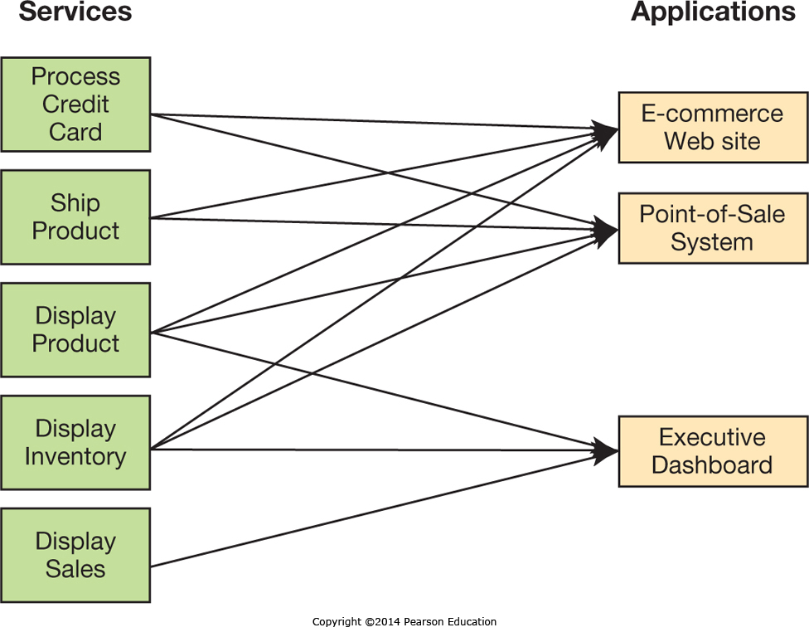
Evolving the ERP Architecture
Notes:
One trend is to evolve the ERP architecture away from the large installations to smaller installations that can also take advantage of online services. This approach, leveraging a “Service Oriented Architecture” or SOA, allows online services to take over non-critical aspects of the system that support the business, simplifying the remaining requirements and installation.

Slide 36
End of Chapter Content

Slide 37
Managing in the Digital World: Amazon.com
Amazon has grown from an online bookstore to a complete marketplace
Almost any product can be purchased though Amazon
Other businesses can sell products through Amazon’s market place
Amazon provides fulfillment for other companies
Amazon’s IT infrastructure provides cloud services and hosting for other companies

Slide 38
Brief Case: Crowdsourcing Cinema at Amazon Studios
Amazon Studios let anyone submit screenplays and movies
Originally anyone could edit any submitted screenplay, this created conflict and had to be modified
Movie makers could shoot screen plays and submit movies
Only one prize winner, but 6000 screenplays and 600 movies in the first year
The first year’s winner still hasn’t had his movie produced

Slide 39
Ethical Dilemma: Too Much Intelligence? RFID and Privacy
RFID tags being used to tag pharmaceuticals
RFID tags can be read by anyone with an RFID reader, creating concerns that a person’s medications could be revealed
A Texas school district planned on tagging students with RFID
This allows tracking them throughout the day
Some feel this is excessive, and RFID shouldn’t be used to track people

Slide 40
Coming Attractions: Power of the Swarm
Social insects like ants and bees use collective intelligence to solve problems
Locating and harvesting food sources
For example, ants mark food trails with Pheromones, and repeated usage reinforces and maintains the trails to good sources
Many simple robots working together can use the same approach
Applications in the military, surveillance, healthcare, and space exploration

Slide 41
Key Players: The Titans of ERP
Oracle
Best known for database software
Grew ERP capabilities both through in-house development and acquisition
18% of the ERP market in 2010
Microsoft
Gained ERP software through acquisition
11% of the ERP market in 2010
SAP
German company founded in 1972
Many of the worlds largest companies use SAP software
24% of the ERP market in 2010

Slide 42
Who’s Going Mobile: Big ERP Systems Embracing Small Mobile Devices
ERP users originally used client PCs to access ERP systems
Mobile ERP now being developed to allow users to access ERP systems on the road
There are many benefits to mobile ERP
Improved service quality
Improved productivity
Strengthened customer relationships
Improved competitive advantage
Improved data timeliness and accuracy

Slide 43
When Things Go Wrong: Time Is a Lot of Money in the Big Apple
In 1998 New York launched a project, “CityTime”, to manage payroll and track hours
Needed to replacing a broken system
Originally budgeted for $63 million
In 2010 over $700 million spent
Federal prosecutors charged several contractors with systematic fraud
Over $600 million of the $700 million spent was tainted in some way
It will take years for auditors to sort out the depth of the corruption and the flaws in the systems development process

Slide 44
Industry Analysis: The Automobile Industry
More than 800 million cars on the road
By 2014 it is predicted 24% of the market will be in Brazil, Russia, India and China
In the US the average car is more than 10 years old
For decades automakers have tried and failed to develop a widely accepted world car
Attempts have fallen short on sales goals
In Europe fuel economy critical, steel doors preferred
Varying regulations and emissions standards
Americans like large cabs and SUVs
But, growing demand around the world for small energy efficient autos
Now automakers are consolidating and becoming more global, as are the automotive suppliers they buy from

