Slide 1
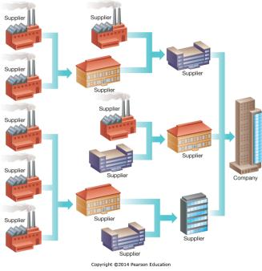
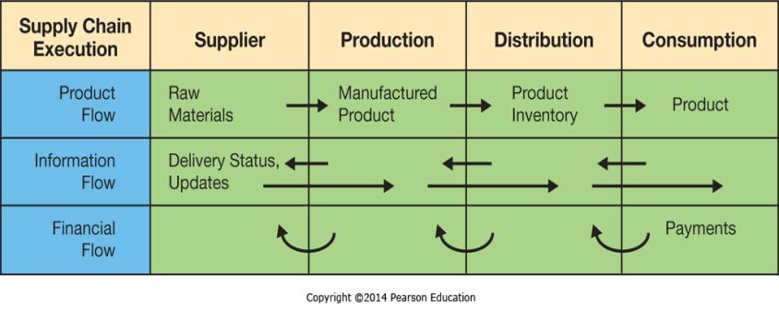
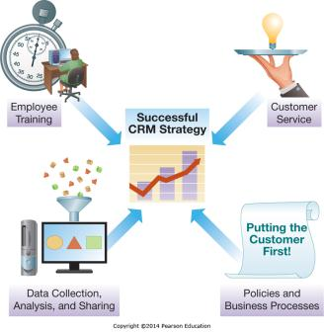
Chapter 8 - Strengthening Business-to-Business Relationships via Supply Chain and Customer Relationship Management
Supply chain management (SCM) systems supporting business-to-business (B2B) transactions, customer relationship management (CRM) systems promote sales and long-term customer relationships

Slide 2
Chapter 8 Learning Objectives
Supply Chain Management
Describe supply chain management systems and how they help to improve interorganizational business processes.
Customer Relationship Management
Describe customer relationship management systems and how they help to improve the activities involved in promoting and selling products to customers as well as providing customer service and nourishing long-term relationships.

Slide 3
Supply Chain Management
Supply Chain Management
Describe supply chain management systems and how they help to improve interorganizational business processes.
Customer Relationship Management
Describe customer relationship management systems and how they help to improve the activities involved in promoting and selling products to customers as well as providing customer service and nourishing long-term relationships.

Slide 4
What Is a Supply Chain?
A collection of companies and processes involved in moving a product from the suppliers of raw materials to the suppliers of intermediate components, then to final production, and, ultimately, to the customer
Referred to as a “chain” as one supplier feeds into the next, then the next, then the next
A “network” is more accurate because businesses have multiple suppliers, who have multiple suppliers
Notes:
A supply chain is comprised of the companies that buy and sell goods to each other to create a product from raw materials. Because one company sells to the next, who then in turn sells to another, often with multiple links before an end product is developed, it is referred to as a chain. In reality, it typically looks more like a network with many suppliers feeding into each company.

Slide 5

A Typical Supply Network
Notes:
A simple example of a Supplier Network. Each Supplier may have one or many upstream suppliers feeding into their business or factory.
At the same time, each supplier is typically selling to many downstream customers, although that isn’t shown here.

Slide 6
Business-to-Business Electronic Commerce: Exchanging Data in Supply Networks
Business-to-Business (B2B) Electronic commerce
  90% of all EC in the United States
  Involve Proprietary Information
  Originally facilitated using Electronic Data Interchange (EDI) prior to the Internet
  Now suppliers use Web-based EDI protocols
  Companies also use Extranets (Chapter 3), Portals and Marketplaces to facilitate B2B EC
Notes:
Business-to-Business Electronic Commerce comprises the lions share of the Electronic Commerce market.
This makes sense because businesses typically make multiple purchases from the same supplier over time.
Automating the procurement process so these can be made electronically and automatically can result is significant procurement cost savings as well as reducing errors and related expenses.

Slide 7
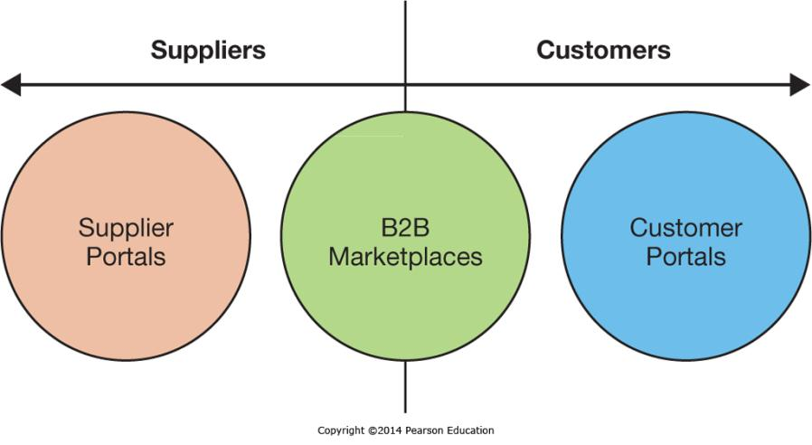
Business-to-Business Electronic Commerce: Exchanging Data in Supply Networks
Portals
  Supplier Portals
  Customer Portals
Notes:
Supplier and Customer Portals are extranets a company sets up for either Suppliers or Customers that contain the communication tools and the proprietary information they need to interact with the company.
Often set up when there is a large number of suppliers or customers to interact with and the cost of the portal is less than the cost of interacting with all the suppliers (or customers) without the functionality of the portal. Portals can also include value-added services such as management tools for customers.

Slide 8
B2B Marketplaces
Link many supplies and customers together
Allow smaller businesses to participate in the markets
Many focused on Vertical Markets
  A Vertical Market is a market within an industry sector
  Highly efficient
Some more general – Alibaba.com
Notes:
B2B Marketplaces are different from portals in that they are controlled by a third party and allow many suppliers and buyers to get together.
For a smaller company that can’t justify the expense of it’s own portal, B2B Marketplaces are efficient ways to participate in the market.
While many B2B marketplaces are industry specific, some are very general, such as the Chinese export marketplace Alibaba.com

Slide 9
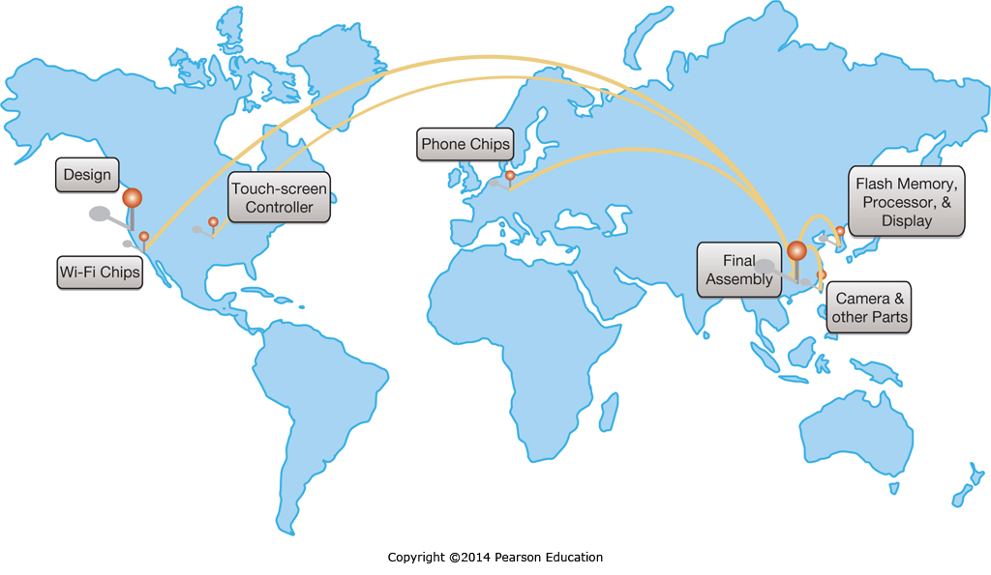
Managing Complex Supply Networks
Notes:
The supply network for the iPhone involves multiple suppliers around the world.
This requires coordination to ensure that all the components are in supply at the assembly plants on an as-needed basis.
When unexpected interruptions occur, such as from an earthquake, the supply chain can cease to flow and manufacturing lines can come to a halt.
Having transparency throughout the supply chain helps management know what is going on and, whenever possible, make adjustments for the unexpected.

Slide 10
Benefits of Effectively Managing Supply Chains
Just-in-Time Production
  Inventory delivered just as it is needed
  Minimizes stock and handling costs
  Reduces obsolescence charges
Vendor-Managed Inventory
  Vendors track usage and replenish supplies
  Reduces procurement and inventory replenishment costs
Notes:
Modern manufacturing practices, such as Just-in-Time Production, that eliminate bringing in large stocks of manufacturing supplies and the associated storage, inventory, and handling costs are part of a lean manufacturing system focused on efficiency.
These practices can significantly reduce manufacturing overhead, but do create the risk of stock-outs if the supply chain isn’t operating effectively.
Vendor managed inventory is another practice that offloads inventory management to the vendor selling the inventory, placing the burden for maintaining a suitable supply on their shoulders which reduces operating costs yet again.

Slide 11
Supply Chain Pitfalls & Considerations
The Bullwhip Effect
Corporate Social Responsibility
  Product Recalls
  Sustainable Business Practices
Notes:
Demand forecasting can create errors. When demand forecasts are being adjusted too rapidly within the supply chain, these errors can create an oscillation of large and small orders. This oscillation will not level out to a steady state, resulting in wildly varying demand within a distribution chain.
As supply chains become global and products are sourced from countries with varying levels of quality standards, substandard parts can enter the supply chain without the knowledge of the downstream manufacturers, resulting in large product recalls or worse.
Good supply chain visibility allows companies to narrow down problems, recall only affected products, and take steps to ensure future quality.
A related issue is sourcing from suppliers who are not engaged in humane or sustainable business practices, resulting in damage to the environment, workers, and the company’s goodwill once the practice is discovered.

Slide 12
SCM Architecture
Supply Chain Planning
Supply Chain Execution
Supply Chain Visibility and Analytics
Notes:
Over the next four slides we will look at each of these in order, and then at an example list of Supply Chain Management modules from an ERP Vendor.

Slide 13
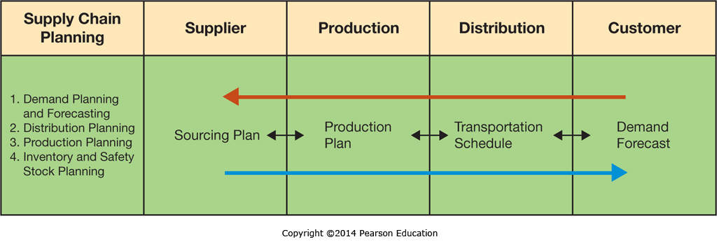
Supply Chain Planning (SCP)
SCP involves multiple SCM tools and modules working together to meet business needs and customer demand
Notes:
The Supply Chain Plan starts with Demand Planning, and works backwards through the Distribution Plan, the Production Plan, and finally to the Sourcing Plan to determine what materials need to be sourced and when to ensure effective business operations.

Slide 14

Supply Chain Execution (SCE)
SCE focuses on the efficient and effective flow of materials, information, and financial transactions
Notes:
Supply Chain Execution is the implementation of the Supply Chain Plan, and involves placing the orders, shipping the goods and materials, and paying for them.
It also includes the information flows necessary to track and monitor the processes involved.

Slide 15
Supply Chain Visibility and Analytics
Supply chain visibility
  Product Tracking
  Anticipating adverse impacts
    Weather impacts
    Labor negotiations
Supply chain analytics
  Monitoring SC Performance
  Identifying problem spots
Notes:
Supply chain visibility is the ability to track products as they move through the supply chain as well as external events that impact or might impact the supply chain.
Supply chain analytics is the analysis and use of key performance indicators to facilitate more effective management and avoid ongoing problems such as suppliers which regularly miss delivery deadlines.

Slide 16
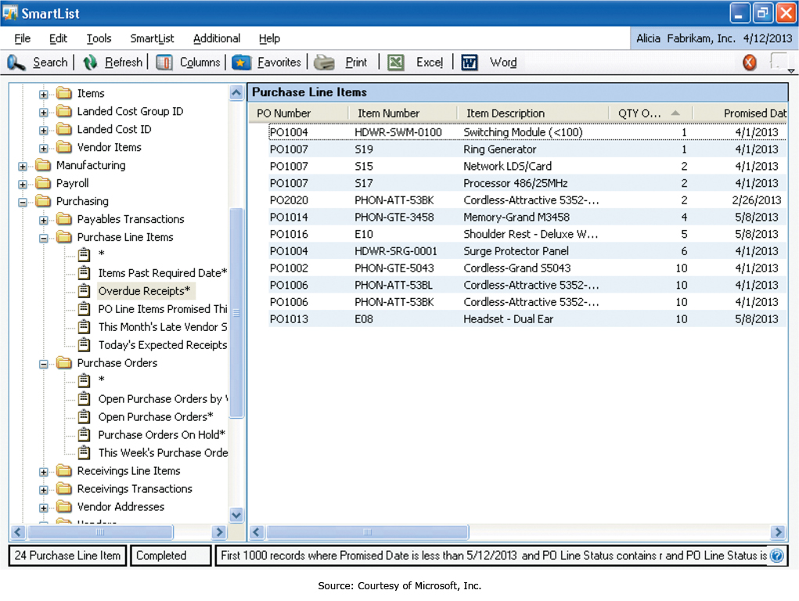
Supply Chain Visibility and Analytics
Notes:
Microsoft Supply Chain Analytics Screenshot showing items ordered, quantities, and vendor-promised delivery dates.

Slide 17
SCM Modules
SCM Module | Key Uses
Demand planning and forecasting | Forecast and plan anticipated demand
Safety stock planning | Assign optimal safety and target stock levels
Distribution planning | Optimize the allocation of available supply
Supply network collaboration | Work with partners across the supply network
Materials management | Ensure production materials are available
Manufacturing execution | Support production processes
Order promising | Provide answers to customer queries
Transportation execution | Manage logistics
Warehouse management | Support receiving, storing, and picking of goods
Supply chain analytics | Monitor key performance indicators
Notes:
Supply Chain Management systems often have multiple modules available to meet specific organizational supply chain needs.

Slide 18
Developing an SCM Strategy
Tradeoffs
  Supply Chain Efficiency
    Minimizes cost, but increased risk of stock-outs
    May sacrifice customer service
  Supply Chain Effectiveness
    Maximizes likelihood of meeting objectives
    Increased costs associated with
      Redundancy
      Sticking levels
      Cross-functionality
Notes:
A supply chain strategy should be developed which mirrors the corporations overall strategy.
If the corporation is focused on customer service, then the company should ensure customer needs can always be met on a timely basis.
If a company is focused on being the lowest cost provider, then the supply chain should push for cost reduction wherever possible, even though that increases the probability that sometimes the supply chain will not meet immediate customer needs.

Slide 19
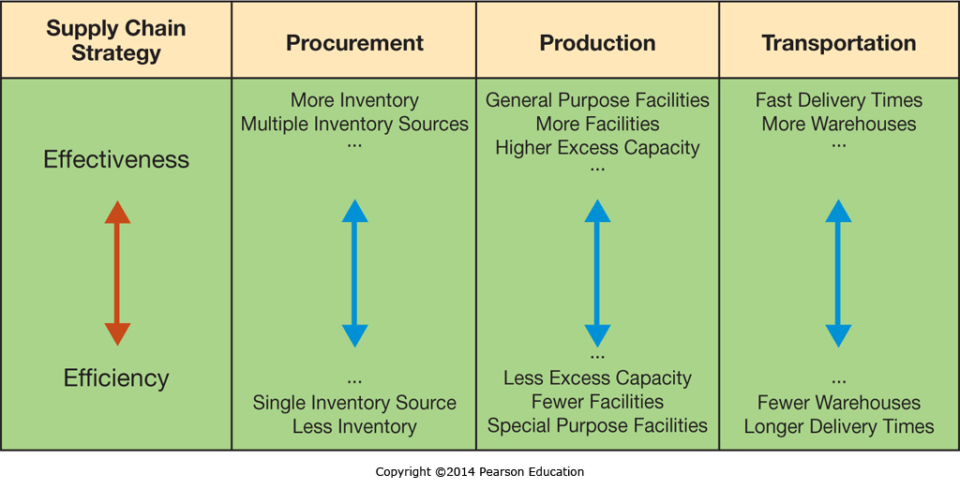
Developing an SCM Strategy
Notes:
The tradeoffs between effectiveness and efficiency are shown here, where the more effective company will be better positioned to ensure delivery, which the more efficient company is taking every possible step to drive down operating and supply chain costs.

Slide 20
Managing B2B Financial Transactions
B2B Financial Transactions
  Extending credit to buyers (terms such as Net 30)
  Payment by check (75%)
Unknown suppliers & customers create significant fraud risk
  Alibaba created the escrow service AliPay to reduce buyer risk
Notes:
Business-to-Business financial transactions involve financial risk, particularly with partners who have an unknown track record.
Buyers may receive inferior goods or no goods at all, sellers may not be paid according to the terms of the agreement.

Slide 21
Key Technologies for Enhancing SCM
Extensible Markup Language
  XML, much like HTML for Web sites, creates a standard many businesses can use to help facilitate exchanging data
Radio Frequency Identification
  Replaces barcodes
  As low as 10 cents
Notes:
XML is a text based markup language that businesses can easily use to exchange machine readable data.
Radio Frequency Identification, or RFID, is an electronic radio equivalent of a barcode, without a barcode’s need to be visible or clean in order to be read.

Slide 22

Key Technologies for Enhancing SCM:
Radio Frequency Identification
Notes:
RFID Tags can range from fractions of an inch to much larger, and can include passive tags that generate power from the reader’s radio signal to active tags that have internal batteries.
Passive tags may only have a range of a few feet, while active tags may have a range of hundreds of feet.

Slide 23
Customer Relationship Management
Supply Chain Management
Describe supply chain management systems and how they help to improve interorganizational business processes.
Customer Relationship Management
Describe customer relationship management systems and how they help to improve the activities involved in promoting and selling products to customers as well as providing customer service and nourishing long-term relationships.

Slide 24
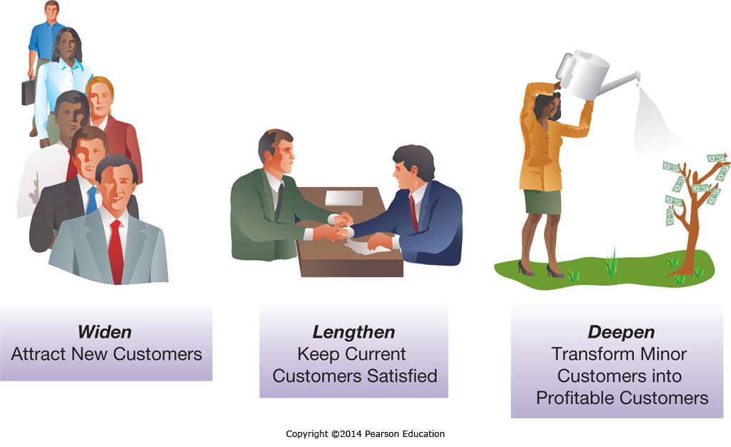
Customer Relationships
Notes:
Companies are constantly looking for opportunities to get new customers, keep current customers longer, and sell more products to their existing customers.
Customer Relationship Management systems are designed to support these efforts.

Slide 25
Customer Relationship Management (CRM) Benefits
Benefit | Examples
Enables 24/7/365 operation | Web-based interfaces
Individualized service | Learn how each customer defines product and service quality
Improved information | Integrate all information for all points of contact
Speeds problem identification/resolution | Improved record keeping and efficient methods of capturing customer complaints
Speeds processes | Integrated information removes information handoffs
Improved integration | Information from the CRM can be integrated with other systems to streamline business processes
Improved product development | Tracking customer behavior over time helps to identify future product and service offerings
Improved planning | Provides mechanisms for managing and scheduling sales follow-ups
Notes:
Customer relationship benefits range from increased levels of customer service to more efficient and effective execution.

Slide 26
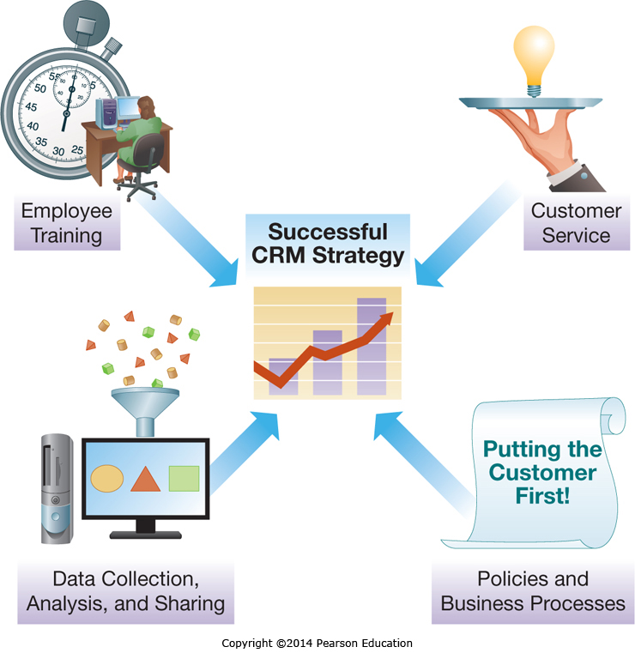
Developing a CRM Strategy
Notes:
Successful CRM strategies need to integrate the different facets of CRM functions. This includes consistent Policies and Procedures, Employee Training, Customer Service, and Data Collection and Analysis.

Slide 27
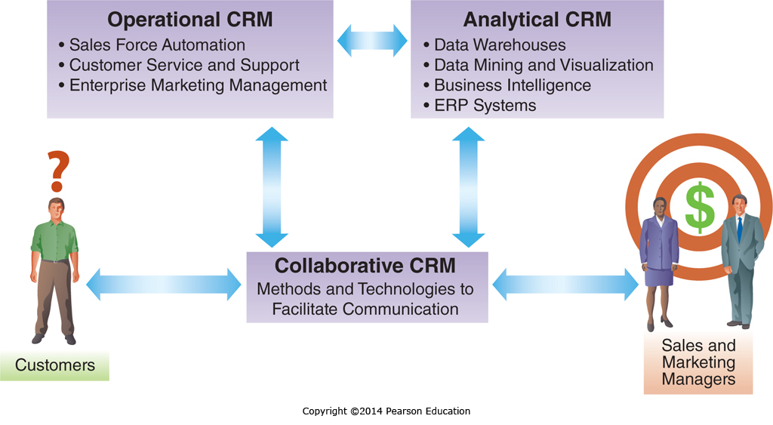
Architecture of a CRM System
Notes:
A complete CRM system includes not only the Operational CRM, which manages customer interactions, but also Analytical CRM which is focused on having appropriate business intelligence and Collaborative CRM which facilitates communication.

Slide 28
Operational CRM
Sales Force Automation (SFA)
  Supports day-to-day sales force activities
Customer Service and Support (CSS)
  Automates service requests, complaints, product returns, and information requests
Enterprise Marketing Management (EMM)
  Improves the management of promotional campaigns
Notes:
Operational CRM is focused on the execution of Customer Relationship Management.
It has three components, Sales Force Automation, Customer Service and Support, and Enterprise Marketing Management.
We will discuss each of these in more depth next.

Slide 29
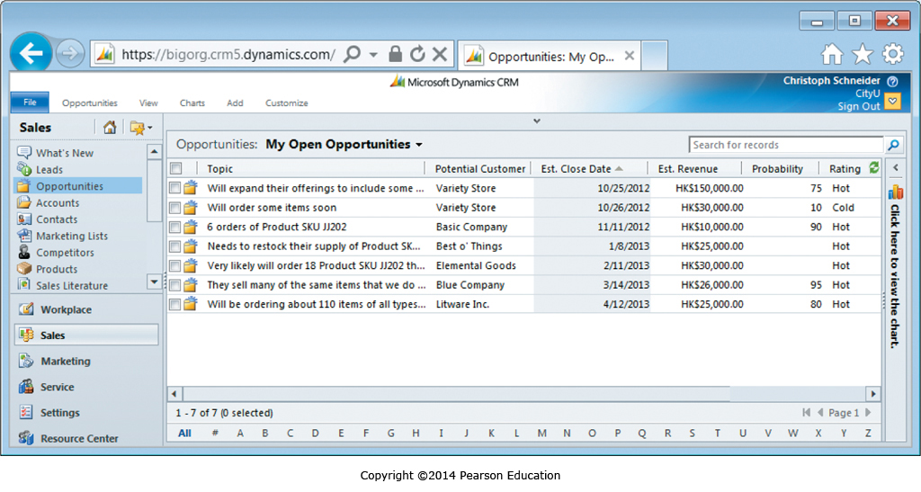
Operational CRM:
Sales Force Automation
Notes:
Sales Force automation supports the day-in-and-day-out sales force and sales manager functions.
It automates paperwork functions, allowing more time to be spent with customers, reducing errors, and ensuring leads are followed up.

Slide 30
Operational CRM:
Customer Service and Support
  Customer interaction centers (CIC) support multiple communication Channels
  Web
    Self-service technologies
  Facebook
  Industry Blogs
  Phone
  Face-to-Face
Notes:
Customer Service and Support Technologies allow companies to provide customer service and support across multiple channels ranging from 24/7 Web sites that incorporate self-service technologies to face-to-face interactions, and everything in between.

Slide 31
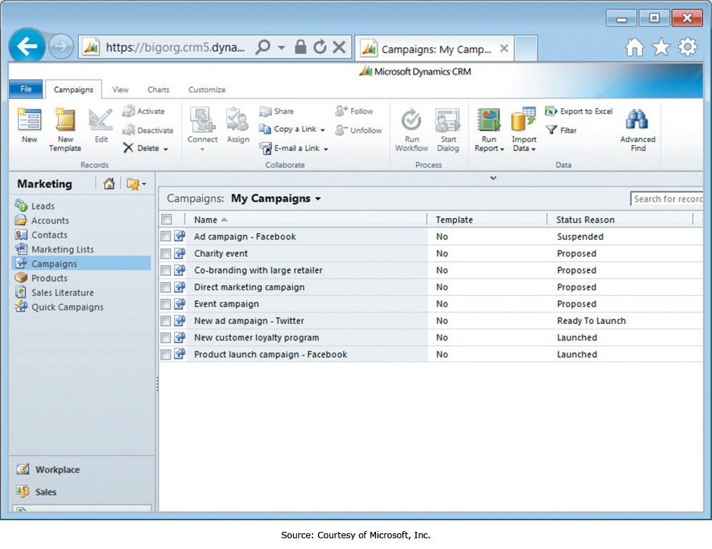
Operational CRM:
Enterprise Marketing Management
Notes:
Enterprise marketing management, or EMM, helps companies manage the efficient and effective execution of marketing campaigns across different media.
This helps make sure the right message reaches the right people at the right time.
EMM systems also provide extensive capabilities to track and analyze campaign effectiveness.

Slide 32
Analytical CRM
“Analyzing customer behavior and perceptions in order to provide the business intelligence necessary to identify new opportunities and to provide superior customer service”
Key Analytical Technologies (Chapter 6)
  Data mining
  Decision support
  Other business intelligence technologies
Notes:
Analytical CRM is closely tied to Business Intelligence and uses Business Intelligence tools to identify new business, sales, and marketing opportunities.

Slide 33
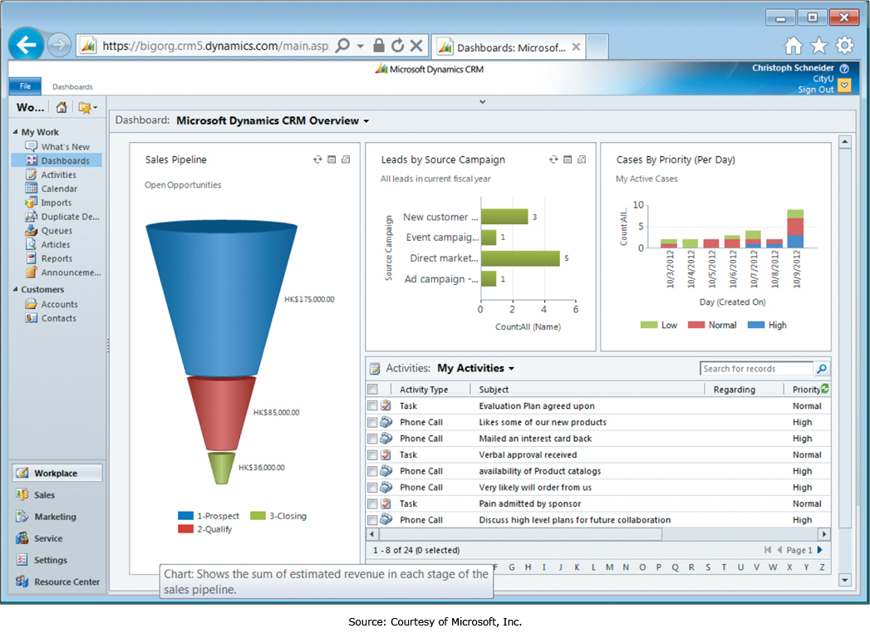
Analytical CRM:
Digital Dashboards
Notes:
Digital dashboards allow managers to rapidly see the status of Key Performance Indicators (KPIs) and evaluate CRM performance metrics.
Often Digital Dashboards provide extensive functionality, such as the ability to click on a chart or graph and “drill down” to see more detailed information.

Slide 34
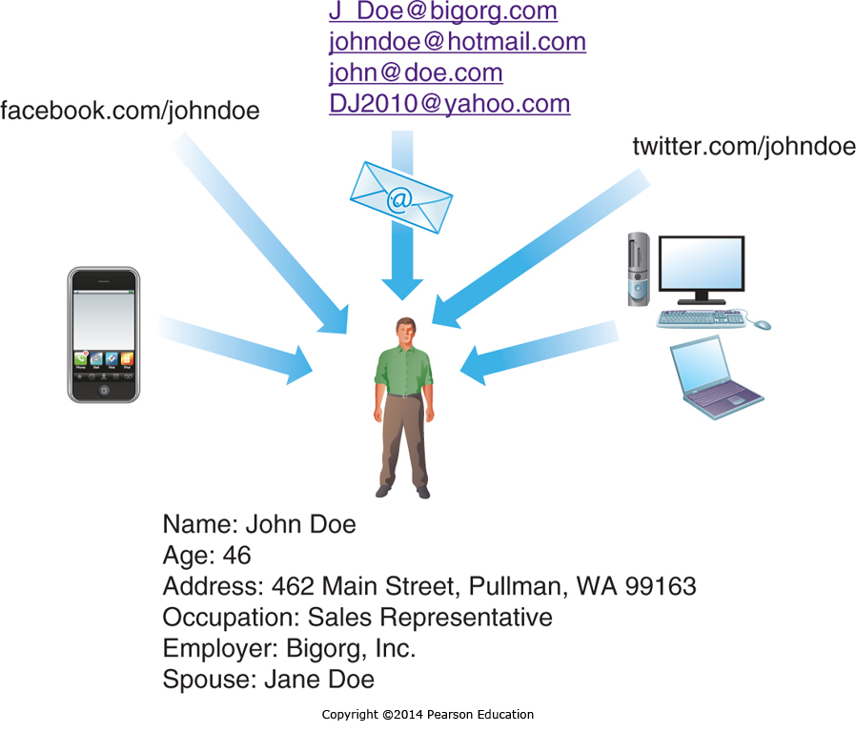
Analytical CRM:
Identity Management
Notes:
Customers often have multiple online accounts, both email and social media.
Identity Management helps companies integrate these so a clear and complete picture of the the customer emerges from the data.

Slide 35
Collaborative CRM
“Systems for providing effective and efficient communication with the customer from the entire organization”
Greater Customer Focus
  Understanding customer history and current needs
Lower Communication Barriers
  Personnel have complete customer information
  Personnel use customer preferred communication methods
Increased Information Integration
  Personnel know prior and ongoing communication
Notes:
Collaborative CRM is focused on ensuring customer support personnel have the tools and information they need to effectively interact with the customer regardless of the last point of contact with the company.
It provides customer support personnel with a history of customer interactions and ongoing communication, ensuring personnel have complete and accurate information and are able to readily address customer needs.

Slide 36
Ethical Concerns with CRM
CRM systems may facilitate coercive sales practices
Systems may categorize customers in a way customers take offense to
Personalized communication may become too personal
Notes:
CRM can provide companies with a great deal of information about their customers, some of which may be considered sensitive or private by that customer.
Using this information to make a sale may result in the customer feeling intruded upon, or could have a coercive effect.
Either of these can create ethical issues, and could also create negative publicity for a company.

Slide 37
End of Chapter Content

Slide 38
Managing in the Digital World:
Supply Chain Havoc
Supply chains now based on a global economy
Natural disasters can have a global impact
  2011 monsoons in Thailand impacted global hard drive supplies, 70% of all hard drive motors are manufactured in Thailand, worldwide shortages lasted over a year
  When part of a supply chain disrupted, there is a domino effect, impacting all downstream products
  Highly efficient supply chains that minimize inventory can increase the risk of disruption and make the supply chains more fragile

Slide 39
When Things Go Wrong: Apple’s “Very Angry Birds” Disrupt App Store Supply Chain
An Apple server inserted incorrect Digital Rights Management (DRM) code into multiple apps
Users were them prompted to update these apps
  Users updated apps
  The apps all crashed on launch
  Very angry users flooded Apple’s app store with negative review of the crashing apps
  The apps weren’t at fault
  Apple had to remove negative review of apps that weren’t caused by the apps
With hundreds of millions of customers relying on Apple’s app store, when things go wrong, they can go very very wrong

Slide 40
Brief Case: The Formula for Success: Demand Media
Demand Media, Inc. focuses on providing answers to common questions
  Uses search data and auction data to identify topics with high interest
  Demand Media crowdsources solutions as articles and video clips and posts them to it’s own sites and YouTube
  The traffic to view the answers generates advertising revenue
  Demand Media has created a very large content base
    Over 45 sites with more traffic than ESPN and NBC combined
    Publishes 4000 articles and videos a day
    Posted over 170,000 YouTube uploads

Slide 41
Coming Attractions:
Saving Lives through 3D Bioprinting
3D printing is an alternative to cutting and milling materials to create a part
  3D printing builds a part up, eliminating waste
  3D printing is now very precise and accurate
3D printing now moving into the world of medicine
  At Wake Forest University, new skin is being printed directly onto burn wounds of US Troops from Afghanistan
  3D printing may be able to create tissues drug companies can use to rapidly eliminate drugs with side effects, reducing the cost of drug development
  3D printing may one day be able to print entire human organs from a recipient’s own cells, eliminating both organ shortages and organ rejection

Slide 42
Key Players:
Salesforce.com
CRM software is becoming key to business success
  Critical for most medium to large organizations
  Becoming a necessity for many small businesses
  Small business often don’t have the infrastructure to host complete CRM solutions
Salesforce.com hosts a CRM in an online cloud
  Applications for Sales, Service, and Collaboration
  External developers can add additional functionality
  Small businesses can use the features they need from any online computer and many mobile devices

Slide 43
Who’s Going Mobile:
The Power of Mobile CRM
In many organizations, the sales staff is often in the field
  Mobile CRM allows staff to use CRM features on the road
  The best mobile CRM has all the functionality of desktop CRM
  Mobile CRM promotes efficiency and effectiveness, with many benefits
    Increased revenue growth and customer renewals
    Larger deal size
    Increased user adoption and higher quota attainment
    Lower sales force turnover
  CRM, including mobile CRM, spending is increasing faster than any other application software investment

Slide 44
Ethical Dilemma:
CRM: Targeting or Discriminating?
CRM systems allow companies to send targeted offers to select customers
Benefits include less advertising to uninterested parties
Fine segmentation may allow companies to take advantage of population groups
Some companies also sell data, without user knowledge or consent, at times in violation of their own stated practices
Often these practices are legal, but are they ethical?

Slide 45
Industry Analysis:
Manufacturing
Computer-aided Design (CAD)
  Facilitates drawing, design, sharing, and collaboration
  CAD design prototypes can be printed on 3D printers
Computer-aided Engineering (CAE)
  Test designs from CAD systems to refine before prototypes are made
Computer-aided Manufacturing (CAM)
  Controls the production of the final product
  Uses the output of CAD systems
  Also manages inventory, scheduling, and warehouses

Slide 46
