Slide 1
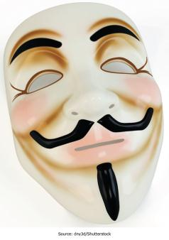
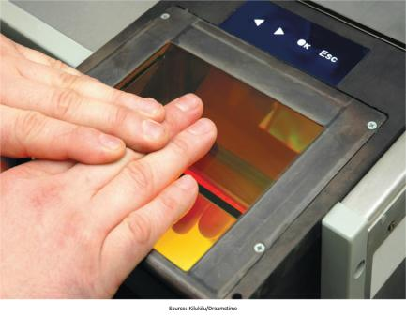
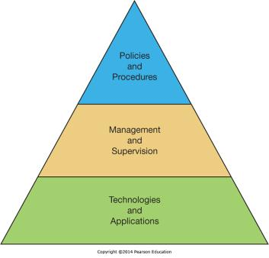
Chapter 10 - Securing Information Systems
IS Security is a critical aspect of managing in the digital world

Slide 2
Chapter 10 Learning Objectives
Computer Crime
Define computer crime and describe several types of computer crime.
Cyberwar and Cyberterrorism
Describe and explain the differences between cyberwar and cyberterrorism.
Information Systems Security
Explain what is meant by the term “IS security” and describe both technology and human based safeguards for information systems.
Information Systems Controls, Auditing, and the Sarbanes-Oxley Act
Describe how organizations can establish IS controls to better ensure IS security.
Managing IS Security
Discuss how to better manage IS security and explain the process of developing an IS security plan.

Slide 3
Computer Crime
Computer Crime
Cyberwar and Cyberterrorism
Describe and explain the differences between cyberwar and cyberterrorism.
Information Systems Security
Explain what is meant by the term “IS security” and describe both technology and human based safeguards for information systems.
Information Systems Controls, Auditing, and the Sarbanes-Oxley Act
Describe how organizations can establish IS controls to better ensure IS security.
Managing IS Security
Discuss how to better manage IS security and explain the process of developing an IS security plan.
Define computer crime and describe several types of computer crime.

Slide 4
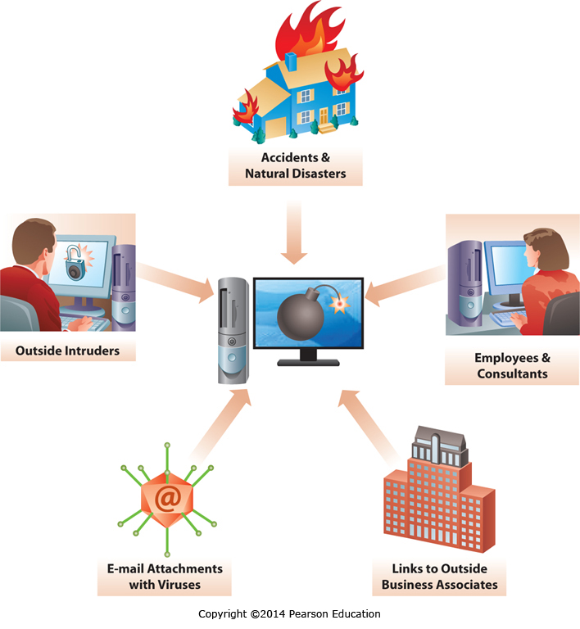
Threats to IS Security
Notes:
Threats to Information Security include any threat, not just intentional ones. Unintentional threats such as employee mistakes, accidents, and natural disasters can also have a huge impact on system availability and integrity.
Intentional threats, either from inside or outside the company, may come from employees, from hackers, or from malware such as viruses and Trojan horses. All of these threats need to be considered as part of a comprehensive information security plan.

Slide 5
What Is Computer Crime?
“Using a computer to commit an illegal act”
Targeting a computer while committing an offense
Unauthorized access of a server to destroy data
Using a computer to commit an offense
Using a computer to embezzle funds
Using computers to support a criminal activity
Maintaining books for illegal gambling on a computer
Notes:
Simply put, if you commit a crime against a computer, while using a computer, or even simply use a computer to support other criminal activities, it is considered computer crime.

Slide 6
Hacking and Cracking
Hackers
Anyone with enough knowledge to gain unauthorized access to computers
Hackers who aren’t crackers don’t damage or steal information belonging to others
Crackers
Individuals who break into computer systems with the intent to commit crime or do damage
Hacktivists: Crackers who are motivated by political or ideological goal and who use Cracking to promote their interests
Notes:
There is a fine line between Hacking and Cracking, and sometimes the only difference is intent. However, hackers do not damage, deface, or steal data, while crackers do. Hacking originated at MIT when expert computer users would write programs, or “hacks”, that allowed them to roam through the mainframe computers and see what was there.

Slide 7
Types of Computer Crimes
Unauthorized Access
Stealing information
Stealing use of computer resources
Accessing systems with the intent to commit Information Modification
Information Modification
Changing data for financial gain (e.g.: embezzlement)
Defacing a Web site (e.g.: hactivists making a statement)
Notes:
Two of the most common computer crimes are Unauthorized Access and Information Modification. Unauthorized access may be a precursor to other activities such as data theft, using corporate resources for personal gain, and information modification. Information modification can involve changing data for financial benefit or other purposes, such as a hacktivist who defaces a Web site to make a political statement.

Slide 8
Types of Computer Criminals
Computer criminals come in all shapes and sizes, in order of infractions they are:
Current or former employees; most organizations report insider abuses as their most common crime (CSI, 2011)
People with technical knowledge who commit business or information sabotage for personal gain
Career criminals who use computers to assist in crimes
Outside crackers – crackers commit millions of intrusions per year
Most cause no harm
Estimates are that only around 10 percent of cracker attacks cause damage
Notes:
Computer criminals can no longer be stereotyped. There are many different criminals performing many different criminal acts. However, by order of infractions, the number one computer criminal is a current or former employee. The next three in descending order are people with technical knowledge who commit sabotage for personal gain, career criminals, and finally outside crackers.

Slide 9
Other Threats
Often institutions and individuals fail to exercise proper care and implement effective controls
Passwords and access codes written down on paper, in plain sight or unsecured
Antivirus software isn’t installed or isn’t maintained
Systems left with default manufacturer passwords in place after being deployed
Information carelessly shared over the phone, or by letting unauthorized individuals see monitor screens
Company files and resources without proper access controls
Failure to install and maintain Firewalls and Intrusion Prevention/Detection systems
Poor background checks on new hires
Employees with unmonitored access to data and resources
Fired employees left unmonitored and have access to damage the system before they leave the company
Notes:
Many threats seem like common sense, but it requires constant diligence to ensure secure practices are consistently followed. Security systems and antivirus software have to be deployed and maintained on an ongoing basis. Effective security controls need to be in place ensuring people don’t have access to systems they don’t need access to, and access to critical systems is logged and monitored. Terminated employees who have access to critical resources need to be monitored or removed from a position where they could do harm if so motivated.

Slide 10
Computer Viruses and Other Destructive Code
Computer Viruses
Worms, Trojan Horses, and Other Sinister Programs
Denial of Service
Spyware, Spam, and Cookies
Spyware
Spam
Cookies
The Rise of Botnets and the Cyberattack Supply Chain
Identity Theft
Notes:
Destructive code is called Malware, and includes computer viruses and other types of code designed to infect computers or perform other malicious or criminal activities. Viruses, Worms, and Trojan’s all fall into this category.

Slide 11
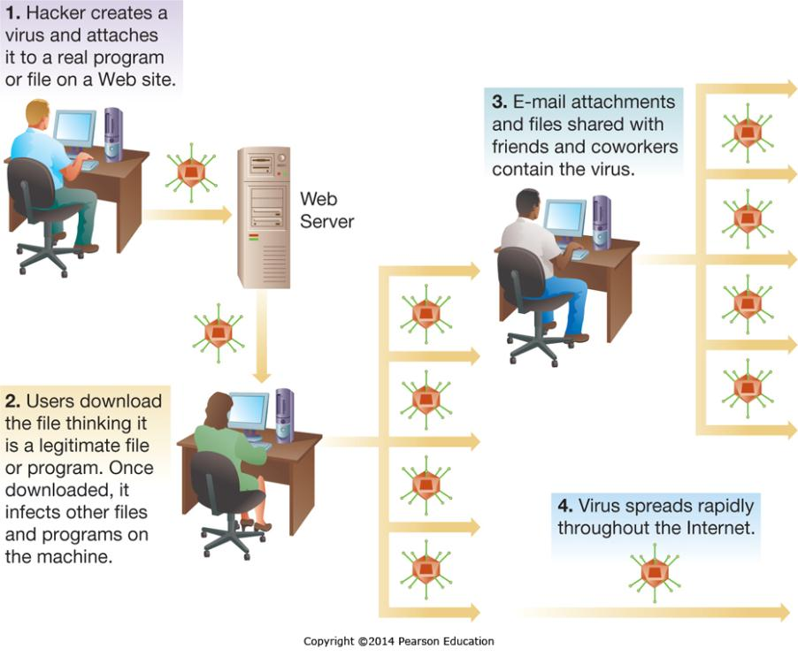
Computer Viruses and Other Destructive Code: Viruses
Notes:
Viruses infect a computer, and then spread to other computers through mechanisms such as email attachments and the sharing of infected files. A virus can spread very rapidly through and across organizations.

Slide 12
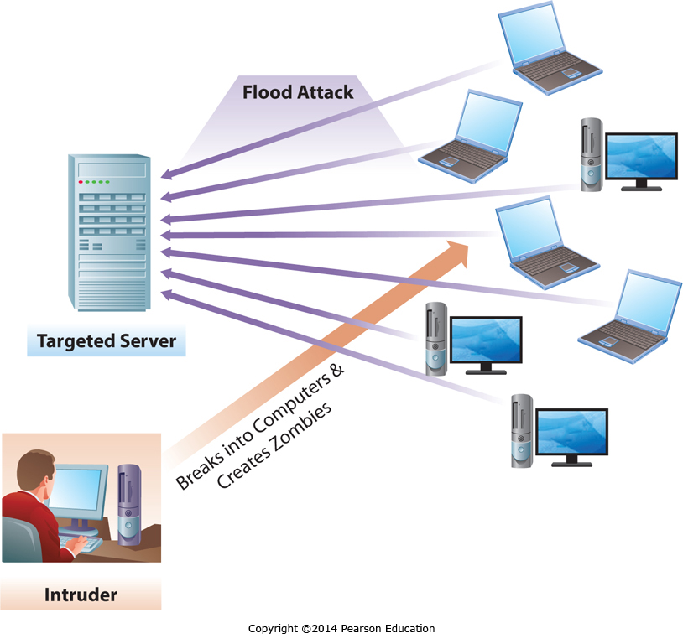
Computer Viruses and Other Destructive Code: Denial-of-Service
Notes:
When a server has too many requests to handle, it becomes overloaded and unable to serve the requests of legitimate users. A Denial-of-Service attack seeks to overload servers, typically using a network of hacked computers that are controlled remotely, by sending too many requests or messages to the server for it to handle.

Slide 13
Computer Viruses and Other Destructive Code: Spyware, Spam, and Cookies
Spyware, Spam, and Cookies
Spyware: software that monitors the activity on a computer, such as the Web sites visible or even the keystrokes of the user
Spam: Bulk unsolicited email sent to millions of users at extremely low cost, typically seeking to sell a product, distribute malware, or conduct a phishing attack
Cookies: A small file Web sites place on user’s computer. Can be legitimate (to capture items in a shopping cart) but can be abused (to track individuals browsing habits) and can contain sensitive information (like credit card numbers) and pose a security risk
Notes:
Spyware monitors computer use, and can have legitimate uses such as monitoring a child or employee’s activity as well as illegitimate ones such as capturing credit card numbers.
Spam is bulk email sent to large numbers of people, few of which would have interest in it, often attempting to sell products or distribute malware.
Cookies are a Web technology designed to allow Web sites to work with individual browsers by tracking such information as shopping cart contents, but they can also be used for other purposes, such as tracking a person’s browsing behaviors across multiple Web sites. If the Web site stores sensitive information in a cookie that can also be a security threat.

Slide 14
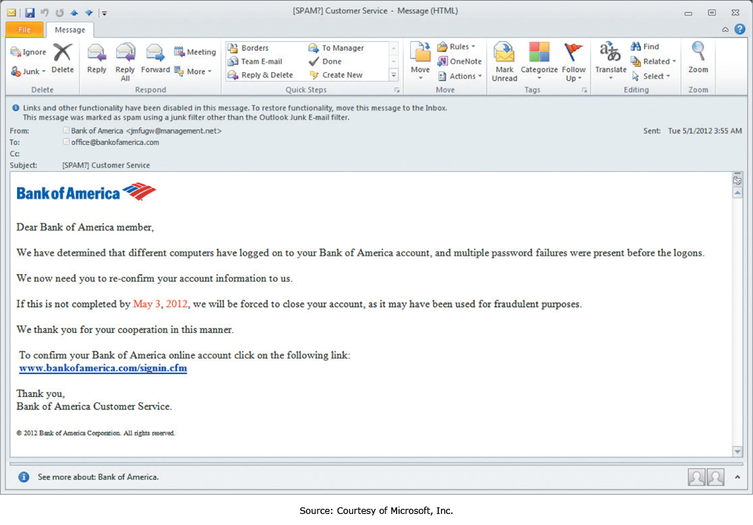
Phishing
Notes:
Phishing is the “casting” of email messages typically hoping to trick users into sending in usernames and passwords. It is a common form of spam, and some phishing attacks can be very realistic. A variation of phishing is “Spear Phishing” where a single targeted email message might be sent to an individual in a company seeking specific information, such as an email to the COO asking about product development which is shown as coming from the office of the CEO and which references the people the COO works with by name, making it seem very plausible.

Slide 15
Internet Hoaxes & Cybersquatting
Internet Hoaxes
False messages circulated about topics of interest
Users should verify the content of emails before forwarding
May be used to harvest emails for SPAM mailings
Cybersquatting
Buying & holding a domain name with the intent to sell
The 1999 Anti-Cybersquatting Consumer Protection Act makes it a crime if the intent is to profit from the goodwill of a trademark belonging to someone else
Notes:
Internet hoaxes often involve false messages which people are encouraged to forward to everyone they know. This wastes the time and resources of people and organizations. Some are used to gather emails for future SPAM mailings.
Cybersquatting is the practice of buying Internet domain names that might be of significant value to another company or person, then holding them for sale. However, if the individual doing so is profiting off a trademark then it is a crime and they can be forced to release the domain name.

Slide 16
Cyberharassment, Cyberstalking, and Cyberbullying
Cyberharassment
Use of a computer to communicate obscene, vulgar, or threatening content that causes a reasonable person to endure distress
Cyberstalking
Tracking an individual, performing harassing acts not otherwise covered by Cyberharassment, or inciting others to perform harassing acts
CyberBullying
Deliberately causing emotional distress
All three are closely related, a Cyberstalker may be committing Cyberharassment and Cyberbullying
Notes:
These three concepts tend to overlap. For example, CyberBullying could be considered Cyberharassment with the specific intent to bully and cause emotional distress, while Cyberharassment may include other types of distress. Cyberstalking may be necessary to have enough information to perform Cyberharassment, or it might not be. Cyberstalking isn’t always detected by the target of the stalking, and can include a wide range of acts from tracking what an individual is doing to committing acts to damage the reputation of the individual. Many states and countries have laws against one or more of these activities, although enforcement can be difficult.

Slide 17
Software Piracy
Region | Piracy Level | Dollar Loss (in US$ millions)
North America Western | 19% | 10,958
Europe | 32% | 13,749
Asia/Pacific | 60% | 20,998
Latin America | 61% | 7,459
Middle East/Africa | 58% | 4,159
Eastern Europe | 62% | 6,133
Worldwide | 42% | 63,456
Notes:
Software piracy is the practice of using software that isn’t properly licensed and paid for, such as by purchasing one copy of a product and then using it on multiple computers. Piracy is illegal, violating copyright and sometimes patent laws. Copyrights include creations of the mind, which typically applies to software, while patents refer to specific processes for doing something, which may be imbedded into a software application.
Copyright violations are a felony, and are illegal even when no profit is being made from the violation.
In some countries, such as Georgia and Zimbabwe, the percentage of software that is illegal can exceed 90%.

Slide 18
Federal Laws
Federal Laws
The Computer Fraud and Abuse Act of 1986
A crime to access government computers or communications
A crime to extort money by damaging computer systems
A crime to threaten the President, VP, members of congress, administration officials
Electronic Communications Privacy Act of 1986
A crime to break into any electronic communications service, including telephone services
Prohibits the interception of any type of electronic communications
Notes:
Two critical federal laws both make it a crime to attack or threaten government agencies or officials. They also make it a crime to extort funds, break into telephone services, or even intercept electronic communications.

Slide 19
Cyberwar and Cyberterrorism
Computer Crime
Define computer crime and describe several types of computer crime.
Cyberwar and Cyberterrorism
Information Systems Security
Explain what is meant by the term “IS security” and describe both technology and human based safeguards for information systems.
Information Systems Controls, Auditing, and the Sarbanes-Oxley Act
Describe how organizations can establish IS controls to better ensure IS security.
Managing IS Security
Discuss how to better manage IS security and explain the process of developing an IS security plan.
Describe and explain the differences between cyberwar and cyberterrorism.

Slide 20
Cyberwar
Cyberwar Vulnerabilities
Command-and-control systems
Intelligence collection, processing, and distribution systems
Tactical communication systems and methods
Troop and weapon positioning systems
Friend-or-foe identification systems
Smart weapons systems
The New Cold War
more than 120 nations are developing ways to use the Internet as a weapon to target financial markets, governmental computer systems, and key infrastructure
Notes:
Modern military systems rely on their own sophisticated networks to help the military execute its mission, and cyberwar involves protecting a militaries own infrastructure and/or disrupting an enemy’s infrastructure. As more and more governments work on developing the tools and techniques necessary to engage in cyberwarfare, a new cyber arms race has begun.

Slide 21
Cyberterrorism
What kinds of attacks are considered Cyberterrorism?
Attacks by individuals and organized groups
political, religious, or ideological goals
How the Internet is changing the business processes of terrorists
Terrorists are leveraging the Internet to coordinate their activities, recruit, and perform fundraising
Notes:
Cyberterrorism involves cyber attacks not by government agencies, but by individuals and groups. At the same time, terrorists of all stripes are leveraging the Internet to support all their organizational needs.

Slide 22
Cyberterrorism (continued)
Assessing the Cyberterrorism threat
The Internet is generally open and accessible from anywhere in the world
There have been many attacks, and while not significantly damaging, the will and potential exist
The globalization of terrorism
Terrorism is now a global business
Attacks can be launched from anywhere in the world
Notes:
Cyberterrorism is a unique problem due to the open nature of the Internet. Attacks can be launched from anywhere in the world, against any Internet-connected target in the world. While attacks to date have had limited impact, there is the potential for significant attacks in the future.

Slide 23
Information Systems Security
Computer Crime
Define computer crime and describe several types of computer crime.
Cyberwar and Cyberterrorism
Describe and explain the differences between cyberwar and cyberterrorism.
Information Systems Security
Explain what is meant by the term “IS security” and describe both technology and human based safeguards for information systems.
Information Systems Controls, Auditing, and the Sarbanes-Oxley Act
Describe how organizations can establish IS controls to better ensure IS security.
Managing IS Security
Discuss how to better manage IS security and explain the process of developing an IS security plan.

Slide 24
Safeguarding IS Resources
Risk Reduction
Actively installing countermeasures
Risk Acceptance
Accepting any losses that occur
Risk Transference
Insurance
Outsourcing
Notes:
IS Resources face risks, and these risks are handled by businesses using three strategies, either individually or together.
Risk reduction is when we take steps to reduce the likelihood of an event, or the consequences of it. For example, installing an antivirus reduces the chance of getting infected, while regular hard drive backups limit the financial loss should a hard drive fail.
Risk acceptance is understanding that some risks are better absorbed if and when they occur than by attempting to reduce them.
Risk transference is a good strategy when a different entity is better positioned to accept and/or reduce the risk, for example an insurance company.

Slide 25
Technological Safeguards
Physical access restrictions
Firewalls
Encryption
Virus monitoring and prevention
Audit-control software
Secure data centers
Notes:
Technological safeguards are technical solutions to mitigate or control risk to Information Systems. There are many types that play a key role in security, we will discuss each of these individually next.

Slide 26
Technological Safeguards: Physical access restrictions
Physical access controls typically focus on authentication
Something you have
Keys
Smart Cards
Something you are
Biometrics
Something you know
Password
PIN Code
Notes:
Physical Access restrictions typically focus on an individual identifying him- or herself, and then one or more forms of authentication being utilized to verify the stated identification. This two-step process greatly enhances security over a one-step process, such as using a fingerprint to both identify and authorize an individual.

Slide 27
Technological Safeguards: Firewalls
Filter traffic
Incoming and/or outgoing traffic
Filter based on traffic type
Filter based on traffic source
Filter based on traffic destination
Filter based on combinations of parameters
Notes:
Firewalls are a form of security based on filtering, where access is typically limited to those functions that actually need access. It is like the network equivalent of restricting people to parts of a building where they legitimately need to be.

Slide 28
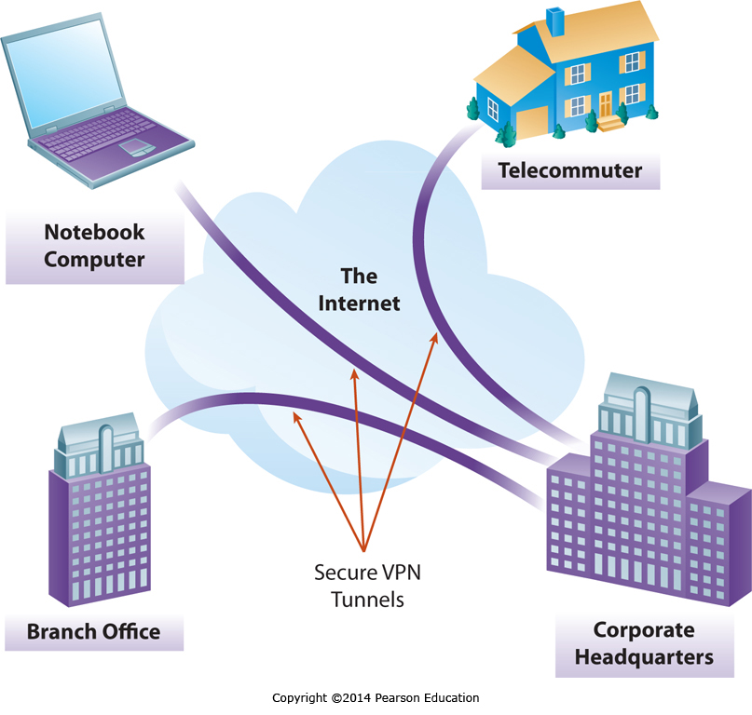
Technological Safeguards: Encryption
Notes:
Encryption is the practice if safeguarding data by encrypting it so it can only be accessed by a decryption process that requires a cypher and a suitable password, key, or certificate.
Encryption can be applied to email, data on hard drives, communication over the Internet, data being taken offsite for backup purposes, or other forms of communication or data storage.
This figure shows a Virtual Private Network, which involves encrypting all traffic between two locations, where a location could be a notebook, a house, or another office of the organization.
Encryption is an effective tool for safeguarding information.

Slide 29
Technological Safeguards: Virus monitoring and prevention
Standard precautions
Purchase, install, and maintain antivirus software
Do not use flash drives or shareware from unknown or suspect sources
Use reputable sources when downloading material from the Internet
Delete without opening any e-mail message received from an unknown source
Do not blindly open e-mail attachments, even if they come from a known source
If your computer system contracts a virus, report it
Notes:
Viruses and malware pose a constant threat to information systems.
A combination of antivirus software and secure practices cannot eliminate the threat, but can reduce the potential risk significantly.
Beyond antivirus software, the next most important step is to limit the potential for infection by avoiding unknown files and file sources.
If your computer is infected, prompt reporting will allow the infection to be contained and minimize the impact.

Slide 30
Technological Safeguards: Audit-control software
All computer activity can be logged and recorded
Audit-control software keeps track of computer activity
Only protects security if results are monitored
Notes:
Audit-control software is a way of proactively ensuring that employees are engaging in appropriate computer activities by monitoring key events and flagging anything that is or appears inappropriate.

Slide 31
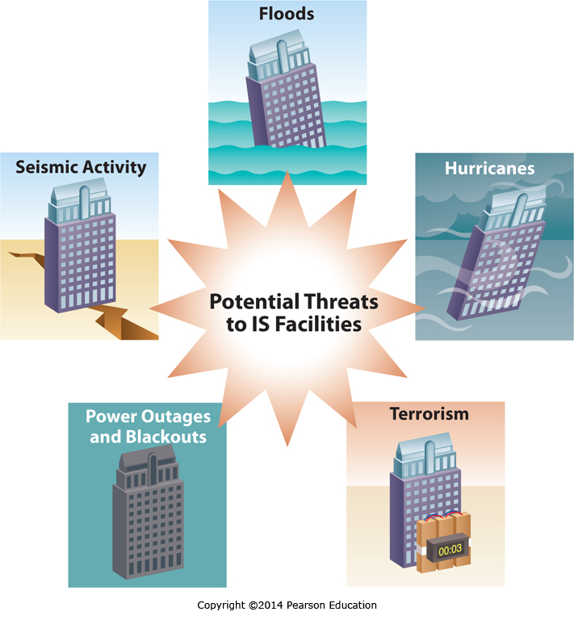
Technological Safeguards: Secure data centers - Ensuring Availability
Notes:
There are a surprising number of threats which can render a data center unavailable, or even destroy it and all the data it contains. Organizations should plan for the worst threats and implement appropriate risk management strategies to ensure the business isn’t threatened by the unexpected.

Slide 32
Technological Safeguards: Secure data centers
Securing the facilities infrastructure
Backups
Backup Sites
Redundant Data Centers
Closed-Circuit Television
Uninterruptible Power Supply
Notes:
Backups of corporate data are critical to ensuring business continuity, but just backing up the data often isn’t enough.
Businesses can also have backup sites with varying levels of preparation. These range from sufficient power and network connectivity to ensure a data center could be installed if needed to complete mirrors of existing data centers with real-time data constantly being updated.
A complete second data center with all data being replicated at all times is a Redundant Data Center, and if something happens to the original data center the redundant data center can take over processing with no service interruption.
Closed circuit television allows for continuous data center monitoring.
Uninterruptible Power Supplies take over in case of power loss or surges to ensure seamless operation.

Slide 33
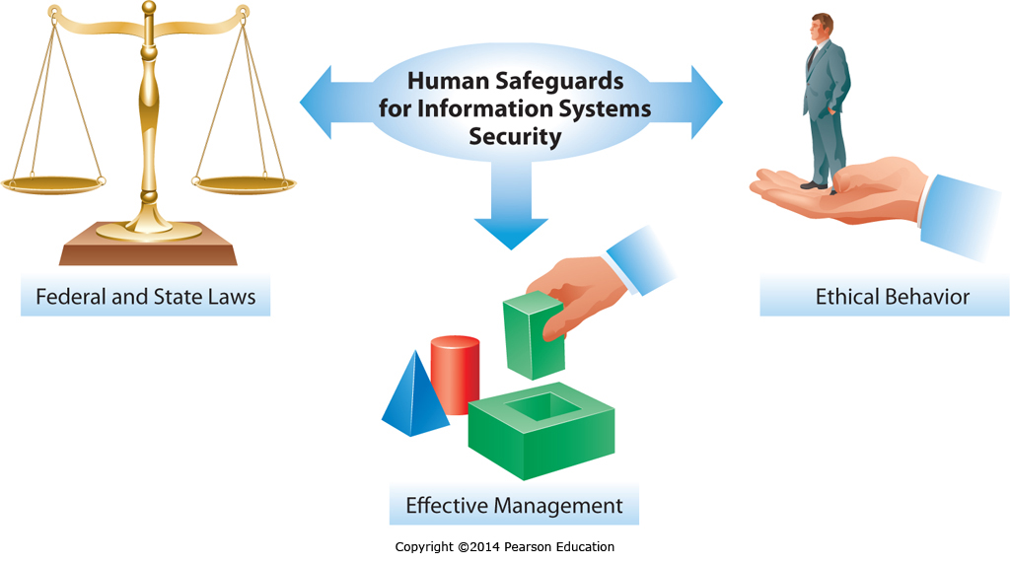
Human Safeguards
Notes:
Human safeguards include ethics, laws, and effective management.
Ethics were covered in Chapter 1, and laws were discussed earlier in this chapter.
Effective management includes implementing and then executing effective security practices on an ongoing basis, and will be covered later in this chapter.

Slide 34
Computer Forensics
Formally evaluating digital information for judicial review
Examining the computers of crime victims for evidence
Examining the computers of criminals for evidence
Auditing computer activity logs
Restoring “deleted” computer data
Notes:
Law enforcement now routinely includes computer forensics in criminal investigations to determine if any digital evidence is available related to the crime.
While criminals can include booby-traps to delete data on their computers, Forensic experts are often able to recover this data with the tools and techniques at their disposal.
This digital evidence now plays a critical role in modern law enforcement.

Slide 35
Managing IS Security
Computer Crime
Define computer crime and describe several types of computer crime.
Cyberwar and Cyberterrorism
Describe and explain the differences between cyberwar and cyberterrorism.
Information Systems Security
Explain what is meant by the term “IS security” and describe both technology and human based safeguards for information systems.
Information Systems Controls, Auditing, and the Sarbanes-Oxley Act
Describe how organizations can establish IS controls to better ensure IS security.
Managing IS Security
Discuss how to better manage IS security and explain the process of developing an IS security plan.
Notes:
Managing IS security is a constant challenge, in this section we discuss managing security and implementing an effective security plan.

Slide 36
Developing an IS Security Plan
Step
1) Risk Analysis | Analyze the value of the data, the risks to it, assess current policies, and recommend changes
2) Policies and Procedures | Create formal policies for use of and safeguarding IS resources, and outline the procedures to be followed and disaster recovery plans
3) Implementation | Institute the security practices, policies, and procedures
4) Training | Personnel need to know the policies, plans, what their roles and tasks are, and how to do them
5) Auditing | This is an ongoing process to ensure practice, compliance, and effectiveness
Notes:
Developing a complete IS security plan is a complex, multistep process that requires the involvement and input of professionals from across the organization. It includes understanding the risk, developing appropriate policies and procedures to manage them, implementing these policies and procedures, training personnel in the policies and procedures, and then conducting regular audits to ensure the policies and procedures continue to be followed.

Slide 37
The State of Systems Security Management
Information Security is a huge management challenge with ongoing opportunities
Organizations are rising to it
Activity logging and intrusion detection
Antivirus and antispyware software
Firewalls and VPNs
Encryption for data in transit and at rest
Notes:
While information security continues to challenge management, organizations are deploying a broad range of tools and controls to effectively manage their security risks.

Slide 38
Information Systems Controls, Auditing, and the Sarbanes-Oxley Act
Computer Crime
Define computer crime and describe several types of computer crime.
Cyberwar and Cyberterrorism
Describe and explain the differences between cyberwar and cyberterrorism.
Information Systems Security
Explain what is meant by the term “IS security” and describe both technology and human based safeguards for information systems.
Information Systems Controls, Auditing, and the Sarbanes-Oxley Act
Describe how organizations can establish IS controls to better ensure IS security.
Managing IS Security
Discuss how to better manage IS security and explain the process of developing an IS security plan.

Slide 39
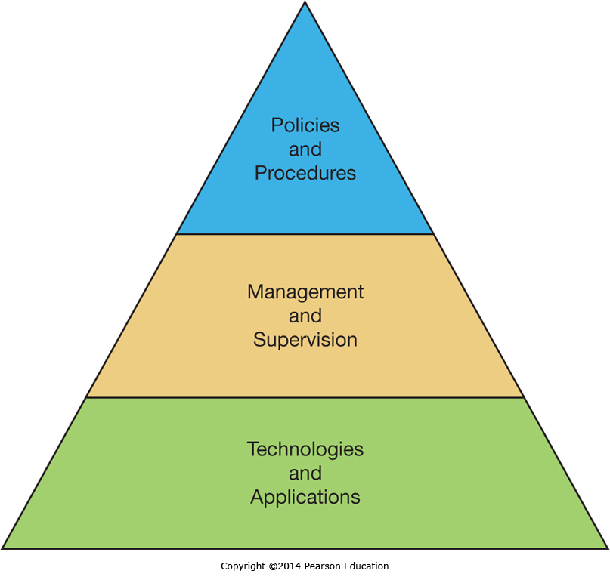
Information System Controls: Hierarchy
Notes:
We can look at Information System controls as varying from high-level policies and procedures through detailed low-level technologies and applications, with effective IT management and supervision bridging the implementation gap between the two.

Slide 40
Information System Controls
Preventive controls
Prevent events from occurring (e.g., block unauthorized access)
Detective controls
Determine if anything has gone wrong (e.g., detect that an unauthorized access has occurred)
Corrective controls
Mitigate problems after they arise
Notes:
Part of effective IS management is the implementation of effective IS controls. Much of what we have been discussing this chapter involves specific types of controls, and as we put it all together we can classify these controls as preventative, detective, or corrective.

Slide 41
The Sarbanes-Oxley Act
The Sarbanes-Oxley (S-OX) Act addresses financial controls
Companies must demonstrate controls are in place
Companies must preserve evidence documenting compliance
Information systems typically used to meet compliance requirements
Growing need for IS Auditors
Notes:
Sarbanes-Oxley is an act that legally requires corporations to have suitable financial controls in place. It requires companies meet control requirements, and document their compliance and preserve evidence. This typically means the appropriate use of information systems to ensure effective and efficient compliance. For example, capturing the evidence often means capturing all emails sent to or from the company in a centralized email repository.

Slide 42
End of Chapter Content

Slide 43
Managing in the Digital World: Not So “Anonymous”—Activists, Hacktivists, or Just Plain Criminals?
Anonymous
A loose collection of hacktivists
Practice civil disobedience by taking part in cyber attacks on websites
Deadliest tool is denial-of-service attack
Referred to as “The Punisher” of the World Wide Web
Well known for Internet vigilantism
Claiming to have good intentions, but activities are illegal
Dilemma between pursuing ideological goals and crossing the bounds of legality

Slide 44
Ethical Dilemma: Industrial Espionage
Industrial espionage is widespread, and critical information is always vulnerable to attacks
Most commonly associated with industries where research and development (R&D) is a significant expense
May be conducted by governments as well as competitors
Employees who can be bribed, coerced, or blackmailed often targeted
Ex-employees also an opportunistic target
When a company has been victimized, they may feel justified in using the same techniques to fight back

Slide 45
Who’s Going Mobile: Mobile Security
With hundreds of thousands of apps in app stores, the potential for mobile malware is significant
Malware could:
Collect data from compromised phones
Send texts which charge the user per text sent
By December of 2011 there were over 13,000 android focused malware apps
Apple and Google scan for Malware, but aren’t perfect
Other app sites often don’t scan, and jail broken phones that can access them are at high risk

Slide 46
Brief Case: 3D Crime Scenes
3D technology has progressed to allow practical law enforcement use
Crime scenes can be scanned and captured in minute detail
They can then be viewed from any possible angle and vantage point
3D maps of cities and buildings are also being stored to help foil future terrorist attacks

Slide 47
Coming Attractions: Speeding Security Screening
Airport and customs screening is time consuming and expensive
University of Arizona researchers have constructed an embodied conversational agent called AVATAR that can interview travelers
Multiple sensor technologies detect the travelers emotional state and likely deceptiveness
As more tests are run, researchers learn more and enhance it’s capabilities
One day it may take the lead in conducting travel interviews

Slide 48
Key Players: White Knights of the Internet Age
Every computer is vulnerable to attack
Security software is big business with many players
$17.7 billion in 2011
Specialized security companies
Symantec, TrendMicro, McAfee, Check Point, Kaspersky, Verint, AVG, etc.
General technology companies
EMC, CA, and IBM are three of the biggest
Many options for users and companies, but educating them in the need, and getting them to take appripriate action, may be the hardest of all

Slide 49
When Things Go Wrong: Stopping Insider Threats: WikiLeaks and Bradley Manning
Bradley Manning worked for the Army as an Intelligence Analyst and had access to multiple classified databases
Using a blank CD, he took unprecedented amounts of classified information and transferred it to WikiLeaks
WikiLeaks has been publishing the information under the belief that governments should be open and transparent
Bradley Manning caught after confiding to another former hacker
New safeguards are being deployed throughout the military and government to ensure there isn’t another Wikileaks type vent

Slide 50
Industry Analysis: Cybercops Track Cybercriminals
Police departments have been playing catch-up with technology, but are now making great strides
Every state and the FBI has dedicated cybercrime resources
Software tools for law enforcement have improved significantly
Law enforcement is reaching out to the community through social media
Law enforcement communications has been upgraded to block eavesdropping
While criminals may now be using technology to commit crimes, Law enforcement is using technology to catch them

