Slide 1
Information Systems in Organizations
2.1.2 Data Modeling with
Entity Relationship Diagrams (ERD)

Slide 2
Roadmap
Week 1: Intro to MIS
Week 2: Systems Analysis
Week 2: Systems Analysis
Week 3: Systems Analysis
Week 3
Swimlanes
ERDs
Decision Trees
Architecture Diagrams
Exam #1
Learn IT! #1
Max Labs 0
What is MIS?
Week 4: Organizational Systems
Week 4: Organizational Systems
Week 5: Organizational Systems
Week 5
Decision Support
SDLC
Exam #2
ERP
Knowledge Management
Digital Innovation
Max Labs 1a & 1b
Week 6: Organizational Systems
Week 6: Organizational Systems
Platforms
Week 7: Organizational Systems
Week 7
Customer Relationship Management Systems
Cloud Computing
Artificial Intelligence
Exam #3 Prep
Supply Chain Management Systems
Week 7: Organizational Systems
Max Labs 3a & 3b
Learn IT! #2
Max Labs 2a & 2b

Slide 3

Max Labs 0
This assignment is purely reading- read it! The other Max Labs are based off this reading.

Slide 4
Tools for Discussing: Processes,
Information, Business Rules, & Systems
2.1 Analyzing Organizations as Systems Processes
Systems Analysis
Systems Architecture
2.1.1 Modeling Processes with Swimlane Diagrams
2.1.2 Data Modeling with ERDs
2.1.3 Modeling Business Rules with Decision Trees
2.1.4 Conceptual Architecture Diagrams

Slide 5
Required Reading
Ultimate Guide to ER Diagrams
Entity Relationship Diagram Examples

Slide 6
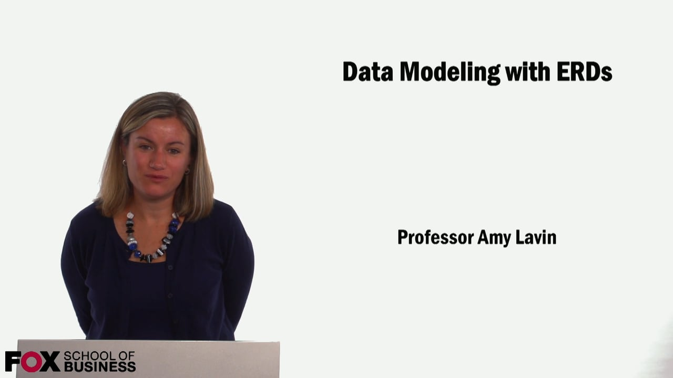
Required Viewing 1/1

Slide 7
Ultimate Guide to ER Diagrams
Discuss:
  What was this article about?
  Why should you care?
ERDs are a tool for modeling information. This article provides all of the basic information you need to model information with an ERD.
While swimlane diagrams are great for modeling business processes, all business processes require information to perform them. An ERD is a great tool to use to model information and the ERD supplements the swimlane diagram to get a better understanding of the entire business process

Slide 8
Entity Relationship Diagram Examples
Discuss:
  What was this article about?
  Why should you care?
This article simply provides examples of ERDs.
ERDs are a little more difficult to visualize than swimlane diagrams and looking through examples of ERDs can frequently make them easier to understand.

Slide 9
?
Entity = Noun
Attribute = Characteristic
What is an “entity relationship diagram”?
Data Model
Relationship = Verb

Slide 10
What is a entity relationship diagram?
An Entity Relationship Diagram (ERD) is a visual representation of different data using conventions that describe how these data are related to each other.

Slide 11
Primary ERD Symbols
Chen’s Database Notation
Entity = noun
example : Shopper or Item
Attribute = characteristic
example : item price
Relationship = verb
example : buys

Slide 12
Translating
A shopper walks into a store to buy an item. When the shopper makes a purchase, the system is updated with information about the person, including their name, loyalty card id and zip code. The store also records which items were purchased, including details like item name, price and item source.

Slide 13
Entity Relationship Diagram (ERD)
Chen’s Database Notation

Slide 14
Entity Relationship Diagram (ERD)
Crow’s Foot Database Notation

Slide 15
Crow’s Foot Database Notation
A shopper walks into a store to buy an item. When the shopper makes a purchase, the system is updated with information about the person, including their name, loyalty card id and zip code. The store also records which items were purchased, including details like item name, price and item source.
Chen’s Database Notation

Slide 16
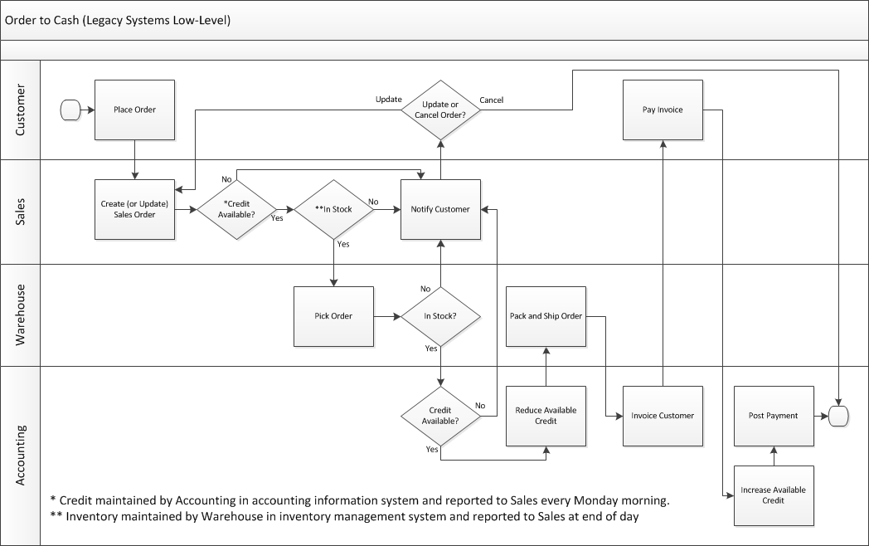
What pieces of information do I need to take, check, ship and bill the customer for this order?
Work with you classmate to make a list.

Slide 17
Relationship, i.e. verb is written on the arrow
Entity listed at the top of the table
Attributes are listed under the entity
Legend :
PK : Primary Key
FK : Foreign Key (refer to PK)

Slide 18
?
Let’s practice ERD…
You are forming a new club at Temple U
You want to create a DB to capture the data on your members, your committee and your events
Name 3 entities, list at least 3 attributes for each
How do they relate to each others? (i.e. relationship)

