Slide 1
Information Systems in Organizations
3.1.1 Running the Business: Enterprise Systems (ERP)

Slide 2
Roadmap
Week 1: Intro to MIS
Week 2: Systems Analysis
Week 2: Systems Analysis
Week 3: Systems Analysis
Week 3
Swimlanes
ERDs
Decision Trees
Architecture Diagrams
Exam #1
Learn IT! #1
Max Labs 0
What is MIS?
Week 4: Organizational Systems
Week 4: Organizational Systems
Week 5: Organizational Systems
Week 5
Decision Support
SDLC
Exam #2
ERP
Knowledge Management
Digital Innovation
Max Labs 1a & 1b
Week 6: Organizational Systems
Week 6: Organizational Systems
Platforms
Week 7: Organizational Systems
Week 7
Customer Relationship Management Systems
Cloud Computing
Artificial Intelligence
Exam #3 Prep
Supply Chain Management Systems
Week 7: Organizational Systems
Max Labs 3a & 3b
Learn IT! #2
Max Labs 2a & 2b

Slide 3
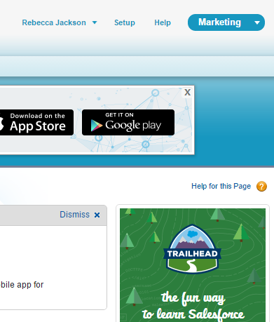
How to: Max Labs
1. Review the preflight checklist. (Trust us, it’s worth it.)
2. Read through and follow Max’s steps on your own Salesforce account.
3. Take screen shots where indicated
  Make sure your name is visible
  You will not receive credit if your name is not visible.
4. Paste screenshots into the numbered spot in the answer sheet.
5. Follow the directions provided by your instructor to hand your answer sheet in before the due date.
6. No late assignments accepted. No exceptions.

Slide 4

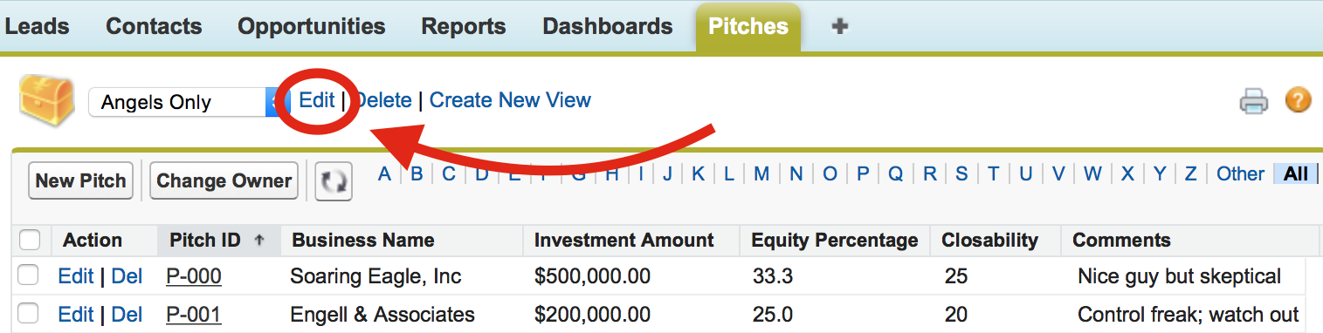
Max Labs 1a & 1b
Due 02/09-11:59PM
– Each part will take about an hour
Max Labs 1a
  2 Screenshots
  Make a salesforce account – use TUmail!
  Make Max’s app!
Max Labs 1b
  4 Screenshots
  Use your app to find “loaded & likely” investors
  Track and monitor tasks

Slide 5
Creating Systems for a Business
3.1 Types of Systems in Organizations
3.1.1 Enterprise Systems (ERP)
3.1.2 Decision Support
3.1.3 Knowledge management, R&D, and social business
3.2 Systems Management
3.3 Digital Business Innovation

Slide 6
Required Reading
What is ERP?
Wikipedia, ERP
Putting the Enterprise into ERP
9 Tips for Selecting and Implementing ERP Systems

Slide 7
What is ERP?
Discuss:
  1. What was this article about?
  2. Why should you care?
This is a short article that provides a basic explanation of what ERP is, where ERP systems came from and the high level benefits of investing in an ERP.
ERP systems represent some of the largest, most expensive, most complicated, highest risk and greatest reward technology investments an organization can make. Business people need to understand them, the pros and the cons, and make good choices.

Slide 8
Wikipedia, ERP
Discuss:
  1. What was this article about?
  2. Why should you care?
While the previous article was a nice introduction to ERP, this article goes into a little more depth in all of the same basic areas.
ERP systems represent some of the largest, most expensive, most complicated, highest risk and greatest reward technology investments an organization can make. Business people need to understand them, the pros and the cons, and make good choices.

Slide 9
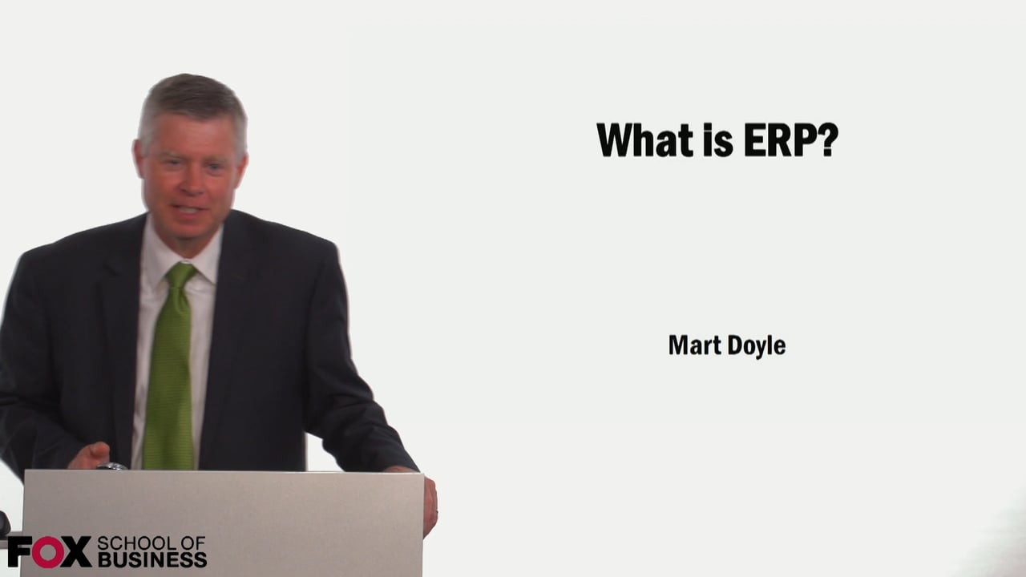
Required Viewing 1/2

Slide 10
?
Business processes that span multiple functional areas
Change
Risks
Single Database
Costs
Executive Support
What is an ERP system?
One copy of data
Many modules
Integration Partner
Benefits
SAP, Oracle and Microsoft
Single System

Slide 11
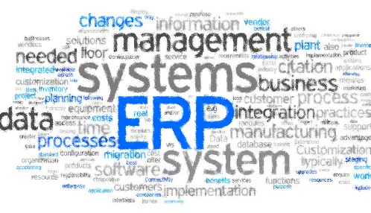
Value Proposition for All Businesses
Gives a global, real-time view of data that can enable companies to address concerns proactively and drive improvements
Improves financial compliance with regulatory standards and reduces risk
Automates core business operations such as lead-to-cash, order-to-fulfillment, and procure-to-pay processes
Enhances customer service by providing one source for billing and relationship tracking.

Slide 12
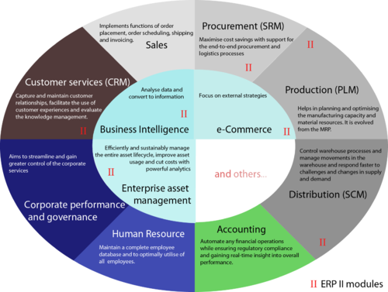

Slide 13
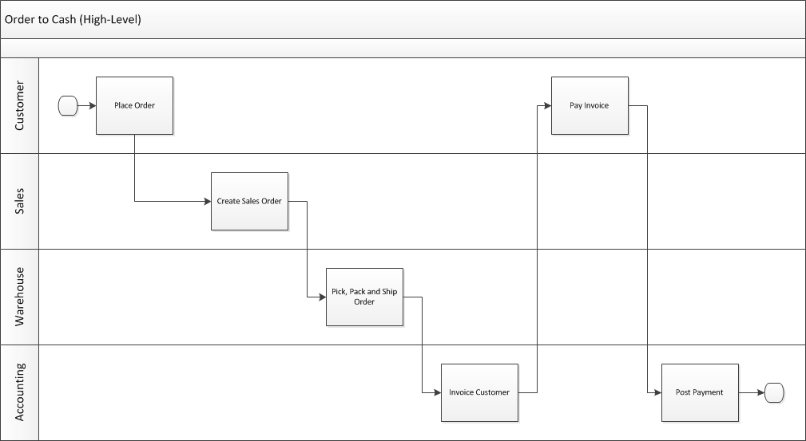
Remember Swim Lane Diagram?
Who does what and when?

Slide 14
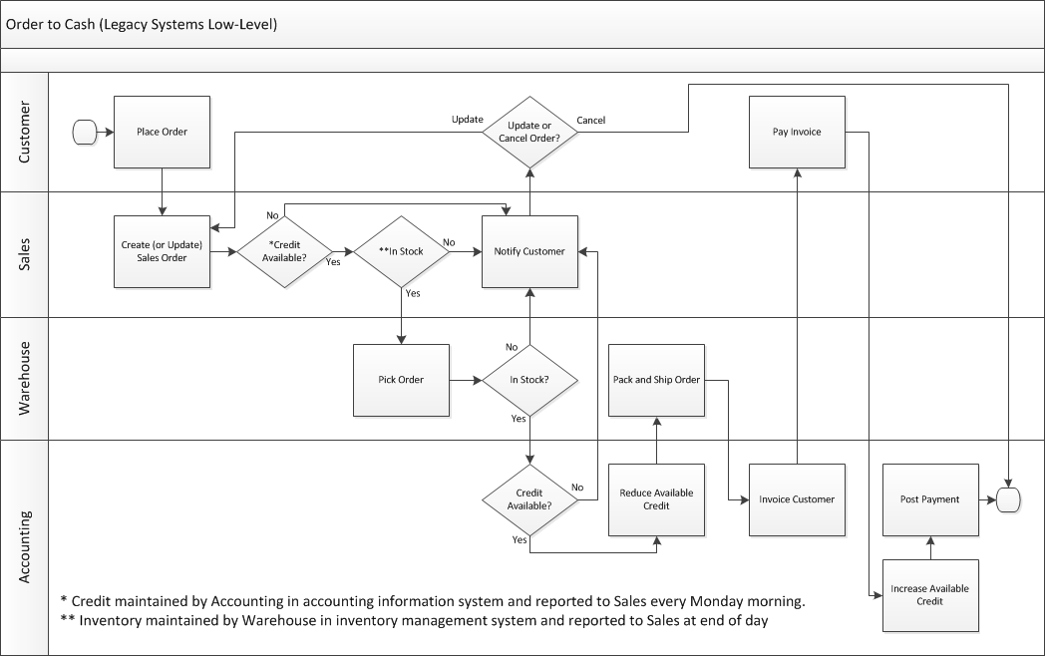

Slide 15
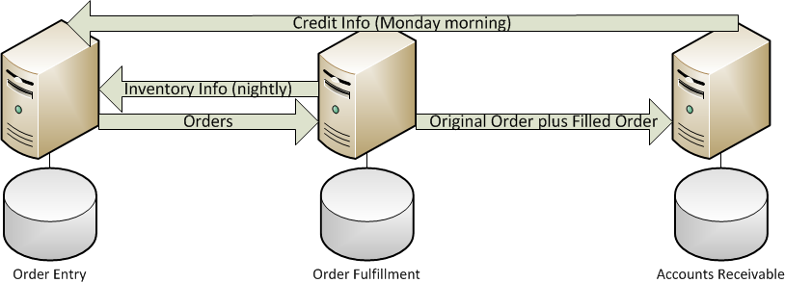
Legacy Systems
Sales
Warehouse
Accounting

Slide 16
Does your customer view your organization as the “well oiled machine”?
What kind of non-value added work is created when inventory data or credit data is old?

Slide 17
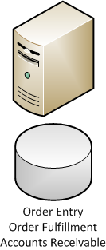
Enterprise System
Sales + Warehouse + Accounting
How many copies of data do I have?
How much non-value added work do I eliminate when inventory and credit data are current?
How much better is my decision making with a single copy of all data?
How much happier are your customers when they are dealing with the “well oiled machine”?

Slide 18
Exercise
On the following slide, identify all of the system interfaces:
  What system needs to talk to what other system
  One line per data flow

Slide 19
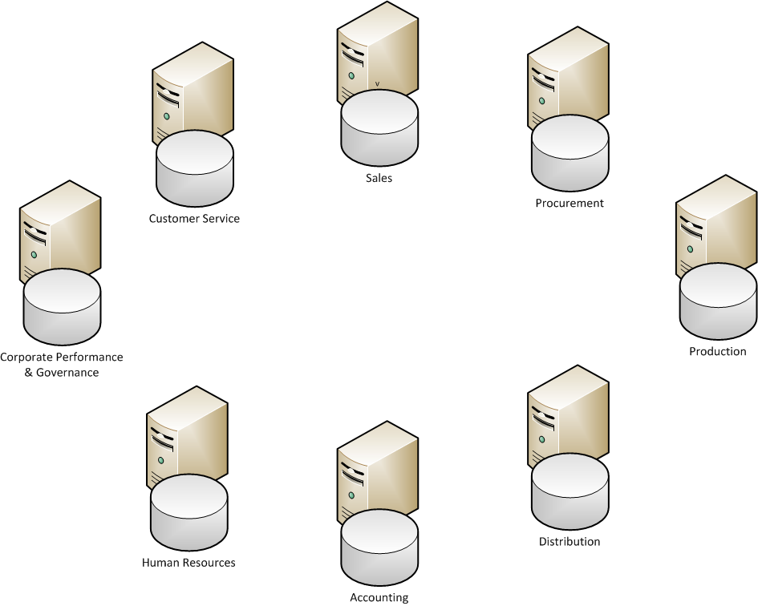

Slide 22
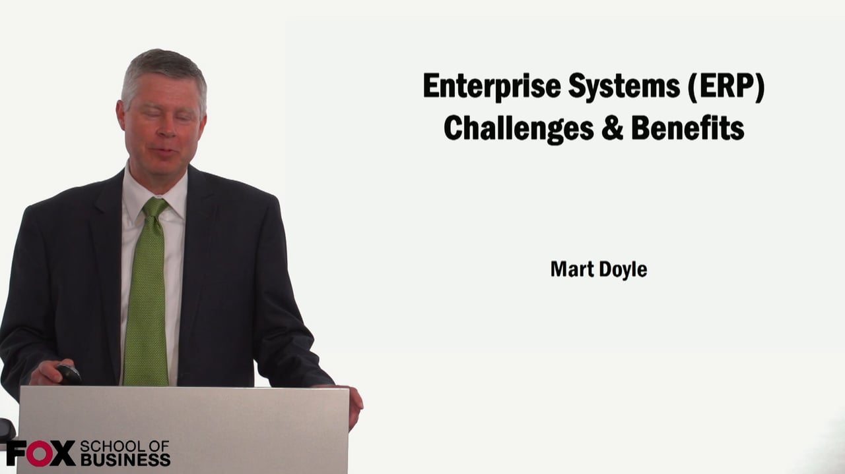
Required Viewing 2/2

Slide 23
ERP Challenges
Adoption – People HATE change!
Configuration is extremely complex
  Vanilla (config change only) vs. Customization
Implementation is extremely complex
Costs
  Rohm and Haas spent $300 million over a period of three years
  What else could they have done with $300 million?
Risks
  Mega-failures with ERP implementations in the mid-90s
  Many companies went out of business as a result
Internally focused
  Need supply chain and customer relationship management too

Slide 24
Putting the Enterprise into Enterprise Systems
Discuss:
  1. What was this article about?
  2. Why should you care?
Enterprise systems are marvels of technology but they are not for everyone. There can be significant downsides for many organizations.
The decision to invest in an enterprise system is a business decision, NOT a technology decision. Organizations need to understand all of the business implications before heading down this path.

Slide 25
ERP Benefits
A single database providing superior, real-time, data-driven decision making
Standardizing business processes based on industry best practices
  Force business process reengineering
Reduced operating costs
  Rohm and Haas saved $200 million/year

Slide 26
Leaders in the ERP Space
SAP
Oracle
Microsoft Dynamics
New cloud based ERP providers?

Slide 27
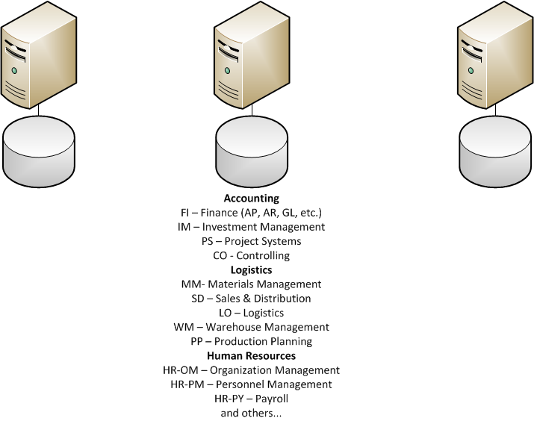
SAP SCM
SAP ERP
SAP CRM

Slide 28
9 Tips for Selecting Implementing an ERP System
Discuss:
  1. What was this article about?
  2. Why should you care?
While the early days of ERP implementations where fraught with peril, over the years industry has developed best practices for successful ERP implementation. This article lists and describes some of these best practices.
If you are working at an organization that is considering investing in an ERP, learn from the past and don’t make costly mistakes that could destroy your business.

Slide 29
Making it Happen
Executive Sponsor
Driven by the business, not by IT
Requires experts from all of the functional areas
Top-tier Integration Partner
Training, training, training
Testing, testing, testing
Don’t cut corners!
  It could cost you a fortune
  It could cost you your business

