Slide 1
Information Systems in Organizations 3.1.2. Managing the business: decision-making 3.1.3. Growing the business: knowledge management, R&D, and social business

Slide 2
Roadmap
Week 1: Intro to MIS
Week 2: Systems Analysis
Week 2: Systems Analysis
Week 3: Systems Analysis
Week 3
Swimlanes
ERDs
Decision Trees
Architecture Diagrams
Exam #1
Learn IT! #1
Max Labs 0
What is MIS?
Week 4: Organizational Systems
Week 4: Organizational Systems
Week 5: Organizational Systems
Week 5
Decision Support
SDLC
Exam #2
ERP
Knowledge Management
Digital Innovation
Max Labs 1a & 1b
Week 6: Organizational Systems
Week 6: Organizational Systems
Platforms
Week 7: Organizational Systems
Week 7
Customer Relationship Management Systems
Cloud Computing
Artificial Intelligence
Exam #3 Prep
Supply Chain Management Systems
Week 7: Organizational Systems
Max Labs 3a & 3b
Learn IT! #2
Max Labs 2a & 2b

Slide 3
Creating Systems for a Business
3.1 Types of Systems in Organizations
3.1.1 Enterprise Systems (ERP)
3.1.2 Decision Support
3.1.3 Knowledge management, R&D, and social business
3.2 Systems Management
3.3 Digital Business Innovation

Slide 4
Required Reading
The Decision-Making Process
How NBA Player Analytics Opened up A Whole New Business for SAP
The Real Reason Organizations Resist Analytics
What is KM? Knowledge Management Explained

Slide 5
Required Viewing 1/5

Slide 6
Required Viewing 2/5

Slide 7
The Decision Making Process
Discuss:
1. What was this article about?
2. Why should you care?
While we make decisions every day, the best decision makers follow a repeatable process (even if they don’t realize it) when making decisions. This article describes this process.
Learn from the best when making decision. Tools like decision support systems, if you know how to use them, can be extremely valuable.

Slide 8
Define the problem.
Identify limiting factors.
Develop potential alternatives
Analyze the alternatives
Select the best alternative
Implement the decision
Establish a control and evaluation system

Slide 9
Structured and Unstructured Data
Structured
Everything we have done in this course thus far
ERD, organizational databases, ERP
Clearly defined data entities, types, relationships, and hierarchies
Unstructured
User generated data
Email
Facebook posts
Tweets
Comments on sites
Images
Videos
Blogs
Chaos!

Slide 10
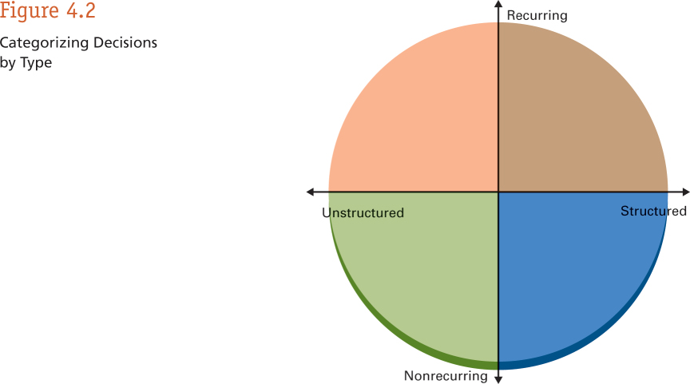
Types of Decisions You Face
Daily & Weekly
regimented tasks
Analytics can help solve big, complex problems and questions

Slide 11
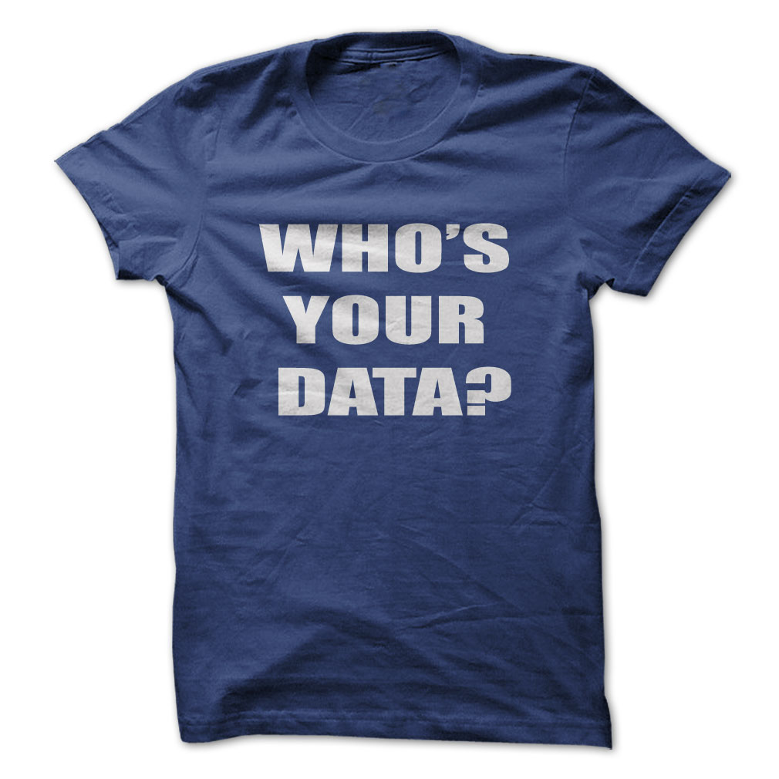
What is
Data Analytics?

Slide 12
…Analytics is the process of making sense of large data sets and unlocking patterns, often using data visualization, to enable better decision making.

Slide 13
What to do with all this Data?
Data
Information
Knowledge
Data analytics is the art and science of examining raw data for the purpose of gaining insight and drawing actionable conclusions about business problems (Alalouf).
Big data analytics is the process of examining big data to uncover hidden patterns, unknown correlations and other useful information that can be used to make better decisions (SAS).

Slide 14
Data Analytics
Descriptive Analytics
Track consumer behavior
How do users interface with a web site?
Describes what is happening
Predictive Analytics
What will consumers buy? (Better yet, what do they want, but don’t know they want yet?)
When will demand surge?

Slide 15
Why should you care about Data?

Slide 17
Google Analytics
Tracks web site metadata & user engagement
# of sessions
Average session duration
Number of pages visited and duration at each
Bounce rate
Conversion
Learn IT #5!!!

Slide 18
How NBA Player Analytics Opened Up A Whole New Business for SAP
Discuss:
1. What was this article about?
2. Why should you care?
This article describes how data analytics has impacted the NBA in ways that nobody would have envisioned a decade ago.
The business world has now gotten religion over data analytics. It has many, many applications in many, many fields. If you haven’t figured out how to leverage it in your business but your competitors have, you may find yourself at a serious competitive disadvantage. Don’t let that happen!

Slide 19
The Real Reason Organizations Resist Analytics
Discuss:
1. What was this article about?
2. Why should you care?
While data driven decision making sounds like it makes complete sense, some organizations resist because they don’t like what the data is telling them.
Data analytics exposes problems, not just opportunities and people don’t like to be held accountable for problems. Leverage data, understand what it is telling you, fix your problems and move forward. If you burry your head in the sand you will lose out to your competitors.

Slide 20
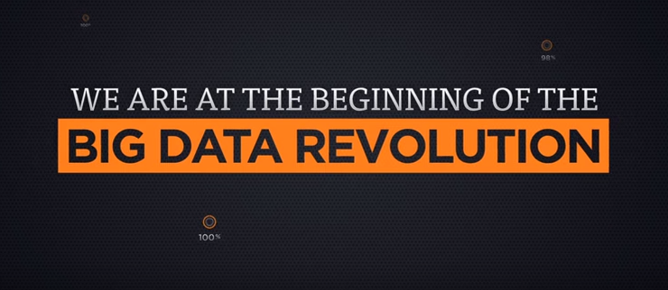
Short Clip: Big Data Revolution

Slide 21
Required Viewing 3/5

Slide 22
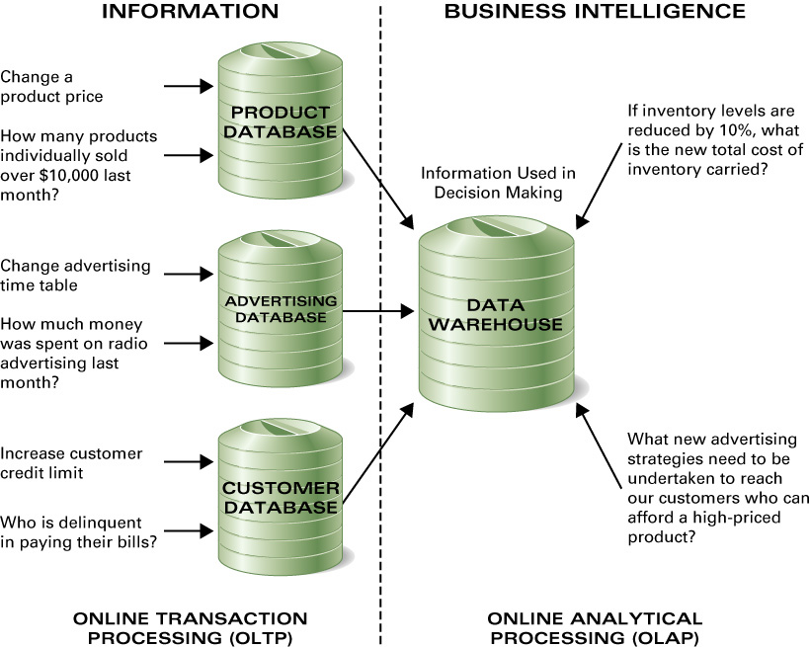
Databases & Data Warehouses

Slide 23
OLTP
Online transaction processing, or OLTP, is a class of information systems that facilitate and manage transaction-oriented applications, typically for data entry and retrieval transaction processing.
OLTP is characterized by a large number of short on-line transactions (INSERT, UPDATE, DELETE). The main emphasis for OLTP systems is put on very fast query processing, maintaining data integrity in multi-access environments and an effectiveness measured by number of transactions per second. In OLTP database there is detailed and current data, and schema used to store transactional databases is the entity model.

Slide 24
OLAP
OLAP is an acronym for online analytical processing, which is a computer-based technique of analyzing data to look for insights. The term cube here refers to a multi-dimensional dataset, which is also sometimes called a hypercube if the number of dimensions is greater than 3.
OLAP is characterized by relatively low volume of transactions. Queries are often very complex and involve aggregations. For OLAP systems a response time is an effectiveness measure. OLAP applications are widely used by Data Mining techniques. In OLAP database there is aggregated, historical data, stored in multi-dimensional schemas.

Slide 25
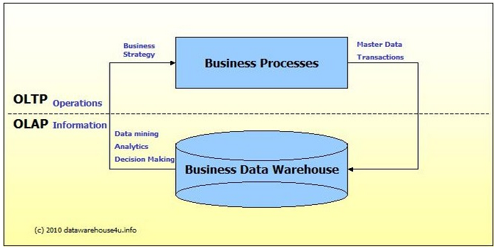
Source: http://datawarehouse4u.info/OLTP-vs-OLAP.html

Slide 26
Required Viewing 4/5

Slide 27
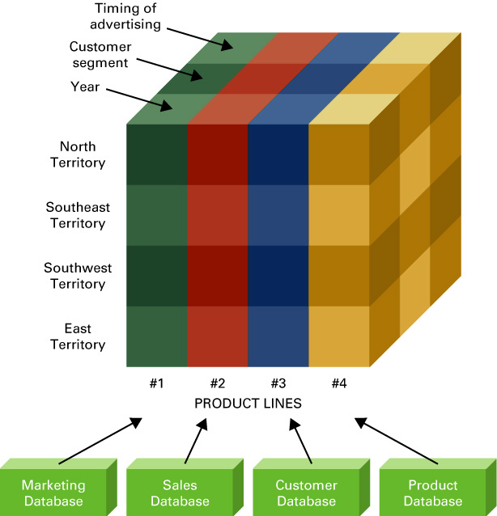
What Is a Hypercube?
Multi-dimensional “cubes” of information that summarize transactional data across a variety of dimensions.

Slide 28
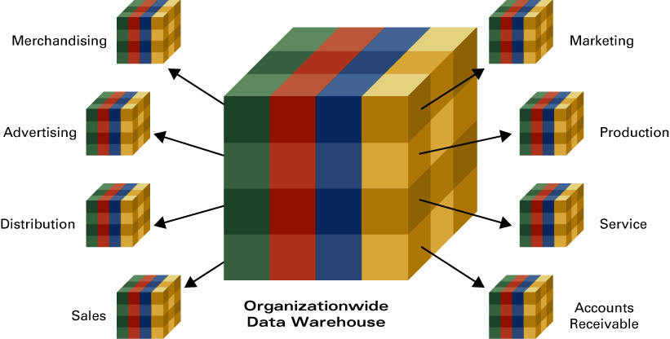
Data Marts

Slide 29
Roadmap
Week 1: Intro to MIS
Week 2: Systems Analysis
Week 3: Systems Analysis
Week 4: Systems Analysis
Week 5
Swimlanes
ERDs
Decision Trees
Architecture Diagrams
Exam #1
Max Labs 0
What is MIS?
Week 6: Organizational Systems
Week 7: Organizational Systems
Week 8: Organizational Systems
Week 9
Decision Support
SDLC
Exam #2
ERP
Knowledge Mgmt
Digital Innovation
Max Labs 1a & 1b
Learn IT! #1
Week 10: Organizational Systems
Week 11: Organizational Systems
Platforms
Week 13: Organizational Systems
Week 14
Customer Relationship Management Systems
Cloud Computing
Artificial Intelligence
Exam #3 Prep
Supply Chain Management Systems
Week 12: Organizational Systems
Max Labs 3a & 3b
Learn IT! #2
Max Labs 2a & 2b

Slide 30
Creating Systems for a Business
3.1 Types of Systems in Organizations
3.1.1 Enterprise Systems (ERP)
3.1.2 Decision Support
3.1.3 Knowledge management, R&D, and social business
3.2 Systems Management
3.3 Digital Business Innovation

Slide 31
What is KM? Knowledge Management Explained
Discuss:
1. What was this article about?
2. Why should you care?
This article explains what knowledge management is all about including the types of knowledge, constitutes knowledge management and the stages of development an organization goes through as they leverage this technology.
A lot of CEOs are losing sleep as the baby-boomers start to retire and knowledge, possibly the most precious asset of an organization, walks out of the office and onto the golf course. Business professional need to understand these technologies and leverage them to limit the impact.

Slide 32
Required Viewing 5/5

Slide 33
?
What is “Knowledge Management”?
Knowledge management (KM) is the process of capturing, developing, sharing, and effectively using organizational knowledge. It refers to a multi-disciplinary approach to achieving organizational objectives by making the best use of knowledge.

Slide 34
Question
What is a “Baby Boomer” and how many of them are in the workforce today?
How many will be in the workforce 10 years from now?
What is “Tacit Knowledge”?
Why is this keeping CEOs awake at night?
Is there technology that we can use to help with this?

Slide 35
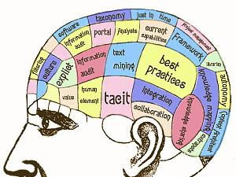

Slide 36
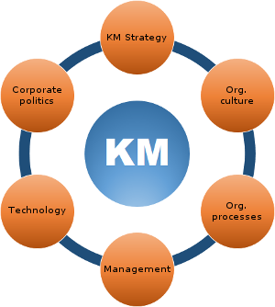
What are the benefits of Knowledge Management?
What are the challenges of Knowledge Management?

Slide 37
Domain
Community
Community of Practice
Practice
Purpose

Slide 38
Roadmap
Week 1: Intro to MIS
Week 2: Systems Analysis
Week 2: Systems Analysis
Week 3: Systems Analysis
Week 3
Swimlanes
ERDs
Decision Trees
Architecture Diagrams
Exam #1
Learn IT! #1
Max Labs 0
What is MIS?
Week 4: Organizational Systems
Week 4: Organizational Systems
Week 5: Organizational Systems
Week 5
Decision Support
SDLC
Exam #2
ERP
Knowledge Management
Digital Innovation
Max Labs 1a & 1b
Week 6: Organizational Systems
Week 6: Organizational Systems
Platforms
Week 7: Organizational Systems
Week 7
Customer Relationship Management Systems
Cloud Computing
Artificial Intelligence
Exam #3 Prep
Supply Chain Management Systems
Week 7: Organizational Systems
Max Labs 3a & 3b
Learn IT! #2
Max Labs 2a & 2b

