Slide 1
Information Systems in Organizations 3.2 Systems Management 3.3 Digital Business Innovation

Slide 2
Roadmap
Week 1: Intro to MIS
Week 2: Systems Analysis
Week 2: Systems Analysis
Week 3: Systems Analysis
Week 3
Swimlanes
ERDs
Decision Trees
Architecture Diagrams
Exam #1
Learn IT! #1
Max Labs 0
What is MIS?
Week 4: Organizational Systems
Week 4: Organizational Systems
Week 5: Organizational Systems
Week 5
Decision Support
SDLC
Exam #2
ERP
Knowledge Management
Digital Innovation
Max Labs 1a & 1b
Week 6: Organizational Systems
Week 6: Organizational Systems
Platforms
Week 7: Organizational Systems
Week 7
Customer Relationship Management Systems
Cloud Computing
Artificial Intelligence
Exam #3 Prep
Supply Chain Management Systems
Week 7: Organizational Systems
Max Labs 3a & 3b
Learn IT! #2
Max Labs 2a & 2b

Slide 3
How to: Max Labs
1. Review the preflight checklist. (Trust us, it’s worth it.)
2. Read through and follow Max’s steps on your own Salesforce account.
3. Take screen shots where indicated
Make sure your name is visible
You will not receive credit if your name is not visible.
4. Paste screenshots into the numbered spot in the answer sheet.
5. Follow the directions provided by your instructor to hand your answer sheet in before the due date.
6. No late assignments accepted. No exceptions.

Slide 4
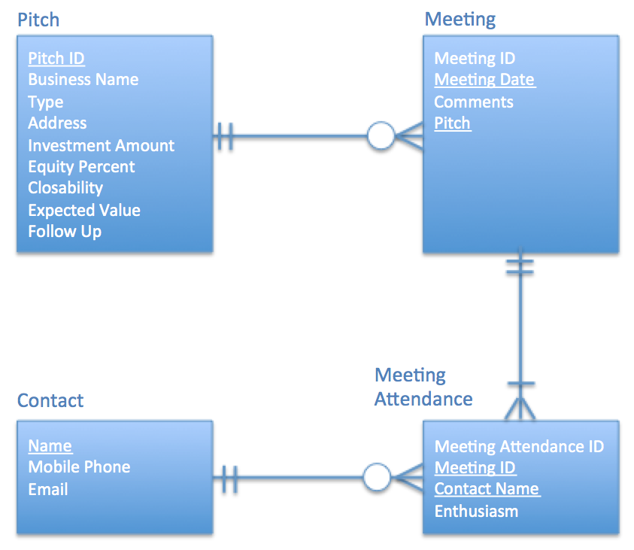
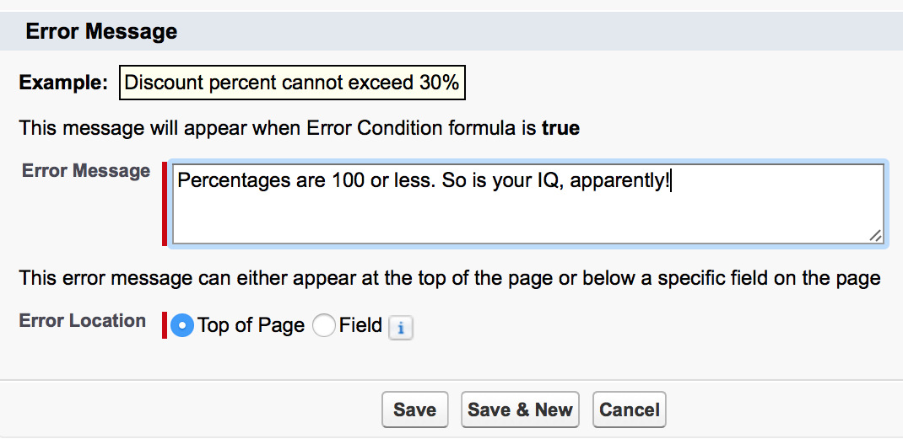
Max Labs 2a & 2b
Due 02/16-11:59PM
– Each part will take about an hour
Max Labs 2a
3 Screenshots
Learn about how to fix & prevent errors in data
Build to the user’s need
Max Labs 2b
2 Screenshots
Protect the integrity of your data
Create a big, beautiful data “map”

Slide 5
Creating Systems for a Business
3.1 Types of Systems in Organizations
3.1.1 Enterprise Systems (ERP)
3.1.2 Decision Support
3.1.3 Knowledge management, R&D, and social business
3.2 Systems Management
3.3 Digital Business Innovation

Slide 6
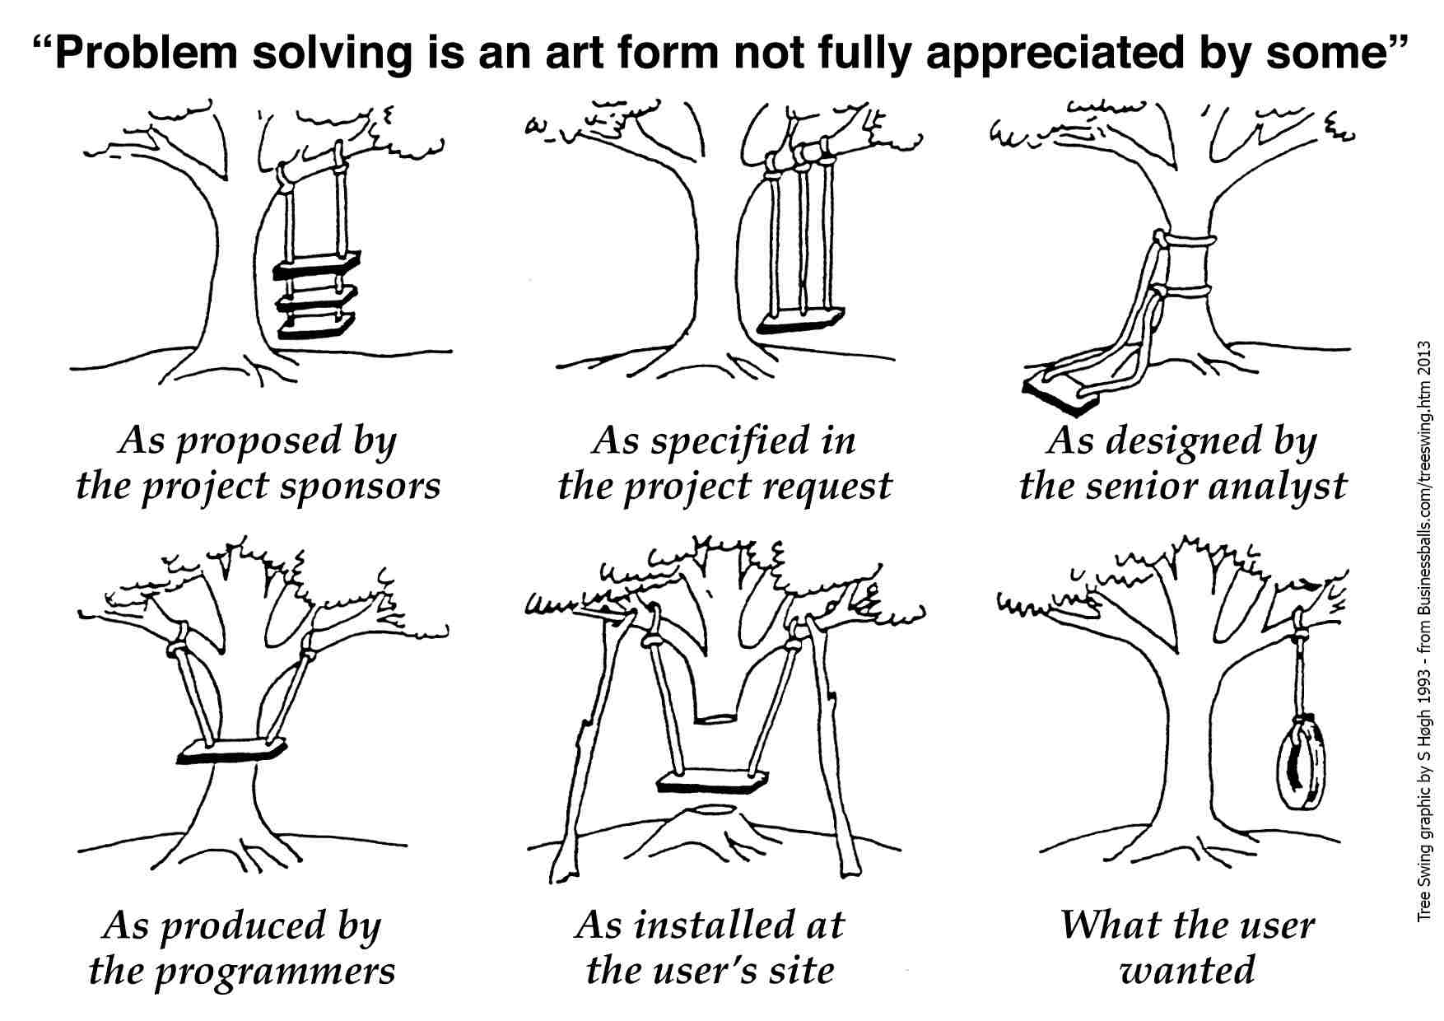

Slide 7
Required Reading
Wikipedia, System Development Lifecycle
Build vs. Buy: How to Know When You Should Build Custom Software Over Canned Solutions
What We Know About the Internet’s Disruptive Power
The 5 Tech Trends that will Dominate CES and 2017
Leagues Sees Real Benefits in Daily Fantasy Sports
Hidden in the Long Tail

Slide 8
Wikipedia, Systems Development Lifecycle
Discuss:
1. What was this article about?
2. Why should you care?
Working as part of the business, IT people create system that provide value to the organization. This article describes the processes followed by the IT organizations when they create systems.
Regardless of your major, as a business person working in an organization, you will be involved in the envisioning, planning and deployment of systems for your organizations. The better you understand how the IT people create system, the more you can contribute to the process and the more successful you all will be.

Slide 9
Required Viewing 1/4

Slide 10
?
Testing
Waterfall
Maintenance
Design
Go Live
Requirements
What is the Systems Development Life Cycle (SDLC)?
Buy vs. Build
Analysis
Training
Coding
Agile

Slide 11
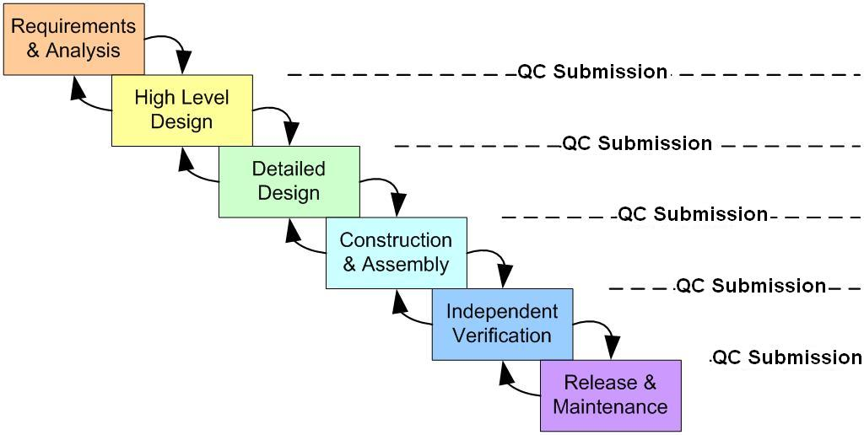
SDLC Phases: Waterfall Methodology
Requirements Gathering and the BRD
Concept Map & Architecture Diagram; Build vs. Buy Decision
Modeling: Swim Lanes & Entity Relationship Diagrams
Engineering & Implementation
Acceptance Testing, Training
Go Live
Maintenance, Upgrade & Support

Slide 12
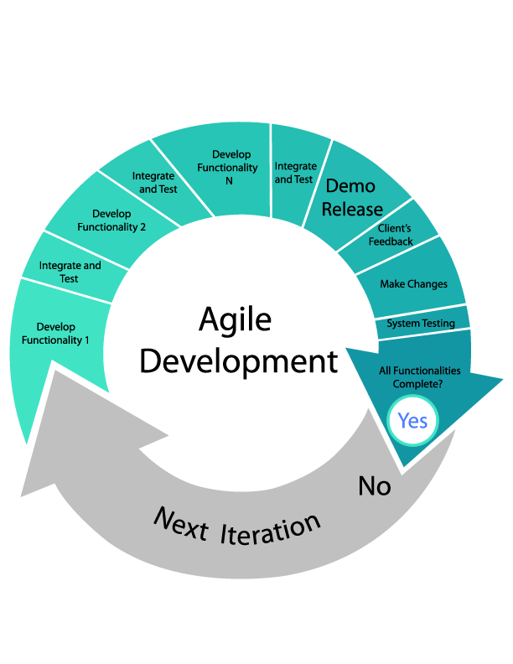

Slide 13
Build vs. Buy: Hot to Know When You Should Build Custom Software Over Canned Solutions
Discuss:
1. What was this article about?
2. Why should you care?
Sometimes it is better to buy a system than build it yourself. Sometimes it is better to build a system than buy it off the shelf. This article explains why you might make one choice over another.
Regardless of your major, as a business person working in an organization, you will be involved in the envisioning, planning and deployment of systems for your organizations. When you must make the “build vs. buy” choice, you need to make the right choice for the right reason.

Slide 14
Required Viewing 2/4

Slide 15
Compliance Considerations
Sarbanes-Oxley
HIPAA
HITECH
FDA
CMS
Safe Harbor Agreement

Slide 16
Sarbanes-Oxley (2002)
Enacted in response to major accounting scandals involving Enron and WorldCom
Designed to prevent accounting fraud, increase corporate transparency, eliminate conflicts of interest, and protect whistle-blowers
Has major impact on ERP systems and business software

Slide 17
Sarbanes-Oxley (2002)
Public Company Accounting Oversight Board (PCAOB)
Auditor Independence
Corporate Responsibility
Enhanced Financial Disclosures
Analyst Conflicts of Interest
Studies and Reports
Corporate and Criminal Fraud Accountability
White Collar Crime Penalty Enhancement
Corporate Tax Returns (CEO)
Corporate Fraud Accountability

Slide 18
HIPAA (1996)
Title I: Health Care Access, Portability, and Renewability
Title II: Preventing Health Care Fraud and Abuse; Administrative Simplification; Medical Liability Reform
HIPAA Privacy Rule (2003)
Transactions and Code Sets Rule
Security Rule
Unique Identifiers Rule (National Provider Identifier)
Enforcement Rule

Slide 19
HITECH Act (2009)
Health Information Technology for Economic and Clinical Health Act
"the most important piece of health care legislation to be passed in the last 20 to 30 years”
"foundation for health care reform”
Electronic Health Record (EHR)

Slide 20
Creating Systems for a Business
3.1 Types of Systems in Organizations
3.1.1 Enterprise Systems (ERP)
3.1.2 Decision Support
3.1.3 Knowledge management, R&D, and social business
3.2 Systems Management
3.3 Digital Business Innovation

Slide 21
Required Viewing 3/4

Slide 22
The Information Age
Redefining the Rules of Business
“Digital innovators are marked by their ability to join two things together –
An understanding of what has become possible due to advances in technology and,
An astute insight into some unmet organizational of societal need
In order to create something new and valuable with digital technology…
This means that just about every business professional today has the opportunity-or even the obligation, given the growing importance of digital technology to organizational success- to become, in some form, a digital innovator.”
- Fichman, Dos Santos and Zheng

Slide 23
What We Know, Now, About the Internet’s Disruptive Power
Discuss:
1. What was this article about?
2. Why should you care?
This article discusses not just the accelerating pace of change introduced by technology but the widening of scale that technology has impacted.
The impact of technology is far more than Facebook and Uber. Understand the changes in technology over the past 30 years, understand your business and position your business to be successful in this chaotic new world or be decimated by your competitors.

Slide 24
The disruptive Power of the Internet
How has the internet changed the way business operates?
How we market products and services
How we process payment
How we discover new prospects
Virtual reality driven businesses
New opportunities for crime

Slide 25
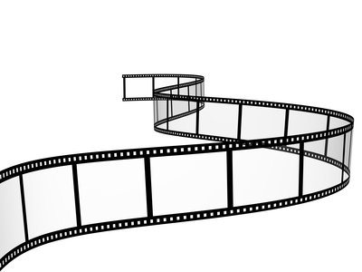
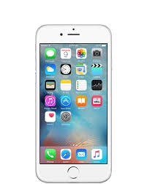
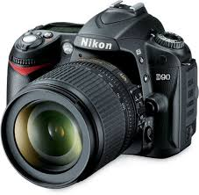
How has the photographic equipment industry been disrupted?
?

Slide 26
Effects of the Internet
Increase in competition
Decrease in margins
Increase in caliber and quality
Increase in rate of change

Slide 27
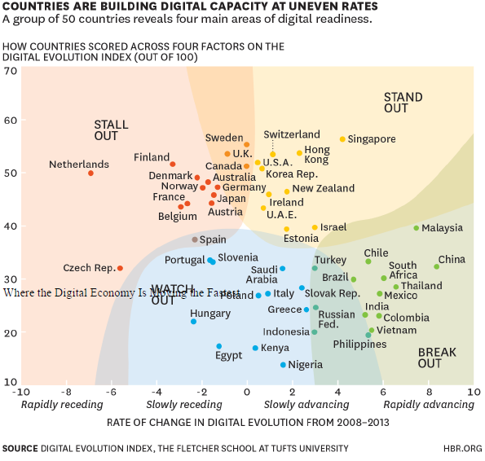

Slide 28
The 5 Tech Trends that will Dominate CES and 2017
Discuss:
1. What was this article about?
2. Why should you care?
This article highlights the five hottest tech trends from the Consumer Electronic Show
Consumer electronics often impact businesses enabling them to transform existing business models or create new business models. Organizations need to keep an eye on these trends to remain competitive in the marketplace.

Slide 29
Different Realities

Slide 30
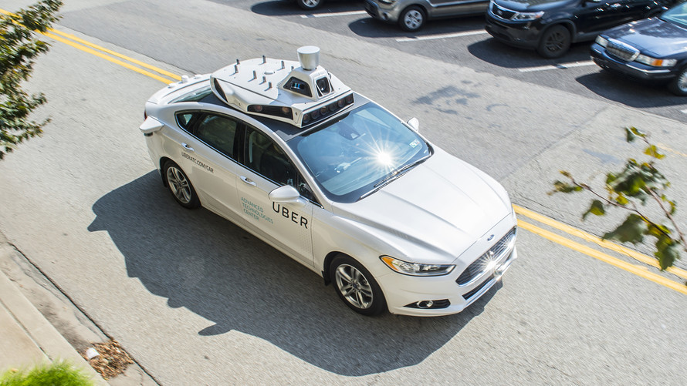
Driverless Cars

Slide 31
Wearables

Slide 32
Artificial Intelligence

Slide 33
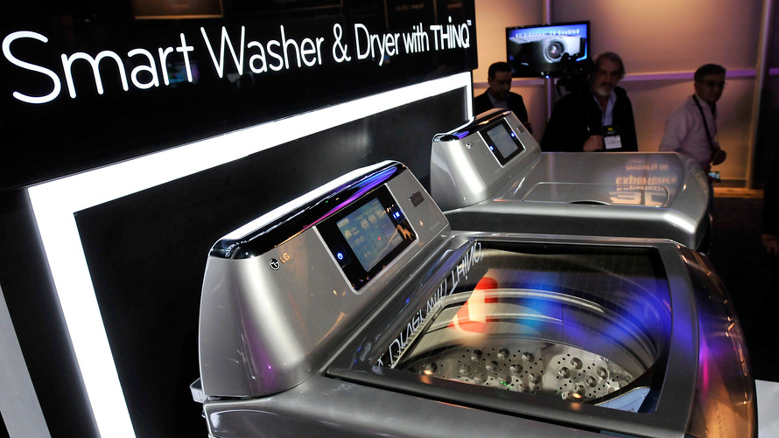
The Cloud and IoT

Slide 34
Leagues See Real Benefits in Daily Fantasy Sports
Discuss:
1. What was this article about?
2. Why should you care?
This article is a great overview of fantasy sports leagues and how people are making money from this.
This is just another great example of how technology has been leveraged to change existing business models and create entirely new business models for those with vision and an understanding of technology.

Slide 35
Fantasy Sports
Great for:
Live viewership
Advertising
Content Providers
Real money in imaginary games

Slide 36
Hidden in the Long Tail
Discuss:
1. What was this article about?
2. Why should you care?
This article describes how the internet has created new, lucrative markets for obscure products that might not be practical to deliver through traditional channels. This is especially true for digital products.
This is just another great example of how technology has been leveraged to change existing business models and create entirely new business models for those with vision and an understanding of technology.

Slide 37
Required Viewing 4/4

Slide 38
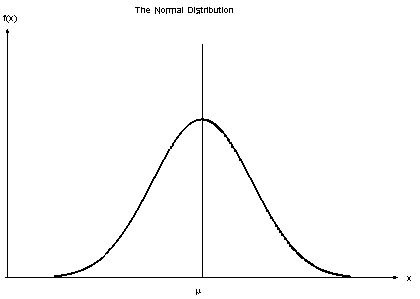
Normal Distribution
J. C. F. Gauss
Central Limit Theorem
Symmetry around μ
μ is the confluence of the mean, median, and mode of the data
μ splits the data in half

Slide 39
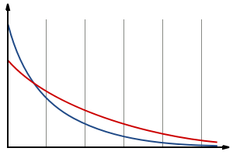
Long Tail Distribution
Variety > bestsellers
Netflix
Amazon
iTunes
There’s money in the tail
Advertising products
Google
Yahoo
Bing
Travel bookings
How does a company “fatten the tail?”

Slide 40
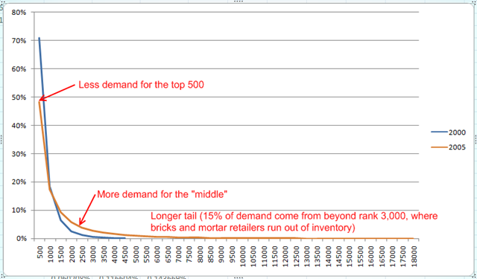
Netflix Long Tail
“…gets most of its profits from a large number of infrequently requested movies rather than from few large and profitable movies.”

Slide 41
Roadmap
Week 1: Intro to MIS
Week 2: Systems Analysis
Week 2: Systems Analysis
Week 3: Systems Analysis
Week 3
Swimlanes
ERDs
Decision Trees
Architecture Diagrams
Exam #1
Learn IT! #1
Max Labs 0
What is MIS?
Week 4: Organizational Systems
Week 4: Organizational Systems
Week 5: Organizational Systems
Week 5
Decision Support
SDLC
Exam #2
ERP
Knowledge Management
Digital Innovation
Max Labs 1a & 1b
Week 6: Organizational Systems
Week 6: Organizational Systems
Platforms
Week 7: Organizational Systems
Week 7
Customer Relationship Management Systems
Cloud Computing
Artificial Intelligence
Exam #3 Prep
Supply Chain Management Systems
Week 7: Organizational Systems
Max Labs 3a & 3b
Learn IT! #2
Max Labs 2a & 2b

