Slide 1
Information Systems in Organizations 6.0 Artificial Intelligence

Slide 2
Roadmap
Week 1: Intro to MIS
Week 2: Systems Analysis
Week 2: Systems Analysis
Week 3: Systems Analysis
Week 3
Swimlanes
ERDs
Decision Trees
Architecture Diagrams
Exam #1
Learn IT! #1
Max Labs 0
What is MIS?
Week 4: Organizational Systems
Week 4: Organizational Systems
Week 5: Organizational Systems
Week 5
Decision Support
SDLC
Exam #2
ERP
Knowledge Management
Digital Innovation
Max Labs 1a & 1b
Week 6: Organizational Systems
Week 6: Organizational Systems
Platforms
Week 7: Organizational Systems
Week 7
Customer Relationship Management Systems
Cloud Computing
Artificial Intelligence
Exam #3 Prep
Supply Chain Management Systems
Week 7: Organizational Systems
Max Labs 3a & 3b
Learn IT! #2
Max Labs 2a & 2b

Slide 3
Required Reading
The AI Revolution: The Road to Superintelligence
Benefits and risks of artificial intelligence
Bill Gates Says You Should Worry About Artificial Intelligence
What is AGI?
What is Watson?

Slide 4
Required Viewing

Slide 5
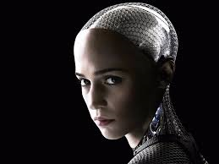
AI what is it?
AI – The School of Life

Slide 6
The AI Revolution: The Road to Superintelligence
Discuss:
1. What was this article about?
2. Why should you care?
This article is a little longer than most but it is a GREAT introduction to AI. It describes why it is so difficult to see the future when we look at the past. It describes where we are now, where we believe we will be in the not too distant future and the inevitable end of the world as we know it!
AI, in your lifetime, may be the biggest game changer our world has ever seen. Stay on top of technology for your entire life so you know what is going on.

Slide 7
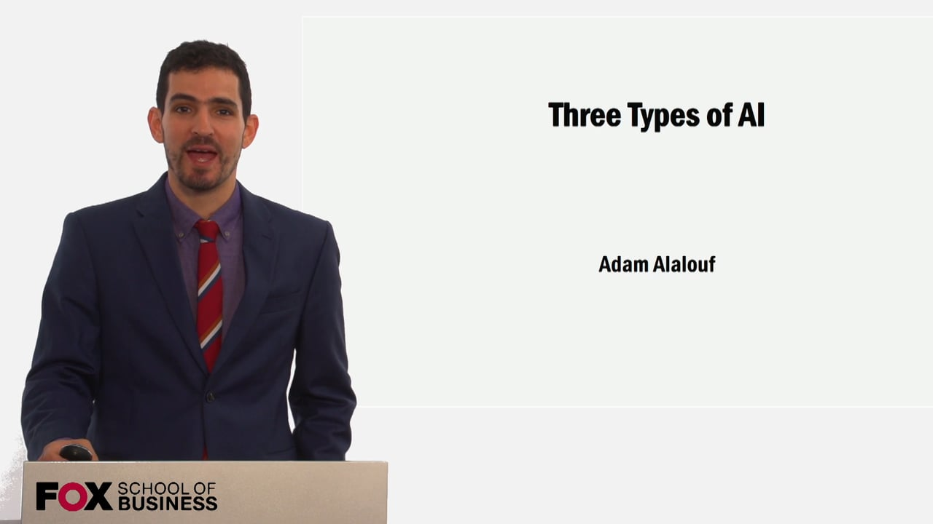
Required Viewing 1/3

Slide 8
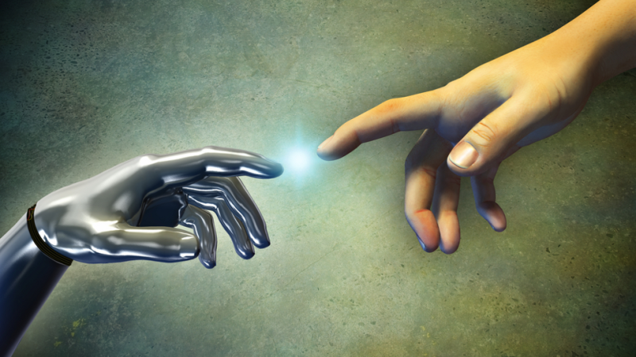
Superintelligence
The future of humanity in the age of superintelligent machines

Slide 9
Benefits and risks of artificial intelligence
Discuss:
1. What was this article about?
2. Why should you care?
It describes the reasons why we should be concern with AI safety and the myths and facts about AI.
Understanding how AI can benefit and/or threaten your future is important. It will impact the social and business aspect of your life!

Slide 10
Bill Gates Says You Should Worry About Artificial Intelligence
Discuss:
1. What was this article about?
2. Why should you care?
Bill Gates and some other very bright, tech savvy people have some genuine concerns about AI and what could happen.
When some science fiction writer, Hollywood producer or wacky person from an MIT research lab warn me that AI could change the world, I don’t worry about it. When Bill Gates and Elon Musk are putting their money on the table to “keep AI friendly”, I get a little concerned and you should too!

Slide 11
Wait But Why: The AI Revolution

Slide 12
Wait But Why: The AI Revolution

Slide 13
Wait But Why: The AI Revolution

Slide 14
Wait But Why: The AI Revolution

Slide 15
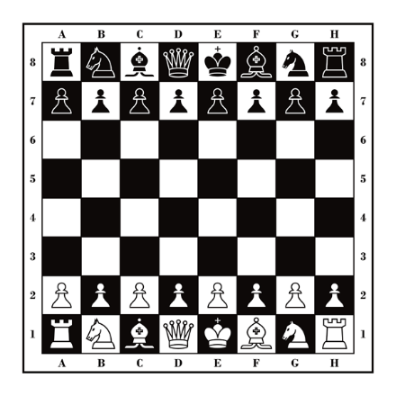
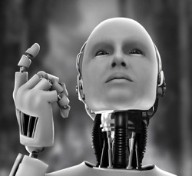
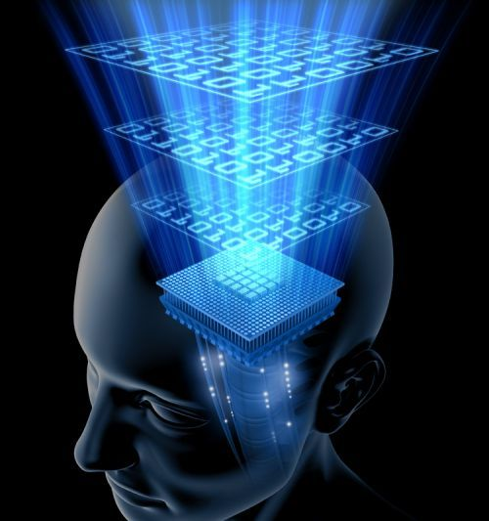
Wait But Why: The AI Revolution
Three types or calibers of AI:
Artificial Narrow Intelligence (ANI)
Artificial General Intelligence (AGI)
Artificial Superintelligence (ASI)
ANI: Chess Program
AGI: Human Level Intelligence
ASI: Superintelligence

Slide 16
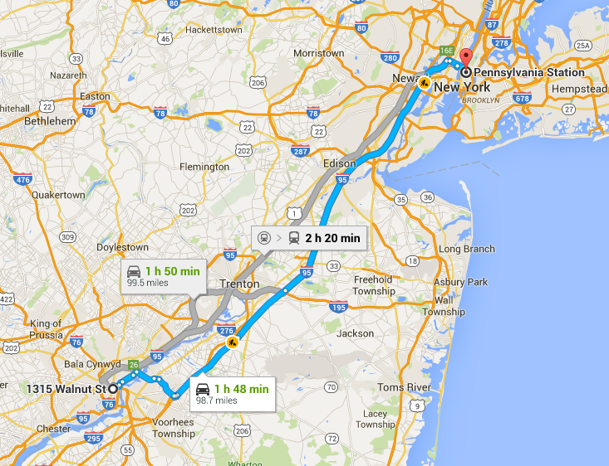
Wait But Why: The AI Revolution
ANI is everywhere:
Google maps
Autonomous cars
Spam filters
Google translate
Travel bookings
Manufacturing
Facebook suggestions

Slide 17
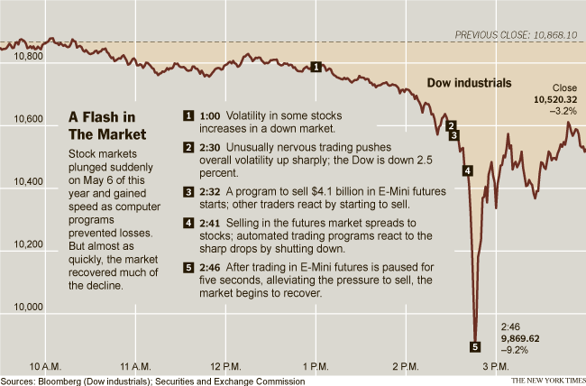
Wait But Why: The AI Revolution
2010 Flash Crash:
ANI caused stock market to plummet
$1 trillion decline in value
Quick recovery

Slide 18
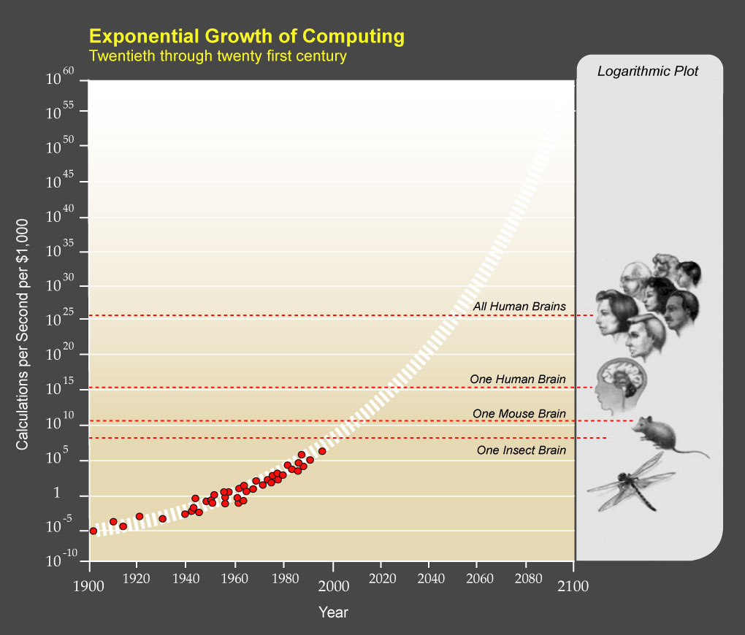
Wait But Why: The AI Revolution
AGI is imminent
AGI is extremely complex and difficult
Requires enormous computational power (remember Moore’s Law?)
Companies are spending billions of dollars
Google
IBM
Cross domain optimization

Slide 19
Wait But Why: The AI Revolution
Computers still have a hard time with tests like these, but for how long?

Slide 20
What is AGI?
Discuss:
1. What was this article about?
2. Why should you care?
While AI in the form of artificial narrow intelligence (ANI) is all around us, the next giant step is artificial general intelligence (AGI). This article provides a simple overview of AGI and how we will know when we get there.
We will achieve AGI during your lifetime. It will have significant implications on your life. Understand what it is and stay on top of technology for your entire life so you know what is going on.

Slide 21
Required Viewing 2/3

Slide 22
AGI Tests
The Turing Test
The Coffee Test
The College Student Test
The Employment Test

Slide 23
Alan Turing (1912-1954)
Father of AI and computer science
Cryptanalyst during WWII
Cracked code that enabled Allies victory
Contributions to physical sciences (see Belousov–Zhabotinsky reaction)
Prosecuted by UK and punished with chemical castration for being gay
Died of cyanide poisoning
Receives public apology in 2009 and royal pardon in 2013

Slide 24
From AGI to ASI

Slide 25
What is Watson?
Discuss:
1. What was this article about?
2. Why should you care?
Watson is an AI platform developed by IBM that, with training from people and access to content from just about any domain, can become an expert in any domain.
Watson is not just a system but a domain agnostic AI platform. Watson takes us one large step closer to AGI.

Slide 26
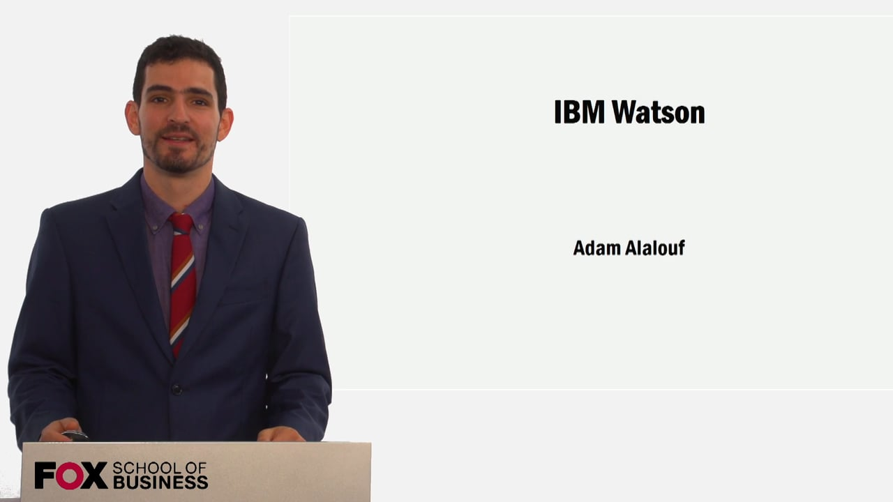
Required Viewing 3/3

Slide 27
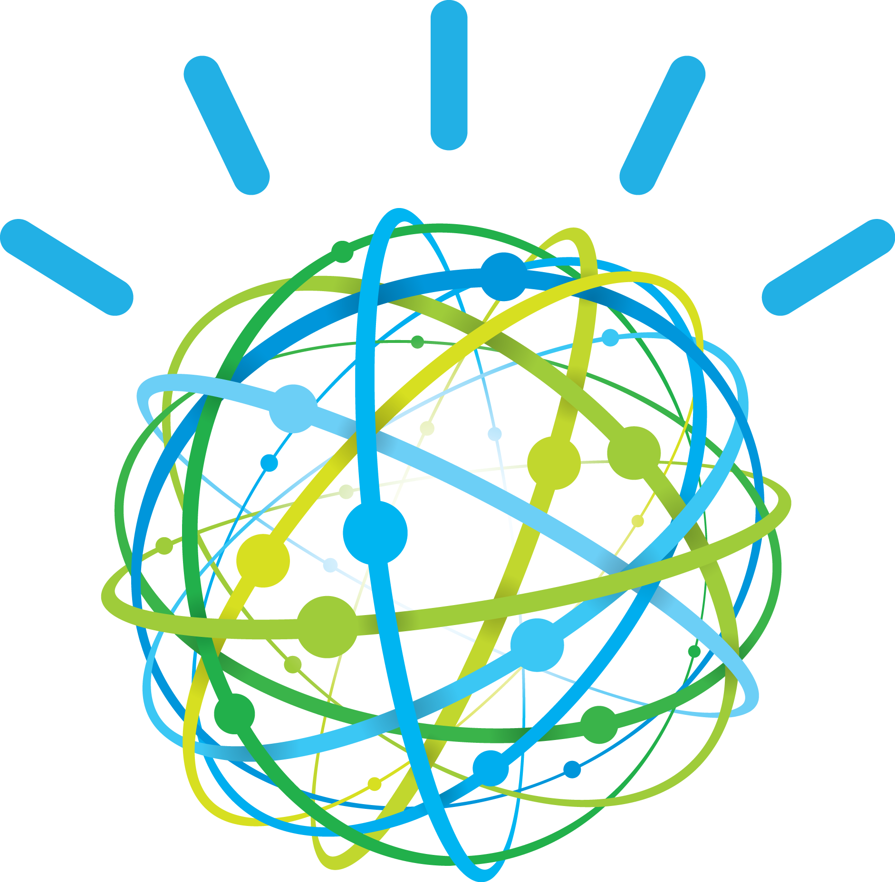
IBM Watson
Analyzes unstructured data
Understands complex questions
Learns human constructs like language, culture, and context

Slide 28
IBM Watson
^ Click image to watch video

Slide 29
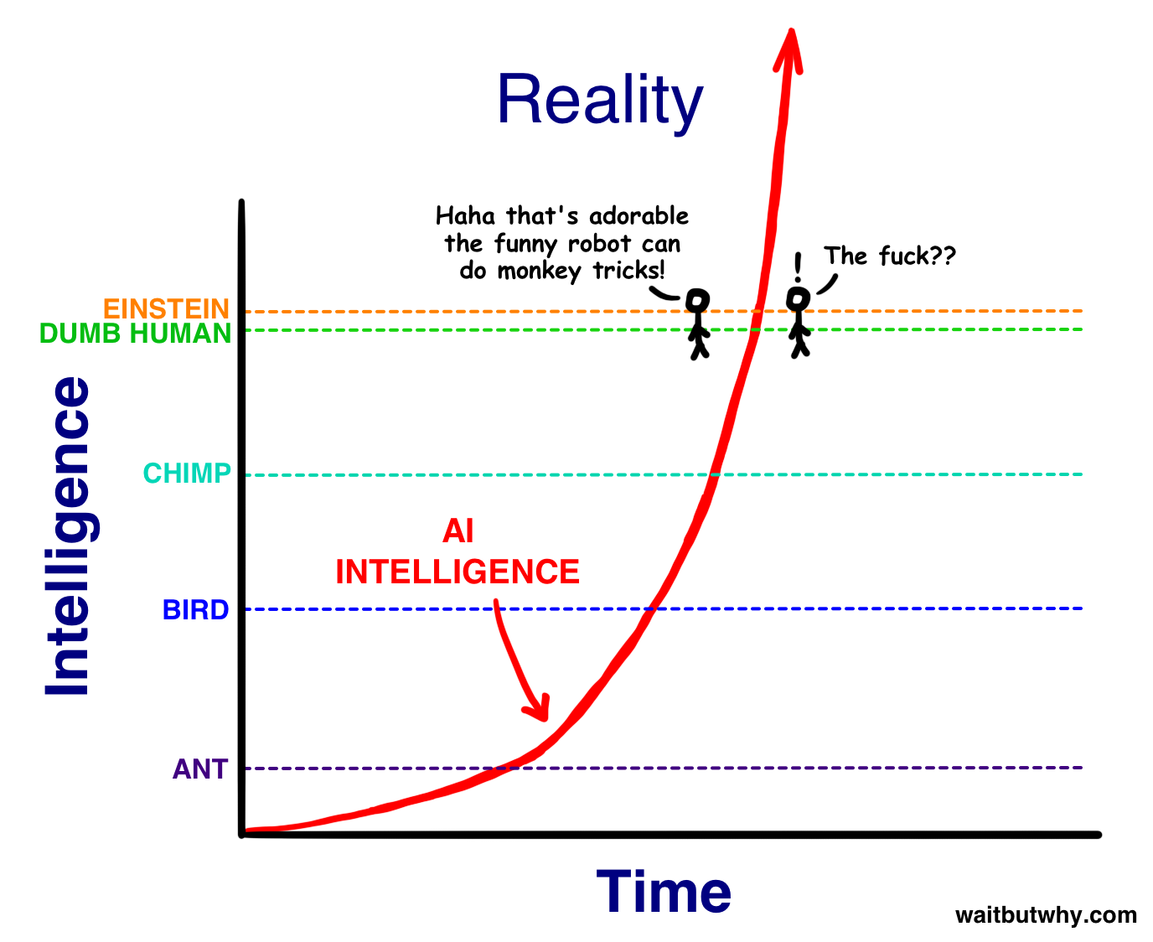
WBW: From AGI to ASI

Slide 30
The future… by the numbers
Software will disrupt most traditional industries in the next 5-10 years.
Uber is just a software tool, they don't own any cars, and are now the biggest taxi company in the world
Airbnb is now the biggest hotel company in the world, although they don't own any properties.
Artificial Intelligence: Computers become exponentially better in understanding the world. This year, a computer beat the best Go player in the world, 10 years earlier than expected.
Watson already helps nurses diagnosing cancer, 4 times more accurate than human nurses. Facebook now has a pattern recognition software that can recognize faces better than humans. In 2030, computers will become more intelligent than humans.
Education: The cheapest smart phones are already at $10 in Africa and Asia. By 2020, 70% of all humans will own a smart phone. That means, everyone has the same access to world class education.
Autonomous cars: In 2018 the first self driving cars will appear for the public. Around 2020, the complete industry will start to be disrupted. You don't want to own a car anymore. You will call a car with your phone, it will show up at your location and drive you to your destination. You will not need to park it, you only pay for the driven distance and can be productive while driving.

Slide 31
Discussion Questions?
What do you think about AI?
Excited or Scared?
What do you think the future holds?

