Slide 1

MIS 2101 Exam 1 Review

Slide 2



Advice
Review the slide decks
Review the assigned readings/videos
Review MaxLabs
How to prepare…

Slide 3
Introduction & Systems Analysis
Topics and Required Reading
Acquiring Information Systems And Services
Systems Architecture
Systems Analysis
Required Viewing
What is MIS? The Modern Organization System
Systems Analysis & Systems Architecture

Slide 4

Collection of Systems
Systems = People + Process + Technology
Manipulation of information = value
Managed by MIS professionals
Systems surround us 24/7
Application Program Interface (API’s)
“Information System – an integrated set of components for collecting, storing, and processing data and for providing information, knowledge and digital products.”

Slide 5



Collection of Technologies
Including:
Hardware
Software
Policies
Education Tools
API’s

Slide 6
Designing UX (User Experience)
Four Steps
Problem Definition
Documenting Business Processes
Process Decomposition
Data Modeling

Slide 7
Systems Analysis
What is “Systems analysis?”: Problem solving technique that “decomposes” a system into its component pieces for the purpose of studying how well these parts work & interact to accomplish their purpose

Slide 8
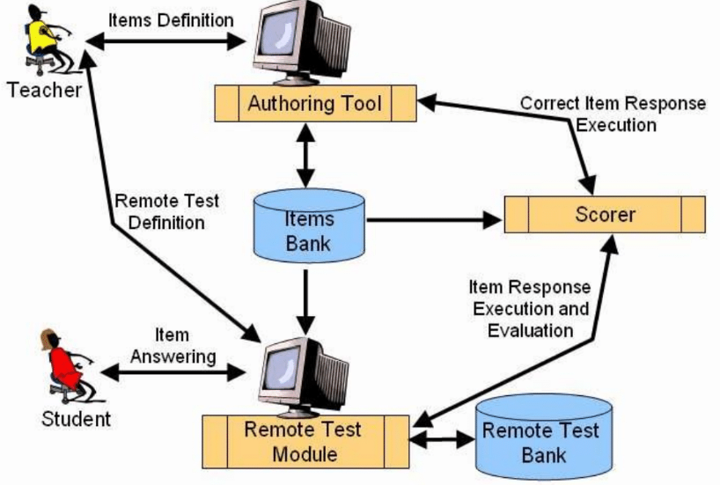
Systems Architecture
Conceptual Diagram
Structural Components
Identify/Solve Problems
Existing or New
Communication Tool

Slide 9
Introduction to Process Mapping
Topics and Required Reading
An Introduction to Swim Lane Diagrams
Required Viewing
Process Mapping with Swim Lane Diagrams

Slide 10

Process Mapping
What
Visual Representation
Why
Identify Problems
How
Draw the “as-is”

Slide 11
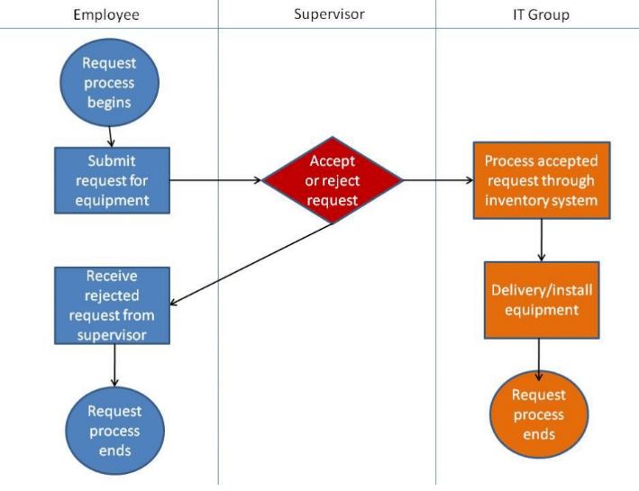
Swim Lane Diagrams
Advantages
Identifies who does what & in what order
  Logical & Chronological
  Indicates hand-offs
Versatile
Applied to other diagrams
Training Tool

Slide 12
Swim Lane Diagrams - Symbols
Circle : signifies the starting and ending of an event in the process
Rectangle : represents an activity in the process
Diamond : represents a decision that must be made
Arrow : indicates the flow of the process
Cylinder : represents stored data

Slide 13
Digital Product Management
Topics and Required Reading
Max Labs Pre-Flight
Entity Relationship Diagram
What is Entity Relationship Diagram (ERD)?
Required Viewing
Digital Product Management
Max’s Story
Concepts of Max Labs
Data Modeling with ERDs
What hiring managers look for in your social media profile

Slide 14

Why Salesforce?
A great platform to deliver cloud-based systems products
Enables & Enhances Business
Used by Industry Fortune 100’s
  Across all business function areas
Enabling Organizations
Technology enables organizations to work faster/smarter/more efficient
  See how it works
  Understand how it used by industry

Slide 15
Max Labs – Pre-Flight
A great platform to deliver cloud-based systems products
Professional Development
  Developing a professional brand
Innovation
  Scalability & new markets
Business & Digital Models
  B2B (Business to Business)
  Used to managed their relationships to customers
Data/Databases/Apps/Platforms
  Platform: a collection of tools & services you can piece together to build a database and apps

Slide 16
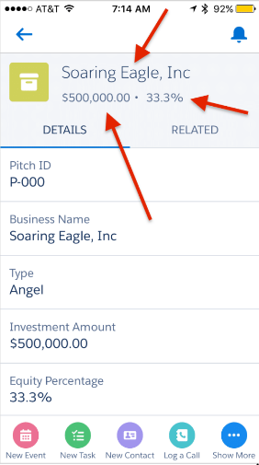
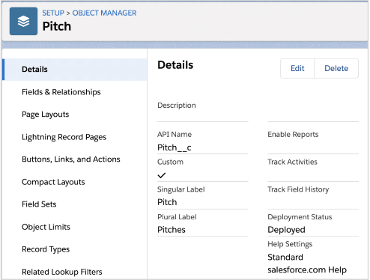
Max Labs – 1a
Creating Databases (objects)
  Why do we need these lists?
Determining Data Needs
  Max’s needs for creating the “Pitch” (custom Object)
Page Layouts
  What information do we want to show?
Mobile App

Slide 17
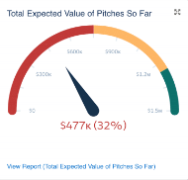
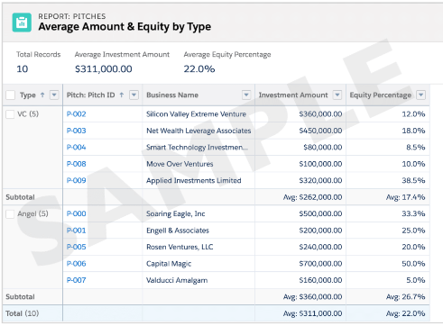
Max Labs – 1b
Digital Business Models
  Share & Communicate
Monetize Max’s Blog
Pitch Data File
  CSV Files, organization
Generating Reports
  Visualizing the data
Dynamic Dashboards
  Real-time Monitoring
  Collaboration
  Customization
  Report Generation

Slide 18
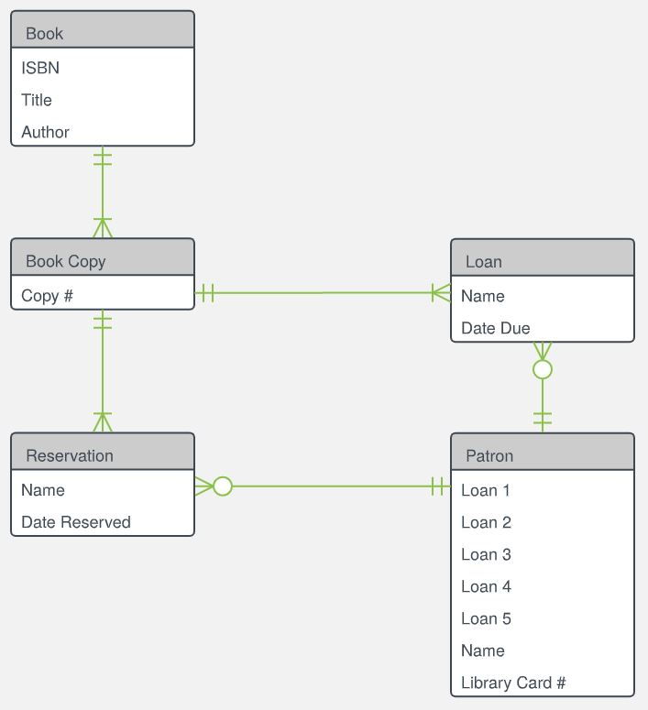
What is an Entity Relationship Diagram?
An Entity Relationship Diagram (ERD) is a visual representation of different data using conventions that describe how these data are related to each other.
Source:https://d2slcw3kip6qmk.cloudfront.net/marketing/pages/chart/examples/libraryerdiagram.svg

Slide 19
Primary ERD Symbols: Chen’s Database Notation
Entity = noun
ex: shopper, item
Attribute = adjective/characteristic
ex: item price
Relationship = verb
ex: buys

Slide 20
Entity Relationship Diagram: ERD tables
Crow’s Foot Database Notation

