Slide 1
Information Systems in Organizations
4.1 Learn IT! #1 and #2 Kickoff
FOX
MIS
Notes:
Digital Brand Identity

Slide 2
ROADMAP
START
Week 1:
Introduction & Systems Analysis
Course Description
Systems Thinking
Week 1:
Introduction to Process Mapping
Systems & Processes
Swim Lane Diagrams
Max Labs 0- due
Week 2:
Digital Product Management & ERD
Max Labs 1A/1B- due
Week 2:
Introduction to Data Modeling
Week 2:
Exam #1
1/24-1/26: Exam Availability
Week 4 :
Exam #2
2/7-2/9 Exam Availability
Week 4:
Cybersecurity & AI
Protection Protocols
Artificial Intelligence
Cybersecurity/AI assignment due
Max Labs 3a/3b due
Week 4:
Platforms & Digital Business Models
API’s
Cloud
Week 3:
Information Systems
ERP & CRM
Data Analytics & SCM
Max Labs 2A/2B due
Lean IT #1 due
Week 5:
JavaScript Unit #1 & 2
Hello World, Variables
Input and Output
Operator types
Strings
Watch Lynda.com video – due
Code Academy due
Coding assignment #1-due
Week 6:
JavaScript Unit #3&4
Logical Operators
Conditional Types
Intro to Loops
While and Do
Writing the code
Coding Assignment #2-due
Week 7:
HTML & CSS
Coding Assignment #3-due
Lean IT #2 due
Week 7:
Exam #3
2/28-2/29: Exam Availability
FINISH

Slide 3
Learn IT! #1 and #2
Spring 2020
FOX
MIS

Slide 4
Learn IT! #1 and #2 Kickoff
What?
  Learn what Learn IT! #1 and #2 are all about
Why?
  Position yourself for success in Learn IT! #1 and #2
FOX
MIS

Slide 5
Learning Goals
TOPICS
Individual branding and reputation management
TECHNOLOGIES
Digital identity and portfolio
Search neutrality
Communities of practice
Community platform
Cloud system architecture
E-portfolio
Web analytics
SEO
Privacy
FOX
MIS

Slide 6
What is a digital identity?
Personal relationships
FACEBOOK
Purchase history
TARGET
Credit history
EQUIFAX
Ideas
DROPBOX
Finances
WELLS FARGO
Likes and dislikes
NETFLIX
Daily commute
IPHONE
GOOGLE
Your identity is the product
Grades and Graduation
TEMPLE
Source: The next revolution will be reclaiming your digital identity by Nik Milanovic, https://techcrunch.com/2017/10/17/the-next-revolution-will-be-reclaiming-your-digital-identity/
FOX
MIS

Slide 7
AUTHENTICATION
Prove who you are
PRIVACY
Control what others can access
SECURITY
Prevent and recover from theft
REPUTATION
Personal and professional brand
NETWORKS
Connect with relevant others
PROMOTION
Help others find you
Digital identity management
FOX
MIS

Slide 8
Active digital identity management
Shape professional reputation
Connect with relevant others
FOX
MIS

Slide 9
Community Platform
Cloud based platform built on WordPress
social exchanges,
open co-creation,
Website
E-portfolios
Professional achievement program
Courses
digital branding
Only platform that integrates web, professional development & coursework.
Proprietary to the nationally ranked Fox School’s MIS department.
FOX
MIS

Slide 10
Digital Identity Management Assignment
Digital identity & profile
Digital portfolio &
E-portfolio
Build a professional network
Assess with analytics
Professional achievement program
(MIS majors only)
FOX
MIS

Slide 11
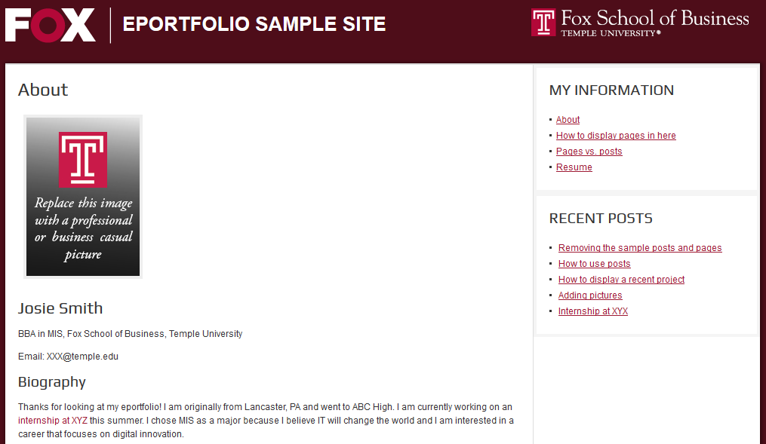
Fox major e-portfolio design requirements
Professional picture
About me (home) page
Three pages including “My Interests”
Remove all extra posts and pages
2
3
1
FOX
MIS

Slide 12
E-portfolio tips
DO’S
Help Google: Include full name in the site title.
Sample work. This is your digital portfolio!
Describe work experience.
Involvement in non-profits.
Pictures of professional experiences.
Proofread
Google and Mobile friendly formatting.
DON’TS
Inappropriate photos
Inappropriate content
Private information
Broken hyperlinks
Word documents
Don’t password protect or close the site.
Don’t use custom formatting or CSS.
FOX
MIS

Slide 13
Google Analytics
Create a Google Analytics account to generate a site tracking code
Connect the code to your e-portfolio
Insert the code into the Google Analytics plugin available within the community platform
Each time a user visits your e-portfolio
A small software program is invisibly and automatically loaded into each user’s browser
The program stores and transmits information about the use (AKA ‘cookie’) to a Google server
View Google Analytics
Aggregated activity is displayed in Google Analytics
FOX
MIS

Slide 14
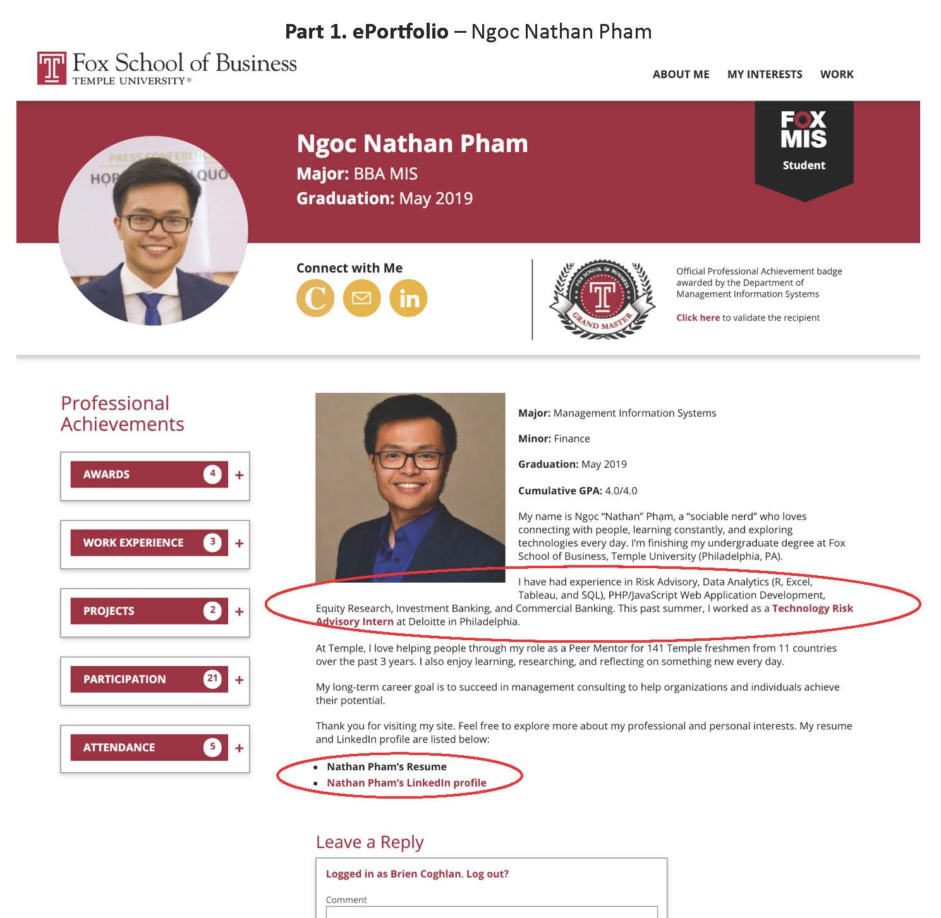
Learn IT! #1 & #2
FOX
MIS

Slide 15
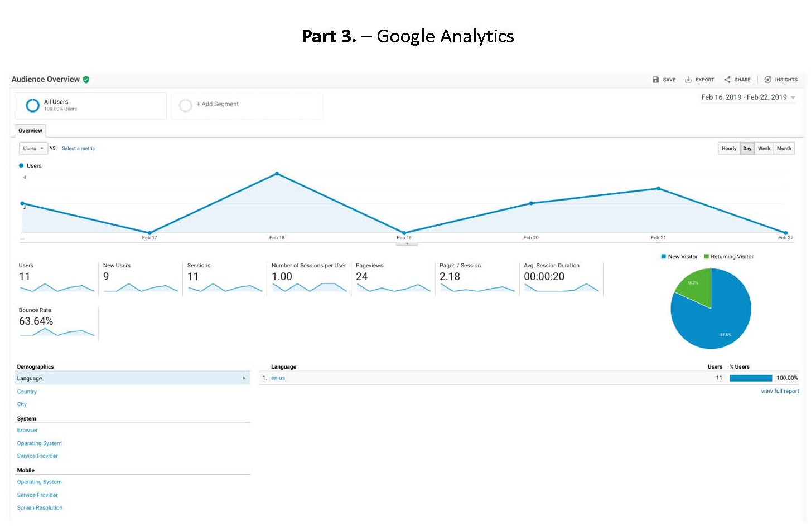
Learn IT! #1 & #2
FOX
MIS

Slide 16
Information Systems in Organizations
5.1 Information Systems Part I – CRM & ERP
FOX
MIS

Slide 17
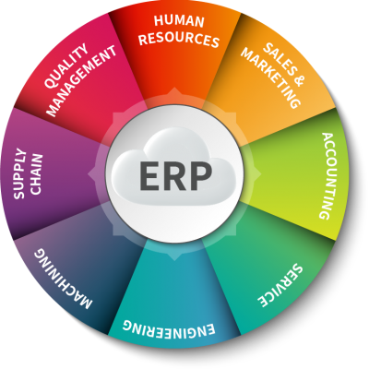
What is ERP?
Enterprise Resource Planning
Software or a System that:
  Integrates functions
  Streamlines processes
  Manage core business
What problems could be solved by an ERP?
Are you familiar with Banner?
Source: https://erpinnews.com/5-enterprise-resource-planning-erp-trends-to-watch-in-2019
FOX
MIS

Slide 18
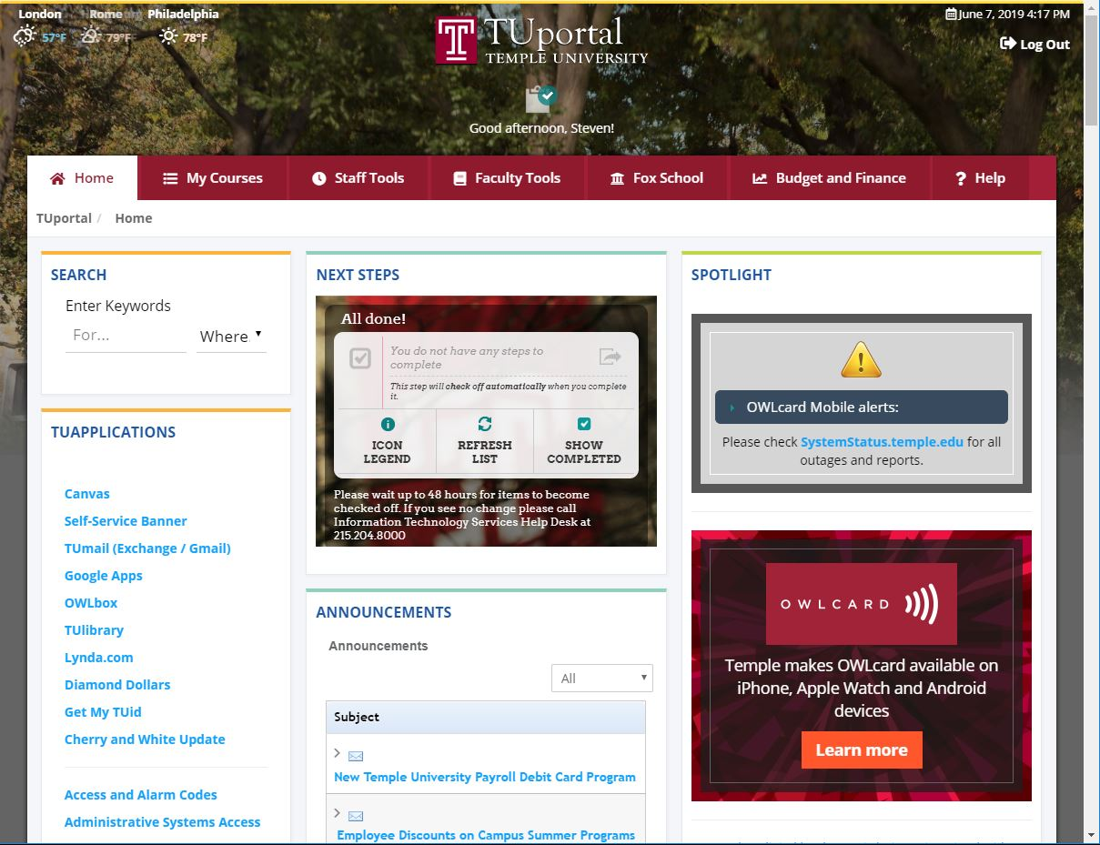
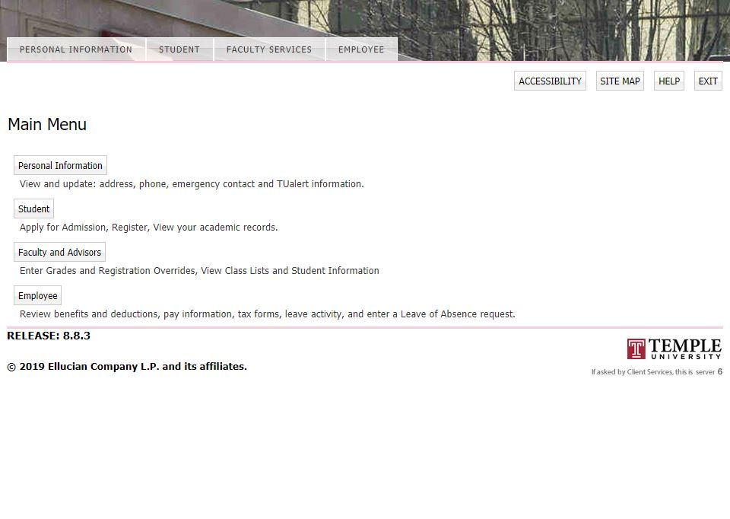
ERP - example
Database with a holistic vision!
Who else uses banner?
What functions does banner serve for each user?
What are the benefits to the University?
FOX
MIS

Slide 19
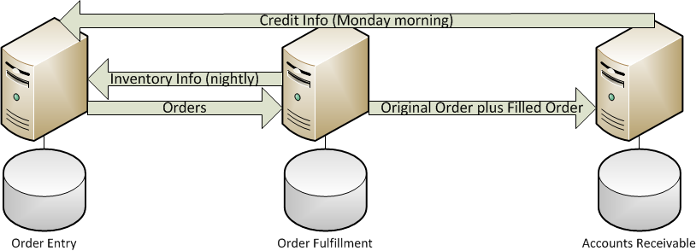
Legacy Systems
Sales
Warehouse
Accounting
1st
System
2nd System
3rd System
FOX
MIS

Slide 20

Enterprise Systems
Sales + Warehouse + Accounting
ERP analysis
How many copies of data?
What about decision making?
What is eliminated?
Client impact?
One
System
FOX
MIS

Slide 21

ERP – Key Takeaways
How does ERP create value?
Integrated Database
  One copy of data
Collaboration
  Improves decision making
Flexibility & Mobility
  Access anywhere/anytime
Lowers costs
Source: http://blog.pragtech.co.in/erp-business-success/
FOX
MIS

Slide 22

ERP – Value Proposition
Automates core business operations
Why is this important for…
  Risk Management?
  Marketing majors?
  HR & Accounting?
  Finance & Strategy?
  Anyone else?
Source: https://www.strategic.com/blog/2017/3-reasons-erp-training-important/
FOX
MIS

Slide 23
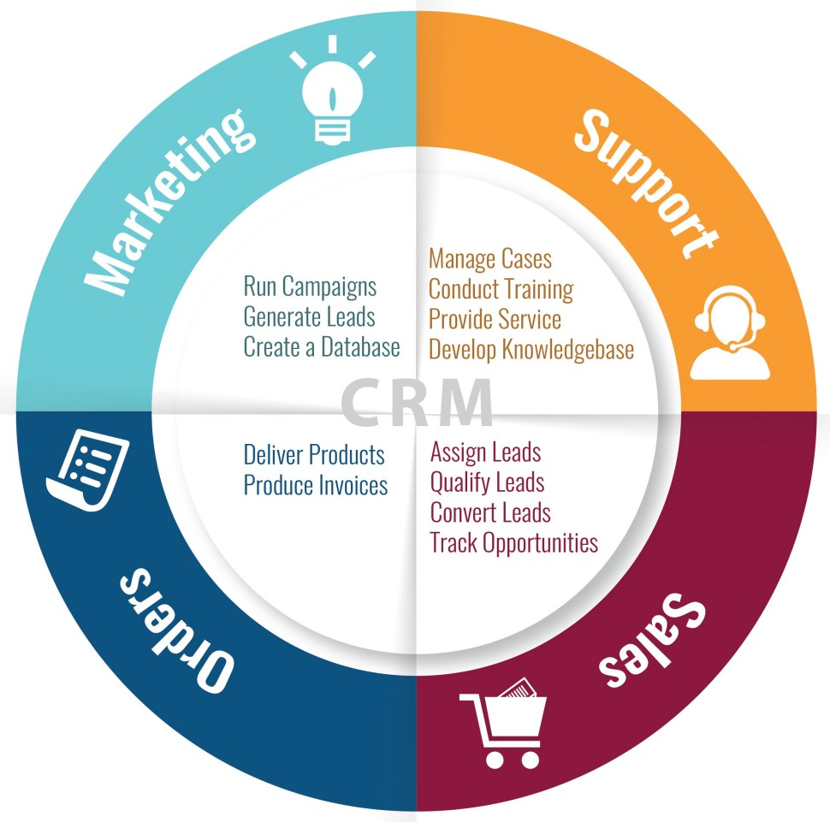
What is CRM?
Customer Relationship Management
Who Uses CRM?
Sales
Marketing
HR
Accounting
Strategy
Source: https://collectiveinnovation.com/the-art-of-customer-relationship-management/
FOX
MIS

Slide 24

What is CRM?
Customer Service:
Have you experienced this? Why?
Transferred 2 or more times
Repeat Story
Disconnected
Hold time approximately…
  Fantastic music
Source: http://donthatethegeek.com/cellular-carriers-screwing-phones/
FOX
MIS

Slide 25
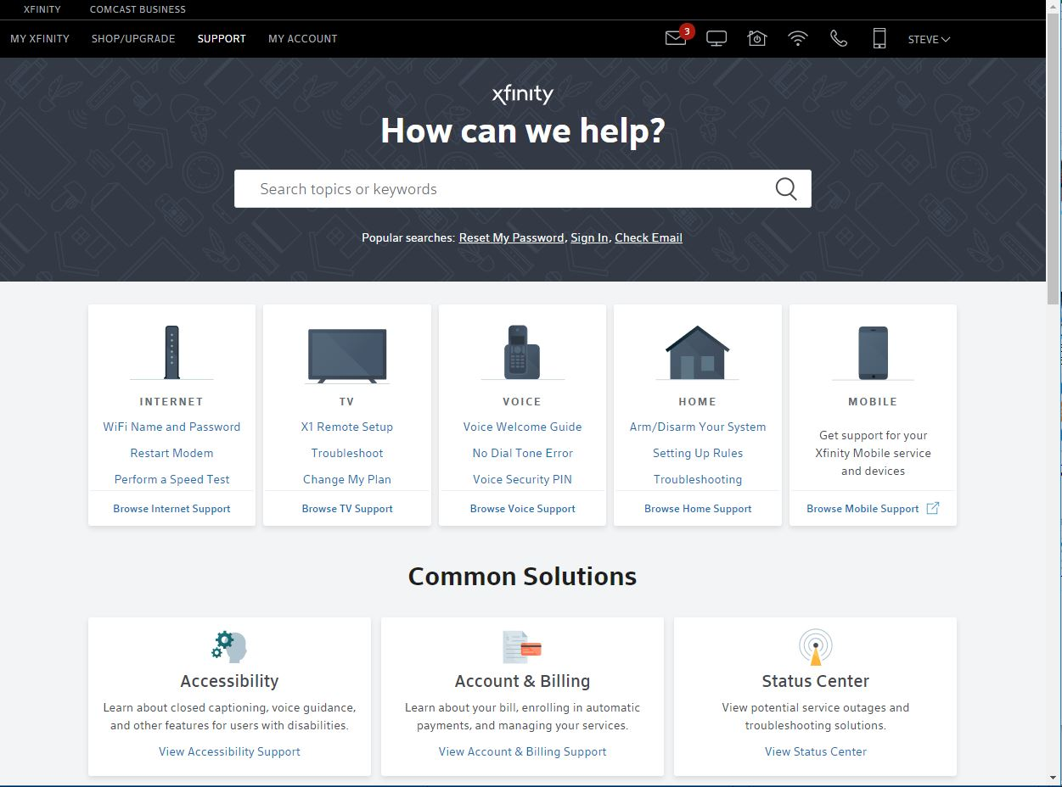
CRM Case Study:
Xfinity
Source: https://www.xfinity.com/support/?CMP=ILC:MA:BAU:SUB:COM:HLP:INT55e0877fe16f7/
FOX
MIS

Slide 26
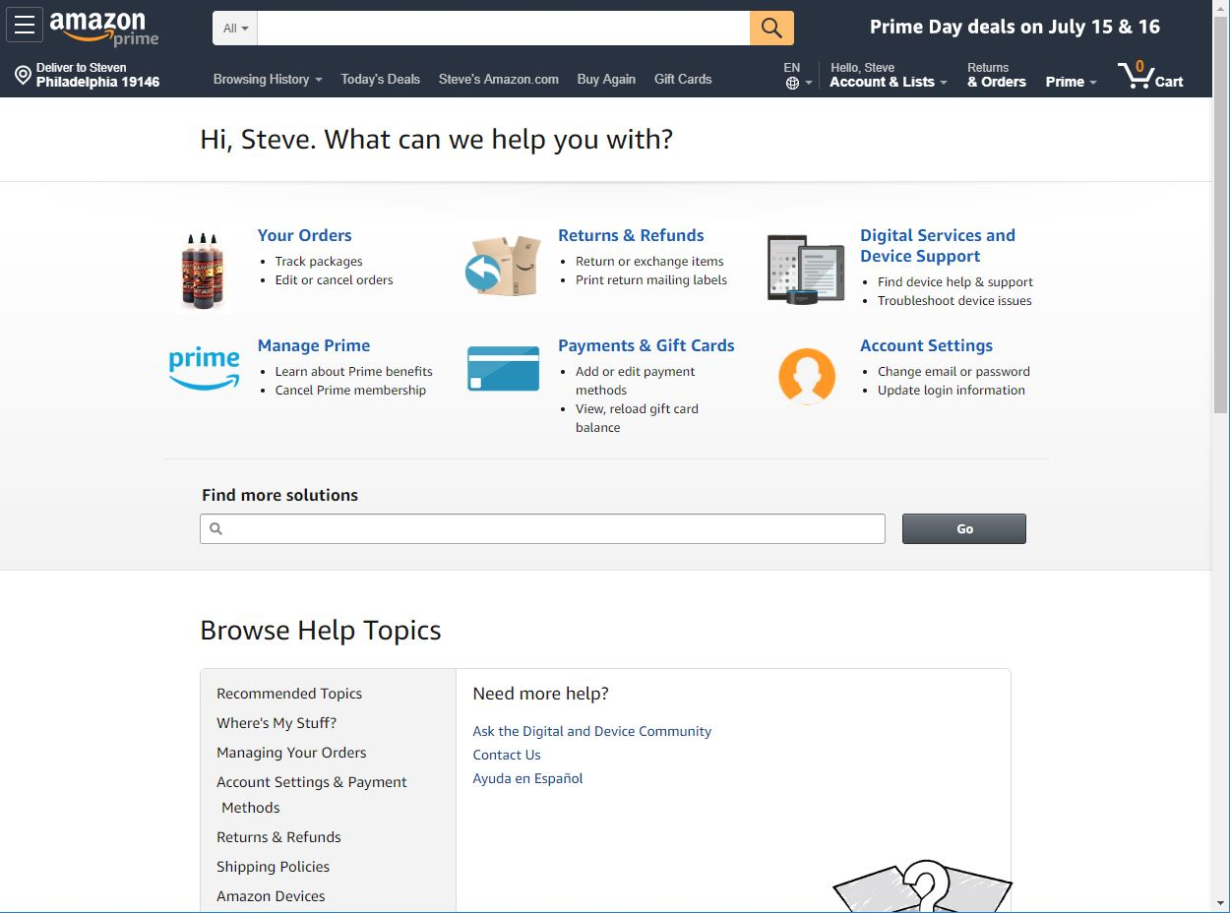
CRM Case Study: Amazon
Amazon
Data Collection
Personal Storage
Recommendations
Support
Source: https://www.amazon.com/gp/help/customer/display.html?nodeId=508510&ref_=nav_cs_help
FOX
MIS

Slide 27

Why purchase CRM?
Customer Relationship Management
CRM’s track what kind of data?
How do organizations use data?
Source: https://www.salesforce.com/hub/service/customer-service-examples/
FOX
MIS

Slide 28
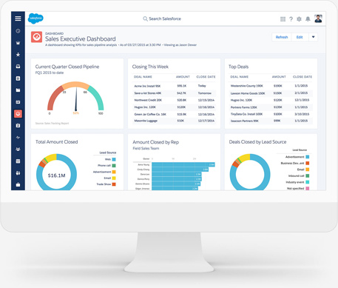
CRM Dashboards
What do they do?
Who in the organization might want or need a CRM dashboard?
Why are they important?
Source: https://www.salesforce.com/eu/learning-centre/crm/what-is-crm/
FOX
MIS

Slide 29

CRM Accountability
What does this mean?
Where is the data?
Why is this important?
Source: https://www.workwisellc.com/crm-software/what-is-crm/
FOX
MIS

Slide 30
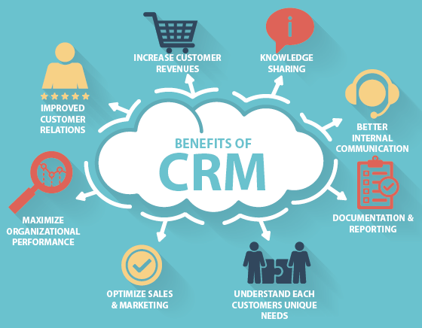
CRM Benefits
Maximize Profits
Understand Your Customer (data)
  Analyze Buying Patterns
  Problem Solve
Accountability
Customer Communication
What else?
Source: https://strategiesgroup.com/blog/benefits-of-crm/
FOX
MIS

Slide 31
ERP & CRP
What’s the Difference?
Which is a better first investment for a business?
Why?
ERP
ABOUT THE BUSINESS
INTERNAL FOCUS
CRM
ABOUT THE CUSTOMER
EXTERNAL
FOCUS
SHARED
DATA
INCREASED
PROFIT
FOX
MIS

Slide 32
Information Systems in Organizations
6.1 Procure to Pay (P2P)
In-Class Activity
FOX
MIS

Slide 33
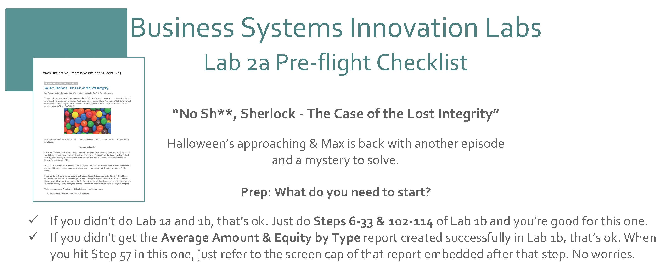
Max Labs 2a
Spring 2020
FOX
MIS

Slide 34

Max Labs – 2a Discussion
Managing Data Corruption
What’s the Issue?
  Error Messages?
Mitigation
  Best Practices?
  Validation Rules?
Source: http://techgenix.com/tgwordpress/wp-content/uploads/2018/06/data-corruption-Shutterstock.jpg
FOX
MIS

Slide 35

Max Labs – 2a Discussion
Data Redundancy
Root Causes?
Misrepresentation of Facts:
  Corrupted Reports & Dashboard
Solutions
  Creating a Plan
Source: https://news.bitcoin.com/wp-content/uploads/2016/02/fl00.jpg
FOX
MIS

Slide 36
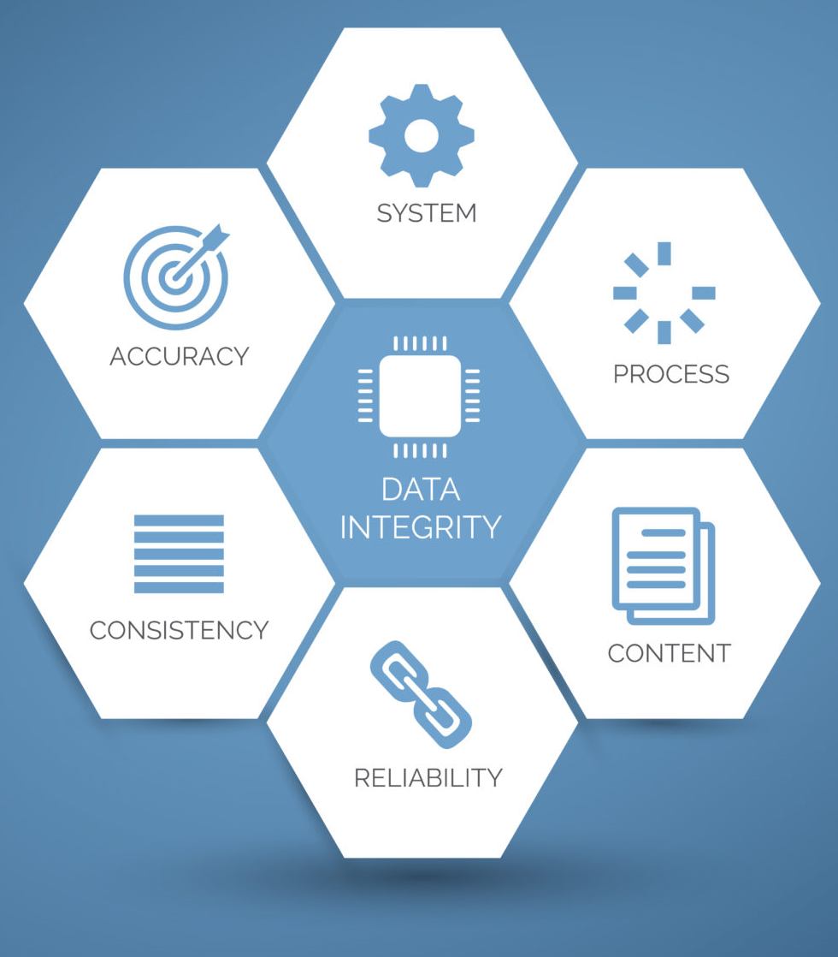
Max Labs – 2a Discussion
Data Integrity
Velocity & Veracity
Five Principles
Source: http://www.rightpatient.com/wp-content/uploads/2015/05/Data-Integrity-2.jpg
FOX
MIS

Slide 37
Max Labs – 2a Discussion
Entity Relationship Diagrams (ERD’s)
Cardinality & Crow’s Feet
Data Modeling Requirements
  Understanding Users Needs
  Preventing Redundancy
Source: https://sites.google.com/site/dracvbms/entity-relationship-diagram
FOX
MIS

Slide 38

Max Labs – 2b Discussion
Importing Data
Creating Tables
Avoiding Redundancy
Source: https://nebulaconsulting.co.uk/wp-content/uploads/2014/04/pexels-photo-1179800.jpeg
FOX
MIS

Slide 39

Max Labs – 2b Discussion
Avoiding Redundancy
Data Normalization
Understanding Relationships
ERD’s
Use Cases
Source: https://www.salesforce.com/blog/2015/11/3-steps-to-the-proper-care-and-handling-of-your-data.html
FOX
MIS

Slide 40
Information Systems in Organizations
6.1 Information Systems Part II – Data Analytics and SCM
FOX
MIS

Slide 41

What is Data Analytics?
Thoughts?
“The use of tools & people to uncover hidden patterns in the data that might not be readily available to the naked eye”
– Professor Lavin
Two Types of Analytics:
Descriptive
Predictive
Source: https://i2.wp.com/johnbauerconsulting.com/wp-content/uploads/2017/06/Big-Data-Analysis-In-HR-Department.jpg
FOX
MIS

Slide 42
“Analytics is the process of making sense of large data sets and unlocking patterns, often using data visualization, to enable better decision making.”
- Professor Amy Lavin

Slide 43

Data Investments…Why Care?
Top Reasons Why:
Decrease Expenses
Find New Innovations
Launch New Products/Services
Increase Efficiency
Transform Business
Establish Data-Driven Culture
https://hbr.org/2017/04/how-companies-say-theyre-using-big-data
Source: https://hbr.org/video/3633937151001/the-explainer-big-data-and-analytics
FOX
MIS

Slide 44

Big Data & Mickey D’s
$300 Million Acquisition
Infrastructure Improvements
Technology Transformation
Digital Innovation
Efficiency & Effectiveness
Customer Experience
Predictive Analytics?
Source: KIYOSHI OTA/BLOOMBERG/GETTY IMAGES
FOX
MIS

Slide 45
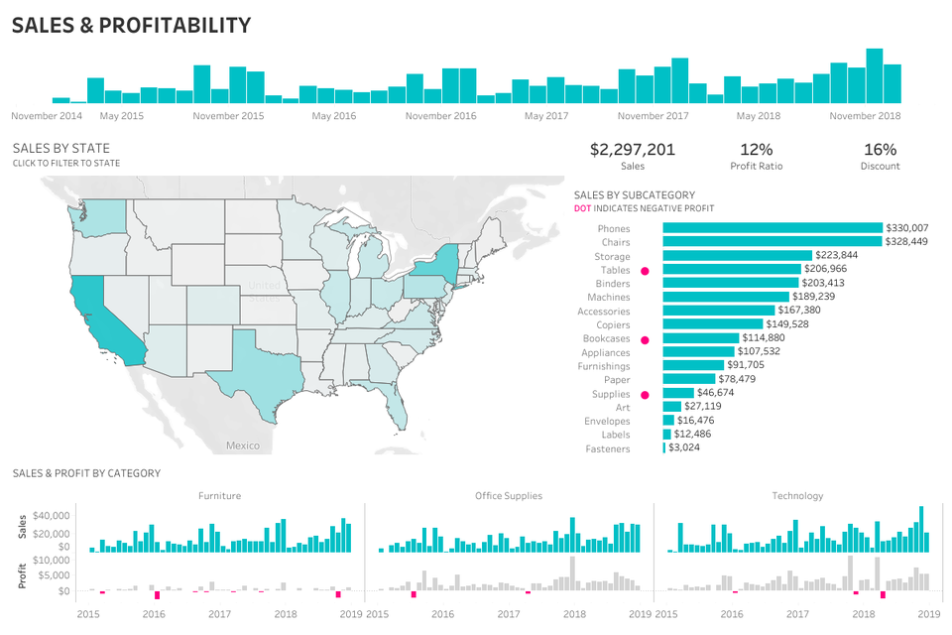
What can data do for you?
Data Analysis & Data Visualization
What’s the difference?
What’s the role of the dashboard?
  Who are your stakeholders?
  Which industries utilize dashboards?
  When do you need them?
Source: https://thumbor.forbes.com/thumbor/960x0/https%3A%2F%2Fblogs-images.forbes.com%2Fevamurray%2Ffiles%2F2019%2F03%2FExecutive-Sales-Profitability.jpg
FOX
MIS

Slide 46

What is Business Intelligence (BI)?
BI Leverages Software & Services to Transform Data
Mobile BI
User friendly
Agile & Intuitive Systems
Leads to Strategic Business Decisions
Source: https://blog.radware.com/tag/internet-of-things/page/3/
FOX
MIS

Slide 47
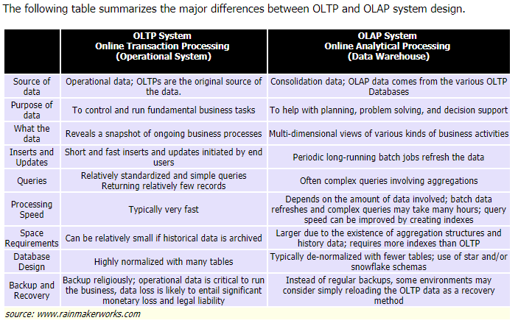
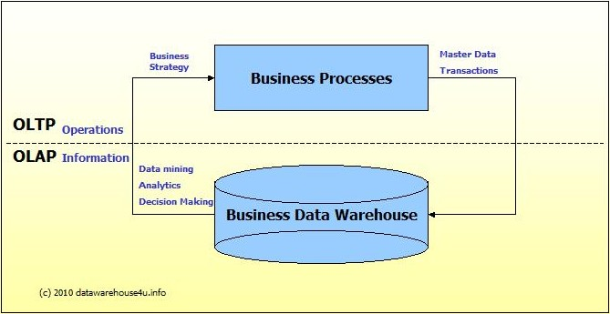
OLTP vs. OLAP
OLTP: Transactional –
Provides source data to the data warehouse
OLAP: Analytical
Systems help analyze the data
Source: https://cdn.buttercms.com/zFQw590wTKmzkcHLoO48
Source: http://datawarehouse4u.info/OLTP-vs-OLAP.html
FOX
MIS

Slide 48
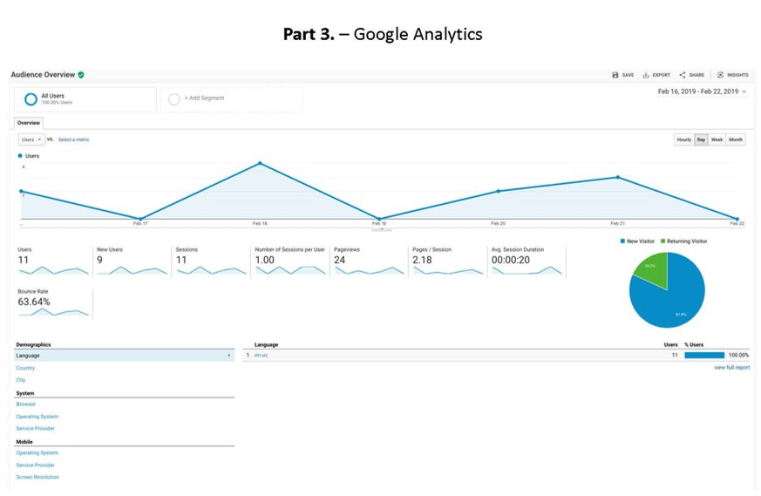
Google Analytics
What Can We Track?
web site metadata & user engagement
Number of Sessions
Average Session Duration (minutes, hours, etc.,)
Number of pages visited
  Duration of Each Visit
Bounce Rate
Conversion Rate
FOX
MIS

Slide 49

What is Supply Chain Management (SCM)?
Thoughts?
“Supply Chain includes many components…from Procurement to Manufacturing to Distribution. It’s about getting the right product on the right shelf at the right time!” – Professor Doyle
Cross Functional Approach:
Improves trust & collaboration
Improves inventory visibility & velocity
Source: https://www.chainstoreage.com/wp-content/uploads/2017/06/supplychain.jpg
FOX
MIS

Slide 50
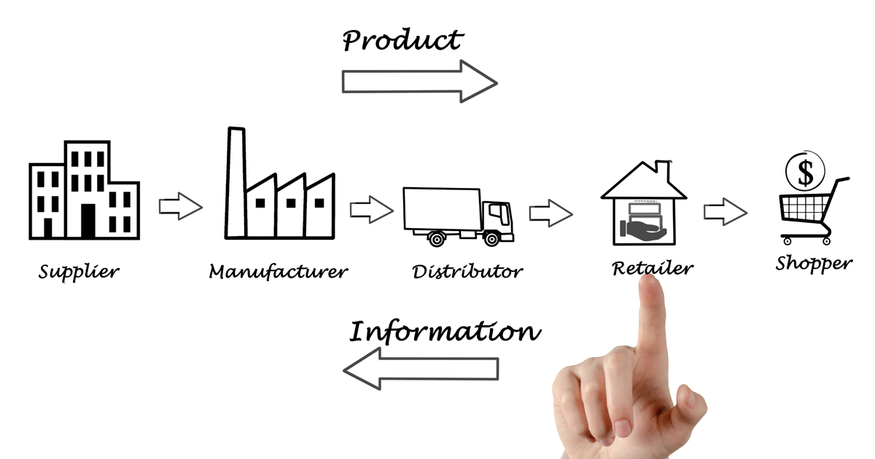
Supply Chain Management…
Pick a product
Who are the key actors?
What types of materials are involved?
What about technology?
What skills are required?
What’s missing?
Source: https://www.containersolutions.ca/what-we-do/supply-chain-management/
FOX
MIS

Slide 51
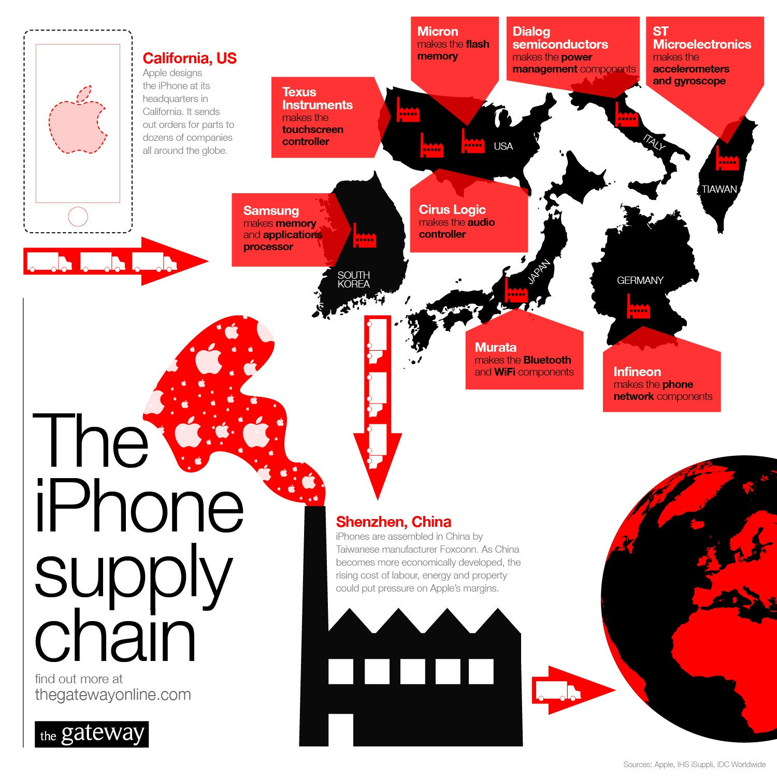
Case Study: iPhone Xs
Where is your iPhone Made?
What happens in Shenzhen, China if there are any delays?
How do you plan for problems?
  Weather
  Material shortages
  Strikes
Source: https://www.containersolutions.ca/what-we-do/supply-chain-management/
FOX
MIS

Slide 52

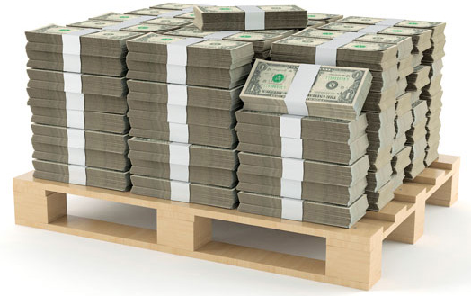
Safety Stock – That’s the Answer!!!
What people in fulfillment see…
What people in Accounting see…
FOX
MIS

Slide 53
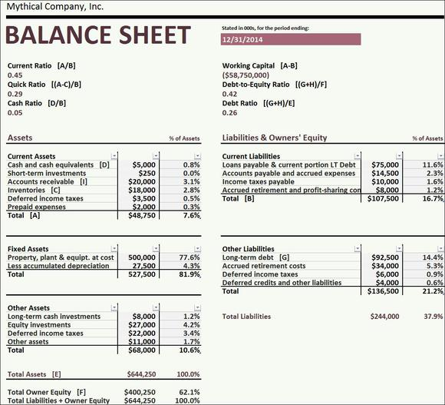

What else could you do with this cash?
If this goes up…
Then this goes down
What do our accounting friends tell us?
Source: https://www.dhresource.com/webp/m/0x0s/f2-albu-g7-M00-00-25-rBVaSVu7R-iANMDzAAP6nmYGKS4175.jpg/alec-monopoly-cash-is-king-home-decor-hd.jpg
FOX
MIS

Slide 54

Supply Chain
Optimization
SCM Modules Support two functions:
Supply Chain Planning
  Work Backwards
Supply Chain Execution
  Efficient flow of products, information, & financing
Source: https://liquidplanner-wpengine.netdna-ssl.com/wp-content/uploads/2019/04/Supply-Chain-graphic.jpg
FOX
MIS

Slide 55

What is RFID
What is RFID?
Radio Frequency Identification
Wireless technology that lets you identify objects that have been fitted with special RF identification tags
What is RFID good for?
Inventory control, access control…
How it works
Antenna reads electromagnetic energy
Can penetrate non-metallic solid objects
Source: https://journals.ala.org/index.php/ltr/article/viewFile/4514/5301/6514
FOX
MIS

Slide 56
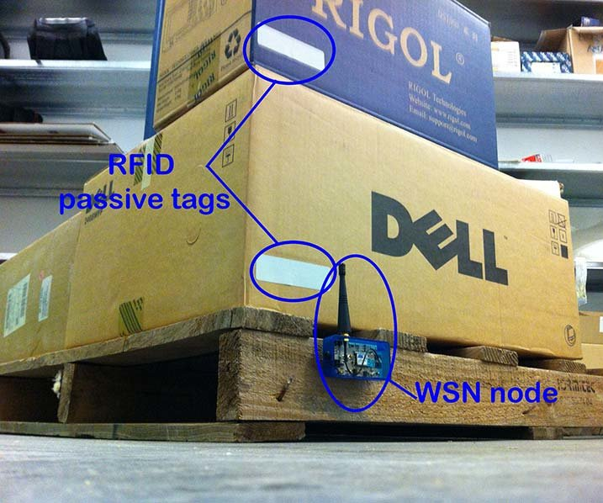
RFID explained
The use of electromagnetic energy to transit energy between a reader (transceiver) and the tag (antenna).
RFID tags can contain more information than bar codes.
Tags are programmable
Scanning can be done from greater distance.
Passive tags—inexpensive, range of few feet.
Active tags—more expensive, longer range
Source:_https://www.researchgate.net/profile/Jose_San_Jose_Vieco/publication/261430560/figure/fig1/AS:564991784742913@1511715946690/WSN-Node-and-RFID-tags-in-a-pallet.png
FOX
MIS

Slide 57

Case Study:
Disney Magic Band
Why Did Disney Invest $1 Billion?
Marketing Opportunities
UX & CX
Patron Tracking
  Multiple Parks
  Hotels
Endless Possibilities!
Source:_https://media.wired.com/photos/593275a15c4fbd732b552d4a/master/w_1200,c_limit/disneymagicband2_f.jpg
FOX
MIS

Slide 58
More to Come
Prepare with Readings & Videos before our next class!!!

