Slide 1
Information Systems in Organizations
Exam#3 Review – CSS, HTML & JavaScript – Code Diagnosis
FOX
MIS

Slide 2
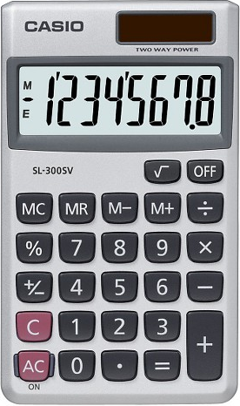
Exam Will Cover Discussions from week 5,6 &7
Total of 17 multiple choice questions
Readings, Videos and Lectures (35%)
CSS, HTML and JavaScript basics
Variables
Operator Types
Strings
Logical Operators
Conditional Types
Loops
Coding – Demonstrate your ability to apply (65%)
Code Analysis & Diagnosis
Bring a CALCULATOR
Source: https://target.scene7.com/is/image/Target/GUEST_a97f68d0-6348-4802-9d47-89b3a854a20e?wid=488&hei=488&fmt=pjpeg
Source: https://ccesnews.org/opinion/2018/04/23/10-tips-for-exam-preparation/#photo
FOX
MIS

Slide 3
Sample Question:
A loop cannot start with a negative number?
Refer to the example below:
for (var i = -10; i <= 30; i=i+5) {
True or False
FOX
MIS

Slide 4
Sample Question:
A loop cannot start with a negative number?
Refer to the example below:
for (var i = -10; i <= 30; i=i+5) {
True or False
FOX
MIS
Notes:
Bring a #

Slide 5
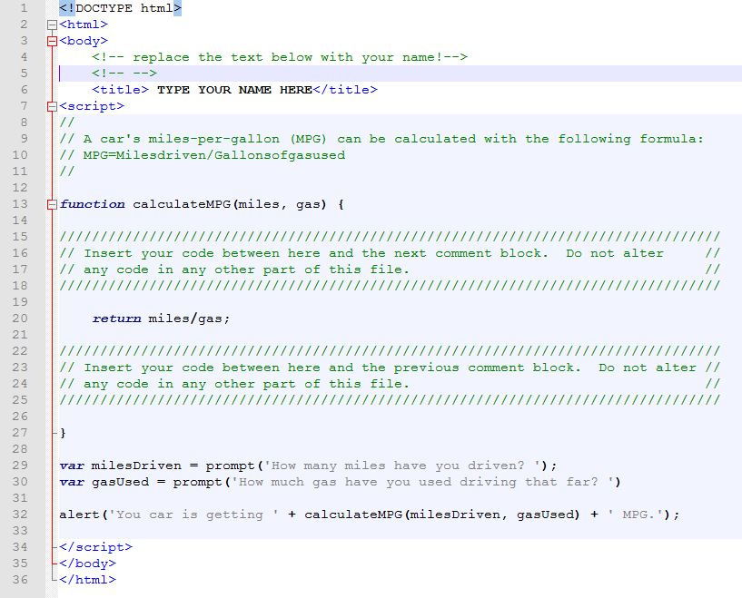
Sample Question:
What is your MPG if you have driven 320 Miles and used 20 Gallons of gas? (analyze the code)
A. 15
B. 16
C. 20
D. 32
FOX
MIS
Notes:
Bring a #

Slide 6
Sample Question:
What is your MPG if you have driven 320 Miles and used 20 Gallons of gas? (analyze the code)
A. 15
B. 16
C. 20
D. 32
FOX
MIS
Notes:
Bring a #

Slide 7
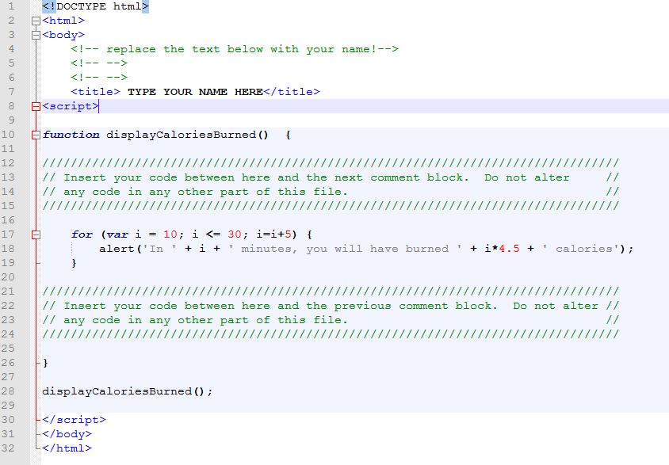
Sample Questions:
1. After 10 minutes, how many calories have you burned?`
A. 0 B. 45 C. 67.5
2. After 30 minutes, how many total calories have you burned?`
A. 112.5 B. 135 C. 450 D. 1350
3. If we change the initial value of i to 20 how many times does the function run and how many total calories are burned?
A. 3, 90 B. 5, 135 C. 3, 135 D. Does not run
4. If we change i <= 30 to i <=40 how many times does the function run and how many total calories are burned?
A. 5, 135 B. 7, 180 C. 7, 225 D. Does not run
FOX
MIS
Notes:
Bring a #

Slide 8
Sample Questions:
1. After 10 minutes, how many calories have you burned?`
A. 0 B. 45 C. 67.5
2. After 30 minutes, how many total calories have you burned?`
A. 112.5 B. 135 C. 450 D. 1350
3. If we change the initial value of i to 20 how many times does the function run and how many total calories are burned?
A. 3, 90 B. 5, 135 C. 3, 135 D. Does not run
4. If we change i <= 30 to i <=40 how many times does the function run and how many total calories are burned?
A. 5, 135 B. 7, 180 C. 7, 225 D. Does not run
FOX
MIS

Slide 9
Sample Question:
What’s wrong with the statement listed below?
var 365days = prompt (“How many days are in a year?");
FOX
MIS

Slide 10
Sample Question:
What’s wrong with the statement listed below?
var 365days = prompt (“How many days are in a year?");
Variable name cannot begin with a number!
FOX
MIS

Slide 11
Good Luck!!!
Study individually and in groups

