Slide 1
Information Systems in Organizations
An Introduction to Programming
FOX
MIS

Slide 2
ROADMAP
START
Week 1:
Introduction & Systems Analysis
Course Description
Systems Thinking
Week 1:
Introduction to Process Mapping
Systems & Processes
Swim Lane Diagrams
Max Labs 0- due
Week 2:
Digital Product Management & ERD
Max Labs 1A/1B- due
Week 2:
Introduction to Data Modeling
Week 2:
Exam #1
1/24-1/26: Exam Availability
Week 4 :
Exam #2
2/7-2/9 Exam Availability
Week 4:
Cybersecurity & AI
Protection Protocols
Artificial Intelligence
Cybersecurity/AI assignment due
Max Labs 3a/3b due
Week 4:
Platforms & Digital Business Models
API’s
Cloud
Week 3:
Information Systems
ERP & CRM
Data Analytics & SCM
Max Labs 2A/2B due
Lean IT #1 due
Week 5:
JavaScript Unit #1 & 2
Hello World, Variables
Input and Output
Operator types
Strings
Watch Lynda.com video – due
Code Academy due
Coding assignment #1-due
Week 6:
JavaScript Unit #3&4
Logical Operators
Conditional Types
Intro to Loops
While and Do
Writing the code
Coding Assignment #2-due
Week 7:
HTML & CSS
Coding Assignment #3-due
Lean IT #2 due
Week 7:
Exam #3
2/28-2/29: Exam Availability
FINISH

Slide 3
An Introduction to Programming
Week 5
FOX
MIS

Slide 4
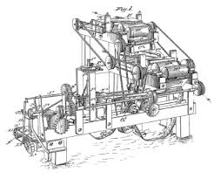

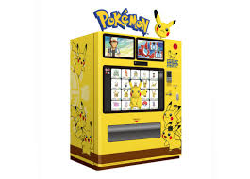
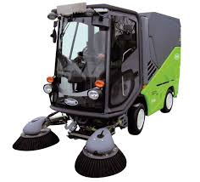
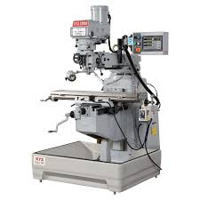
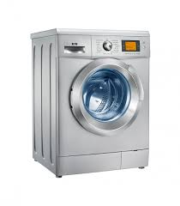
Machines
How many different things does a machine do?
Source: https://lh3.googleusercontent.com/_MsstYyQ4UORpFRdwNu6BN2_cL3vu_raiYq-RErSsdf_Y6v_lKZss8N-8qCO-Tnf3aalDw=s170
Source: https://lh3.googleusercontent.com/GB8PJSrB61OSat3rBAJO-wEjTGstYfB2N4ECL2LSYOahESElAVf7LWJMNrJ0undIP10o=s119
Source: https://lh3.googleusercontent.com/VVZxPvd2BpOPvECeBytaSZqFUfAg5UqPmeroft5ONc3bQVKYqr2s5IxoI4NvEP4unuJiFDI=s94
Source: https://lh3.googleusercontent.com/eZGdlrLtdzW9nEKR758LiagZ3_-wjxflYbpU-IfZeVdny34bXSgn4s0DQTsfS3t_O2eZ_g=s85
Source: https://lh3.googleusercontent.com/OCVAphS1iC9nYvF2FeP_llNXwWQ69mCX8HjK2DJ7UU_xGnoHOgXd4YX8O4Zes09WIcIFxP8=s85
Source: https://lh3.googleusercontent.com/mCtpPS6Qz3guK0-cyCruwUwgbKYAJhWH1iTqGbCNjMOvSnGMvL1FeBGeDIBYboOC7P-gfQ=s102
FOX
MIS

Slide 5
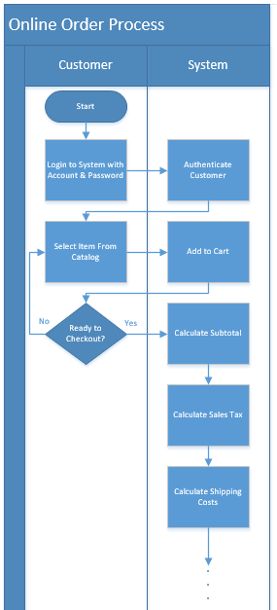


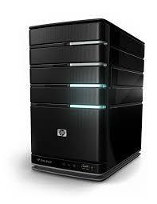

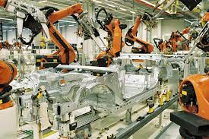
Machines (cont.)
How many different things does a computer do?
How can this machine do so many different things?
Source: https://lh3.googleusercontent.com/59wm5Z8eXC40_WKib3Ghe3ORRuSITa17Xl5BN8QIikEh_cDnScrGnOouZnO4X-cBY6ad5w=s128
Source: https://lh3.googleusercontent.com/luQcPRIrni_WsHytr016U1SPu7FvyVlK2AfyBH3fXEjhoBPrmpzuTfgjvQV40UR63ZTq1jk=s134
Source: https://lh3.googleusercontent.com/Mkj8bl6o0XbrVqnFs40Y3AFVMibSJX1xra-Ll5rwbMCxGs67gpljSny2TUI4KASK1u8sD-M=s85
Source: https://lh3.googleusercontent.com/dMhdY1wyo91ER5uMkI1recx4-0w7fOjNUNmSB9ZCgVnIMqqqXNDkxiw9ckuWij_vtzFSEw=s128
Source: https://lh3.googleusercontent.com/qu1kdMmaM8SbvpyiDQEULPMPGfCrHneGT7WZ494FhgM8N4SHp-TOQvmuKBK2leESFBSPUjg=s151
FOX
MIS

Slide 6
Software
Programs = Software = Apps
But aren’t all programmers geeks?
FOX
MIS

Slide 7


In the digital economy, geeks are…
Problem Solvers
Designers
Creators
Enablers
Source: https://lh3.googleusercontent.com/1w8YU_tUBElGdnnz7bm6J11P0r1ULETREi4a66qF_kQCwwMF4VRdytLg_iu2sXcFSeru=s128
Source: https://lh3.googleusercontent.com/T1uuAU2Ov5B0oYU4KCifPlOaYu8cZCqbUBwF_4KXAHzvbU_VKp0ymBGetZ1pBUL0Q73oL4o=s159
FOX
MIS

Slide 8
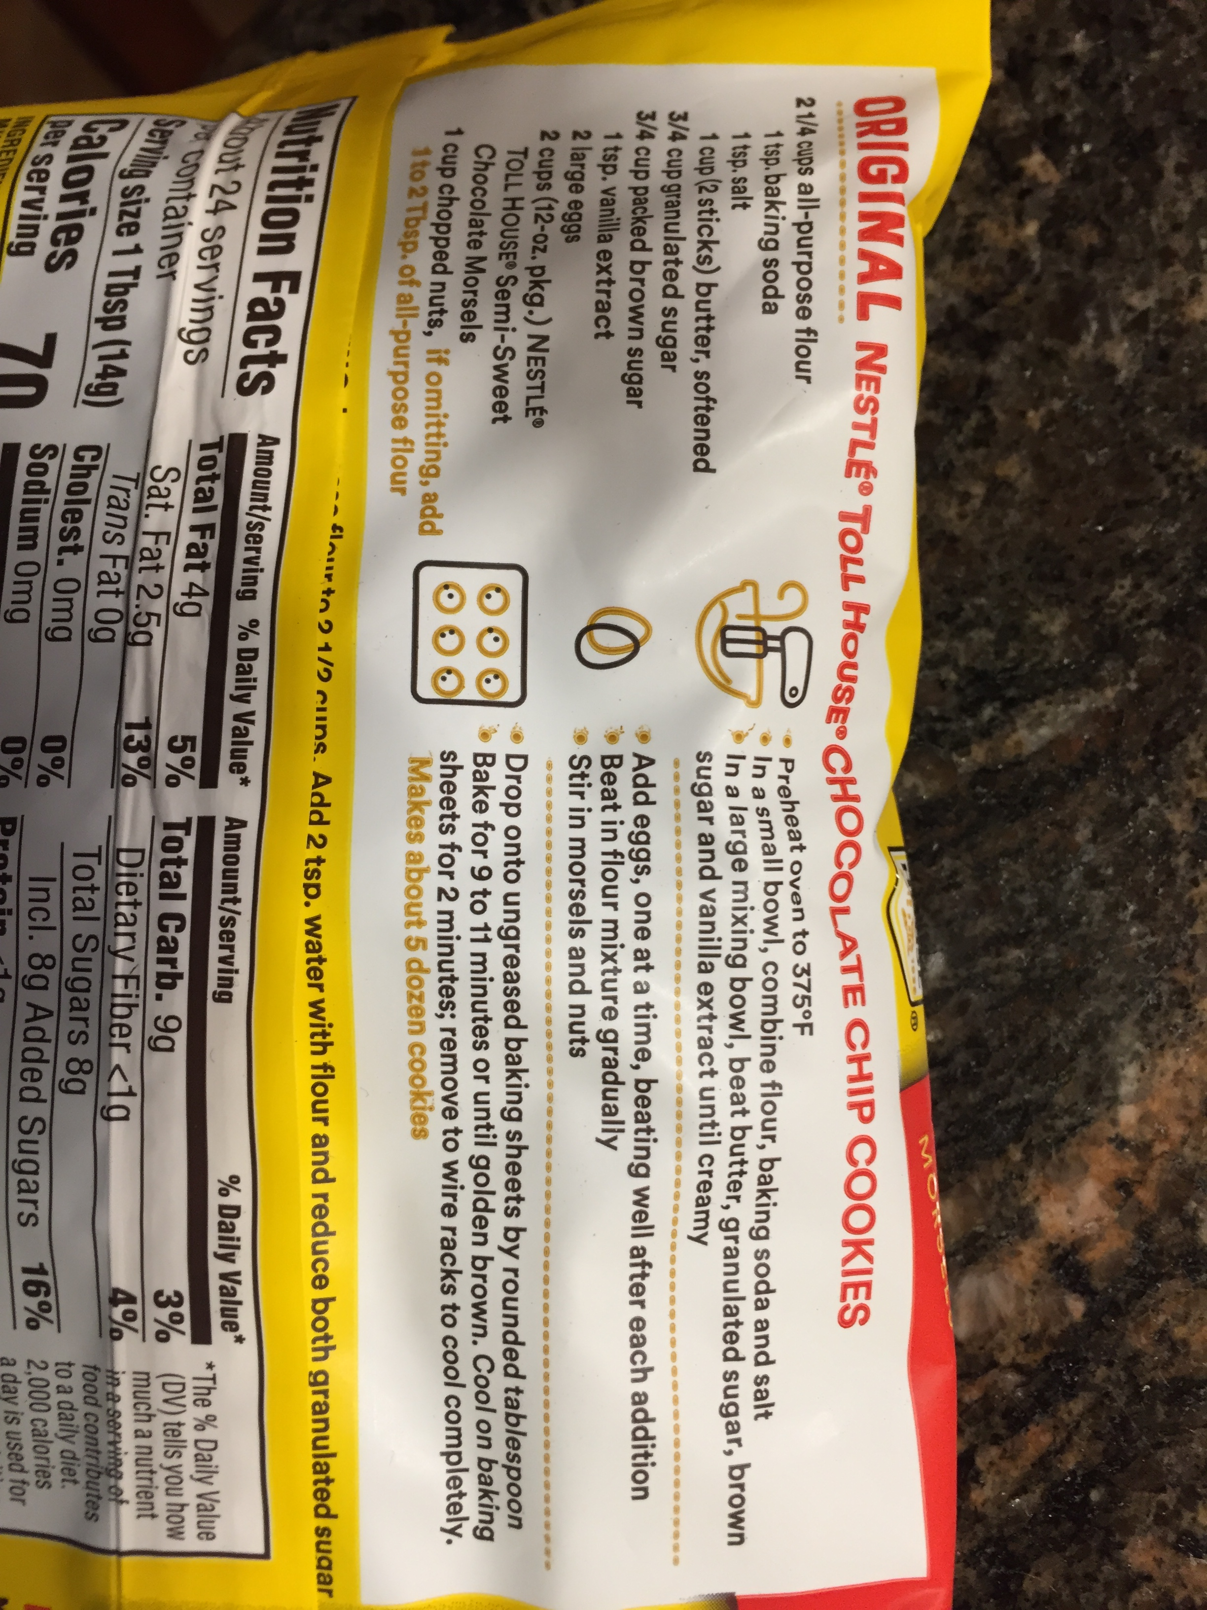
What exactly is a program?
Source: https://lh3.googleusercontent.com/ZcDhYsffPS_f2HRcyXUenTLZm9EeoVwHGlxcMrlw7G4HsGcCE_7o3HcToGjynKLosbP2EQ=s114
FOX
MIS

Slide 9
How to learn how to program
Program
Program some more
Program more after that
Delete everything and program it all over again
Source: https://i.pinimg.com/originals/75/0f/6f/750f6fae522eb0e3b03d49a7e46b6c58.jpg
FOX
MIS

Slide 10
“To err is human, but to really foul things up you need a computer.”
- Paul R. Ehrlich
FOX
MIS

Slide 11

Managing Expectations
Who here just LOVES music?
Source: https://lh3.googleusercontent.com/nLWIDzFEKGeMf5fbx1TqPCByiu0FAqARpXYexvoOsJeyccXS1U0fgllH946Zjdrr0L6MSw=s157
FOX
MIS

Slide 12
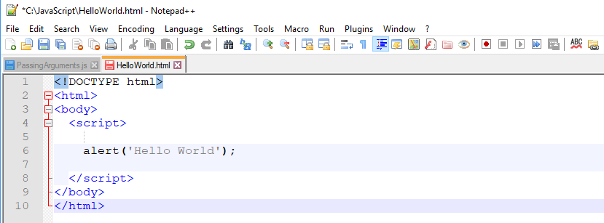
Hello World
Keep track of where you store your code!
}
This is the HTML and never changes
This is the JavaScript code
}
This is the HTML and never changes
FOX
MIS

Slide 13
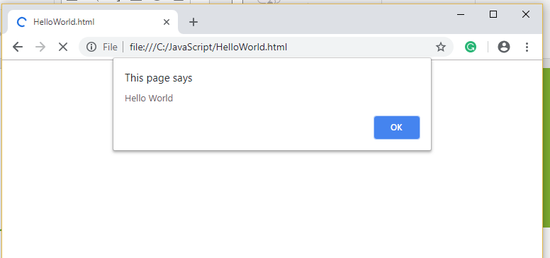
Hello World
Keep track of where you store your code!
Output from Alert
FOX
MIS

Slide 14
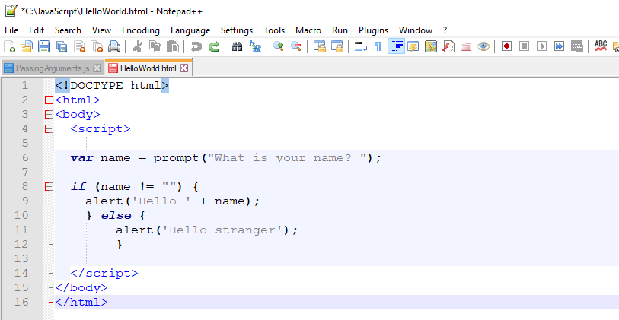
Fancy Hello World!
}
This is the HTML and never changes
}
This will make more sense in the coming weeks
}
This is the HTML and never changes
FOX
MIS

Slide 15
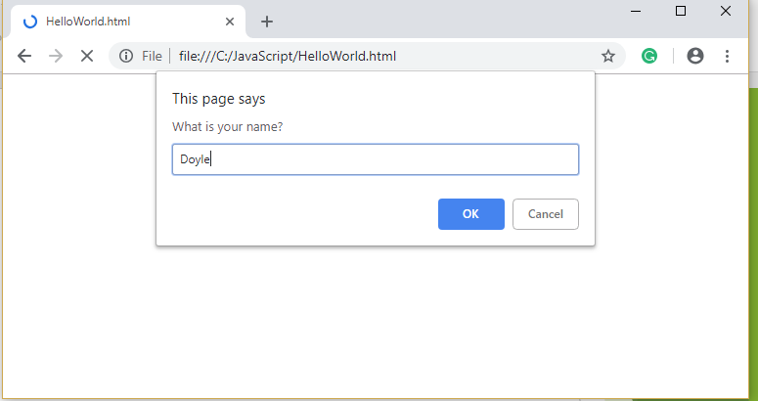
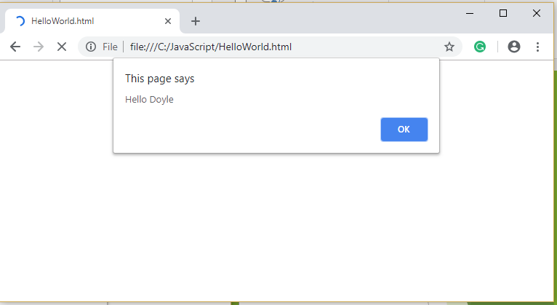
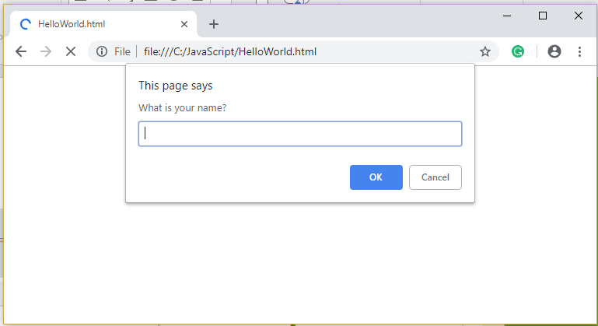
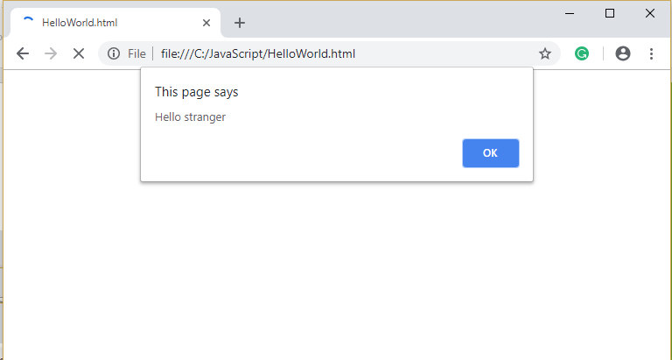
Fancy Hello World!
FOX
MIS

Slide 16
To code, we will need a text editor:
Installing-VS-Code-Windows
Installing-VS-Code-Mac-OS
FOX
MIS

Slide 17
File Naming Convention: lastname_firstname_Unit1_01_HelloWorld.html
Properly naming you file is very important, if it is improperly named then you will not receive the points for your assignments and challenges.
FOX
MIS

Slide 18
Values and Variables
Week 5
FOX
MIS

Slide 19
In JavaScript, every piece of data that you provide or use is considered to contain a value.
FOX
MIS

Slide 20
We saw this example earlier…
alert("hello, world!");
FOX
MIS

Slide 21
These words have a specific representation under the covers. They are considered values.
FOX
MIS

Slide 22
Because you’ll be working with values a whole lot, there are two things you need to simplify your life when working with them. You need to be able to:
Easily identify them
Reuse them throughout your application without unnecessarily duplicating the value itself
FOX
MIS

Slide 23
The way to use variables is by using the var keyword followed by the name you want to give your variable. Here is us declaring a variable:
var myText
FOX
MIS

Slide 24
Right now, your variable has simply been declared. It doesn't contain a value. We can fix that by initializing our variable to a value like...
FOX
MIS

Slide 25
Our variable myText has now been initialized to the value of hello, world!
var myText = “hello, world!”;
FOX
MIS

Slide 26
<script>
var myText = "hello, world!";
alert(myText);
</script>
The “assignment” operator
“alert()” is used to display information
What gets displayed is hello, world!
FOX
MIS

Slide 27
<script>
var myText = “hi everybody!”;
alert(myText);
</script>
What gets displayed now?
FOX
MIS

Slide 28
<script>
var myText = prompt("What text would you like to display? ");
alert(myText);
</script>
“prompt()” lets you get input from the user
What gets displayed now?
FOX
MIS

Slide 29
An “if” statement with a Boolean (true/false) expression
<script>
var name = prompt("What is your name? ");
if (name != "") {
alert('Hello ' + name);
} else {
alert('Hello stranger');
}
</script>
…what we do if the Boolean expression is true
…what we do if the Boolean expression is false
What gets displayed now?
FOX
MIS

Slide 30
Throughout your code, wherever you referenced the myText variable, you will now see the new text appear.
For larger applications, this convenience with having just one location where you can make a change that gets reflected everywhere is a major time saver.
FOX
MIS

Slide 31
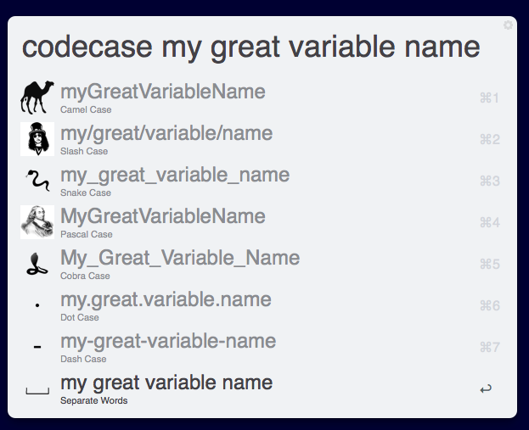
You have a lot of freedom in naming your variables however you see fit. Ignoring what names you should give things based on philosophical / cultural / stylistic preferences, from a technical point of view, JavaScript is very lenient on what characters can go into a variable name.
Source: https://content.invisioncic.com/r229491/monthly_2018_02/codecase.png.9abc0521d2c0925906f5d0c309ed3f7b.png
FOX
MIS

Slide 32
Basically, keep the following things in mind when naming them:
Your variables can be as short one character, or they can be as long as you want - think thousands and thousands...and thousands of characters.
Your variables can start with a letter, underscore, or the $ character. They can't start with a number.
Outside of the first character, your variables can be made up of any combination of letters, underscores, numbers, and $ characters. You can also mix and match lowercase and uppercase to your heart's content.
Spaces are not allowed.
FOX
MIS

Slide 33
var myText;
var $;
var r8;
var _counter;
var $field;
var thisIsALongVariableName_butItCouldBeLonger;
var __$abc;
var OldSchoolNamingScheme;
FOX
MIS

Slide 34
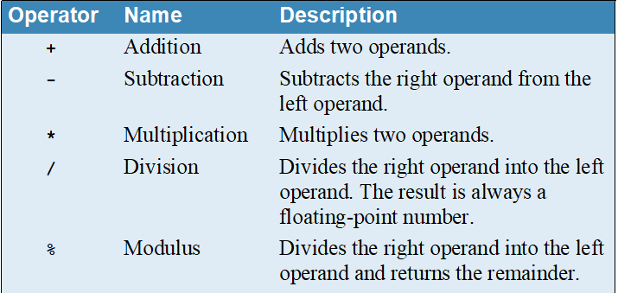
Arithmetic operators
WARNING! This is not a complete list.
FOX
MIS

Slide 35
FOX
MIS

Slide 36
Concatenation operator
Just a fancy name for putting two strings together.
Concatenation is a very common task!
FOX
MIS

Slide 37
Prompt(), addition and concatenation
Prompt always returns a string
If the string looks like a number, JavaScript will convert the string to a number to do arithmetic
JavaScript doesn’t always do what you expect when using the “+” operator because it is used to perform addition when dealing with numbers and concatenation when dealing with strings
If JavaScript isn’t converting strings to numbers as you expect, use parseInt() or parseFloat() to convert them
FOX
MIS

Slide 38
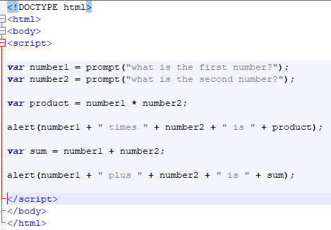
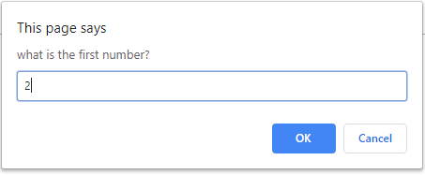
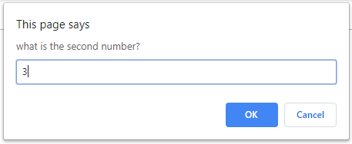
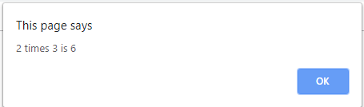
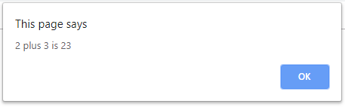
Output if JavaScript doesn’t convert the number to a number
FOX
MIS

Slide 39
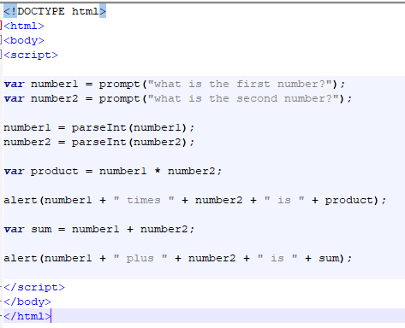
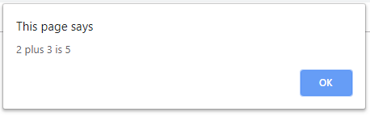
Output once we use parseInt to convert the string to a number
FOX
MIS

Slide 40
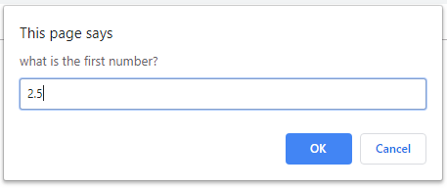
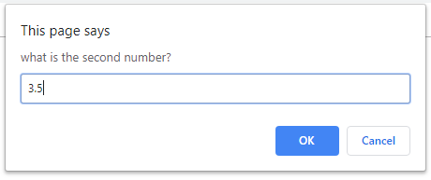
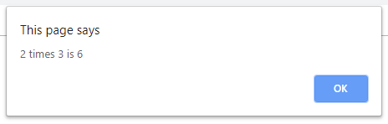

Is parseInt what we want if we’re dealing with floating point numbers (a.k.a. numbers with a decimal point)?
FOX
MIS

Slide 41
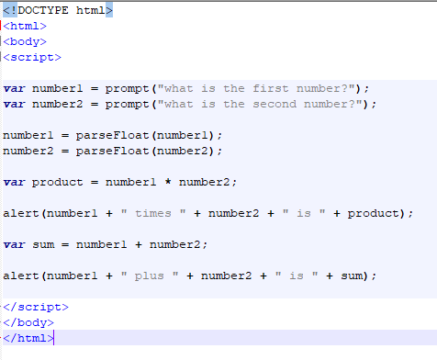

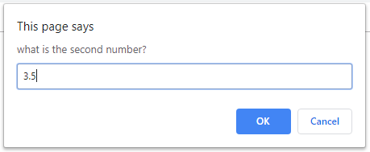
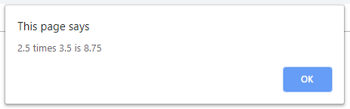
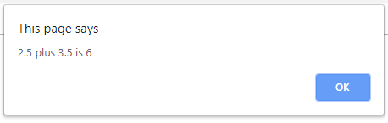
Use parseFloat when we’re dealing with floating point numbers (a.k.a. numbers with a decimal point)?
FOX
MIS

Slide 42
How to write a program in 3 easy steps!
Understand the Problem
Develop the Algorithm
Write the Code
If you don’t REALLY understand the problem, you’ll never in a million years write a program that solves the problem
The logical steps that solves this particular problem
The automated process
FOX
MIS

Slide 43
The only part that is language specific…
Once you have the algorithm (the hard part!), translating the algorithm to a particular programming language is fairly easy. If writing the code seems difficult, your problem is usually a bad algorithm!
You can use lots of different languages. Some languages do some things better than others but they all do the same basic things.
In this class we will be using JavaScript, the de-facto standard for applications that run in a browser.
JavaScript
Ruby
Write the Code
C#
Visual Basic
Objective-C
C
PHP
Python
Java
FOX
MIS

Slide 44
If Swim Lane diagrams model processes and
If a program is just an automated process
Can we use a similar technique to model automated processes?
FOX
MIS

Slide 45
Flowcharts
Beginning or End
Decision
Input or Output
Flow
A step in a process
A function
FOX
MIS

Slide 46
Hello World
Step #2 – Develop the Algorithm
Step #1 – Understand the Problem
Start
Prompt the user for their name. If the user enters their name then display the message “Hello” and their name. If the user does not enter their name then display the message “Hello Stranger”
Prompt user for name
Is the name not null
Yes
No
Display “Hello” and their name
Display “Hello Stranger”
End
FOX
MIS

Slide 47
Step #3 – Write the Code
<script>
var name = prompt("What is your name? ");
if (name != "") {
alert('Hello ' + name);
} else {
alert('Hello stranger');
}
</script>
Thought Process:
Make the basic tags like <html>, <script>
Ensure that the tags are properly closed
Inside the script tag, write the code
Ask user to enter a name
Assign a variable which will contain the name
If user enters the name as “Sam” then display the user name with “Hello Sam”
Else If user does not enters any name then display “Hello stranger”
FOX
MIS

Slide 48
Time for “Challenges”!
FOX
MIS

Slide 49
Pair programming is an agile software development technique in which two programmers work together at one workstation. One, the driver, writes code while the other, the observer or navigator, reviews each line of code as it is typed in. The two programmers switch roles frequently.
-Wikipedia
FOX
MIS

Slide 50
Challenges
HelloWorld (already done)
HelloWorld2 (already done)
Address
GuessANumber
Profits
LandCalculations
TotalPurchases
FOX
MIS

Slide 51
Address
Step #1 – Understand the Problem
Step #2 – Develop the Algorithm
Start
Prompt the user for their name, their address (with city state and zip), their telephone number and their major. Store each of these in variables and then display their values.
Prompt user for name.
Prompt user for address.
Prompt user for city.
Prompt user for State.
Prompt user for zip code.
Prompt user for telephone number
Prompt user for major.
Display name.
Display address.
Display city.
Display State.
Display zip code.
Display telephone number
Display major.
End
FOX
MIS

Slide 52
TIME TO CODE!
FOX
MIS

Slide 53
Step 3: Write the code
Make the tags: <html> for the html page, <body> for the content in the page, <script> for the code in the page.
<html>
<body>
<script>
var name = prompt("What is your name? ");
var address = prompt("What is your street address? ");
var city = prompt("What city do you live in? ");
var state = prompt("What state do you live in? ");
var zip = prompt("What is your zipcode? ");
var telephone = prompt("What is your telephone number? ");
var major = prompt("What is your college major? ");
alert('Hello ' + name);
alert('from ' + address + ' ' + city + ', ' + state + ' ' + zip);
alert('who can be reached at ' + telephone);
alert('and is studying ' + major);
</script>
</body>
</html>
2. Here we get the name from the user and store it in variable called name.
“var” helps us make variables,
“=“ assigns the value to the variable
“prompt” gets the data from the user.
3. “alert”, displays a box on the browser with the information. Now display all the details
4. Close the tags
FOX
MIS

Slide 54
GuessANumber
Step #1 – Understand the Problem
Step #2 – Develop the Algorithm
Write a program that generates a random integer from 1 to 100 and stores that value in a variable.
Display the number.
Start
Generate a random number (1-100)
Display the number
End
FOX
MIS

Slide 55
TIME TO CODE!
FOX
MIS

Slide 56
Step 3: Write the code
<html>
<body>
<script>
var randomNumber = Math.floor(Math.random() * 100) + 1;
alert('The random number generated is ' + randomNumber);
</script>
</body>
</html>
Make the tags: <html> for the html page, <body> for the content in the page, <script> for the code in the page.
2. Make a variable for random number. Then assign the random number equation to it.
“var” helps in creating a variable
“=“ helps in assigning the value to a variable.
3. Display the random number
4. Close the tags
FOX
MIS

Slide 57
Profits
Step #1 – Understand the Problem
Step #2 – Develop the Algorithm
A company has determined that its annual profit is typically 23 percent of total sales.
Prompt the user to enter the projected amount of total sales, then displays the profit that will be made from that amount.
Hint: Use the value 0.23 to represent 23 percent.
Start
Prompt for projected total sales
Calculate projected profits
Display projected profits
End
FOX
MIS

Slide 58
TIME TO CODE!
FOX
MIS

Slide 59
Step 3: Write the code
<html>
<body>
<script>
var totalSales = prompt("What are your projected total sales? ");
var profits = totalSales * .23;
alert('the expected profits on ' + totalSales + ' in total sales is ' + profits);
</script>
</body>
</html>
Make the tags: <html> for the html page, <body> for the content in the page, <script> for the code in the page.
2. Here we get the total sales from the user and store it in variable called totalsales.
“var” helps us make variables
“=“ assigns the value to the variable
“prompt” gets the data from the user.
3. “alert”, displays a box on the browser with the information. Now display all the details
4. Close the tags
FOX
MIS

Slide 60
Functions
Week 5
FOX
MIS

Slide 61
What is a function in Excel?
=TODAY()
=NOW()
=SUM(A1,B1)
=AVERAGE(A1:A10)
=MIN(A1:A10)
=MAX(A1:A10)
FOX
MIS

Slide 62
What is a function in Excel? (cont.)
All functions
  Have a name
  Are passed zero or more pieces of information
  Return a value
FOX
MIS

Slide 63
Functions allow our code to be more maintainable and reusable!
FOX
MIS

Slide 64
What is a function in JavaScript?
A way to organize your code to make it easier to create, maintain and reuse
All functions
  Have a name
  Are passed zero or more pieces of information
  Return a value (usually)
Main program just does basic input/output. All of the real work is packaged up and performed in functions
FOX
MIS

Slide 65
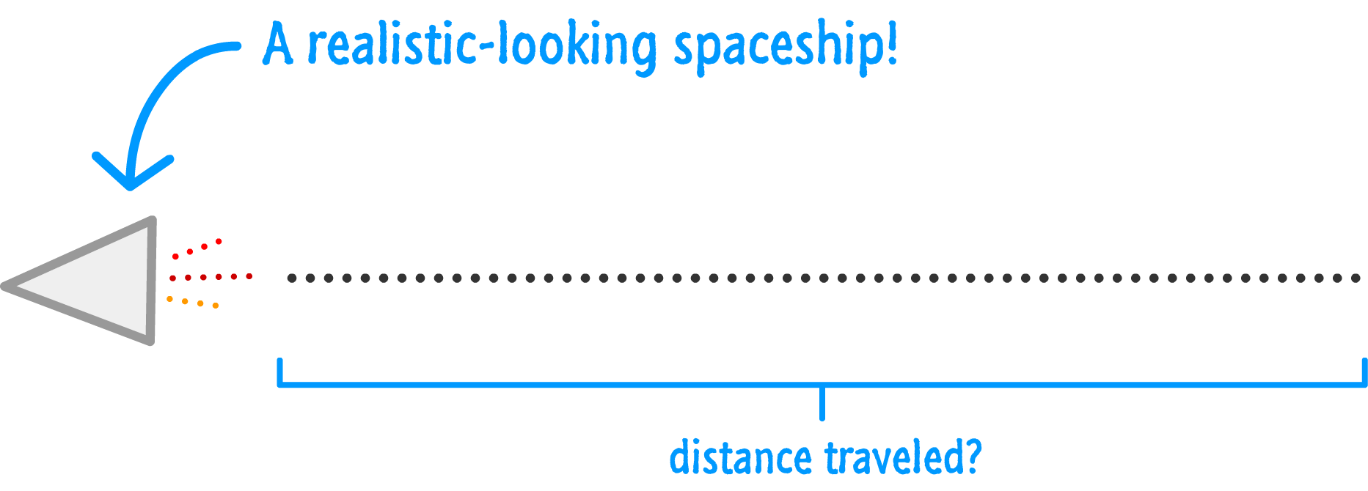
Source: JavaScript Absolute Beginner’s Guide by Kirupa Chinnathambi
FOX
MIS

Slide 66

Source: JavaScript Absolute Beginner’s Guide by Kirupa Chinnathambi
FOX
MIS

Slide 67
Meanwhile in JS Land
That diagram can be turned into the following:
var speed = 10;
var time = 5;
alert(speed * time);
FOX
MIS

Slide 68
var speed = 10;
var time = 5;
alert(speed * time);
var speed1 = 85;
var time1 = 1.5;
alert(speed1 * time1);
var speed2 = 12;
var time2 = 9;
alert(speed2 * time2);
var speed3 = 42;
var time3 = 21;
alert(speed3 * time3);
Let’s say we have to calculate the distance multiple times.
Our code might look as follows.
FOX
MIS

Slide 69
You should avoid unnecessarily repeating code. It makes your life more complicated.
FOX
MIS

Slide 70
This is where functions come in...
FOX
MIS

Slide 71
Meet the Function
Using functions, the code we saw earlier can look like this:
function showDistance(speed, time) {
alert(speed * time);
}
showDistance(10, 5);
showDistance(85, 1.5);
showDistance(12, 9);
showDistance(42, 21);
FOX
MIS

Slide 72
What exactly is a function?
At a very basic level, a function is nothing more than a wrapper for some code. It does two things well:
Groups statements together
Makes your code reusable
You will rarely write or use code that doesn't involve functions!
FOX
MIS

Slide 73
var speed = 10;
var time = 5;
alert(speed * time);
var speed1 = 85;
var time1 = 1.5;
alert(speed1 * time1);
var speed2 = 12;
var time2 = 9;
alert(speed2 * time2);
var speed3 = 42;
var time3 = 21;
alert(speed3 * time3);
function showDistance(speed, time) {
alert(speed * time);
}
showDistance(10, 5);
showDistance(85, 1.5);
showDistance(12, 9);
showDistance(42, 21);
vs.
FOX
MIS

Slide 74
A Simple Function
function sayHello() {
alert("hello!");
}
You have the function keyword, followed by your function name, some weird parentheses and brackets, and the code your function will run when called.
FOX
MIS

Slide 75
Calling a Function
function sayHello() {
alert("hello!");
}
sayHello();
The function call is typically the name the function you want to call (aka invoke) followed again by the parentheses.
FOX
MIS

Slide 76
What exactly a function does can be customized. It doesn’t have to be boring and predictable like what have seen so far. One way is by providing what are known as arguments where your function call contains some data that you pass into the function.
FOX
MIS

Slide 77
Hello, again!
The showDistance function takes two arguments: speed, time:
function showDistance(speed, time) {
alert(speed * time);
}
showDistance(10, 5);
showDistance(85, 1.5);
showDistance(12, 9);
showDistance(42, 21);
FOX
MIS

Slide 78
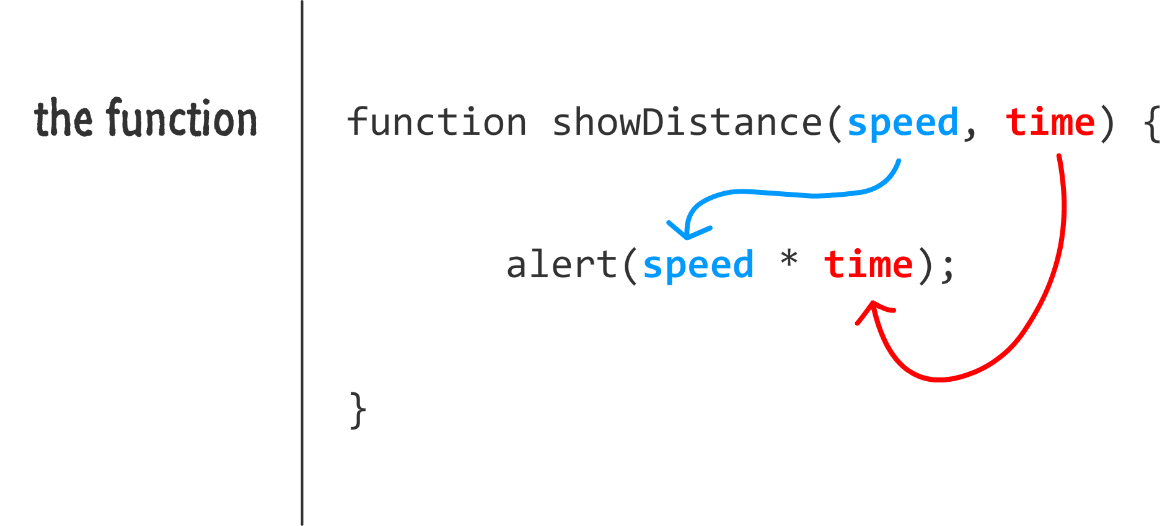
Source: JavaScript Absolute Beginner’s Guide by Kirupa Chinnathambi
FOX
MIS

Slide 79
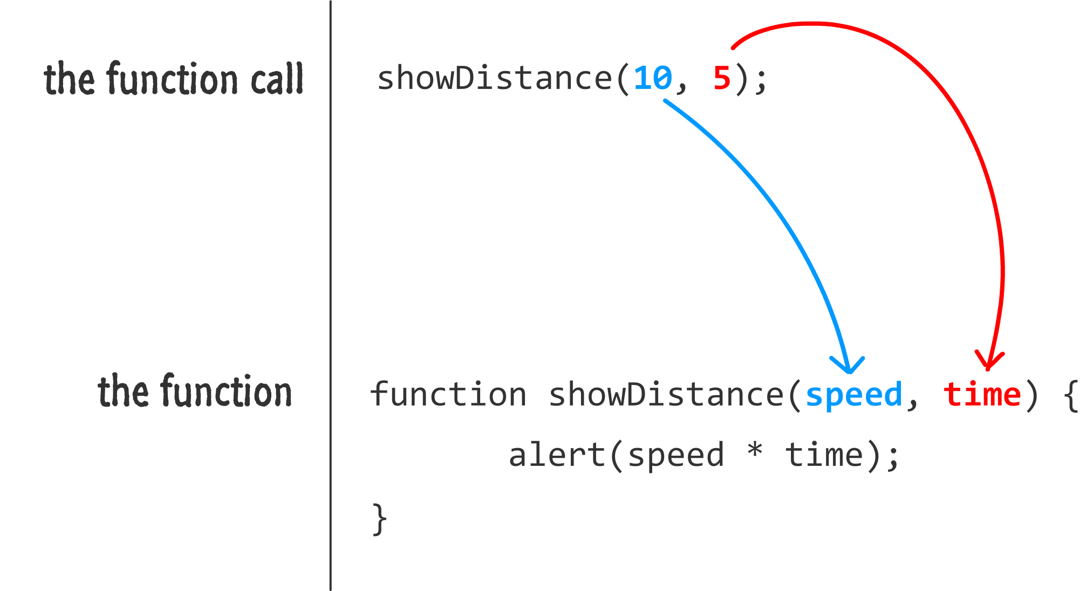
Source: JavaScript Absolute Beginner’s Guide by Kirupa Chinnathambi
FOX
MIS

Slide 80
Returning Data
function getDistance(speed, time) {
var distance = speed * time;
return distance;
}
var myDistance = getDistance(10, 5);
alert(myDistance);
The return keyword allows you to send data back to whatever called your function in the first place.
FOX
MIS

Slide 81
Once your function hits the return keyword, it stops everything it is doing at that point, returns whatever value you specified to the caller, and exits the function only. It does not exit the program!!!!
No code in your function after return will run.
function getDistance(speed, time) {
var distance = speed * time;
return distance;
if (speed < 0) {
distance *= -1;
}
}
FOX
MIS

Slide 82
Time for “Challenges”!
FOX
MIS

Slide 83
In-Class Challenges
TotalDistance
SalesTax
MPG
TipTaxTotal
C2F
IngredientAdjuster
FOX
MIS

Slide 84
TotalDistance
Step #1 – Understand the Problem
Step #2 – Develop the Algorithm
Step #3 – Write the Code
Assuming there are no accidents or delays, the distance that a car travels down the interstate can be calculated with the following formula:
Distance=Speed*Time
Write a program that prompts for both Speed and Time and calls a function to calculate the distance traveled.
Main Start
Prompt for Speed
distanceTraveled
Prompt for Time
Calculate Distance Traveled
distanceTraveled
Return Distance Traveled
Display Distance Traveled
Main End
FOX
MIS

Slide 85
Time to Code!
FOX
MIS

Slide 86
Step 3: Write the code
Make the tags: <html> for the html page, <body> for the content in the page, <script> for the code in the page.
<html>
<body>
<script>
function distanceTraveled(drivingSpeed, timeDriving) {
return drivingSpeed * timeDriving;
}
var speed = prompt('How fast are you traveling in miles per hour? ');
var time = prompt('How long are you driving at that speed in hours? ')
alert('While driving at ' + speed + ' miles/hour, you will have traveled ' + distanceTraveled(speed, time) + ' miles in ' + time + ' hours.');
</script>
</body>
</html>
2. Here we call the function. It is like an equation with variables in it. The word “function” helps in creating a function. The variables inside the parenthesis are the values a function takes. This function named distanceTraveled returns the distance which is the product of speed and time.
3. Here we get the speed in miles/hour and time in hours taken to drive.
“var” helps us make variables
“=“ assigns the value to the variable
“prompt” gets the data from the user.
4. “alert”, displays a box on the browser with the information. Notice how the function is called here, with the parameters. Now display all the details
5. Close the tags
FOX
MIS

Slide 87
SalesTax
Step #1 – Understand the Problem
Step #2 – Develop the Algorithm
Step #3 – Write the Code
Write a program that will ask the user to enter the amount of a purchase.
The program should then call a function to compute the state and county sales tax. Assume the state sales tax is 5% and the county sales tax is 2.5%. The function should return the total for the purchase including the original purchase price plus state sales tax and county sales tax.
Hint: Use the value 0.025 to represent 2.5%, and 0.05 to represent 5%.
Main Start
orderTotal
_______________
__________
Prompt for Purchase Amount
Calculate State
Sales Tax
orderTotal
Calculate County Sales Tax
_______________
_____
Display Order Total
Calculate Order
Total
Return Order Total
Main End
FOX
MIS

Slide 88
Time to Code!
FOX
MIS

Slide 89
Step 3: Write the code
1.Make the tags: <html> for the html page, <body> for the content in the page, <script> for the code in the page.
<html>
<body>
<script>
function orderTotal(subtotal) {
var stateSalesTax = subtotal * .05;
var countySalesTax = subtotal * .025;
return subtotal + stateSalesTax + countySalesTax;
}
var amountOfPurchase = parseFloat(prompt('What is the amount of the purchase? '));
alert('The total for the order is $' + orderTotal(amountOfPurchase) + ' include state and county sales tax.');
</script>
</body>
</html>
2. Here we call the function. It is like an equation with variables in it. The word “function” helps in creating a function. The variables inside the parenthesis are the values a function takes. This function named orderTotal is called with subtotal as parameter and:
stateSalesTax which is calculate with respect to subtotal
countySalesTax which is also calculated with respect to subtotal
3. The function returns the equation by adding up all the variables
4. Here we get the amount in dollars from the user and store it in variable called amountOfPurchase.
“var” helps us make variables
“=“ assigns the value to the variable
“prompt” gets the data from the user.
“parseFloat” converts the data into decimals
5. “alert”, displays a box on the browser with the information. Notice how the function is called here, with the parameters. Now display all the details
6. Close the tags
FOX
MIS

