Slide 1
Information Systems in Organizations
Logical Operators and Conditional Logic
FOX
MIS

Slide 2
ROADMAP
START
Week 1:
Introduction & Systems Analysis
Course Description
Systems Thinking
Week 1:
Introduction to Process Mapping
Systems & Processes
Swim Lane Diagrams
Max Labs 0- due
Week 2:
Digital Product Management & ERD
Max Labs 1A/1B- due
Week 2:
Introduction to Data Modeling
Week 2:
Exam #1
1/24-1/26: Exam Availability
Week 4 :
Exam #2
2/7-2/9 Exam Availability
Week 4:
Cybersecurity & AI
Protection Protocols
Artificial Intelligence
Cybersecurity/AI assignment due
Max Labs 3a/3b due
Week 4:
Platforms & Digital Business Models
API’s
Cloud
Week 3:
Information Systems
ERP & CRM
Data Analytics & SCM
Max Labs 2A/2B due
Lean IT #1 due
Week 5:
JavaScript Unit #1 & 2
Hello World, Variables
Input and Output
Operator types
Strings
Watch Lynda.com video – due
Code Academy due
Coding assignment #1-due
Week 6:
JavaScript Unit #3&4
Logical Operators
Conditional Types
Intro to Loops
While and Do
Writing the code
Coding Assignment #2-due
Week 7:
HTML & CSS
Coding Assignment #3-due
Lean IT #2 due
Week 7:
Exam #3
2/28-2/29: Exam Availability
FINISH

Slide 3
If / Else Statements
Week 6
FOX
MIS

Slide 4
If and Else statements allow you to run some code based on whether a condition is true or false.
FOX
MIS

Slide 5
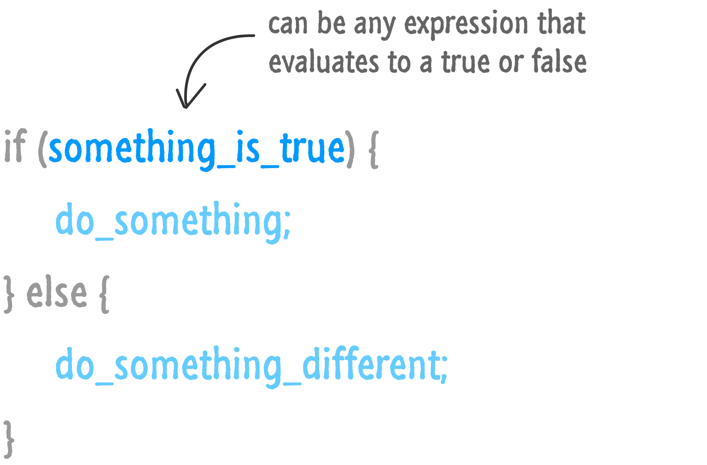
Source: JavaScript Absolute Beginner’s Guide by Kirupa Chinnathambi
FOX
MIS

Slide 6
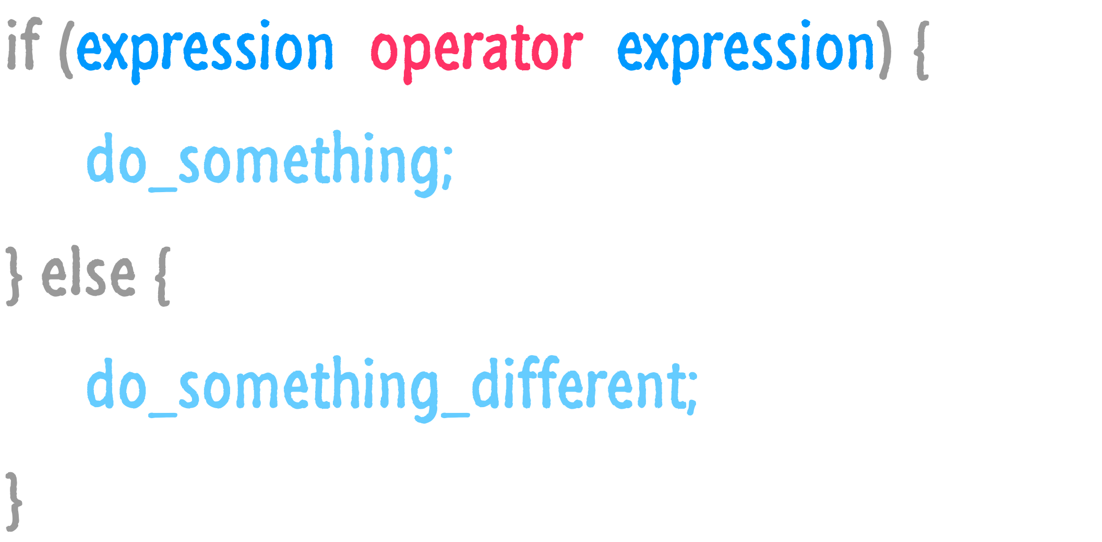
Source: JavaScript Absolute Beginner’s Guide by Kirupa Chinnathambi
FOX
MIS

Slide 7
Operator | When it is true...
== | If the first expression evaluates to something that is equal to the second expression.
>= | If the first expression evaluates to something that is greater or equal to the second expression
> | If the first expression evaluates to something that is greater than the second expression
<= | If the first expression evaluates to something that is lesser or equal to the second expression
< | If the first expression evaluates to something that is less than the second expression
!= | If the first expression evaluates to something that is not equal to the second expression
&& | If the first expression and the second expression both evaluate to true
|| | If either the first expression or the second expression evaluate to true
! | Flips the value from false to true or true to false
Relational Operators
Logical Operators
FOX
MIS

Slide 8
Conditional Expressions
lastName == "Hopper"
testScore == 10
firstName != "Grace"
months != 0
testScore > 100
age < 18
distance >= limit
stock <= reorder_point
rate / 100 >= 0.1
Expressions evaluate to true or false.
FOX
MIS

Slide 9
Handy Boolean Expression
The syntax of the global isNaN method
isNaN() is a global method. The term “global” means it is available everywhere in your JavaScript code. Global methods are also sometimes called functions.
FOX
MIS

Slide 10
Conditional expressions with logical operators
Expressions evaluate to true or false.
What do each of these expressions evaluate to?
FOX
MIS

Slide 11
Putting conditional expressions to work!
The syntax of the if statement
FOX
MIS

Slide 12
An if statement with multiple else clauses
FOX
MIS

Slide 13
An Example
var speedLimit = 55;
function amISpeeding(speed) {
if (speed >= speedLimit) {
alert("Yes. You are speeding.");
} else {
alert("No. You are not speeding. What's wrong with you?");
}
}
amISpeeding(53);
amISpeeding(72);
FOX
MIS

Slide 14
var xPos = 300;
var yPos = 150;
function sendWarning(x, y) {
if ((x < xPos) && (y < yPos)) {
alert("Adjust the position");
} else {
alert("Things are fine!");
}
}
sendWarning(500, 160);
sendWarning(100, 100);
sendWarning(201, 149);
Your if and else statements can be nested to help you simulate more complex situations!
FOX
MIS

Slide 15
Time for “Challenges”!
FOX
MIS

Slide 16
In-Class Challenges
GuessANumber
DayOfTheWeek
AreasOfRectangles
AgeClassifier
RomanNumerals
MassAndWeight
FOX
MIS

Slide 17
GuessANumber
Step #3 – Write the Code
guessMade
Step #1 – Understand the Problem
Step #2 – Develop the Algorithm
Guess > Random Number?
Update your GuessANumber program so that after the random number is generated and the user is prompted for a guess. If the guess is “Too high”, “Too low” or “Correct”, display the random number that was generated, the number that was guessed and an appropriate message that indicates if the guess was too high, too low or correct.
Main Start
No
Yes
Generate a Random Number (1-100)
Display _________
“Too High”
Guess < Random Number?
Prompt for the User’s Guess
No
Yes
guessMade
Display “Too Low”
Display _________
“Correct!”
Main End
FOX
MIS
Return

Slide 19
Step 3: Write the code
Make the tags: <html> for the html page, <body> for the content in the page, <script> for the code in the page.
<html>
<body>
<script>
function guessMade(numberGuessed){
if (numberGuessed > randomNumber) {
alert('Your guess is too high');
} else if (numberGuessed < randomNumber) {
alert('Your guess is too low');
} else {
alert('Your guess is correct!');
}
}
var randomNumber = Math.floor(Math.random() * 100) + 1;
var numberGuessed = prompt('Guess a number from 1 to 100: ');
guessMade(numberGuessed);
</script>
</body>
</html>
2. Here we make the function called guessMade which takes in numberGuessed variable as a parameter.
3. This function does not returns a value, instead based on the conditions, it will display text
4. Here we already set a random number using the random equation and get the user to take a guess.
5. The function is called with the guess as parameter and based on the conditions, the user will see the alert on the browser
6. Close the tags
FOX
MIS

Slide 20
DayOfTheWeek
dayOfTheWeek
Day = 1?
Yes
Day = ______
Monday
No
Step #1 – Understand the Problem
Main Start
Day = 2?
Yes
Day = Tuesday
Write a program that asks the user for a number in the range of 1 through 7. The program should call a function which returns the corresponding day of the week, where 1 = Monday, 2 = Tuesday, 3 = Wednesday, 4 = Thursday, 5 = Friday, 6 = Saturday, and 7 = Sunday. The program should display an error message if the user enters a number that is outside the range of 1 through 7.
No
Prompt for the day as a number
Day = 3?
Yes
Day = Wednesday
No
Day = 4?
Yes
Day = Thursday
dayOfTheWeek
No
Day = 5?
Yes
Day = Friday
Display the day as text
No
Day = 6?
Yes
Day = Saturday
No
Day = 7?
Yes
Day = Sunday
Main End
No
Day = ____
Return Day
FOX
MIS
Error

Slide 22
Step 3: Write the code
<html>
<body>
<script>
function dayOfTheWeek(day) {
if (day == 1) {
valueToReturn = 'Monday';
} else if (day == 2) {
valueToReturn = 'Tuesday';
} else if (day == 3) {
valueToReturn = 'Wednesday';
} else if (day == 4) {
valueToReturn = 'Thursday';
} else if (day == 5) {
valueToReturn = 'Friday';
} else if (day == 6) {
valueToReturn = 'Saturday';
} else if (day == 7) {
valueToReturn = 'Sunday';
} else {
valueToReturn = 'is not a valid day of the week';
}
return valueToReturn;
}
var day = parseInt(prompt('What day of the week (number)? '));
alert('Day ' + day + ' of the week is ' + dayOfTheWeek(day));
</script>
</body>
</html>
Make the tags: <html> for the html page, <body> for the content in the page, <script> for the code in the page.
2. Here we make the function called dayOfTheWeek which takes a number variable called day as the parameter.
3. This function does the conditional checking based on day and then returns a string, the name of the day
4. The value is returned from the function
5. The function is called with the guess as parameter and based on the conditions, the user will see the alert on the browser
6. Close the tags
FOX
MIS

Slide 23
Loops
Week 6
FOX
MIS

Slide 24
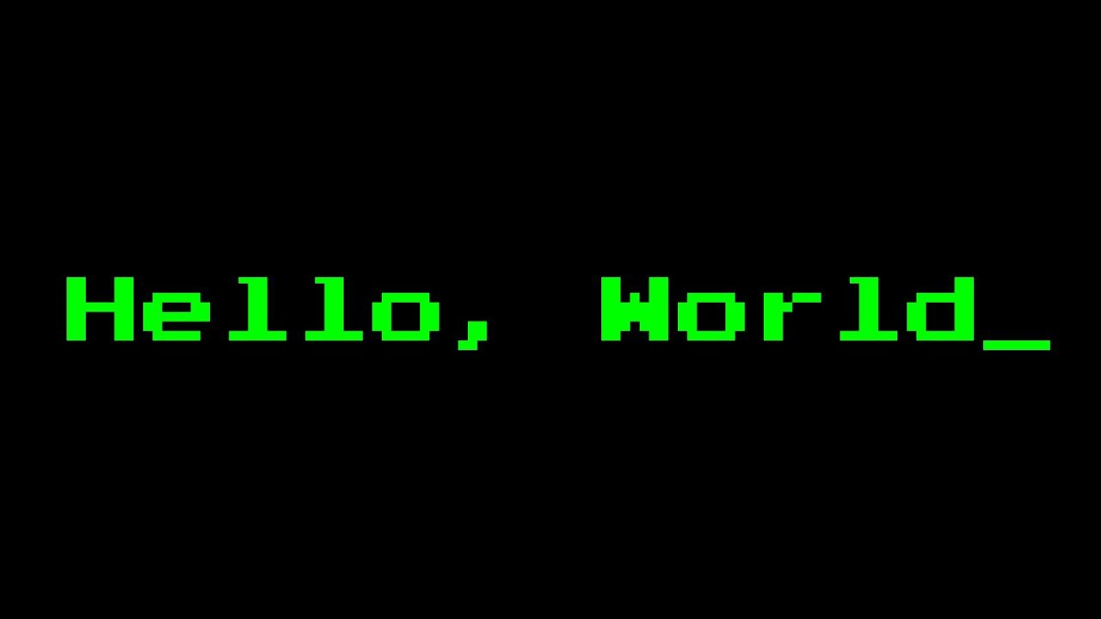

So, what if you wanted to say Hello World ten times?
Source: https://lh3.googleusercontent.com/ALTNv-dmwvGK0MTCa4XTQ9mCD1PMZZNfsaWSCt7PF9gbhpzol1hsHN5x-C6PXvjVldlkbek=s151
Source: https://lh3.googleusercontent.com/b7Cy0wGI1lYwR4mUZ7jpBLGxd0h0K_qBsK4zh61CXoEd2d1E5d4SV4KVh8a02KIH-tSy=s85
FOX
MIS

Slide 25
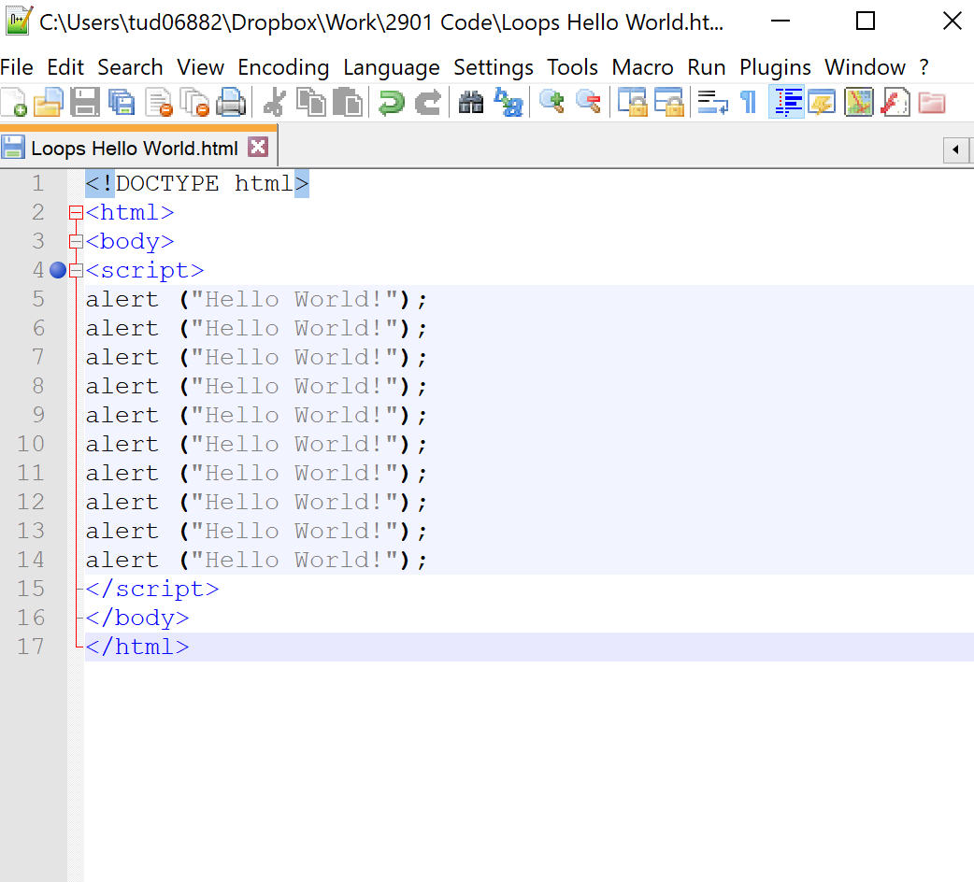
You could do this…
FOX
MIS

Slide 26
But wouldn’t this be easier?
for (var i = 0; i < 10; i++)
{
alert("Hello World!");
}
FOX
MIS

Slide 27
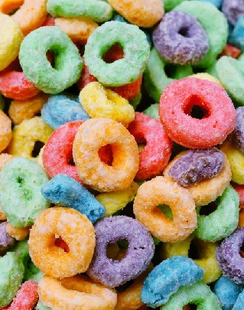
Enter the loop…
A sequence of instructions that is repeated until a certain condition is reached.
An operation is done, such as getting an item of data and changing it, and then some condition is checked such as whether a counter has reached a prescribed number.
Source: https://lh3.googleusercontent.com/lD3-M72vTnUEBpUxd_l835K2WC_ZUVjSkp7shlUbyX8jRDwPb2i7G-e7e9axmD19FbUEwg=s85
FOX
MIS

Slide 28
You will often want to repeat some code many MANY times.
FOX
MIS

Slide 29
Don’t do this!
saySomething();
saySomething();
saySomething();
saySomething();
saySomething();
saySomething();
saySomething();
saySomething();
FOX
MIS

Slide 30
You will often want to repeat some code many MANY times.
A loop will help you out.
FOX
MIS

Slide 31
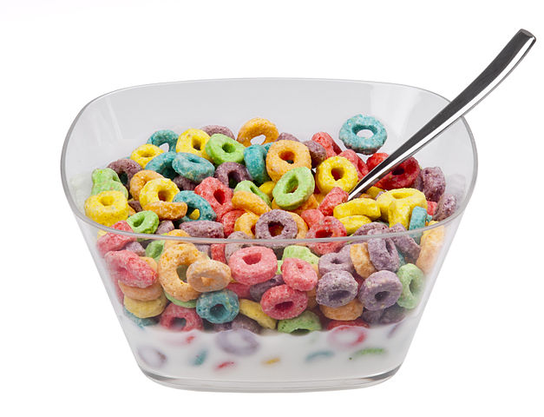
Meet the loops!
There are three types of loops you can use to repeat some code:
for loop
while loop
do...while loop
Source: https://lh3.googleusercontent.com/JSm2SSzaaB-sCwjg17mUWXPnca7FtOFItKZPsRby1DolGhyb_Kq_Nx7XB_AV4mMLluY8=s111
FOX
MIS

Slide 32
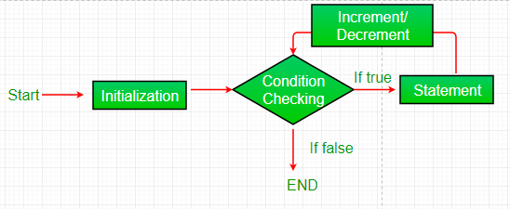
The for loop
for (var i = 0; i < 10; i++) {
saySomething();
}
The for loop is all business. It requires you to define the looping conditions up front.
Source: https://lh3.googleusercontent.com/CAHXxrd2kB6nLkX4_NkIm4bqcvgyRmSxlps8LiKm8Ij8XuFwyOKTv2fDjHnkk1AwumdpJQ=s170
FOX
MIS

Slide 33
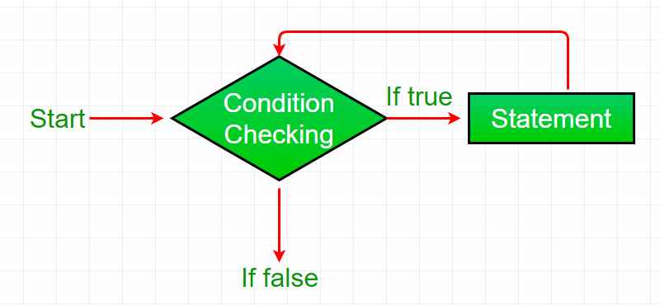
The while loop
var count = 0;
while (count < 10) {
saySomething();
count++;
}
The while loop will run until its looping condition evaluates to being false.
Source: https://lh3.googleusercontent.com/QYgoZkxEXZXRGVwkPq-q_D0YhQZ9DiDQnXty1LYS6nVAegwJPcxwzvVnJdDFtRgZAmkSKqo=s170
FOX
MIS

Slide 34
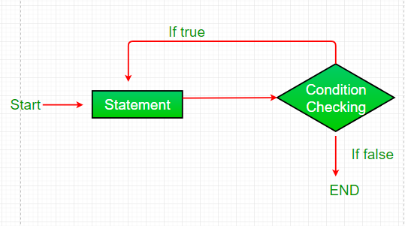
The do...while loop
var count = 0;
do {
count++;
saySomething();
} while (count < 10);
The do...while loop is similar to the while loop we looked at earlier, but its looping condition is specified at the end.
Source: https://lh3.googleusercontent.com/OkdSdzKtxXuAXvIzm8DXa36ychqd1Ei3CgqDbrQKhhaSvaRow4DoUDSV6x-Vks5QGRk6=s152
FOX
MIS

Slide 35
Difference between while loop and do…while loop
Source: https://lh3.googleusercontent.com/79GT7HztldIm8wE-zJmIqNrvTH7NvOOq-u0vMjpZmdn3KKWKjF1KEwiKIBtpqb5ZyU7K4G4=s114

Slide 36
Time for “Challenges”!
FOX
MIS

Slide 37
In-Class Challenges
BugCollector
CaloriesBurned
BudgetAnalysis
DistanceTraveled
C2FTable
GuessANumber
FOX
MIS

Slide 38
BugCollector
countBugs
A bug collector collects bugs every day for five days. Write a function that keeps a running total of the number of bugs collected during the five days. The loop should ask for the number of bugs collected for each day, and when the loop is finished, the program should display the total number of bugs collected.
totalBugsCollected = 0
i = 0
Main Start
i < 5?
No
countBugs
Yes
Prompt for bugs collected today
Display Result
__________
____________
______
Add bugs collected today to totalBugsCollected
Main End
i = i + 1
Return totalBugsCollected
______
________________
FOX
MIS

Slide 39
Time to Code!
FOX
MIS

Slide 40
Write the code
1. Make the tags: <html> for the html page, <body> for the content in the page, <script> for the code in the page.
<html>
<body>
<script>
function countBugs() {
var totalBugsCollected = 0;
for (var i = 0; i < 5; i++ ) {
var bugsCollectedThisDay = parseInt(prompt('How many bugs were collected on day ' + parseInt(i+1) + '? ‘));
totalBugsCollecetd = totalBugsCollecetd + bugsCollectedThisDay;
}
return totalBugsCollecetd;
}
alert('Over the past five days, ' + countBugs() + ' bugs were collected');
</script>
</body>
</html>
2. Here we make the function called countBugs which has no parameter since we are taking input from the user inside the function.
3. This function does returns a total. So we make a variable that will increase the total every time the loop runs. The loop will ask user five time to enter the bug count and then add it to the total bug collected variable.
4. Here we return the total
5. The function is called with no parameter and the user will see the alert on the browser based on total bugs
6. Close the tags
FOX
MIS

Slide 41
CaloriesBurned
displayCaloriesBurned
i = 10
Running on a particular treadmill you burn 4.2 calories per minute. Write a program that calls a function that uses a loop to display the number of calories burned after 10, 15, 20, 25, and 30 minutes.
No
i <= 30?
Main Start
Yes
displayCaloriesBurned
__________
____________
Display Calories Burned
Main End
5
i = i + __
Return
FOX
MIS

Slide 42
Time to Code!
FOX
MIS

Slide 43
Write the code
1. Make the tags: <html> for the html page, <body> for the content in the page, <script> for the code in the page.
<html>
<body>
<script>
function displayCaloriesBurned() {
for (var i = 10; i <= 30; i=i+5) {
alert('In ' + i + ' minutes, you will have burned ' + i*4.5 + ' calories’);
}
}
displayCaloriesBurned();
</script>
</body>
</html>
2. Here we make the function called displayCaloriesBurned with no parameters.
3. This function which is a for loop displaying the calories burned after 10, 15, 20, 25, and 30 minutes.
4. The function is called without parameters and the information is displayed in the browser
5. Close the tags
FOX
MIS

