Slide 1
Information Systems in Organizations
HTML and CSS Basics
FOX
MIS

Slide 2
ROADMAP
START
Week 1:
Introduction & Systems Analysis
Course Description
Systems Thinking
Week 1:
Introduction to Process Mapping
Systems & Processes
Swim Lane Diagrams
Max Labs 0- due
Week 2:
Digital Product Management & ERD
Max Labs 1A/1B- due
Week 2:
Introduction to Data Modeling
Week 2:
Exam #1
1/24-1/26: Exam Availability
Week 4 :
Exam #2
2/7-2/9 Exam Availability
Week 4:
Cybersecurity & AI
Protection Protocols
Artificial Intelligence
Cybersecurity/AI assignment due
Max Labs 3a/3b due
Week 4:
Platforms & Digital Business Models
API’s
Cloud
Week 3:
Information Systems
ERP & CRM
Data Analytics & SCM
Max Labs 2A/2B due
Lean IT #1 due
Week 5:
JavaScript Unit #1 & 2
Hello World, Variables
Input and Output
Operator types
Strings
Watch Lynda.com video – due
Code Academy due
Coding assignment #1-due
Week 6:
JavaScript Unit #3&4
Logical Operators
Conditional Types
Intro to Loops
While and Do
Writing the code
Coding Assignment #2-due
Week 7:
HTML & CSS
Coding Assignment #3-due
Lean IT #2 due
Week 7:
Exam #3
2/28-2/29: Exam Availability
FINISH

Slide 3
HTML & CSS Basics
Week 7
FOX
MIS

Slide 4
HTML is all about displaying content. CSS is all about making content look good. JavaScript adds the interactivity.
You need all three to create nifty looking sites.
FOX
MIS

Slide 5
Source: JavaScript Absolute Beginner’s Guide by Kirupa Chinnathambi
FOX
MIS

Slide 6
What you can’t do using just HTML and CSS is provide interactivity. That’s a problem. This means you can’t have...
FOX
MIS

Slide 7
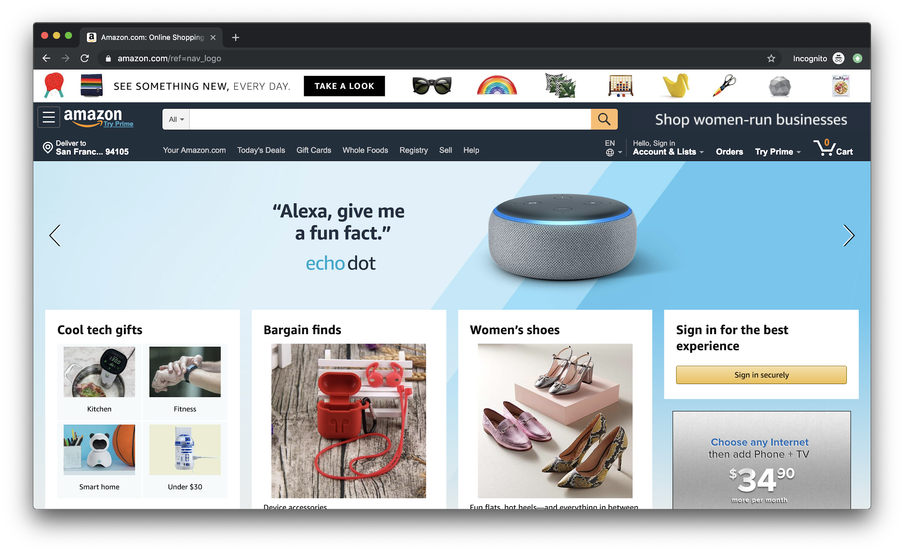
Source: JavaScript Absolute Beginner’s Guide by Kirupa Chinnathambi
FOX
MIS

Slide 8
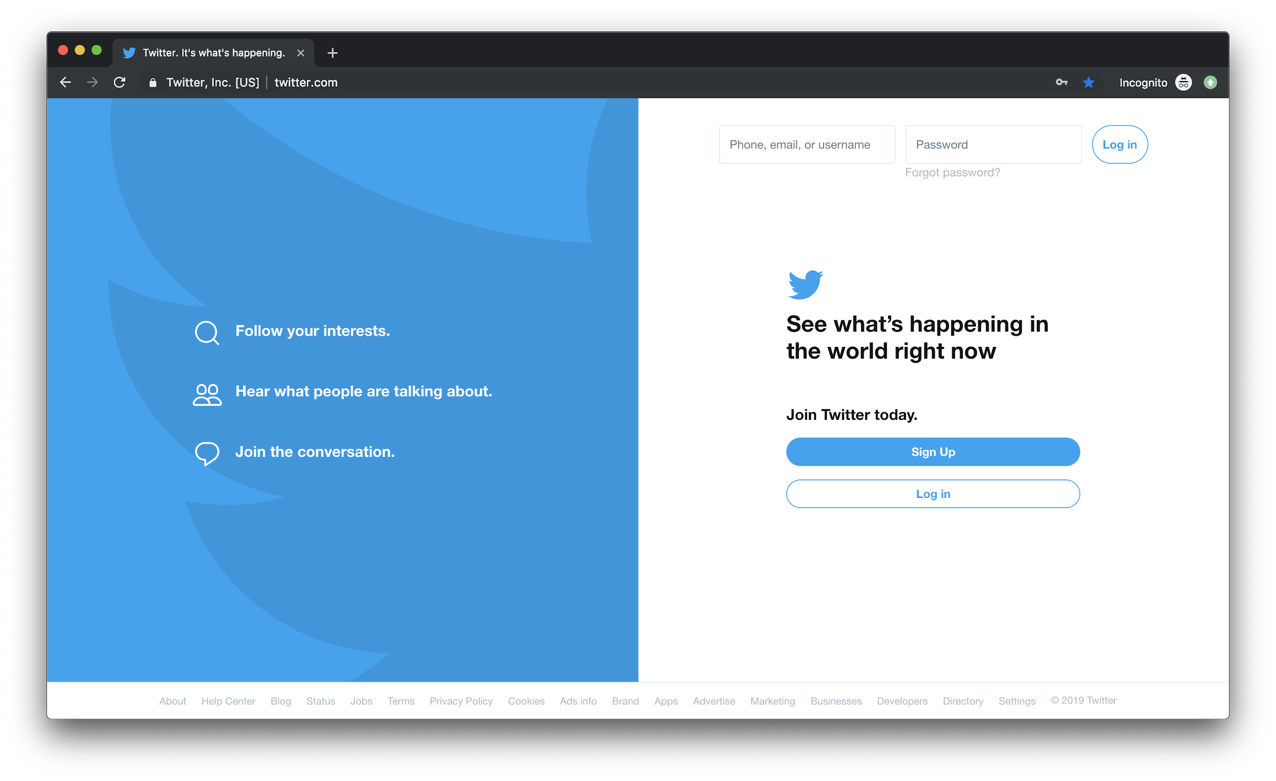
Source: JavaScript Absolute Beginner’s Guide by Kirupa Chinnathambi
FOX
MIS

Slide 9
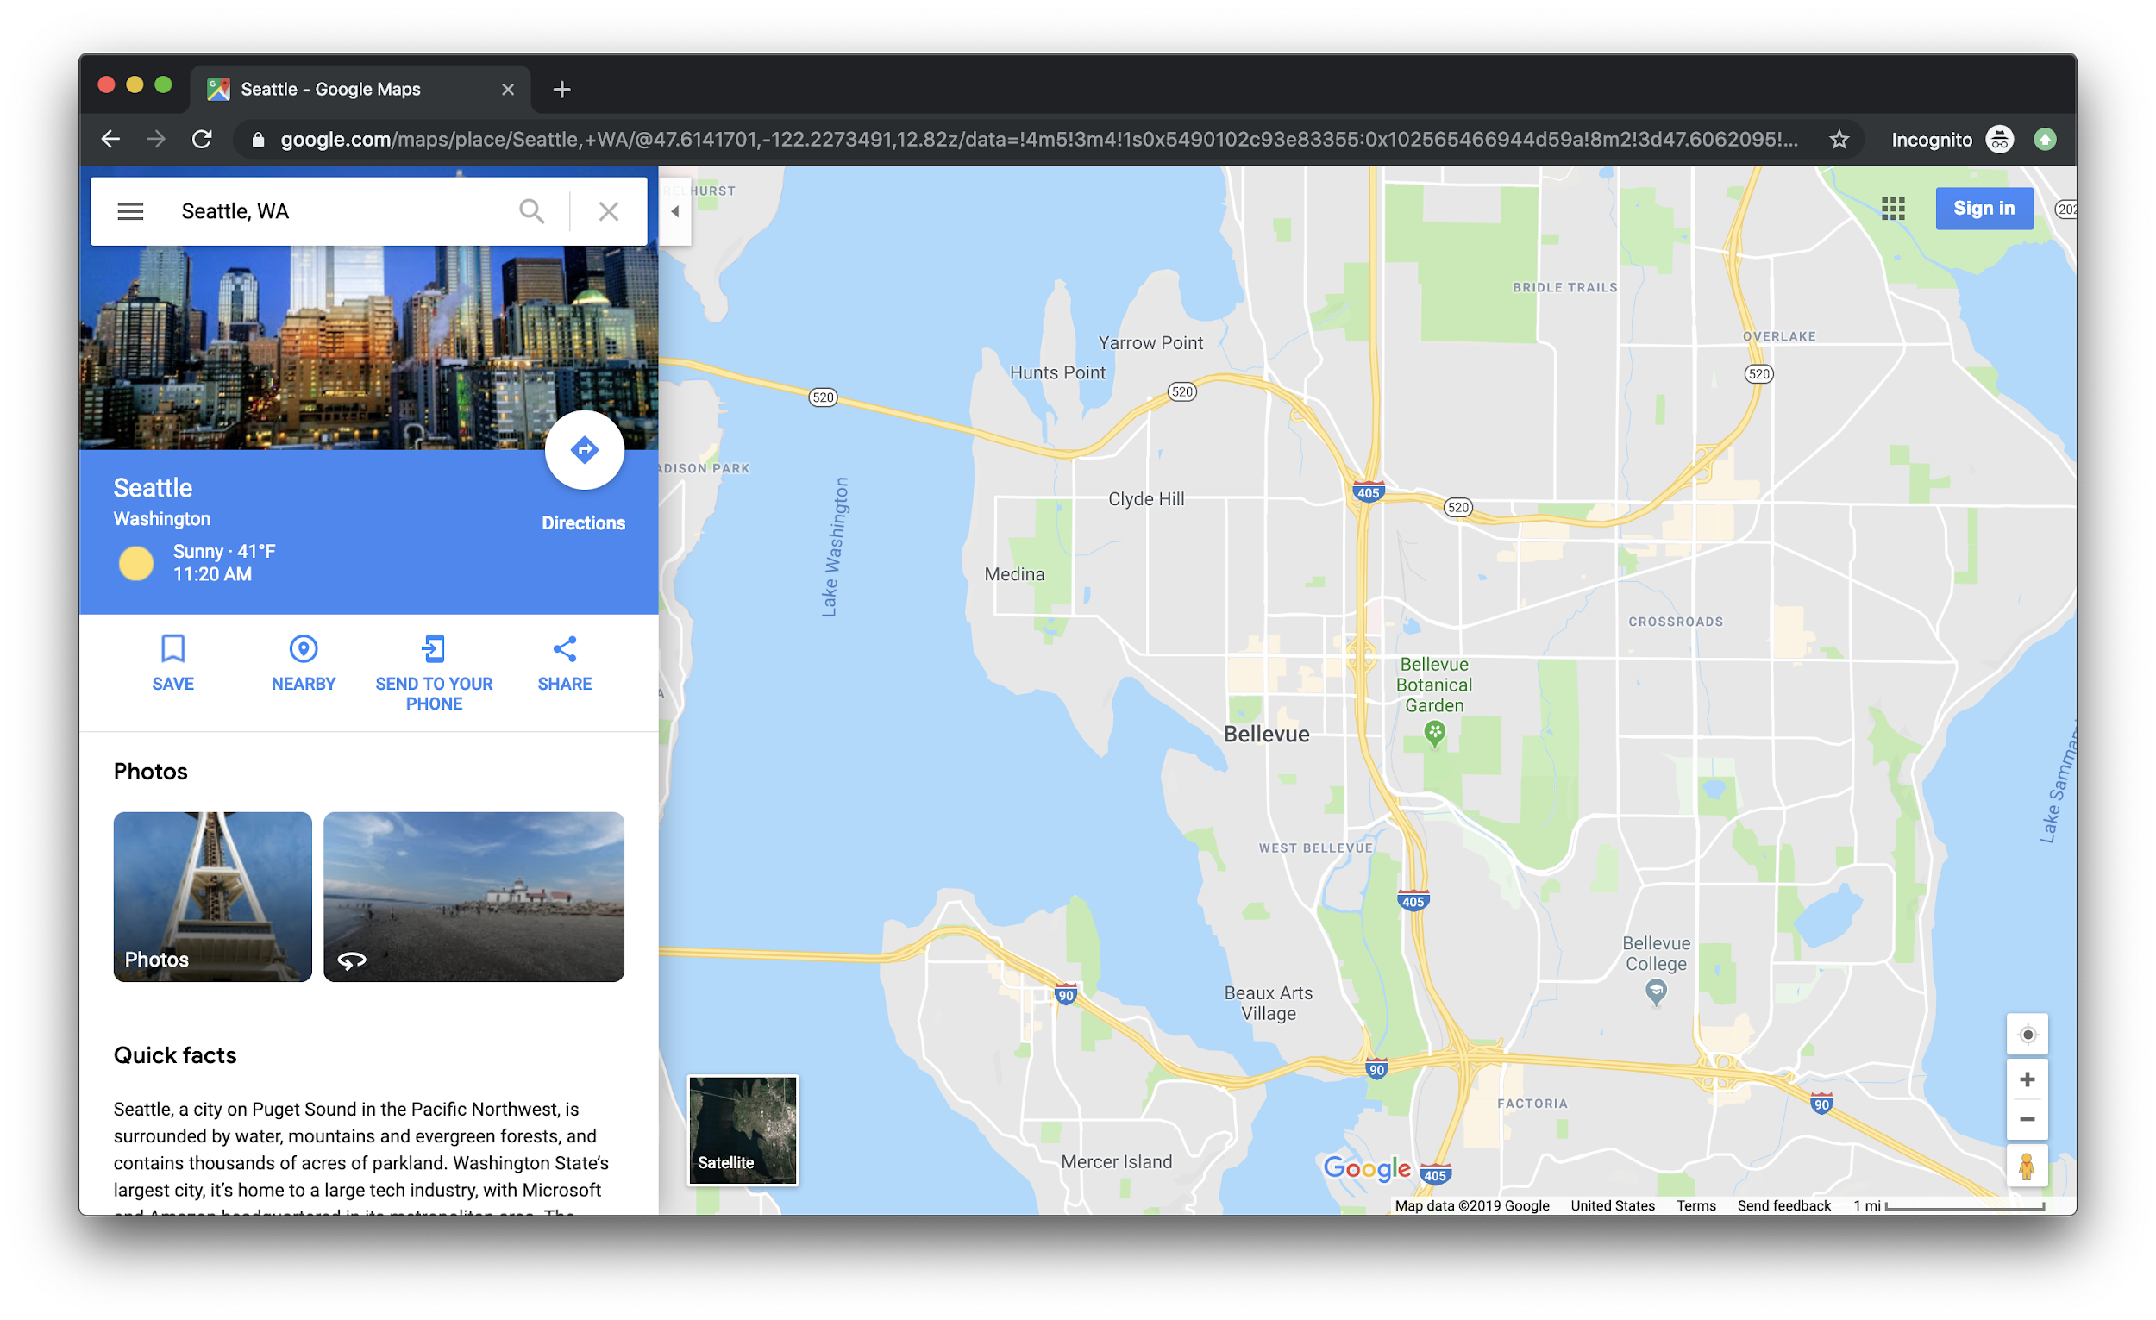
Source: JavaScript Absolute Beginner’s Guide by Kirupa Chinnathambi
FOX
MIS

Slide 10
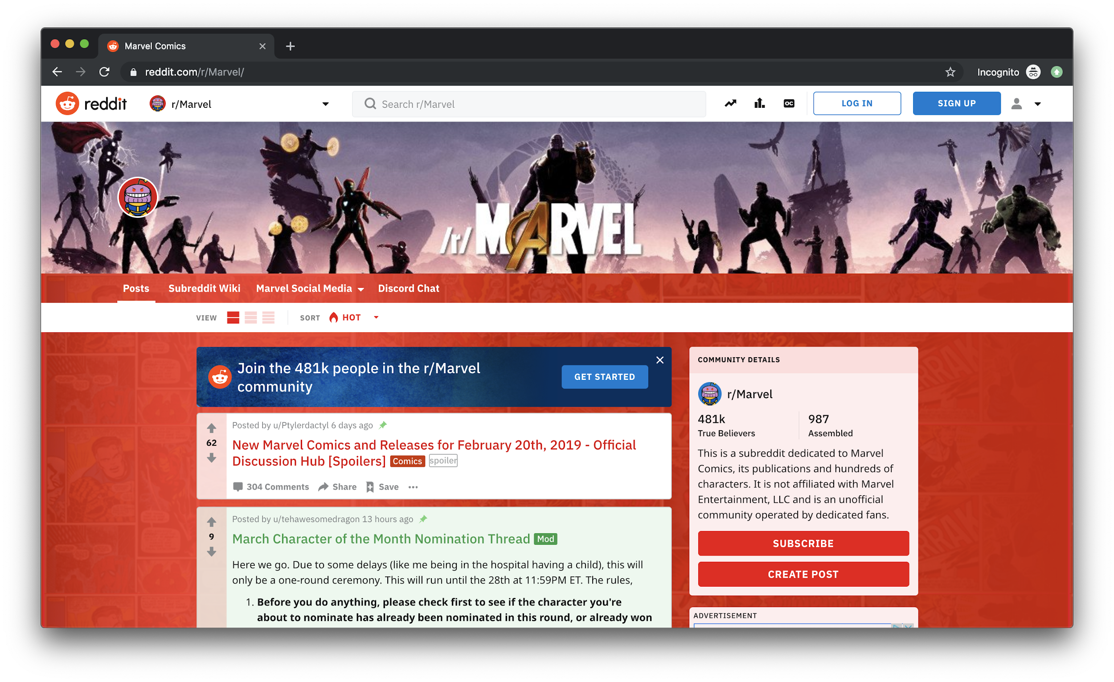
Source: JavaScript Absolute Beginner’s Guide by Kirupa Chinnathambi
FOX
MIS

Slide 11
Without interactivity, so much of the internet just won’t work. This interactivity is provided by JavaScript.
FOX
MIS

Slide 12
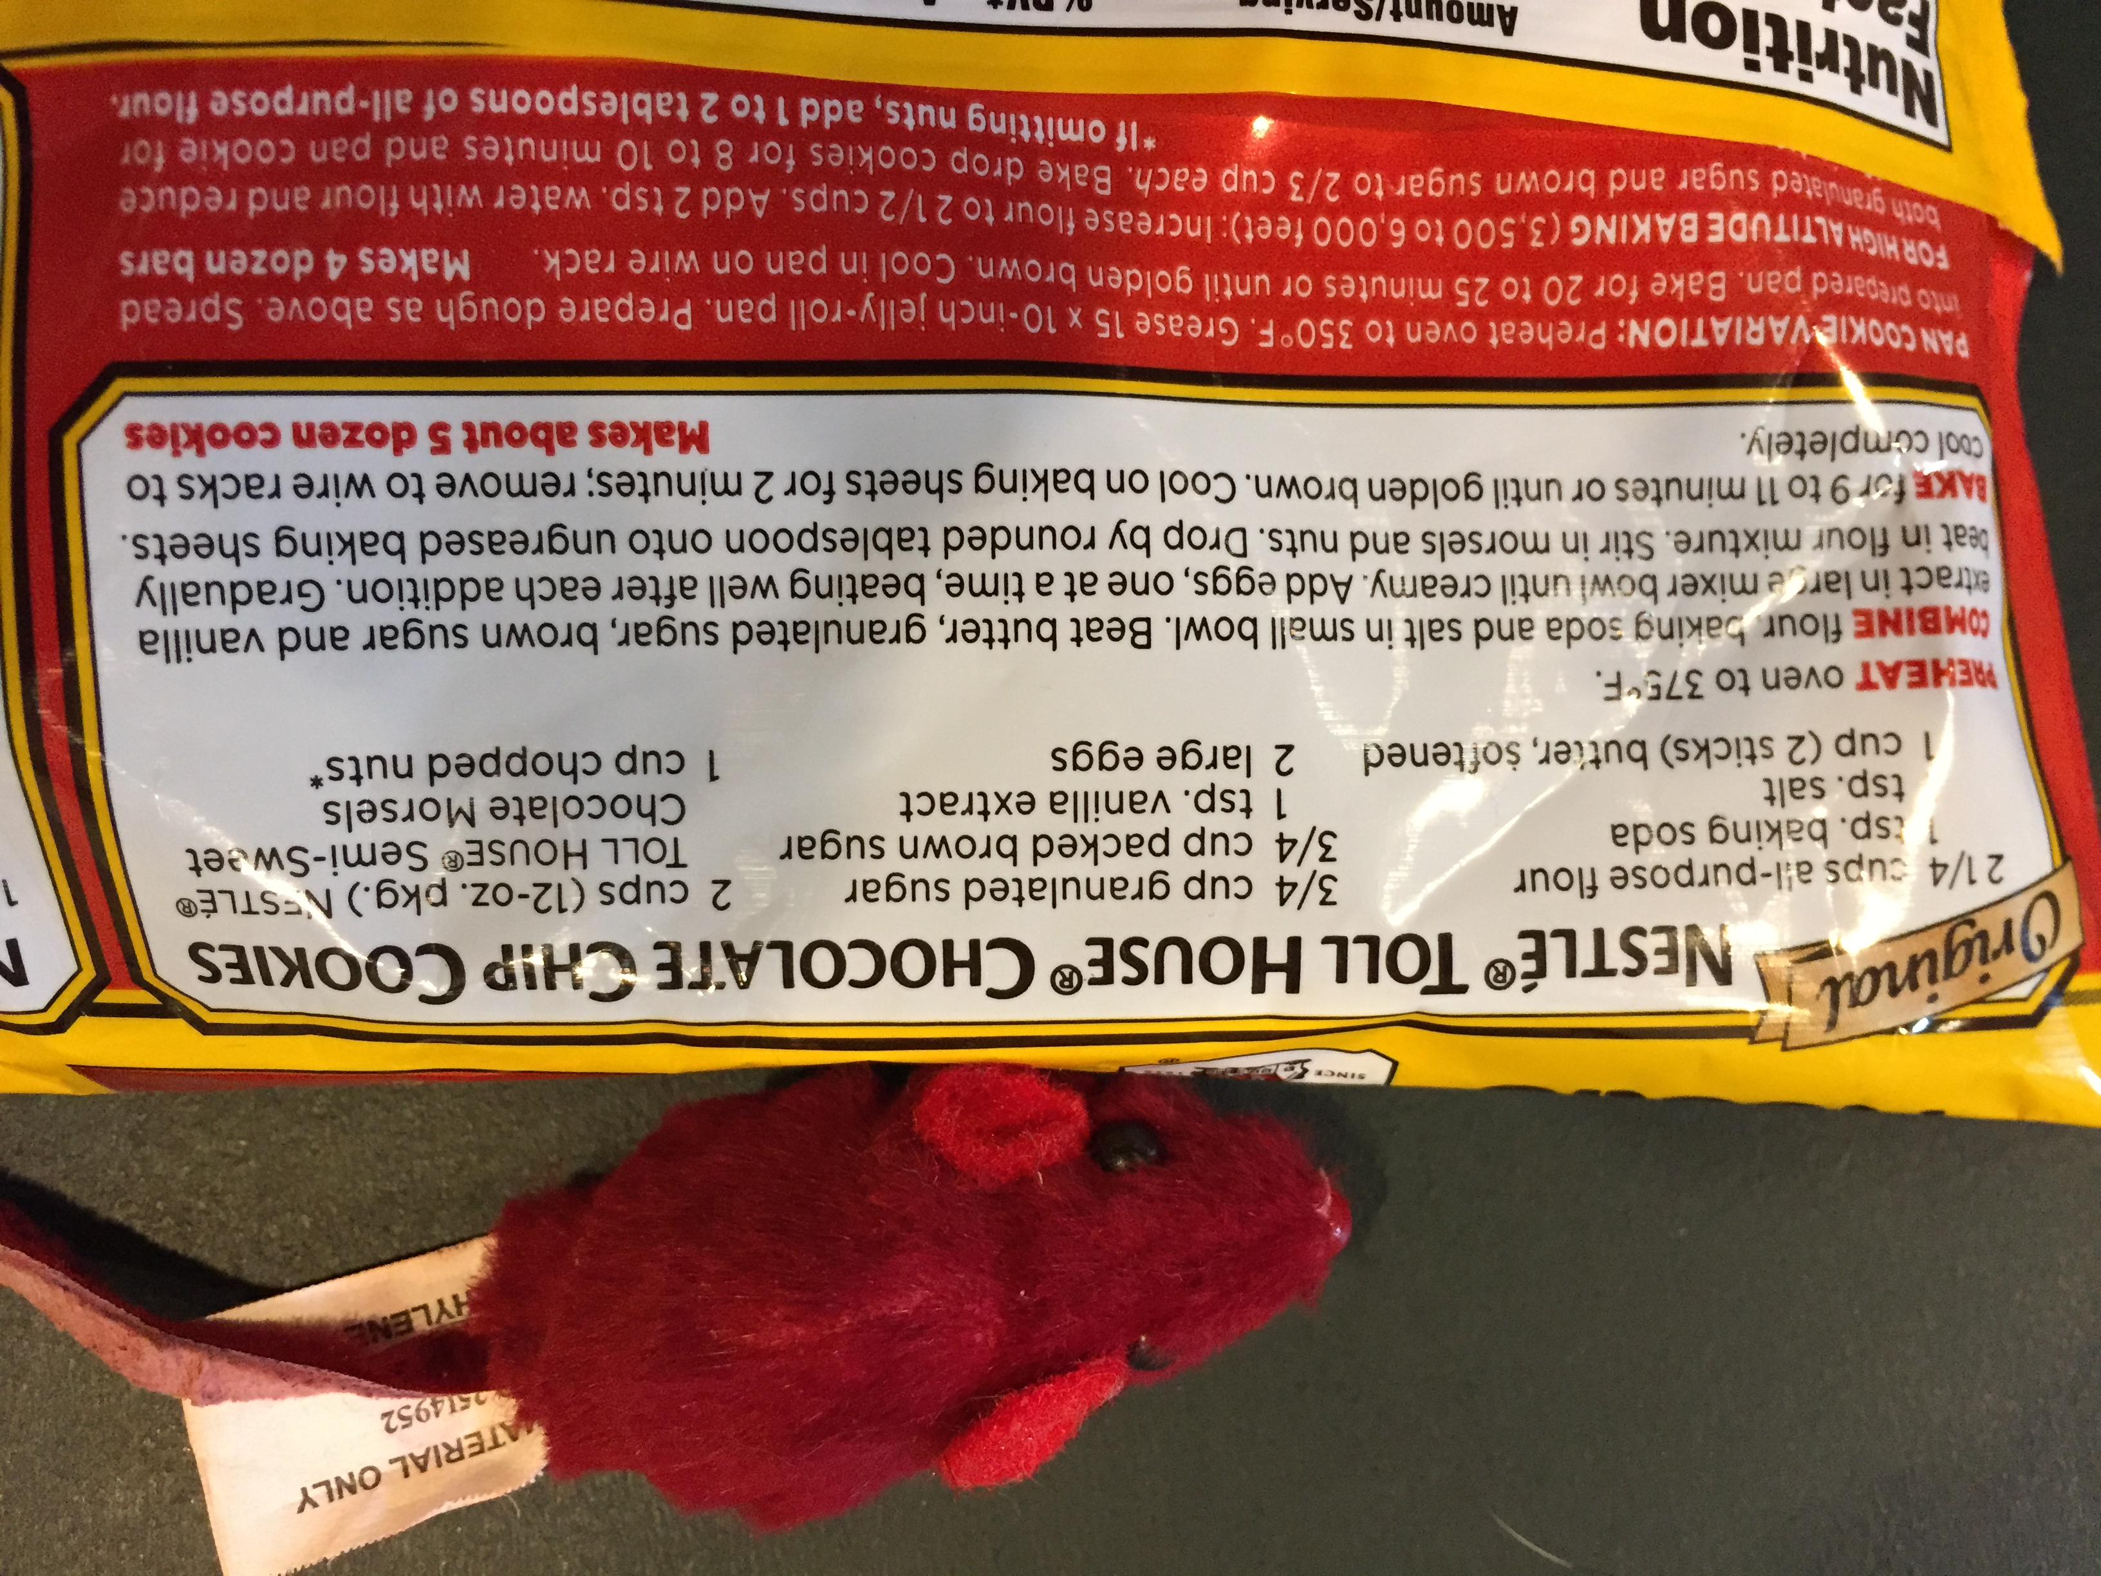
What exactly is a program?
Source: https://lh3.googleusercontent.com/BkMwD5swSP8l_C0qJF75D61nxmQk1qy2TSPpz4cgkBDOIqxNkH6kLj4o1-oUDbicW9qC=s131
FOX
MIS

Slide 13
JavaScript (commonly shortened to just JS) is a programming language made up of English-looking words arranged in a particular way to tell your browser to do something.
FOX
MIS

Slide 14
What JavaScript Looks Like
var defaultName = "JavaScript";
function sayHello(name) {
if (name == null) {
alert("Hello, " + defaultName + "!");
} else {
alert("Hello, " + name + "!");
}
}
Btw: Don’t worry if none of this makes sense yet!
FOX
MIS

Slide 15
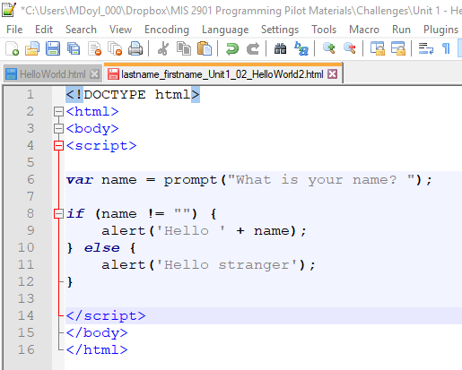
All JavaScript and no HTML or CSS
FOX
MIS

Slide 16
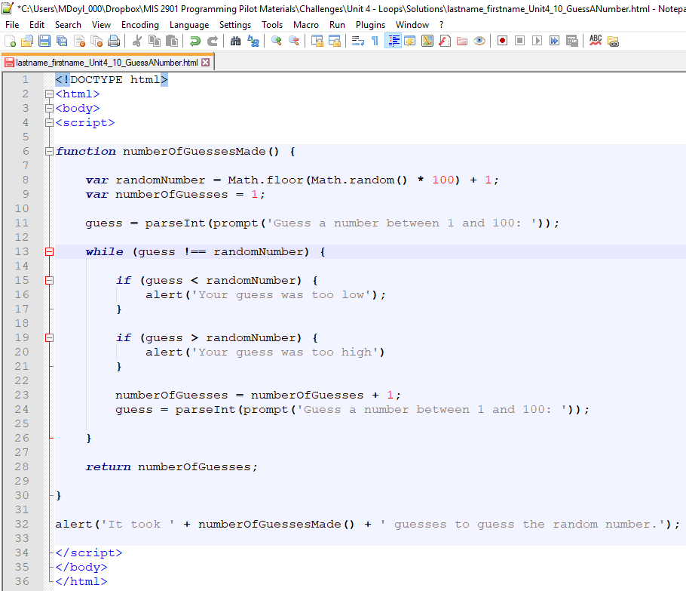
All JavaScript and no HTML or CSS
FOX
MIS

Slide 17
JavaScript is “Event Driven”, that is, interactive. It waits for the user to do something and then executes code.
But how does your code get access to the information typed on the form?
FOX
MIS

Slide 18
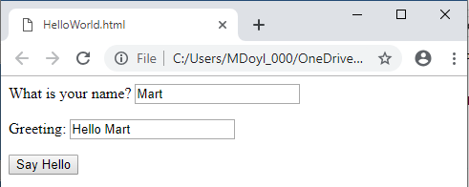
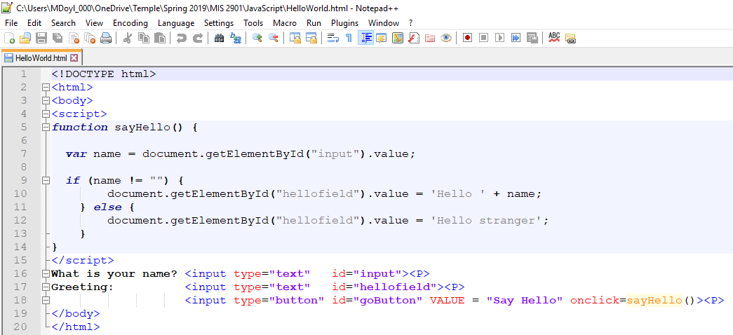
JavaScript with a Little HTML
FOX
MIS

Slide 19
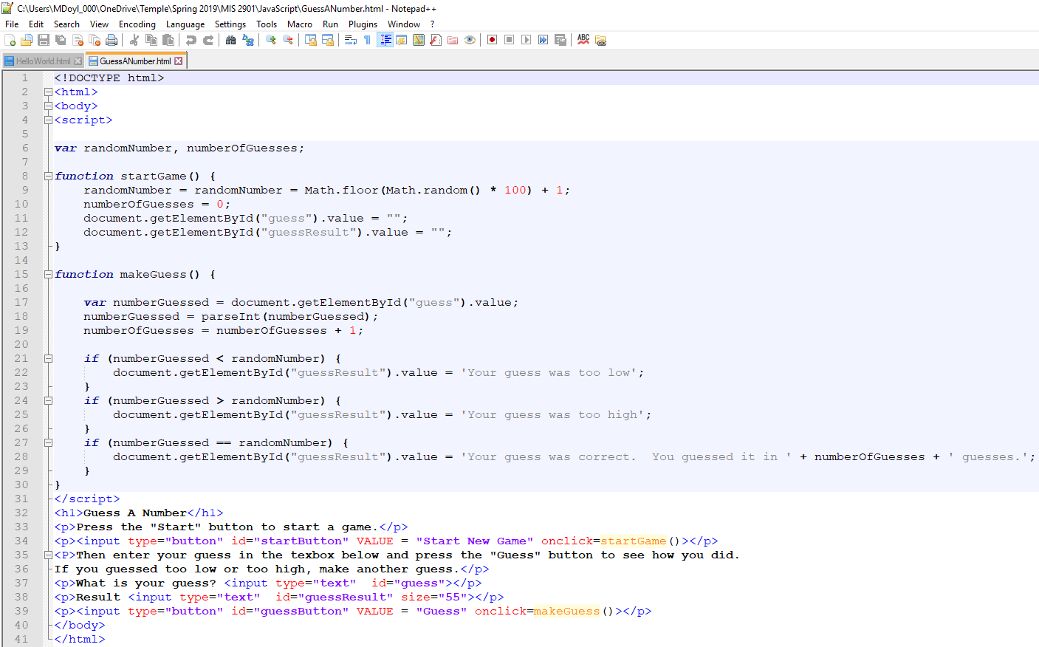
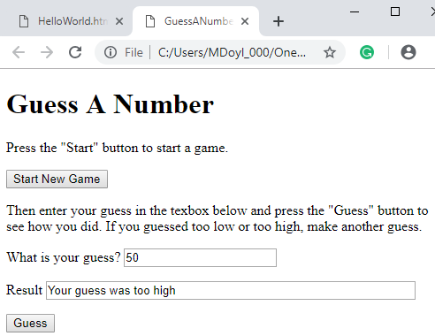
More JavaScript with a Little HTML
What code gets executed when you press these buttons?
How do we get access to what was typed in?
How do we display the results?

Slide 20
CSS is all about making your page look good
CSS stands for Cascading Style Sheets
Describes how HTML elements are to be displayed on the screen
Inline – Using style attributes in each HTML element
Internal – Using a <style> element in the <head> section
External – Using an external CSS file
Saves a lot of work and can control the layout of multiple pages all at once
FOX
MIS

Slide 21
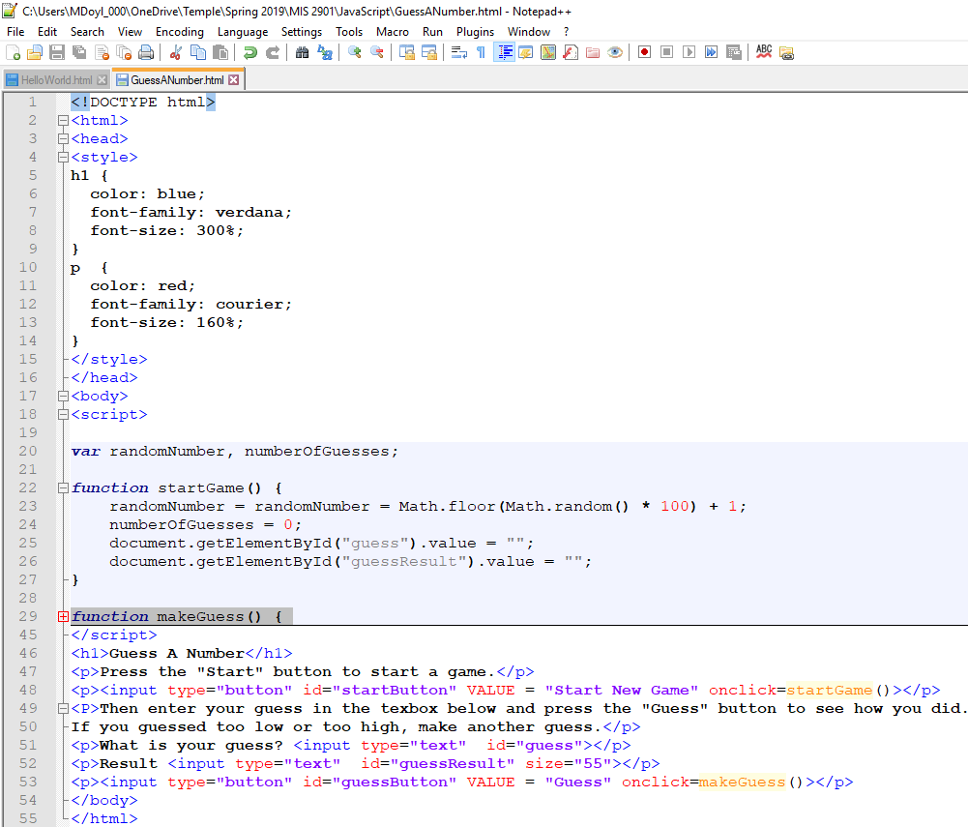
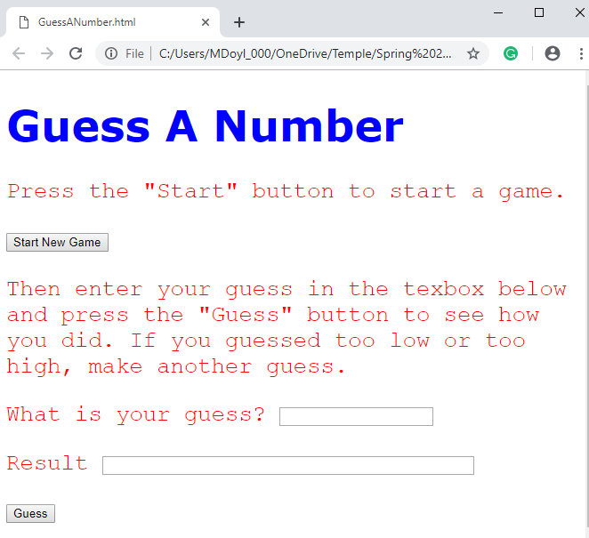
FOX
MIS

Slide 22
Time for “Challenges”!
FOX
MIS

Slide 23
Challenges – Start with your old programs and add a web interface
Unit 1 – Profits
Unit 1 – TotalPurchases
Unit 2 – SalesTax
Unit 2 – MaleAndFemalePercentages
Unit 3 – RomanNumerals
Unit 3 – MagicDates
Unit 4 – PenniesForPay
FOX
MIS

Slide 24
Profits
Open up the profits program we did earlier and try to add the textboxes and buttons to it. Once you done with it, try adding a style tag to define the fonts, color for the header and paragraph tags.
FOX
MIS

Slide 25
TIME TO CODE!
FOX
MIS

Slide 26
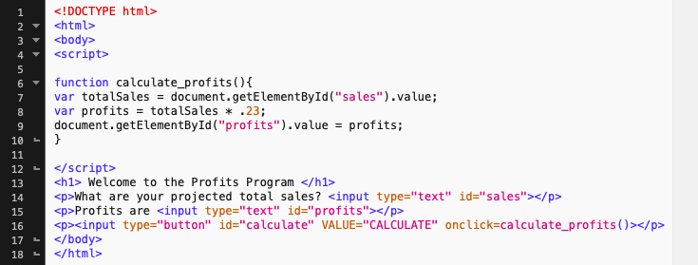
Write the code
These make the tags. You should be accustomed to it by now.
Our function which gets the sales from the text box and then calculates the profits. Then it assigns the textbox for profit with the value of profits we calculated.
Notice how this is different than we did in previous challenges. Here we use header <h1> and paragraph <p> tags to display the text. The input tags define what type of the value is present on the page. Id refers to the specific element on the page.
FOX
MIS

Slide 27
Total Purchases
Open up the TotalPurchases challenge that we did earlier, instead of using prompts try using textboxes to get the input and display the data using textboxes after the user clicks the button.
FOX
MIS

Slide 28
TIME TO CODE!
FOX
MIS

Slide 29
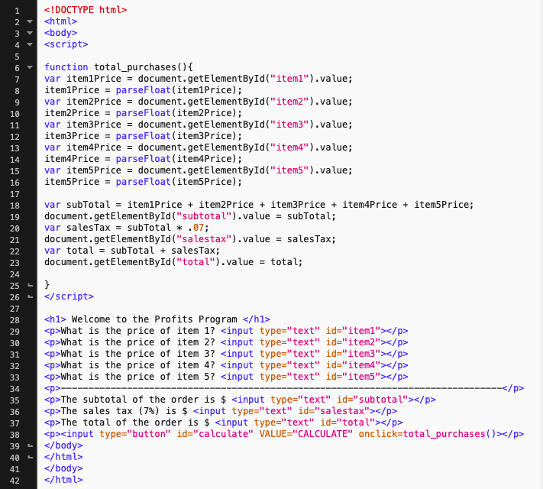
Write the code
This is where our function goes, here we get the data from the five text boxes with the prices, store them in variables, convert them to decimals.
Calculate subtotal by adding them up, assign the element for subtotal with the value of subtotal.
Calculate the sales tax using subtotal, assign the element for sales tax with the value of sales tax.
Calculate total with the addition of sales tax and subtotal, assign the element for total with the value of variable total.
After script tag, make header and paragraph tags for fonts on the webpage.
Make textboxes for getting prices of items
Then display the subtotal, sales tax, total in a textbox
Make a button to initiate the function.
FOX
MIS

Slide 30
Sales tax
Open up the sales tax program we did earlier and try to add the textboxes and buttons to it. Again, get the amount using textboxes and display the total with salestax.
FOX
MIS

Slide 31
TIME TO CODE!
FOX
MIS

Slide 32
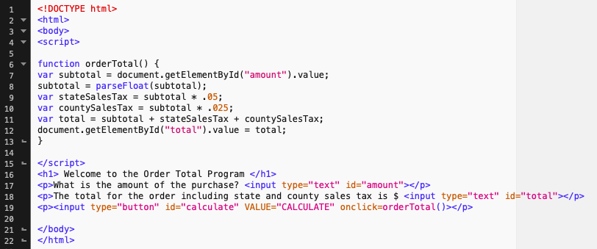
Write the code
This function gets the subtotal from the textbox, parses it, then calculates the state sales tax, county sales tax, and total. It assigns the element for total with the value of variable total.
We create the header <h1> and paragraph <p> tags with some texts to make the program look more presentable. We’ll also make a button to call the function to do the calculation and display the output.
FOX
MIS

Slide 33
Female and Male Percentages
Open up the MaleAndFemalePercentages program which asks user the number of females and males present, after that display the total number of people, percentage of females and percentage of males.
FOX
MIS

Slide 34
TIME TO CODE!
FOX
MIS

Slide 35
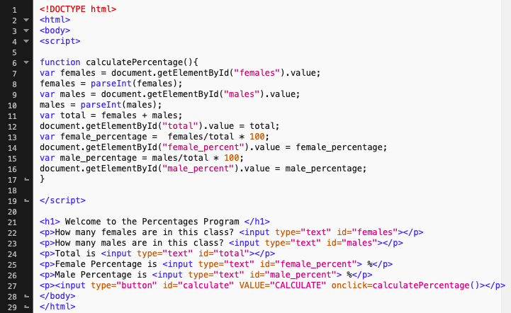
Write the code
This function gets the count of females and males from the textbox, parses it, then calculates the total, percentage of females, and percentage of males. It assigns the element for total with the value of variable total. Similarly for female and male percentage.
Now in the body, we make textboxes to ask user number of females and males. Then we also make textboxes to display the data back to the user. The button here will invoke the function which will be responsible for all the calculations.
FOX
MIS

Slide 36
Exam 3: Opens Friday (2/28) at 6AM Close Saturday (2/29) at 6PM
Good luck on the finals!

