Slide 1
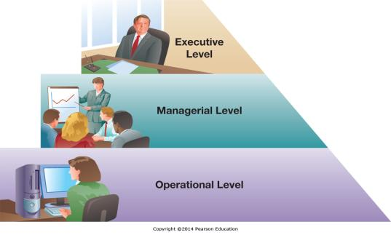
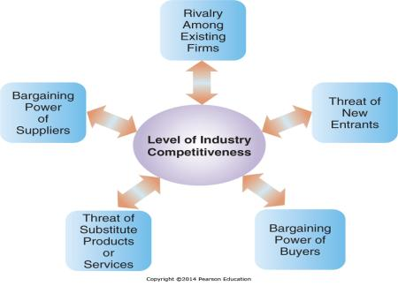
Chapter 2 - Gaining Competitive Advantage through Information Systems
A firm has competitive
advantage over rival firms when it
can do something better, faster,
more economically, or uniquely

Slide 2
Chapter 2 Learning Objectives
Enabling Organizational Strategy through Information Systems
Discuss how information systems can be used for automation, organizational learning, and strategic advantage.
International Business Strategies in the Digital World
Describe international business and IS strategies used by companies operating in the digital world.
Valuing Innovations
Explain why and how companies are continually looking for innovative ways to use information systems for competitive advantage.
Freeconomics: Why Free Products are the Future of the Digital World
Describe freeconomics and how organizations can leverage digital technologies to provide free goods and services to customers as a business strategy for gaining a competitive advantage.

Slide 3
Enabling Organizational Strategy through Information Systems
Enabling Organizational Strategy through Information Systems
Discuss how information systems can be used for automation, organizational learning, and strategic advantage.
International Business Strategies in the Digital World
Describe international business and IS strategies used by companies operating in the digital world.
Valuing Innovations
Explain why and how companies are continually looking for innovative ways to use information systems for competitive advantage.
Freeconomics: Why Free Products are the Future of the Digital World
Describe freeconomics and how organizations can leverage digital technologies to provide free goods and services to customers as a business strategy for gaining a competitive advantage.

Slide 4
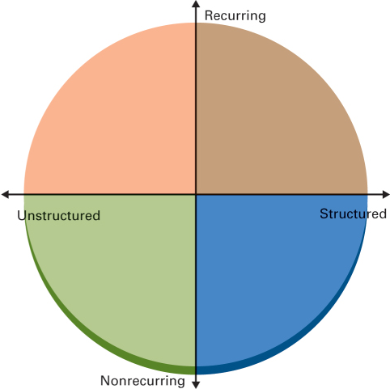
Types of Decisions You Face

Slide 5
Organizational Decision-Making Levels
Who has had a job?
What level has this job been at?
What types of decisions do you make?
Structured vs. Unstructured
Recurring vs. Non-recurring

Slide 6
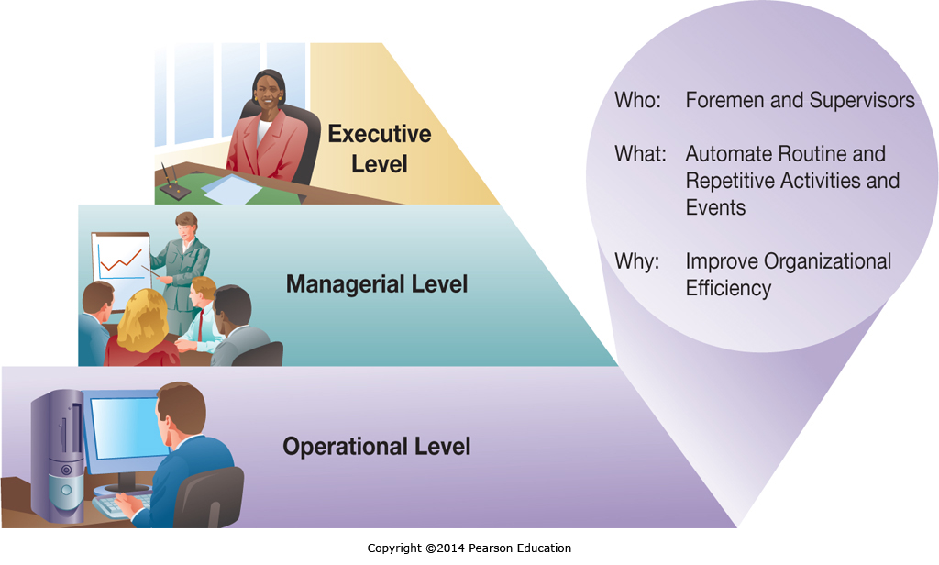
Organizational Decision-Making Levels: Operational Level

Slide 7
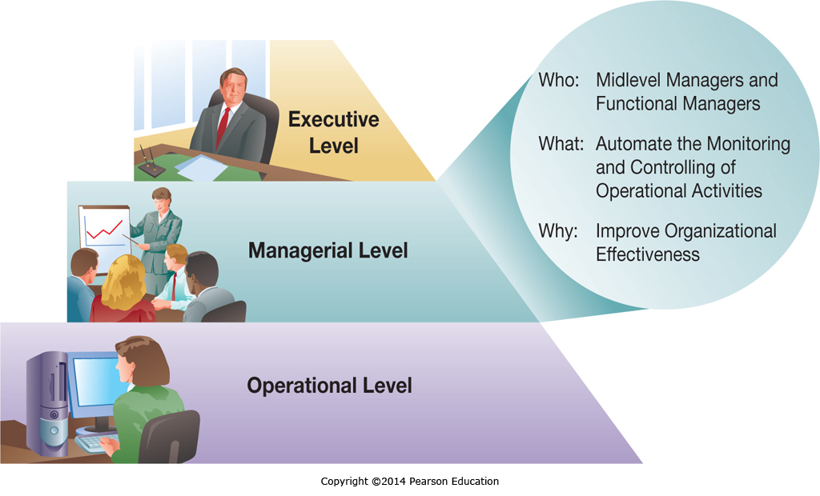
Organizational Decision-Making Levels: Managerial/Tactical Level

Slide 8
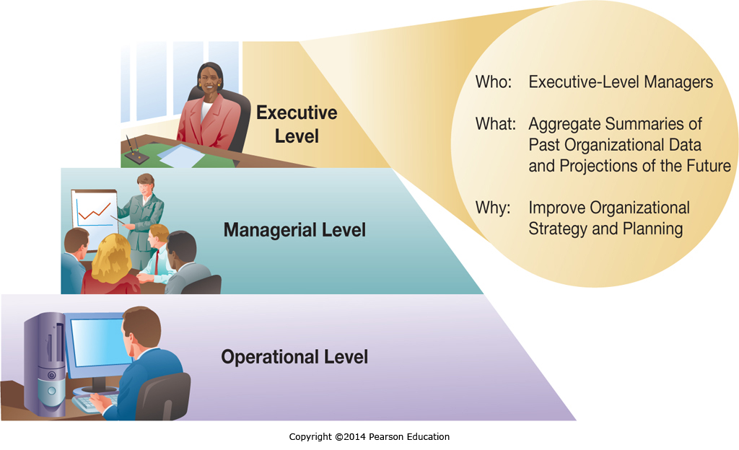
Organizational Decision-Making Levels: Executive/Strategic Level

Slide 9
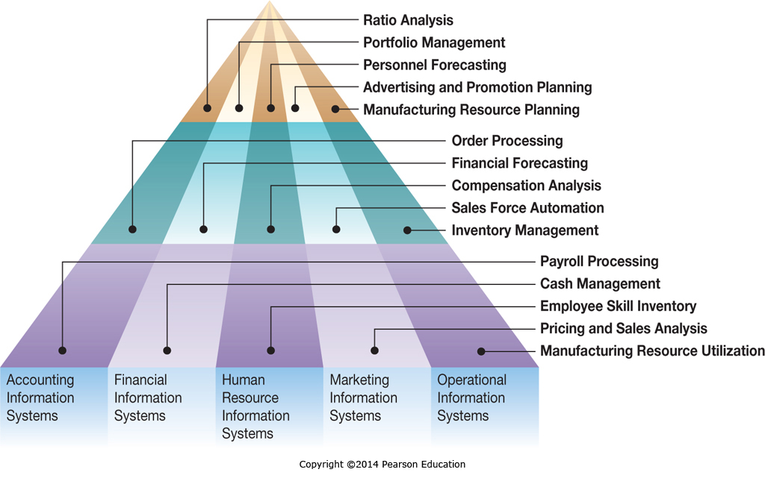
Organizational Functions and Functional Levels

Slide 10
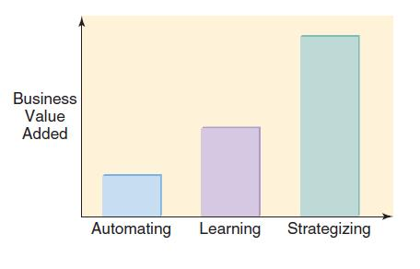
Major IS Tasks: Business Value Added
What do we mean when we say we create business value by automating, organizational learning and supporting strategy

Slide 11
Information Systems for Automating: Doing Things Faster
Primary Activities of Loan Processing | Manual Loan Process | Technology-Supported | Fully Automated
Complete and submit application | Completed at home (1.5 days) | Completed at home (1.5 days) | Completed online (15 minutes)
Check application for errors | Done in batches (2.5 days) | Done in batches (2.5 days) | Computerized (3.5 sec)
Input data into the information system | NA some paper handling (1 hr) | Done in batches (2.5 days) | NA (already done)
Assess loan apps under $250K | Done by hand (15 days) | Computer assisted (1 hr) | Computer processed (1 sec)
Committee decides if loan over $250k | (15 days) | (15 days) | (15 days)
Applicant notified | Batches (5 days) | (1 day) | E-mail (3.5 sec)
Total time | 25 to 40 days | 5 to 20 days | 15 min to 15 days

Slide 12
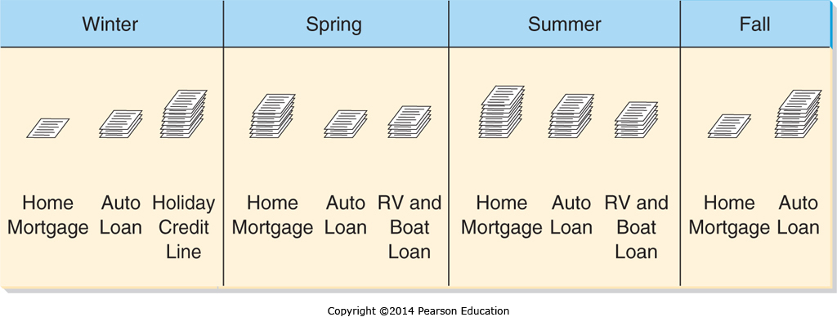
Information Systems for Organizational Learning: Doing Things Better
Information systems can track and identify trends and seasonality
Managers can use this to plan staffing levels and cross-training

Slide 13
Information Systems for Supporting Strategy: Doing Things Smarter
Firms have a competitive strategy
Information Systems should be implemented that support that strategy
Low cost strategy implies information systems to minimize expenses
High quality strategy implies information systems to support ensuring excellent quality and minimal defects

Slide 14
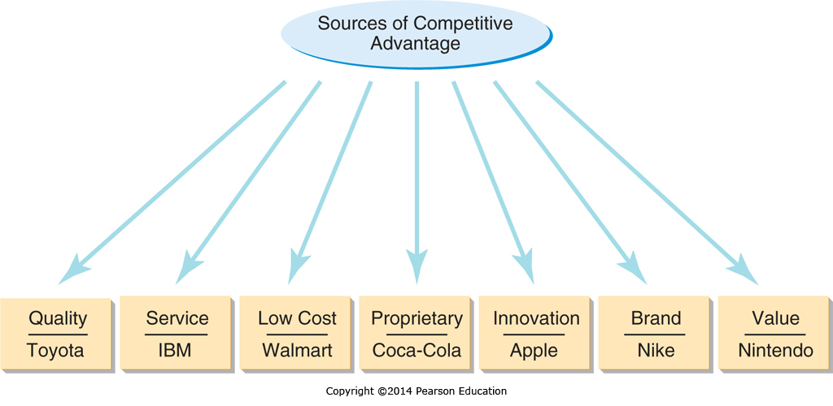
Sources of Competitive Advantage

Slide 15
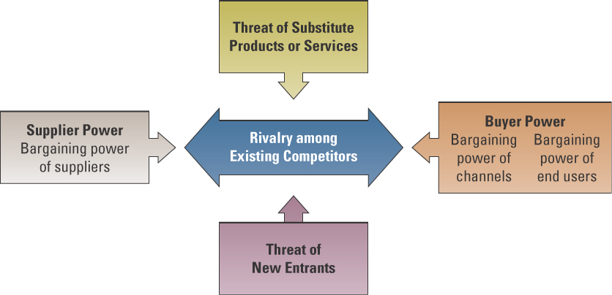
The Five Forces Model – Evaluating Business Segments
Product returns
Lower market share
Lost customers
Decision support and business intelligence
CAD product redesign
Increased costs
Reduced quality
Reduce prices
Increase quality
Value added services
Competition in price, distribution and service
Electronic connections to more suppliers
ERP to reduce costs and
react more quickly
ERP reduce costs
CRM
CAD/CAM improve quality
Better web presence
Lower costs through ERP, supply chain, etc.
Reduced prices
Lost market share

Slide 16
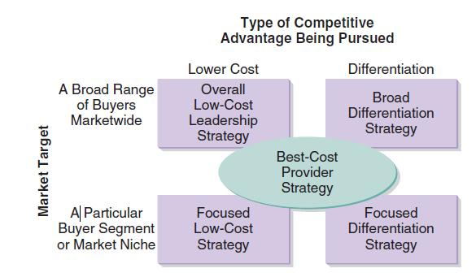
Pursuit of Competitive Advantage
What technologies enable an organization:
Best-made product
Superior customer service
Lower costs than rivals
Proprietary manufacturing technology
Shorter development/test lead times
Well-known brand name
More value for the money

Slide 17
International Business Strategies in the Digital World
Enabling Organizational Strategy through Information Systems
Discuss how information systems can be used for automation, organizational learning, and strategic advantage.
International Business Strategies in the Digital World
Describe international business and IS strategies used by companies operating in the digital world.
Valuing Innovations
Explain why and how companies are continually looking for innovative ways to use information systems for competitive advantage.
Freeconomics: Why Free Products are the Future of the Digital World
Describe freeconomics and how organizations can leverage digital technologies to provide free goods and services to customers as a business strategy for gaining a competitive advantage.

Slide 18
International IS Strategies
There are four international business strategies
Home Replication
Global
Multidomestic
Transnational
Each has pros and cons in terms of complexity, cost benefits, local responsiveness, and control

Slide 19
Home-Replication Strategy
Focused Domestically
Exporting products to generate additional sales
Secondary emphasis on international operations
Information Systems not a significant factor in facilitating international export sales

Slide 20
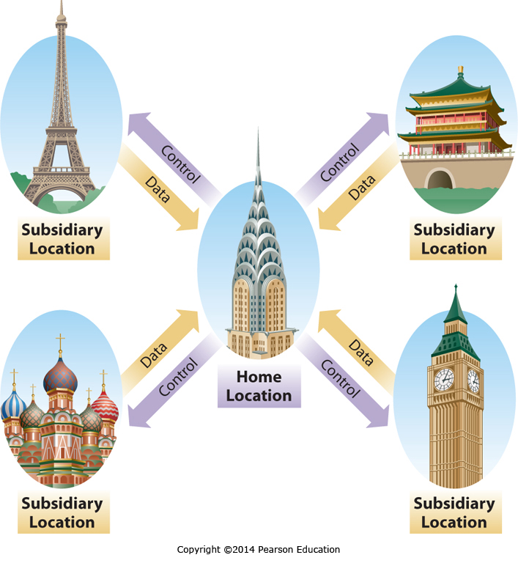
Global Business Strategy

Slide 21
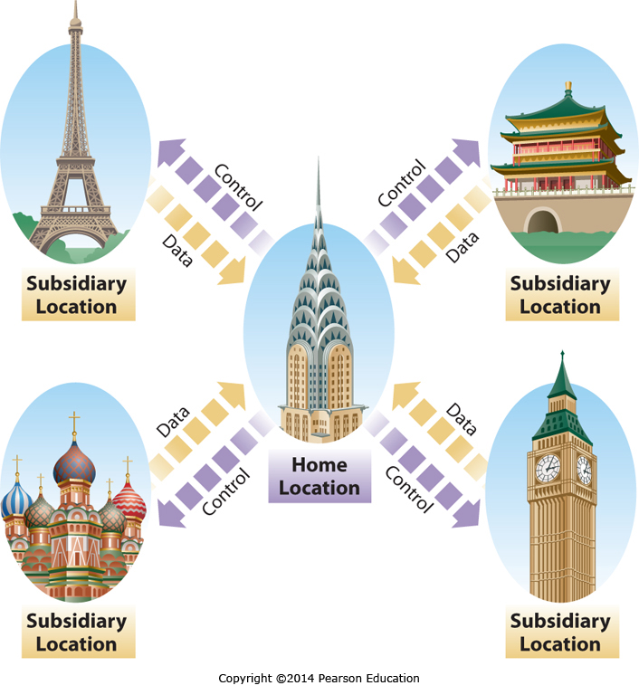
Multidomestic Business Strategy

Slide 22
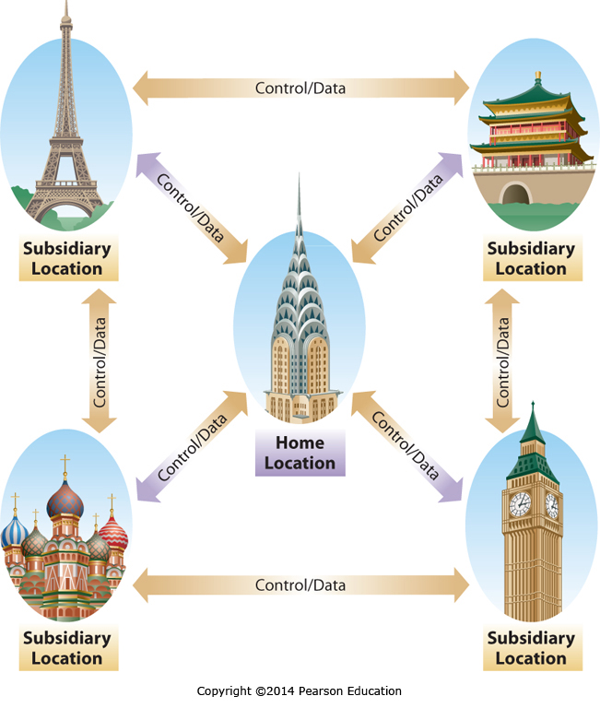
Transnational Business Strategy

Slide 23
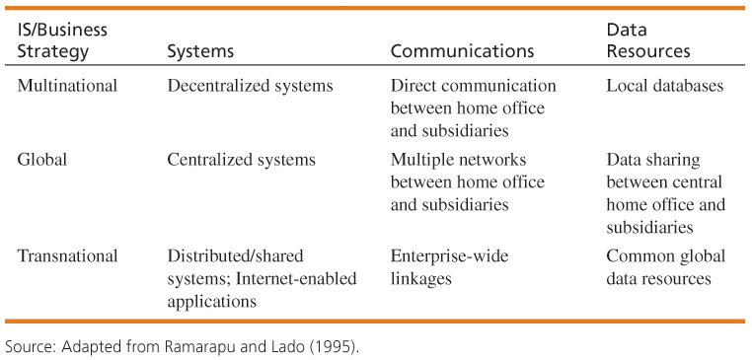
Business/Information Systems Strategies

Slide 24
Valuing Innovations
Enabling Organizational Strategy through Information Systems
Discuss how information systems can be used for automation, organizational learning, and strategic advantage.
International Business Strategies in the Digital World
Describe international business and IS strategies used by companies operating in the digital world.
Valuing Innovations
Explain why and how companies are continually looking for innovative ways to use information systems for competitive advantage.
Freeconomics: Why Free Products are the Future of the Digital World
Describe freeconomics and how organizations can leverage digital technologies to provide free goods and services to customers as a business strategy for gaining a competitive advantage.

Slide 25
The Need for Constant IS Innovation
“The most important discoveries of the next 50 years are likely to be ones of which we cannot now even conceive” John Maddox
Transformation Technologies are difficult or even impossible to see coming
Think of the Internet in 1999
Many of the critical discoveries in the next 50 years will be in areas we don’t see coming

Slide 26
Miniaturization – What is Moore’s Law?
What is Moore’s Law

Slide 27
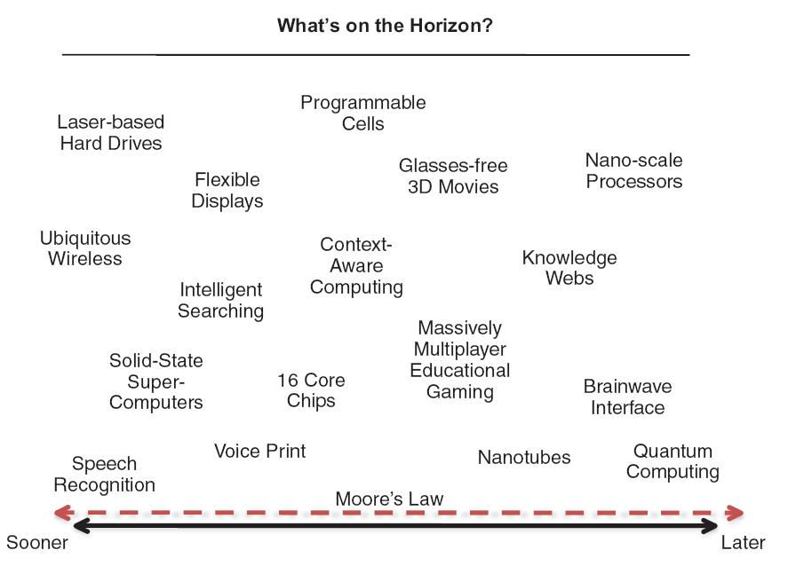
Valuing Innovations
Which new technology will make or break your business?

Slide 28
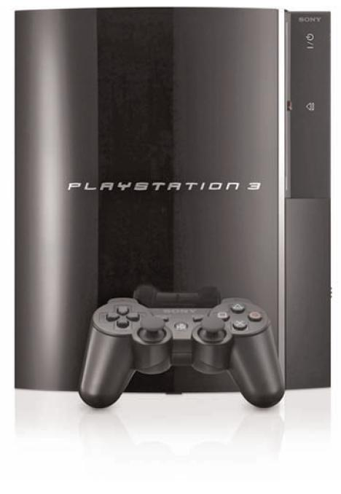
Successful Innovation Is Difficult
Innovation is often fleeting.
The advantages gained from innovations are often short lived.
Innovation is often risky.
Sometimes even superior products can lose the race.
Blu-ray vs. HD DVD
Innovation choices are often difficult.
Foreseeing the future is not always possible.
In 1994, the Internet was not given much attention.

Slide 29
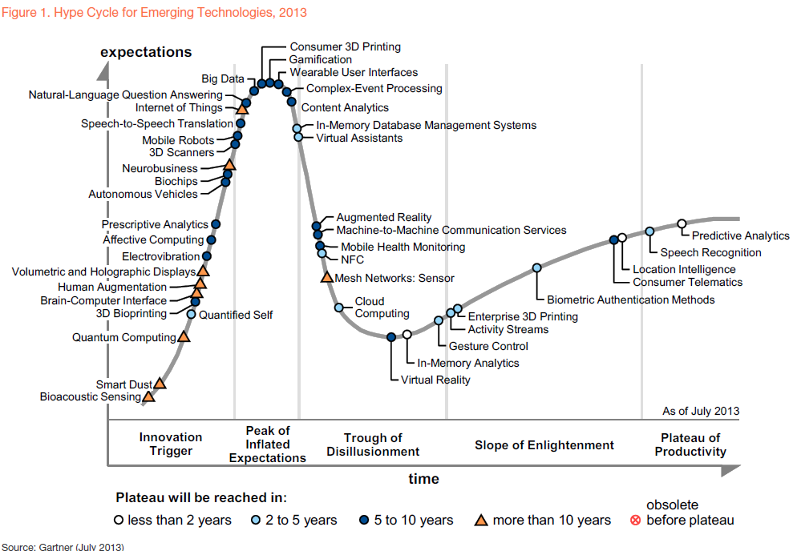

Slide 30
Organizational Requirements for Innovation
Process requirements—the organization has to be willing to do whatever it takes to implement the change.
Resource requirements—need to have the human capital necessary for successful deployment of the system
Risk tolerance requirements—organizational members must have appropriate tolerance of risk and uncertainty.

Slide 31
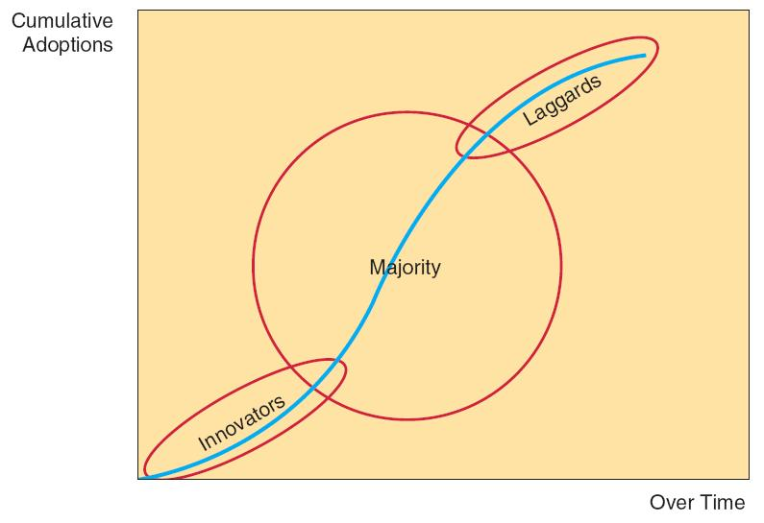
Predicting the Next New Thing
Deciding which innovations to adopt is very difficult.
Diffusion of Innovations
Classic view of adoption of innovations

Slide 32
Predicting the Next New Thing
Many innovations can be copied
Limited time span of any advantage
May become a requirement for staying competitive
Some innovations deliver longer advantages
Unique customer service based on customer data
High levels of customer investment in proprietary systems – high switching costs
Technologies that are very difficult to copy

Slide 33
Disruptive Innovations Examples from Table 2.8
Disruptive Innovation | Displaced or Marginalized Technology
Digital photography | Chemical photography
Online stock brokerage | Full-service stock brokerages
Online retailing | Brick-and-mortar retailing
Distance education | Classroom education
Unmanned aircraft | Manned aircraft
Semiconductors | Vacuum tubes
MP3 players and music downloading | Compact discs and music stores
Smartphones | MP3 players, dedicated GPS navigation
Tablets | Notebook computers

Slide 34
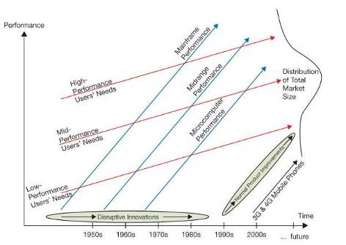
Disruptive Innovations
1970s: mid- and high-performance users were bulk of the market
Digital Equipment Company (DEC) tried to sell to those markets
Microcomputers seen as “toys”

Slide 35
Disruptive Innovations (cont’d)
1980s: Microcomputers focusing on low-performance users’ needs
Ignored by DEC

Slide 36
Disruptive Innovations (cont’d)
1990s: Growing performance of Microcomputers, meeting mid-performance users’ needs
DEC lost biggest market segment

Slide 37
Disruptive Innovations (cont’d)
Today, micro-computers meeting entire market’s needs
DEC out of business
Next disruptive innovation: 3G and 4G mobile phones?

Slide 38
The Innovator’s Solution
Christensen outlines a process—disruptive growth engine—that helps organizations respond to disruptive innovations more effectively.
Start early.
Executive leadership.
Build a team of expert innovators.
Educate the organization.

Slide 39
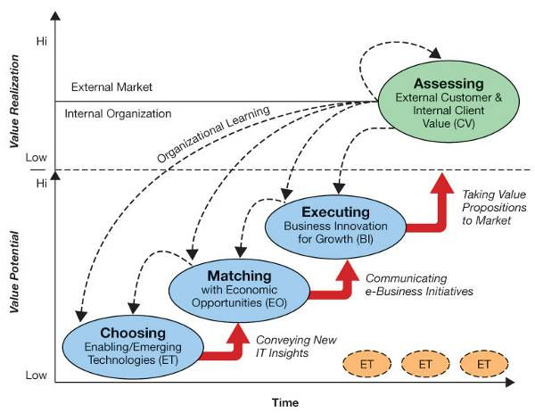
Implementing the Innovation Process
E-Business Innovation Cycle
The key to success is the extent of IS use in timely and innovative ways.
Based on: Wheeler (2002)

Slide 40
E-Business Innovation Cycle
Choosing Enabling/Emerging Technologies
Process/ group devoted to looking for emerging IT
Based on: Wheeler (2002)

Slide 41
E-Business Innovation Cycle (cont’d)
Matching Technologies to Opportunities
Most promising new technology matched with current economic opportunities
Based on: Wheeler (2002)

Slide 42
E-Business Innovation Cycle (cont’d)
Executing Business Innovation for Growth
Stage at which the change is actually implemented
Based on: Wheeler (2002)

Slide 43
E-Business Innovation Cycle (cont’d)
Assessing Value
Value created for customers and internal operations assessed
Based on: Wheeler (2002)

Slide 44
Raspberry Pi
Raspberry Pi x 64

Slide 45
Freeconomics: Why Free Products are the Future of the Digital World
Enabling Organizational Strategy through Information Systems
Discuss how information systems can be used for automation, organizational learning, and strategic advantage.
International Business Strategies in the Digital World
Describe international business and IS strategies used by companies operating in the digital world.
Valuing Innovations
Explain why and how companies are continually looking for innovative ways to use information systems for competitive advantage.
Freeconomics: Why Free Products are the Future of the Digital World
Describe freeconomics and how organizations can leverage digital technologies to provide free goods and services to customers as a business strategy for gaining a competitive advantage.

Slide 46
Question?
How many of you would take a free smartphone, both the phone and no cost monthly service, if all you had to do was put up with a few advertisements?
Free smartphone and free service

Slide 47
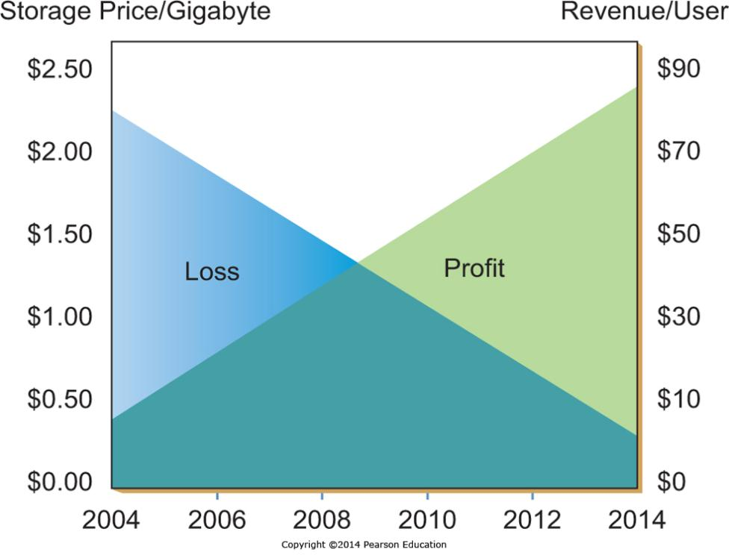
How Freeconomics Works

Slide 48
The Freeconomics Value Proposition
Free doesn’t mean no profit
Google gives away search
Users give Google search results their attention
This can include attention to sponsored links
Google sells space for sponsored links
Advertisers pay Google for that attention to sponsored links
Some users convert into customers
Customers pay advertising firms for their products

Slide 49
Applying Freeconomics in the Digital World
Approach | What it Means | Examples
Advertising | Free services are provided to customers & paid for by a third party | ▪ Yahoo!’s banner ads ▪ Google’s pay-per-click
Freemium | Basic services are free, a premium is charged for special features | ▪ Skype ▪ Dropbox.com
Cross subsidies | Sale price of one item is reduced in order to sell something else of value | ▪ Free cell phone with two-year contract
Zero Marginal Cost | Products are distributed to customers without an appreciable cost to anyone | ▪ iTunes music distribution ▪ Software distribution ▪ YouTube Video content
Labor Exchange | The act of customers using free services creates value | ▪ Yahoo! Answers ▪ Answers.com
Gift Economy | People participate and collaborate to create value for Everyone | ▪ Open source software ▪ Wikipedia

