Slide 1
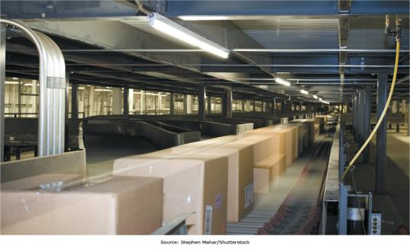
Chapter 1 - Managing in the Digital World
Managers are facing unique challenges as Digital Technologies permeate the workplace

Slide 2
Chapter 1 Learning Objectives
Information Systems Today
Describe the characteristics of the digital world and the advent of the Information Age.
Evolution of Globalization
Define globalization, describe how it evolved over time, and describe the key drivers of globalization.
Information Systems Defined
Explain what an information system is, contrasting its data, technology, people, and organizational components.
IS Ethics
Describe how computer ethics impact the use of information systems and discuss the ethical concerns associated with information privacy and intellectual property.
The Dual Nature of Information Systems
Describe the dual nature of information systems in the success and failure of modern organizations.

Slide 3
Information Systems Today
Information Systems Today
Learning Objective: Describe the characteristics of the digital world and the advent of the Information Age.
Evolution of Globalization
Define globalization, describe how it evolved over time, and describe the key drivers of globalization.
Information Systems Defined
Explain what an information system is, contrasting its data, technology, people, and organizational components.
IS Ethics
Describe how computer ethics impact the use of information systems and discuss the ethical concerns associated with information privacy and intellectual property.
The Dual Nature of Information Systems
Describe the dual nature of information systems in the success and failure of modern organizations.

Slide 4
Question
The ability to independently learn new technologies as they emerge and assess their impact on your work and life is called ________.
A) computer adaptation
B) computer programming
C) computer compatibility
D) computer assisted learning
E) computer fluency

Slide 5
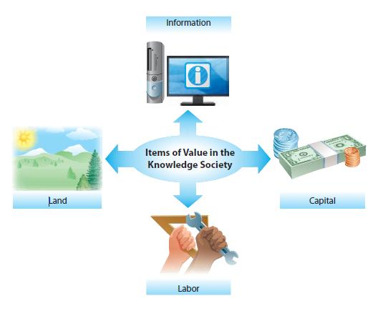
The Knowledge Society
Information is now as important as land, labor, and capital resources.

Slide 6
Information Systems Today
The Knowledge Worker
Term coined by Peter Drucker in 1959
An individual who is relatively well educated and who creates, modifies, and/or synthesizes knowledge as a fundamental part of a job
Knowledge Society
New Economy/Digital World
Digital Divide—those with access to information technology have great advantages over those without access.

Slide 7
Questions
How many of the MIS majors expect to work as knowledge workers upon graduation?
How many of the non-MIS majors expect to work as knowledge workers upon graduation?

Slide 8
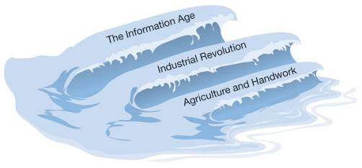
The Three Waves of Change
The Third Wave by Alvin Toffler describes three phases or “waves of changes”.
First wave
A civilization based on agriculture and handwork
Relatively primitive stage
Lasted thousands of years
Luddites opposed technology.

Slide 9
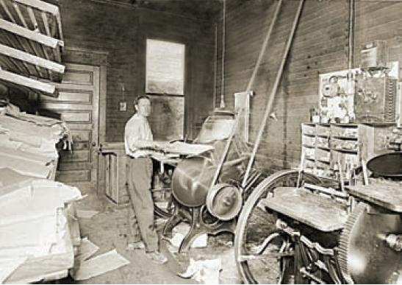
The Three Waves of Change (cont’d)
Second wave
The Industrial Revolution
Began at the end of the 18th century and lasted about 150 years
Third wave
The Information Age
Information becomes the currency of the realm
The printing press gave birth to the information age.

Slide 10
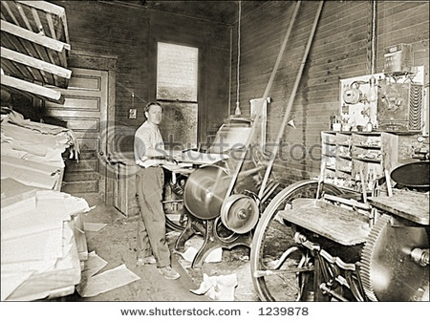
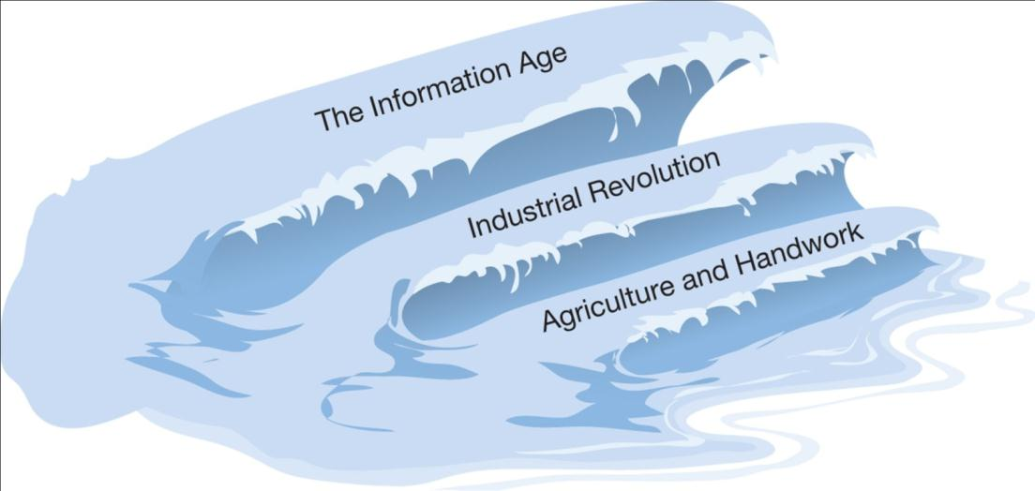
The Rise of the Information Age
Could the conventional wisdom of the day during the age of agriculture and handwork every prepare a young person to be successful during the industrial age? How would your parents and teachers tell you to prepare?
When you were trying to figure out what to study in college, who did you go to for advice?

Slide 11
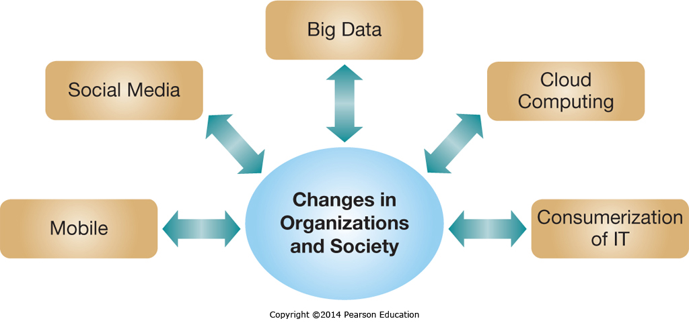
Five IT Megatrends in the Information Age

Slide 12
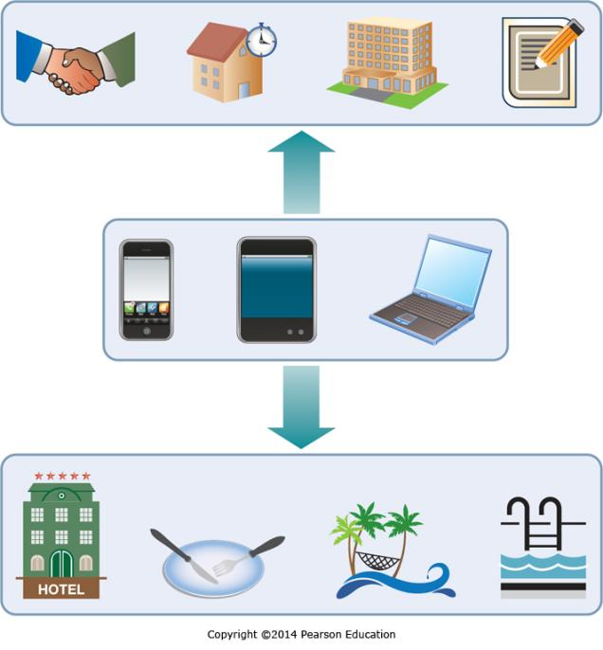
Five IT Megatrends in the Information Age: Mobile Computing
Many believe that we’re living in a post-PC era.
In the developing world mobile devices often leapfrog traditional PCs.
Implications:
Increased collaboration
The ability to manage business in real time
New ways to reach customers

Slide 13
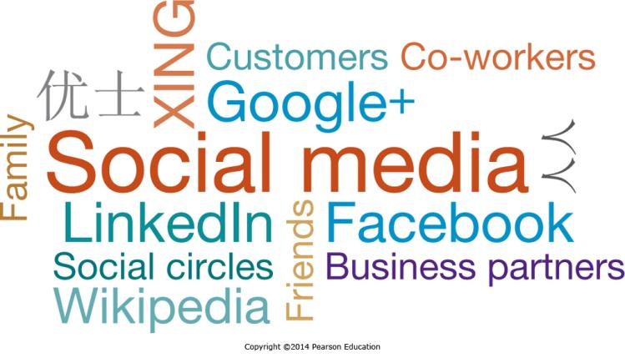
Five IT Megatrends in the Information Age: Social Media
Over 800 million Facebook users share status updates or pictures with friends and family
Organizations use social media to encourage employee collaboration or to connect with their customers

Slide 14
Five IT Megatrends in the Information Age: Big Data
IDC estimated that in 2011, 1.8 zettabytes of data were generated and consumed
How much is 1.8 zettabytes? 1.8 trillion gigabytes, or the equivalent of 57 billion 32GB iPads (IDC, 2011)
This number is forecast to grow by 50 times by 2020

Slide 15
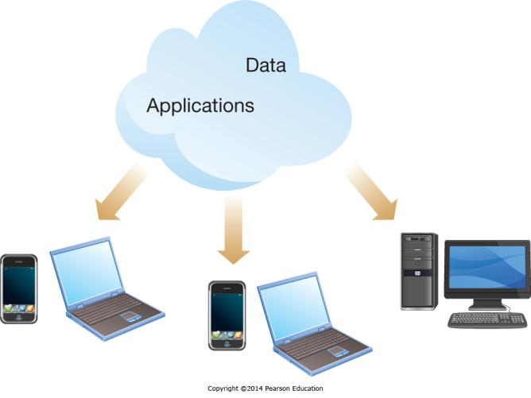
Five IT Megatrends in the Information Age: Cloud Computing
Web technologies enable using the Internet as the platform for applications and data
Many regard cloud computing as the beginning of the “fourth wave”
the applications but also the data reside in the cloud

Slide 16
Five IT Megatrends in the Information Age: Consumerization of IT
Consumerization may be the most significant trend affecting organizational IT personnel
Today’s employees bring their own devices to work
Initially used for emails / social networking
Now used for other important tasks such as enterprise resource planning
Creates security concerns
Opens up new opportunities

Slide 17
Evolution of Globalization
The Rise of the Information Age
Describe the characteristics of the digital world and the advent of the Information Age.
Evolution of Globalization
Learning Objective: Be able to define globalization, describe how it evolved over time, and describe key globalization drivers.
Information Systems Defined
Explain what an information system is, contrasting its data, technology, people, and organizational components.
IS Ethics
Describe how computer ethics impact the use of information systems and discuss the ethical concerns associated with information privacy and intellectual property.
The Dual Nature of Information Systems
Describe the dual nature of information systems in the success and failure of modern organizations.

Slide 18
What is “globalization” and how is it manifested?
Did you know 3.0?
How much of this has been enabled by technology?
Does any of this make you feel a little threatened and uncomfortable?

Slide 19
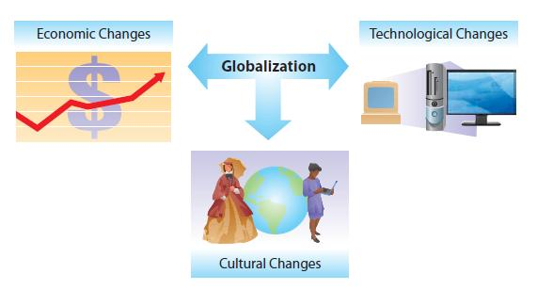
Globalization: Economic Changes
Economic Changes
Increases in international trade, development of global financial systems and currency, and outsourcing of labor

Slide 20
Globalization: Cultural Changes
Cultural Changes Increased Multiculturalism through:
TV and movies
International travel and immigration
Ethnic Foods
Social Media: Facebook, Twitter, and YouTube

Slide 21
Globalization: Technological Changes
Technological Changes
Low-cost computing platforms and communication technologies & infrastructure
e-mail, Skype, and instant messaging
global patent and copyright enforcement

Slide 22
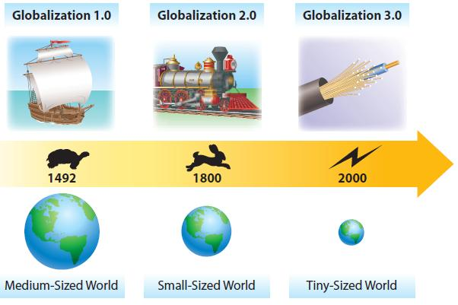
Globalization: 1.0, 2.0, 3.0
The World is Flat

Slide 23
Key Factors Enabling Globalization 3.0
November 9, 1989—The Fall of the Berlin Wall
August 9, 1995—Release of Netscape Web Browser
Work Flow Software
Uploading
Outsourcing
Offshoring
Supply Chaining
In-Sourcing
In-Forming
The Steroids
Triple convergence:
Enablers work together, enhancing collaboration
Move from vertical to horizontal collaboration
Inclusion of China, India, and Soviet Union

Slide 24
The Rise of Information Systems Outsourcing
Outsourcing: moving of business processes or tasks to another company
Facilitated by declining telecommunication costs
Driven by cost reduction
Reduced labor costs for low-skilled labor: Apple outsourcing manufacturing to China
Reduced labor costs for relatively high-skilled labor: Boeing outsourcing 787 Aeronautical Engineering to Russia

Slide 25
The Rise of Information Systems Outsourcing: Key Reasons for Outsourcing
To reduce or control costs
To free up internal resources
To gain access to world-class capabilities
To increase revenue potential of the organization
To reduce time to market
To increase process efficiencies
To be able to focus on core activities
To source specific capabilities or skills

Slide 26
Opportunities of Operating in the Digital World
Falling Transportation Costs
Shipping a bottle of wine from Australia to Europe merely costs a few cents
Falling Telecommunication Costs
These have helped create shared perspectives of behavior, desirable goods, and even forms of government
Reaching Global Markets
Accessing a Global Labor Pool
Highly skilled or low cost labor pools exist in many countries which are now economically accessible

Slide 27
Challenges of Operating in the Digital World
Government
Political instability
Regulatory: privacy, control, standards, censorship
Geopolitical
Time zones, infrastructure
Workforce: welfare, demographics, expertise
Cultural
Working with, providing services too

Slide 28
Information Systems Defined
The Rise of the Information Age
Describe the characteristics of the digital world and the advent of the Information Age.
Evolution of Globalization
Define globalization, describe how it evolved over time, and describe the key drivers of globalization.
Information Systems Defined
Learning Objective: Explain what an information system is, contrasting its data, technology, people, and organizational components.
IS Ethics
Describe how computer ethics impact the use of information systems and discuss the ethical concerns associated with information privacy and intellectual property.
The Dual Nature of Information Systems
Describe the dual nature of information systems in the success and failure of modern organizations.

Slide 29
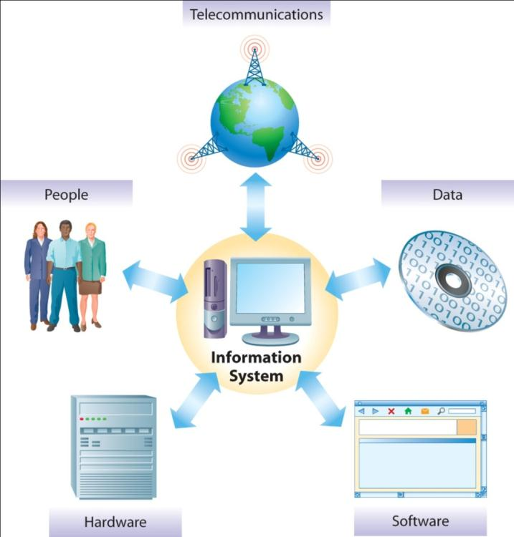
The Components of Information Systems
Five Components of Information Systems:
People
Telecommunications
Hardware
Data
Software

Slide 30
Data: The Root and Purpose of Information Systems
Data is analyzed and processed into information
When there is an ability to understand the information and make decisions using it, it becomes knowledge

Slide 31
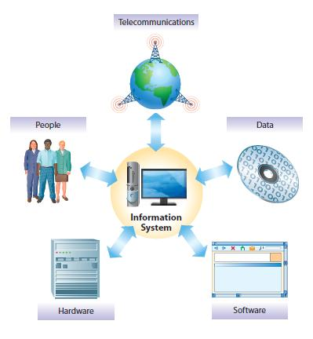
The Components of Information Systems
Information System ➔ Computer Information System
Hardware—CPU, disk drives, monitors, keyboards, and so on
Software—provide hardware with processing instructions
Telecommunications networks—allow computers to share information and services

Slide 32
People: The Builders, Managers, and Users of Information Systems
An ecosystem of Users, Builders, Managers, and those who study information systems
As the use of information systems grows, so does the need for dedicated IS professionals
Growing demand focused on those with advanced and/or unique skills

Slide 33
People: The Builders and Managers of IS
Career opportunities are strong and expected to grow.
U.S. Bureau of Labor Statistics: Employment for computer and IS managers will grow faster than the average for all occupations through 2016.
Median annual earnings of IS managers in May 2009 were $113,720.
Starting salary offers for IS majors, with one year or less of experience, averaged $54,038.
Some titles: systems analysts, systems programmers, systems operators, network administrators, database administrators, systems designers, systems managers, and chief information officers

Slide 34
IS Positions Rank Among the Best Jobs in America
Rank | Career | Job Growth (10-year forecast) | Median Pay
1 | Software developer | 32% | $82,400
2 | Physical therapist | 30% | $75,900
3 | Financial adviser | 30% | $93,900
4 | Civil engineer | 24% | $74,700
5 | Marketing specialist | 28% | $52,200
6 | Management consultant | 24% | $111,000
7 | IT consultant | 20% | $96,500
8 | Database administrator | 20% | $86,600
9 | Financial analyst | 20% | $62,600
10 | Environmental engineer | 31% | $81,200

Slide 35
INDUSTRY ANALYSIS Business Career Outlook
Globalization trend is increasing the need for “Global Skills”—What can you do?
Gain international experience
Learn more than one language
Sensitize yourself to global cultural and political issues
In addition—Immerse yourself into the culture:
Read books and newspapers.
Talk to people who know the culture.
Watch locally produced television.
Share meals with local workers.
Learn key phrases in the language.

Slide 36
Organizations: The Context of Information Systems
Information Systems can help organizations
Be more productive and profitable
Gain competitive advantage
Reach more customers
Improve service to their customers
This holds true for all types of organizations—professional, social, religious, educational, and governmental

Slide 37
Types of Info Systems Used in Organizations

Slide 38
Types of Info Systems Used in Organizations

Slide 39
Organizing the IS Function
Early History: Poor Service and Worse Attitudes
Early systems were cumbersome to use, over budget, and late.
The Rise and Fall of End-User Development
Users developed their own applications or improved existing systems.
Today’s complex systems designed by professionals (see Chapter 9)
The Modern Information Systems Organization
Attitudes changed and service mentality emerged

Slide 40
The Spread of Technology in Organizations
IS personnel tend to spend most of their time out in the business unit.
IS personnel often have dual-reporting relationships—reporting to both the central IS group and the business function they serve.
Clearly a need for people who know the technology side and the business side of the business

Slide 41
The Dual Nature of Information Systems
The Rise of the Information Age
Describe the characteristics of the digital world and the advent of the Information Age.
Evolution of Globalization
Define globalization, describe how it evolved over time, and describe the key drivers of globalization.
Information Systems Defined
Explain what an information system is, contrasting its data, technology, people, and organizational components.
IS Ethics
Describe how computer ethics impact the use of information systems and discuss the ethical concerns associated with information privacy and intellectual property.
The Dual Nature of Information Systems
Learning Objective: by able to describe the dual nature of information systems in the success and failure of modern organizations.

Slide 42
The Dual Nature of IS
IS can help you or hurt you.
Toyota Prius—The failure (with redemption)
Braking system software glitch
Severely blemished Toyota’s reputation for safety and quality
Fortunately, dealerships could easily install new software to fix the problem
FedEx—The success
$ 32 billion family of companies—largest express transportation company
Information hub for business where managing information is the business

Slide 43
Information Systems for Competitive Advantage
FedEx is just one firm using information systems for competitive advantage
Firms of all types and sizes can use information systems to gain or sustain a competitive advantage over their rivals
Whether it is a small mom-and-pop boutique or a large government agency, every organization can find a way to use information technology to beat its rivals

Slide 44
Question
Does a great payroll or order entry system give your organization a competitive advantage?
What if the order entry system is connected to a CRM system which helps you cross sell or up sell additional goods and services?

Slide 45
Coming Attractions The Future of Cloud-Based Communications
By 2020, all sorts of our communications-related information could come to be stored in the cloud
This information could be analyzed
Helping know where friends and family are
Knowing how and when to reach them
The cloud could wind up knowing more about our lives then we do
Still, the benefits could be amazing

Slide 46
IS Ethics
The Rise of the Information Age
Describe the characteristics of the digital world and the advent of the Information Age.
Evolution of Globalization
Define globalization, describe how it evolved over time, and describe the key drivers of globalization.
Information Systems Defined
Explain what an information system is, contrasting its data, technology, people, and organizational components.
IS Ethics
Learning Objective: Describe how computer ethics impact the use of information systems and discuss the ethical concerns associated with information privacy and intellectual property.
The Dual Nature of Information Systems
Describe the dual nature of information systems in the success and failure of modern organizations.

Slide 47
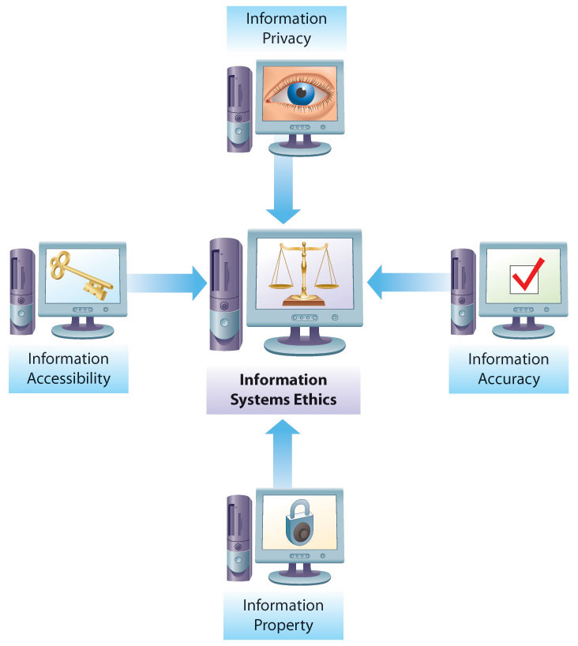
Computer Ethics
Key Ethical Concerns
Information Privacy
Information Accuracy
Information Property
Information Accessibility

Slide 48
Information Privacy
What information should you have to reveal?
What information you might want to keep private?
What is identity theft?

Slide 49
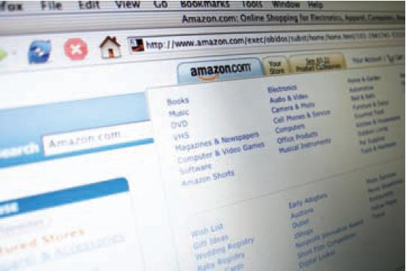
Information Privacy (cont’d)
Companies seem to know about our every move—how much information do we need to reveal?
Amazon.com is famous for personalization
What are the costs?

Slide 50
Question
________ is concerned with ensuring the authenticity and fidelity of information as well as with identifying who is responsible for informational errors that harm people.
A) Information accessibility
B) Information privacy
C) Information protection
D) Information accuracy
E) Information property

Slide 51
Information Accuracy
Who is responsible for ensuring of the authenticity and fidelity of information?

Slide 52
Information Property
Who owns information about individuals?
How can this information be sold and exchanged?

Slide 53
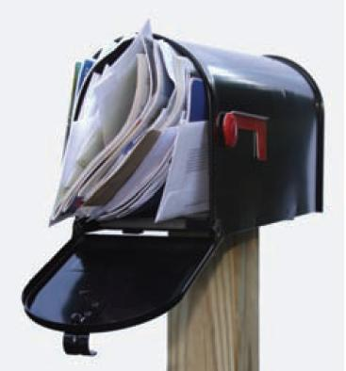
Data Privacy Statements
Company maintaining the database with customer information legally owns it
Is free to sell it?
Must it ensure proper data handling practices?
Social networking complicates matters
Complexity of privacy settings
Friends can tag you without your knowledge.

Slide 54
Information Accessibility
Who has the right to monitor the information?

Slide 55
The Need for a Code of Ethical Conduct: Computer Ethics Institute Guidelines
The guidelines prohibit:
Using a computer to harm others
Interfering with other people’s computer work
Snooping in other people’s files
Using a computer to steal
Using a computer to bear false witness
Copying or using proprietary software without paying for it
Using other’s resources without authorization or compensation
Appropriating other people’s intellectual output
The guidelines recommend:
Review social consequences of programs and systems you design
Use computers in ways that show consideration and respect for others

Slide 56
The Digital Divide
Many people are being left behind in the information age
Strong linkage between computer literacy and a person’s ability to compete in the information age
People in rural communities, the elderly, people with disabilities, and minorities lag behind national averages for Internet access and computer literacy
The challenges in overcoming the digital divide are even greater in developing countries

Slide 57
Digital Divide
The gap between people who are computer literate and have access to the Internet and those who do not
Strong linkage between computer literacy and a person’s ability to compete in the information age
Good news: the digital divide in America is rapidly shrinking.
Still, people in rural communities, the elderly, people with disabilities, and minorities lag behind national averages.
One Laptop per Child (OLPC): global project that attempts to distribute low-cost laptops to children in developing countries

Slide 58
End of Chapter Content
See next slides – if we have time!

Slide 59
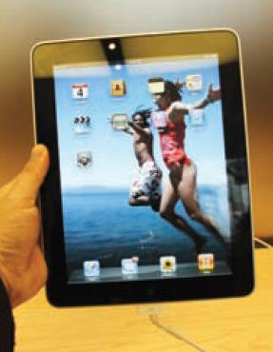
Managing in the Digital World: Apple Computer
April Fools’ Day 1976
Stephen Wozniak and Steven Jobs officially formed the Apple Computer Company.
Both dropped out of college to build computers.
The Apple I debuted shortly after the company was formed and sold for $666.66.
Apple II’s 17-year life span is a record within the computer industry.
Highs and lows
Failures—Lisa, Apple III
Successes—Macintosh (with AppleMouse II), iMac, Mac OS X
iPod, iPhone, and iPad
Problems—environmental concerns, Jobs’ health

Slide 60
WHEN THINGS GO WRONG Failure: The Path to Success?
Management consultant Tom Peters
tells managers that a company’s survival depends on employees who fail repeatedly as they try new ideas
In this spirit, Wired magazine in 2008 celebrated Apple’s greatest failures:
Newton operating system
Pippin game player
Twentieth Anniversary Macintosh
Macintosh television
PowerMac G4 Cube
Apple IIc
Puck mouse
Lisa

Slide 61
NET STATS Worldwide Internet Usage
In 2010, about 14.4 percent of active Internet users were located in North America.
Internet usage:
Highest—North America: 76.2 percent of population
Lowest—Africa: 8.7 percent of population

Slide 62
ETHICAL DILEMMA Online Rights Not Always Universal
Governments in some countries regulate access to information on the Web (e.g., China).
Reporters Without Borders call this behavior unethical.
In 2010, Google decided to stop censoring its search results after it was hacked by people who tried to spy on Chinese dissidents.
Responses from other companies are mixed.
Who owns Web-posted data?

