Slide 1

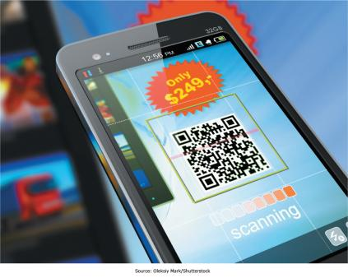

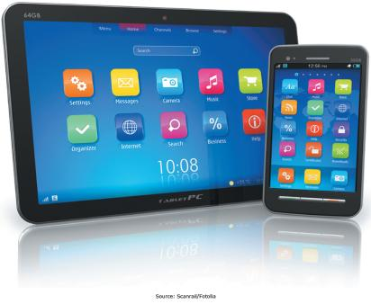
Chapter 4 - Enabling Business-to-Consumer Electronic Commerce
The Internet and World Wide Web are extremely well suited for conducting business electronically on a global basis

Slide 2
“There is no physical analog for what Amazon.com is becoming.”
Jeff Bezos
Cofounder and long-time CEO of Amazon.com
Complete the following sentences:
Amazon.com is ____________________
In the physical world, Amazon.com is like _________________________________

Slide 3
Chapter 4 Learning Objectives
After this chapter, you will be able to:
Electronic Commerce Defined
Describe electronic commerce, how it has evolved, and the strategies that companies are adopting to compete in cyberspace.
Business-to-Consumer E-Commerce and Internet Marketing
Describe the stages of business-to-consumer electronic commerce, understand the keys to successful electronic commerce applications, and explain the different forms of Internet marketing.
Mobile Commerce, Consumer-to-Consumer EC, and Consumer-to-Business EC
Describe mobile commerce, consumer-to-consumer electronic commerce, and consumer-to-business electronic commerce.
E-Government
Explain different forms of electronic government.
Managing Finances and Navigating Legal Issues in EC
Describe how to conduct financial transactions and navigate the legal issues of electronic commerce.

Slide 4
Electronic Commerce Defined
Electronic Commerce Defined
Describe electronic commerce, how it has evolved, and the strategies that companies are adopting to compete in cyberspace.
Business-to-Consumer E-Commerce and Internet Marketing
Describe the stages of business-to-consumer electronic commerce, understand the keys to successful electronic commerce applications, and explain the different forms of Internet marketing.
Mobile Commerce, Consumer-to-Consumer EC, and Consumer-to-Business EC
Describe mobile commerce, consumer-to-consumer electronic commerce, and consumer-to-business electronic commerce.
E-Government
Explain different forms of electronic government.
Managing Finances and Navigating Legal Issues in EC
Describe how to conduct financial transactions and navigate the legal issues of electronic commerce.

Slide 5
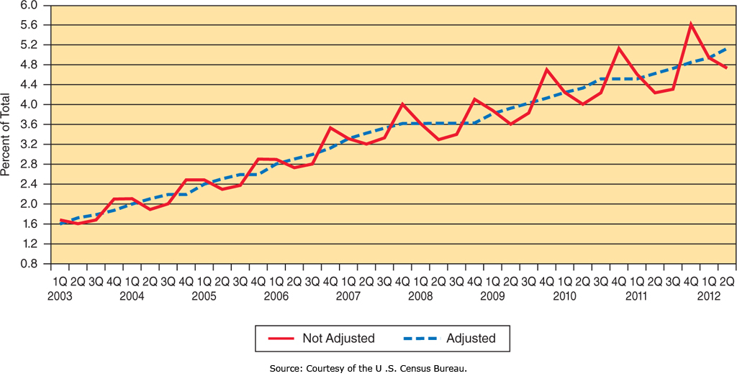
Electronic Commerce Defined
Electronic Commerce
    “the exchange of goods, services, and money among firms, between firms and their customers, and between customers, supported by communication technologies and, in particular, the Internet”

Slide 6
Question
What are the most common types of E-Commerce?

Slide 7
Electronic Commerce Defined:
Types of Electronic Commerce (EC)
Type of EC | Description
Business-to-consumer (B2C) | Transactions between businesses and their customers
Business-to-business (B2B) | Transactions among businesses
Consumer-to-business (C2B) | Transactions between customers and businesses
Consumer-to-consumer (C2C) | Transactions between people not necessarily working together
Government-to-citizen (G2C) | Transactions between a government and its citizens
Government-to-business (G2B) | Transactions between a government and businesses
Government-to-government (G2G) | Transactions among governments

Slide 8
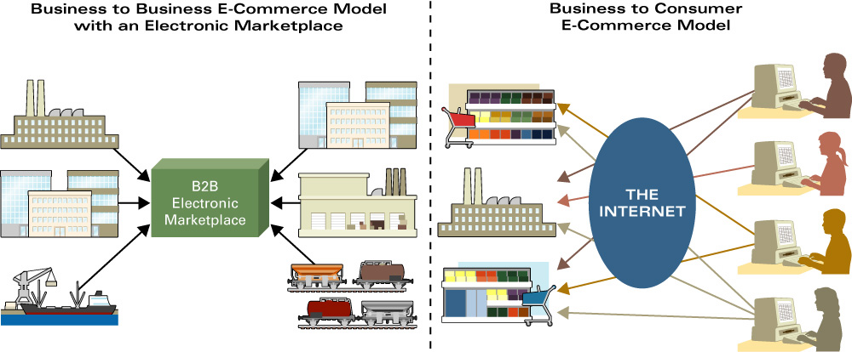
Where is the money…B2B or B2C?
Management Information Systems for the Information Age, Haag and Cummings

Slide 9
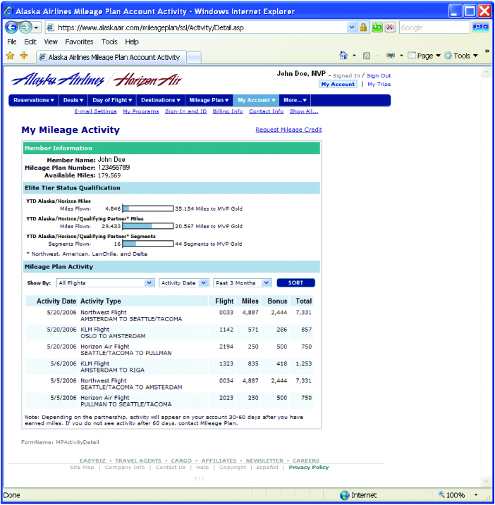
Key Capabilities: Integration

Slide 10
Question
What type of integration exists between organizations?

Slide 11
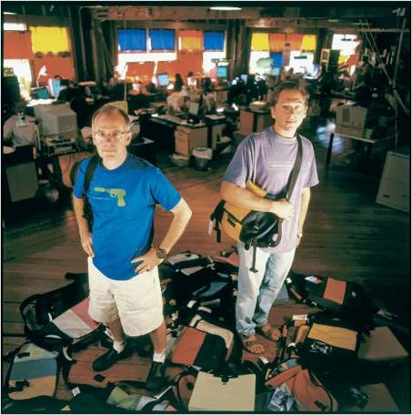
Key Capabilities:
Mass Customization

Slide 12

Key Capabilities:
Interactive Communication

Slide 13
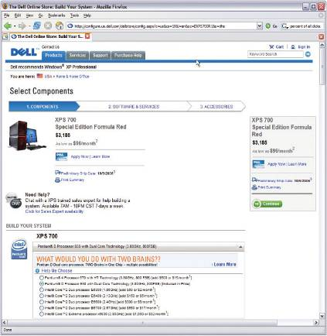
Key Capabilities:
Transaction Support

Slide 14
Question
What do we mean when we say an organization is…
  Brick and Mortar
  Click and Mortar
  Click only
Examples?

Slide 15
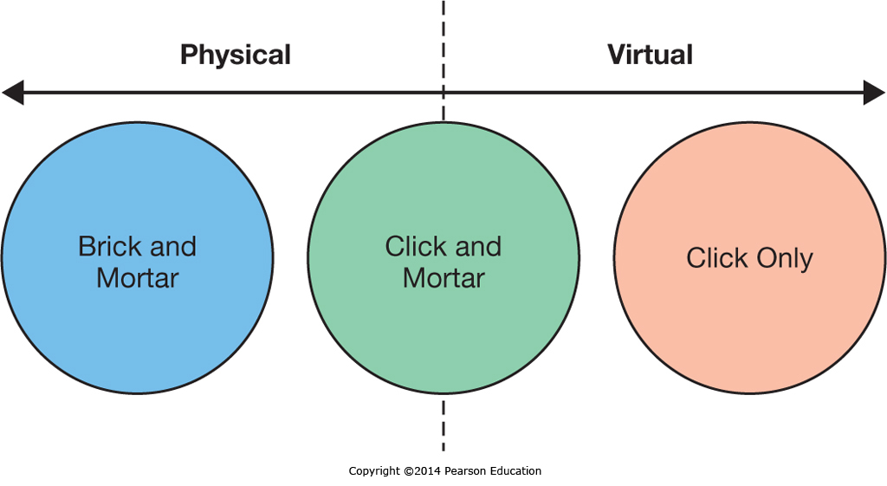
EC Business Strategies

Slide 16
EC Business Strategies:
Revenue Models
Revenue Type | Description | Who is Doing This?
Affiliate marketing | Paying businesses that bring or refer customers to another business | Amazon.com’s Associates program
Subscription | Users pay a monthly or yearly recurring fee for the product/service | Netflix.com, World of Warcraft
Licensing | Users pay a fee for using protected intellectual property | Symantec, Norton
Transaction fees/Brokerage | A commission is paid to the business for aiding in the transaction | PayPal.com, eBay.com, Groupon.com
Traditional sales | A consumer buys a product/service from the Web site | Nordstrom.com, iTunes.com
Web advertising | A free service/product is supported by advertising on the Web site | Facebook.com, Answers.com

Slide 17
Question
What is the difference between…
  The Internet
  An Extranet
  An Intranet

Slide 18
The Internet . . . A network of networks
Computers and other devices capable of communicating
  Servers, desktops and laptops
  Phones, PDAs and other mobile devices
  Xbox 360, Wii
  Vending machines, appliances, etc.
The infrastructure that connects them (fiber optics, copper, modems, routers, microwave, etc.)
The software tools and protocols that make communication possible
It is more than the World Wide Web!

Slide 19
As a result of the standards
Things you probably take for granted…
  You can retrieve material using a browser from any Web Server regardless of technology or location
  You can send email to any email account regardless of technology or location
  Dissimilar computers at multiple locations can function together to complete a process

Slide 20
Business-to-Business E-Commerce
B2B involves exchanges between two or more businesses; these exchanges do not include end customers (consumers).
Supply chain—companies and processes moving product from suppliers of raw materials to suppliers of intermediate components, to final production, to the customer.

Slide 21
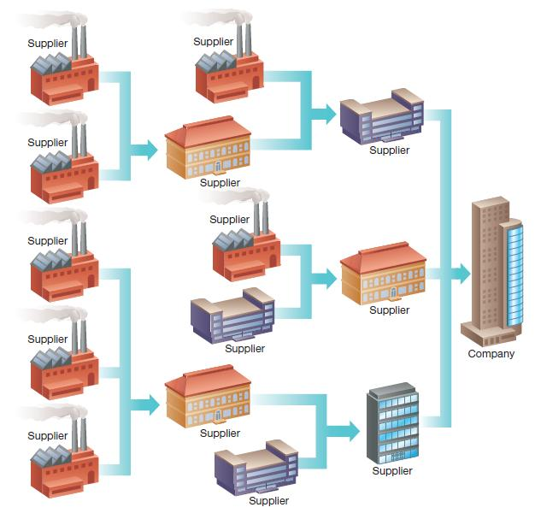
Supply Network
The farther out in the supply chain one looks, the more suppliers are involved, forming a supply network.

Slide 22
Question
What is EDI and what do companies do with it?
What’s older, EDI or you?
What’s older, EDI or me?

Slide 23
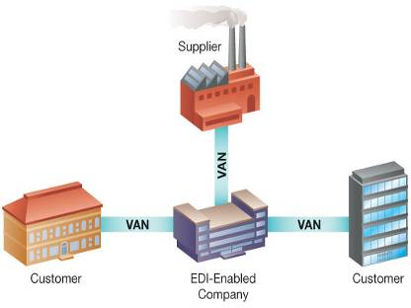
Electronic Data Interchange (EDI)

Slide 24
Web Services
The Gap
Stock DB
BigStore.com
“In stock” confirmation
ProductLookup Application
Credit card confirmation
Client
Account
DB
Shopping Application
GiantBank
The BigStore.com application can check whether a product is in stock at The Gap, or the verify a customer’s credit card at GiantBank.
BigStore.com doesn’t have to know the technology in use at the Gap or at GiantBank.
Credit verification application

Slide 25
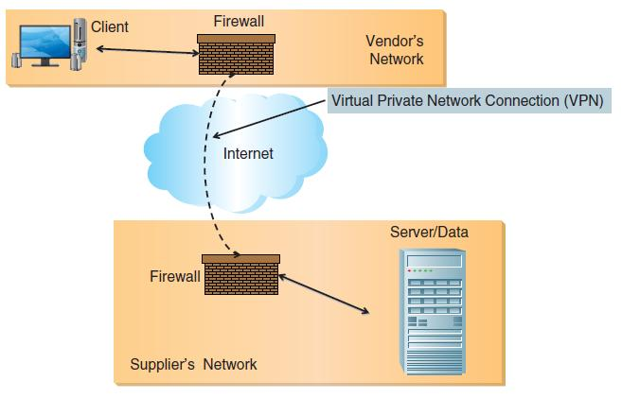
Extranet System Architecture

Slide 26
Business-to-Employee Electronic Commerce
Business-to-employee (B2E) electronic commerce
Internet based private network using Web technologies
Boeing
  Intranet serves more than 200,000 employees.
  More than 1 million pages
Intranet—Used to facilitate secured transmission of proprietary information within companies.
Intranets offer similar benefits as extranets.

Slide 27
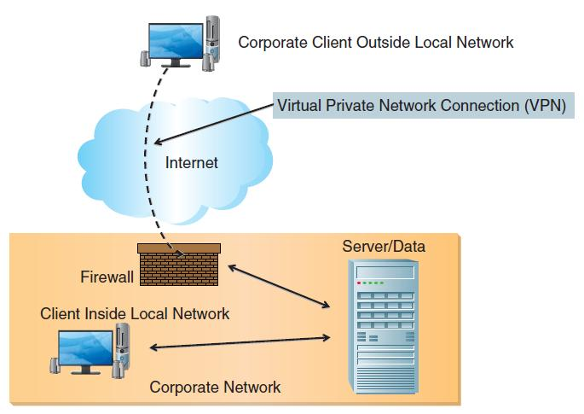
Intranet System Architecture

Slide 28
Intranet Applications
Training
  Boeing’s Quality eTraining program
Personalized Intranet Pages
  Employee see only content that pertains to his or her job.
Real-Time Access to Information
  Less complicated to manage, update, distribute, and access corporate information
  Improve employee productivity
Online Entry of Information
  Paper-base human resourced form:$20–$30
  Web-based human resourced form:$2–$4
Collaboration
  Timely communication of business activities

Slide 29
Business-to-Consumer E-Commerce and Internet Marketing
Electronic Commerce Defined
Describe electronic commerce, how it has evolved, and the strategies that companies are adopting to compete in cyberspace.
Business-to-Consumer E-Commerce and Internet Marketing
Describe the stages of business-to-consumer electronic commerce, understand the keys to successful electronic commerce applications, and explain the different forms of Internet marketing.
Mobile Commerce, Consumer-to-Consumer EC, and Consumer-to-Business EC
Describe mobile commerce, consumer-to-consumer electronic commerce, and consumer-to-business electronic commerce.
E-Government
Explain different forms of electronic government.
Managing Finances and Navigating Legal Issues in EC
Describe how to conduct financial transactions and navigate the legal issues of electronic commerce.

Slide 30
Mobile Commerce, Consumer-to-Consumer EC, and Consumer-to-Business EC
Electronic Commerce Defined
Describe electronic commerce, how it has evolved, and the strategies that companies are adopting to compete in cyberspace.
Business-to-Consumer E-Commerce and Internet Marketing
Describe the stages of business-to-consumer electronic commerce, understand the keys to successful electronic commerce applications, and explain the different forms of Internet marketing.
Mobile Commerce, Consumer-to-Consumer EC, and Consumer-to-Business EC
Describe mobile commerce, consumer-to-consumer electronic commerce, and consumer-to-business electronic commerce.
E-Government
Explain different forms of electronic government.
Managing Finances and Navigating Legal Issues in EC
Describe how to conduct financial transactions and navigate the legal issues of electronic commerce.

Slide 31
E-Auctions
Forward auction
  Sellers post goods or services for sale.
  Buyers bid on these items.
  Highest bid wins.
Reverse auction
  Buyers post a request for quote (RFQ).
  Seller proposes a bid.
  Lowest seller bid wins.
  This is frequently in B2B e-commerce.

Slide 32
E-Auction Fraud
E-auctions marred with more fraud than any other Internet activity.
  E-auctions represent 45 percent of all Internet fraud-related complaints.
  Average loss: $724
Types of e-Auction fraud:
  Bid luring
  Reproductions
  Bid shielding
  Shipping fraud
  Payment failure
  Nonshipment

Slide 33
Mobile EC
Location-Based M-Commerce
  Services can be offered tailored to a person’s needs based on their current location
Information on the Go
  Customers can get further information about a product wherever they are, including in the store, but this can lead to “showrooming”
Product and Content Sales
  Consumers use mobile apps to make purchases while on-the-go

Slide 34
Managing Finances and Navigating Legal Issues in EC
Electronic Commerce Defined
Describe electronic commerce, how it has evolved, and the strategies that companies are adopting to compete in cyberspace.
Business-to-Consumer E-Commerce and Internet Marketing
Describe the stages of business-to-consumer electronic commerce, understand the keys to successful electronic commerce applications, and explain the different forms of Internet marketing.
Mobile Commerce, Consumer-to-Consumer EC, and Consumer-to-Business EC
Describe mobile commerce, consumer-to-consumer electronic commerce, and consumer-to-business electronic commerce.
E-Government
Explain different forms of electronic government.
Managing Finances and Navigating Legal Issues in EC
Describe how to conduct financial transactions and navigate the legal issues of electronic commerce.

Slide 35
E-Banking
Online Banking
  Convenience
  Security Concerns
  Mobile banking
Online Investing
  Increased access to financial information and analytical tools
  Online investing
  Mobile investing

Slide 36
Payment Services
Online transactions without sharing private information with actual seller
Payment service keeps information secure.
  PayPal (owned by eBay)
    Can send and receive money if you have an e-mail account.
  Google Checkout
    Linked with Google search
    Users can see if merchants offer this option.

Slide 37
Securing Payments in the Digital World
Credit and Debit Cards
  Credit Cards are a simple mechanism
  Consumers have to transfer a lot of personal information to the seller
Managing Risk
  Businesses are financially liable for fraudulent transactions
  Businesses have to look for fraud indicators and sometimes reject risky transactions

Slide 38
Legal Issues in EC
Taxation
  Sales Taxes
Digital Rights Management
  Preventing unauthorized duplication
  Restrict which devices can play media
  Limit number of times media can be played

Slide 39
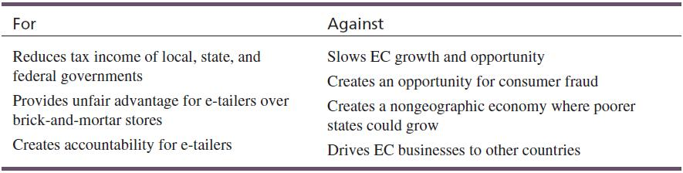
Legal Issues in EC—Taxation
The Internet Tax Freedom Act (1998)
Internet Tax Nondiscrimination Act (2004)
Internet sales treated as mail-order sales
No sales taxes paid in states where the company has no presence
Arguments for and against Ecommerce Taxation:

Slide 40
E-Government
Electronic Commerce Defined
Describe electronic commerce, how it has evolved, and the strategies that companies are adopting to compete in cyberspace.
Business-to-Consumer E-Commerce and Internet Marketing
Describe the stages of business-to-consumer electronic commerce, understand the keys to successful electronic commerce applications, and explain the different forms of Internet marketing.
Mobile Commerce, Consumer-to-Consumer EC, and Consumer-to-Business EC
Describe mobile commerce, consumer-to-consumer electronic commerce, and consumer-to-business electronic commerce.
E-Government
Explain different forms of electronic government.
Managing Finances and Navigating Legal Issues in EC
Describe how to conduct financial transactions and navigate the legal issues of electronic commerce.

Slide 41
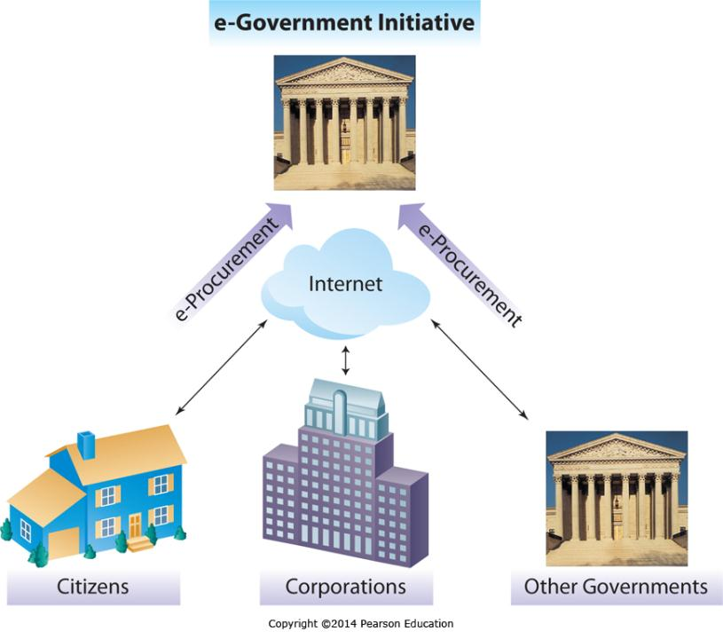
E-Government
Government-to-Citizens
Government-to-Business
Government-to-Government

