Slide 1
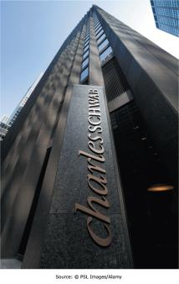
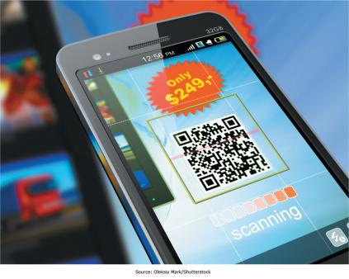
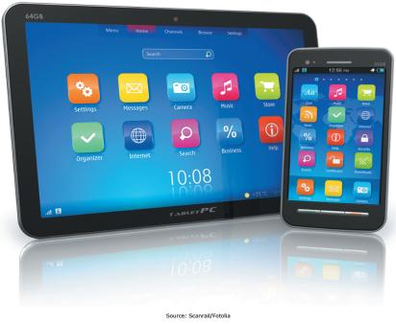
Chapter 4 - Enabling Business-to-Consumer Electronic Commerce
The Internet and World Wide Web are extremely well suited for conducting business electronically on a global basis

Slide 2
“There is no physical analog for what Amazon.com is becoming.”
Jeff Bezos
Cofounder and long-time CEO of Amazon.com
Complete the following sentences:
Amazon.com is ____________________
In the physical world, Amazon.com is like _________________________________
Notes:
It’s an online consignment shop. Ever think there would be big money in being a consignment shop?

Slide 3
Chapter 4 Learning Objectives After this chapter, you will be able to:
Electronic Commerce Defined
Describe electronic commerce, how it has evolved, and the strategies that companies are adopting to compete in cyberspace.
Business-to-Consumer E-Commerce and Internet Marketing
Describe the stages of business-to-consumer electronic commerce, understand the keys to successful electronic commerce applications, and explain the different forms of Internet marketing.
Mobile Commerce, Consumer-to-Consumer EC, and Consumer-to-Business EC
Describe mobile commerce, consumer-to-consumer electronic commerce, and consumer-to-business electronic commerce.
E-Government
Explain different forms of electronic government.
Managing Finances and Navigating Legal Issues in EC
Describe how to conduct financial transactions and navigate the legal issues of electronic commerce.

Slide 4
Electronic Commerce Defined
Electronic Commerce Defined
Describe electronic commerce, how it has evolved, and the strategies that companies are adopting to compete in cyberspace.
Business-to-Consumer E-Commerce and Internet Marketing
Describe the stages of business-to-consumer electronic commerce, understand the keys to successful electronic commerce applications, and explain the different forms of Internet marketing.
Mobile Commerce, Consumer-to-Consumer EC, and Consumer-to-Business EC
Describe mobile commerce, consumer-to-consumer electronic commerce, and consumer-to-business electronic commerce.
E-Government
Explain different forms of electronic government.
Managing Finances and Navigating Legal Issues in EC
Describe how to conduct financial transactions and navigate the legal issues of electronic commerce.

Slide 5
Question
Electronic commerce is used to conduct business with business partners such as suppliers and intermediaries. This form of EC is commonly referred to as ________ electronic commerce.
A) consumer-to-consumer
B) peer-to-peer
C) business-to-business
D) business-to-consumer
E) business-to-employee

Slide 6
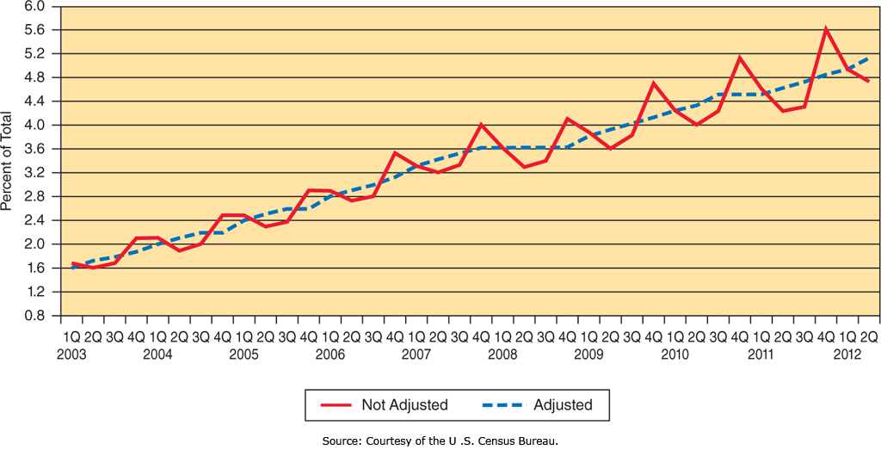
Estimated Quarterly U.S. Retail E-commerce Sales as a Percent of Total Quarterly Retail Sales: 1st Quarter 2003 – 3rd Quarter 2012
Electronic Commerce
“the exchange of goods, services, and money among firms, between firms and their customers, and between customers, supported by communication technologies and, in particular, the Internet”
Notes:
Electronic Commerce occurs when any aspect of the transaction is facilitated by Electronic Communication Technologies.
We typically think of the Internet, which is where the vast majority of Electronic Commerce takes place.
Exchanges can involve consumer, businesses, and the government where any of these can be the buyer, the seller, or both.

Slide 7
Question
What are the two most common types of E-Commerce?
Notes:
Business-to-consumer (B2C)
A person buys a book from Amazon.com
Business-to-business (B2B)
Retailer like Wal-Mart ordering from distributors
Book talks about a bunch of other’s that are complete bullshit or I really just don’t care (B2E, C2C, G2C, B2B, G2G)

Slide 8
Electronic Commerce Defined: Types of Electronic Commerce (EC)
Type of EC | Description | Example
Business-to-consumer (B2C) | Transactions between businesses and their customers | Customer buys a book from Amazon
Business-to-business (B2B) | Transactions among businesses | Manufacturer contacts a supplier
Consumer-to-business (C2B) | Transactions between customers and businesses | An individual offers photos to Shutterstock.com
Consumer-to-consumer (C2C) | Transactions between people not necessarily working together | An individual purchases tickets from another person through eBay.com; Stubhub
Government-to-citizen (G2C) | Transactions between a government and its citizens | A person files income tax return online
Government-to-business (G2B) | Transactions between a government and businesses | Government agency purchases supplies through the Internet-enabled procurement site
Government-to-government (G2G) | Transactions among governments | State agency reports online a birth to the SSA via
Notes:
There are many types of Electronic Commerce, based on who is interacting or selling to whom.
Business to Consumer is Businesses selling to Consumers; Consumer to Business is Consumers selling to Businesses.

Slide 9
Capabilities of the Web

Slide 10
Question
Which of the following statements is true about electronic commerce?
A) Consumer-to-consumer electronic commerce is a complete reversal of the traditional business-to-consumer electronic commerce.
B) It is limited to transactions between businesses and consumers.
C) All forms of electronic commerce involve business firms.
D) Electronic commerce between businesses and their employees is not possible.
E) Business-to-business is by far the largest form of electronic commerce in terms of revenues.

Slide 11
Information Dissemination
Firms across the world have access to customers.
Economical medium for marketing products and services
Increased geographical reach

Slide 12
Integration
Integration of information via Web sites
Real-time access to personalized information
No time lag between company decisions and customers’ ability to access these

Slide 13
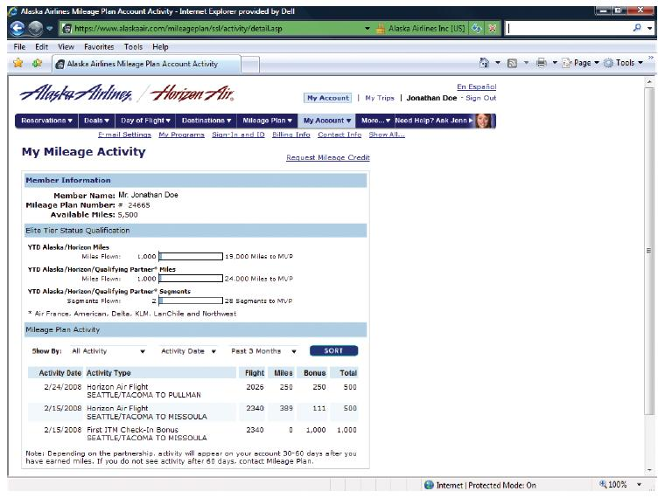
Example: Integration
Alaska Airlines customers can access their mileage program any time.
Real-time link between company database and customer

Slide 14
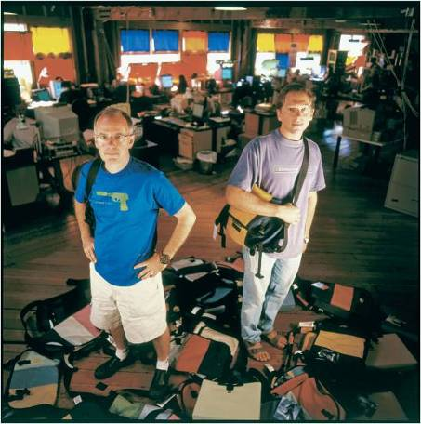
Mass Customization
Meeting particular customers’ needs on a large scale
Timbuk2.com
Custom Messenger Bag Builder
Customers create a virtual bag.
Preference-tracking helps Timbuk2 in marketing efforts.

Slide 15
Interactive Communication
Immediate feedback between company and customers
E-mail notifications
Customer service online chat
Best Buy
Geek Squad
24-hour computer support

Slide 16
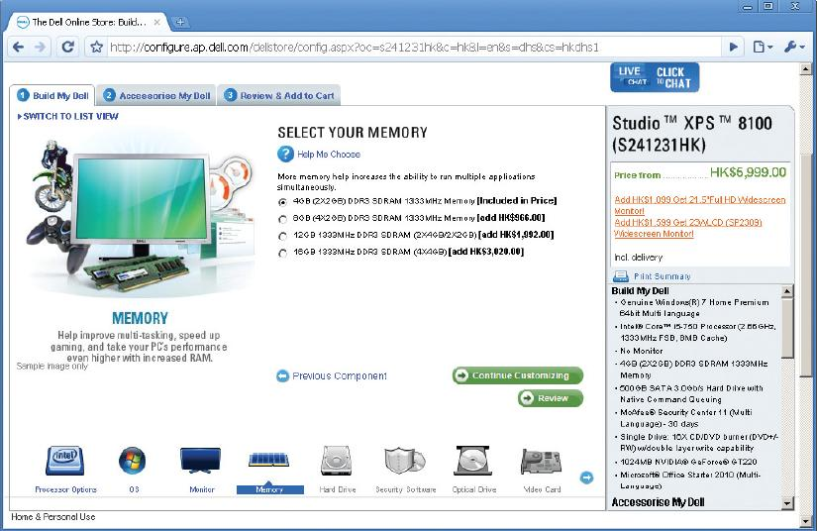
Transaction Support; Disintermediation
Internet and the Web:
Reduced transaction costs
Enhanced operational efficiency
Dell—automated transaction support
Cost savings per sale
Disintermediation-
Cut out middlemen
Direct to consumers
Reintermediation
Reintroduction of middlemen
Example: Orbitz.com

Slide 17
Question
Which of the following statements is true about companies pursuing a click-only business strategy?
A) These companies approach business activities in a traditional manner by operating physical locations.
B) These companies do not indulge in electronic commerce to conduct their businesses.
C) These companies do not have physical store locations.
D) These companies operate in both physical and virtual arenas.
E) These companies choose to operate solely in the traditional physical markets.

Slide 18
Question
What do we mean when we say an organization is…
Brick and Mortar
Click and Mortar
Click only
Examples?

Slide 19
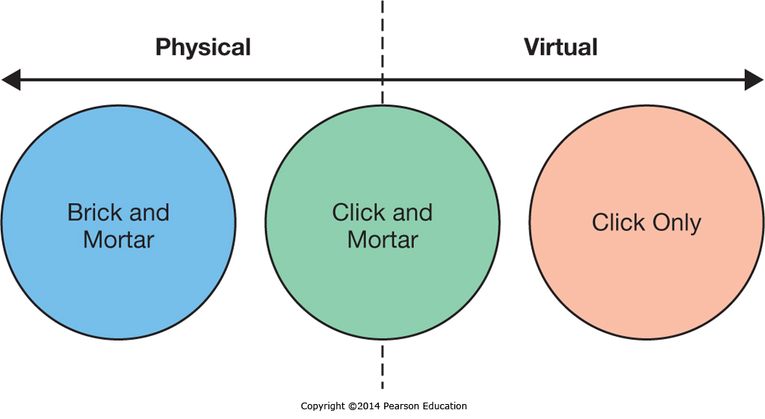
EC Business Strategies
Notes:
Companies can ignore E-Commerce and just sell through physical outlets, can be virtual companies that only sell through online store fronts, or can combine them using a “Click and Mortar” approach that allows both online transactions and physical store sales.
The physical, store-only company has a limited product reach as well as limited sales and support hours.
The online company can sell anywhere in the world 24/7, but customers must wait for their product to be shipped and some products require physical inspection and testing to verify suitability.
Click-and-Mortar stores often combine the best of both worlds, but retailers must overcome the pricing differences inherent between online and physical locations as well as the complexity of two sales channels.

Slide 20
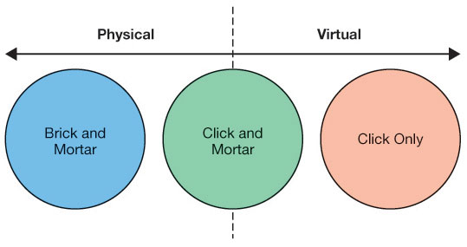
Brick-and-Mortar Business Strategy
Physical locations only
Traditional stores, no E-Commerce
Limited geographical reach

Slide 21
Click-and-Mortar Business Strategy
Bricks-and-clicks business strategy
Hybrid strategy
Added complexity combining two different environments

Slide 22
Click-Only Business Strategy
Business conducted in cyberspace—no physical location
Price savings
Difficulty with returns. Customers uncomfortable with online transactions

Slide 23
Components of a Business Model
A plan of how to achieve EC success

Slide 24
EC Business Strategies: Revenue Models
Revenue Type | Description | Who is Doing This?
Affiliate marketing | Paying businesses that bring or refer customers to another business | Amazon.com’s Associates program
Subscription | Users pay a monthly or yearly recurring fee for the product/service | Netflix.com, Luminosity, NY Times, LinkedIn
Licensing | Users pay a fee for using protected intellectual property | Symantec, Norton
Transaction fees/Brokerage | A commission is paid to the business for aiding in the transaction | PayPal.com, eBay.com, Groupon.com
Traditional sales | A consumer buys a product/service from the Web site | Nordstrom.com, iTunes.com
Web advertising | A free service/product is supported by advertising on the Web site | Facebook.com, Answers.com
Notes:
There are many ways E-Commerce can be monetized outside of simple sales transactions. Some companies work strictly as referrals companies, receiving affiliate marketing fees.
Subscription fees allow access or use for a limited time period.
Licensing transfers the right to use, but not ownership.
Transaction fees are based on aiding a transaction between two parties.
Web advertising leverages the users visiting a site to derive advertising revenue.

Slide 25
Question
What is the difference between…
The Internet
An Extranet
An Intranet

Slide 26
The Internet . . . A network of networks
Computers and other devices capable of communicating
Servers, desktops and laptops
Phones, PDAs and other mobile devices
Xbox 360, Wii
Vending machines, appliances, etc.
The infrastructure that connects them (fiber optics, copper, modems, routers, microwave, etc.)
The software tools and protocols that make communication possible
It is more than the World Wide Web!
Notes:
Not in book so just discuss

Slide 27
As a result of Internet Protocol standards
Things you probably take for granted…
You can retrieve material using a browser from any Web Server regardless of technology or location
You can send email to any email account regardless of technology or location
Dissimilar computers at multiple locations can function together to complete a process
Notes:
Before TCP/IP
Some people could exchange e-mail depending on the platform (R&D and Engineering but not with Home Office)
To move data from one computer system to another you might be able to use tape if you were lucky
Don’t even think about getting to the order entry system if you were using a Vax

Slide 28
Business-to-Business E-Commerce – Where the money is
B2B involves exchanges between two or more businesses; these exchanges do not include end customers (consumers).
Supply chain—companies and processes moving product from suppliers of raw materials to suppliers of intermediate components, to final production, to the customer.

Slide 29
Supply Network
The farther out in the supply chain one looks, the more suppliers are involved, forming a supply network.

Slide 30
Question
Prior to the introduction of the Internet and Web, the secure communication of proprietary information in business-to-business electronic commerce was facilitated using ________.
A) executive information system
B) cloud computing
C) enterprise resource planning
D) electronic data interchange
E) supply chain management

Slide 31
Electronic Data Interchange (EDI)
Used prior to the introduction of the Internet
EDI = computer–computer communication (without human intervention) following standards:
UN Economic Commission (Europe), and
American National Standards Institute .
However:
Use dedicated telecommunications networks ; therefore costly.
Web-based EDI protocols are more economical.

Slide 32
Question
Which of the following statements is true about the extranet?
A) It restricts the company's information from going "on the Web."
B) It contains company related information which all the employees of an organization can access.
C) It requires large expenditures to train users on the technologies.
D) It can be accessed only by employees within an organization.
E) It enables two or more firms to use the Internet to do business together.

Slide 33
Exchanging Organizational Data Using Extranets
Extranet
a private part of the Internet,
cordoned off from ordinary users, and
enables two or more firms to use the Internet for EDI purposes.
One of the best ways for organizations to gain a positive return on their technology-based investments
Example: Boeing’s extranet involves over 1000 authorized business partners.

Slide 34
Benefits of Extranets
Information Timeliness and Accuracy
Cost effective, global medium for distributing proprietary information
Central management of documents
Technology Integration
Cross-platform—Web protocols mitigate differences in platforms, operating systems, and so on.
Low Cost–High Value
Low training needs; most employees know how to use the Web.
Automate business transactions
Reduce processing costs
Achieve shortened cycle times
Reduce errors

Slide 35
Question
Companies use ________ to secure proprietary information stored within the corporate local area network and/or wide area network so that the information can be viewed only by authorized users.
A) phishing
B) pharming
C) firewalls
D) rootkits
E) bots

Slide 36
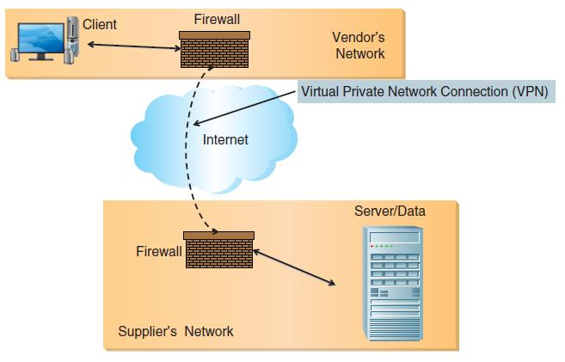
Extranet System Architecture

Slide 37
Question
Which of the following distinguishes an intranet from an extranet?
A) Users access their company's intranet using their Web browser.
B) In its simplest form, intranet communications do not travel across the Internet.
C) An intranet looks and acts just like a publicly accessible Web site.
D) An intranet uses the same networking technologies as a publicly accessible Web site.
E) An intranet uses the same hardware as a publicly accessible Web site.

Slide 38
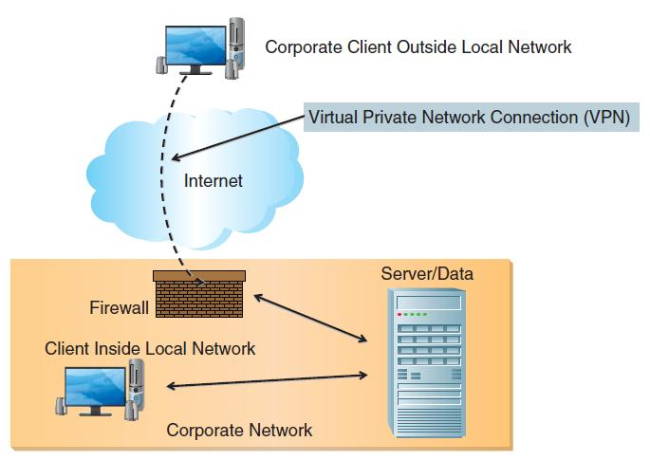
Intranet System Architecture

Slide 39
Question
Intranets mostly affect the ________ of an organization.
A) suppliers
B) employees
C) customers
D) advertisers
E) retailers

Slide 40
Business-to-Employee Electronic Commerce
Business-to-employee (B2E) electronic commerce
Internet based private network using Web technologies
Boeing
Intranet serves more than 200,000 employees.
More than 1 million pages
Intranet—Used to facilitate secured transmission of proprietary information within companies.
Intranets offer similar benefits as extranets.

Slide 41
Intranet Applications
Training
Boeing’s Quality eTraining program
Personalized Intranet Pages
Employee see only content that pertains to his or her job.
Real-Time Access to Information
Less complicated to manage, update, distribute, and access corporate information
Improve employee productivity
Online Entry of Information
Paper-base human resourced form:$20–$30
Web-based human resourced form:$2–$4
Collaboration
Timely communication of business activities

Slide 42
Question
The term ________ refers to a class of software that enables people to work together more effectively.
A) freeware
B) malware
C) pestware
D) groupware
E) webware

Slide 43
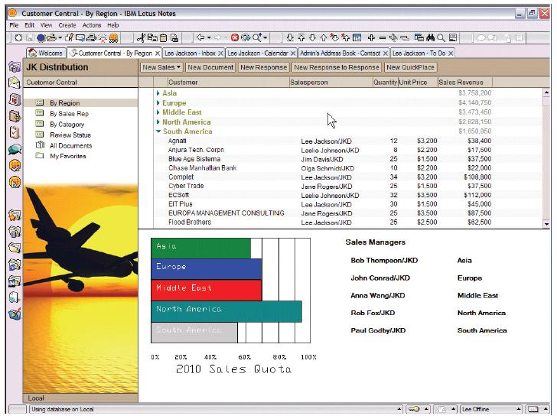
Lotus Notes – now known as IBM Notes – as of 11/2012
Award-winning groupware application
Millions of users worldwide

Slide 44
Collaboration Using Videoconferencing
Desktop videoconferencing
PC, Web-cam, high-speed Internet
Videoconferencing software
Skype, Windows Live Messenger, Go To Meeting
Dedicated videoconferencing
Within conference rooms
Highly realistic
Expensive
Many benefits:
Saves $$$ on business travel and office space
Saves time
Has immediacy, meetings can be set up on the fly

Slide 45
Business-to-Consumer E-Commerce and Internet Marketing
Electronic Commerce Defined
Describe electronic commerce, how it has evolved, and the strategies that companies are adopting to compete in cyberspace.
Business-to-Consumer E-Commerce and Internet Marketing
Describe the stages of business-to-consumer electronic commerce, understand the keys to successful electronic commerce applications, and explain the different forms of Internet marketing.
Mobile Commerce, Consumer-to-Consumer EC, and Consumer-to-Business EC
Describe mobile commerce, consumer-to-consumer electronic commerce, and consumer-to-business electronic commerce.
E-Government
Explain different forms of electronic government.
Managing Finances and Navigating Legal Issues in EC
Describe how to conduct financial transactions and navigate the legal issues of electronic commerce.

Slide 46
Use of Internet Technologies
Characteristics of the Internet, intranet, and extranet
B2B and B2E rely on extranet and intranet.
Internet provides an opportunity for B2C commerce.

Slide 47
Question
Which of the following provides customers with the ability to obtain personalized information by querying corporate databases and other information sources?
A) e-filing
B) e-tailing
C) e-information
D) e-integration
E) e-transaction

Slide 48
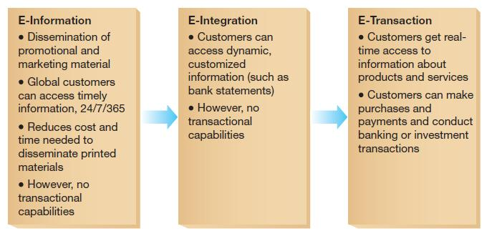
Stages of B2C E-Commerce
Web sites range from passive to active.

Slide 49
Question
Which of the following occurs in a reverse pricing system?
A) Customers are provided with the product and its price.
B) Customers are provided with a product and can decide how much they are willing to pay for it.
C) Customers specify the product they are looking for and how much they are willing to pay for it.
D) Customers cannot decide the product but they can decide the price of the products available.
E) Customers specify the product they are looking for and the company provides the product with a price.

Slide 50
E-Tailing
Selling goods and services online
Click-and-mortar
Walmart.com
Click only
Amazon.com
Virtual company
Priceline.com
Reverse pricing vs. menu-driven pricing

Slide 51
E-Tailing Benefits
Product benefits
Unlimited number and variety of products
Easier comparison shopping
Examples: AllBookstores, BizRate, or SideStep
Place benefits
Anywhere, anytime
Purchasing on global scale
Price benefits
Higher inventory turnover rate
No expenditures for physical retail space

Slide 52
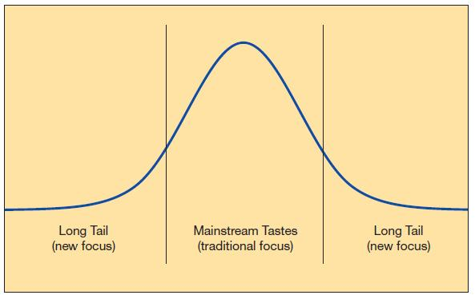
The Long Tail
Traditional stores
Focus on mainstream needs
Target the average customer
Example: Barnes & Noble
E-Tailers
Can focus on niche markets
Example: Netflix

Slide 53
E-Tailing Drawbacks
Product delivery drawbacks
Delay between product order and delivery
Except for products that can be downloaded
Direct product experience drawbacks
Lack of sensory information
Smell, taste, feel
Lack of the social element
Cannot replace going to the mall with friends

Slide 54
Attracting and Retaining Online Customers
Basic rule of commerce
Offer valuable products/services at fair prices
Additional e-commerce rules
The Web site should offer something unique.
The Web site must be aesthetically pleasing.
The Web site must be easy to use and fast.
The Web site must motivate people to visit, stay, and return.
You must advertise your presence on the Web.
You should learn from your Web site.

Slide 55
Mobile Commerce, Consumer-to-Consumer EC, and Consumer-to-Business EC
Electronic Commerce Defined
Describe electronic commerce, how it has evolved, and the strategies that companies are adopting to compete in cyberspace.
Business-to-Consumer E-Commerce and Internet Marketing
Describe the stages of business-to-consumer electronic commerce, understand the keys to successful electronic commerce applications, and explain the different forms of Internet marketing.
Mobile Commerce, Consumer-to-Consumer EC, and Consumer-to-Business EC
Describe mobile commerce, consumer-to-consumer electronic commerce, and consumer-to-business electronic commerce.
E-Government
Explain different forms of electronic government.
Managing Finances and Navigating Legal Issues in EC
Describe how to conduct financial transactions and navigate the legal issues of electronic commerce.

Slide 56
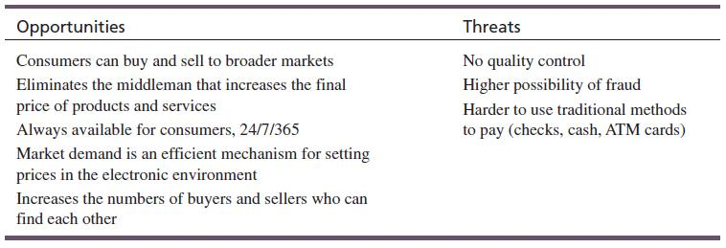
C2C E-Commerce
C2C commerce has always been present.
Bartering, auctions, tendering
Seventeen percent of American adults have sold online.

Slide 57
Question
________ is a form of e-auction where buyers post a request for quote.
A) A forward auction
B) A reverse auction
C) An exchange
D) Bartering
E) A request for proposal

Slide 58
E-Auctions
Forward auction
Sellers post goods or services for sale.
Buyers bid on these items.
Highest bid wins.
Reverse auction
Buyers post a request for quote (RFQ).
Seller proposes a bid.
Lowest seller bid wins.
This is frequently in B2B e-commerce.

Slide 59
E-Auction Fraud
E-auctions marred with more fraud than any other Internet activity.
E-auctions represent 45 percent of all Internet fraud-related complaints.
Average loss: $724
Types of e-Auction fraud:
Bid luring: luring bidders from a legitimate auction to another place at a lower price
Reproductions: counterfeits
Bid shielding: bidding on your own items to inflate the price
Shipping fraud: jacking up shipping prices
Payment failure: Buyer doesn’t pay
No shipment: Seller doesn’t ship after payment is made
Notes:
You can say “a friend of mine” even if it really happened to you!
Bid luring – Luring bidders from a legitimate auction to buy the same item at a lower price
Reproductions – Not an “original” as advertised
Bid shielding – Bidding on your own items to inflate the price
Shipping fraud – Jacking up shipping/handling fees
Payment failure – Buyer doesn’t pay
Nonshipment – Seller doesn’t ship

Slide 60
Types of Internet Marketing
Search Marketing
For Google or other search engines; search optimization
Display Ads
Static and interactive banners; videos
E-mail Marketing
Replacing direct mail; low cost
Social Media
Facebook, Twitter
Mobile Marketing
Audi built a game for the iPhone
Pricing Models – e.g., pay-per-click

Slide 61
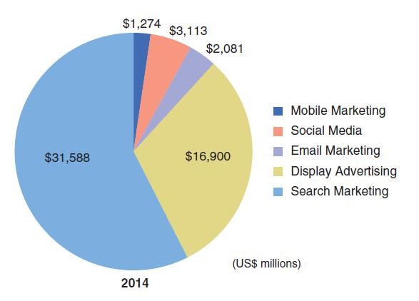
Search Marketing
Search marketing will continue to have the largest share of interactive marketing spend.
VanBoskirk (2009)

Slide 62
Mobile EC
Location-Based M-Commerce
Services can be offered tailored to a person’s needs based on their current location
Information on the Go
Customers can get further information about a product wherever they are, including in the store, but this can lead to “showrooming”
Product and Content Sales
Consumers use mobile apps to make purchases while on-the-go
Notes:
Mobile E-Commerce is an emerging field that is still finding it’s place.
The promise of Mobile E-Commerce includes location-based services.
Customers can also look up additional information in a store about it’s products, but this sometimes leads to comparison shopping with online retailers.
Finally, mobile apps now allow consumers to make purchases wherever they are.

Slide 63
Question
________ is an example of m-commerce.
A) e-tailing
B) e911
C) e-filing
D) e-integrating
E) e-auctions

Slide 64
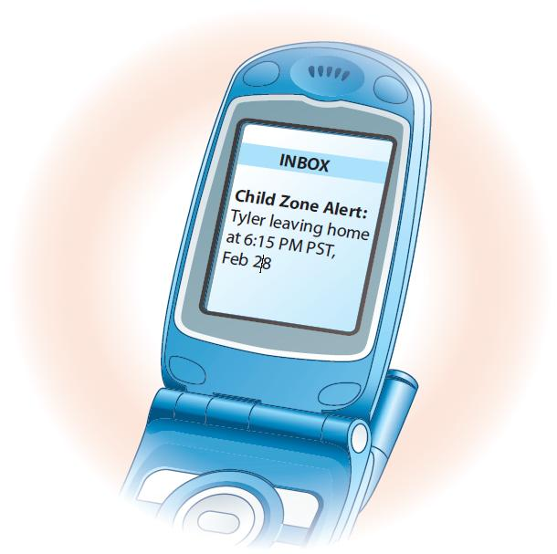
Location-Based M-Commerce
Highly personalized mobile services
Based on location
GPS functionality
Bluetooth
e911
Federal mandate
Correct routing of emergency calls
GPS specifies location within 50 meters
Phone locator
Location of family members’ cell phones
Alerting system when child leaves a certain area

Slide 65
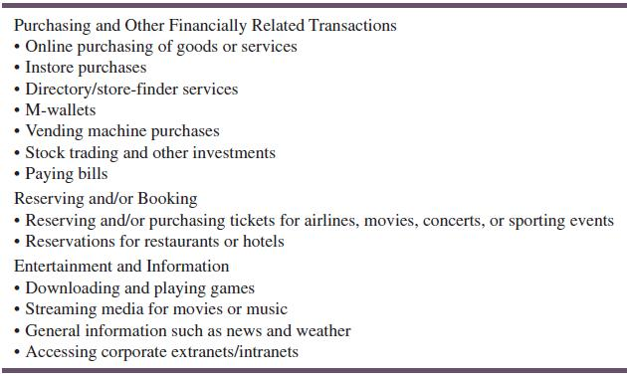
M-Commerce Applications

Slide 66
Location-Based Services
Next big thing: cell phone social networking

Slide 67
Managing Finances and Navigating Legal Issues in EC
Electronic Commerce Defined
Describe electronic commerce, how it has evolved, and the strategies that companies are adopting to compete in cyberspace.
Business-to-Consumer E-Commerce and Internet Marketing
Describe the stages of business-to-consumer electronic commerce, understand the keys to successful electronic commerce applications, and explain the different forms of Internet marketing.
Mobile Commerce, Consumer-to-Consumer EC, and Consumer-to-Business EC
Describe mobile commerce, consumer-to-consumer electronic commerce, and consumer-to-business electronic commerce.
E-Government
Explain different forms of electronic government.
Managing Finances and Navigating Legal Issues in EC
Describe how to conduct financial transactions and navigate the legal issues of electronic commerce.

Slide 68
E-Banking
Online Banking
Convenience
Security Concerns
Mobile banking
Online Investing
Increased access to financial information and analytical tools
Online investing
Mobile investing
Notes:
Online banking has become widely accepted, although many people are still worried about the security aspect.
An emerging trend is mobile banking apps allowing anytime, anywhere banking.
Online investing has also taken off, with a variety of sites offering financial information, investment advice, and online brokerage accounts.

Slide 69
Payment Services
Payment service keeps information secure.
PayPal (owned by eBay)
Can send and receive money if you have an e-mail account
Starbucks payments via phone via Square Wallet
Google Wallet – a mobile payment system – 5/2011
Stored customers’ debit/credit cards, gift cards, redemption coupons
Works with 300K+ MasterCard and Visa Merchants
Users can see if merchants offer this option
Available only in the US

Slide 70
Securing Payments in the Digital World
Credit and Debit Cards
Credit Cards are a simple mechanism
Consumers have to transfer a lot of personal information to the seller
Managing Risk
Businesses are financially liable for fraudulent transactions
Businesses have to look for fraud indicators and sometimes reject risky transactions
Notes:
Online payments are readily made using credit cards, which offer consumers some protection against fraud by the seller, who typically still requires a significant amount of personal information to complete the sale.
At the same time, the merchant is at significant risk of fraud from buyers, and unlike “card-present” sales in traditional stores, when a sale is made online the merchant is financially liable if the sale is fraudulent.
Merchants now employ additional safeguards to flag and reject sales that have warning signs indicating they may not be legitimate.

Slide 71
Legal Issues in EC—Taxation
The Internet Tax Freedom Act (1998)
Internet Tax Nondiscrimination Act (2004)
Internet sales treated as mail-order sales
No sales taxes paid in states where the company has no presence
Arguments for and against Ecommerce Taxation:

Slide 72
Legal Issues in EC—Digital Rights Management
Technological solution that allows publishers to control their digital media
Entertainment industry: DRM allows copyright holders to minimize sales losses by preventing unauthorized duplication.
Critics: publishers are arbitrary on how they enforce DRM, and infringe on existing consumer rights.
Digital watermark: an electronic version of physical watermarks placed on paper currency to prevent counterfeiting.

Slide 73
E-Government
Electronic Commerce Defined
Describe electronic commerce, how it has evolved, and the strategies that companies are adopting to compete in cyberspace.
Business-to-Consumer E-Commerce and Internet Marketing
Describe the stages of business-to-consumer electronic commerce, understand the keys to successful electronic commerce applications, and explain the different forms of Internet marketing.
Mobile Commerce, Consumer-to-Consumer EC, and Consumer-to-Business EC
Describe mobile commerce, consumer-to-consumer electronic commerce, and consumer-to-business electronic commerce.
E-Government
Explain different forms of electronic government.
Managing Finances and Navigating Legal Issues in EC
Describe how to conduct financial transactions and navigate the legal issues of electronic commerce.

Slide 74
Question
E-filing is an example of a ________ tool.
A) government-to-citizen
B) business-to-business
C) consumer-to-consumer
D) consumer-to-business
E) government-to-government

Slide 75
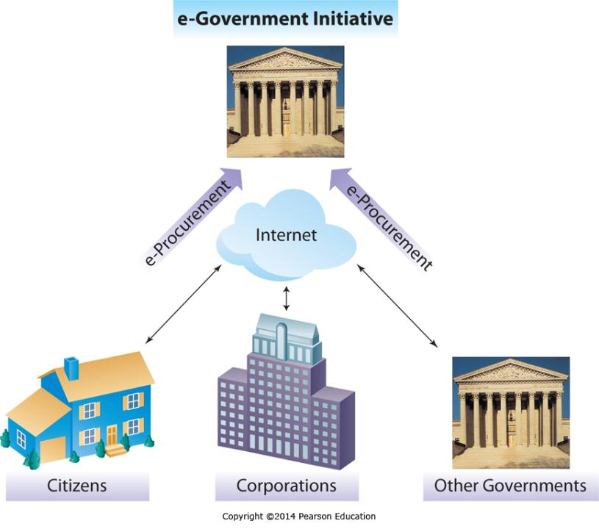
E-Government
Government-to-Citizens
Government-to-Business
Government-to-Government
Notes:
Governments use e-Government to increase efficiency and effectiveness much like businesses do.
By reducing paperwork and allowing for the electronic dissemination of information and the automated processing of transactions, governments can significantly reduce operating costs while increasing services.
Examples of this might include the electronic filing of income tax returns, the online filing of business license applications, or the ability to share data electronically between different law enforcement agencies.

