Slide 1
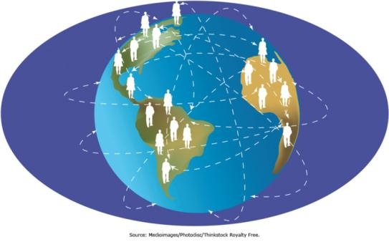
Chapter 5 - Enhancing Organizational Communication and Collaboration Using Social Media
Social media provides new opportunities, and threats, for today’s organizations

Slide 2
Facebook
How many of you are Facebook customers?

Slide 3
Chapter 5 Learning Objectives
The Need for Communication and Collaboration
Explain organizations’ needs for communication and collaboration.
The Evolving Web
Explain social media and Enterprise 2.0.
Traditional Collaboration Tools
Describe traditional technologies used to support communication and collaboration.
Managing the Enterprise 2.0 Strategy
Describe how companies can manage their Enterprise 2.0 strategy and deal with potential pitfalls associated with social media.
Social Media and the Enterprise
Describe various social media applications, and explain their role in enhancing communication, collaboration, cooperation, and connection.

Slide 4
The Need for Communication and Collaboration
The Need for Communication and Collaboration
Explain organizations’ needs for communication and collaboration.
The Evolving Web
Explain social media and Enterprise 2.0.
Traditional Collaboration Tools
Describe traditional technologies used to support communication and collaboration.
Managing the Enterprise 2.0 Strategy
Describe how companies can manage their Enterprise 2.0 strategy and deal with potential pitfalls associated with social media.
Social Media and the Enterprise
Describe various social media applications, and explain their role in enhancing communication, collaboration, cooperation, and connection.

Slide 5
Virtual Teams
Who has ever worked on a virtual team?
Why was a virtual team needed?
What tools did you use while working on these team?
What were the pros/cons?

Slide 6
The Evolving Web
The Need for Communication and Collaboration
Explain organizations’ needs for communication and collaboration.
The Evolving Web
Explain social media and Enterprise 2.0.
Traditional Collaboration Tools
Describe traditional technologies used to support communication and collaboration.
Managing the Enterprise 2.0 Strategy
Describe how companies can manage their Enterprise 2.0 strategy and deal with potential pitfalls associated with social media.
Social Media and the Enterprise
Describe various social media applications, and explain their role in enhancing communication, collaboration, cooperation, and connection.

Slide 7
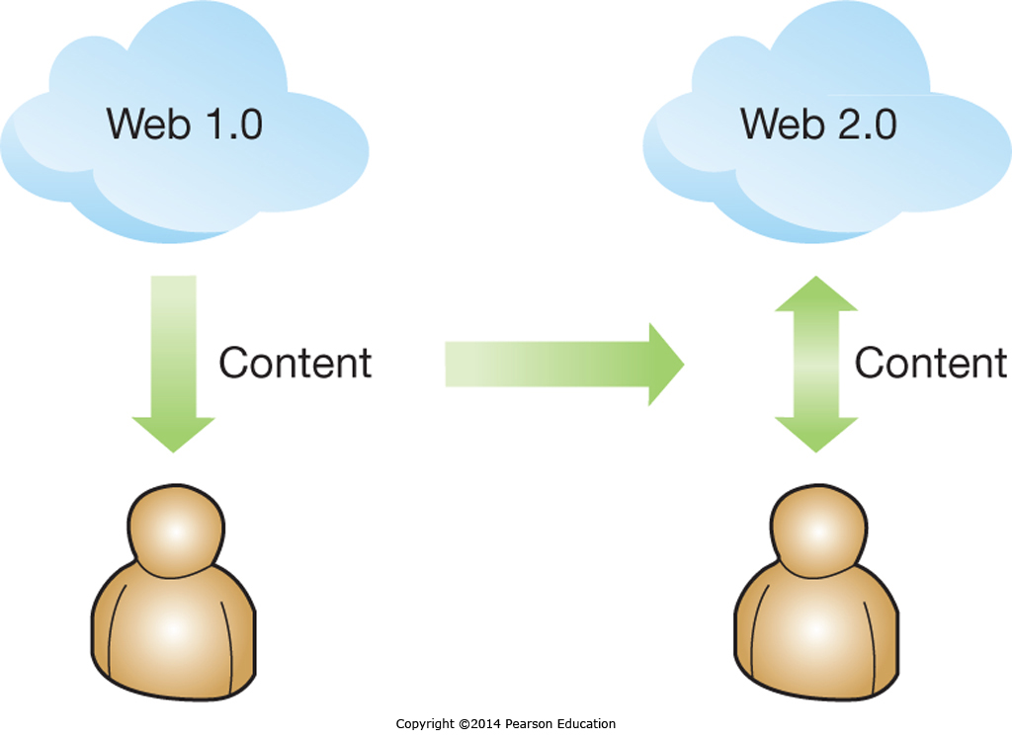
Evolving Capabilities

Slide 8
Evolving Social Interaction
Web 2.0 Technologies change how people interact and enable Social Media
Online information at our fingertips
Personal expression available 24/7
Individuals often post very private information
About themselves
About others
Without thinking about the consequences

Slide 9
Evolving Collaboration through Collective Intelligence: Shifting Perspectives
Web 1.0 | Web 2.0
Me | Me and you
Read | Read and write
Connect ideas | Connect ideas and people
Search | Receive and give recommendations to friends and others
Find | Share
Techies rule | Users rule
Organizations | Individuals

Slide 10
The Evolving Workspace
A generation of social media users
Different workplace expectations
Portfolio careers, not cradle-to-grave
State-of-the-art technology valued
55% use Instant Messaging as a work tool

Slide 11
Future Web Capabilities
The Semantic Web
Machine readable Web pages
Enhanced search results
Web 3.0, or ‘What comes next?’
Mobility?
The contextual Web?
Enterprise 2.0
Leverage social media for Enterprise objectives

Slide 12
Traditional Collaboration Tools
The Need for Communication and Collaboration
Explain organizations’ needs for communication and collaboration.
The Evolving Web
Explain social media and Enterprise 2.0.
Traditional Collaboration Tools
Describe traditional technologies used to support communication and collaboration.
Managing the Enterprise 2.0 Strategy
Describe how companies can manage their Enterprise 2.0 strategy and deal with potential pitfalls associated with social media.
Social Media and the Enterprise
Describe various social media applications, and explain their role in enhancing communication, collaboration, cooperation, and connection.

Slide 13
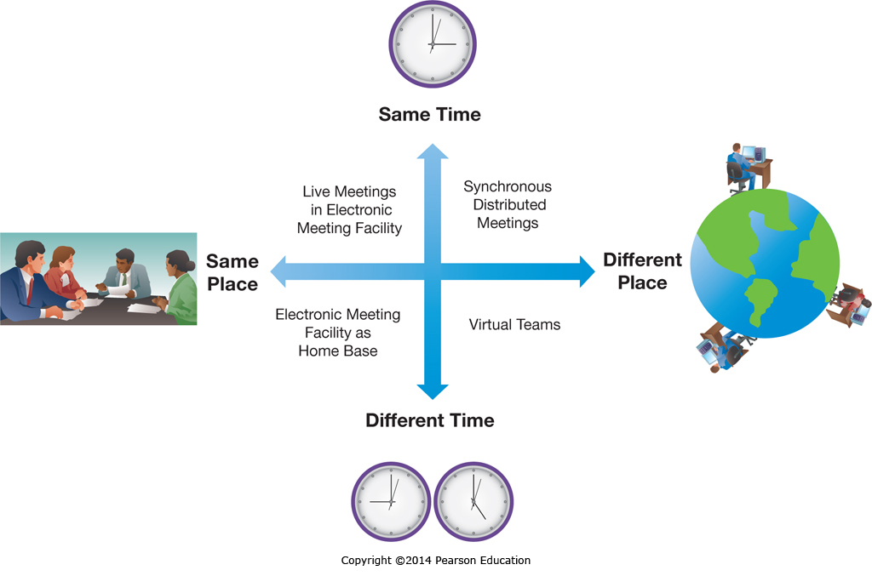
Groupware

Slide 14
Groupware: Benefits
Benefit | Example
Process structuring | Keeps the group on track and helps it avoid costly diversions
Parallelism | Enables many people to speak and listen at the same time
Group size | Enables larger groups to participate
Group memory | Automatically records member ideas, comments, and votes
Access to external information | Can easily incorporate external electronic data and files
Spanning time and space | Enables members to collaborate from different places at different times
Anonymity | Members can discuss controversial or sensitive topics without fear of identification or retribution

Slide 15
Videoconferencing
Desktop Videoconferencing
Simple & low cost
Internet based
Dedicated Videoconferencing
Organizational conference rooms
Multiple people and/or locations
Highly realistic/excellent video and audio quality
Can be extremely expensive, up to $500k

Slide 16
Intranets and Employee Portals
Real-Time Access to Information
Updated information instantly available throughout the organization
Enterprise Search
Company focused, including corporate databases
Collaboration
Document sharing and co-editing
Employee Portals
Employee benefits self-service

Slide 17
Social Media and the Enterprise
The Need for Communication and Collaboration
Explain organizations’ needs for communication and collaboration.
The Evolving Web
Explain social media and Enterprise 2.0.
Traditional Collaboration Tools
Describe traditional technologies used to support communication and collaboration.
Managing the Enterprise 2.0 Strategy
Describe how companies can manage their Enterprise 2.0 strategy and deal with potential pitfalls associated with social media.
Social Media and the Enterprise
Describe various social media applications, and explain their role in enhancing communication, collaboration, cooperation, and connection.

Slide 18
Blogs
Who has a blog and what do you blog about?
Web 2.0…the creation vs. the consumption of content!

Slide 19
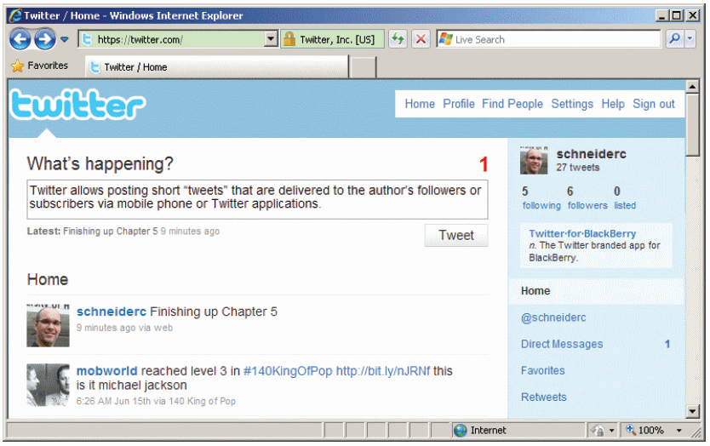
Social Presence
Who is a micro blogger and what does it do for you?

Slide 20
Instant Messaging
Has instant messaging been replaced by text messaging and microblogging?

Slide 21
Virtual Worlds
Who participates in a virtual world and how to companies make money from this?

Slide 22
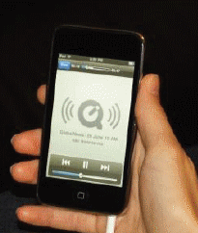
Media Sharing
How many different ways to individuals and organizations share media and how to commercial organizations make money from this?
Could you create a video, post it to YouTube and integrate it into your e-Portfolio?

Slide 23
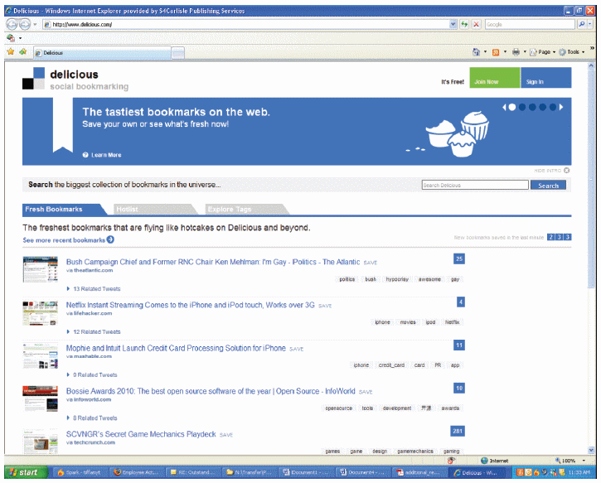
Social Bookmarking
What are your “favorites” and why would I care?

Slide 24
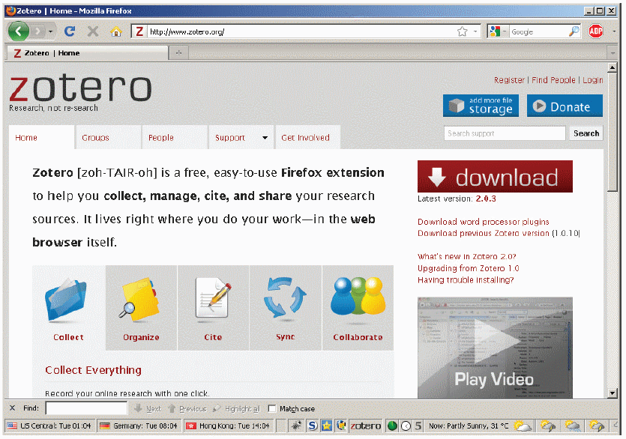
Social Cataloging
What is the value proposition of sites like zotero?

Slide 25
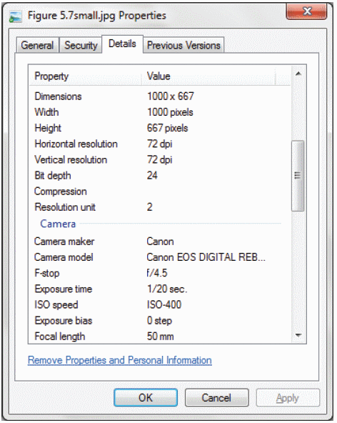
Tagging – Who, where, when, why,…
What do we mean when we say that metadata is data about data?
What is tagging and geotagging and how does this create value?
When you store media in the cloud, who owns the metadata and what can they do with it?

Slide 26
Tag Clouds
How do you interpret a tag cloud?
If Google generated a tag cloud from your e-Mail, what would it look like?
If Google wanted to see this data, who would be interested?

Slide 27
Tools for Collaboration
Collaboration tools help with many different communication needs, such as talking, sharing documents, or making decisions.

Slide 28
Google Apps
Why is using Google Apps better than just e-mailing documents around in your team?
Gmail
Google Calendar
Google Talk
Google Docs
Google Sites

Slide 29
Microsoft SharePoint
What is Microsoft SharePoint and why would anyone use SharePoint when Goggle Apps is free?

Slide 30
Wikis
What is a Wiki?
How many of you utilize Wikipedia for school assignments?
What are the pros/cons of using a tool like Wikipedia?

Slide 31
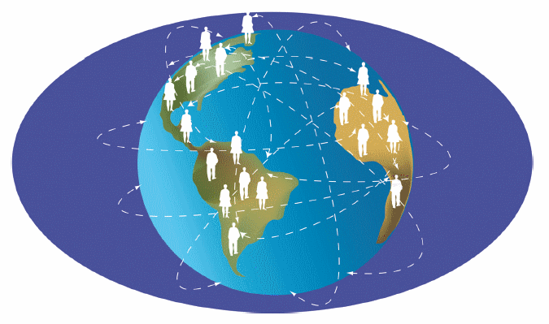
Human-Based Computing (Crowdsourcing)
What is “crowdsourcing” and has anyone ever worked on a project that utilized crowdsourcing?
What are the pros/cons?

Slide 32
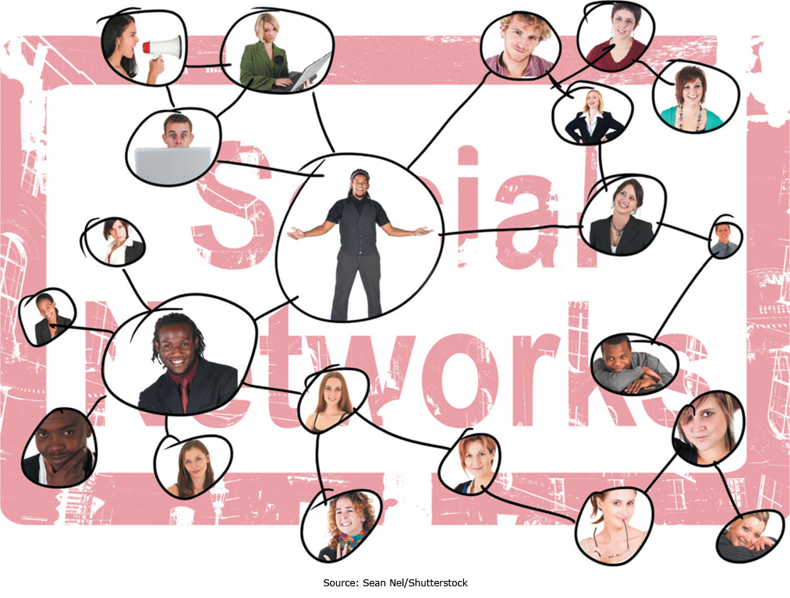
Enhancing Connection with Social Media

Slide 33
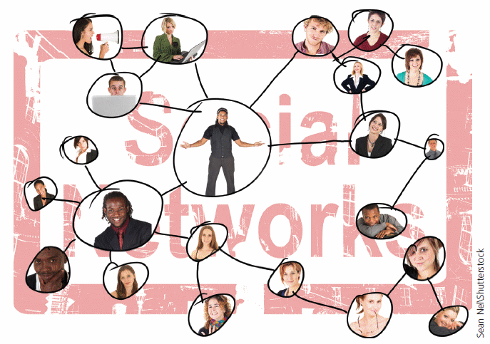
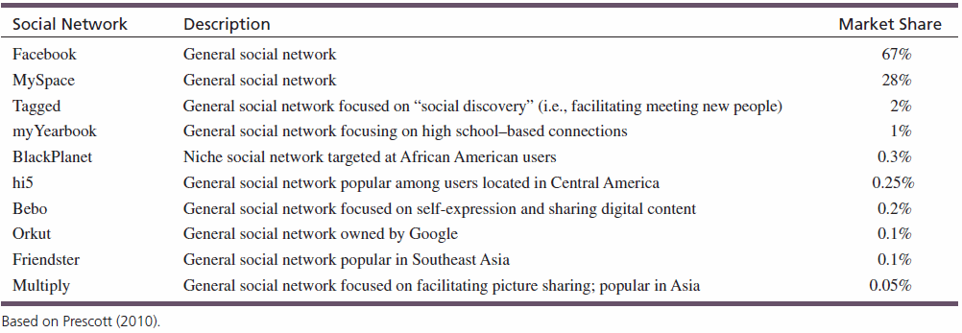
Social Networking Communities
Will Google+ get any traction or will the network effect of Facebook be too powerful to overcome?
Why did MySpace crash-n-burn?
What will displace Facebook and Why?

Slide 34
Viral Marketing
How would you use the Internet to drive a viral marketing campaign?
Remember to…
Do something unexpected.
Make people feel something.
Make sequels.
Allow sharing and easy distribution.
Never restrict access to the content.

Slide 35
Social Search
What are the pros/cons of including content from social networks, blogs, or microblogging services compared to the traditional techniques used by Google?

Slide 36
Managing the Enterprise 2.0 Strategy
The Need for Communication and Collaboration
Explain organizations’ needs for communication and collaboration.
The Evolving Web
Explain social media and Enterprise 2.0.
Traditional Collaboration Tools
Describe traditional technologies used to support communication and collaboration.
Managing the Enterprise 2.0 Strategy
Describe how companies can manage their Enterprise 2.0 strategy and deal with potential pitfalls associated with social media.
Social Media and the Enterprise
Describe various social media applications, and explain their role in enhancing communication, collaboration, cooperation, and connection.

Slide 37
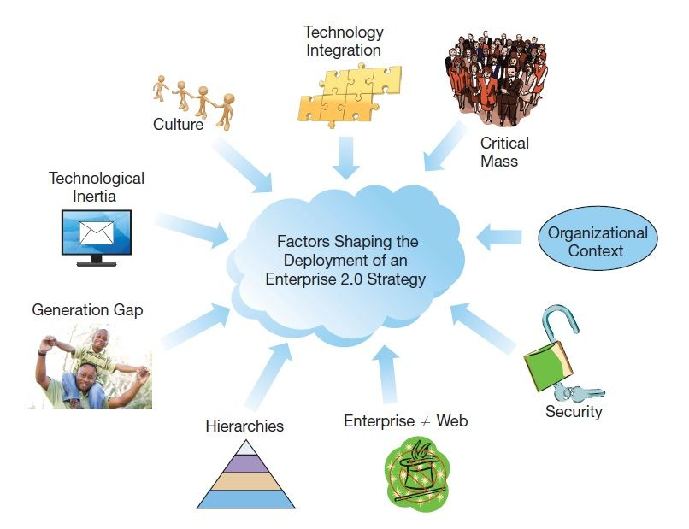
Organizational Issues

Slide 38
Pitfalls of Web 2.0 Marketing
Online Product Reviews
Negative reviews from competitors
Companies paying for positive reviews
Microblogging
Easy to “cross a line” and offend
Negative publicity can come quickly
Social Networks
Fine line between maintaining control and offending customers
Individuals sharing too much personal information

Slide 39
More Pitfalls of Web 2.0 Marketing
Bad Vibes going Viral
Negative publicity can spread like wildfire
Videos can easily go viral
Lessons Learned
News travels fast
Have a crisis team and a plan
Prepare for your worst social media nightmare
Monitor the environment
Respond within 24 hours

