Slide 1
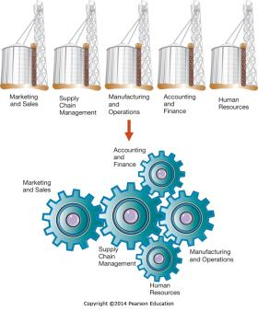
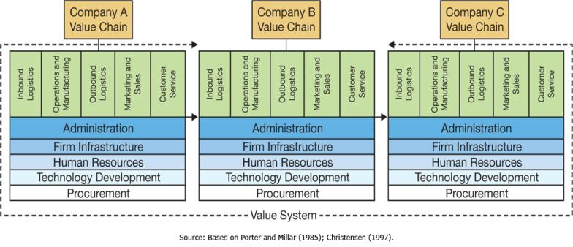
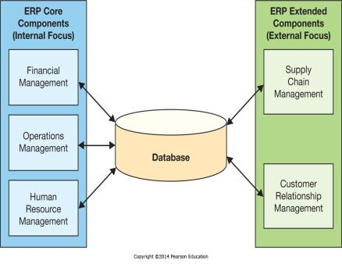
Chapter 7 - Enhancing Business Processes Using Enterprise Information Systems
Enterprise systems integrate business activities across the organization and with business partners

Slide 2
Chapter 7 Learning Objectives
Core Business Processes and Organizational Value Chains
Explain core business processes that are common in organizations.
Enterprise Systems
Describe what enterprise systems are and how they have evolved.
Enterprise Resource Planning
Describe enterprise resource planning systems and how they help to improve internal business processes.
The Formula for Enterprise System Success
Understand and utilize the keys to successfully implementing enterprise systems.

Slide 3
Core Business Processes and Organizational Value Chains
Core Business Processes and Organizational Value Chains
Explain core business processes that are common in organizations.
Enterprise Systems
Describe what enterprise systems are and how they have evolved.
Enterprise Resource Planning
Describe enterprise resource planning systems and how they help to improve internal business processes.
The Formula for Enterprise System Success
Understand and utilize the keys to successfully implementing enterprise systems.

Slide 4
Scenario
You work for a mid-sized manufacturer of supplies for white boards.
Working in groups of 3…each of you will take responsibility for:
  Inbound Logistics/Procurement
  Operations/Manufacturing
  Outbound logistics/Order Fulfillment
What information do you need to make your team efficient and effective?

Slide 5
Scenario (cont.)
What types of information needs to flow from one team to the next to make the organization efficient and effective?
How do we facilitate this flow of information from one system to the next?

Slide 6
Scenario (cont.)
What type of information flows between teams within your organization & what type of information flows between your organization and your business partners (suppliers & customers)?

Slide 7
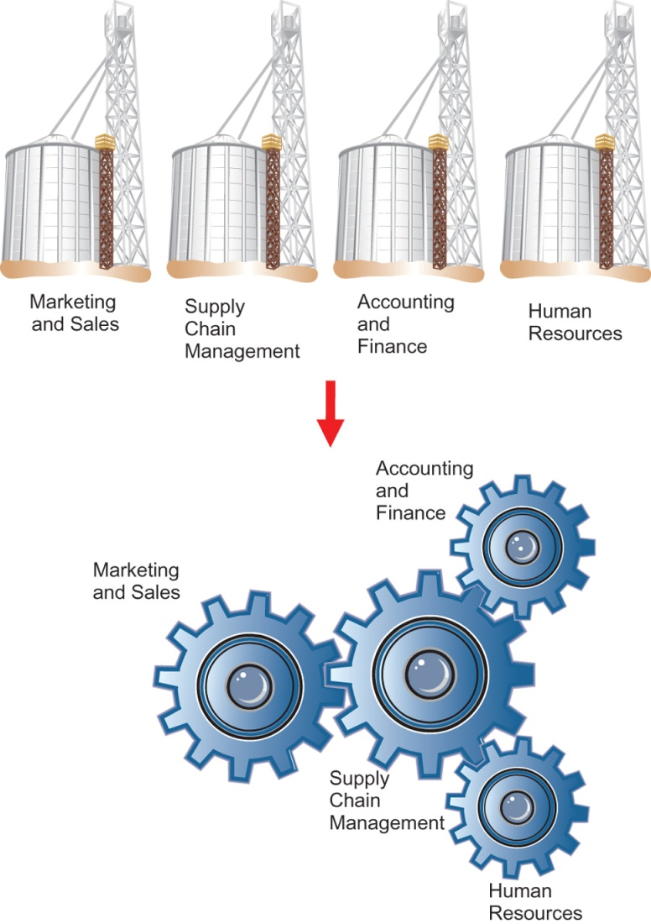
Core Business Processes
Traditional business functions:
  Marketing and sales
  Supply chain management
  Accounting and finance
  Human resources
Not distinct independent silos, but instead highly interrelated
Business processes cross boundaries of business functions.

Slide 8
Break the class up into 4 groups

Slide 9
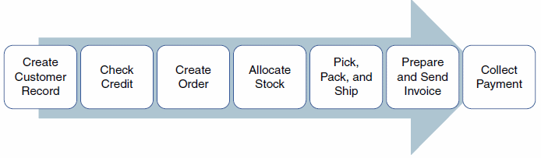
Order-to-Cash Process
The processes associated with selling a product or service

Slide 10
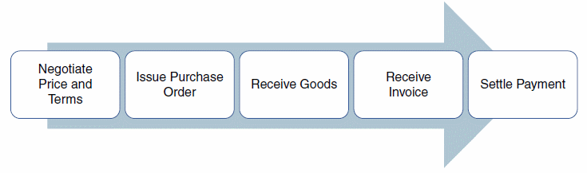
Procure-to-Pay Process
The processes associated with procuring goods from external vendors

Slide 11
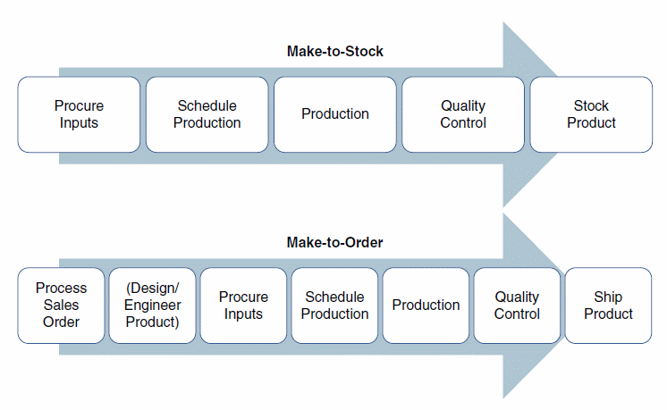
Make-to-Stock / Make-to-Order Process
The processes associated with producing goods
Who has worked at a place that used Make-to-Stock?
Who has worked at a place that used Make-to-Order?

Slide 12
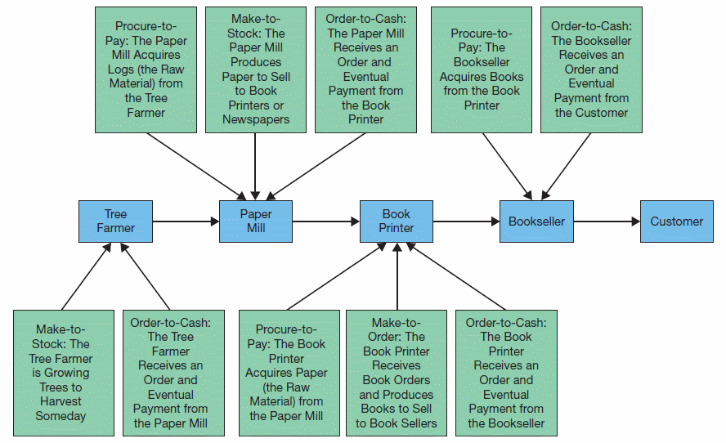
Supply Chain
Core business processes enable the creation of supply chains.
Resembles a river
  Start at source
  Move downstream

Slide 13
Value Chain
Value Chain—The set of business activities that add value to the end product.
Information flows through a set of business activities.
  Core activities—functional areas that process inputs and produce outputs.
  Support activities—enable core activities to take place.

Slide 14
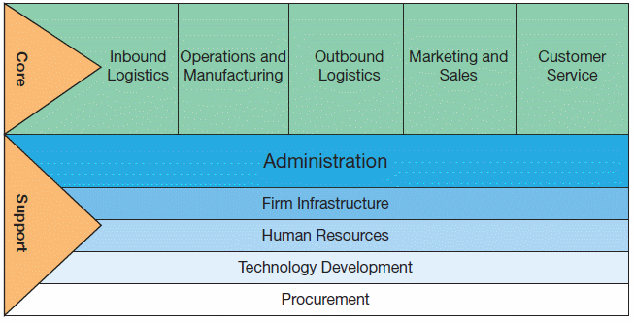
Value Chain Framework

Slide 15
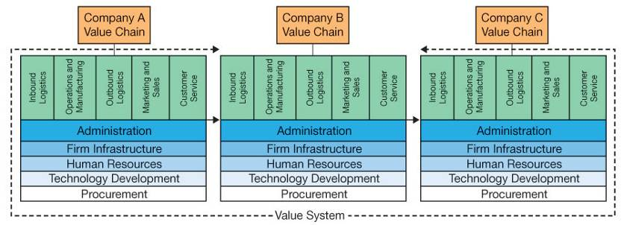
Externally Focused Applications—Value System
Coordination of organizational value chains
Information Flows in a Value System
  Upstream information flow—information received from another company
  Downstream information flow—information produced by a company and sent to another organization

Slide 16
Enterprise Systems
Core Business Processes and Organizational Value Chains
Explain core business processes that are common in organizations.
Enterprise Systems
Describe what enterprise systems are and how they have evolved.
Enterprise Resource Planning
Describe enterprise resource planning systems and how they help to improve internal business processes.
The Formula for Enterprise System Success
Understand and utilize the keys to successfully implementing enterprise systems.

Slide 17
The Rise of Enterprise Systems
Stand-alone applications
  Not designed to communicate with other system
  Variety of computing hardware platforms
  Enable departments to conduct daily business activities
  Not helpful for other areas in the firm
Proprietary systems
  From vendors
  Not designed to share with other vendors’ systems
  Problem of knitting together (hodgepodge portfolio of discordant proprietary applications)
  Lack of integration

Slide 18
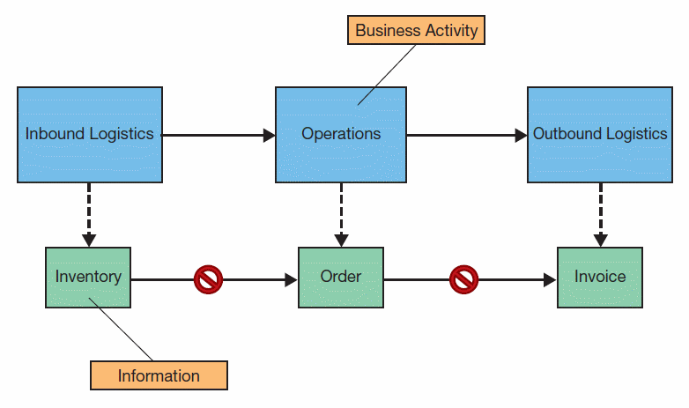
Legacy Systems
Each department has its own system.
  Infrastructure specific
  Inefficient processes
  Potential for inaccuracies
  Too many “rocks in the river”

Slide 19
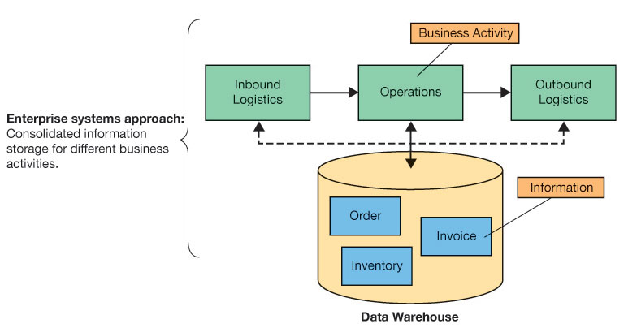
Enterprise System Approach
Integrated suite of business applications for virtually every department, process, and industry

Slide 20
ERP Challenges
What are some of the challenges with implementing an ERP?
Why would a company want to do this?
Who might resist? Why?

Slide 23
Enterprise Resource Planning
Who are the largest and most influential ERP vendors?

Slide 24
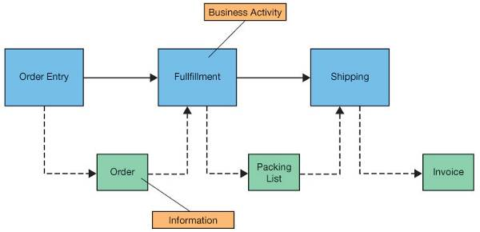
Supporting Business Processes
Internally focused systems

Slide 25
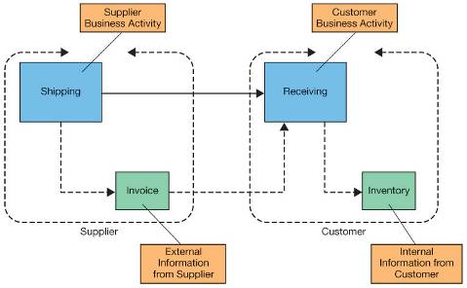
Supporting Business Processes
Externally focused systems (interorganizational systems)

Slide 26
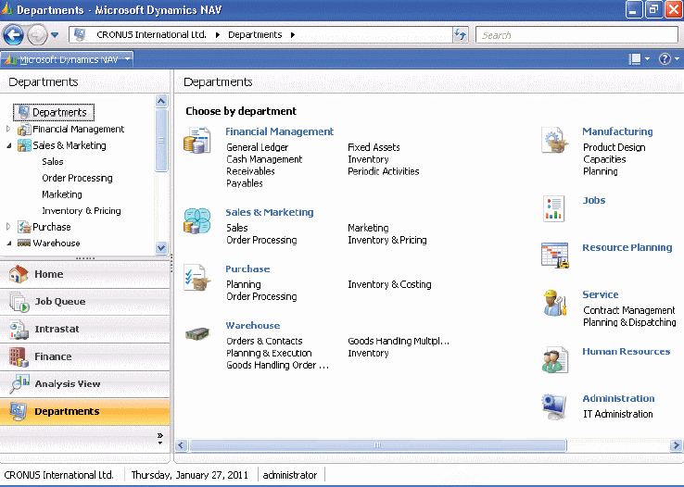
Modules of Enterprise Systems
Each module in an enterprise system replaces a stand-alone legacy system.

Slide 27
Vanilla Versus Customized Software
Vanilla version
  This version contains features and modules that an enterprise system comes with out of the box.
  Certain processes might not be supported.
Customization
  This version contains additional software or changes to vanilla version.
  It always needs to be updated with new versions of vanilla.

Slide 28
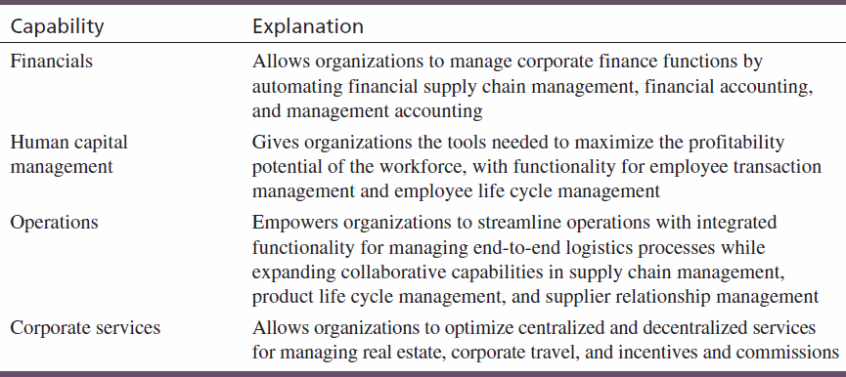
Capabilities of SAP’s ERP System

Slide 29
Best Practices-Based Software
Most ERP vendors build best practices into their ERP systems.
  Identify business processes in need of change
  Future updates are smoother if businesses change their business processes to fit with ERP systems.
Is following the best practices always the best strategy?
  If companies have competitive advantage from unique business processes, forcing best practices may actually hurt.

Slide 30
Enterprise Resource Planning
Core Business Processes and Organizational Value Chains
Explain core business processes that are common in organizations.
Enterprise Systems
Describe what enterprise systems are and how they have evolved.
Enterprise Resource Planning
Describe enterprise resource planning systems and how they help to improve internal business processes.
The Formula for Enterprise System Success
Understand and utilize the keys to successfully implementing enterprise systems.

Slide 31
Enterprise Resource Planning (ERP) Systems
Enterprise Resource Planning—Applications that integrate business activities across departmental boundaries.
ERP evolved during the 1990s from material/manufacturing requirements planning packages.
Emphasis has since shifted from “resources” and “planning” to “enterprise.”
Integrate legacy information on a company-wide basis

Slide 32
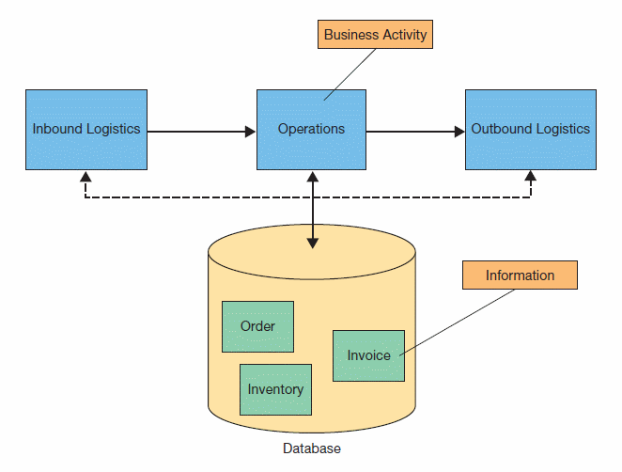
Integrating Data to Integrate Applications
Central information repository
  ERP replaces stand-alone applications
  Modules based on
    Common database
    Similar application interfaces

Slide 33
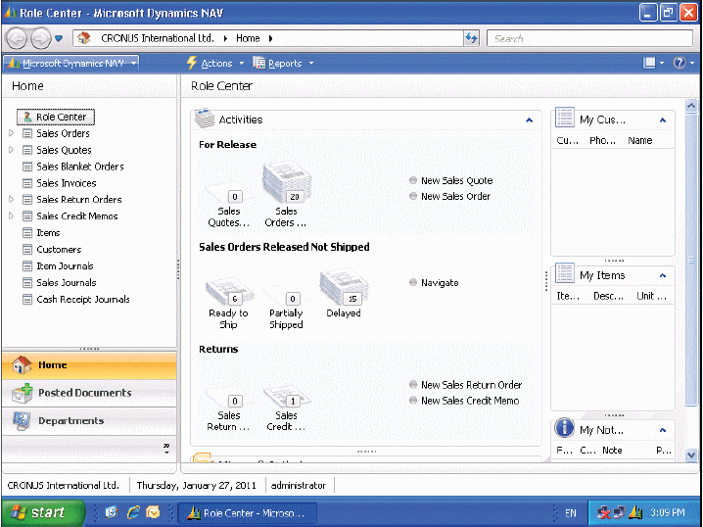
Example ERP Screen
An ERP system can provide employees with relevant, up-to-date information.

Slide 34
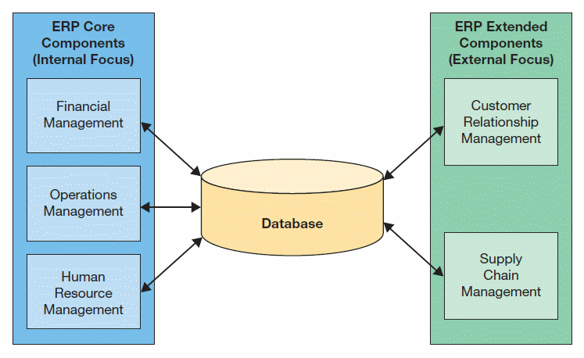
Core and Extended ERP Components
Core components—support primary internal activities.
Extended components—support primary external activities.

Slide 35
ERP Core Components
Financial Management
  accounting, financial reporting, performance management, corporate governance
Operations Management
  simplify, standardize, and automate business processes for inbound/outbound logistics, product development, manufacturing, sales and service
Human Resource Management
  employee recruitment, assignment tracking, performance reviews, payroll, regulatory requirements

Slide 36
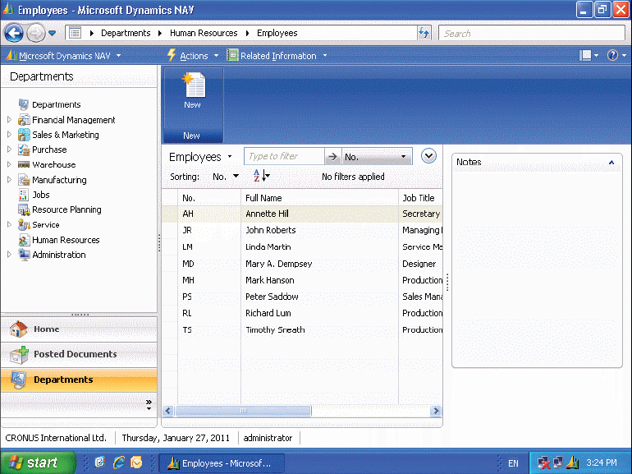
Human Resources Management

Slide 37
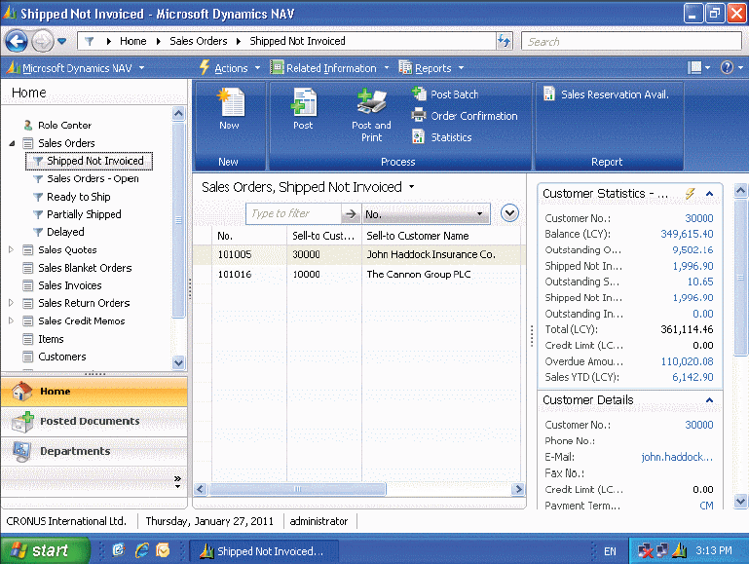
Order-to-Cash

Slide 38
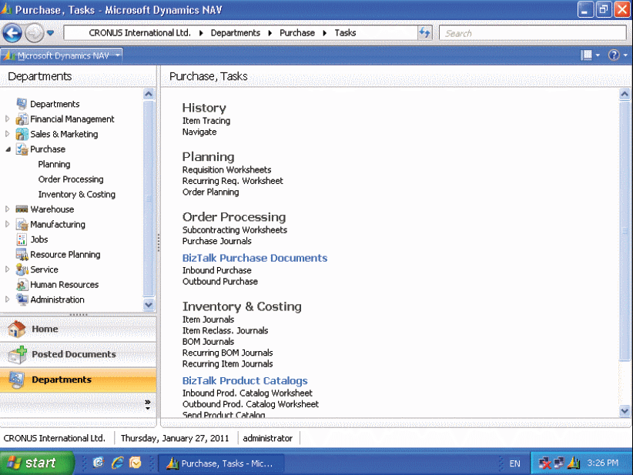
Procure-to-Pay

Slide 39
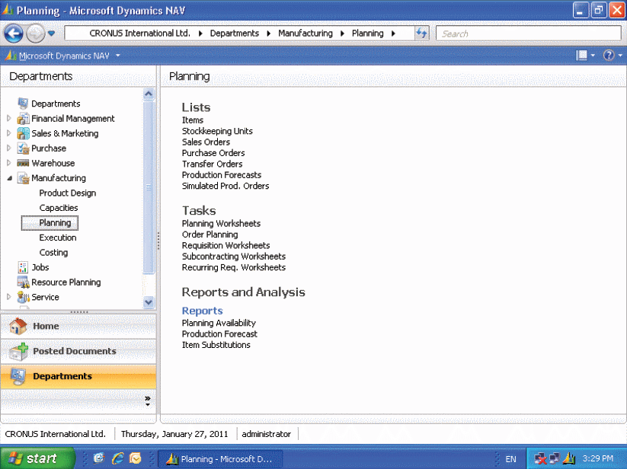
Production

Slide 40
ERP Installation
Configuration of the ERP systems is performed during any ERP implementation.
System must be configured to reflect business processes and associated business rules.
Organizations have to make countless decisions on how to configure thousands of database tables to fit the business’s needs.
Organizations hire experienced business analysts or outside consultants to assist with implementation.

Slide 41
ERP Limitations
ERP falls short in communicating across organizational boundaries.
They tend to be not well suited for managing value system activities.
Other systems can work with ERP to provide these capabilities.

Slide 42
The Formula for Enterprise System Success
Core Business Processes and Organizational Value Chains
Explain core business processes that are common in organizations.
Enterprise Systems
Describe what enterprise systems are and how they have evolved.
Enterprise Resource Planning
Describe enterprise resource planning systems and how they help to improve internal business processes.
The Formula for Enterprise System Success
Understand and utilize the keys to successfully implementing enterprise systems.

Slide 43
The Formula for Enterprise System Success
Secure executive sponsorship .
  Most failures are due to lack of top-level management support.
Get help from outside experts.
  Consultants are specifically trained.
  Implementation tends to happen faster.
Thoroughly train users.
  Training is the most overlooked, underestimated, and poorly budgeted expense.
  Training can prevent dissatisfaction.
Take a multidisciplinary approach to implementations.
  Include end users from all functional areas in the implementation.
Initiate evolving the ERP Architecture.

