Slide 1
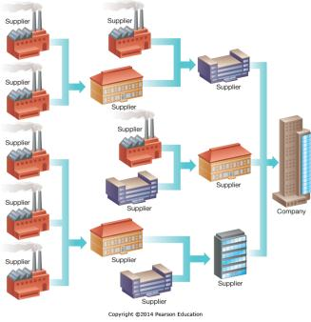
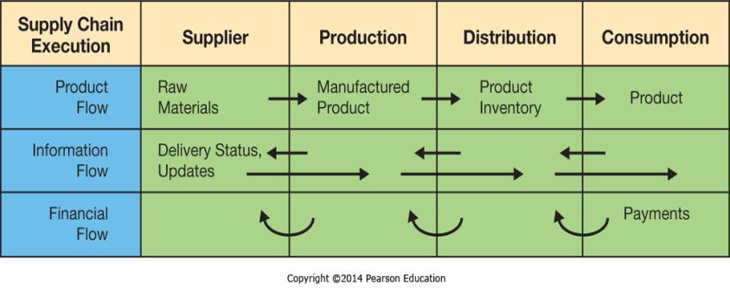
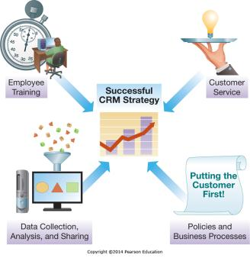
Chapter 8 - Strengthening Business-to-Business Relationships via Supply Chain and Customer Relationship Management
Supply chain management (SCM) systems supporting business-to-business (B2B) transactions, customer relationship management (CRM) systems promote sales and long-term customer relationships

Slide 2
Chapter 8 Learning Objectives
Supply Chain Management
Describe supply chain management systems and how they help to improve interorganizational business processes.
Customer Relationship Management
Describe customer relationship management systems and how they help to improve the activities involved in promoting and selling products to customers as well as providing customer service and nourishing long-term relationships.

Slide 3
Supply Chain Management
Supply Chain Management
Describe supply chain management systems and how they help to improve interorganizational business processes.
Customer Relationship Management
Describe customer relationship management systems and how they help to improve the activities involved in promoting and selling products to customers as well as providing customer service and nourishing long-term relationships.

Slide 4
Question
Who works for a company which manufactures some product?
What do you make?
What stuff do you need to make your product?
Where do you get this stuff?
What happens to you if they run out of this stuff?

Slide 5
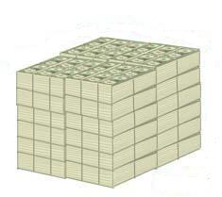
Your Warehouse?
Instead of picturing pallets of finished goods…
picture the capital that it took to produce your finished goods…
Think you could put that cash to better use?

Slide 6
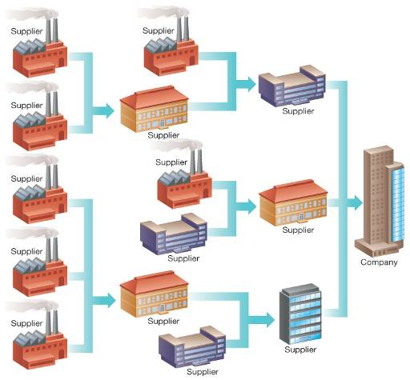
Supply Network

Slide 7
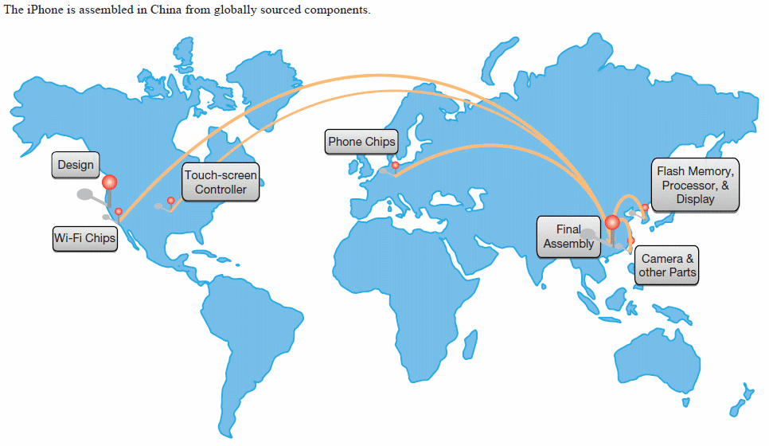
Supply Chain for Apple’s iPhone

Slide 8
Benefits and Problems with Supply Chains
Potential benefits (the well oiled machine!)
  Process innovations
  Just-In-time Production (JIT)
  Vendor-Managed Inventory (VMI)
Potential problems (with primitive supply chains)
  Distorted information
  Excessive inventories
  Inaccurate capacity plans
  Missed product schedules

Slide 9
Just-in-Time Production (JIT)
Keeping inventory is costly (storage, capital, missed production schedules).
JIT optimizes ordering quantities.
  Parts and raw materials arrive when needed for production.
  As orders arriver in smaller quantities, but at higher frequency) investment in storage space and inventory is minimized.
The approach was pioneered by Toyota.
It is used extensively by computer manufacturers to avoid component obsolescence (Moore’s law).
  Example: Dell keeps only two hours of inventory in stock
JIT requires tight cooperation between all partners in the supply network.

Slide 10
Vendor-Managed Inventory (VMI)
VMI is a business model in which suppliers manage the manufacturer’s (or retailer’s) inventory levels based on pre-established service levels.
Supplier monitor’s stock levels and sales data.
VMI requires manufacturer (retailer) to share real-time data.
Benefits
  Cost savings
  Minimized stock-out situations
  Accurate forecasts
  Reduced errors
  Prioritized goods shipments

Slide 11
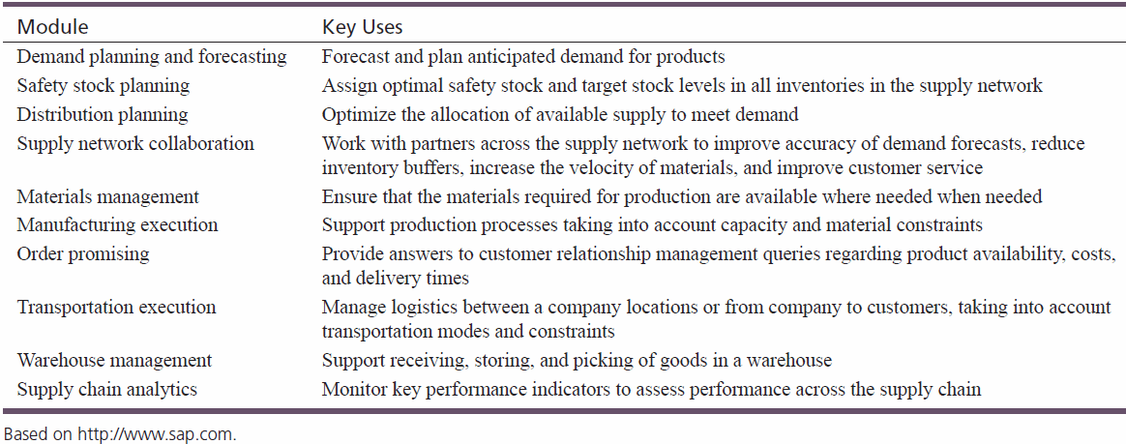
Functions That Optimize the Supply Network
Supply Chain Management (SCM) improves the coordination of suppliers, product or service production, and distribution.

Slide 12
Integrating SCM with ERP and CRM
ERP systems are primarily used to optimize business processes within the organization.
SCM is used to improve business processes that span organizational boundaries.
Tight ERP/CRM/SCM integration reaps great benefits.
SCM uses data about customer orders (from CRM) and payments (from ERP).

Slide 13
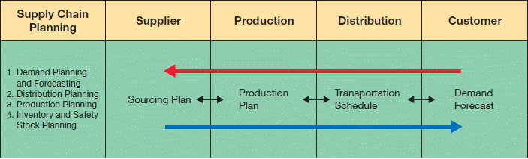
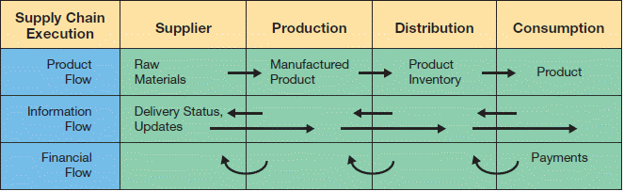
SCM Architecture
SCM modules support two functions.
  Supply chain planning—development of resource plans to support production.
  Supply chain execution—efficient flow of products, information, and financing.

Slide 14
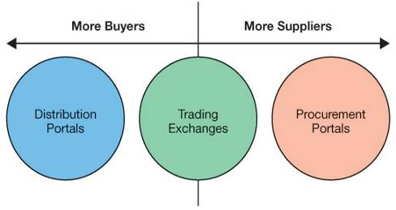
Tightly Integrated SCM vs. Portals
Dell with Many Customers
Elemica
Big 3 with Many Suppliers

Slide 15
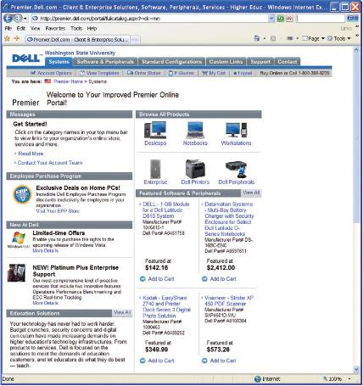
Example: Distribution Portal
What is a “distribution portal” and what types of businesses use them?

Slide 16
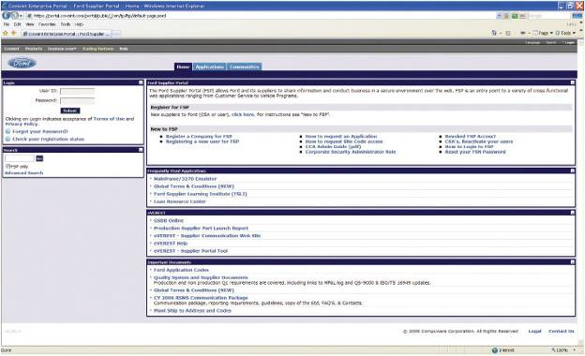
Example: Procurement Portal
What is a “procurement portal” and what types of businesses use them?

Slide 17
Supply Chain Visibility and Analytics
Supply chain visibility—the ability to track products as they move through the supply chain but also to foresee external events.
Supply chain analytics—the use of key performance indicators to monitor performance of the entire supply chain, including sourcing, planning, production, and distribution.

Slide 18
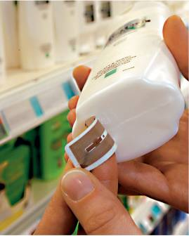
Radio Frequency Identification (RFID)
RFID tags will soon replace standard bar codes.
  RFID is the use of electromagnetic energy to transit energy between a reader (transceiver) and the tag (antenna).
  Line-of-sight reading is not necessary.
  RFID tags can contain more information than bar codes.
Tags are programmable, so there is a vast array of potential uses.
Scanning can be done from greater distance.
  Passive tags—inexpensive, range of few feet.
  Active tags—more expensive, range of hundreds of feet.
Source: METRO AG.

Slide 19
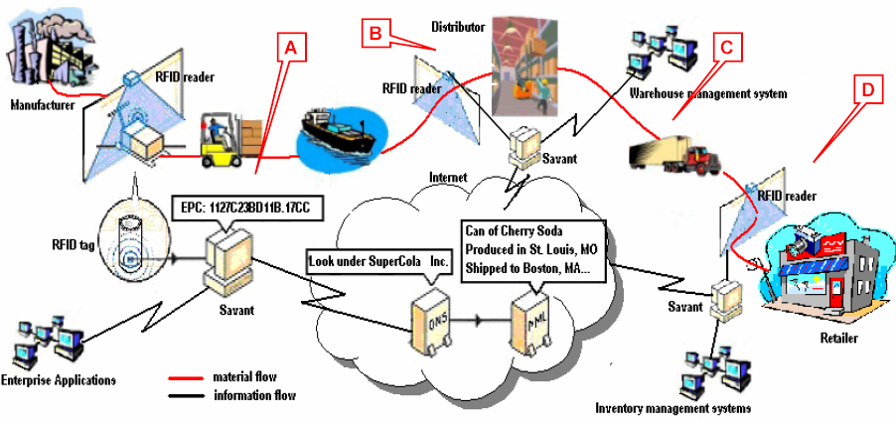
The Big Picture

Slide 20
Customer Relationship Management
Supply Chain Management
Describe supply chain management systems and how they help to improve interorganizational business processes.
Customer Relationship Management
Describe customer relationship management systems and how they help to improve the activities involved in promoting and selling products to customers as well as providing customer service and nourishing long-term relationships.

Slide 21
Question?
Forget about MIS and technology and computer systems…as a business professional, what do you think about when it comes to attracting and retaining the most profitable customers?
What information do you need to do these things?

Slide 22
Sales - “Art” or “Science”?
If you asked a good salesman, is sales an “art” or a “science”, what would they say?
If you asked a great salesman, is sales an “art” or a “science”, what would they say?
CRM adds the “science” to sales and makes good salesmen great!

Slide 23

Customer Relationship Management (CRM)

Slide 24
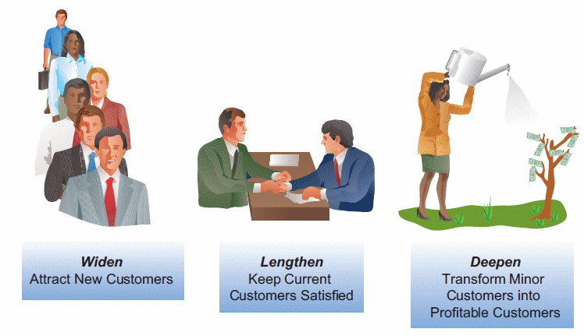
Customer Relationship Management(CRM) (cont’d)
Companies search for ways to widen, lengthen, and deepen customer relationships.

Slide 25
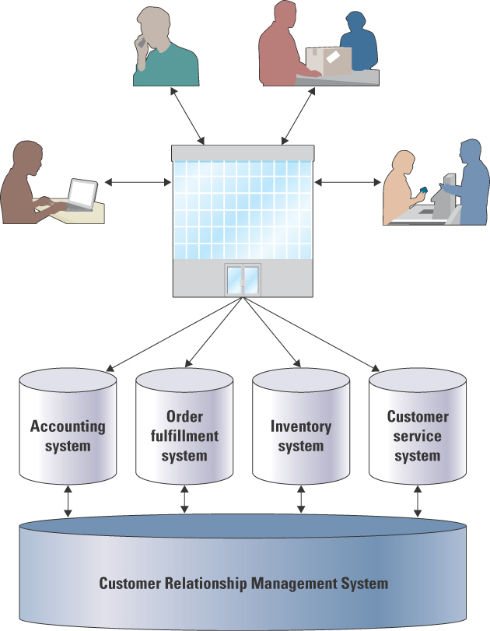
Customer Relationship Management
Like all enterprise systems, CRM spans many functional areas

Slide 26
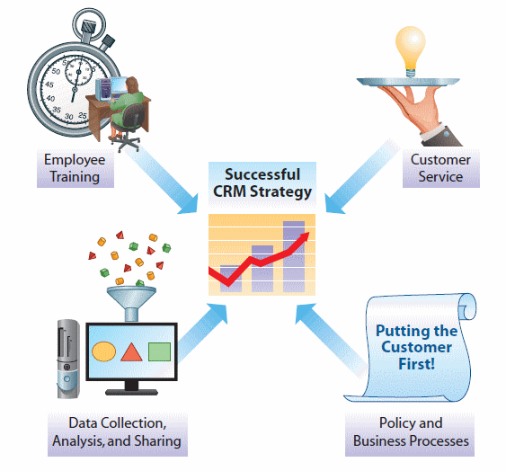
Developing a CRM Strategy
More than just software purchase and installation
Enterprise-wide changes

Slide 27
Policy and Business Process Changes
Policies and procedures need to reflect customer-focused culture.

Slide 28
Customer Service Changes
Key metrics need to reflect customer-focused measures of quality.
Companies that implement successful CRM strategy, experience greater customer satisfaction.

Slide 29
Employee Training Changes
Employees from all business areas must value customer service and satisfaction.

Slide 30
Data Collection, Analysis, and Sharing Changes
All aspects of customer experience must be tracked, analyzed, and shared.
Consider ethical concerns.

Slide 31
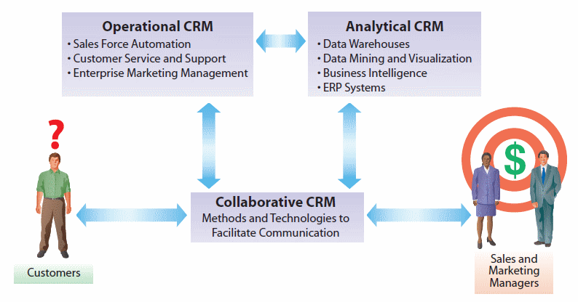
Architecture of a CRM Environment

Slide 32
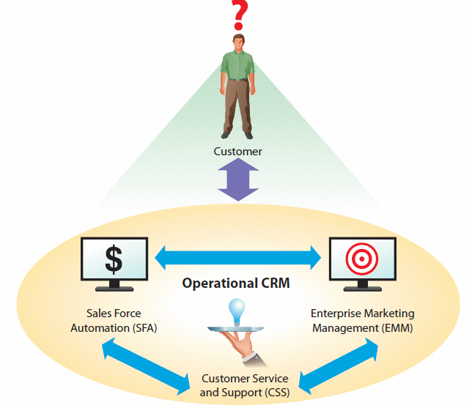
Operational CRM
Systems for customer interaction and service
  Enables direct interaction with customers
  Personalized and efficient customer service
  Access to complete information about customer

Slide 33
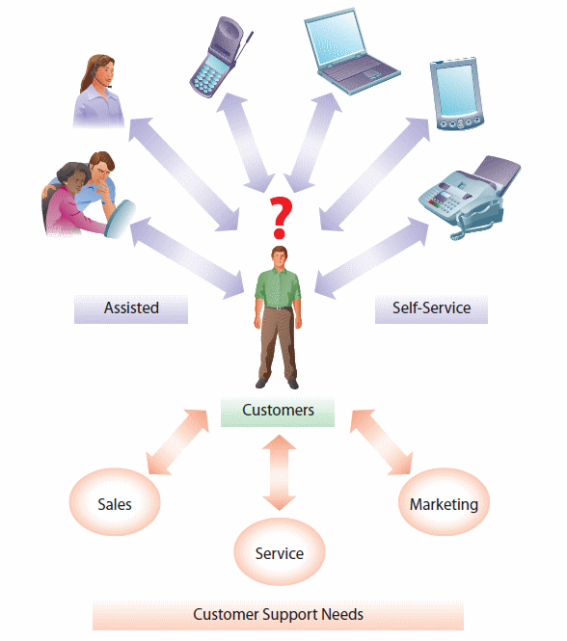
Customer Service and Support (CSS)

Slide 34
Enterprise Marketing Management (EMM)
Third component of an operational CRM is Enterprise Marketing Management (EMM)
Improve management of promotional campaigns
  Make sure right messages are sent to the right people through the right channels
    Customer lists need to be managed carefully
    Individualized attention to each potential customer
  Extensive analytical capabilities that can help to analyze effectiveness of campaigns

Slide 35
Analytical CRM
Analysis of customer behavior and perceptions
Customized marketing
  Up-selling, cross-selling
  Retaining customers
Key technologies used to create predictive models
  Data mining
  Decision support systems
Continuous data collection and analysis is necessary.

Slide 36
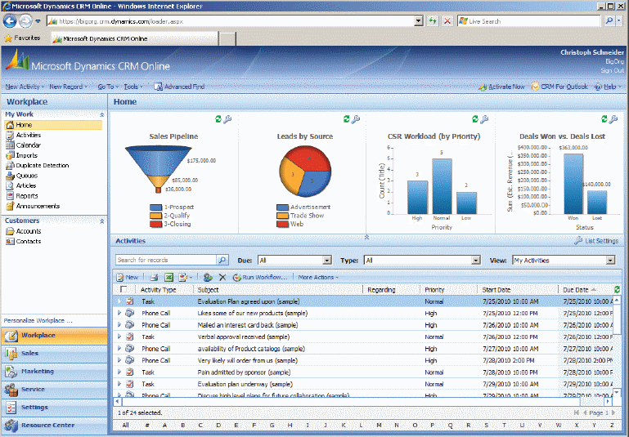
Digital Dashboards for CRM
Digital dashboards help to visualize key CRM performance metrics.

Slide 37
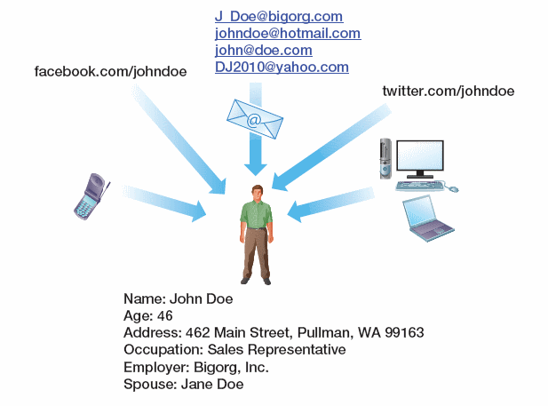
Dealing with Multiple Identities
Many people have various different online identities
  Different social networks
  Multiple e-mail addresses
Analytical CRM helps merge different identities for the same person
  Uses fuzzy logic-based algorithms

Slide 38
Collaborative CRM
CRM refers to systems providing effective and efficient communication with the customer from the entire organization.
  CIC is the key.
Collaborative CRM enhances communication.
  Greater customer focus
    Understanding of historical and current needs
  Lower communication barriers
    Communication preferences of the customer considered
  Increased information integration
    Customer information shared across the organization

