Slide 1
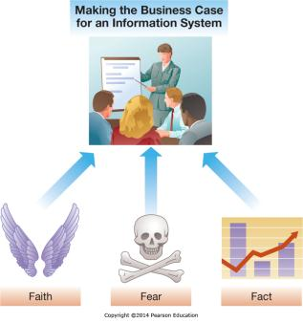
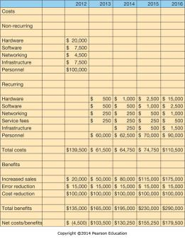
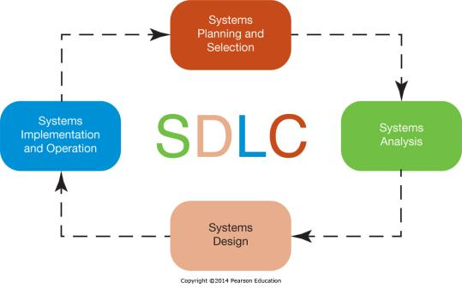
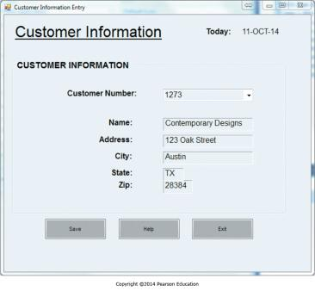
Chapter 9 - Developing and Acquiring Information Systems
Managers from across organizations are involved in developing and acquiring information systems

Slide 2
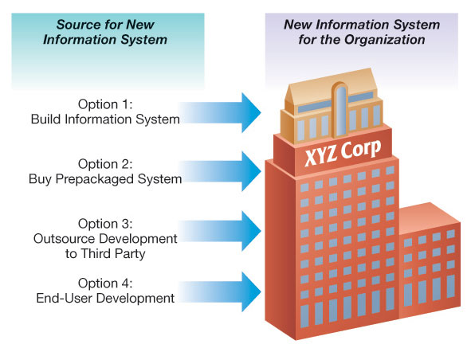
Combining Customized and Packaged software
There are a variety of sources for information systems.

Slide 3
Chapter 9 Learning Objectives
Making the Business Case
Describe how to formulate and present the business case for technology investments.
The Systems Development Process
Describe the systems development life cycle and its various phases.
Acquiring Information Systems
Explain how organizations acquire systems via external acquisition and outsourcing.

Slide 4
Making the Business Case
Making the Business Case
Describe how to formulate and present the business case for technology investments.
Cyberwar and Cyberterrorism
Describe and explain the differences between cyberwar and cyberterrorism.
Acquiring Information Systems
Explain how organizations acquire systems via external acquisition and outsourcing.

Slide 5
Productivity Gains
Easy to identify costs with developing an IS
How do you measure productivity gains?
Why hasn’t productivity increased at the rate of IS investments?

Slide 6
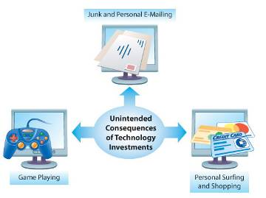
The Productivity Paradox
Give an example of how information systems may be used in unintended ways.

Slide 7
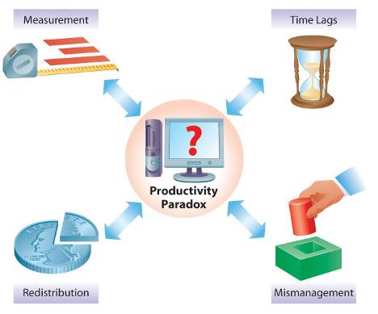
Measurement Problems
Give an example of how the wrong things can be measured

Slide 8
Time Lags
When can the benefits of an information system lag behind the realized benefits?

Slide 9
Redistribution
If an information systems simply redistributes the pieces of the pie rather than make the pie bigger, does it create any value?

Slide 10
Mismanagement
Can a good information system overcome a bad business model?

Slide 11
Productivity Business Case
Employees | 20,000
Average Salary | $42,523
Total Salary | $850,460,000
10% Productivity Increase | $85,046,000
Cost of Project | $4,000,000
Employees | 75
Average Salary | $37,520
Total Salary | $2,814,000
10% Headcount Reduction | $281,400
Cost of Project | $400,000

Slide 12
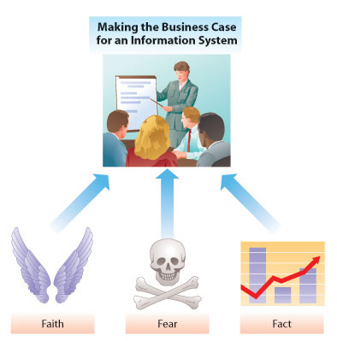
Making a Successful Business Case

Slide 13
Arguments Based on Faith
Do you need a cost benefits analysis for an argument based on faith?

Slide 14
PROFS to cc:Mail Migration
Manager struggled to make business case based on fact
  Sticking with PROFS was less expensive than migrating to cc:Mail
cc:Mail migration was necessary to gain support for migration from centralized to distributed world
Made case on “Faith”, not “Fact”

Slide 15
Arguments Based on Fear
Do you need a cost benefits analysis for an argument based on fear?
Come on, how do you instill “fear” in an organization?

Slide 16
Scenario
You are the CIO of a small to mid sized company
You are meeting with an independent consultant who is trying to get you to hire him to develop a business continuity plan and a disaster recovery plan
Is a business case based on “Fear” effective?

Slide 17
Business Continuity and
Disaster Recovery
Catastrophic loss of ability to deliver services from primary location
Must resume services from alternate location
Disaster recovery plan driven by the business’
  Recover time objective (RTO)
  Recovery point objective (RPO)
Business Continuity – How you continue to provide essential business services between time of the disaster and the execution of DR plan

Slide 18
Sobering Statistics
From the U.S. National Fire Protection Agency and the U.S. Bureau of Labor
  Nearly 75% of all U.S. businesses have experienced a business interruption
  20% of small to medium size businesses suffer a major disaster every five years
  43% of US companies never reopen after a disaster and 29% close within three years
  93% of companies that suffer a significant data lose are out of business within five years

Slide 19
It’s not always what you expect
It’s in not always an earthquake or a hurricane

Slide 20
Arguments Based on Fear
Do you need a cost benefits analysis for an argument based on fear?

Slide 21
Arguments Based on Fact
Do you need a cost benefits analysis for an argument based on fact?

Slide 22
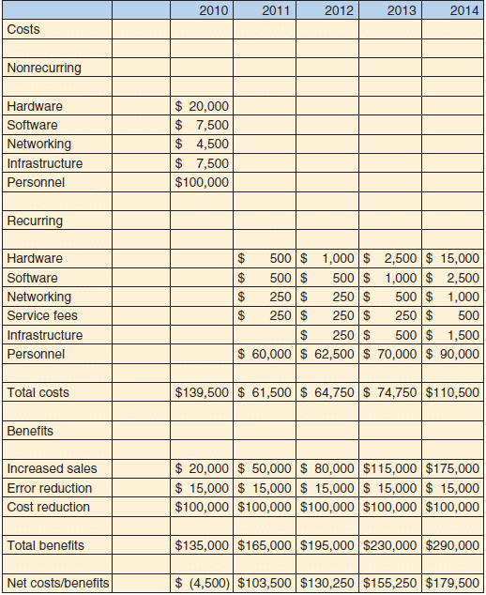
Cost-Benefit Analysis Example
Worksheet showing a simplified cost–benefit analysis for a Web-based order fulfillment system.

Slide 23
The Systems Development Process
Making the Business Case
Describe how to formulate and present the business case for technology investments.
The Systems Development Process
Describe the systems development life cycle and its various phases.
Acquiring Information Systems
Explain how organizations acquire systems via external acquisition and outsourcing.

Slide 24
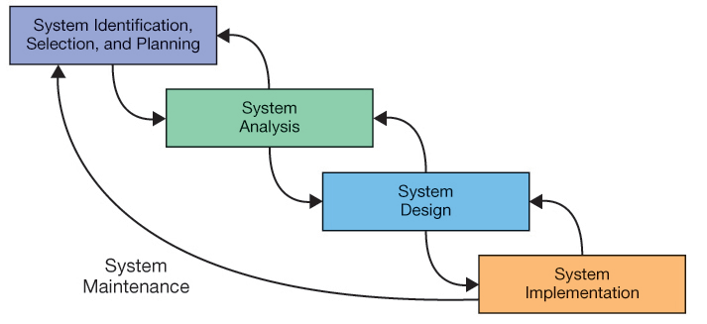
Steps in the Systems Development Process
Building my deck vs. a new sales system for Chuck’s Bikes

Slide 25
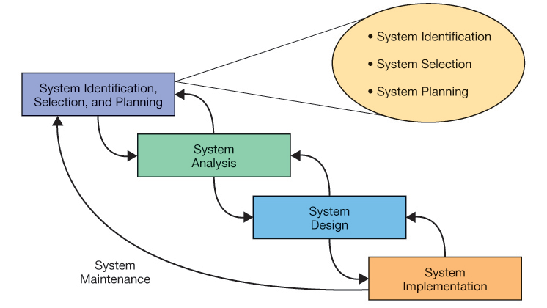
Phase 1: Systems Identification, Selection and Planning

Slide 26
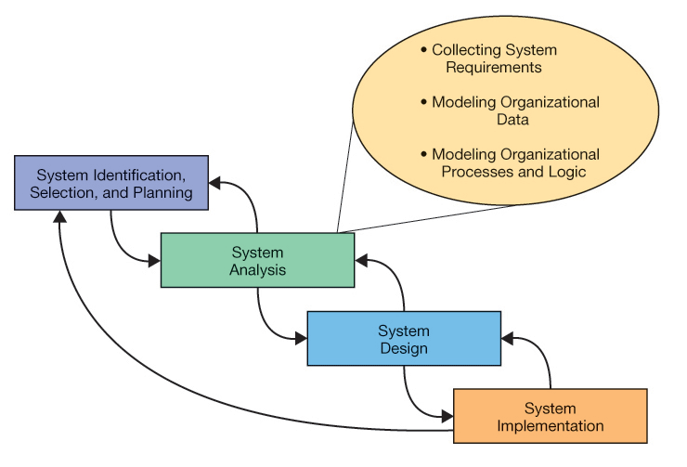
Phase 2: Systems Analysis

Slide 27
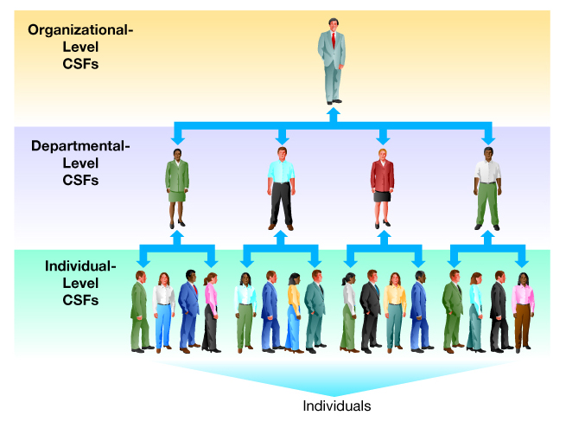
Critical Success Factors

Slide 28
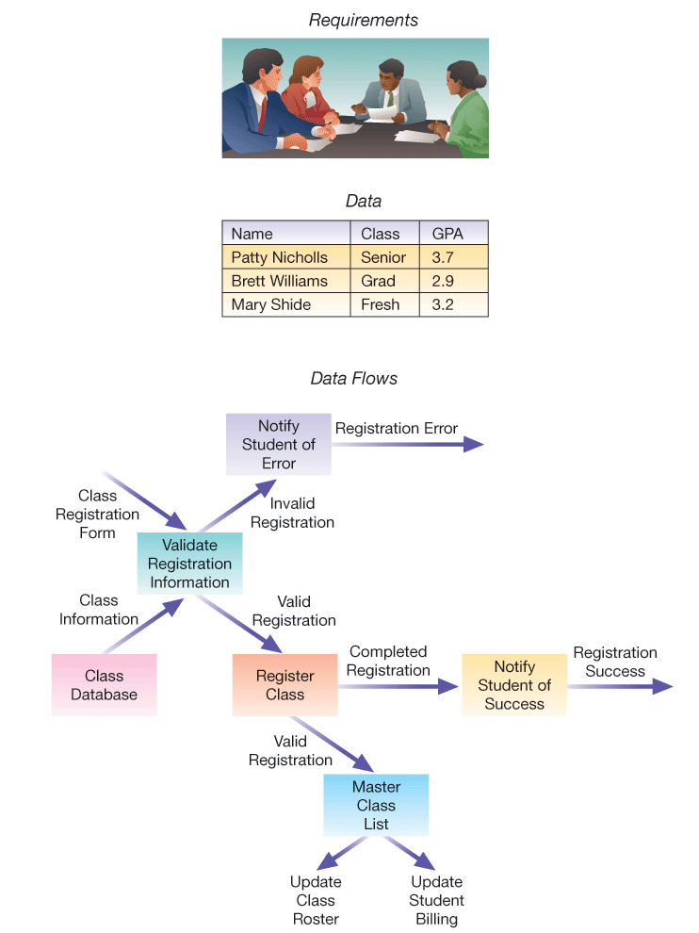
System Analysis

Slide 29
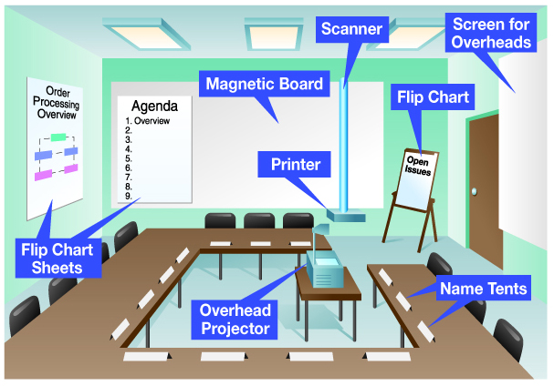
JAD Session

Slide 30
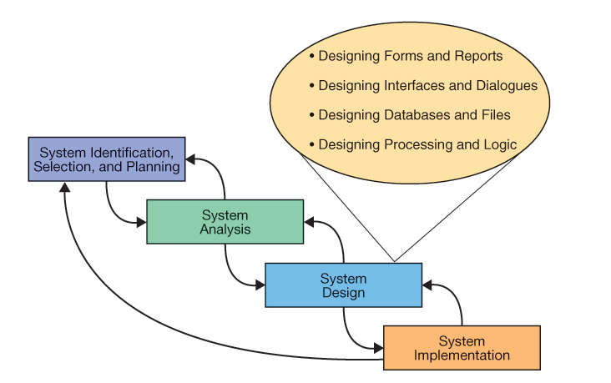
Phase 3: System Design

Slide 31
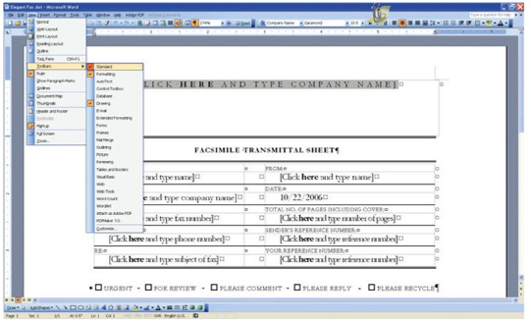
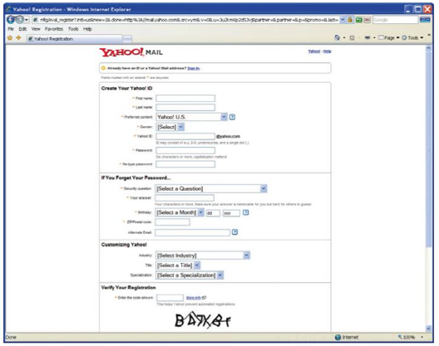
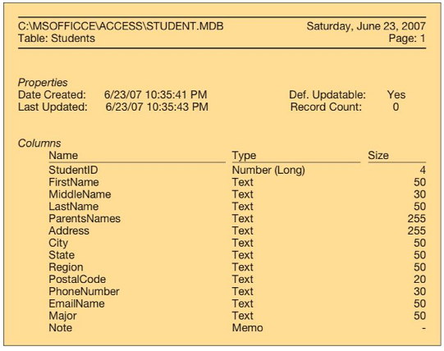
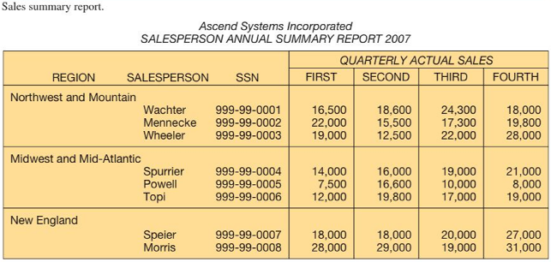
System Design
Forms
Interfaces
Reports
Databases

Slide 32
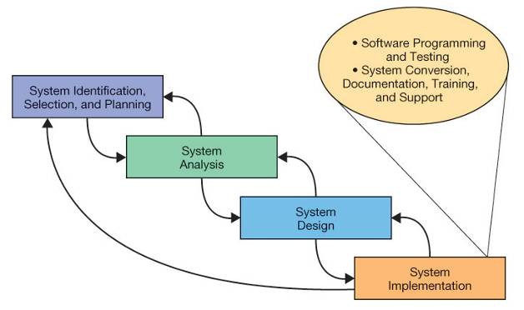
Phase 4: System Implementation

Slide 33
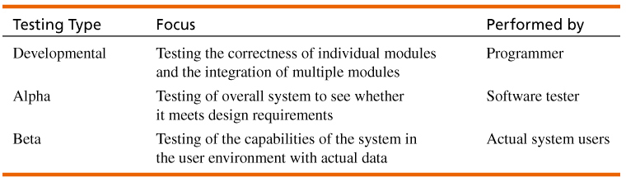
Testing

Slide 34
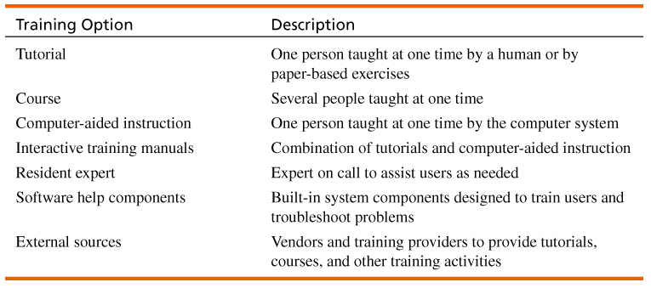
Training

Slide 35
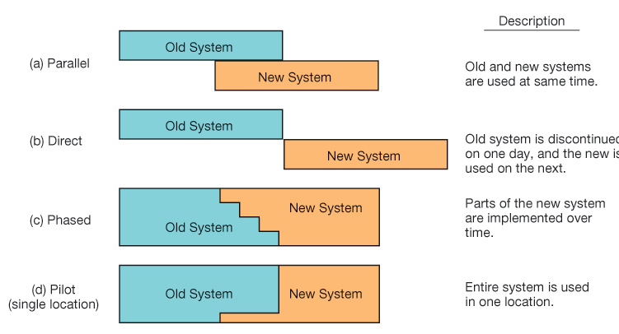
System Conversion and Installation

Slide 36
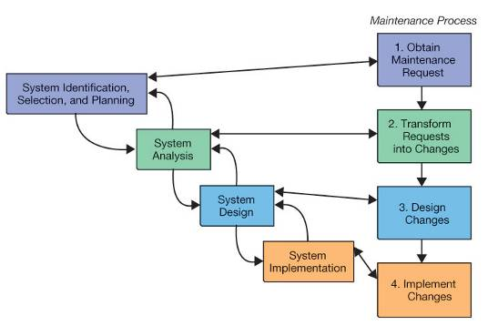
System Maintenance

Slide 37
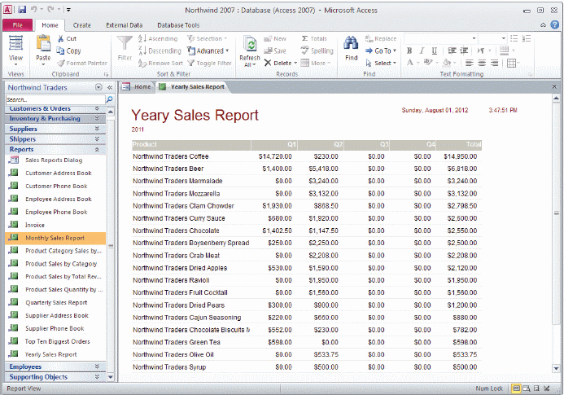
End-User Development
End-user development is a commonly used practice by tech-savvy managers who want to enhance their decision making and business intelligence.
Using tools such as Microsoft Access, a sales manager can develop an application to track sales.

Slide 38
Acquiring Information Systems
Making the Business Case
Describe how to formulate and present the business case for technology investments.
The Systems Development Process
Describe the systems development life cycle and its various phases.
Acquiring Information Systems
Explain how organizations acquire systems via external acquisition and outsourcing.

Slide 39
Steps in External Acquisition
Competitive bid process—find the best system for lowest possible price.
  Systems planning and selection
  Systems analysis
  Development of a request for proposal
  Proposal evaluation
  Vendor selection
The first two steps are similar to SDLC.

Slide 40
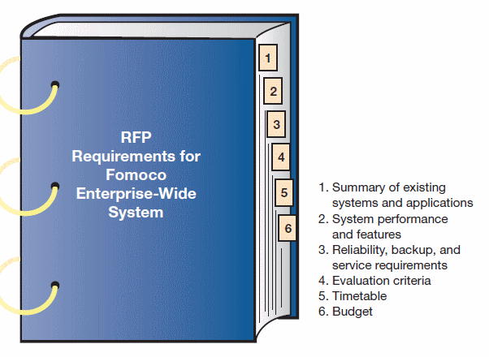
Development of a Request for Proposal (RFP)
Areas covered in an RFP

Slide 41
Proposal Evaluation
Proposal evaluation—An assessment of proposals received from vendors.
  May include system demonstrations
  System benchmarking
    Standardized tests to compare different proposed systems
    Common system benchmarks
      Response time given a specified number of users
      Time to sort records
      Time to retrieve a set of records
      Time to produce a given record
      Time to read in a set of data

Slide 42
Vendor Selection
Usually more than one system will meet the criteria.
Determine the best fit
Need to prioritize/rank the proposed systems
  Best ranking system is chosen.
  Formal approach—devise a scoring system for the criteria
  Less formal approaches:
    Checklists
    Subjective processes

Slide 43
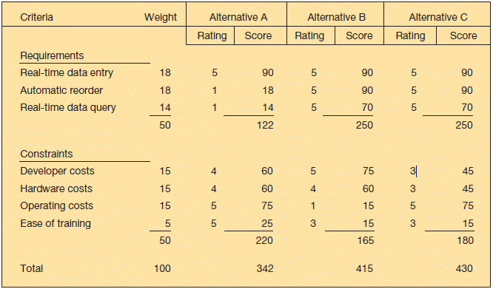
Multicriteria Analysis Example
Alternative projects and system design decisions can be assisted using weighted multicriteria analysis.

Slide 44
Application Service Providers (ASP)
Problems
  Managing the software infrastructure is a complex task.
  High operating costs
  Scalability issues
ASPs provide software as a service (SaaS)
  Reduced need to maintain or upgrade software
  Variable fee based on actual use of services
  Ability to rely on a provider’s expertise

Slide 45
Outsourcing Systems Development
Outsourcing systems development—Turning over responsibility for some or all of an organization’s IS development and operations to an outside firm.
  Your IS solutions may be housed in their organization.
  Your applications may be run on their computers.
  They may develop systems to run on your existing computers (within your organization).

Slide 46
Why Outsourcing?
Cost and quality concerns—higher quality or lower cost systems may be available through outsourcing.
Problems in IS performance—IS departments might have problems meeting acceptable standards.
Supplier pressure—aggressive sales force convinces senior management to outsource IS functions.
Simplifying, downsizing, and reengineering— focusing on core competencies.

Slide 47
Why Outsourcing? (cont’d)
Financial factors—liquidation of IT assets.
Organizational culture—external IS groups are devoid of political ties.
Internal irritants—external IS group may be better accepted by other organizational users.

Slide 48
Managing the IS Outsourcing Relationship
Ongoing management of an outsourcing alliance is needed.
  Strong, active CIO and staff
  Clear, realistic performance measurements of the system
  Multiple levels of interface between customer and outsourcer
Full-time relationship managers should be assigned.

Slide 49
Not All Outsourcing Relationships Are the Same
Outsourcing relationships
  No longer just a legal contract
  Strategic, mutually beneficial partnership
  Different types of outsourcing relationships
    Basic relationship—“Cash & Carry”
    Preferred relationship—Set preferential pricing
    Strategic relationship—Share risks/rewards

