Slide 1
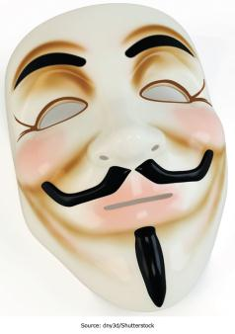
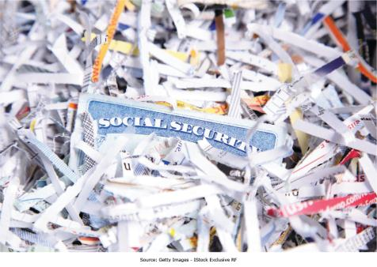
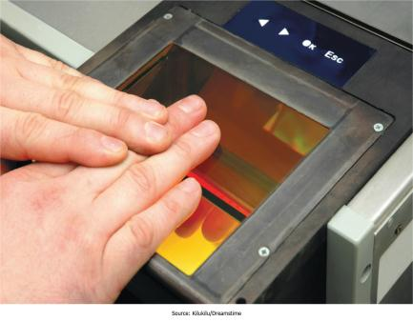
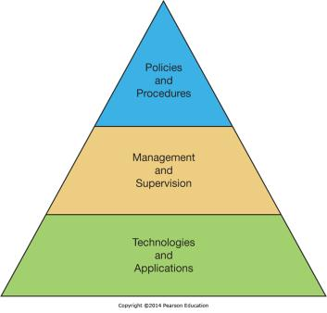
Chapter 10 - Securing Information Systems
IS Security is a critical aspect of managing in the digital world

Slide 2
MS in Information Technology Auditing and Cyber-Security
Risk
ITACS is about assuring the confidentiality, integrity and availability of a company’s systems
MIS
ACCT

Slide 3
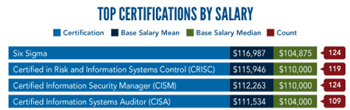
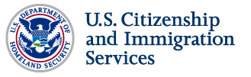
The Career
Public Accounting
Internal Accounting
Government Service
Corporate Security
IT Management
S.T.E.M.

Slide 4
The MS ITACS Program
Ten plus courses, professional MS program
Professional certification (CISA) preparation
$1,000 per credit
Scholarships available
Looking for:
Accounting, Finance, MIS, or Risk majors
Some systems background
GPA 3.0 or higher

Slide 5
For more information about ITACS check out:
community.mis.temple.edu/itacs
Or contact:
Rich Flanagan, Director ITACS Program
215 204 3077
richard.flanagan@temple.edu

Slide 6
Worldwide losses due to software piracy in 2005 exceeded $34 billion.
Business Software Alliance, 2006
Worldwide losses due to software piracy in 2008 exceeded $50 billion.
Business Software Alliance, 2009
Worldwide losses due to software piracy in 2010 exceeded $59 billion.
Business Software Alliance, 2011

Slide 7
Chapter 10 Learning Objectives
Computer Crime
Define computer crime and describe several types of computer crime.
Cyberwar and Cyberterrorism
Describe and explain the differences between cyberwar and cyberterrorism.
Information Systems Security
Explain what is meant by the term “IS security” and describe both technology and human based safeguards for information systems.
Information Systems Controls, Auditing, and the Sarbanes-Oxley Act
Describe how organizations can establish IS controls to better ensure IS security.
Managing IS Security
Discuss how to better manage IS security and explain the process of developing an IS security plan.

Slide 8
Computer Crime
Computer Crime
Cyberwar and Cyberterrorism
Describe and explain the differences between cyberwar and cyberterrorism.
Information Systems Security
Explain what is meant by the term “IS security” and describe both technology and human based safeguards for information systems.
Information Systems Controls, Auditing, and the Sarbanes-Oxley Act
Describe how organizations can establish IS controls to better ensure IS security.
Managing IS Security
Discuss how to better manage IS security and explain the process of developing an IS security plan.
Define computer crime and describe several types of computer crime.

Slide 9
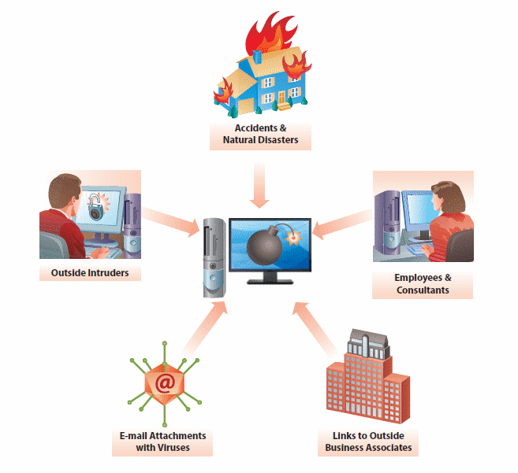
Primary Threats to Information
Systems Security
Natural disasters
  Power outages, hurricanes, floods, and so on
Accidents
  Power outages, cats walking across keyboards
Employees and consultants
Links to outside business contacts
  Travel between business affiliates
Outsiders
  Viruses

Slide 10
Computer Crime
Computer crime—The act of using a computer to commit an illegal act.
  Targeting a computer while committing an offense.
  Using a computer to commit an offense.
  Using computers to support a criminal activity.
Overall trend for computer crime has been declining over the past several years (CSI, 2011).
Many incidents are never reported.

Slide 11
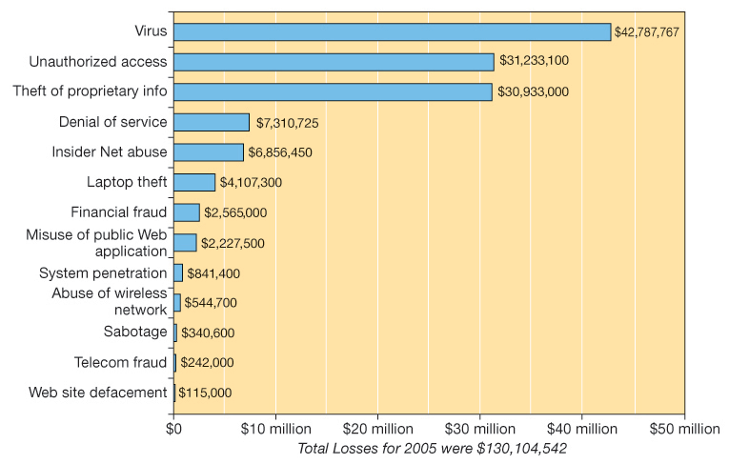
Types of Computer Crimes and Financial Losses
What do you think happens to a company’s stock price if they report that their systems have been compromised?
Would you report it if you didn’t have to?

Slide 12
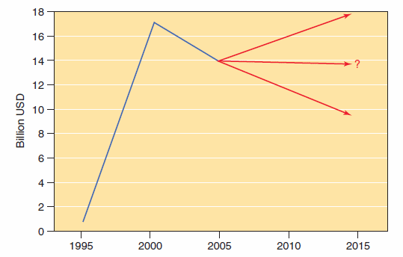
Computer Virus Attacks
Financial impact of virus attacks, 1995–2006, and beyond.
Source: Based on: http://www.computereconomics.com.

Slide 13
Federal and State Laws
The two main federal laws against computer crime are:
  Computer Fraud and Abuse Act of 1986
    Stealing or compromising data about national defense, foreign relations, atomic energy, or other restricted information
    Violating data belonging to banks or other financial institutions
    Intercepting or otherwise intruding on communications between states or foreign countries
    Threatening to damage computer systems in order to extort money or other valuables from persons, businesses, or institutions
  Electronic Communications Privacy Act of 1986
    makes it a crime to break into any electronic communications service, including telephone services
    prohibits the interception of any type of electronic communications

Slide 14
Other Federal Laws
Patent protection
U.S. Copyright Act
  amended in 1980 for computer software
Financial Privacy Act
  protects information: credit card, credit reporting , bank loan applications
Enforcement responsibilities
  FBI—espionage, terrorism, banking, organized crime, and threats to national security
  Secret Service—crimes against U.S. Treasury Department computers and against violations of the Right to Financial Privacy Act

Slide 15
Hacking and Cracking
Which one is the “bad guy”?
  Hackers
  Crackers
  Hacktivists

Slide 16
Types of Criminals
No clear profile as to who commits computer crimes
Four groups of computer criminals
  Current or former employees
    85–95% of theft from businesses comes from the inside
  People with technical knowledge committing crimes for personal gain
  Career criminals using computers to assist them in crimes
  Outside crackers hoping to find information of value
    About 12 percent of cracker attacks cause damage

Slide 17
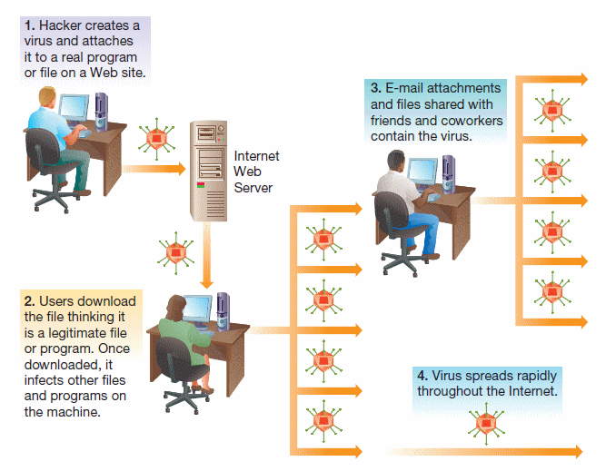
Computer Viruses and Other Destructive Code
What is your favorite virus?

Slide 18
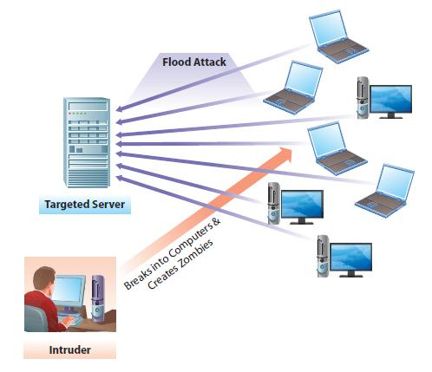
Denial of Service Attack
Attackers prevent legitimate users from accessing services.
Zombie computers
  Created by viruses or worms
  Attack Web sites
Servers crash under increased load.
  MyDoom attack on Microsoft’s Web site

Slide 19
Cybersquatting
The practice of registering a domain name and later reselling it.
Some of the victims include:
  Eminem
  Panasonic
  Hertz
  Avon
Anti-Cybersquatting Consumer Protection Act in 1999
  Fines as high as $100,000
  Some companies pay the cybersquatters to speed up the process of getting the domain.

Slide 20
Cyber Harassment, Stalking, and Bullying
Cyber harassment—Crime that broadly refers to the use of a computer to communicate obscene, vulgar, or threatening content.
Cyber stalking
  Making false accusations that damage reputation of another
  Gaining information on a victim by monitoring online activities
  Using the Internet to encourage others to harass a victim
  Attacking data and equipment of a victim by sending e-mail viruses or other destructive code
  Using the Internet to place false orders for goods or services

Slide 21
Cyberwar and Cyberterrorism
Computer Crime
Define computer crime and describe several types of computer crime.
Cyberwar and Cyberterrorism
Information Systems Security
Explain what is meant by the term “IS security” and describe both technology and human based safeguards for information systems.
Information Systems Controls, Auditing, and the Sarbanes-Oxley Act
Describe how organizations can establish IS controls to better ensure IS security.
Managing IS Security
Discuss how to better manage IS security and explain the process of developing an IS security plan.
Describe and explain the differences between cyberwar and cyberterrorism.

Slide 22
Cyberterrorism

Slide 23
Information Systems Security
Computer Crime
Define computer crime and describe several types of computer crime.
Cyberwar and Cyberterrorism
Describe and explain the differences between cyberwar and cyberterrorism.
Information Systems Security
Explain what is meant by the term “IS security” and describe both technology and human based safeguards for information systems.
Information Systems Controls, Auditing, and the Sarbanes-Oxley Act
Describe how organizations can establish IS controls to better ensure IS security.
Managing IS Security
Discuss how to better manage IS security and explain the process of developing an IS security plan.

Slide 24
Safeguarding IS Resources
Risk Reduction
  Actively installing countermeasures
Risk Acceptance
  Accepting any losses that occur
Risk Transference
  Insurance
  Outsourcing

Slide 25
Information Systems Security
All systems connected to a network are at risk.
  Internal threats
  External threats
Information systems security
  Precautions to keep IS safe from unauthorized access and use
Increased need for good computer security with increased use of the Internet

Slide 26
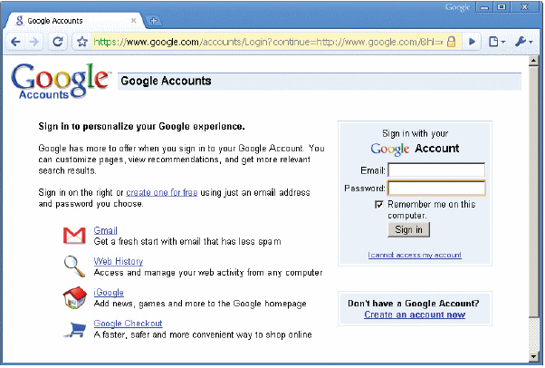
Technological Safeguards
Physical access restrictions
Authentication
  Use of passwords
  Photo ID cards, smart cards
  Keys to unlock a computer
  Combination
Authentication dependent on
  Something you have
  Something you know
  Something you are

Slide 27
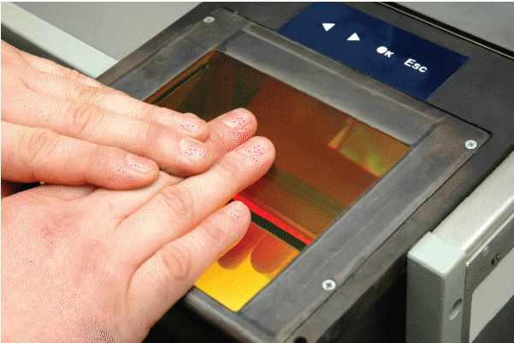
Biometrics
Form of authentication
  Fingerprints
  Retinal patterns
  Facial features and so on
Fast authentication
High security
Recent visit to Disney ESPN Wide World of Sports…

Slide 28
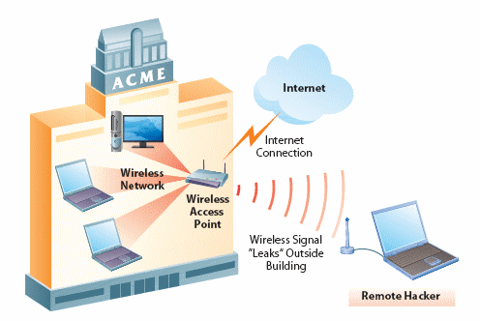
Wireless LAN Control
Wireless LAN cheap and easy to install
Use on the rise
Signal transmitted through the air
  Susceptible to being intercepted
  Drive-by hacking

Slide 29
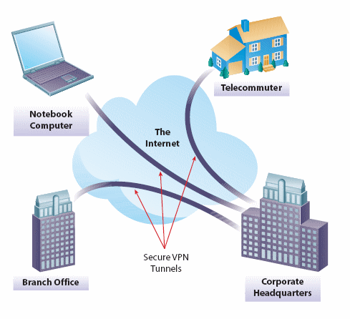
Virtual Private Networks
Connection constructed dynamically within an existing network
Tunneling
  Send private data over public network
  Encrypted information

Slide 30
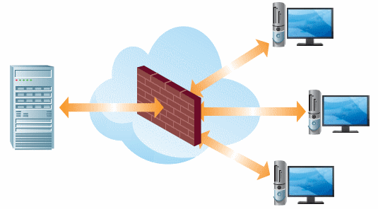
Firewalls
Firewall—A system designed to detect intrusion and prevent unauthorized access
Implementation
  Hardware, software, mixed

Slide 31
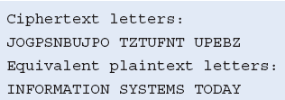
Encryption
Message encoded before sending
Message decoded when received
Cryptography—the science of encryption.
  It requires use of a key for decoding.
Certificate authority—manages distribution of keys on a busy Web site.
Secure Sockets Layer (SSL)—popular public key encryption method.

Slide 32
Virus Monitoring and Prevention
Virus prevention
  Purchase and install antivirus software.
    Update frequently.
  Do not download data from unknown sources.
    Flash drives, disks, Web sites
  Delete (without opening) e-mails from unknown sources.
  Do not blindly open e-mail attachments
    Even if they come from a known source.
  Report any viruses to the IT department.

Slide 33
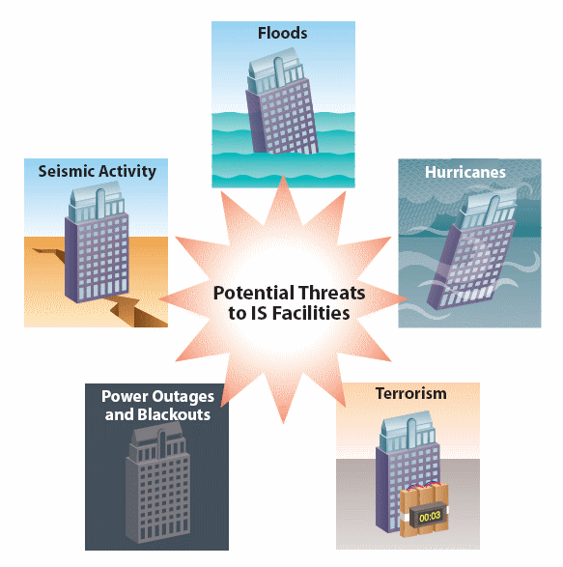
Secure Data Centers
Specialized facilities are important.
Technical Requirements
  Power
  Cooling
How do organizations reliably protect themselves from threats?

Slide 34
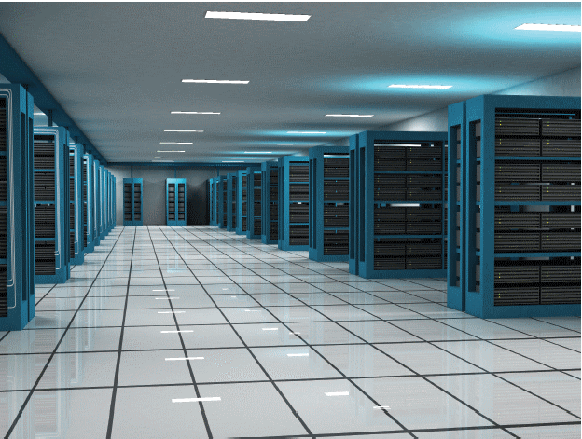
Ensuring Availability
High-availability facilities
  To ensure uninterrupted service
  Self-sufficient
  Backup cooling systems
  Raised floors (to more easily reconfigure systems)
  Built to withstand storms
Collocation facilities
UPS servers need 24/7/365 reliability

Slide 35
Securing the Facilities Infrastructure
Backups
  Secondary storage devices
  Regular intervals
Backup sites
  Cold backup site
  Hot backup site
Redundant data centers
  Different geographic areas
Closed-circuit television (CCTV)
  Monitoring for physical intruders
  Video cameras display and record all activity
  Digital video recording
Uninterruptible power supply (UPS)
  Protection against power surges

Slide 36
What is “Computer Forensics”?

Slide 37
Managing IS Security
Computer Crime
Define computer crime and describe several types of computer crime.
Cyberwar and Cyberterrorism
Describe and explain the differences between cyberwar and cyberterrorism.
Information Systems Security
Explain what is meant by the term “IS security” and describe both technology and human based safeguards for information systems.
Information Systems Controls, Auditing, and the Sarbanes-Oxley Act
Describe how organizations can establish IS controls to better ensure IS security.
Managing IS Security
Discuss how to better manage IS security and explain the process of developing an IS security plan.

Slide 38
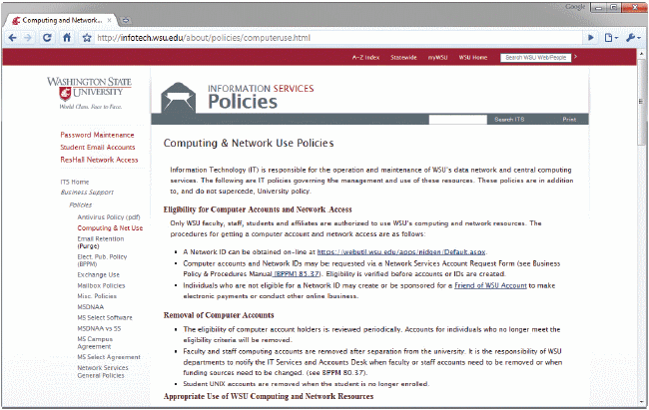
Managing Information Systems Security
Non-technical safeguards
  Management of people’s use of IS
    Acceptable use policies
  Trustworthy employees
  Well-treated employees

Slide 39
Disaster Planning
Disasters can’t be completely avoided. Need to be prepared.
Business continuity plan
  describes how a business resumes operation after a disaster
Disaster recovery plan
  Subset of business continuity plan
  Procedures for recovering from systems-related disasters
  Two types of objectives
    Recovery time objectives (Maximum time allowed to recover)
    Recovery point objectives (How current should the backup material be?)

Slide 40
Responding to a Security Breach
Restore lost data
Perform new risk audit
Implement additional safeguards
Contact law enforcement (yeah, right!)
  Computer Emergency Response Team Coordination Center (Federal government center of Internet security expertise)

Slide 41
Information Systems Controls, Auditing, and the Sarbanes-Oxley Act
Computer Crime
Define computer crime and describe several types of computer crime.
Cyberwar and Cyberterrorism
Describe and explain the differences between cyberwar and cyberterrorism.
Information Systems Security
Explain what is meant by the term “IS security” and describe both technology and human based safeguards for information systems.
Information Systems Controls, Auditing, and the Sarbanes-Oxley Act
Describe how organizations can establish IS controls to better ensure IS security.
Managing IS Security
Discuss how to better manage IS security and explain the process of developing an IS security plan.

Slide 42
Hierarchy of IS Controls

Slide 43
Types of IS Controls
Policies
  Define aim and objectives.
Standards
  Support the requirements of policies.
Organization and management
  Define the lines of reporting.
Physical and environmental controls
  Protect the organization’s IS assets.

Slide 44
Types of IS Controls (cont’d)
Systems software controls
  Enable applications and users to utilize the systems.
Systems development and acquisition controls
  Ensure systems meet the organization’s needs.
Application-based controls
  Ensures correct input, processing, storage, and output of data; maintain record of data as it moves through the system.

Slide 45
IS Auditing
Information Systems audit
  Performed by external auditors to help organizations assess the state of their IS controls.
    To determine necessary changes
    To assure the IS availability, confidentiality, and integrity
Risk assessment
  Determine what type of risks the IS infrastructure faces.
Computer-Assisted Auditing Tools (CAAT)
  Specific software to test applications and data, using test data or simulations.

Slide 46
The Sarbanes-Oxley Act
The Sarbanes-Oxley Act was formed as a reaction to large-scale accounting scandals.
  WorldCom, Enron
It primarily addresses the accounting side of organizations.
Companies have to demonstrate that:
  controls are in place to prevent misuse and fraud,
  controls are in place to detect potential problems, and
  measures are in place to correct problems
COBIT (Control Objectives for Information and Related Technology)
  Set of best practices
    Help organizations to maximize the benefits from their IS infrastructure
    Establish appropriate controls

