Slide 1
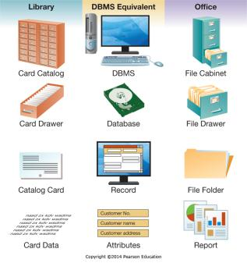
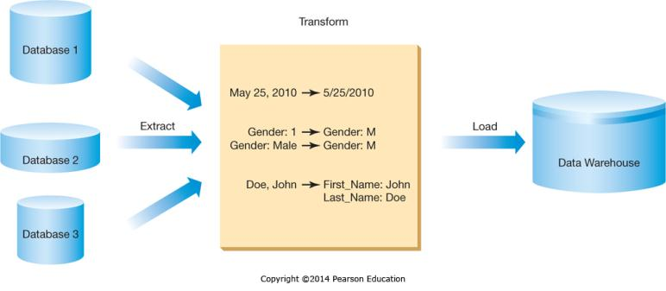
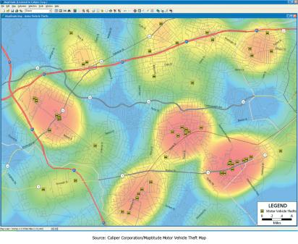
Chapter 6 - Enhancing Business Intelligence Using Information Systems
Managers need high-quality and timely information to support decision making

Slide 2
Chapter 6 Learning Objectives
Business Intelligence
Describe the concept of business intelligence and how databases serve as a foundation for gaining business intelligence.
Business Intelligence Components
Explain the three components of business intelligence: information and knowledge discovery, business analytics, and information visualization.

Slide 3
Business Intelligence (BI)
Business Intelligence (BI) is the use of information systems to gather and analyze information from internal and external sources in order to make better business decisions.
BI is used to integrate data from disconnected:
  Reports
  Databases
  Spreadsheets
Integrated data helps to monitor and fine-tune business processes.

Slide 4
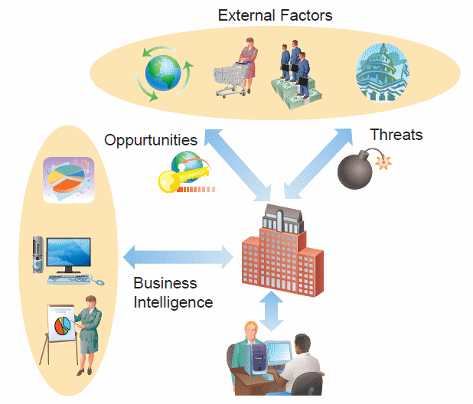
BI: Responding to Threats and Opportunities
BI can help with reacting to various threats and opportunities, including:
  Unstable markets
  Global threats
  Fierce competition
  Short product life cycles
  Stringent regulations
  Wider choices for consumers

Slide 5
Why Organizations Need Business Intelligence: Understanding Big Data
Businesses are dealing with the challenge of “Big Data”
  High Volume
    Unprecedented amounts of data
  High Variety
    Structured data
    Unstructured data
  High Velocity
    Rapid processing to maximize value

Slide 6
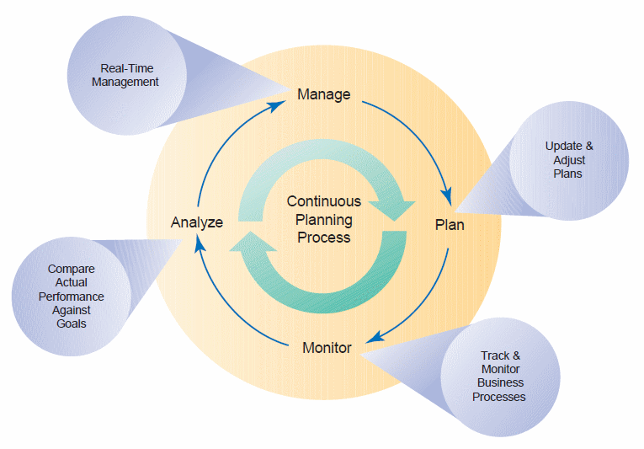
BI: Continuous Planning
Organizations need to continuously monitor and analyze business processes.
Results lead to ongoing adjustments.
It involves decision makers from all levels.

Slide 7
Databases: Inputs to BI Applications
Data and knowledge are among the most important assets for an organization.
Databases are collections of related data organized in a way that facilitates data searches.
Uses:
  Identify customers for personalized communications
  Database technology fuels electronic commerce on the Web.

Slide 8
Main Database Elements
Entity—something you collect data about, such as people or classes.
Table—contains entities. Consists of rows an columns.
Row (record)—a record in a table. One row pertains to one entity instance.
Column (attribute)—one cell in a row. Each attribute contains a piece of information about the entity.

Slide 9
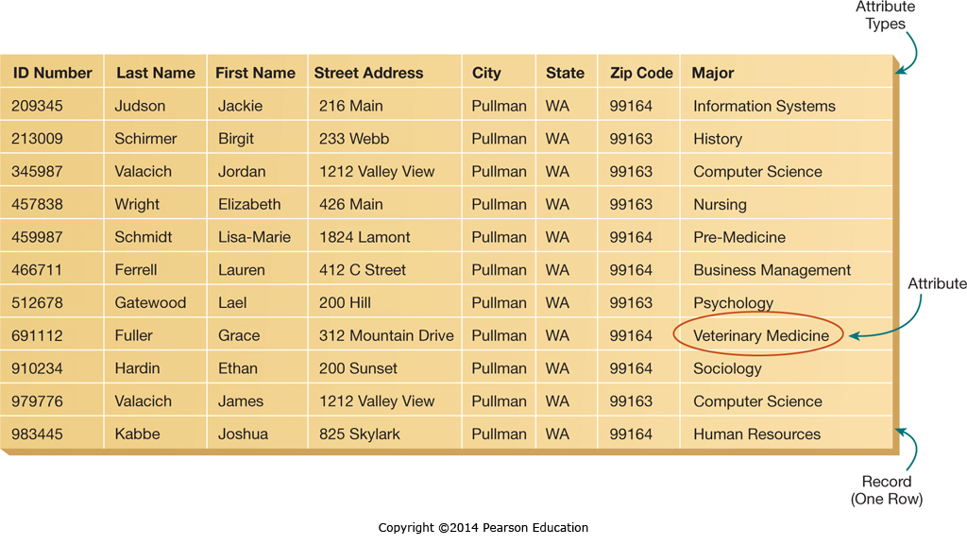
Databases: Tables and Records

Slide 10
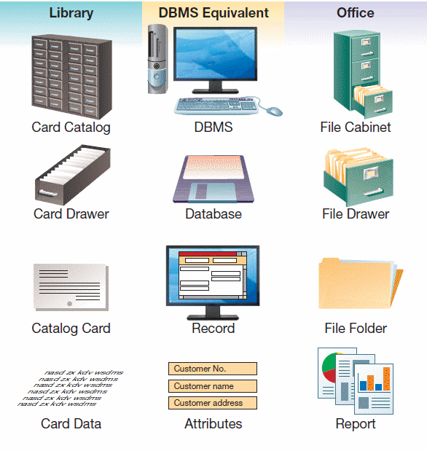
Databases: Foundation Concepts
Database management systems (DBMS)—software to create, store, organize, and retrieve data from one or more databases.
E.g., Microsoft Access

Slide 11
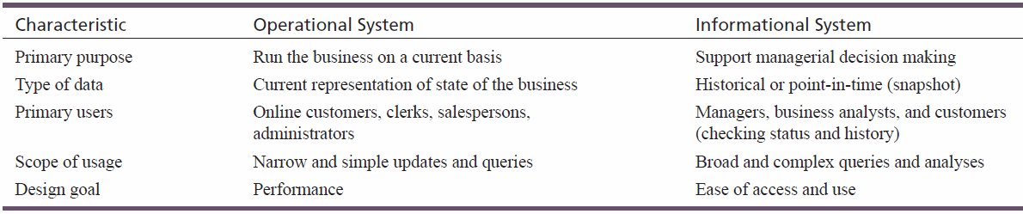
Operational vs. Informational Systems

Slide 12
Data Warehouses
Data warehouses integrate multiple databases and other information sources into a single repository.
For direct querying, analysis, or processing
Purpose: put key business information into the hands of decision makers.
Take up hundreds of gigabytes (even terabytes) of data

Slide 13
Data Marts
A data mart is a data warehouse that is limited in scope.
Each data mart is customized for decision support of a particular end-user group.
It is popular for small and medium-sized businesses and departments within larger organizations.
Data marts can be deployed on less powerful hardware.

Slide 14
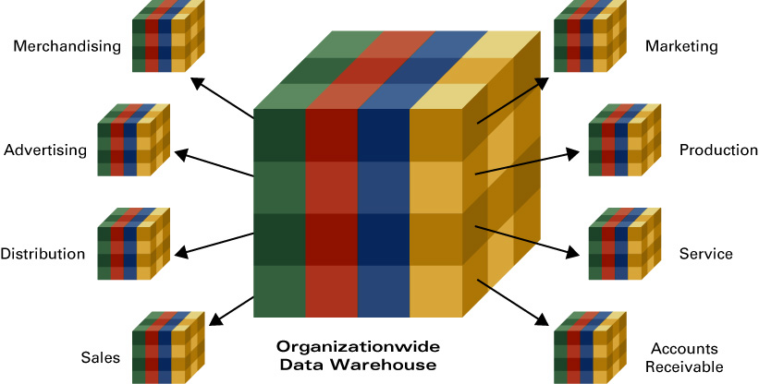
Data Marts

Slide 15
Business Intelligence Components
Business Intelligence
Describe the concept of business intelligence and how databases serve as a foundation for gaining business intelligence.
Business Intelligence Components
Explain the three components of business intelligence: information and knowledge discovery, business analytics, and information visualization.

Slide 16
Business Intelligence Components
Three types of tools
  Information and knowledge discovery
  Business analytics
  Information visualization
Information and Knowledge Discovery
  Search for hidden relationships.
  Hypotheses are tested against existing data.
    For example: Customers with a household income over $150,000 are twice as likely to respond to our marketing campaign as customers with an income of $60,000 or less.

Slide 17
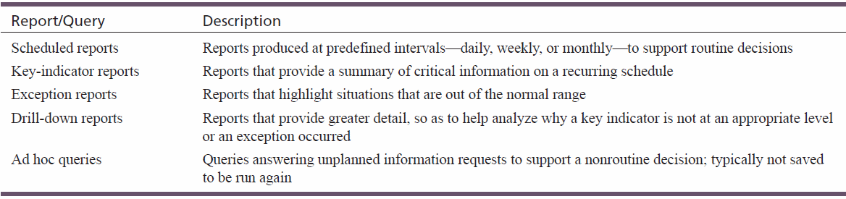
Ad Hoc Reports and Queries

Slide 18
Online Analytical Processing (OLAP)
Complex, multidimensional analyses of data beyond simple queries
OLAP server —main OLAP component
Key OLAP concepts:
  Measures and dimensions
  Cubes, slicing, and dicing
  Data mining
  Association discovery
  Clustering and classification
  Text mining and Web content mining
  Web usage mining
One application of OLAP…

Slide 19
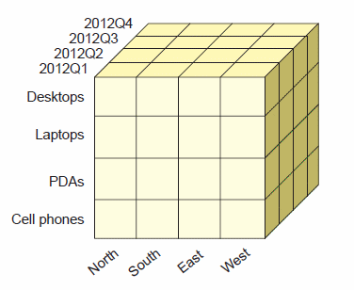
Cubes
Cube—an OLAP data structure organizing data via multiple dimensions
Cubes can have any number of dimensions
  Be careful, most people can’t comprehend after 3 dimensions!
A cube with three dimensions

Slide 20
Measures and Dimensions
Measures (facts)—values or numbers to analyze.
  Examples: sum of sales, number of orders placed
Dimensions—groupings of data, providing a way to summarize the data.
  Examples: region, time, product line
Dimensions are organized as hierarchies (general-to-detailed).
  Examples: year–month–day, state–county–city
Drill-down—viewing measures at lower levels of hierarchy.
Roll-up—viewing measures at higher levels of hierarchy.

Slide 21
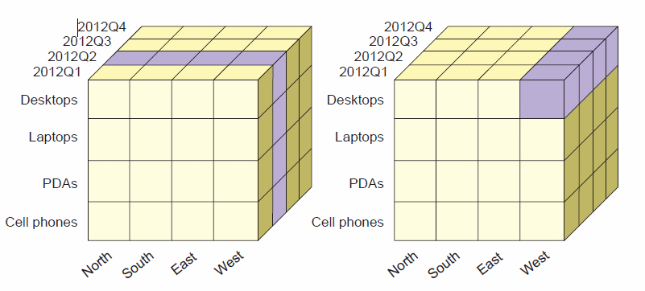
Slicing and Dicing
Slicing and dicing—analyzing the data on subsets of the dimensions

Slide 22
Data Mining
Used for discovering “hidden” predictive relationships in the data
  Patterns, trends, or rules
  Example: identification of profitable customer segments or fraud detection
  Any predictive models should be tested against “fresh” data.
Data-mining algorithms are run against large data warehouses.
  Data reduction helps to reduce the complexity 0f data and speed up analysis.

Slide 23
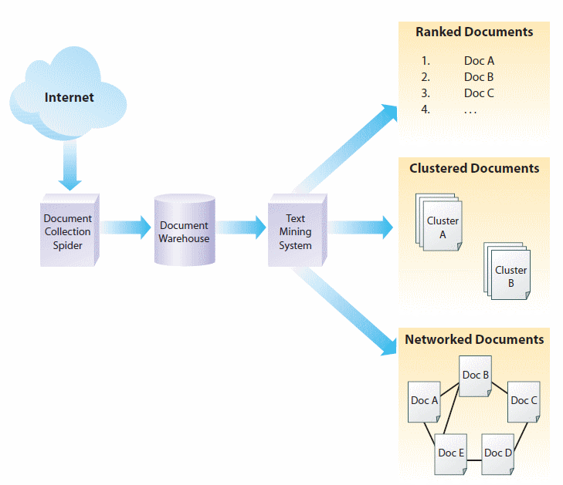
Text mining the Internet

Slide 24
Textual Analysis Benefits
Marketing—learn about customers’ thoughts, feelings, and emotions.
Operations—learn about product performance by analyzing service records or customer calls.
Strategic decisions—gather competitive intelligence.
Sales—learn about major accounts by analyzing news coverage.
Human resources—monitor employee satisfaction or compliance to company policies (important for compliance with regulations such as the Sarbanes-Oxley Act).

Slide 25
Web Usage Mining
Used by organizations such as Amazon.com
Used to determine patterns in customers’ usage data.
  How users navigate through the site
  How much time they spend on different pages
Clickstream data—recording of the users’ path through a Web site.
Stickiness—a Web page’s ability to attract and keep visitors.

Slide 26
Web Usage Mining
Project 3
  Create an e-Portfolio
  Enable Google Analytics
  Analyze the traffic to your site
What will you be doing with Google Analytics?

Slide 27
Twitter Feeds
Have you ever heard of anyone mining Twitter feeds?
As a business person, what kind of information could you learn about your customers if you subscribed to every Twitter feed imaginable and mined the data?

Slide 28
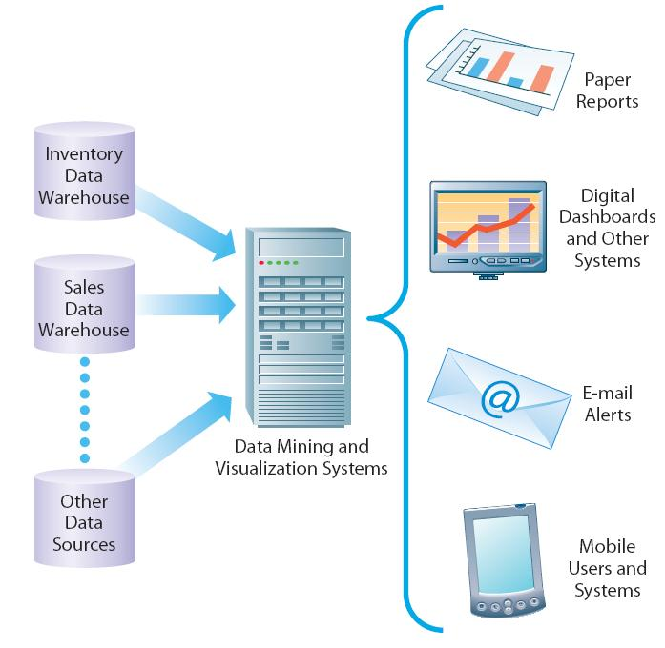
Presenting Results

Slide 29
Any Danger?
Is there any danger in a business student becoming too “tech savvy”?
Is there an danger in a business student not becoming “tech savvy” enough?
What is a “program” and is there anything that is more nerdy that being a “programmer”?

Slide 30
Business Analytics
BI applications to support human and automated decision making
  Business Analytics—predict future outcomes
  Decision Support Systems (DSS)—support human unstructured decision making
  Intelligent systems
  Enhancing organizational collaboration

Slide 31
Decision Support Systems (DSS)
Decision-making support for recurring problems
Used mostly by managerial level employees (can be used at any level)
Interactive decision aid
What-if analyses
  Analyze results for hypothetical changes
  Example: Microsoft Excel

Slide 32
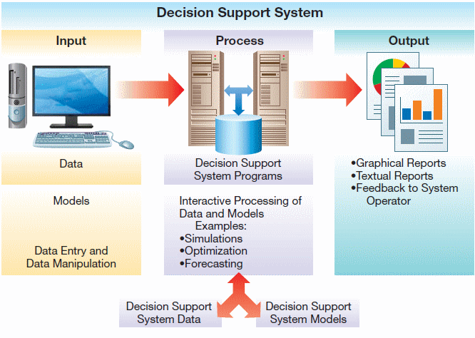
Architecture of a DSS

Slide 33
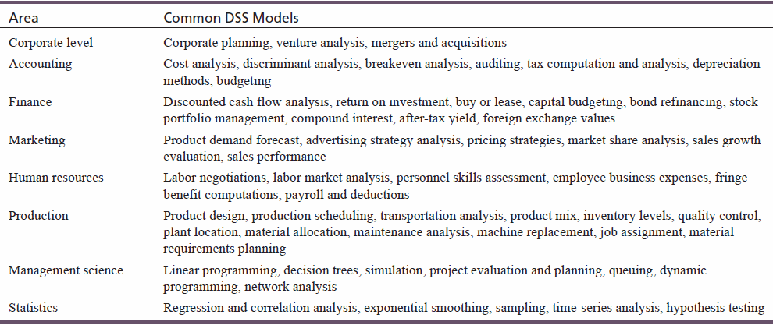
Common DSS Models

Slide 34
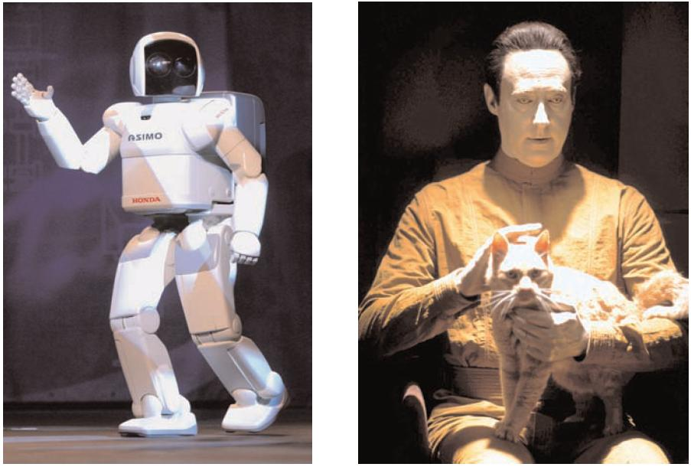
Artificial Intelligence
  Is Nicholas’ robot “intelligent”? Will it become “intelligent” over the summer?
  Be wary of “Artificial” anything?
Spencer Platt/Getty Images, Inc.
.
© 2002 Paramount Pictures/Courtesy: Everett Collection.
.
.

Slide 35
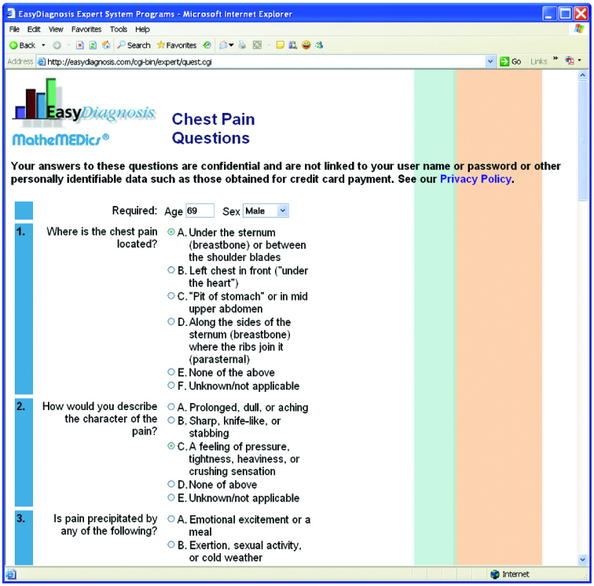
Expert Systems

Slide 36
Could You Use an Expert System?
Talk to the person next to you about the various jobs that you have had.
Discuss situations where a decision tree could be used to lead an employee who wasn’t really an expert through a series of questions and eventually to the answer they are looking for.
Where is the intelligence…in the employee or the decision tree?

Slide 37

Can you recognize patterns and be trained?
You see a new breed of dog
How do you know it is a dog?
How do you know it is even an animal?
How do you know if an animal is a mammal?
How about a whale?
How about a platypus?

Slide 38
Scenario – Loan Officer
You need to make approval/rejection decisions on loan applications?
What information do you look at to make your decisions?
Do you make decisions based on individual pieces of information or combinations of information?
What combinations correlate with good/bad loans?

Slide 39
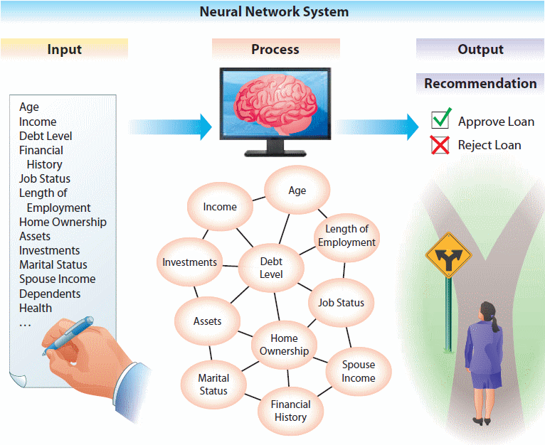
Example: Neural Network System

Slide 40
Intelligent Agent Systems
Program working in the background
Bot (software robot)
Provides service when a specific event occurs

Slide 41
Types of Intelligent Agent Systems
User agents
  Performs a task for the user
Buyer agents (shopping bots)
  Search for the best price
Monitoring and sensing agents
  Keep track of information and notifies users when it changes
Data-mining agents
  Continuously browse data warehouses to detect changes
Web crawlers (aka Web spiders)
  Continuously browses the Web
Destructive agents
  Designed to farm e-mail addresses or deposit spyware

Slide 42
Questions
What is a “Baby Boomer” and how many of them are in the workforce today?
How many will be in the workforce 10 years from now?
What is “Tacit Knowledge”?
Why is this keeping CEOs awake at night?
Is there technology that we can use to help with this?

Slide 43
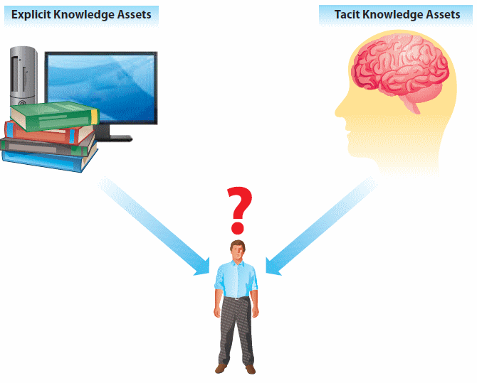
Knowledge Asset Categories
Explicit knowledge assets
  Can be documented
Tacit knowledge assets
  Located in one’s mind
  Often reflect an organization’s best practices

Slide 44
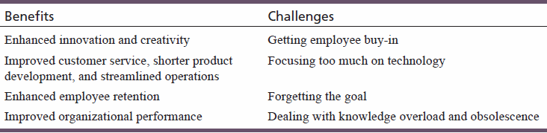
Benefits and Challenges of Knowledge-Based Systems

Slide 45
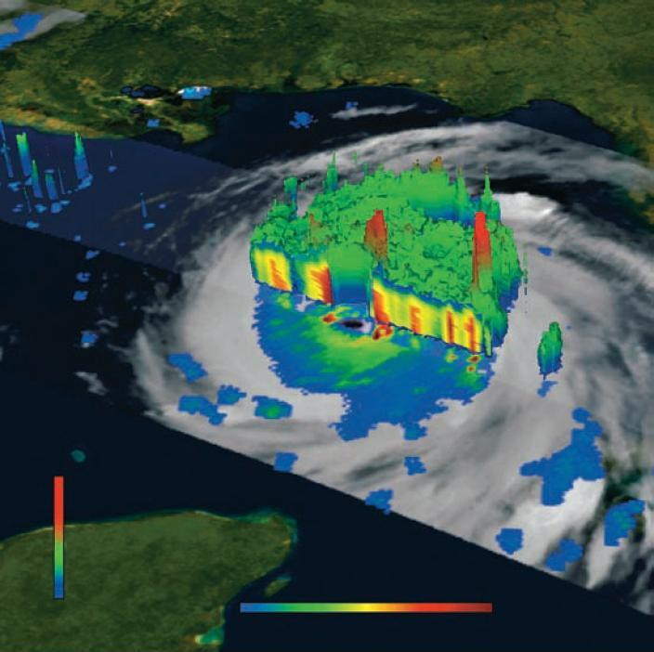
Information Visualization
Display of complex data relationships using graphical methods
  Enables managers to quickly grasp results of analyses
  Visual analytics
  Dashboards
  Geographic information systems

Slide 46
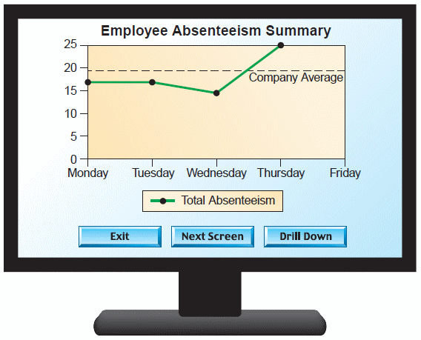
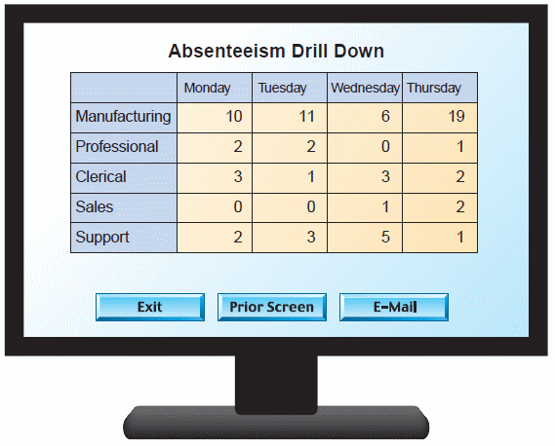
Digital Dashboards

Slide 47
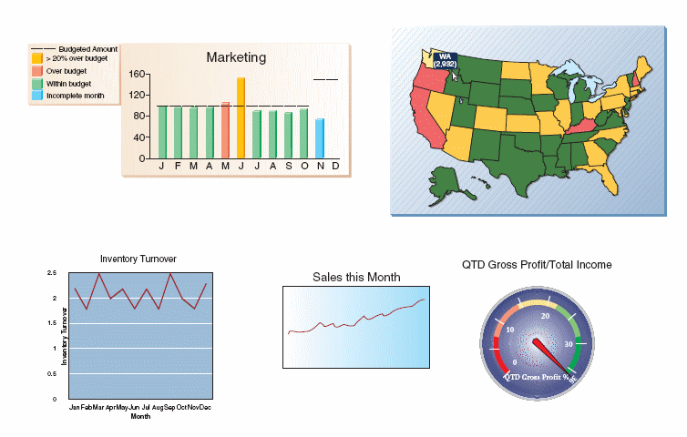
Dashboards
Dashboards use various graphical elements to highlight important information.

Slide 48
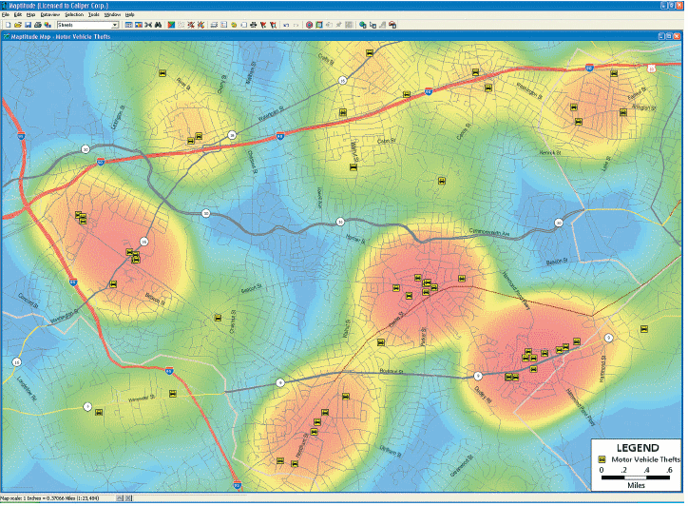
Thematic Maps
A thematic map showing car thefts in a town

Slide 49
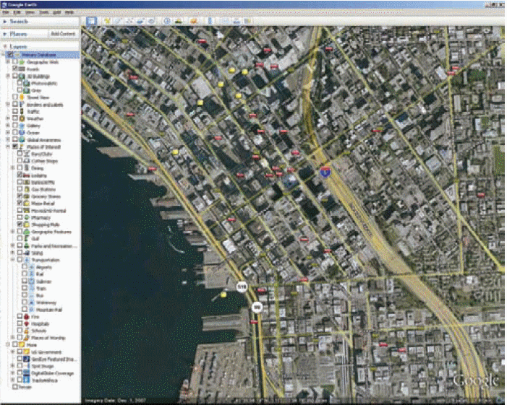
Geographic Information System (GIS)

Slide 50
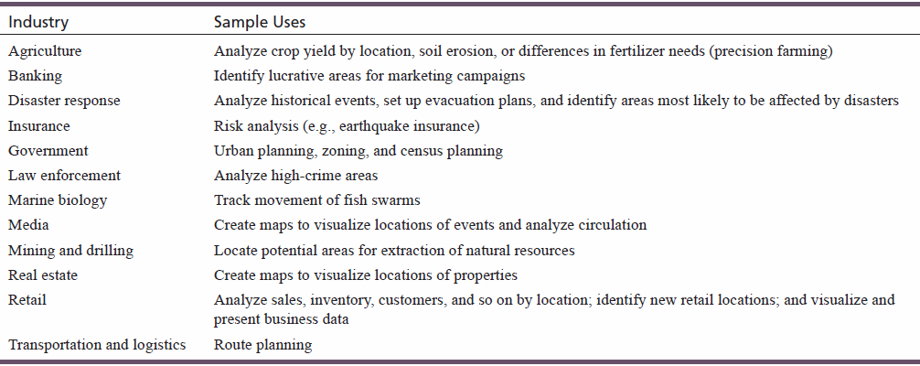
Industry Uses of GIS

Slide 51
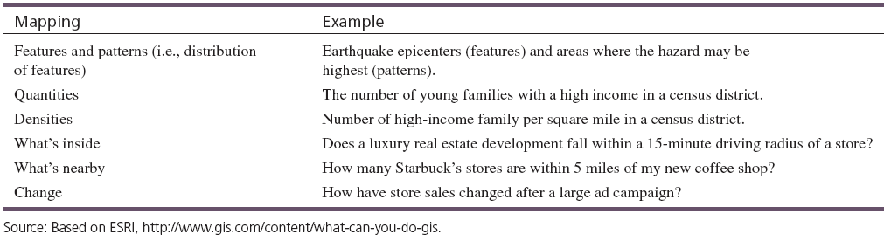
Various Ways of Representing Geospatial Data

