Slide 1
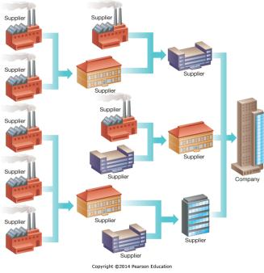
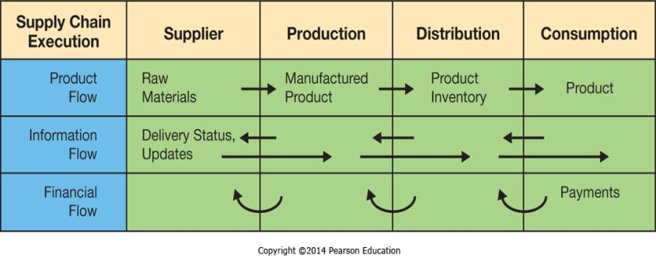
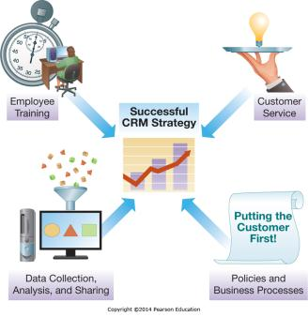
Chapter 8 - Strengthening Business-to-Business Relationships via Supply Chain and Customer Relationship Management
Supply chain management (SCM) systems supporting business-to-business (B2B) transactions, customer relationship management (CRM) systems promote sales and long-term customer relationships

Slide 2
Chapter 8 Learning Objectives
Supply Chain Management
Describe supply chain management systems and how they help to improve interorganizational business processes.
Customer Relationship Management
Describe customer relationship management systems and how they help to improve the activities involved in promoting and selling products to customers as well as providing customer service and nourishing long-term relationships.

Slide 3
What Is a Supply Chain?
A supply chain is a collection of companies and processes moving a product:
  suppliers of raw materials
  suppliers of intermediate components
  final production
  to the customer
Upstream—flow from sources of raw materials and components
Downstream—flow to customers
Suppliers have their own supply chain
A more accurate name: supply network

Slide 4
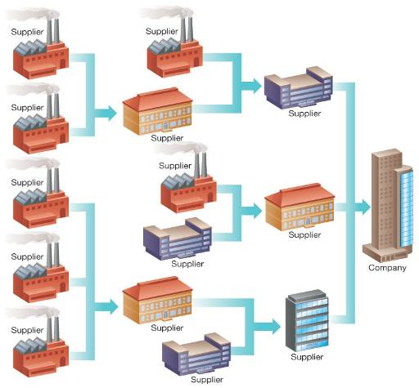
Supply Network:
Supply Network:
A network of multiple (sometimes related) producers of supplies that a company uses
Web-based EDI technologies enable information sharing via a company extranet and portals

Slide 5
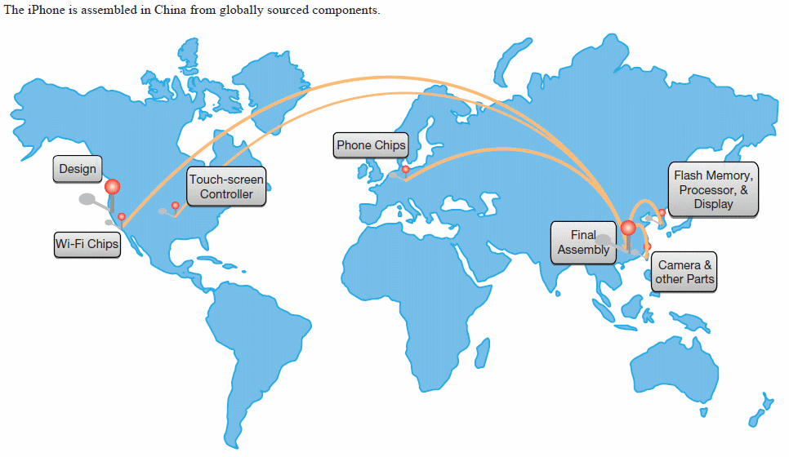
Supply Chain for Apple’s iPhone

Slide 6
Benefits and Problems with Supply Chains
Potential benefits (the well oiled machine!)
  Process innovations
  Just-In-time Production (JIT)
  Vendor-Managed Inventory (VMI)
Potential problems (with primitive supply chains)
  Distorted information
  Excessive inventories
  Inaccurate manufacturing capacity plans
  Missed product schedules

Slide 7
Corporate Social Responsibility
Transparency and accountability within the supply chain helps save costs and create a good image.
Product Recalls
  Shortcuts on quality standards
  Examples
    Cadmium in McDonald’s Shrek-themed glasses
    Johnson & Johnson children’s medicines
    GM – faulty ignition switches
  It is, therefore, very important to have complete information throughout the supply network of all the suppliers
Sustainable Business Practices
  Ethical treatment of workers
  Green image

Slide 8

Supply Chain Disruption
When disruptions in the supply chain occur because of weather, labor issues, or natural disasters, the operations of the business can be devastated and have ripple effects throughout the world.
Tsunamis in the Pacific
Dock strike in California
Volcano eruption in Iceland and supply chain disruption
  Kenya: flowers and vegetables
  Netherlands: tulips and peonies
  Italy: cheeses

Slide 9
Just-in-Time Production (JIT)
Keeping inventory is costly (storage, capital, missed production schedules).
JIT optimizes ordering quantities.
  Parts and raw materials arrive when needed for production.
  As orders arriver in smaller quantities, but at higher frequency) investment in storage space and inventory is minimized.
The approach was pioneered by Toyota.
It is used extensively by computer manufacturers to avoid component obsolescence (Moore’s law).
  Example: Dell keeps only two hours of inventory in stock
JIT requires tight cooperation between all partners in the supply network.

Slide 10
Vendor-Managed Inventory (VMI)
VMI is a business model in which suppliers manage the manufacturer’s (or retailer’s) inventory levels based on pre-established service levels.
Supplier monitors stock levels and sales data.
VMI requires manufacturer (retailer) to share real-time data.
Benefits
  Cost savings
  Minimized stock-out situations
  Accurate forecasts
  Reduced errors
  Prioritized goods shipments

Slide 11
The Bullwhip Effect:
Definition: Large fluctuations in suppliers’ forecasts caused by small fluctuations in demand for the end product and the need to create safety buffers
Ripple effects in which forecast errors and safety stocks multiply when moving up the supply chain
Happens when businesses include safety buffer to prevent stock-outs
Small end-product demand fluctuations cause large fluctuations further up the supply chain.
Small forecasting errors at end of supply chain cause large errors further up the supply chain.
Integrated business processes help mitigate the bullwhip effect.

Slide 12
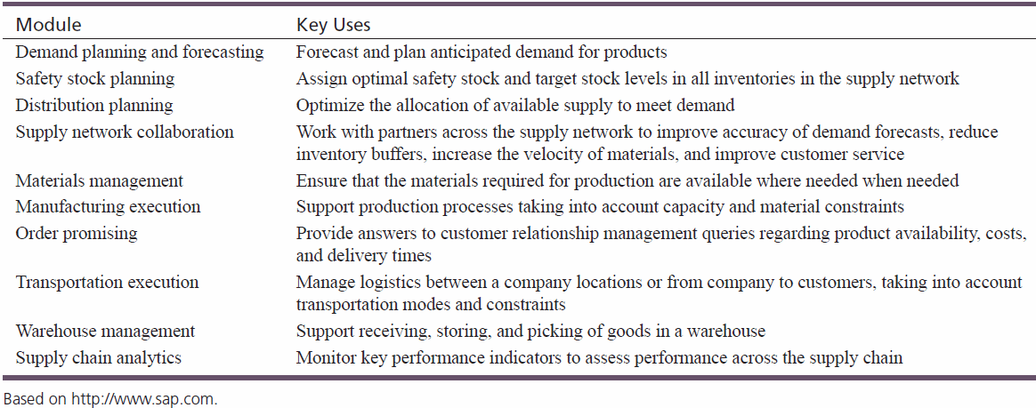
Functions That Optimize the Supply Network
Supply Chain Management (SCM) improves the coordination of suppliers, product or service production, and distribution.
Has two main objectives: to accelerate product development and innovation while reducing costs.

Slide 13
Integrating SCM with ERP and CRM
ERP systems are primarily used to optimize business processes within the organization.
SCM is used to improve business processes that span organizational boundaries.
Tight ERP/CRM/SCM integration reaps great benefits.
SCM uses data about customer orders (from CRM) and payments (from ERP).

Slide 14
Supply Chain Planning (SCP)
Four types of plans are developed:
  Demand planning and forecasting
    Examination of historic data
  Distribution planning
    Delivering products to consumers
    Warehousing, delivering, invoicing, and payment collection
  Production scheduling
    Coordination of activities needed to create the product/service
    Optimization of the use of materials, equipment, and labor
  Inventory and safety stock planning
    Development of inventory estimates

Slide 15
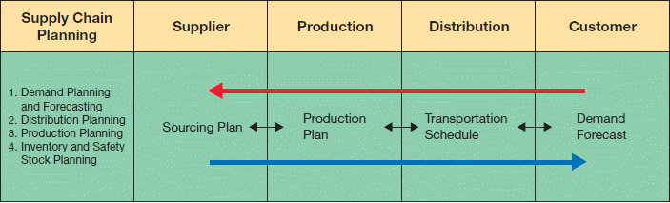
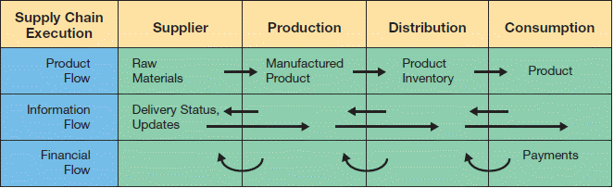
SCM Architecture
SCM modules support two functions.
  Supply chain planning (SCP) —development of resource plans to support production.
  Supply chain execution(SCE) —efficient flow of products, information, and financing.

Slide 16
Emerging SCM Trends
Key trends
  Supplier portals
  Customer portals
  Business-to-business (B2B) marketplaces:
    Many buyers and many sellers can come together
    Popular trading exchanges:
    www.scrapsite.com (steel)
    www.paperspace.com (paper)
    www.sciquest.com (medical equipment)
Key enabling technologies
  Extensible Markup Language (XML)
  Radio Frequency Identification (RFID)

Slide 17
B-2-B Portals
An access point or front door through which a business partner accesses secured proprietary information from an organization – typically using extranets.
Enables interactions between a single company and its suppliers or customers
Portals allow access to critical info needed to conduct business – portals provide productivity gains and cost savings for B2B transactions.
Supplier Portals and Customer Portals
  Supplier Portals:
    Automate the business processes involved in purchasing or procuring products between a single buyer and multiple suppliers
  Customer Portals:
    Automate the business processes involved in selling or distributing products from a single supplier to multiple buyers
Supplier Portal
Customer Portal
Single Supplier Multiple Buyers
Multiple Suppliers Single Buyer

Slide 18
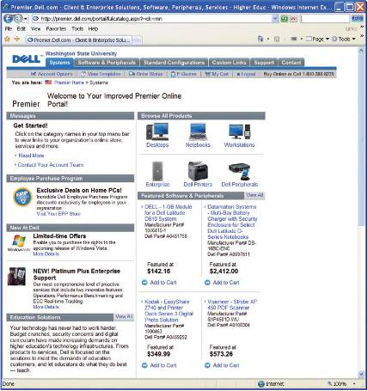
Example: B2B Customer Portal
An enterprise portal designed to automate the business processes that occur before, during and after sales between a supplier and multiple customers.
Business customers can manage all phases of the purchasing cycle
Notes:
Automation of business processes between supplier and multiple customers
Before transaction
During transaction
After transaction
Customers can manage all phases of the purchasing cycle!

Slide 19
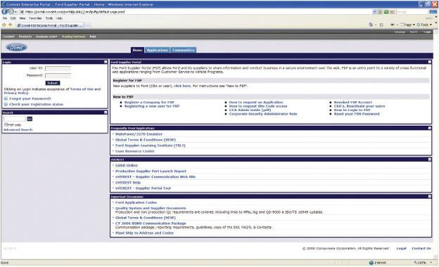
Example: Procurement Portal
Supplier Portals
- A subset of an organization’s extranet designed to automate the business processes that occur before, during an after sales have been transacted between a single buyer an multiple suppliers.
-Also referred to as sourcing portal or procurement portal.
Notes:
Automation of business processes between a buyer and multiple suppliers

Slide 20
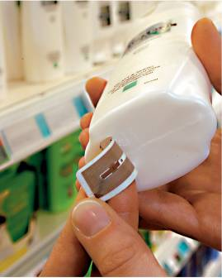
Radio Frequency Identification (RFID)
RFID tags will soon replace standard bar codes.
  RFID is the use of electromagnetic energy to transit energy between a reader (transceiver) and the tag (antenna).
  Line-of-sight reading is not necessary.
  RFID tags can contain more information than bar codes.
Tags are programmable, so there is a vast array of potential uses.
Scanning can be done from greater distance.
  Passive tags—inexpensive, range of few feet.
  Active tags—more expensive, range of hundreds of feet.
Source: METRO AG.

Slide 21

NET STATS
RFID on the Rise
RFID on the Rise
  Expected growth of 28 percent between 2010 and 2013 ($11 billion revenue)
  Software and services play an increasingly larger role to help companies utilize RFID-generated data.
  Adoption in health care, retail, automotive, packaged goods, government, transportation
  Requires large start-up investment, but provides strong long-term ROI

Slide 22
Supply Chain Visibility and Analytics
Supply chain visibility—the ability to track products as they move through the supply chain but also to foresee external events.
Supply chain analytics—the use of key performance indicators to monitor performance of the entire supply chain, including sourcing, planning, production, and distribution.

Slide 23
Customer Relationship Management
Supply Chain Management
Describe supply chain management systems and how they help to improve interorganizational business processes.
Customer Relationship Management
Describe customer relationship management systems and how they help to improve the activities involved in promoting and selling products to customers as well as providing customer service and nourishing long-term relationships.

Slide 24
Question?
Forget about MIS and technology and computer systems…as a business professional, what do you think about when it comes to attracting and retaining the most profitable customers?
What information do you need to do these things?

Slide 25
Sales - “Art” or “Science”?
If you asked a good salesman, is sales an “art” or a “science”, what would they say?
If you asked a great salesman, is sales an “art” or a “science”, what would they say?
CRM adds the “science” to sales and makes good salesmen great!

Slide 26
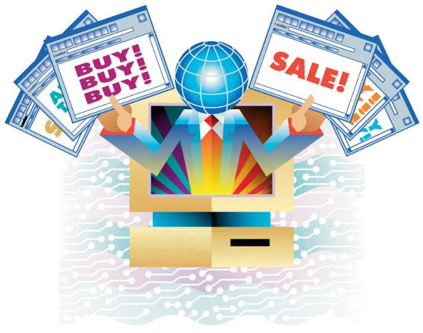
Customer Relationship Management (CRM)
Organizations must work harder than ever to attract and retain customers where comparison shopping is the norm and competitors are just a click away.
Customers have the power.
Economic transformation is taking place; i.e., from transactions to relationships.
Keeping customers satisfied is key.

Slide 27
Customer Relationship Management (CRM)
Involves managing all aspects of a customer’s relationship to increase customer loyalty and retention and profitability
CRM Applications focusing on downstream information flows have 3 objectives:
Attract potential customers
Create customer loyalty
Portray a positive corporate image
  Managers need to be able to monitor and analyze factors driving customer satisfaction.
Notes:
Customer relationship management (CRM) – involves managing all aspects of a customer’s relationship with an organization to increase customer loyalty and retention and an organization's profitability
CRM is not just technology, but a strategy, process, and business goal that an organization must embrace on an enterprise-wide level
CRM can enable an organization to:
Identify types of customers
Design individual customer marketing campaigns
Treat each customer as an individual
Understand customer buying behaviors

Slide 28
Customer Relationship Management (CRM)
CRM is not just technology, but a strategy, process, and business goal that an organization must embrace on an enterprise-wide level.
CRM can enable an organization to:
Identify types of customers
Design individual customer marketing campaigns
Treat each customer as an individual
Understand customer buying behaviors
Notes:
Customer relationship management (CRM) – involves managing all aspects of a customer’s relationship with an organization to increase customer loyalty and retention and an organization's profitability
CRM is not just technology, but a strategy, process, and business goal that an organization must embrace on an enterprise-wide level
CRM can enable an organization to:
Identify types of customers
Design individual customer marketing campaigns
Treat each customer as an individual
Understand customer buying behaviors

Slide 29
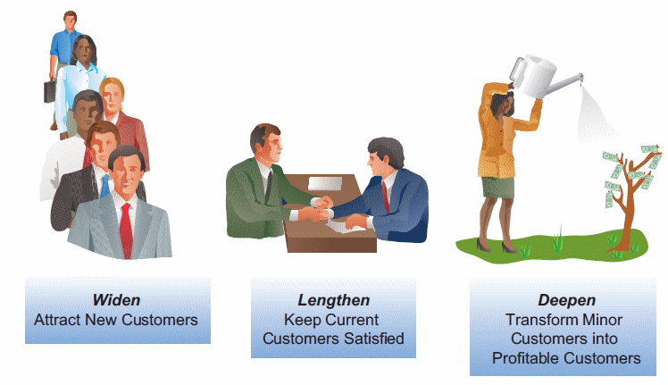
Customer Relationship Management(CRM) (cont’d)
Companies search for ways to widen, lengthen, and deepen customer relationships.

Slide 30
Key Benefits of CRM
Enables 24/7/365 operation
Individualized service
Improved information
Speeds problem identification/resolution
Speeds processes
Improved integration
Improved product development
Improved planning

Slide 31
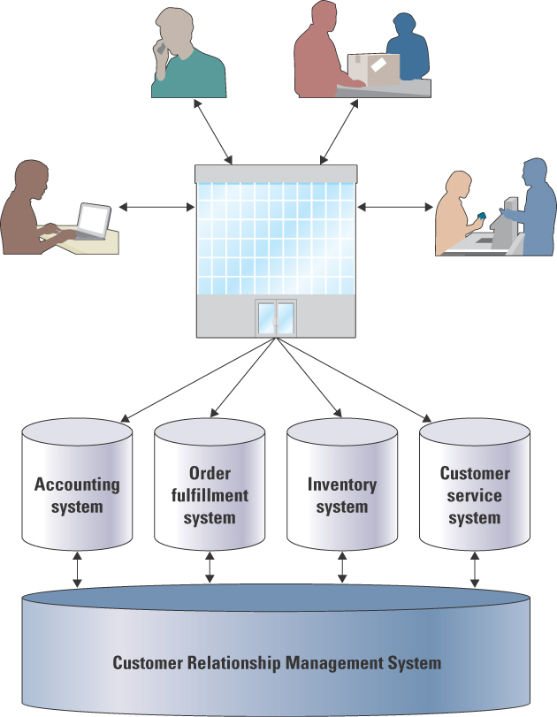
Customer Relationship Management
Like all enterprise systems, CRM spans many functional areas
Notes:
Multiple Contact Points
The goal is to provide a single, integrated view of all customer activity, available to all employees who interact with the customer.
Feedback, Individual Needs, and Cross Selling
Having better information enables workers to provide better service, meet the individual needs of each customer.

Slide 32
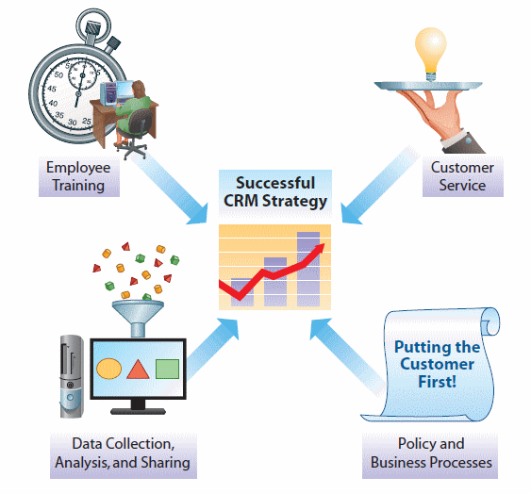
Developing a CRM Strategy
More than just software purchase and installation
Enterprise-wide changes

Slide 33
Policy and Business Process Changes
Policies and procedures need to reflect customer-focused culture.

Slide 34
Customer Service Changes
Key metrics need to reflect customer-focused measures of quality.
Companies that implement successful CRM strategy experience greater customer satisfaction.

Slide 35
Employee Training Changes
Employees from all business areas must value customer service and satisfaction.

Slide 36
Data Collection, Analysis, and Sharing Changes
All aspects of customer experience must be tracked, analyzed, and shared.

Slide 37
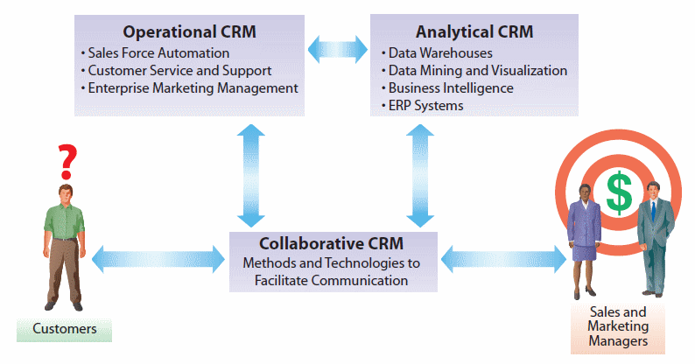
Architecture of a CRM Environment

Slide 38
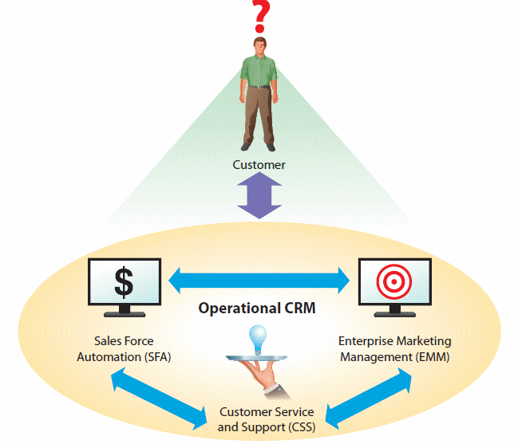
Operational CRM: fundamental business processes: Marketing, Sales, Support
Systems for customer interaction and service
  Enables direct interaction with customers
  Personalized and efficient customer service
  Access to complete information about customers

Slide 39
Sales Force Automation - SFA
Component of operational CRM
Supports day-to-day sales activities:
  Order processing and tracking
  Account and contact management
  Opportunity management
  Sales management
  Territory management
  Customer history preferences, (product and communication) management
  Sales forecasting and performance analysis

Slide 40
Examples of Sales Measures Tracked by SFA
Sales pipeline for each salesperson, including rating and probability
Revenue per sales person, per territory, or as a percentage of sales quota
Margins by product category, customer segment, or customer
Number of calls per day, time spent per contract, revenue per call, cost per call, ratio of orders to calls
Number of lost customers per period or cost of customer acquisition
Percentage of goods returned, number of customer complaints, or number of overdue accounts

Slide 41
Question
________ refers to systems that automate complaints, product returns, and information requests, among others.
  A) Customer service and support
  B) Sales force automation
  C) Enterprise marketing management
  D) Data warehouse
  E) Execution management

Slide 42
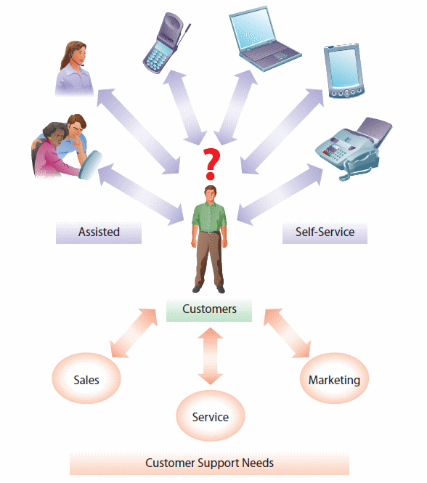
Customer Service and Support (CSS)
Second component of Operational CRM
Automation of traditional “help desk” services
Customer interaction center (CIC)
  Multiple communication channels (blogs, Facebook, phone, face-to-face, e-mail, and so on)
  Customer service anytime, anywhere through any channel
  Low support cost

Slide 43
Enterprise Marketing Management (EMM)
Third component of an operational CRM is Enterprise Marketing Management (EMM)
Improve management of promotional campaigns
  Make sure right messages are sent to the right people through the right channels
    Customer lists need to be managed carefully
    Individualized attention to each potential customer
  Extensive analytical capabilities that can help to analyze effectiveness of campaigns

Slide 44
Analytical CRM – one goal: a 360 degree view of the customer to maximize the outcomes of sales and marketing campaigns and t find the most profitable customers
Analysis of customer behavior and perceptions
Customized marketing
  Up-selling, cross-selling more profitable products and more profitable bundles of products or services tailored to specific customers
  Zip code, state, and regional analysis
  Customers’ preferred communication channels
  Retaining customers
Key technologies used to create predictive models for acquisition and retention:
  Data mining
  Takes into account: customer demand, product usage as well as competitors: price, quality, and satisfaction
Continuous data collection and analysis is necessary

Slide 45
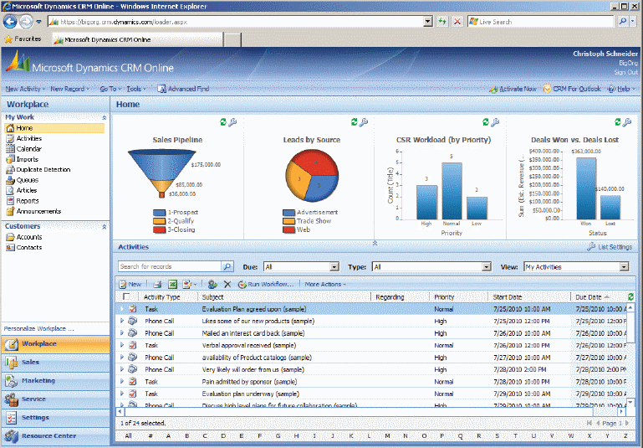
Digital Dashboards for CRM
Digital dashboards help to visualize key CRM performance metrics.

Slide 46
Customer Focused Business Processes Addressed by Analytical CRM
Marketing campaign management and analysis
Customer campaign customization
Customer communication optimization
Customer segmentation and sales coverage optimization
Pricing optimization and risk assessment and management
Price, quality, and satisfaction analysis of competitors
Customer acquisition and retention analysis
Customer satisfaction and complaint management
Product usage, life-cycle analysis, and product development
Product and service quality tracking and management

Slide 47
Collaborative CRM
CRM refers to systems providing effective and efficient communication with the customer from the entire organization.
  CIC is the key.
Collaborative CRM enhances communication:
  Greater customer focus
    Understanding of historical and current needs
  Lower communication barriers
    Communication preferences of the customer considered
  Increased information integration
    Customer information shared across the organization
    Customer can get status updates from any touchpoint

