Slide 1
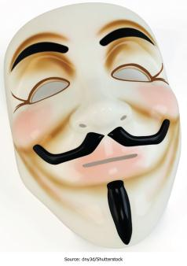
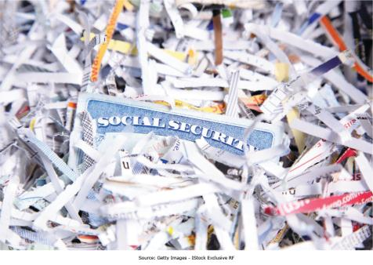
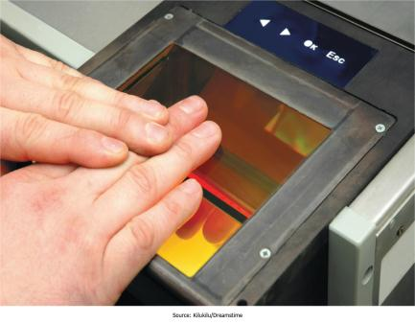
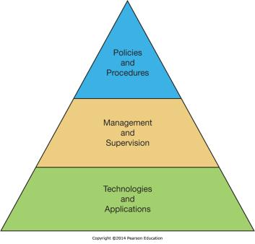
Chapter 10 - Securing Information Systems
IS Security is a critical aspect of managing in the digital world

Slide 2
MS in Information Technology Auditing and Cyber-Security
Risk
ITACS is about assuring the confidentiality, integrity and availability of a company’s systems
MIS
ACCT
Notes:
Info Tech Auditing and Cyber security
IT Risk is real to all organizations
Intersection of Risk, Accounting and MIS
We are looking for interested students from these, or related, disciplines

Slide 3
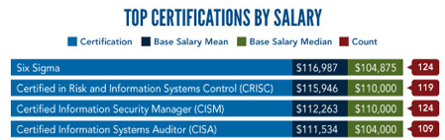
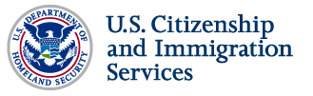
The Career
Public Accounting
Internal Accounting
Government Service
Corporate Security
IT Management
S.T.E.M.
Notes:
Jobs in a variety of sectors/industries
Fastest growing line of business in Big Four
IT Auditors used by IRS and FBI (counter terrorism and cyber-crime)
STEM = Science.Technology Engineering Math - ITACS only Fox degree recognized as STEM
STEM status means international students who graduate can work in US for up to 29 months without sponsorship

Slide 4
The MS ITACS Program
Ten plus courses, professional MS program
Professional certification (CISA) preparation
$1,000 per credit
Scholarships available
Looking for:
Accounting, Finance, MIS, or Risk majors
Some systems background
GPA 3.0 or higher
Notes:
Professionally oriented, hands on, graduate education in IT risk assurance.
You will work with many of the technology components that you will fine in the field
An executive coach will work with you on your business consulting skills
An experienced CISA who is familiar with the exam will help you prepare for the CISA exam

Slide 5
For more information about ITACS check out:
community.mis.temple.edu/itacs
Or contact:
Rich Flanagan, Director ITACS Program
215 204 3077
richard.flanagan@temple.edu

Slide 6
Chapter 10 Learning Objectives
Computer Crime
Define computer crime and describe several types of computer crime.
Cyberwar and Cyberterrorism
Describe and explain the differences between cyberwar and Cyberterrorism.
Information Systems Security
Explain what is meant by the term “IS security” and describe both technology and human based safeguards for information systems.
Information Systems Controls, Auditing, and the Sarbanes-Oxley Act
Describe how organizations can establish IS controls to better ensure IS security.
Managing IS Security
Discuss how to better manage IS security and explain the process of developing an IS security plan.

Slide 7
Can you identify this organization?
Within Any 24 Hour Period:
  Our firewall rejects 33.6 million suspicious or unauthorized connections
  Our antivirus software blocks more then 28,552 spyware and malware attempts
  Our intrusion prevention system screens and intercepts approximately 57,000 adverse events defined as malicious
  Our email system processes 2,166,666 e-mails
  Our email security system blocks 73% which are categorized as SPAM (excludes email)

Slide 8
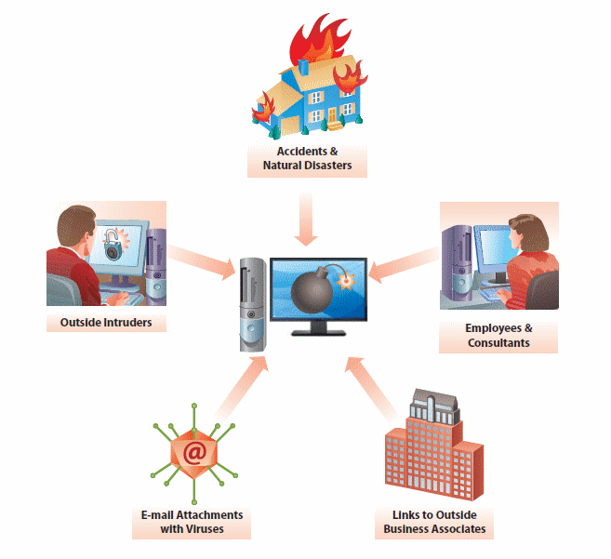
Primary Threats to Information
Systems Security
Natural disasters
  Power outages, hurricanes, floods, and so on
Accidents
  Power outages, cats walking across keyboards
Employees and consultants
Links to outside business contacts
  Travel between business affiliates
Outsiders
  Viruses

Slide 9
Computer Crime
Computer crime—The act of using a computer to commit an illegal act.
  Targeting a computer while committing an offense.
  Using a computer to commit an offense.
  Using computers to support a criminal activity.
Overall trend for computer crime has been declining over the past several years (CSI, 2011).
IS Risk Management, gaining an understanding of the interplay between:
  Threats: undesirable event that can cause harm
  Vulnerabilities: weakness in an organization’s systems or security policies
  Impact: Severity of the consequences if a threat causes damage by exploiting a vulnerability

Slide 10
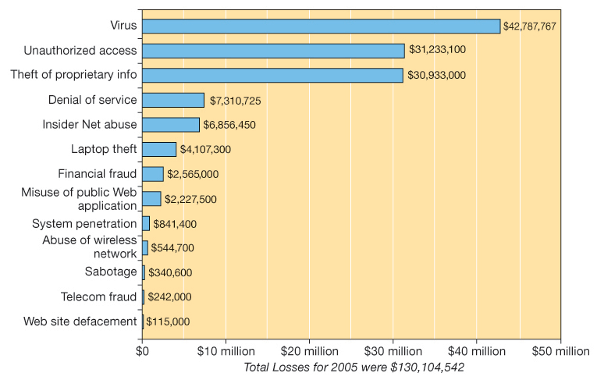
Types of Computer Crimes and Financial Losses
Computer Crime – A Fact of Life in the Digital Age
What do you think happens to a company’s stock price if they report that their systems have been compromised?
Would you report it if you didn’t have to?
Notes:
FBI Computer Crime and Security Survey
Figures based on a survey of 639 organizations
This was reported…how much wasn’t reported?

Slide 11
Worldwide losses due to software piracy in 2005 exceeded $34 billion.
Business Software Alliance, 2006
Worldwide losses due to software piracy in 2008 exceeded $50 billion.
Business Software Alliance, 2009
Worldwide losses due to software piracy in 2010 exceeded $59 billion.
Business Software Alliance, 2011
Notes:
http://www.bsa.org/country/News%20and%20Events/News%20Archives/global/05122009-idc-globalstudy.aspx
Have you ever gone to a friend’s house with a blank diskette or CD and copied a program, a game, music or a movie?
Has anyone offered to give you a “free” copy of a program or game?
How do you feel about making an illegal copy of such items?
Is it all right to let someone else copy your programs, games, music or movies as long as your own copies are not pirated?

Slide 12
Software Piracy
Legal activities
  Making one backup copy for personal use
  Sharing free software (shareware or public domain software)
Illegal activities
  Making copies of purchased software for others
  Offering stolen proprietary software (warez peddling)
Intellectual property
  Patents: process or machine inventions
  Copyrights: creations of the mind
  Various copyright laws applicable to software

Slide 13
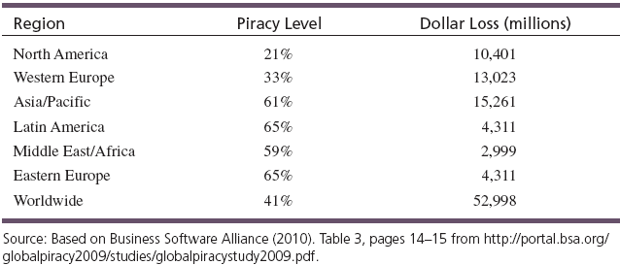
Software Piracy Is a Global Business
Worldwide losses exceeded $53 billion in 2008
Some factors influencing piracy around the world
  Concept of intellectual property differs between countries
  Economic reasons for piracy
  Lack of public awareness about the issue

Slide 14
Federal and State Laws
The two main federal laws against computer crime are:
  Computer Fraud and Abuse Act of 1986
    Stealing or compromising data about national defense, foreign relations, atomic energy, or other restricted information
    Violating data belonging to banks or other financial institutions
    Intercepting or otherwise intruding on communications between states or foreign countries
    Threatening to damage computer systems in order to extort money or other valuables from persons, businesses, or institutions
  Electronic Communications Privacy Act of 1986
    makes it a crime to break into any electronic communications service, including telephone services
    prohibits the interception of any type of electronic communications

Slide 15
Hacking and Cracking
Which one is the “bad guy”?
  Hackers
  Crackers
  Hacktivists
Notes:
Hacker – Someone who is knowledgeable enough to gain access to computer systems without authorization - done out of curiosity and not with the desire to do hard
Crackers – Those who break into computer systems with the intention of doing damage or committing a crime
Hacktivists – Those who attempt to break into systems or deface Web Sites to promote political or ideological goals (free speech, human rights, and antiwar campaigns

Slide 16
Types of Criminals
No clear profile as to who commits computer crimes
Four groups of computer criminals
  Current or former employees
    85–95% of theft from businesses comes from the inside
  People with technical knowledge committing crimes for personal gain
  Career criminals using computers to assist them in crimes
  Outside crackers hoping to find information of value
    About 10 percent of cracker attacks cause damage
Notes:
Unauthorized access: an IS security breach where an unauthorized individual sees, manipulates, or otherwise handles electronically stored information
Information Modification - an intentional change of electronic information by authorized users.e.g. crackers hack into a govt website and change info or when employees give themselves electronic raises or bonuses.

Slide 17
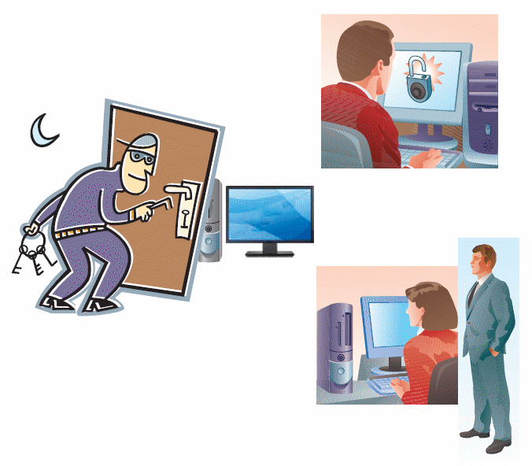
Unauthorized Access: an IS security breach where an unauthorized individual sees, manipulates, or otherwise handles electronically stored information
Examples:
  Employees do personal business on company computers.
  Intruders break into government Web sites and change the information displayed.
  Thieves steal credit card numbers and Social Security numbers from electronic databases, then use the stolen information to charge thousands of dollars in merchandise to victims.
  An employee at a Swiss bank steals data that could possibly help to charge the bank’s customers for tax evasion, hoping to sell this data to other countries’ governments for hefty sums of money.

Slide 18
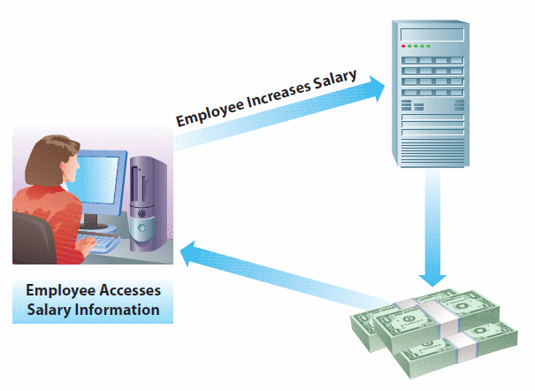
Information Modification:
An intentional change of electronic information by authorized users
User accesses electronic information.
User changes information.
  Employee gives herself a raise.

Slide 19
Other Threats to IS Security
Many times, computer security is breached simply because organizations and individuals do not exercise proper care in safeguarding information.
Examples:
  Keeping passwords or access codes in plain sight
  Failing to install antivirus software or keep up-to-date
  Continue to use default network passwords
  Careless about letting outsiders view computer monitors
  Failure to limit access to company files and system resources
  Failure to install effective firewalls or intrusion detection systems, or they install but fail to monitor them regularly
  Failure to provide proper employee background checks
  Unmonitored employees
  Disgruntled workers

Slide 20
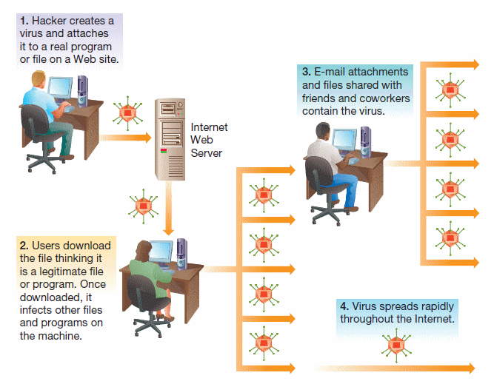
Computer Viruses and Other Destructive Code
Malware—short for “malicious software” such as viruses, worms, and Trojan horses.
Virus—a destructive program that disrupts the normal functioning of computer software:
  Replicates itself by sharing of files mainly through email attachments, removable media or file downloads from malicious websites

Slide 21
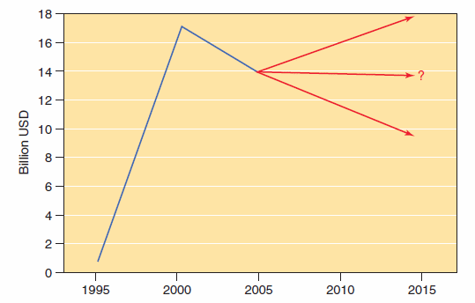
Computer Virus Attacks
Financial impact of virus attacks, 1995–2006, and beyond.
Source: Based on: http://www.computereconomics.com.
Notes:
2009 White house estimate suggested that cybercrime and industrial espionage approached US$1T/year – nearly 2% of global GDP
Virus attack – a virus is destructive program that disprupts the normal functioning of computer systems. Viruses differ fro other types of malicious code in that they can reproduce themselves – hence the name virus. They erase file on the hard drive of slow computer processing or otherwise compromise the system. Viruses infect a single computer and then spready to other computers if infected files are shared. Th3ey are planted in host computers but most ofen spread throug malicious email attachements, the sharing of removable media or dile downloads from malicous web sites

Slide 22
Worms, Trojan Horses, and Other Malware
Worm
  Variation of a virus that is targeted at networks, taking advantage of security holes; replicate endlessly across the Internet, causing servers to crash which denies access to Internet users
Trojan Horse
  Appears to be legitimate but carries a destructive payload
  Does not replicate, but causes damage. Codes are hidden
  Works in the background, establishing powerful unauthorized account for future intruders
Logic bombs or time bombs
  Variations of Trojan horses
  Time bombs are set off by specific dates; logic bombs are set off by certain types of operations.
Notes:
Former ee in MINN demanded $ to deactivate the time bomb he planted in company computers before it destroyed ee payroll records

Slide 23
Spyware
Hidden within freeware or shareware, or embedded within Web sites
Gathers information about a user without the user’s knowledge
  Credit card information which is transmitted to someone else – Identity
Eats up computer’s memory and network bandwidth causing sluggishness or system crashes
Adware
  Free software paid by advertisements
  Behavior tracking for marketing purposes
  Sometimes contains spyware
  Collects information for banner ad customization

Slide 24
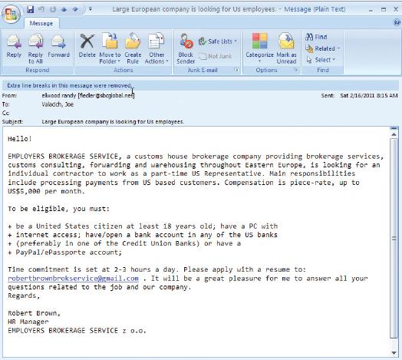
Spam
Electronic junk mail
Advertisements of products and services
Eats up storage space
Compromises network bandwidth
90 percent of all Internet e-mail is spam!
Spam filters can help

Slide 25
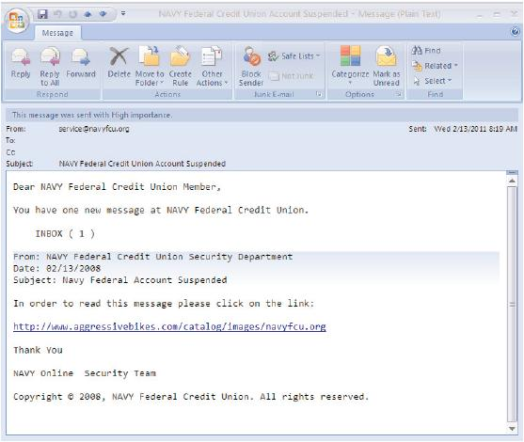
Phishing (Spoofing)
Attempts to trick users into giving away credit card numbers
Phony messages
Duplicates of legitimate Web sites
Examples: eBay, PayPal have been used
Spear phishing
Notes:
Spear phishing is more sophisticated fraudulent email attack that targets a specific person or organization – attacker needs specific info in order to optimally target the phishing message which can be gotten fro social media like facebook

Slide 26
Cookies
Cookies are messages passed to a Web browser from a Web server.
They are stored in a text file.
They are used for Web site customization.
Cookies may contain sensitive information
Managing cookies
  Cookie killer software
  Web browser settings – you can set levels of restrictions
Notes:
Normally used for legitimate purposes such as identifying a user in order to present a customized web page or for authentication purposes.
You can choose not to accept cookies. But then you may not be able to visit the site or it may not function properly. Eg. Ready the NY Times online, you must register by entering your name and other info. When you register your name and othe r inof the cookies are then stored on the machine. - If you don’t accept the cookies, you are not allowed to access the online paper most onlline shopping carts require cookies to function proplerly - can pose a risk because of stored credit card info.
Should go back and review and delete periodically

Slide 27
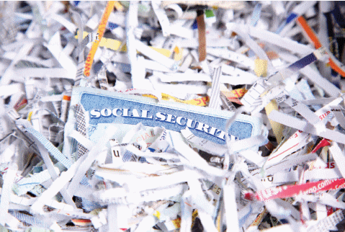
Identity Theft
Fastest growing “information crime”
Stealing another person’s:
  Credit card number
  Social Security number
  Other personal information
Results in bad credit for victim

Slide 28
Cyberwar and Cyberterrorism
Computer Crime
Define computer crime and describe several types of computer crime.
Cyberwar and Cyberterrorism
Information Systems Security
Explain what is meant by the term “IS security” and describe both technology and human based safeguards for information systems.
Information Systems Controls, Auditing, and the Sarbanes-Oxley Act
Describe how organizations can establish IS controls to better ensure IS security.
Managing IS Security
Discuss how to better manage IS security and explain the process of developing an IS security plan.
Describe and explain the differences between cyberwar and Cyberterrorism.

Slide 29
Cybersquatting
The practice of registering a domain name and later reselling it for $$$
Some of the victims include:
  Eminem
  Panasonic
  Hertz
  Avon
Anti-Cybersquatting Consumer Protection Act in 1999
  Fines as high as $100,000
  Some companies pay the cybersquatters to speed up the process of getting the domain
  Regardless, dealing with cybersquatting takes up valuable time and money
Notes:
World Intellectual Property Organization of the UN to stop others from using their name without permission

Slide 30
Cyber Harassment, Stalking, and Bullying
Cyber harassment—Crime that broadly refers to the use of a computer to communicate obscene, vulgar, or threatening content.
Cyber stalking
  Making false accusations that damage reputation of another
  Gaining information on a victim by monitoring online activities
  Using the Internet to encourage others to harass a victim
  Attacking data and equipment of a victim by sending e-mail viruses or other destructive code
  Using the Internet to place false orders for goods or services
Notes:
Against a group or person to express hatred or seek revenge

Slide 31
Cyberwar
Cyberwar—Military’s attempt to disrupt or destroy another country’s information and communication systems
  Goal is to diminish opponent’s communication capabilities.
  It is used in concert with traditional methods.

Slide 32
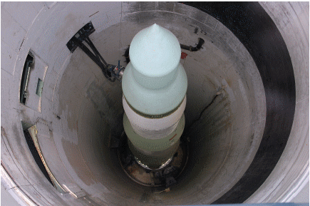
The New Cold War
A 2007 McAfee report on Internet security listed a cyber cold war as an imminent threat.
Reminiscent of the Cold War between the United States and the Soviet Union from the mid-1940s until the early 1990s —intelligence agencies are testing networks for possible weaknesses.
Patriot Hackers—independent
citizens that attack perceived
enemies of the state.

Slide 33
Cyberwar Vulnerabilities
Systems at risk:
  Command and control systems
  Intelligence collection and distribution systems
  Information processing and distribution systems
  Tactical communication systems and methods
  Troop and weapon positioning systems
  Friend-or-foe identification systems
  Smart weapons systems
Propaganda
  Web vandalism
  Cyber propaganda

Slide 34
Assessing the Cyberterrorism Threat
Internet infrastructure is extremely vulnerable to Cyberterrorism.
  Some successful attacks
    1991—Gulf War
      Dutch crackers stole information about the movement of U.S. troops and offered it for sale to Iraq.
      The Iraqis turned down the offer.
    2000—U.S. presidential elections
      Web sites were targeted by crackers with political motives.
      DoS attacks launched.
    2007—Government and bank networks within Estonia came under attack for the removal of a Soviet-era memorial.
    2010—Chinese-based hackers attacked Google who threatened to remove Chinese filter searches from the search engine.

Slide 35
Cyberterrorism
Governments are not involved.
Attacks can be launched from anywhere in the world.
Goal is to cause fear, panic, and destruction.
Cyberterrorism will likely become weapon of choice.

Slide 36
The Globalization of Terrorism
Increasing dependence on technology
Increasing possibilities of Cyberterrorism
International laws and treaties must evolve.
However: likelihood of large attacks is small.
  Successful large attack would require:
    Intelligence information
    Years of preparation
    At least $200 million

Slide 37
Obstacles to Cyberterrorism
Computer systems are complex and attacks may not have desired outcome.
Security measures are fast-changing.
Cyber attacks rarely cause physical harm to victims.

Slide 38
Information Systems Security
Computer Crime
Define computer crime and describe several types of computer crime.
Cyberwar and Cyberterrorism
Describe and explain the differences between cyberwar and Cyberterrorism.
Information Systems Security
Explain what is meant by the term “IS security” and describe both technology and human based safeguards for information systems.
Information Systems Controls, Auditing, and the Sarbanes-Oxley Act
Describe how organizations can establish IS controls to better ensure IS security.
Managing IS Security
Discuss how to better manage IS security and explain the process of developing an IS security plan.

Slide 39
Safeguarding IS Resources
Risk Analysis:
The value of the assets being protected is assesse, determine their probability with estimated costs of whatever protective measures will be taken.
Three General Ways to Respond/React:
Risk Reduction
  Actively installing countermeasures, antivirus software
Risk Acceptance
  Accepting losses that occur
  Some risks are better absorbed if and when they occur than by attempting to reduce them
Risk Transference
  A good strategy when a different entity is better positioned to accept and/or reduce risk, e.g.
    Insurance companies
    Outsourcing companies
Notes:
IS Resources face risks, and these risks are handled by businesses using three strategies, either individually or together.
Risk reduction is when we take steps to reduce the likelihood of an event, or the consequences of it. For example, installing an antivirus reduces the chance of getting infected, while regular hard drive backups limit the financial loss should a hard drive fail.
Risk acceptance is understanding that some risks are better absorbed if and when they occur than by attempting to reduce them.
Risk transference is a good strategy when a different entity is better positioned to accept and/or reduce the risk, for example an insurance company.
Risk Analysis: the value of the assets being protected is assesse, determine their probability with estimated costs of whatever protective measures will be taken

Slide 40
Information Systems Security
All systems connected to a network are at risk.
  Internal threats
  External threats
Information systems security
  Precautions to keep IS safe from unauthorized access and use
Increased need for good computer security with increased use of the Internet

Slide 41
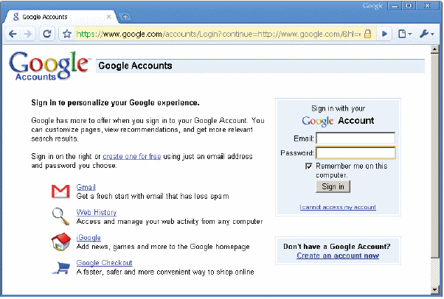
Technological Safeguards
Physical access restrictions
Authentication: confirming the identity of the user who is attempting to access a restricted system or website.
Authentication dependent on:
Something you have:
  keys
  smart card
  smart badge
Something you know:
  Password
  Code number
  PINs
  Lock combos
  Answers to security questions
Something you are: Unique Attributes:
  Fingerprints
  Voice patterns
  Retinal patterns.

Slide 42
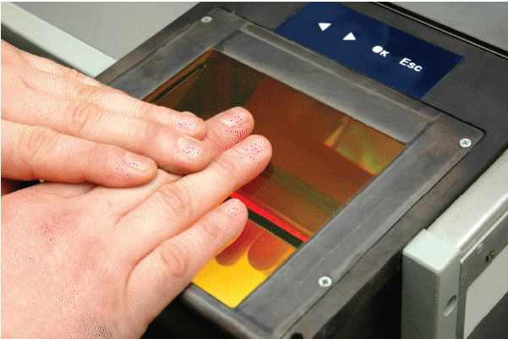
Biometrics
Form of authentication
  Fingerprints
  Retinal patterns
  Facial features and so on
Fast authentication
High security
Notes:
Many laptops now have fingertip readers; retinal scans at border crossings
Hong Kong – smart card and thumb prints

Slide 43
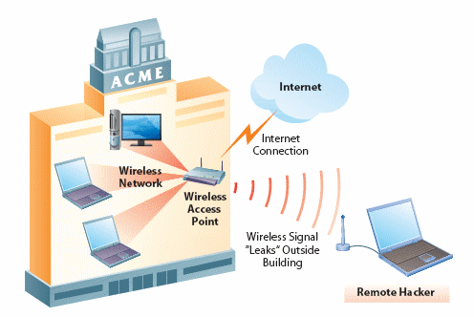
Wireless LAN Control - Refers to methods of configuring the LAN so that only authorized users gain access
Wireless LAN cheap and easy to install
Use on the rise
Signal transmitted through the air
  Susceptible to being intercepted
  Drive-by hacking
Notes:
Refers to methods of configuring the LAN so that only authorized users gain access

Slide 44
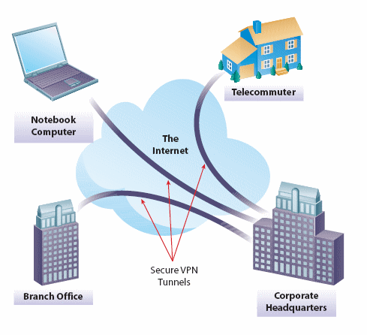
Virtual Private Networks - VPN
Connection constructed dynamically within an existing network
Widely in use
Tunneling
  Send private data over public network
  Encrypted information

Slide 45
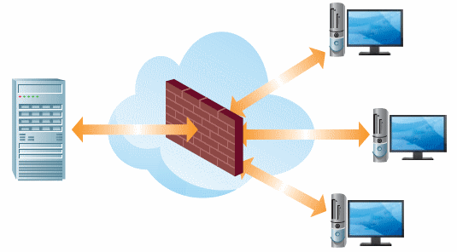
Firewalls- Virtual Security Fence
Firewall—A system designed to detect intrusion and prevent unauthorized access
Prevents Internet users from accessing VPNs, especially private corporate intranets
All messages entering or leaving the intranet pass through the firewall which examines each message and blocks those that don’t meet the specified criteria

Slide 46
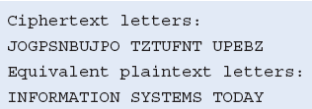
Encryption
Message encoded before sending; Message decoded when received
Uses a key that scrambles and decodes messages
Cryptography—the science of encryption.
  It requires use of a key for decoding.
Certificate authority—manages distribution of keys on a busy Web site.
Secure Sockets Layer (SSL)—popular public key encryption method.
Notes:
Scrambles them before they enter the airwaves or networks; decodes upon receipt.

Slide 47
Virus Monitoring and Prevention
Virus prevention
  Purchase and install antivirus software.
    Update frequently.
  Do not download data from unknown sources.
    Flash drives, disks, Web sites
  Delete (without opening) e-mails from unknown sources.
  Do not blindly open e-mail attachments
    Even if they come from a known source.
  Report any viruses to the IT department.

Slide 48
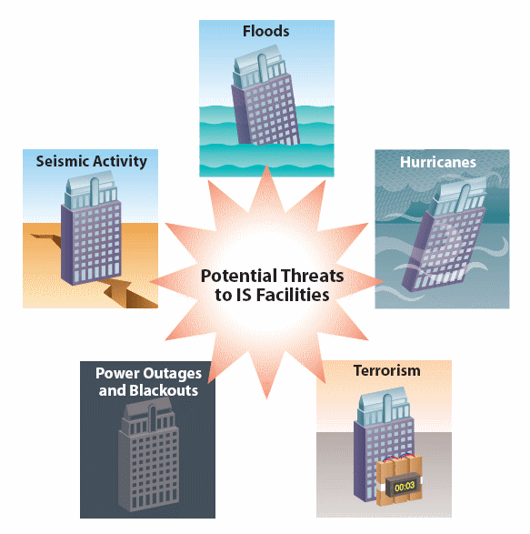
Secure Data Centers
Specialized facilities are important.
Technical Requirements
  Power
  Cooling
How do organizations reliably protect themselves from threats?

Slide 49
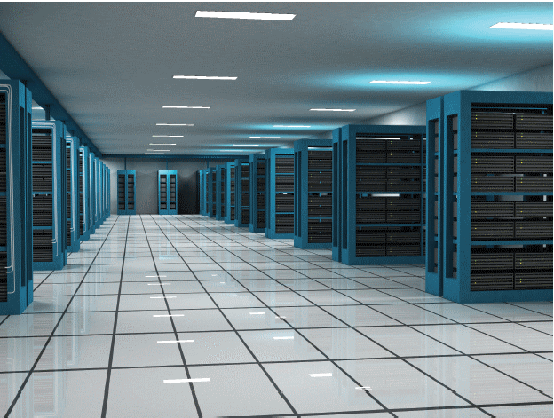
Ensuring Availability
High-availability facilities
  To ensure uninterrupted service
  Self-sufficient
  Backup cooling systems
  Raised floors (to more easily reconfigure systems)
  Built to withstand storms
Collocation facilities
UPS servers need 24/7/365 reliability

Slide 50
Securing the Facilities Infrastructure
Backups to important files to external hard drives
  Secondary storage devices
  Regular intervals
Backup sites - an organization’s office in a temporary location
  Cold backup site –empty facility with power and web servers
  Hot backup site – fully equipped facility, including redundant back-up of data
Redundant data centers
  Different geographic areas
Closed-circuit television (CCTV)
  Monitoring for physical intruders
  Video cameras display and record all activity
  Digital video recording
Uninterruptible power supply (UPS)
  Protection against power surges and potential information loss

Slide 51
Computer Forensics
Use of formal investigative techniques to evaluate digital information
  Evaluation of storage devices for traces of illegal activity
    Now common in murder cases
  Restoration of deleted files
Honeypots used to entice and catch hackers and crackers
  Example: DarkMarket operated by the FBI
Some criminals have special “booby-trap” programs to destroy evidence.
Effective Management is required; enter IT Security

Slide 52
Managing IS Security
Computer Crime
Define computer crime and describe several types of computer crime.
Cyberwar and Cyberterrorism
Describe and explain the differences between cyberwar and Cyberterrorism.
Information Systems Security
Explain what is meant by the term “IS security” and describe both technology and human based safeguards for information systems.
Information Systems Controls, Auditing, and the Sarbanes-Oxley Act
Describe how organizations can establish IS controls to better ensure IS security.
Managing IS Security
Discuss how to better manage IS security and explain the process of developing an IS security plan.
Notes:
Managing IS security is a constant challenge, in this section we discuss managing security and implementing an effective security plan.

Slide 53
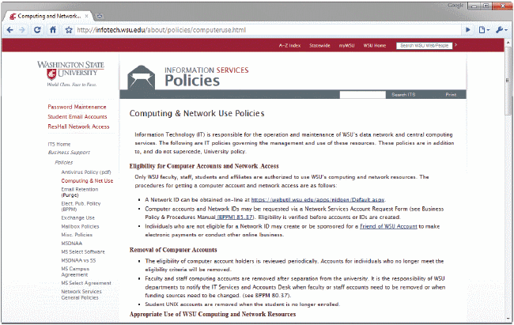
Managing Information Systems Security
Non-technical safeguards
  Management of people’s use of IS
    Acceptable use policies
  Trustworthy employees
  Well-treated employees
Notes:
Acceptable use policies – computer and internet usage policies for employees and contractors within an organziation with clearly spelled out penalties for non-compliance

Slide 54
Disaster Planning
Disasters can’t be completely avoided. Need to be prepared.
Business continuity plan
  describes how a business resumes operation after a disaster
Disaster recovery plan
  Subset of business continuity plan
  Procedures for recovering from systems-related disasters
  Two types of objectives
    Recovery time objectives (Maximum time allowed to recover)
    Recovery point objectives (How current should the backup material be?)
      Mission critical data should have complete redundancy, e.g. transactions
      Data mining could wait longer without disrupting primary business processes

Slide 55
Information Systems Controls, Auditing, and the Sarbanes-Oxley Act
Computer Crime
Define computer crime and describe several types of computer crime.
Cyberwar and Cyberterrorism
Describe and explain the differences between cyberwar and Cyberterrorism.
Information Systems Security
Explain what is meant by the term “IS security” and describe both technology and human based safeguards for information systems.
Information Systems Controls, Auditing, and the Sarbanes-Oxley Act
Describe how organizations can establish IS controls to better ensure IS security.
Managing IS Security
Discuss how to better manage IS security and explain the process of developing an IS security plan.

Slide 56
Hierarchy of IS Controls

Slide 57
Types of IS Controls
Policies
  Define aim and objectives.
Standards
  Support the requirements of policies.
Organization and management
  Define the lines of reporting.
Physical and environmental controls
  Protect the organization’s IS assets.

Slide 58
Types of IS Controls (cont’d)
Systems software controls
  Enable applications and users to utilize the systems.
Systems development and acquisition controls
  Ensure systems meet the organization’s needs.
Application-based controls
  Ensures correct input, processing, storage, and output of data; maintain record of data as it moves through the system.

Slide 59
IS Auditing
Information Systems audit
  Performed by external auditors to help organizations assess the state of their IS controls.
    To determine necessary changes
    To assure the IS availability, confidentiality, and integrity
Risk assessment
  Determine what type of risks the IS infrastructure faces.
Computer-Assisted Auditing Tools (CAAT)
  Specific software to test applications and data, using test data or simulations.

Slide 60
The Sarbanes-Oxley Act
The Sarbanes-Oxley Act was formed as a reaction to large-scale accounting scandals.
  WorldCom, Enron
It primarily addresses the accounting side of organizations.
Companies have to demonstrate that:
  controls are in place to prevent misuse and fraud,
  controls are in place to detect potential problems, and
  measures are in place to correct problems
COBIT (Control Objectives for Information and Related Technology)
  Set of best practices
    Help organizations to maximize the benefits from their IS infrastructure
    Establish appropriate controls

