Slide 1
JavaScript and the DOM
MIS 2402
Maxwell Furman
Department of MIS
Fox School of Business
Temple University

Slide 2
Let’s talk about…
Chapter 6
What DOM short for?
What’s a DOM node?
How can you manipulate the contents of a node?

Slide 3
Agenda
Discuss the DOM and the node interface
Identify some commonly used DOM nodes
Identify some commonly used node properties
Use simple node properties and the click event to manipulate an HTML form
Use an array to work with a collection of nodes

Slide 4
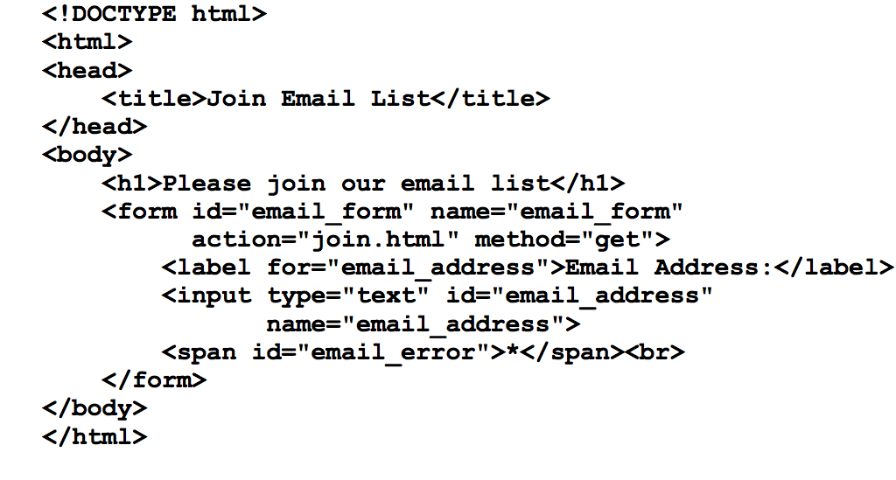
The code for a web page

Slide 5
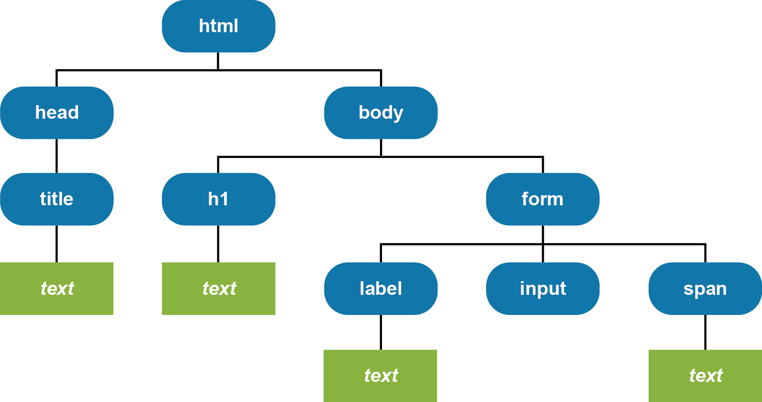
The DOM for the web page
This node would contain attribute nodes of id and name
All this is contained in a document node
The above depicts nodes of type element and text.

Slide 6
Nodes and Properties
The DOM nodes that are commonly used
Some of the properties of the Node interface
Let’s see an example of this (See dom_1.html in dom.zip)

Slide 7
Some Node Methods
Let’s see an example of this (See dom_2.html in dom.zip)

Slide 8
Don’t miss this!
Step 1 – Select some elements to work with
Step 2 – Take some action on each element
Next week we will talk about a library called jQuery that, among other things, will allow us to reduce these two steps to a single line of code. But let's not get ahead of ourselves...

Slide 9
innerHTML and other shortcuts
If navigating to “child node” and then to “node value” to manipulate the content of a tag seems cumbersome… your instinct is correct!
We can be thankful for maturing HTML standards for giving us shortcuts like the innerHTML property that are a little easier to work with.
Let’s see an example of this (See dom_3.html in dom.zip)

Slide 10
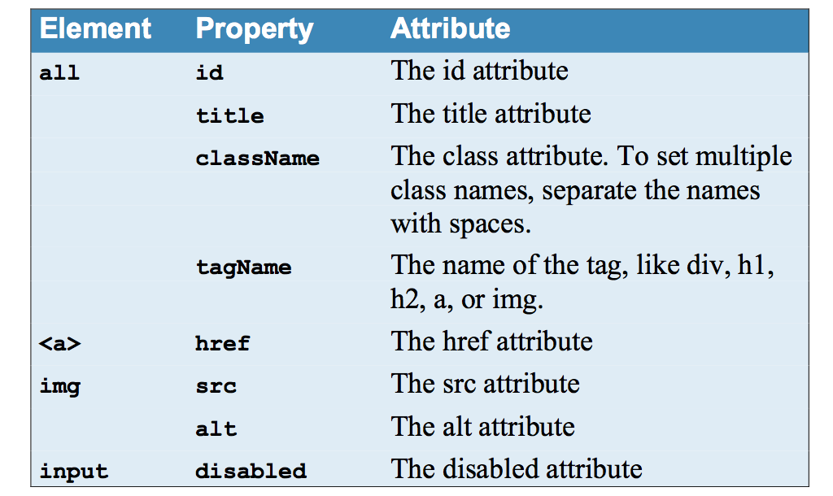
More HTML DOM properties that are nice

Slide 11
How the DOM HTML specification can simplify your code

Slide 12
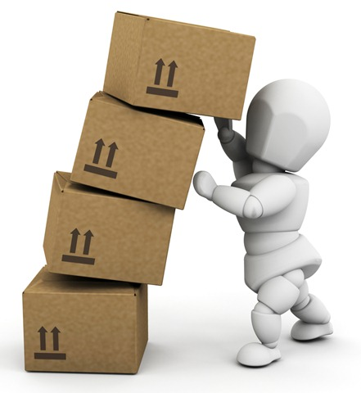
A word of caution
It’s important to remember that the world wide web began in 1990. HTML, JavaScript and CSS have all be evolving over the past three decades.
That means there are a lot of ideas that build on each other. Industry standards have been added and refined over that 30 year period. It also means that there’s always more that one way to do any task.
Next class, we’ll be introducing jQuery – a JavaScript library that was created to simplify common tasks. When we do that, we’ll need to exercise some judgement about when we can use “pure” JavaScript and when we can use one of the “shortcut” methods jQuery gives us.

Slide 13
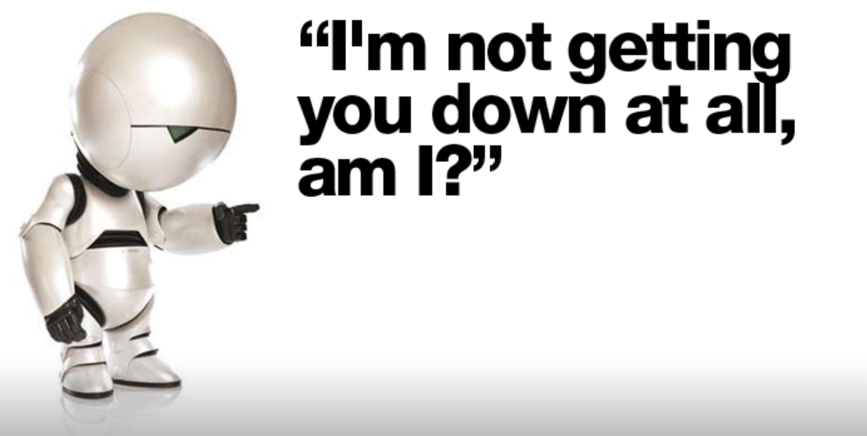
Let’s see what we can build …

