Slide 1
Form Validation (with jQuery, HTML5, and CSS)
Maxwell Furman
Department of MIS
Fox School of Business
Temple University

Slide 2
Let’s think about…
Chapter 6
What is data validation? When we talk about “form validation” what is it we’re trying to do?
What is one of the HTML5 controls that was created to simplify validation?
What’s a regular expression?

Slide 3
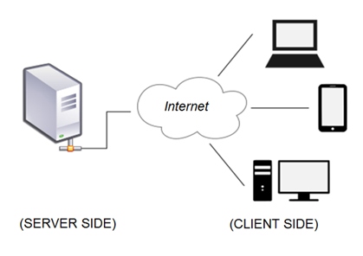
Thinking some more…
Where does our JavaScript/jQuery code run?
Where does data validation need to take place?
What has been our focus in this course?
THE POINT IS: Today we are only focusing on half of what is needed for effective validation of user-provided data. We are focusing on the client-side half. This whole course focuses on just the client side of application development. Server-side resources are explored in MIS3502.

Slide 4
Revisiting HTML forms
The HTML
As seen in the browser…
<h1>Registration Form For Sports</h1>
<form action='http://misdemo.temple.edu/demo_post/handler/' method='post’ id=‘sports_form’>
<label for='player_name'>Name</label>
<input type='text' id='player_name' name='player_name'><br>
<label for='surname'>Sur Name</label>
<input type='text' id='surname' name='surname'><br>
etc. etc. etc.
<input type=‘button' name='button_register' value='register'>
</form>
Recall the purpose of “action” and “method” in the form tag. Note that here we are specifying an input of type button. The form submit action will be initiated from the JavaScript/jQuery.
What’s the point? stop “bad” data user might provide before it is ever sent!

Slide 5
Options for form (data) validation
#2. HTML5 added new controls and attributes intended to simplify form validation. It is taking the major browsers some time to catch up to the specification and support them all. We will focus on the most widely supported options.
#3. CSS – all on its own – doesn’t provide form validation. But CSS3 did introduce special selectors related to form validation.
HTML
JavaScript
CSS
#1. JavaScript and jQuery have always been a good way to implement form validation. Of course, you need to write code to do specify the validation rules.
Today we will only focus on option #1 Let’s see an example: validate_01.html

Slide 6
Things we will want to be able to do…
Initiate form validation when a button is clicked
Get text out of a input tag of type text
Trim the text
Validate the value of a selection list
Validate the value of a selection radio button
Validate the value of a checkbox
Determine if the text matches a pattern… (like, an email address)
Submit the form if the data is good, show an error message if it’s not.
Place error messages in spans that are located next to the problematic data

Slide 7
.trim()
A String's trim method can be used to remove leading and trailing spaces from a string.
Specifically, "some string".trim() removes all newlines, spaces (including non-breaking spaces), and tabs from the beginning and end of the supplied string. If these whitespace characters occur in the middle of the string, they are preserved.
For example: var mytitle = " do androids dream? ".trim();
//var mytitle == 'do androids dream?'
Another way to use .trim() is to attach it as a method to another jQuery method. This is called chaining. For example: var some_variable = (‘#some_tag_id’).val().trim();
See example: validate_02.html

Slide 8
The value of a select tag
HTML Select Tag
Using jQuery to determine the value of an HTML select tag is a two-step process.
#1 - Give every <option> tag a value: <select id="idYourFav" name="favorite_color">
<option value="">Please choose</option>
<option value="red">Red</option>
<option value="orange">Orange</option>
</select>
#2 – Get the value of the selected item with jQuery:
$("#idYourFav").val()
Warning! There are a lot of different ways to do this. What we’re demonstrating here is one of the more simple approaches.
See example: validate_03.html

Slide 9
The value of a radio button
HTML radio buttons. All have the same name.
Get the value of the checked radio button with jQuery:
$("input[name=favorite_color]:checked").val()
See example: validate_04.html

Slide 10
The value of a checkbox
HTML checkboxes. All have different names.
Determining how many checkboxes are checked:
$("#idYourFav input[type=checkbox]:checked").length
See example: validate_05.html

Slide 11
Checking for a pattern (this one is tricky!)
Regular expressions are hard! But, others have gone before you, and compiled many helpful examples. See: http://regexlib.com/
Define the RegEx pattern. Put it in a variable.
var emailPattern = /\b[A-Za-z0-9._%+-]+@[A-Za-z0-9.-]+\.[A-Za-z]{2,4}\b/;
var email = $("#idYourEmail").val().trim();
if (!emailPattern.test(email) ) {
$("#idYourEmail").next("span").html("Invalid email address.");
isValid = false;
}
Get the data that you want to test. Trim it.
Now use the .test() method of the RegEx pattern to validate the string.
See example: validate_06.html

Slide 12
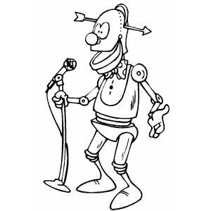
Programmer Joke
“Some people, when confronted with a problem, think ‘I know, I’ll use regular expressions.’ Now they have two problems.” -- Jamie Zawinski, Usenet 1997
Now, on to a challenge…

Slide 13
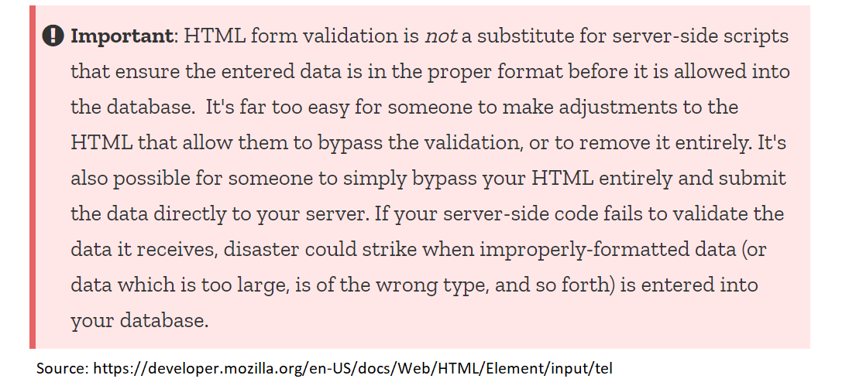
Recall from last time…
Where does our JavaScript/jQuery code run?
Where does data validation need to take place?
What has been our focus in this course?
THE POINT IS: Today we are only focusing on half of what is needed for effective validation of user-provided data. We are focusing on the client-side half. This whole course focuses on just the client side of application development. Server-side resources are explored in MIS3502.

Slide 14
Options for form (data) validation
#2. HTML5 added new controls and attributes intended to simplify form validation. It is taking the major browsers some time to catch up to the specification and support them all. We will focus on the most widely supported options.
#3. CSS – all on its own – doesn’t provide form validation. But CSS3 did introduce special selectors related to form validation.
HTML
JavaScript
CSS
#1. JavaScript and jQuery have always been a good way to implement form validation. Of course, you need to write code to do specify the validation rules.
Let’s see an example: validate_07.html

Slide 15
Things we will want to be able to do…
Explore the (new) HTML5 controls and attributes now available.
Understand why these controls have been slow to be adopted.
Take a second look at Regular Expressions.
Discover what a CSS pseudo class is, and how some can help with form validation.
Return to jQuery, and be able to identify a handler.

Slide 16
HTML5 controls and attributes
HTML5 controls for input data
RED = Not supported in Safari How can you know?
See: https://developer.mozilla.org/en-US/docs/Web/HTML/Element/Input#Browser_compatibility
Inconsistency is frustrating!…. ☹
The basic HTML5 attributes for working with forms
Let’s see an example: validate_08.html
Interactive examples: https://www.w3schools.com/html/html_form_input_types.asp

Slide 17
RegEx, again.
Last class we saw jQuery’s RegEx option and the jQuery test method. Today, we see that HTML5 has RegEx support too! The new attributes to use are “title” and “pattern”
See examples: validate_09.html
So, if you needed to validate a telephone number, and you have a choice between validation that uses an HTML5 control of tel and a email regex pattern, which would you choose? Which would be better? Why?

Slide 18
CSS pseudo classes
What’s a pseudo class? A CSS pseudo-class is a keyword added to a CSS selector that specifies a special state of the selected element(s). For example, :hover can be used to change a button's color when the user hovers over it.
An easy example:
/*apply the color when the mouse hovers over the div*/ div:hover {
background-color: #39c631;
}
There are three pseudo classes that are most relevant to form validation:
:required
:valid
:invalid
See some examples here: validate_10.html and validate_11.html

Slide 19
A little bit more jQuery
There are a number of jQuery methods that help us respond to events related to form validation. Here they are:
focus(handler)
blur(handler)
change(handler)
select(handler)
submit(handler)
We’re going to look at this one
In case you haven’t noticed… we’ve been using the idea of a handler for a while now.
A handler is function that executes in response to an event. A handler is always of the format:
function () { /*commands go here*/ }
See an example here: validate_12.html

Slide 20
Some thoughts…
Support for the new HTML5 input controls has come a long way since they were first recommended by the W3C in 2014.
However, we’ve seen today that their behavior is inconsistent across browser types. Likewise, they do not allow developers the full range of control that most solutions require. Prediction: As support for HTML5 controls continues to improve, they will eventually become mainstream.
Opinion: The desired level of support is not quite there yet. Question: Even if these controls were totally, universally supported – would developers embrace them? Do end users want *every* application to be the same? Why? Why not?

Slide 21
Time for a challenge…

