Slide 1
Introduction to AJAX and JSON
MIS 2402
Maxwell Furman
Department of MIS
Fox School of Business
Temple University

Slide 2
Final Exam Date
Your final exam will be on
Tuesday, Dec. 18th
5:45p - 7:45p

Slide 3
Exam #2 Date
Your next exam will be on
Tuesday, Nov. 6th
Study Session
Nov 2nd, 1-3pm

Slide 4
Visualizing what we have done so far…
Web Server
URL, referencing a web page
Browser
JavaScript Engine
HTTP Response
Database
This is called a “round trip”.
Round trips are relatively expensive (in terms of computing power). We’ve been using JavaScript form validation to prevent unnecessary round trips.
JavaScript/jQuery run here, in the browser, and do not interact with any resource outside the browser.

Slide 5
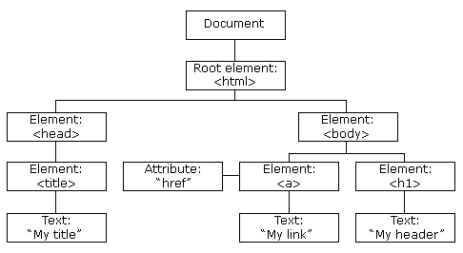
The DOM (Document Object Model)
JavaScript can change all the HTML elements in the page
JavaScript can change all the HTML attributes in the page
JavaScript can change all the CSS styles in the page
JavaScript can remove existing HTML elements and attributes
JavaScript can add new HTML elements and attributes
JavaScript can react to all existing HTML events in the page
JavaScript can create new HTML events in the page
All of these activities are accomplished through the properties and methods of objects. NEW FOR TODAY: We can use data, provided by AJAX, and present it in the DOM.
Source: http://www.w3schools.com/js/js_htmldom.asp

Slide 6
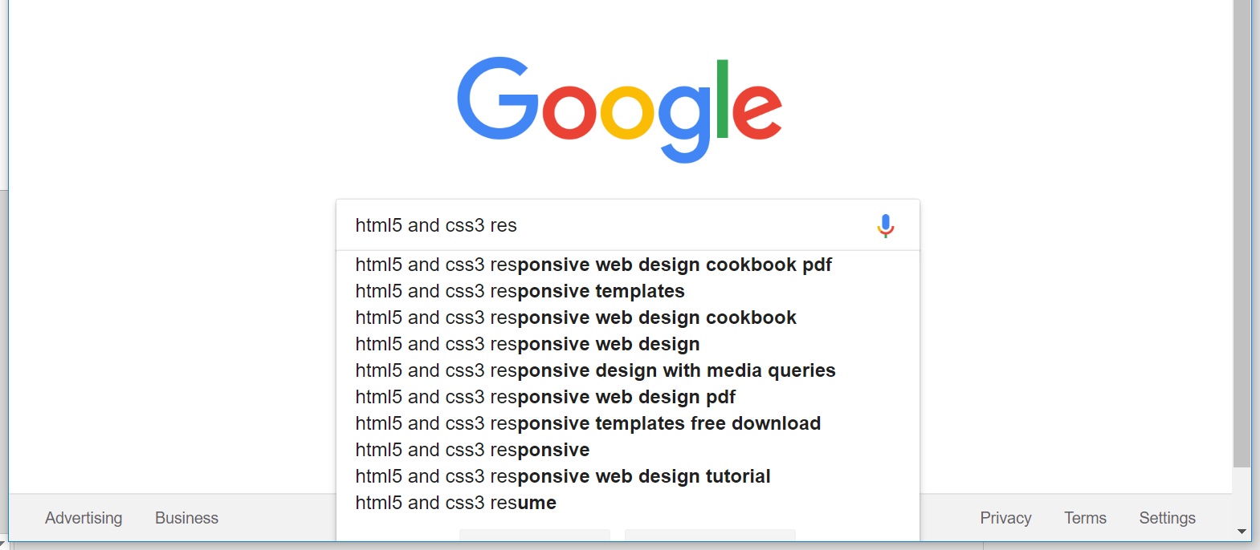
An AJAX call we see every day…

Slide 7
So, what’s AJAX?
Asynchronous
Javascript
And
XML

Slide 8
So, what’s AJAX?
Asynchronous
is the opposite of...

Slide 9
So, what’s AJAX?
Synchronous
"together in time"

Slide 10
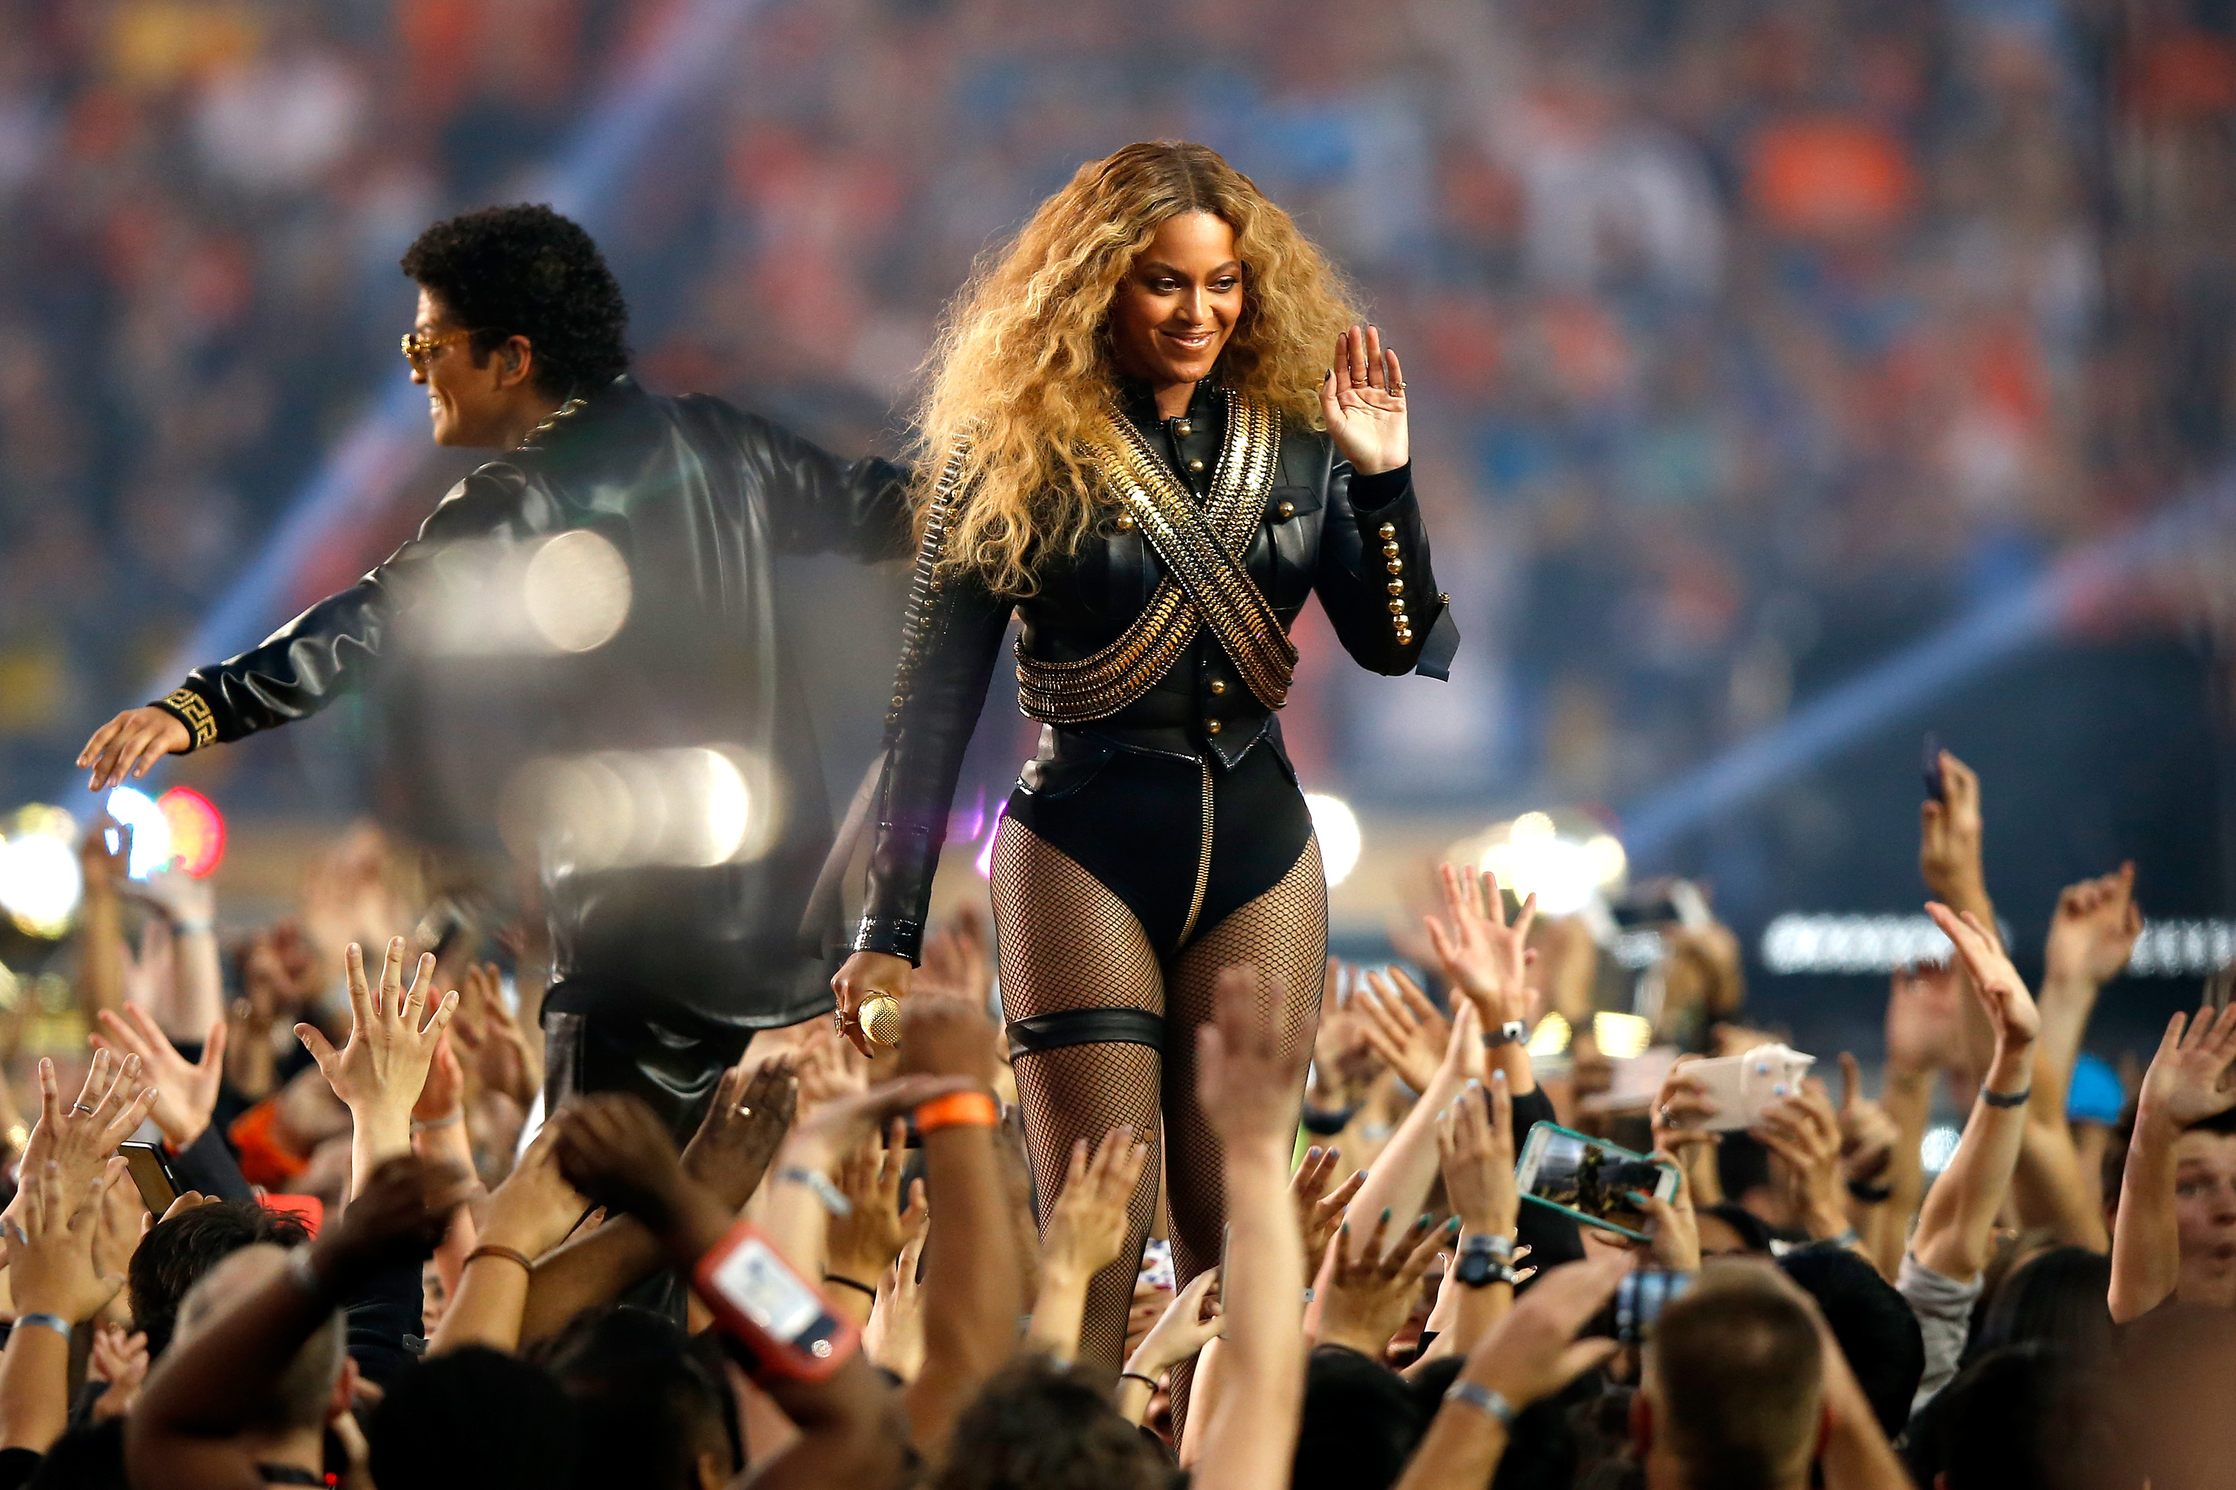
So, what’s AJAX?
Synchronous

Slide 11
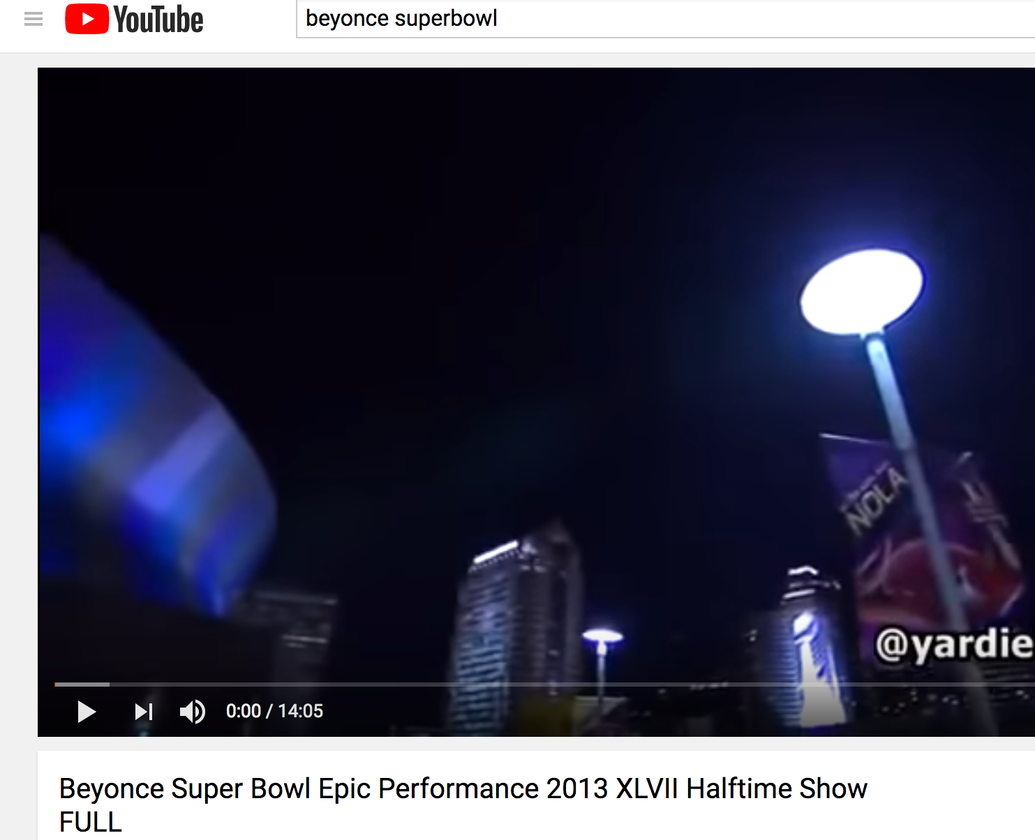
So, what’s AJAX?
Asynchronous

Slide 12
So, what’s AJAX?
VS

Slide 13
AJAX uses JavaScript to call web services
Web Server
URL, referencing a web page
Browser
JavaScript Engine
HTTP Response (the WHOLE page)
Database
Must load the whole page at once

Slide 14
AJAX uses JavaScript to call resources
Web server
Browser
HTTP Request
(just the data we need)
JavaScript Engine
Database
Can get new data without reloading the entire page

Slide 15
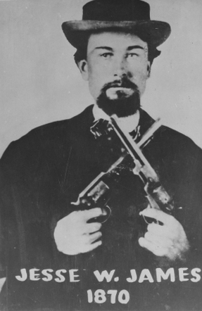
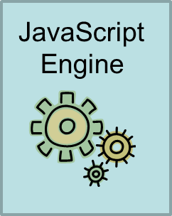
AJAX uses JavaScript to call Resources
Not this Jesse James! ☺
The term "Ajax" was publicly stated on 18 February 2005 by Jesse James Garrett in an article titled "Ajax: A New Approach to Web Applications", based on techniques used on Google pages.
This object acts like a browser, inside the browser. The object is used to retrieve a web resource.
XMLHttpRequest()

Slide 16
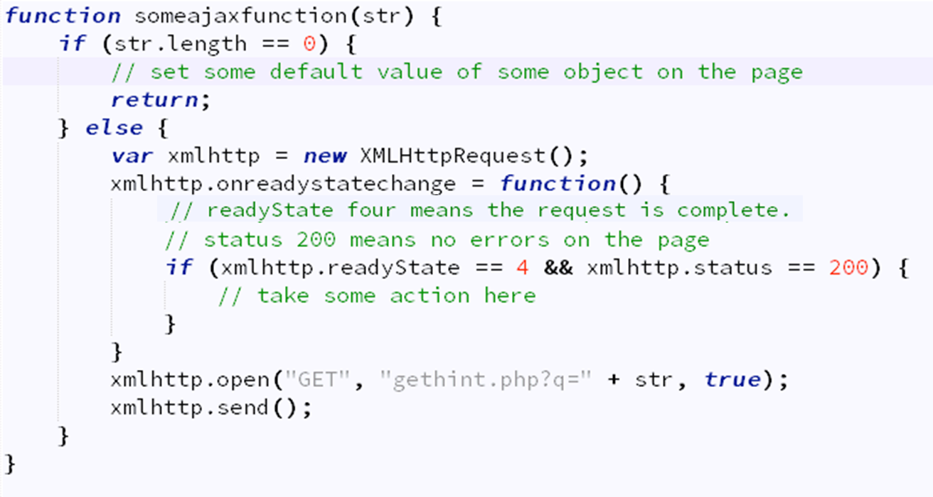
XMLHttpRequest allows us to do things like this…
☹

Slide 17
Or… using jQuery ☺
Yes, there really is a dot here.
There’s actually a piece here that we’re intentionally leaving out today. We would use an optional parameter here to send data to someurl
$.getJSON(someurl, function(result) { some things to do })
There are other jQuery methods used to do make Ajax calls:
.ajax()
.load()
.get() .post()
A list of jQuery Ajax methods can be found here:
https://www.w3schools.com/jquery/jquery_ref_ajax.asp
This piece is called “the callback function”.
It is the function, that runs, when the call to someurl comes back.

Slide 18
An Example
$.getJSON(
'http://www.weather.com/forecast/today',
function (forecast) {
$('#forecast').append(
'<p>Today's forecast is ' + forecast + '</p>'
);
}
);

Slide 19
So, what is JSON?

Slide 20
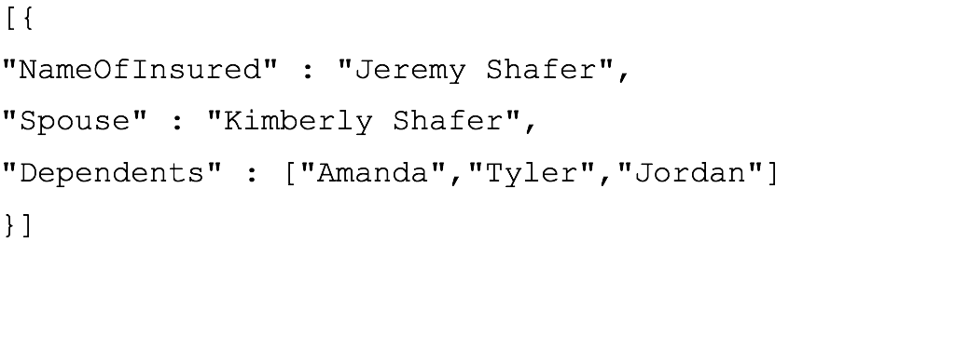
JSON
JSON is short for JavaScript Object Notation
JSON is an alternative to XML
A JSON object looks like this:

Slide 21
JSON vs. XML
An XML object looks a little like this: <Customer>
<NameOfInsured>Jeremy Shafer</NameOfInsured>
<Spouse>Kimberly Shafer</Spouse>
<Dependents>
<Firstname>Amanda</Firstname>
<Firstname>Tyler</Firstname>
<Firstname>Jordan</Firstname>
</Dependents> </Customer>

Slide 22
Where is JSON used?
Web server
Browser
HTTP Request
How is the data formatted? JSON? XML? Plain text?
JavaScript Engine
Database

Slide 23
Why JSON and XML are a big deal…
Back in the day, if you wanted to exchange data between two systems, you specified the format of a flat file.
For example:
NameOfInsured, Spouse, Dependent1, Dependent2, Dependent3
Jeremy Shafer, Kimberly Shafer, Amanda, Tyler, Jordan
Greg Mathews, Krista Mathews, Melonie, Lauren, William

Slide 24
Why JSON and XML are a big deal (2)
But this approach assumed that you could anticipate the quantities of all the attributes. The data transfer file was denormalized
So, sometimes an exception would occur because of an unexpected quantity of elements.
For example:
NameOfInsured, Spouse, Dependent1, Dependent2, Dependent3 Jeremy Shafer, Kimberly Shafer, Amanda, Tyler, Jordan, Ben
Greg Mathews, Krista Mathews, Melanie, Lauren, William
The data needs to be serialized in order to send it from one system to another without any limitation.
Uh oh! Dependent #4!

Slide 25
Then XML came along (circa 1998)
XML allowed us to represent an object with unspecified number of attributes, all in a single file.
XML was (and still is) verbose
JSON emerged as a more streamlined alternative. Originally defined in 2001, with adoption picking up in 2006.

Slide 26
JSON described
JSON (JavaScript Object) Notation, is an open standard format that uses human-readable text to transmit data objects consisting of attribute–value pairs. It is used primarily to transmit data between a server and web application, as an alternative to XML.
Although originally derived from the JavaScript scripting language, JSON is a language-independent data format. Code for parsing and generating JSON data is readily available in many programming languages.
At the end of the day… think key and value pairs in pattern:
{
“KEY” : “VALUE”,
“KEY” : “VALUE”,
“KEY” : “VALUE”
}
http://en.wikipedia.org/wiki/JSON

Slide 27
Let’s come back to this…
This is the callback function that will execute when the Ajax call is a success.
$.getJSON(someurl, function(result) { some things to do});
The URL to visit
Result is the simple object returned by the getJSON method.
One or more commands. I can use the data in result here!

Slide 28
Let’s slay this beast….

Slide 29
We’ve come a long way …

Slide 30
Things we’ve learned about
HTML and CSS
JavaScript
jQuery
jQuery as a tool for manipulating the DOM
jQuery as a tool for animating the DOM
Form validation using jQuery
Form validation using HTML5 controls and CSS3
Ajax and JSON
We even learned a little bit about Regular Expressions!

Slide 31
What for?
Every new concept we learn is a new tool in our mental toolbox.
This mental toolbox helps us:
Understand how applications work
Envision what’s possible
For example:
You might not be a great web designer, but you should know enough HTML and CSS to work with a good design template.
You might not know how to validate a time in military time… but you should know that there’s a regular expression for that!
You might not know how to write a chatbot, but there’s probably an API for that that uses Ajax and JSON!

Slide 32
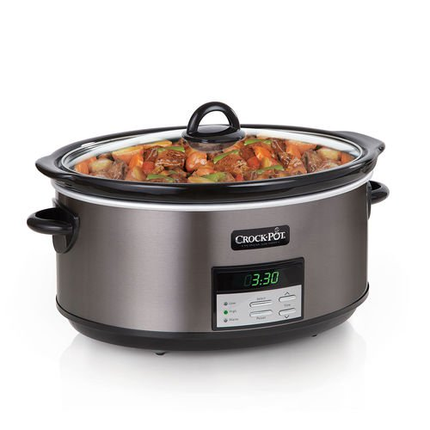
These next two classes …
We’re going to take a step back and let some of those big ideas simmer for a while.
In these next two classes we will be looking at some functionality in JavaScript itself.
This functionality is available to us without jQuery or any external resource!
jQuery is great at simplifying code. But it doesn’t simplify everything.
Think of these next two classes as “extra ingredients” to think about while we let the other material sink in.

Slide 33
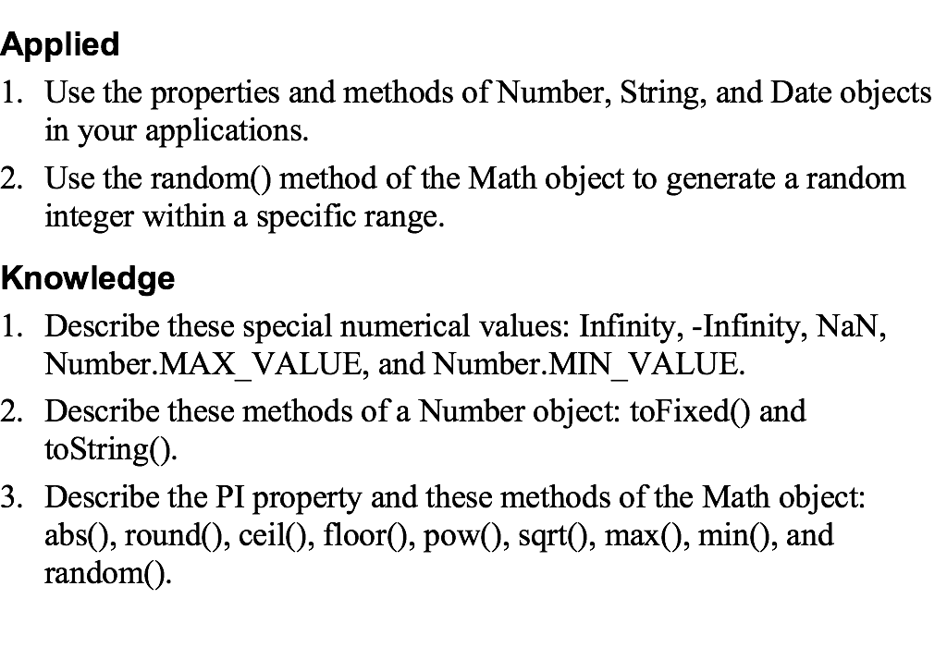
Objectives (this class and next)

Slide 34
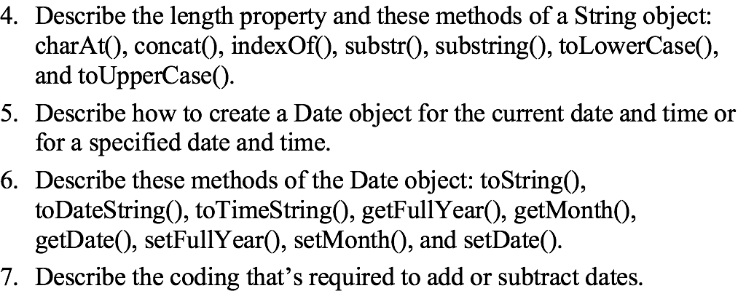
Objectives (continued)

Slide 35
Objects, objects, objects!
Recall that JavaScript and jQuery rely heavily on the notion of objects.
Some objects we have seen:
Window
Document
jQuery … which can also be written as $
We also observed that JavaScript arrays and strings are objects.
Here are two new objects for today:
Number
Math

Slide 36
Properties of the Number object

Slide 37
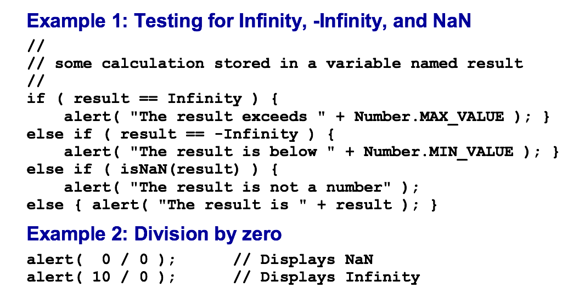
Examples of properties of the Number object

Slide 38
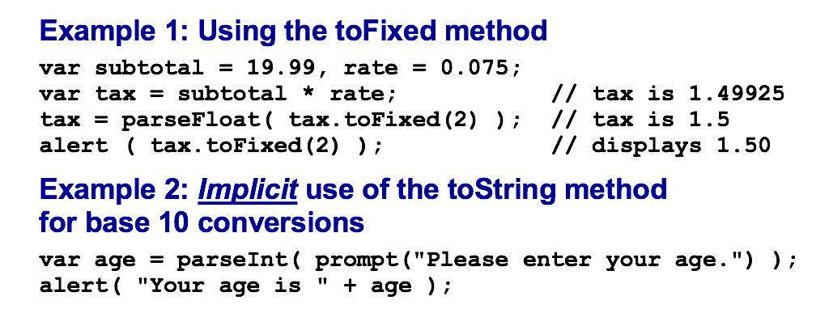
Methods of the Number object
Let’s see some examples: number.html

Slide 39
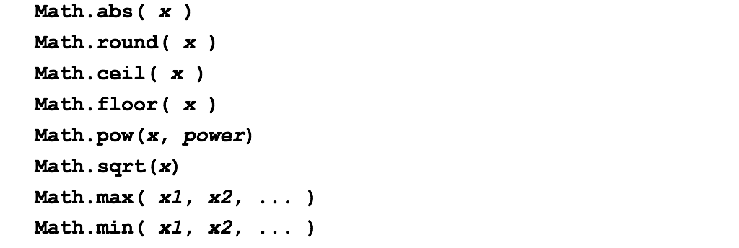
The Math object
One property of the Math object
Common methods of the Math object

Slide 40
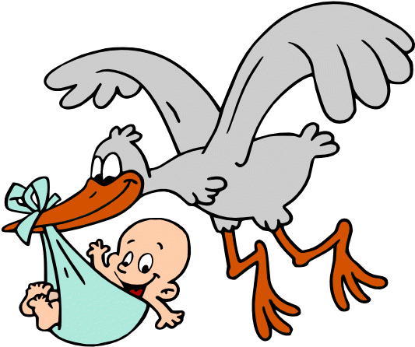
More about the Math object
Where did JavaScript come from? https://en.wikipedia.org/wiki/ECMAScript
The exponentiation operator of ECMAScript 2016 and beyond
The random() method of the Math object
Let’s see some examples: math.html

Slide 41
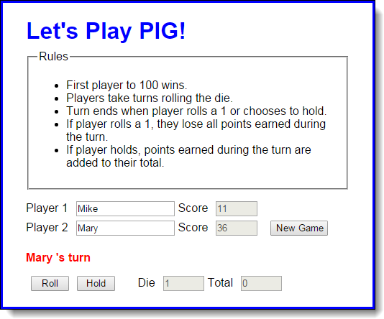
Let’s play a game…
Use the chrome developer tools to step through the application.

Slide 42
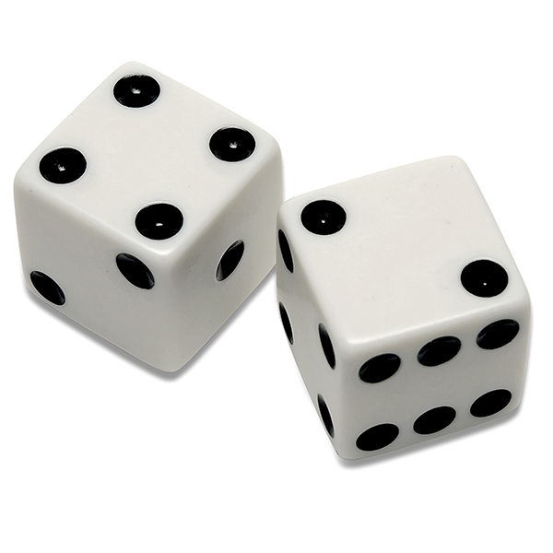
Something to think about
What if you wanted to change the rules? What if each player had to roll two dice at a time? How could you simulate that?
With two dice, rolling a one would be impossible. But you could make the game harder / more interesting by making a value of 7 the trigger to lose points. How could you make that change?

