Slide 1
Responsive Web Design and Bootstrap
Maxwell Furman
Department of MIS
Fox School of Business
Temple University

Slide 2
Responsive Web Design
What is RWD?
The idea of responsive web design has been called many things: “flexible”, “fluid”, “elastic”, etc.
Bottom line: a responsive web site (or web interface) is an interface that adapts to browser dimensions
Responsive Web Design is important because …
… we live in a world full of different devices.

Slide 3
Where this topic fits…
HTML and CSS are the basic tools used to implement a Responsive Web Design.
Today’s material compliments JavaScript, but does not require JavaScript
HTML
JavaScript
CSS

Slide 4
RWD defined
Ethan Marcotte is a web designer, author, and public speaker. See http://ethanmarcotte.com
He described the theory and practice of responsive web design in his brief 2011 book titled Responsive Web Design.
Also in 2011, something called Bootstrap was released by a development team at Twitter.
Bootstrap is a CSS framework. (A framework is a collection of existing technologies, bundled together in a new, novel, and consistent way.)
Bootstrap is a convenient way to get a flexible grid layout.
Bootstrap is free to use, Open Source, and remains popular today.
Ethan Marcotte, defines RWD as these three things:
A Flexible Grid Layout
Flexible Images
Media Queries

Slide 5
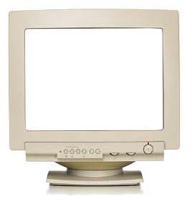
Bootstrap’s flexible grid layout
Bootstrap layout is oriented around the notion of spans. Conceptually, a typical Bootstrap layout slices a monitor into 12 columns called spans.
Twelve might seem like an awkward number to choose, but it made sense back in 2011. Web designers were attempting to accommodate 1024x768 monitors.
Designers found it convenient to assume a 960 pixel width screen. 960 pixels is close to 1024 and conveniently divisible by 1, 2, 3, 4, 5, 6, 8, 10, 12, 15, and 16
1024 px
960 pixels
wide (or twelve 80px columns)
768 px
Look at index01.html and index02.html to see the benefit of a flexible grid.

Slide 6
How to get bootstrap…
The viewport meta tag is important! See: https://www.w3schools.com/css/css_rwd_viewport.asp
<head>
<meta name="viewport" content="width=device-width, initial-scale=1">
<link rel="stylesheet" href="https://maxcdn.bootstrapcdn.com/bootstrap/4.1.3/css/bootstrap.min.css">
<script src="https://ajax.googleapis.com/ajax/libs/jquery/3.3.1/jquery.min.js"></script>
<script src="https://cdnjs.cloudflare.com/ajax/libs/popper.js/1.14.3/umd/popper.min.js"></script>
<script src="https://maxcdn.bootstrapcdn.com/bootstrap/4.1.3/js/bootstrap.min.js"></script>
</head>
Pro tip! Knowing what a CDN URL is, and how to add one to your solution, is a powerful way to extend the options available to you, the programmer.
So, just like we got the jQuery library from a Content Delivery Network (CDN) reference, we get the bootstrap framework from yet another CDN.

Slide 7
Next step…
Once you have linked to a bootstrap.min.css file, you get a whole bunch of classes set up for you, for free!
The “container” class is essential. Everything needs to be inside of it.
The “row” class is almost as important. Use it to specify groupings of columns.
Finally, there are a number of classes named with the pattern col-grid class-?.
(huh?)
<div class="col-md-10">Some Content here.</div>
Grid Class

Slide 8
Grid Classes
To specify a particular column’s width, we specify both the grid class, and the span of the column.
The Bootstrap 4 grid system has five classes:
- (Extra small - for phones / viewport width less than 576px)
-sm (Small - for tablets / viewport width of 576px or greater)
-md (Medium - for typical laptops / width of 768px or greater)
-lg (Large - for larger desktops / width of 992px or greater)
-xl (eXtra Large - width of 1200px or greater)
FYI: Bootstrap 3’s grid classes are slightly different, but “sm”, “md” and “lg” are found there too!
Tip: Each class scales up! So a best practice is to design around the smallest anticipated viewport size.

Slide 9
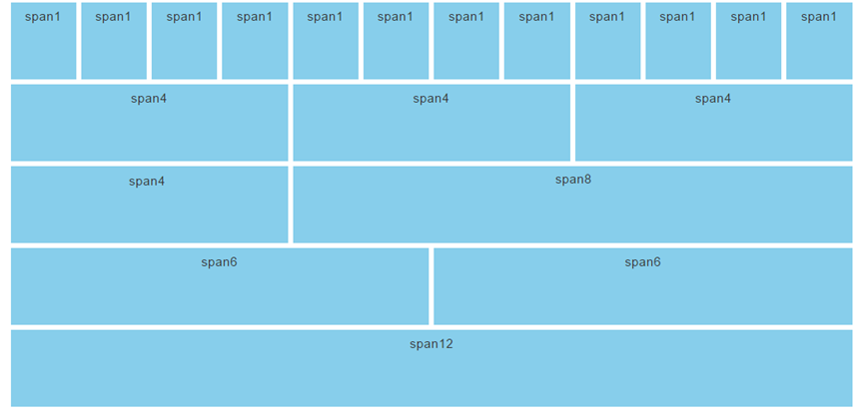
Spans should add up to 12
After you specify the grid class, indicate the width of the column in spans.
<div class="col-md-10">Some Content here.</div>
In bootstrap, the column 12 spans equate to the full width of the viewport.
The bootstrap grid system is responsive, and the columns will re-arrange automatically depending on the screen size.
A best practice is to make sure that the column widths add up to 12 spans. (There are occasional exceptions to that best practice.)
Width in spans

Slide 10
Some sample code for a 3 column layout
<div class="container">
<div class="row">
<div class="col-md-4">A</div>
<div class="col-md-4">B</div>
<div class="col-md-4">C</div>
</div>
</div>
A
B
C

Slide 11
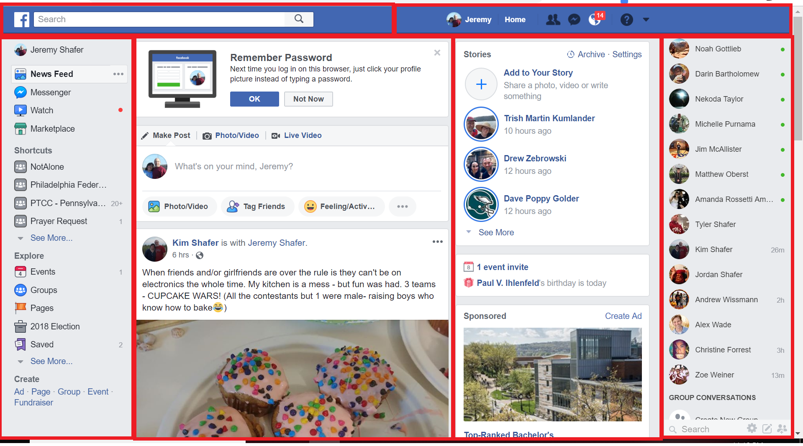
Another example
6 spans
6 spans
ROW #1
CONTAINER
ROW #2
2 spans
5 spans
3 spans
2 spans

Slide 12
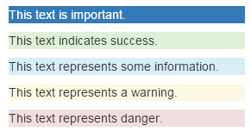
Contextual Classes
Bootstrap also gives us contextual classes. For example, there are CSS classes for background colors: .bg-primary, .bg-success, bg-info, bg-warning, and .bg-danger
<p class="bg-primary">This text is important.</p>
<p class="bg-success">This text indicates success.</p>
<p class="bg-info">This text represents some information.</p>
<p class="bg-warning">This text represents a warning.</p>
<p class="bg-danger">This text represents danger.</p>
The class names are “contextual” because they convey the meaning of the style, not it’s appearance.

Slide 13
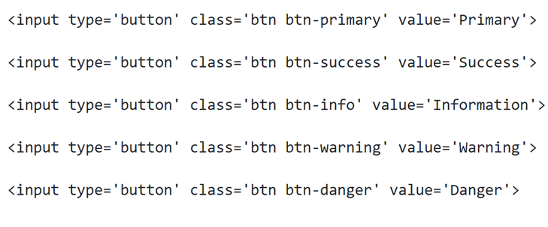
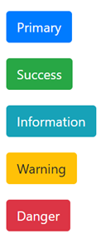
Contextual Classes - buttons
See index03.html

Slide 14
So far…
According to Ethan Marcotte, RWD is three things, working together:
A Flexible Grid Layout
Flexible Images
Media Queries
Bootstrap gives us this (the hardest thing to implement).
It also gives us contextual classes.
Bootstrap doesn’t give us these. So, we need to provide our own CSS.

Slide 15
Where to put our CSS?
<head>
<meta name="viewport" content="width=device-width, initial-scale=1">
<link rel="stylesheet" href="https://maxcdn.bootstrapcdn.com/bootstrap/4.1.3/css/bootstrap.min.css">
<script src="https://ajax.googleapis.com/ajax/libs/jquery/3.3.1/jquery.min.js"></script>
<script src="https://cdnjs.cloudflare.com/ajax/libs/popper.js/1.14.3/umd/popper.min.js"></script>
<script src="https://maxcdn.bootstrapcdn.com/bootstrap/4.1.3/js/bootstrap.min.js"></script>
<!-- a link to my custom CSS //-->
<link rel="stylesheet" href=“app.css">
</head>
We can add our own rules here, after we have had the benefit of all the bootstrap class definitions.

Slide 16
Flexible Images
Flexible Images are necessary to scale images fluidly.
The CSS attribute that allows us to do this is:
max-width: 100%;
That is, if we apply that style to an image, then it will expand (or shrink) to the size of its containing element.
Note: It’s important to have a containing element!
There are a number of extra steps that are necessary to implement this effect in legacy browsers… like IE9. Assuming that you are using a browser released in the last few years you don’t need to worry about that!
See index04.html

Slide 17
Media Queries
Media queries allow us to override previously declared style sheet attributes using an @media rule.
The @media rules allow us to customize styles based on the size of the current viewport.
The @media rules allow us to deal with exceptions that can’t be gracefully addressed by out flexible grid.

Slide 18
Media Queries (2)
For example:
@media (max-width: 576px) { img { display: none; } }
This says … when the viewport is narrow, don’t display any of the images.
Another example:
@media (max-width: 576px) {
#header{
min-height: 20px;
}
}
This says … when the viewport is narrow, style the tag with the id of “header”
See index_5.html

Slide 19
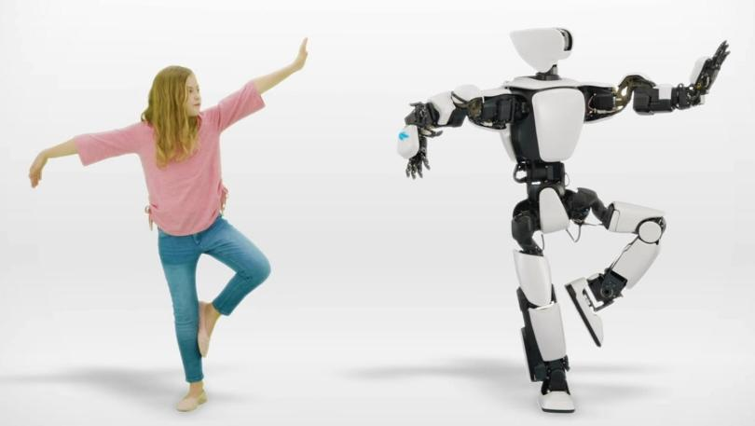
Ok… now you try…

