Slide 1

JavaScript functions
MIS 2402
Department of MIS
Fox School of Business
Temple University

Slide 2

Advisory!
This lecture presents some *big* ideas that will be very important in the days ahead.
It’ll be extra important to think both in terms of generalities (What is it we are trying to do? And why?) and in specifics (How do we express these ideas in JavaScript? What’s the syntax?)
Every lecture is important, but this one in particular will lay the groundwork for the rest of the semester.
Functions are very important!

Slide 3
Before we begin …
Let’s talk about… $
What is that crazy $ thing we keep seeing?
We saw it in week 2. Like this …
var your_name = $("#textEntered1").val();
And this …
$("#textDisplayed1").html("Hello " + your_name);
What does it all mean?

Slide 4
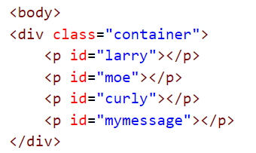
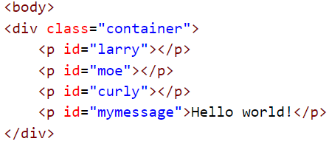
The $ function, explained
OK, it’s time to come clean.
The $ function is really at the heart of something called jQuery. Later in the semester we’ll learn more about what jQuery is, and what it can do. But, for now, think of it this way: the “$” means “Select”.
So, when we say:
$('#mymessage').html('Hello world!’);
The browser selects the tag with the id “mymessage”
!
Now take action on the tag you found.
We haven’t seen the last of the $ function!

Slide 5
Agenda
Talk about what functions are
Equip you with the ability to define your own functions
Discuss the difference between defining a function and calling a function
Discuss why functions are important

Slide 6
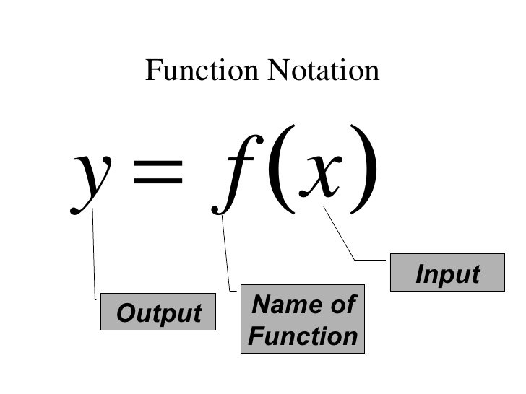
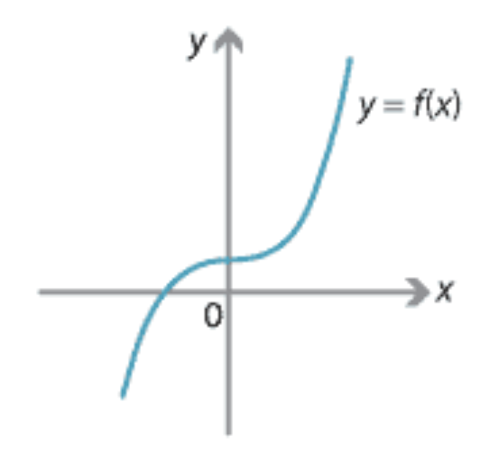
What’s a function?
In mathematics, a function is one or more rules that are applied to an input in order to generate an output.
The input is the number or value put into the function.
The output is the number or value that the function generates.
In this example, we say that f(x) returns the value of y.

Slide 7
What is a function? (2)
In programming, a function is a collection of statements grouped together in such a way that they can receive zero, one, or more pieces of input. One or more programming statements are then used by the function to generate some output.
Here are some examples of functions:
function feet_to_inches(HowManyFeet){
var x = HowManyFeet * 12;
return x;
}
function convertToCelcius(degrees_fahrenheit){
var the_answer = (degrees_fahrenheit - 32) * ( 5 / 9 );
return the_answer;
}
Notice the use of the command return in the above examples.

Slide 8
Defining and Calling
Let’s take a look at the feet_to_inches function.
function feet_to_inches(HowManyFeet){
var x = HowManyFeet * 12;
return x;
}
What we see above is the JavaScript code that defines the function.
Take a look:
The name of the function is feet_to_inches.
It takes one input … and that input is given then name HowManyFeet
The two lines of code in between the { } define what the function does
Defining a function is different from using a function. (Just like building a car is different from driving one, and building a chair is different from sitting in it!) We say we are “calling the function” when we use it.

Slide 9



Calling the function
Here we are calling the feet_to_inches function. Notice that, once it is defined and in the computer’s memory (as on the prior slide) it can be used over and over again with different input values.

Slide 10
Calling the function, saving the result
Here we are calling the function, and storing the result in a new variable called y.
Remember this? See the similarities?

Slide 11

What is a function? (3)
So far, our examples illustrated functions which returned a value. In JavaScript, sometimes we don’t worry about what value the function returns. Sometimes we just want to group a bunch of commands together because it is it convenient to do so. In those cases we leave the return value undefined. For example:
function bottles_of_beer_song(iterations){
for (var i = iterations; i > 0; i--){
console.log(i + ' bottles of beer on the wall, ' );
console.log(i + ' bottles of beer!');
console.log('Take one down, pass it around, ' );
console.log((i - 1) + ' bottles of beer on the wall!');
console.log(' '); //print a blank line
}
}
See fun01.html, fun02.html and fun03.html in funtimes.zip
Don’t forget to set and use breakpoints in the Chrome Developer Tools!

Slide 12
Why would you want to do all this?
Functions in JavaScript (or any other programming language) allow us to “divide and conquer”. They provide a mechanism to break large, complicated problems down into a collection of smaller, simpler problems.
Functions allow use assign meaningful names to blocks of code. For example: the name convertFtoC is more understandable than
y = (x - 32) * (5/9);
Functions help us avoid writing the same sort of code, over and over. Once I write a convertFtoC function, why would I ever write that formula ever again? I shouldn’t have to.

Slide 13

Let’s give it a try…
Vector Design by Vecteezy!

