Slide 1
Logical Operators in JavaScript
MIS 2402
Department of MIS
Fox School of Business
Temple University

Slide 2
Agenda
Logical Operators: Another way to work with Boolean expressions
More practice with conditional statements

Slide 3
The logical operators
It is often useful to consider two or more Boolean expressions at the same time. For example: we might want to know if both condition “A” and condition “B” are both true.
To build such compound expressions, we use logical operators.

Slide 4
Some examples
Expressions evaluate to true or false. Given:
var testScore = 100;
var age = 55;
var limit = 60;
What do each of these expressions evaluate to?

Slide 5
Consider this:
//declare a variable and assign it a value
let age = 20;
let gender = 'male';
//check the variable using comparison
if (age >= 18){
if (gender == 'male'){
console.log('You must: ');
console.log('Register for the Selective Service.');
}
}
console.log('Done.');

Slide 6
Rewritten using the && operator:
//declare a variable and assign it a value
let age = 20;
let gender = 'male';
//check the variable using comparison
if (age >= 18 && gender == 'male'){
console.log('You must: ');
console.log('Register for the Selective Service.');
}
console.log('Done.');

Slide 7
Can you find the logic error?
//declare a variable and assign it a value
let age = 1;
let gender = 'male';
//check the variable using comparison
if (age >= 18 || gender == 'male'){
console.log('You must: ');
console.log('Register for the Selective Service.');
}
console.log('Done.');

Slide 8
Let’s try another one…
//declare a variable and assign it a value
let age = 1;
//check the variable using comparison
if (age <= 2 || age > 98){
console.log('You might need diapers. ');
}
console.log('Done.');

Slide 9
Find the logic error …
//declare a variable and assign it a value
let age = 1;
//check the variable using comparison
if (age <= 2 && age > 98){
console.log('You might need diapers. ');
}
console.log('Done.');

Slide 10
Order of precedence for logical operators
So – what does this evaluate to:
!(1 == 2) && 'monkey' == 'monkey' || 'elephant' == 'hippo'

Slide 11
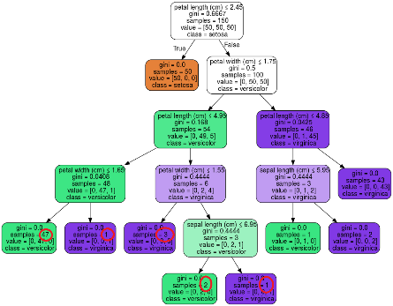
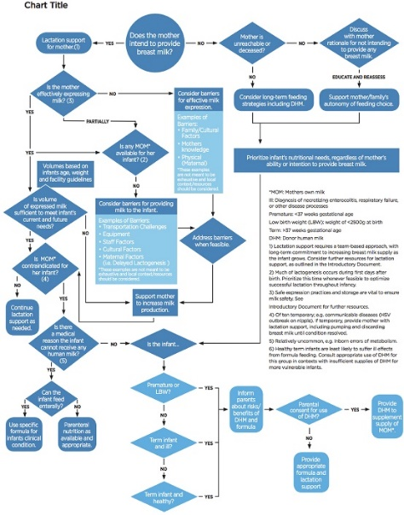
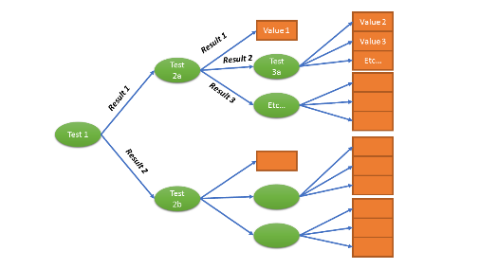
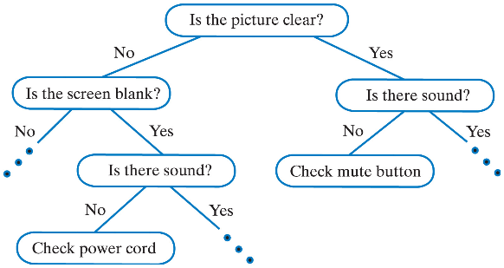
Why are we learning this again?
All programming languages use conditional statements, Boolean expressions and logical operators to implement a “flow of control” for the program.
Anything that can be visualized as a decision tree or a flow diagram must be implemented using conditional statements.
This Photo by Unknown Author is licensed under CC BY-SA
This Photo by Unknown Author is licensed under CC BY-SA
This Photo by Unknown Author is licensed under CC BY

Slide 12
Why are we learning this again? (2)
In the immediate future you’ll need logical operators for performing calculations and client-side error trapping in MIS2402. Conditional statements are also essential for implementing business rules that you will see in MIS3502 APIs.
Beyond that, in your career, these logical expressions are used in data cleansing, spreadsheets, risk analysis software, robotic process automation, supply chain automation, machine learning, and many other tasks…. even if you are not a “programmer”.

Slide 13
Time for some practice

